Slide 1


Influence of diversity index and population of children on Covid-19 cases in the New England region during holiday season 2020
ChE Math Project 1
Shreya Thakkar

Slide 2
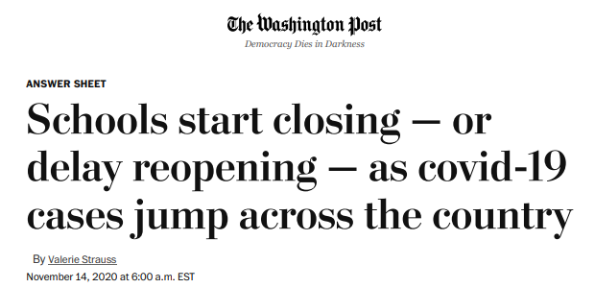

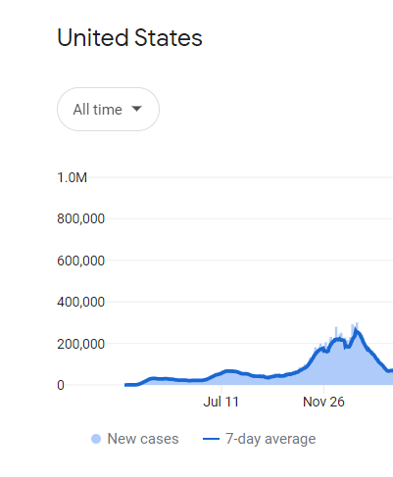



The first year of pandemic
Data comes from Wikipedia, government health ministries, The New York Times, and other authoritative sources
News article snaps accessed on Oct 24,2022

Slide 3



Problem Selection: Effect population of children and diversity index on Covid-19 cases in New England during holiday season 2020
AGE UNDER 18
DIVERSITY INDEX
https://i0.wp.com/indiaeducationdiary.in/wp-content/uploads/2022/08/University-of-Massachusetts-Amherst.jpeg?fit=600%2C400&ssl=1
https://newengland.com/wp-content/uploads/new-england-states-map.jpg
https://newengland.com/wp-content/uploads/new-england-states-map.jpg

Slide 4
Studies of Covid-19 dependence on age of children and diversity index
Notes:
https://www.science.org/doi/10.1126/science.abe8372

Slide 5
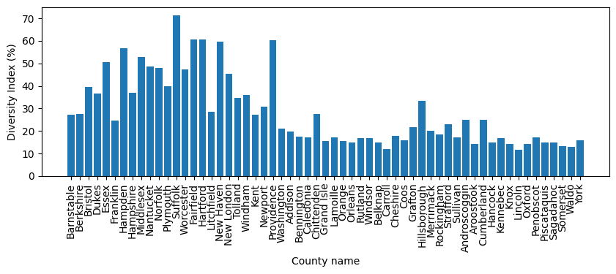
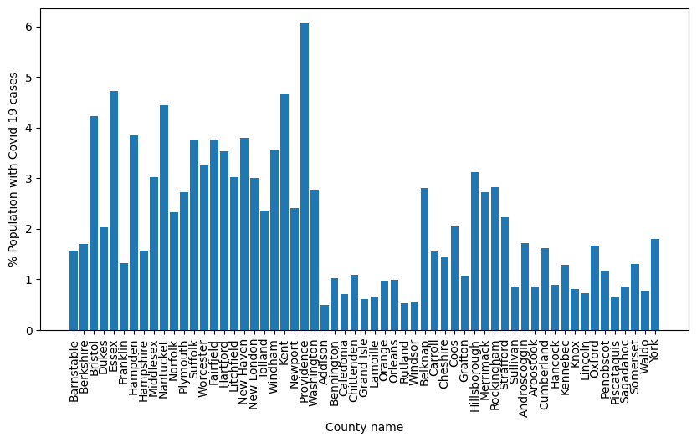
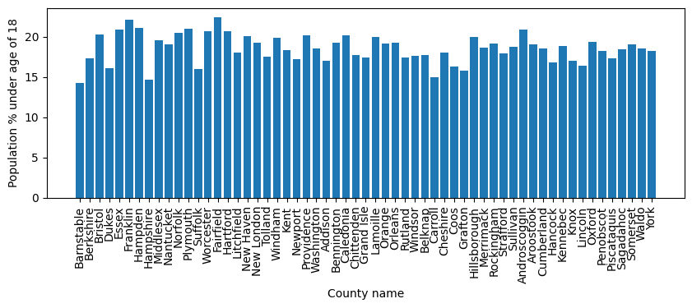
Raw data collected

Slide 6
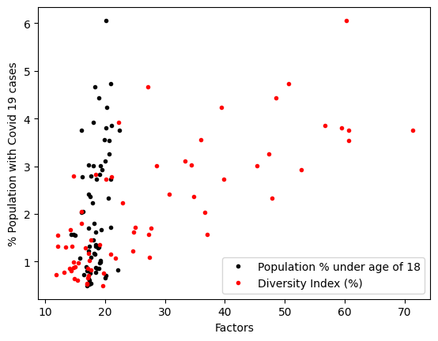
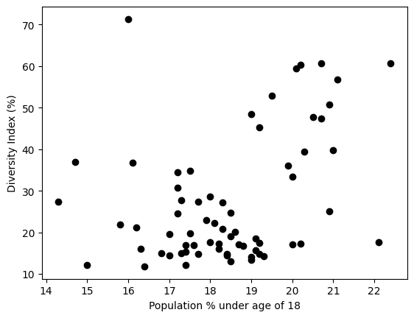
Dependence of factors

Slide 7
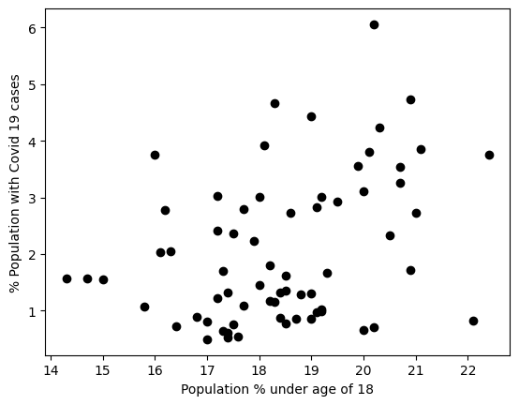
Did counties with higher population of children have lower percentage of Covid-19 cases during the holiday season of the year 2020?
Null hypothesis:
Counties with the population of children (age < 18 years) less than 18 % had lower percent of Covid-19 cases during the holiday season of 2020
2 sample Wilcoxon sum test (U-test) p value = 0.0079
Result : Null hypothesis invalid

Slide 8
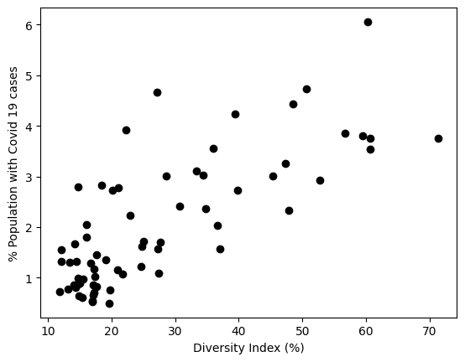
Did counties with higher diversity index have higher percentage of Covid-19 cases during the holiday season of the year 2020?
Null hypothesis:
Counties with the diversity index greater than 25 % had higher percentage of Covid-19 cases during the holiday season of 2020
2 sample Wilcoxon sum test (U-test) p value = 1
Result : Null hypothesis is valid

Slide 9
Did counties with higher diversity index have higher percentage of Covid-19 cases during the holiday season of the year 2020?
Null hypothesis:
Counties with the diversity index greater than 25 % had higher percentage of Covid-19 cases during the holiday season of 2020
2 sample Wilcoxon sum test (U-test) p value = 1
Result : Null hypothesis is valid

