Slide 1

Mathematical modeling of dimer exchange assay of estrogen receptor
ChE Math Project 2
Shreya Thakkar

Slide 2
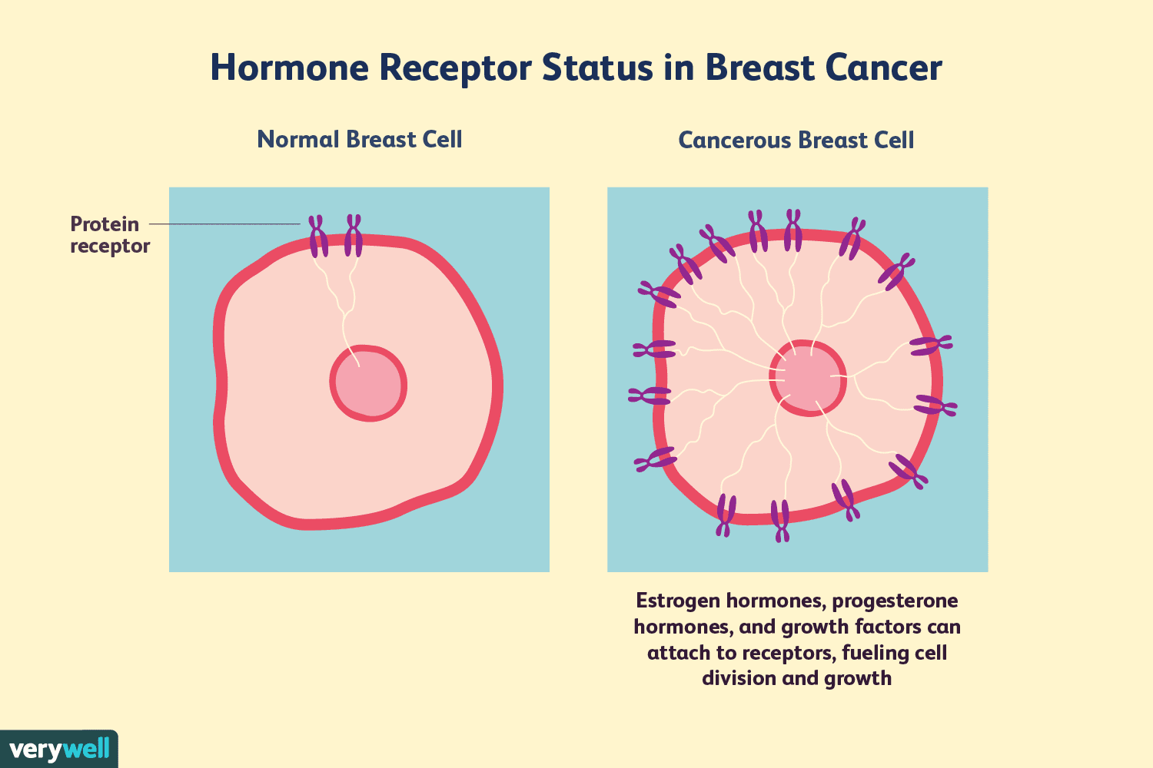
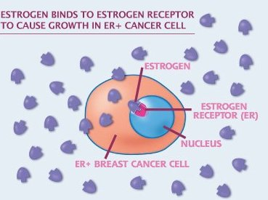
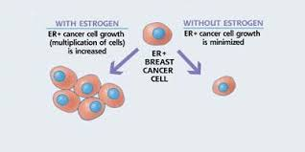
Estrogen receptor and breast cancer
Estrogen receptor (ERα) show elevated protein levels in premalignant and malignant breast lesions compared to normal tissue.
https://www.online-sciences.com/health/the-hormone-therapy-treatment-for-breast-cancer/
https://technical.sanguinebio.com/a-new-molecular-target-for-breast-cancer-therapy/
https://www.verywellhealth.com/hormone-receptor-status-and-diagnosis-430106
Sommer, S. and Fuqua, S.A., 2001, October. Estrogen receptor and breast cancer. In Seminars in cancer biology (Vol. 11, No. 5, pp. 339-352). Academic Press..

Slide 3
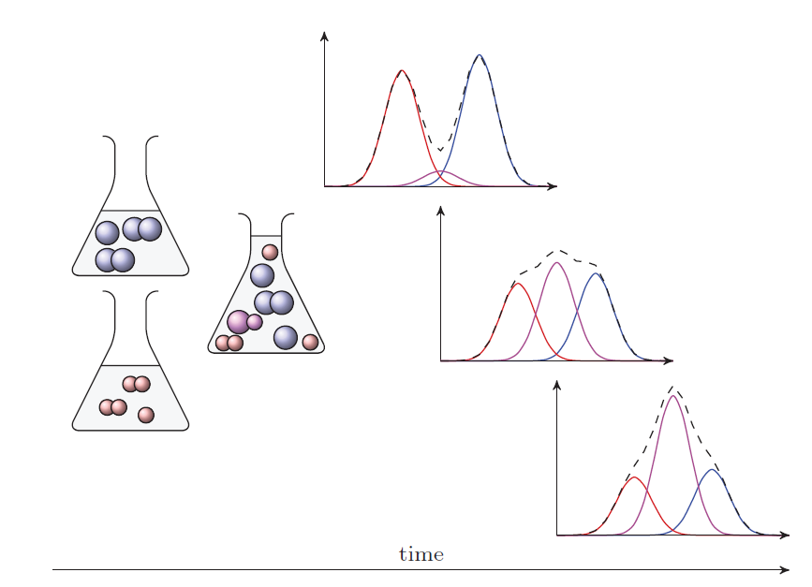
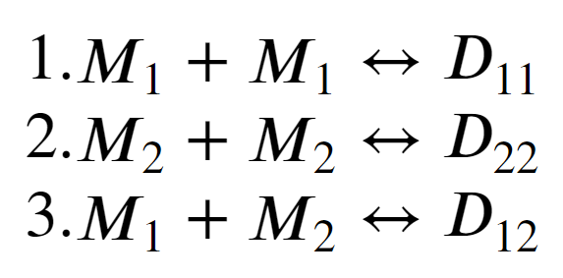
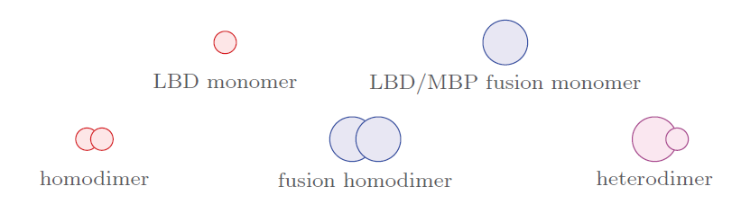
Dimer exchange assay
Goulet, D., 2016. Modeling, simulating, and parameter fitting of biochemical kinetic experiments. siam REVIEW, 58(2), pp.331-353.

Slide 4
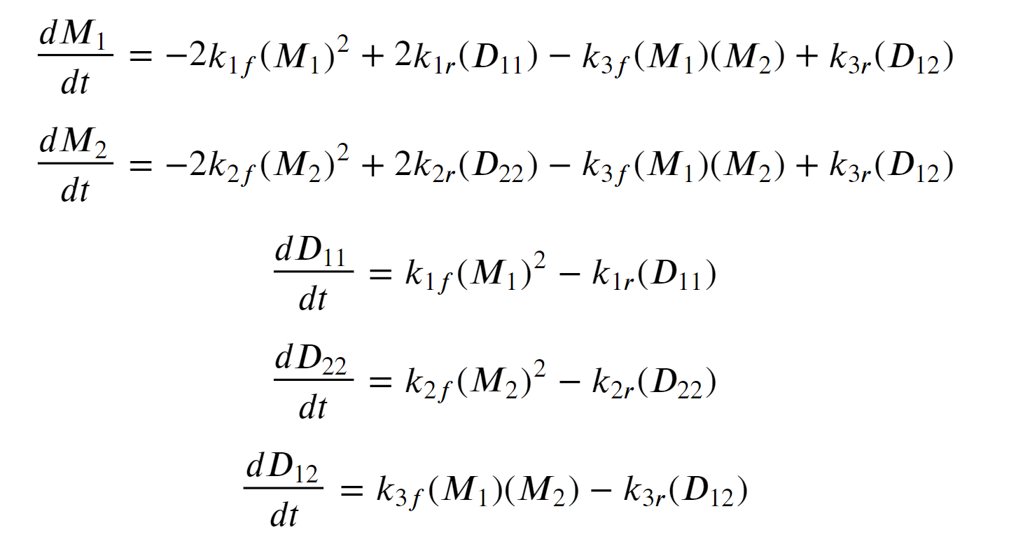
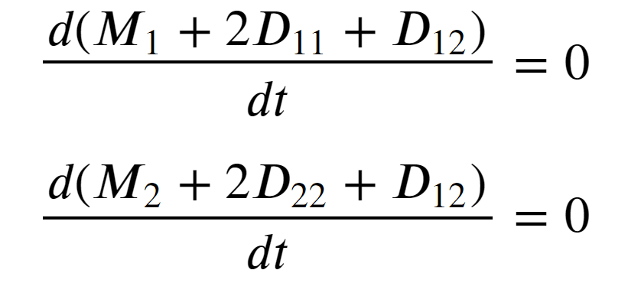
ODE equations and assumptions
Assumptions:
1. Addition of maltose binding protein to ligand binding protein does not significantly alter dimerization kinetic parameters.
2. Initial monomer concentrations are negligible
3. No loss of protein
Goulet, D., 2016. Modeling, simulating, and parameter fitting of biochemical kinetic experiments. siam REVIEW, 58(2), pp.331-353.

Slide 5
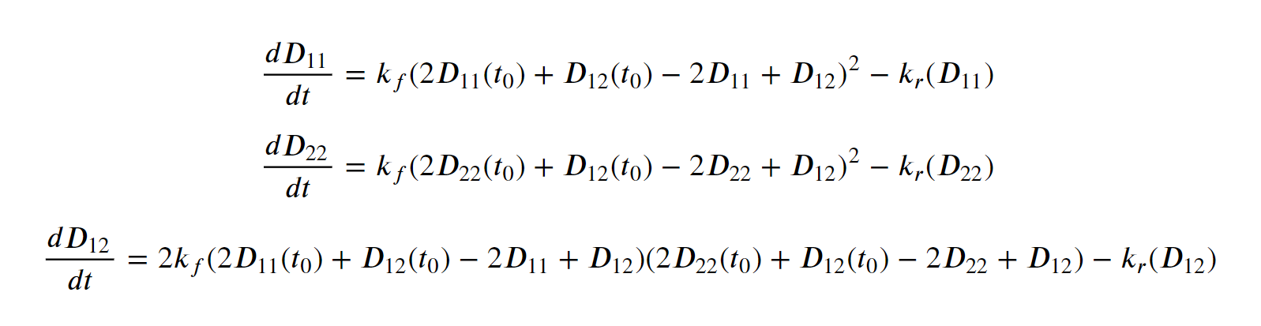
Simplified ODE model
Variables: D₁₁, D₂₂, D₁₂
Parameters: k_{f} and k_{r}
Goulet, D., 2016. Modeling, simulating, and parameter fitting of biochemical kinetic experiments. siam REVIEW, 58(2), pp.331-353.

Slide 6
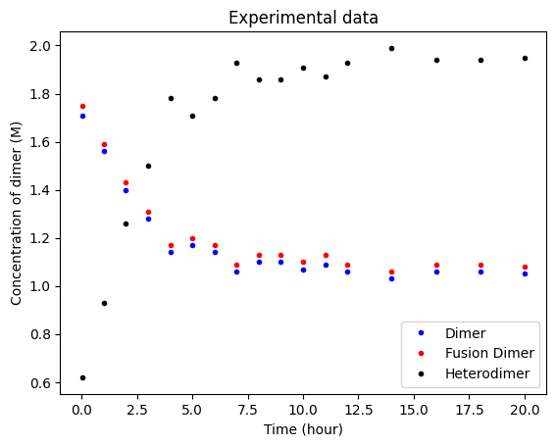
Experimental data

Slide 7
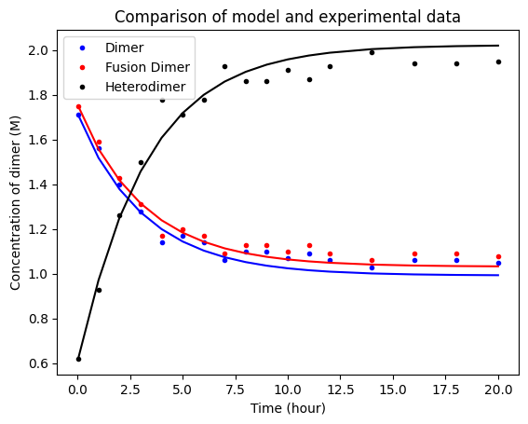
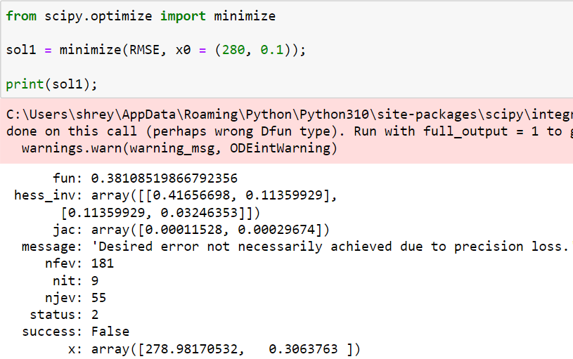
Parameter fitting
Difficult to estimate due to assumptions

Slide 8
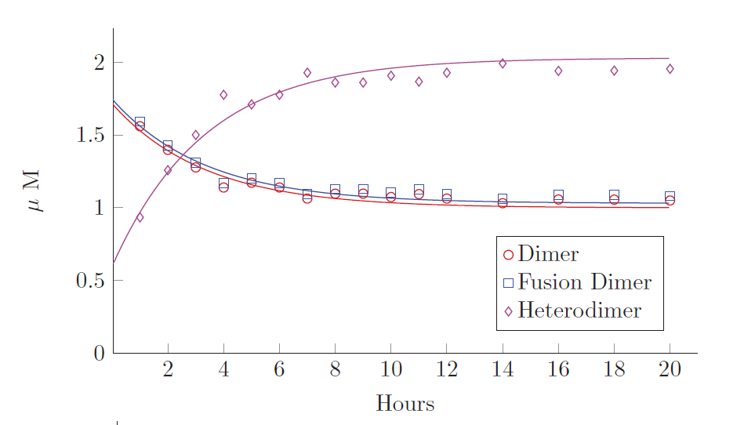
Comparing parameter fit with paper
“Best fit parameters: (kf,kr) =(284, 0.238)
Goulet, D., 2016. Modeling, simulating, and parameter fitting of biochemical kinetic experiments. siam REVIEW, 58(2), pp.331-353.

Slide 9
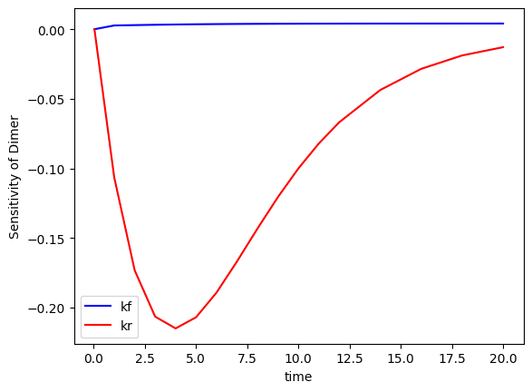
Local sensitivity analysis for dimer formation
Perturbation of parameters by 1% shows that sensitivity to k_{f} is almost zero and k_{r} is relatively significant.

Slide 10
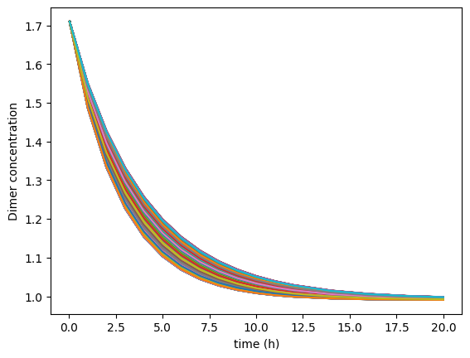
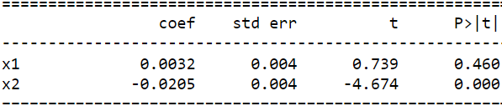
Global sensitivity analysis for dimer formation
Collection of data: Perturbing k_{f} and k_{r} by 20% to fit dimer concentration
Linear regression: Computing dependence on parameters for dimer concentration
Our fitted eqn is DD₁ = 0.0031k_{f} + -0.0205 k_{r}
Thus, the sensitivity to k_{r} is much higher than k_{f} as seen in local sensitivity analysis and convergence of values during parameter fitting

Slide 11
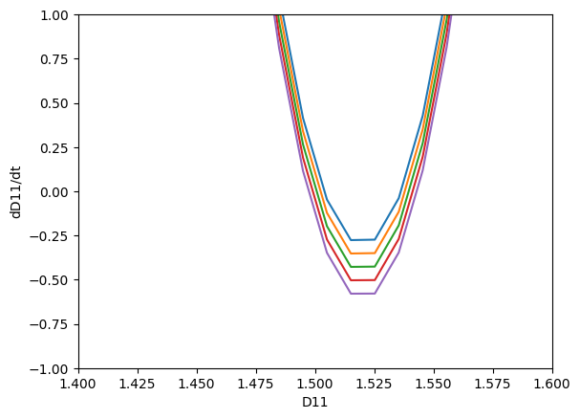
Bifurcation analysis
k_{r} was chosen for bifurcation analysis because of is higher sensitivity.
No obvious deviations are observed from steady state when k_{r} is varied from 0.2 to 0.4

Slide 12
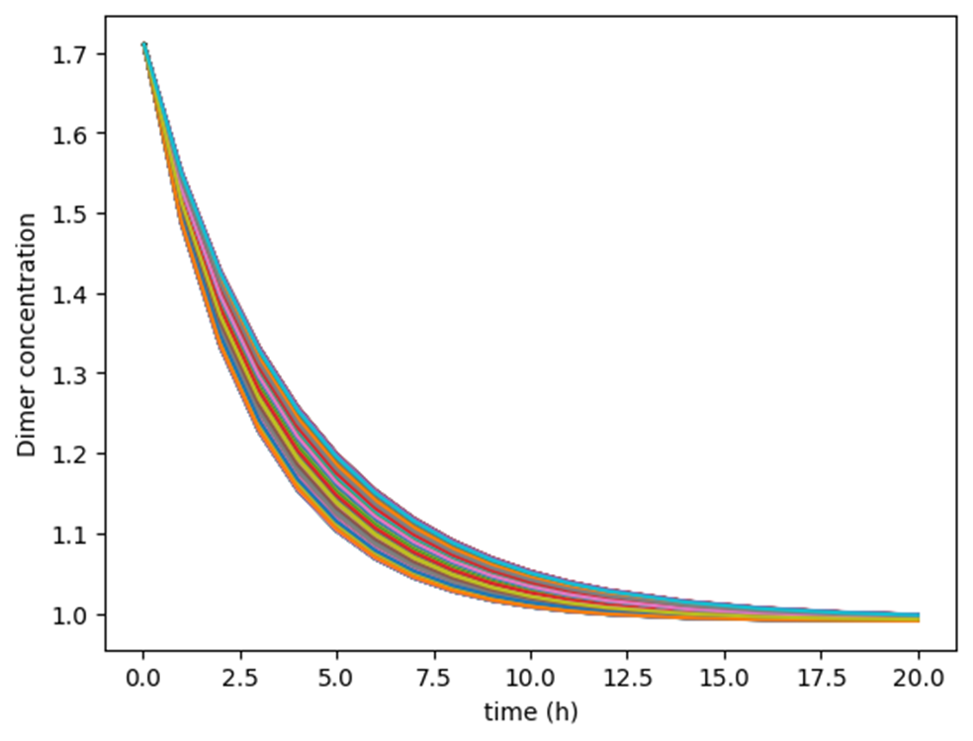
Summary
The model fits backward rate constants well, but estimation of forward rate constant is limited by assumptions.
Backward rate constant has higher sensitivity to estimated dimer concentration than forward rate constant.
Future work
Solving the system of 5 ODEs instead of model reduction and verify if similar conclusions are obtained.

