Slide 1
Multitask Parsing Across Semantic Representations

Slide 2
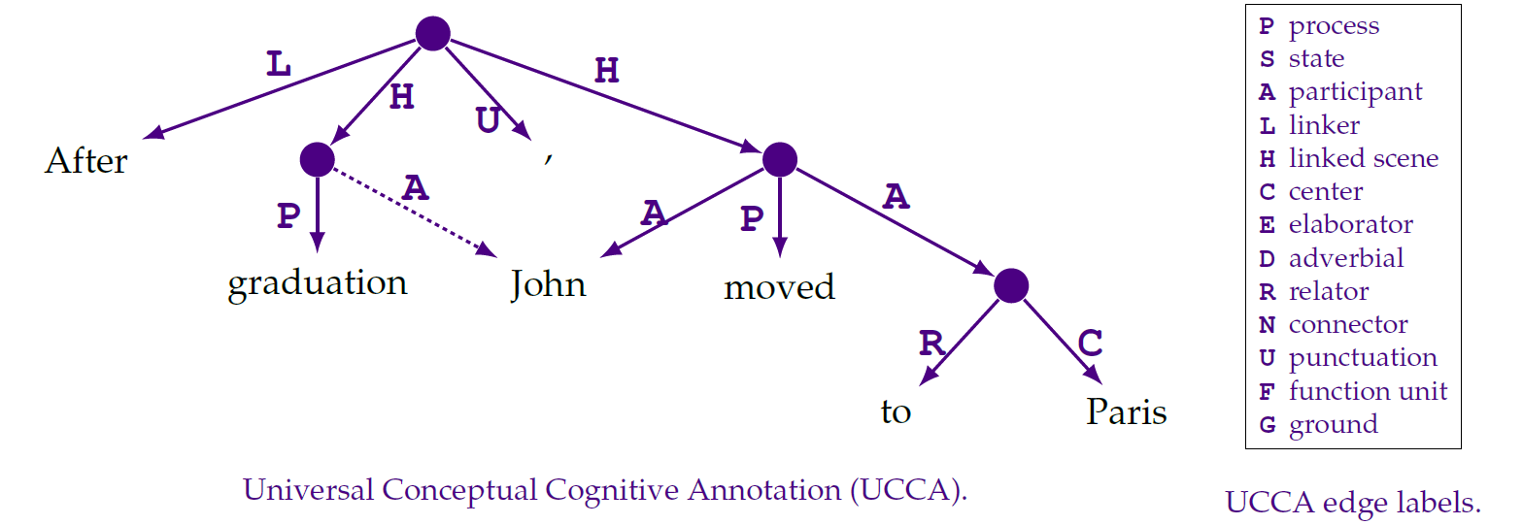
UCCA: Universal Conceptual Cognitive Annotation.

Slide 3
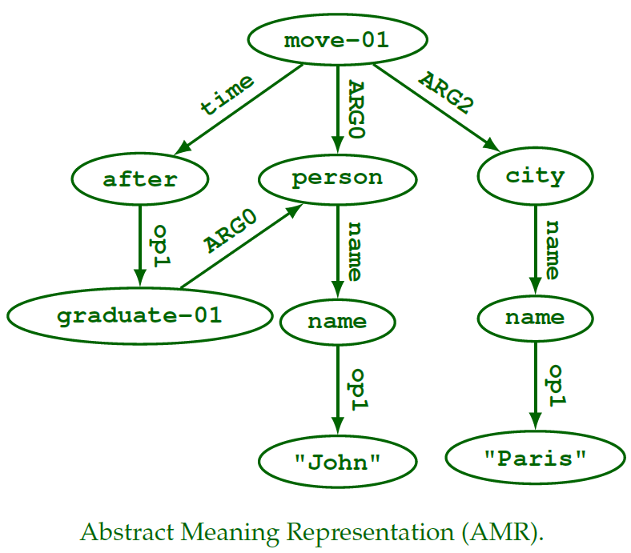
AMR: Abstract Meaning Representation.

Slide 4
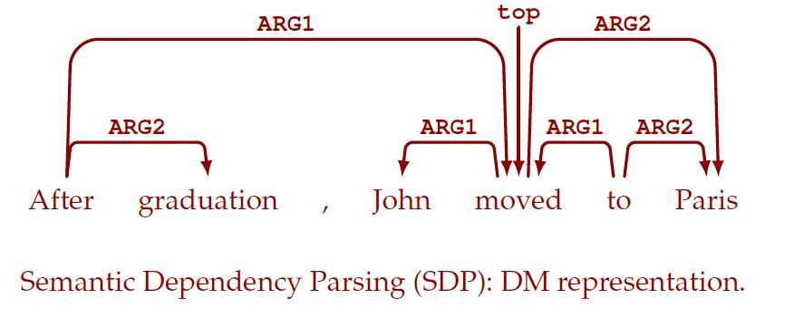
DM: DELPH-IN MRS.

Slide 5
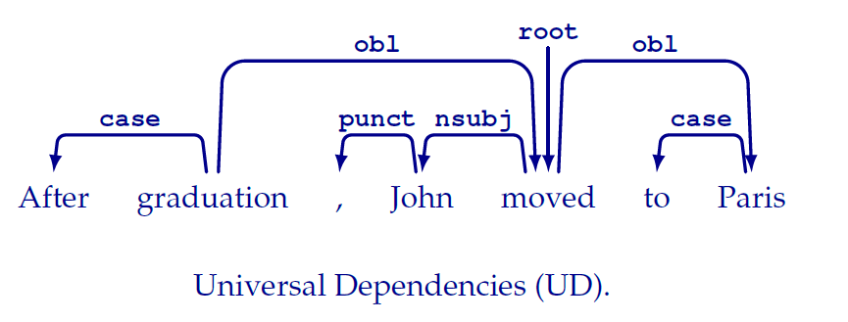
UD: Universal Dependencies.

Slide 6
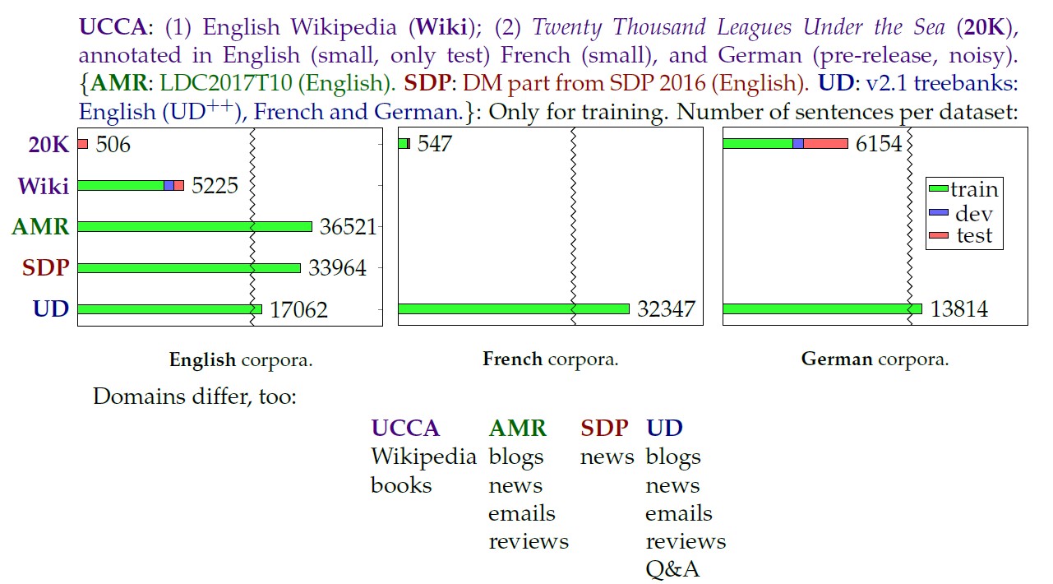
Data

Slide 7
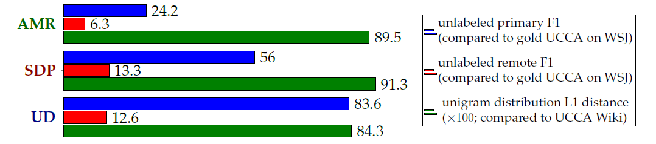
Task Similarity

Slide 8
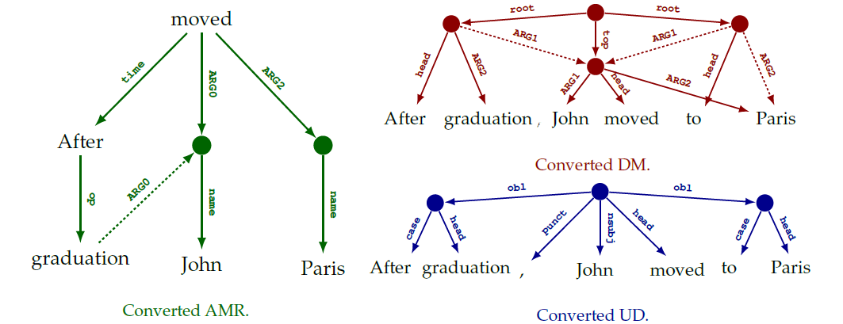
Unified DAG Format

Slide 9
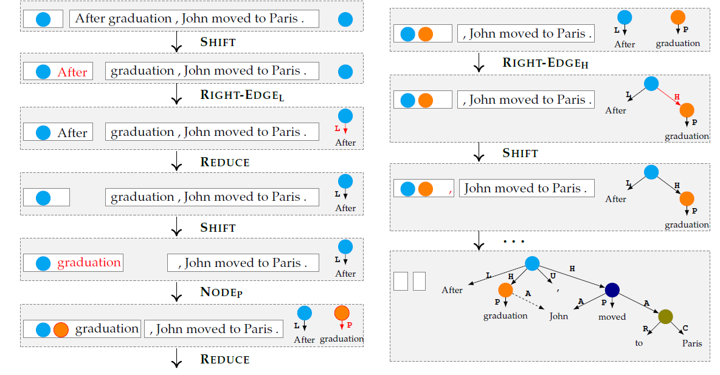
TUPA: A Transition-Based DAG Parser

Slide 10
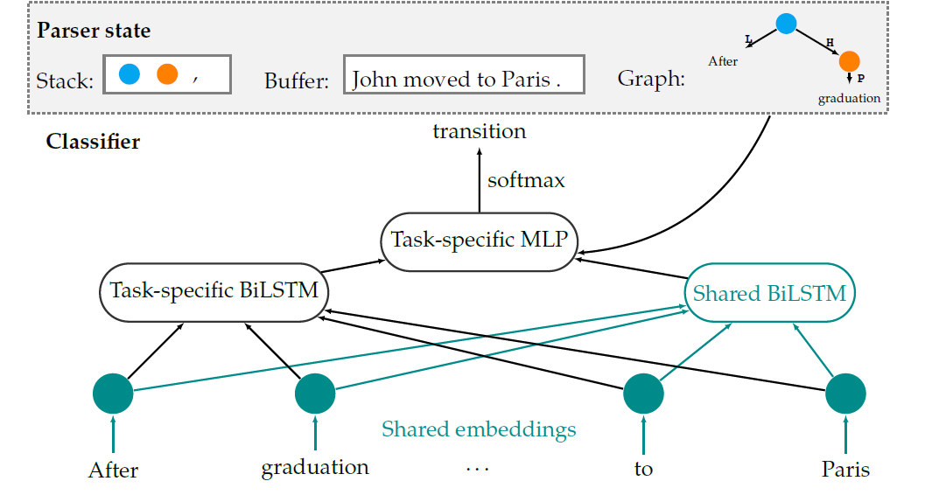
Transition Classifier

Slide 11
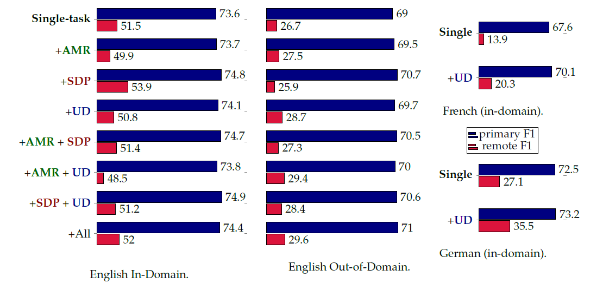
Experiments

