Slide 1

Top 6 Real World Cyber Security Projects in 2021
Image
Ima

Slide 2

1
What is Cyber Security?
2
Use cases of Cyber Security
3
Why Cyber Security is a good career choice?
4
Cyber Security Projects
5
Cyber Security projects for college students

Slide 3
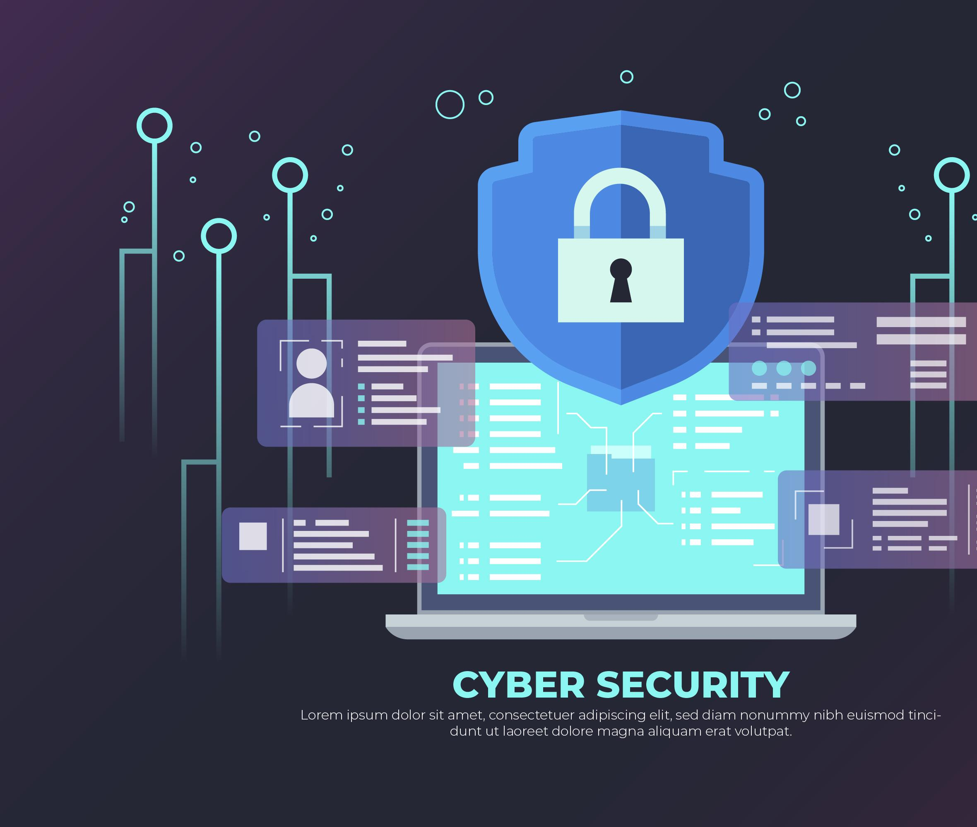
WHAT IS CYBER SECURITY ?

Slide 4
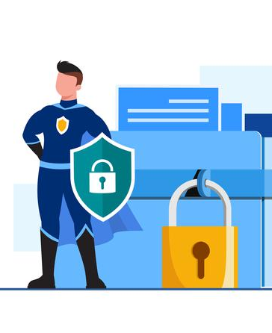
Cyber Security
Cyber security refers to the organization of technologies, procedures, and methods designed to prevent networks, devices, programs, and data from attack, damage, malwares, viruses, hacking, data thefts or unauthorized access.

Slide 5

Use Cases Of Cyber Security

Slide 6
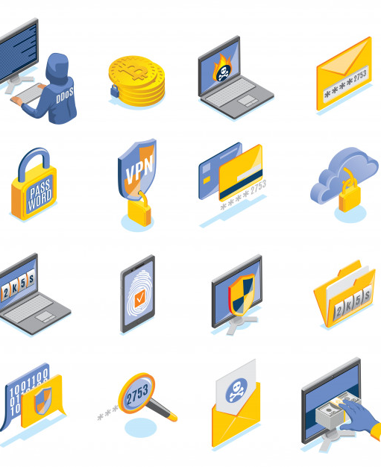
1. Network Threat Identification
Cyber security is very essential for every organization or business.
The main objective of cyber security is to safeguard all organizational resources from both external and internal threats as well as interruptions caused due to natural disasters.

Slide 7

Example
Versive, the AI vendor offers cybersecurity software which uses dissonant detection to detect vulnerable security threats. The organization says its software helps banks and financial institutions to identify adversary detection and security threats.

Slide 8

User Behaviour Modelling
Hackers who have taken a client’s authorizations can access an organization network through genuine approaches and are very difficult to stop and detect.
Thus, a risk management system can be used to detect changes in those methods and to determine password patterns of unambiguous customer behavior

Slide 9
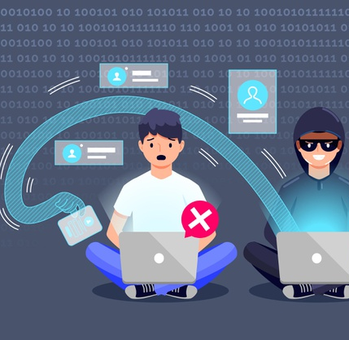
Example
A pioneer AI vendor called ‘Darktrace’ has provided Cybersecurity software.
Taking inputs and other training datasets from subject matter experts, the software learns to detect a vital deviation from normal baseline user behaviour and instantly alerts the company to cyber threats.

Slide 10

Email Monitoring
It is very crucial to understand the significance of monitoring email conversation to avoid Cyber Security hackings such as phishing.
A monitoring software can help in speeding up the detection of cyber threats and developing detection accuracy.

Slide 11

Examle
Tessain offers email monitoring software that helps financial institutions to prevent phishing attacks, misdirected emails, and data breaches.

Slide 12
Why Cyber Security is a good career choice ?

Slide 13



In Demand
Highly Paid
Job Satisfaction
A career in cyber security will give you all these perks

Slide 14



Job Abundance
Versatility
Career Growth
A career in cyber security will give you all these perks

Slide 15
Salary increase of a cyber analyst from 2018-2020

Slide 16

Cyber Security Projects

Slide 17

Web Application Firewall
It protect web applications by cleaning and examining HTTP traffic between a web application and the Internet
Safeguards web applications from attacks such as cross-site forgery, cross-site-scripting , file insertion, and SQL injection, among others.

Slide 18

Website Scraper
A Web Scraper is a program that quite accurately scrapes or gathers data from websites
It is simply the act of gathering data from the internet, in any form.

Slide 19

Log Analyzer
It is the process by which computer-generated log messages are filtered, also known as log events.
Log analyzer provides a valuable system of measurement that paints a clear picture of what has occurred across the structure

Slide 20

Antivirus
If you have good coding skills and are willing to take up a complex project, then you can even try creating your own antivirus.
you need to define the methods of safety that you are going to develop and select programs that your software will support.

Slide 21
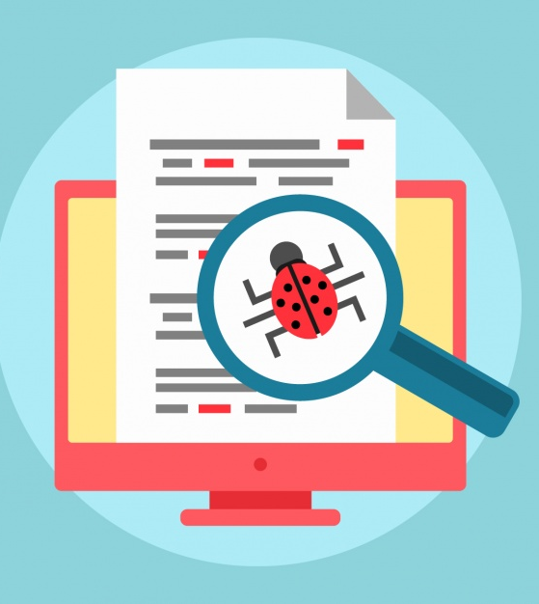
Malware Analysis Sandbox
You can throw any file at it and the software will provide a detailed report outlining the behavior of the file.
It can Study various malicious files (, office documents, executables, emails, etc) as well as mischievous websites under Windows, Linux, macOS, and Android virtualized environments.

Slide 22

A secure erasure code-based cloud storage system
It supports multiple functions. It provides a threshold proxy re-encryption scheme and combines it with a decentralized erasure code such that a reliable distributed storage system is created.
It fully integrates encrypting, encoding, and forwarding.

Slide 23

Cyber Security projects for college students

Slide 24

Encryption Software
Encryption is a massive part of cybersecurity.
This is one of the generally welcomed cyber security project ideas .

Slide 25
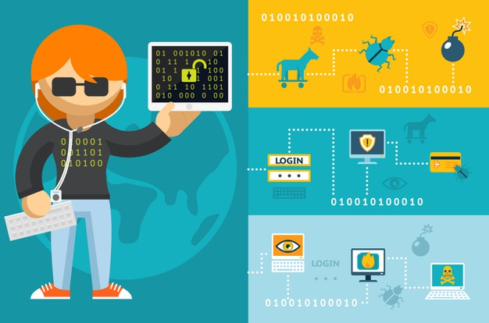
Caesar Code Decoder
Project related to cybersecurity
In this project have to develop an application to crack a Caesar code.

