Slide 1
Investigating Best Rental Location for College Student

Slide 2

Problem
Social Criteria
  Crime Rate (Safety)
  Distance from University
  Venues:
    Gym
    Nightclubs
    Supermarkets
    Public Transport Stops
Economic Criteria
  Average Price of Rental

Slide 3
Data Collection
Borough Geolocations: https://en.wikipedia.org/wiki/List_of_London_boroughs
Distance from the University: Google Maps
Crime Rate: https://www.finder.com/uk/london-crime-statistics Average Price of Rental: https://www.mylondon.news /news/property/london-rent-prices-cheapest-borough/17525488

Slide 4
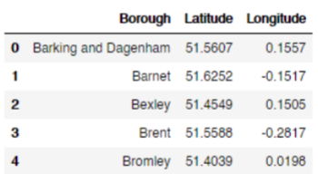
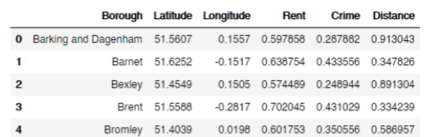
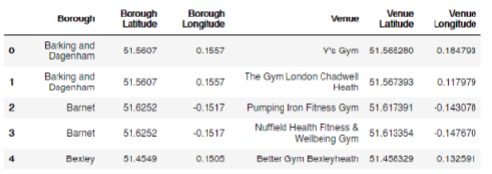
Data Preparation
Parsing Wikipedia Table
Parsing External Data Sources
Extracting Data from Foursquare API

Slide 5
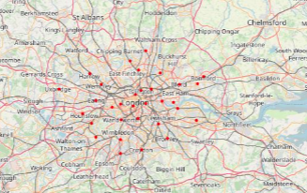
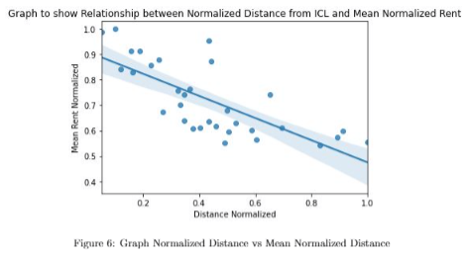
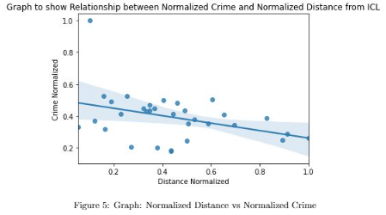
Exploratory Data Analysis

Slide 6
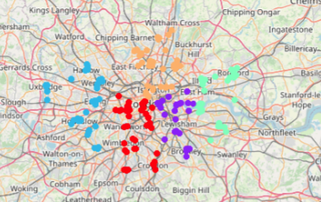
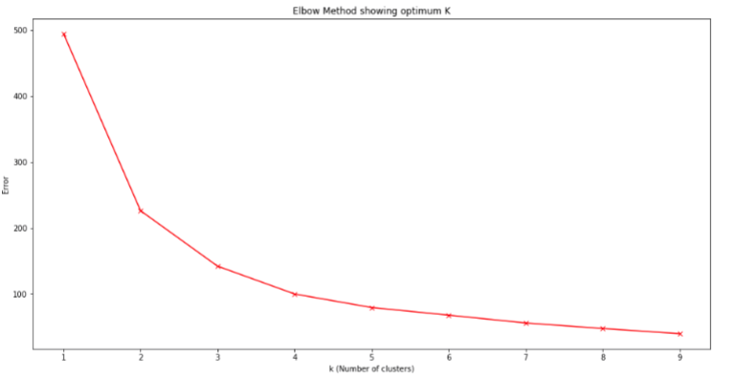
Clustering

Slide 7
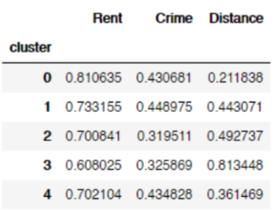
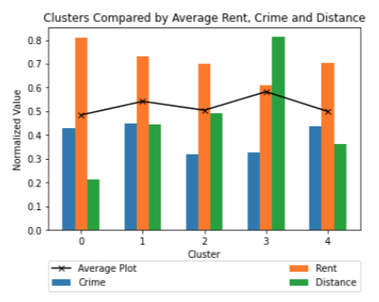
Evaluating Clusters

Slide 8
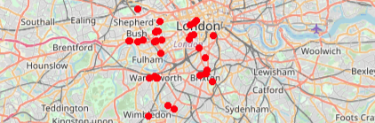
Conclusion

