Slide 1
Shopping Cart Assignment
Demo

Slide 2
Requirements:
Shopping cart website
OOJS for all js functionality.
Multiple pages home, products, login, register, cart.
Mini Cart functionality.
Responsive on tablet and mobile.
Project Structure.
Semantic Markups.

Slide 3
Technologies Used
HTML5
CSS3, SCSS
JS, ES6
Node + MongoDB
Tools Used:
Webpack + handlebars
Express + Mongoose
Karma, Jasmine

Slide 4
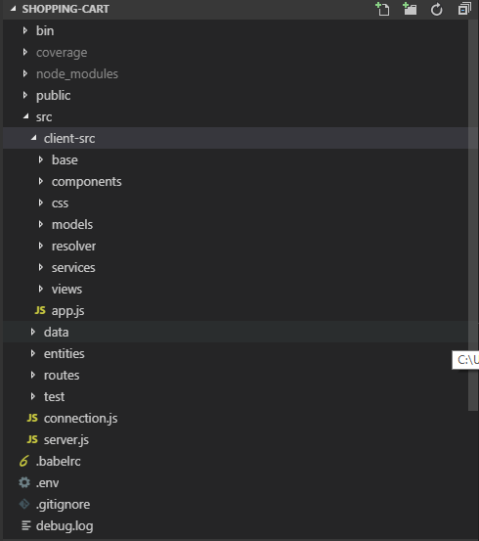
Project structure

Slide 5
Website Approach
Used Single page application approach.
Features covered in spa :-
Components are registered with root module.
Routing is handled by providing routes and method is exposed to component for navigating programmatically.
Component life cycle is maintained. Such as hooks gets triggered for component initiation, after DOM is rendered for attaching DOM events, after router params gets changed and when component gets destroyed for detaching events.
Components and it’s children can be rendered and resolved by using components registered selector with module.
Before component instantiation, all it’s dependency related to data is resolved before creating instance of component.
Used express-handlebars for templating the view part of component.
Used Semantic Html5 tags with scss features like mixins, nesting, variables etc.
Used Webpack for bundling client side js and css.
Used express for making server with mongo DB. Created API for fetching products and saving cart items in database.

Slide 6
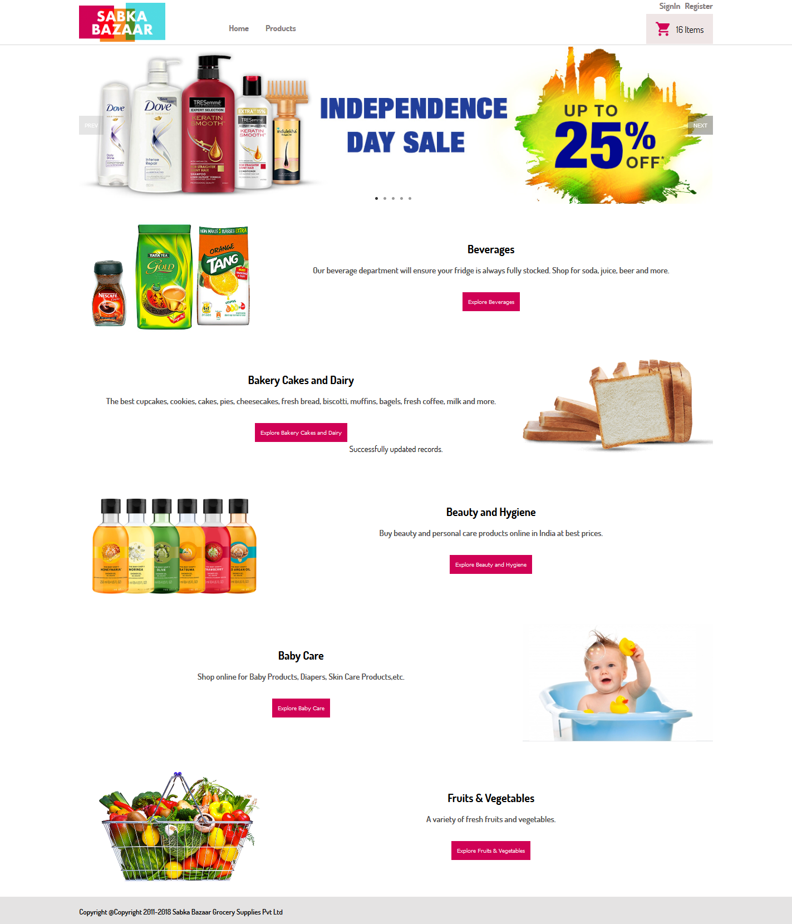
Home Page View

Slide 7
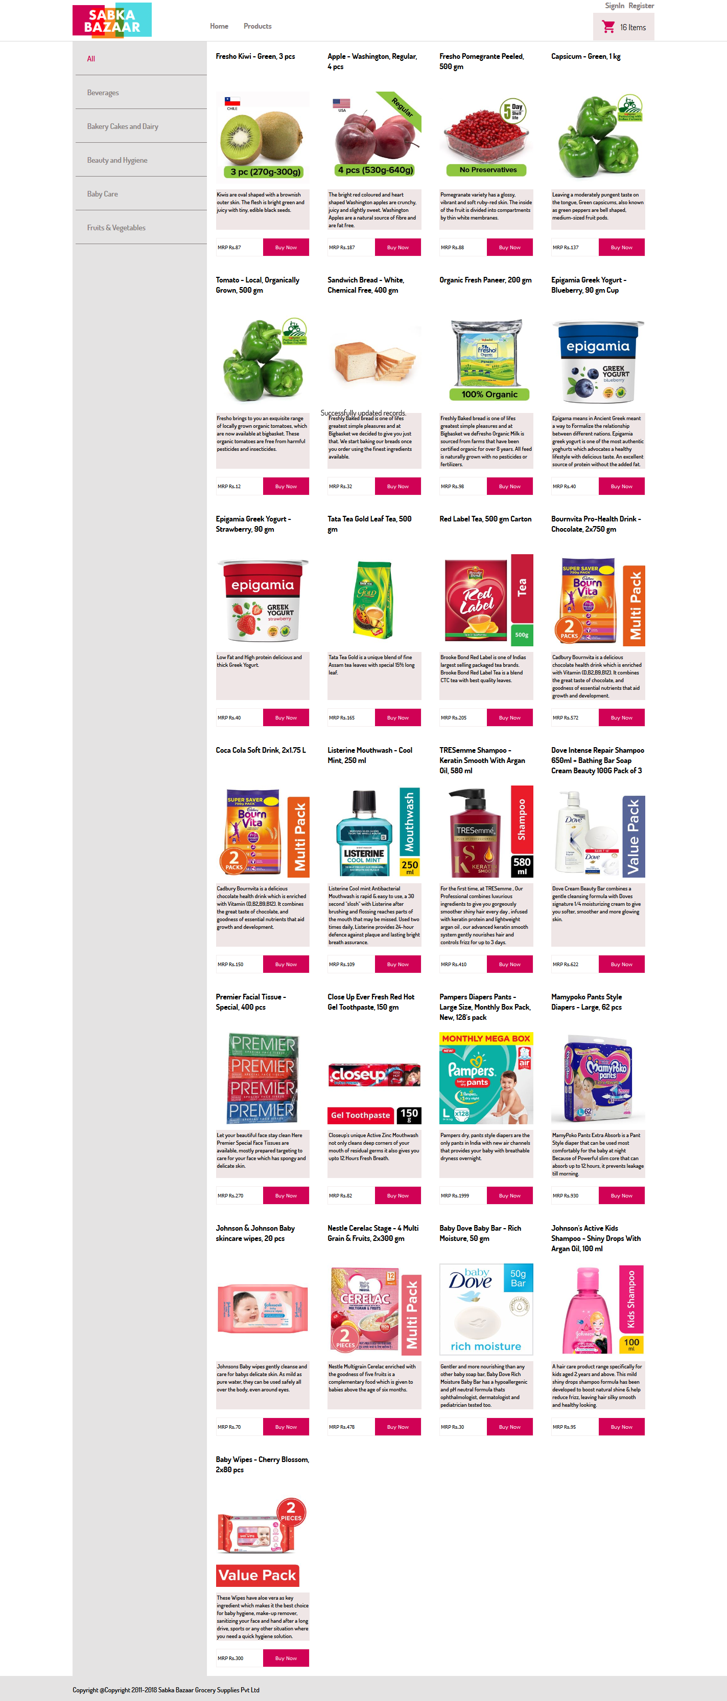
Products Page

Slide 8
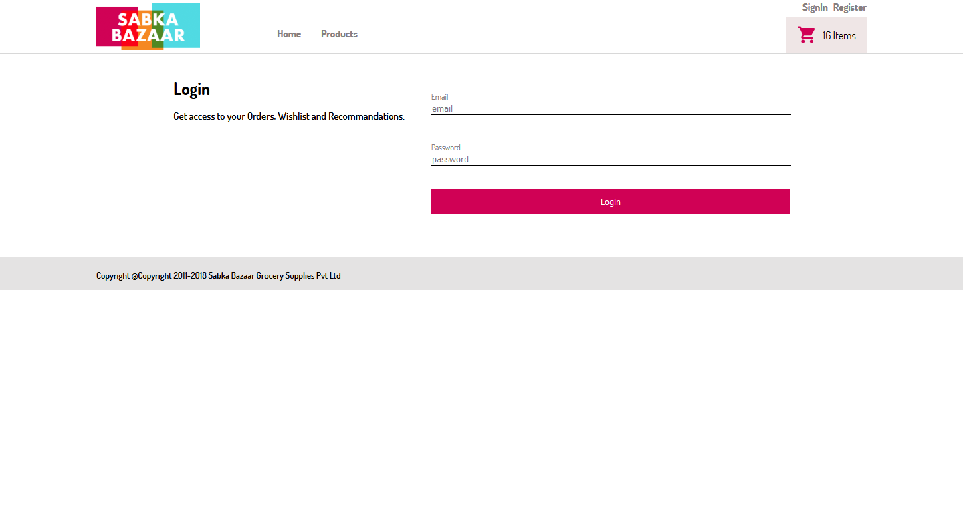
Login View

Slide 9
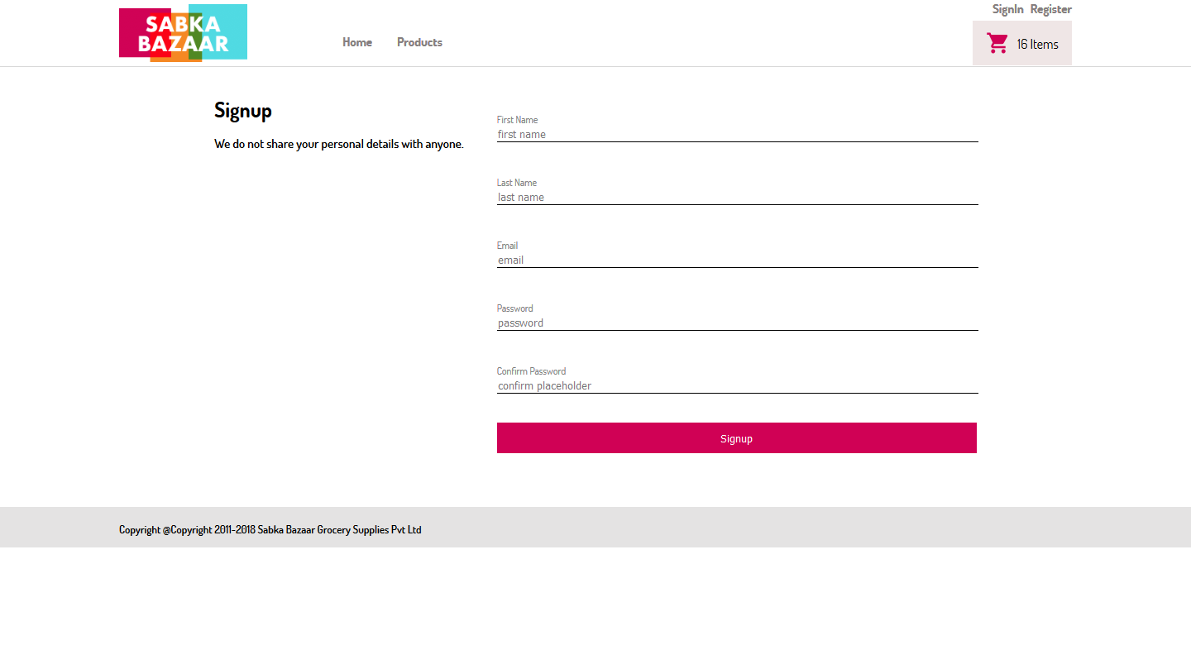
Register View

Slide 10
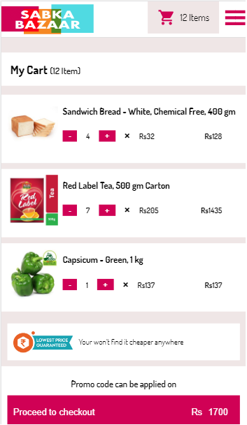
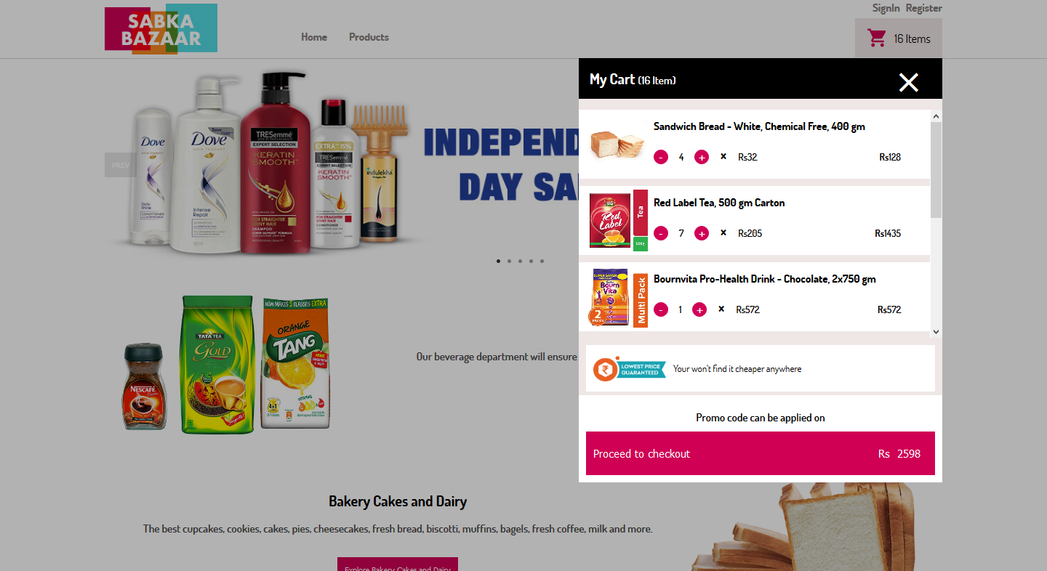
Mini Cart Desktop
Mini Cart Mobile

Slide 11
Thankyou

