Slide 1
Chapter 1
Introduction and Data Collection
Business Statistics, A First Course
4th Edition

Slide 2
Learning Objectives
In this chapter you learn:
How statistics is used in business
The sources of data used in business
The types of data used in business

Slide 3
Basic Concepts of Statistics
Statistics is concerned with:
Processing and analyzing data
Collecting, presenting, and transforming data to assist decision makers

Slide 4
Key Definitions
A population (universe) is the collection of all members of a group
A sample is a portion of the population selected for analysis
A parameter is a numerical measure that describes a characteristic of a population
A statistic is a numerical measure that describes a characteristic of a sample

Slide 5
Population vs. Sample
Population
Sample
a b c d
ef gh i jk l m n
o p q rs t u v w
x y z
b c
g i n
o r u
y
Measures used to describe a population are called parameters
Measures computed from sample data are called statistics

Slide 6
Two Branches of Statistics
Descriptive statistics
  Collecting, summarizing, and presenting data
Inferential statistics
  Drawing conclusions about a population based only on sample data

Slide 7


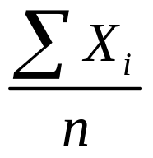
Descriptive Statistics
Collect data
  e.g., Survey
Present data
  e.g., Tables and graphs
Characterize data
  e.g., Sample mean =

Slide 8
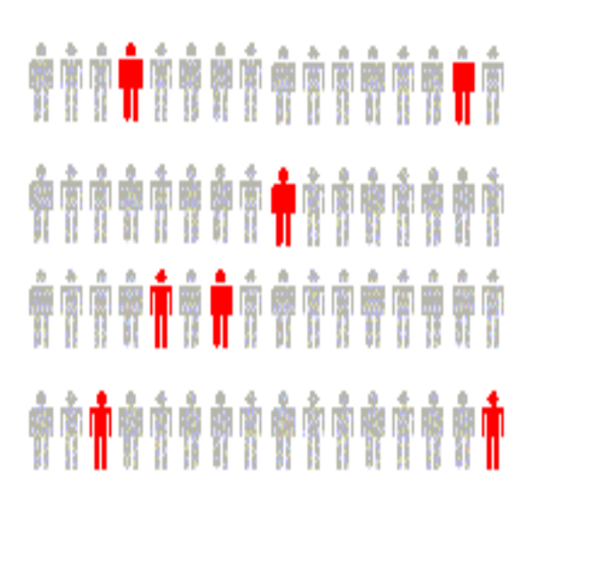
Inferential Statistics
Estimation
  e.g., Estimate the population mean weight using the sample mean weight
Hypothesis testing
  e.g., Test the claim that the population mean weight is 120 pounds
Drawing conclusions about a population based on sample results.

Slide 9




Collecting Data
Primary Sources
Data Collection
Secondary Sources
Data Compilation
Print or Electronic
Observation
Survey
Experimentation

Slide 10
Types of Data
Data
Categorical
Numerical
Examples:
Marital Status
Political Party
Eye Color
(Defined categories)
Discrete
Continuous
Examples:
Number of Children
Defects per hour
(Counted items)
Examples:
Weight
Voltage
(Measured characteristics)

Slide 11
Chapter Summary
Reviewed basic concepts of statistics:
  Population vs. Sample
  Parameter vs. Statistic
  Primary vs. Secondary data sources
Defined descriptive vs. inferential statistics
Reviewed data types
  Categorical vs. Numerical data
  Discrete vs. Continuous data

