Slide 1
Business Statistics, A First Course
4th Edition
Chapter 2
Presenting Data in Tables and Charts

Slide 2
Learning Objectives
In this chapter you learn:
To develop tables and charts for categorical data
To develop tables and charts for numerical data
The principles of properly presenting graphs

Slide 3
Organizing and Presenting
Data Graphically
Data in raw form are usually not easy to use for decision making
  Some type of organization is needed
    Table
    Graph
Techniques reviewed here:
  Bar charts and pie charts
  Pareto diagram
  Ordered array
  Stem-and-leaf display
  Frequency distributions, histograms and polygons
  Cumulative distributions and ogives
  Contingency tables
  Scatter diagrams

Slide 4
Tables and Charts for Categorical Data
Categorical Data
Graphing Data
Tabulating Data
Summary Table
Bar Charts
Pie Charts
Pareto Diagram

Slide 5
The Summary Table
Summarize data by category
Example: Current Investment Portfolio
Investment Amount Percentage
Type (in thousands $) (%)
Stocks 46.5 42.27
Bonds 32.0 29.09
CD 15.5 14.09
Savings 16.0 14.55
Total 110.0 100.0
(Variables are Categorical)

Slide 6
Bar and Pie Charts
Bar charts and Pie charts are often used for categorical data
Height of bar or size of pie slice shows the frequency or percentage for each category

Slide 7
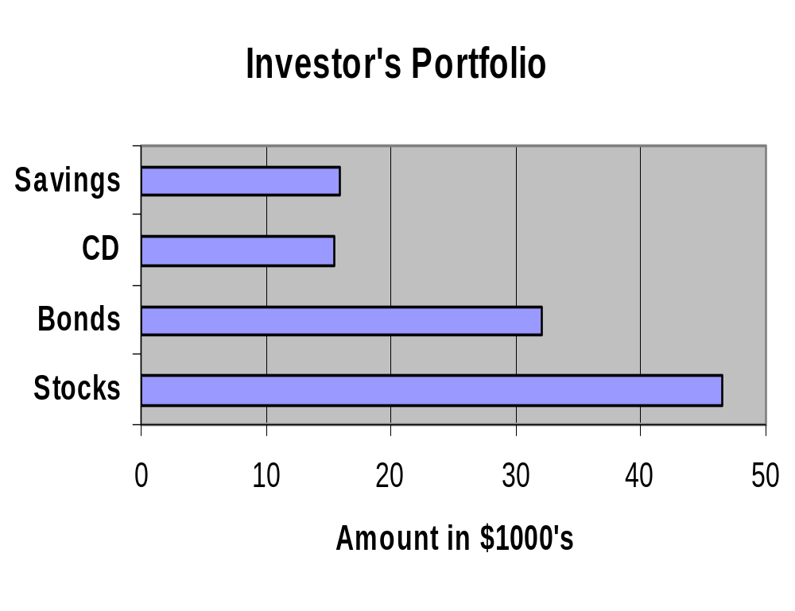
Bar Chart Example
Current Investment Portfolio
Investment Amount Percentage
Type (in thousands $) (%)
Stocks 46.5 42.27
Bonds 32.0 29.09
CD 15.5 14.09
Savings 16.0 14.55
Total 110.0 100.0

Slide 8
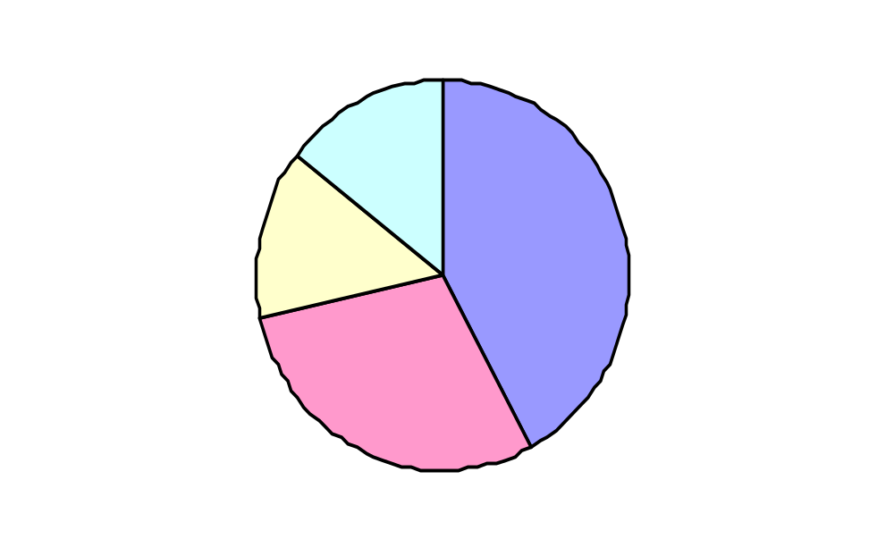
Pie Chart Example
Current Investment Portfolio
Investment Amount Percentage
Type (in thousands $) (%)
Stocks 46.5 42.27
Bonds 32.0 29.09
CD 15.5 14.09
Savings 16.0 14.55
Total 110.0 100.0
Savings
15%
Stocks
42%
CD 14%
Percentages are rounded to the nearest percent
Bonds 29%

Slide 9
Pareto Diagram
Used to portray categorical data (nominal scale)
A bar chart, where categories are shown in descending order of frequency
A cumulative polygon is often shown in the same graph
Used to separate the “vital few” from the “trivial many”

Slide 10
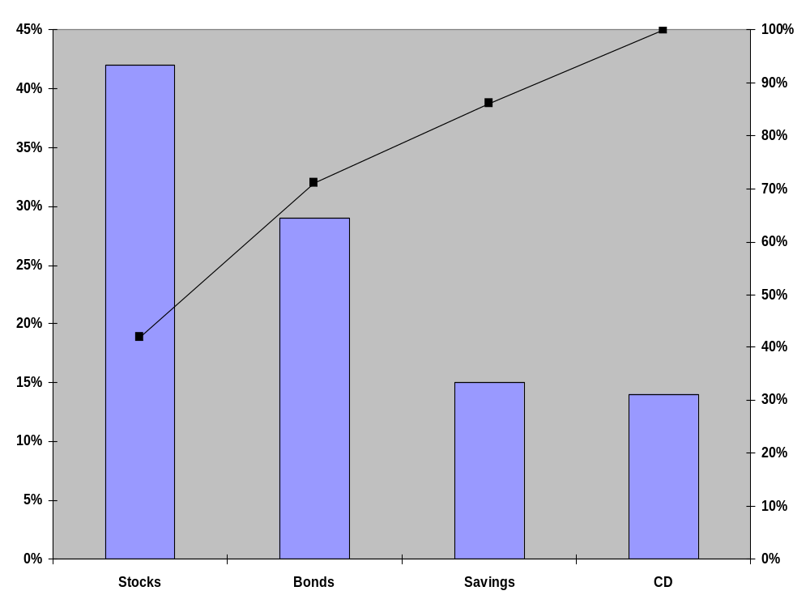
Pareto Diagram Example
Current Investment Portfolio
% invested in each category (bar graph)
cumulative % invested (line graph)

Slide 11
Organizing
Numerical Data
Numerical Data
Frequency Distributions and
Cumulative Distributions
Ordered Array
Stem-and-Leaf
Display
Histogram
Polygon
Ogive

Slide 12
The Ordered Array
  A sequence of data in rank order:
  Shows range (min to max)
  Provides some signals about variability
  within the range
  May help identify outliers (unusual observations)
  If the data set is large, the ordered array is
  less useful

Slide 13
The Ordered Array
(continued)
Data in raw form (as collected):
24, 26, 24, 21, 27, 27, 30, 41, 32, 38
Data in ordered array from smallest to largest:
21, 24, 24, 26, 27, 27, 30, 32, 38, 41

Slide 14
Stem-and-Leaf Diagram
A simple way to see distribution details in a data set
  METHOD: Separate the sorted data series
  into leading digits (the stem) and
  the trailing digits (the leaves)

Slide 15
Example
Data in ordered array:
21, 24, 24, 26, 27, 27, 30, 32, 38, 41
Here, use the 10’s digit for the stem unit:
Stem Leaf
2 1
3 8
4 1
21 is shown as
38 is shown as
41 is shown as

Slide 16
Example
(continued)
Data in ordered array:
21, 24, 24, 26, 27, 27, 30, 32, 38, 41
Completed stem-and-leaf diagram:
Stem | Leaves
2 | 1 4 4 6 7 7
3 | 0 2 8
4 | 1

Slide 17
Using other stem units
Using the 100’s digit as the stem:
  Round off the 10’s digit to form the leaves
    613 would become 6 1
    776 would become 7 8
    . . .
    1224 becomes 12 2
Stem Leaf

Slide 18
Using other stem units
(continued)
Using the 100’s digit as the stem:
  The completed stem-and-leaf display:
  Data:
  613, 632, 658, 717,
  722, 750, 776, 827,
  841, 859, 863, 891,
  894, 906, 928, 933,
  955, 982, 1034, 1047,1056, 1140, 1169, 1224
Stem Leaves
6 1 3 6
7 2 2 5 8
8 3 4 6 6 9 9
9 1 3 3 6 8
10 3 5 6
11 4 7
12 2

Slide 19
Tabulating Numerical Data: Frequency Distributions
What is a Frequency Distribution?
A frequency distribution is a list or a table …
containing class groupings (ranges within which the data fall) ...
and the corresponding frequencies with which data fall within each grouping or category

Slide 20
Why Use a Frequency Distribution?
It is a way to summarize numerical data
It condenses the raw data into a more useful form...
It allows for a quick visual interpretation of the data

Slide 21

Class Intervals and Class Boundaries
Each class grouping has the same width
Determine the width of each interval by
Usually at least 5 but no more than 15 groupings
Class boundaries never overlap
Round up the interval width to get desirable endpoints

Slide 22
Frequency Distribution Example
Example: A manufacturer of insulation randomly selects 20 winter days and records the daily high temperature
24, 35, 17, 21, 24, 37, 26, 46, 58, 30,
32, 13, 12, 38, 41, 43, 44, 27, 53, 27

Slide 23
Frequency Distribution Example
(continued)
Sort raw data in ascending order:
12, 13, 17, 21, 24, 24, 26, 27, 27, 30, 32, 35, 37, 38, 41, 43, 44, 46, 53, 58
Find range: 58 - 12 = 46
Select number of classes: 5 (usually between 5 and 15)
Compute class interval (width): 10 (46/5 then round up)
Determine class boundaries (limits): 10, 20, 30, 40, 50, 60
Compute class midpoints: 15, 25, 35, 45, 55
Count observations & assign to classes

Slide 24
Frequency Distribution Example
(continued)
Data in ordered array:
12, 13, 17, 21, 24, 24, 26, 27, 27, 30, 32, 35, 37, 38, 41, 43, 44, 46, 53, 58
Relative
Frequency
Class Frequency
Percentage
10 but less than 20 3 .15 15
20 but less than 30 6 .30 30
30 but less than 40 5 .25 25
40 but less than 50 4 .20 20
50 but less than 60 2 .10 10
Total 20 1.00 100

Slide 25
Tabulating Numerical Data:
Cumulative Frequency
Data in ordered array:
12, 13, 17, 21, 24, 24, 26, 27, 27, 30, 32, 35, 37, 38, 41, 43, 44, 46, 53, 58
Cumulative Frequency
Cumulative Percentage
Class
Frequency
Percentage
10 but less than 20 3 15 3 15
20 but less than 30 6 30 9 45
30 but less than 40 5 25 14 70
40 but less than 50 4 20 18 90
50 but less than 60 2 10 20 100
Total 20 100

Slide 26
Graphing Numerical Data: The Histogram
A graph of the data in a frequency distribution is called a histogram
The class boundaries (or class midpoints) are shown on the horizontal axis
the vertical axis is either frequency, relative frequency, or percentage
Bars of the appropriate heights are used to represent the number of observations within each class

Slide 27
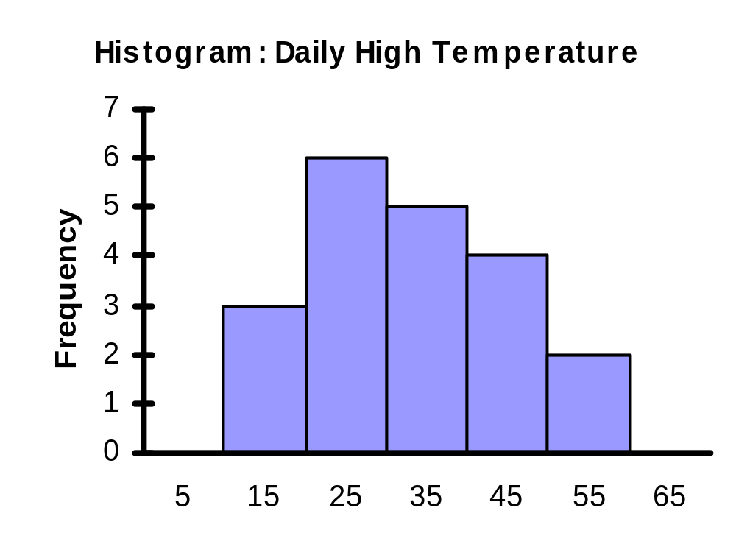
Histogram Example
Class Midpoint
Class
Frequency
10 but less than 20 15 3
20 but less than 30 25 6
30 but less than 40 35 5
40 but less than 50 45 4
50 but less than 60 55 2
(No gaps between bars)
Class Midpoints

Slide 28
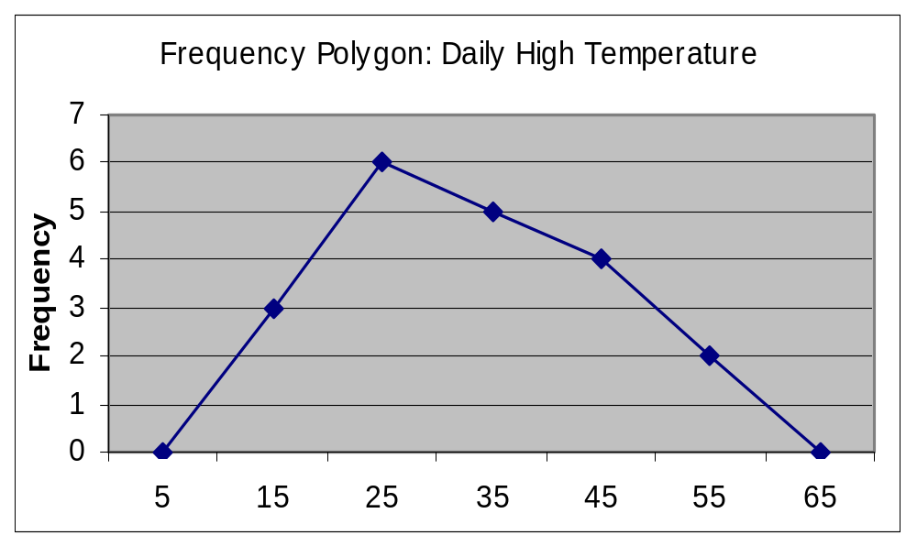
Graphing Numerical Data:
The Frequency Polygon
Class Midpoint
Class
Frequency
10 but less than 20 15 3
20 but less than 30 25 6
30 but less than 40 35 5
40 but less than 50 45 4
50 but less than 60 55 2
(In a percentage polygon the vertical axis would be defined to show the percentage of observations per class)
Class Midpoints

Slide 29
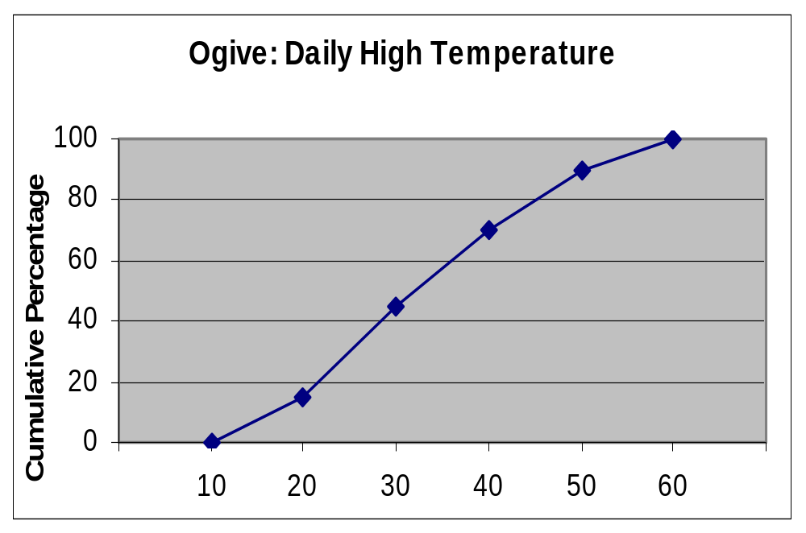
Graphing Cumulative Frequencies:
The Ogive (Cumulative % Polygon)
Lower class boundary
Cumulative Percentage
Class
Less than 10 0 0
10 but less than 20 10 15
20 but less than 30 20 45
30 but less than 40 30 70
40 but less than 50 40 90
50 but less than 60 50 100
Class Boundaries (Not Midpoints)

Slide 30
Tabulating and Graphing
Multivariate Categorical Data
Contingency Table for Investment Choices ($1000’s)
Investment Investor A Investor B Investor C Total
Category
Stocks 46.5 55 27.5 129
Bonds 32.0 44 19.0 95
CD 15.5 20 13.5 49
Savings 16.0 28 7.0 51
Total 110.0 147 67.0 324
(Individual values could also be expressed as percentages of the overall total, percentages of the row totals, or percentages of the column totals)

Slide 31
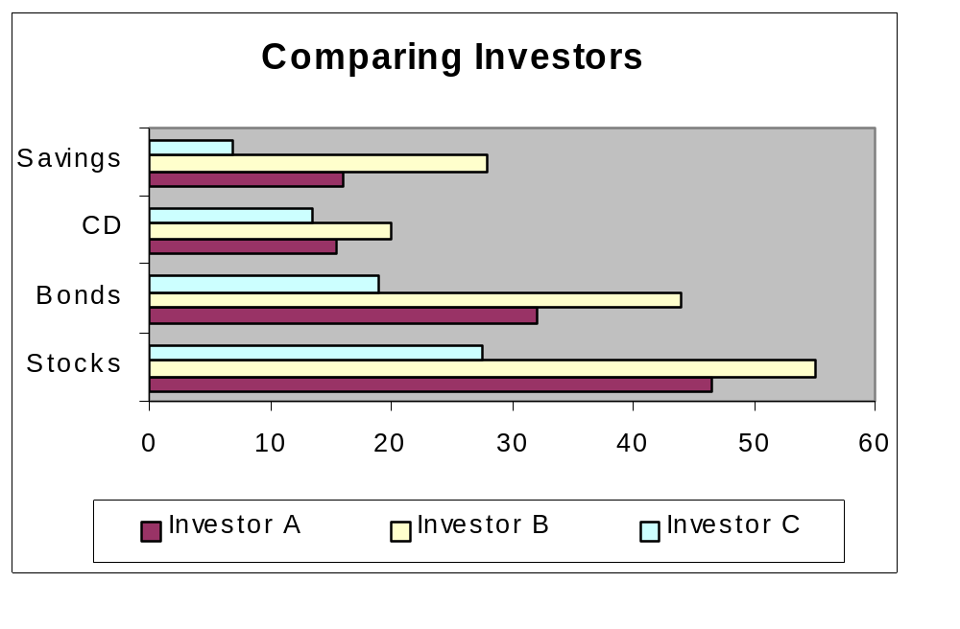
Tabulating and Graphing
Multivariate Categorical Data
(continued)
Side-by-side bar charts

Slide 32
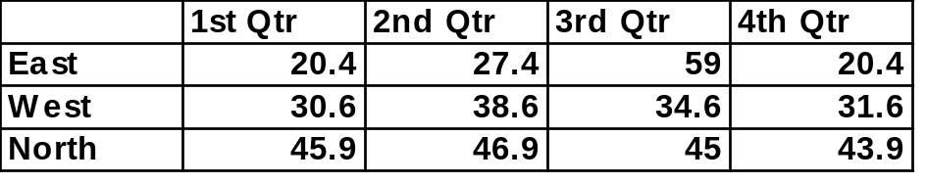
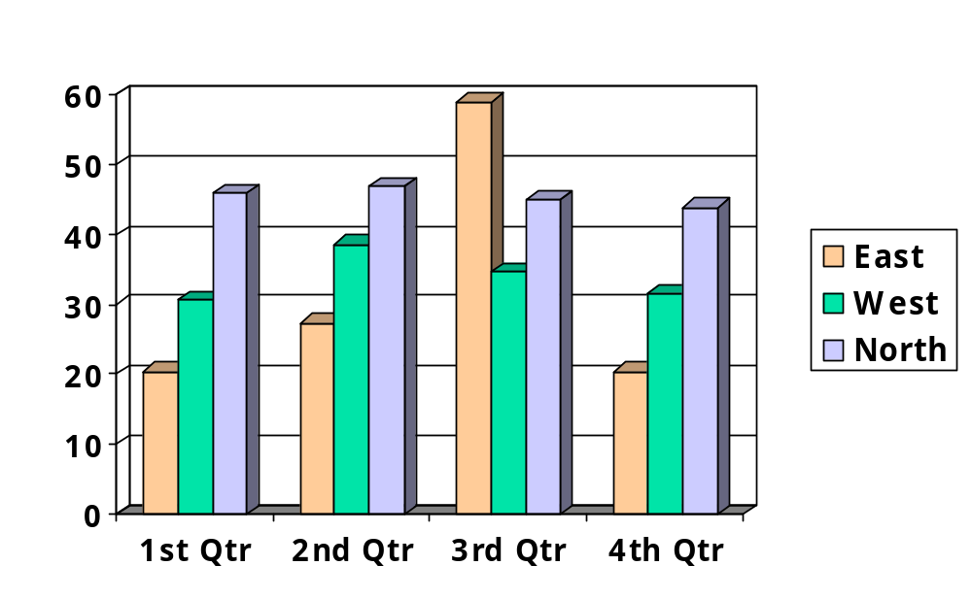
Side-by-Side Chart Example
Sales by quarter for three sales territories:

Slide 33
Scatter Diagrams
Scatter Diagrams are used to examine possible relationships between two numerical variables
The Scatter Diagram:
  one variable is measured on the vertical axis and the other variable is measured on the horizontal axis

Slide 34
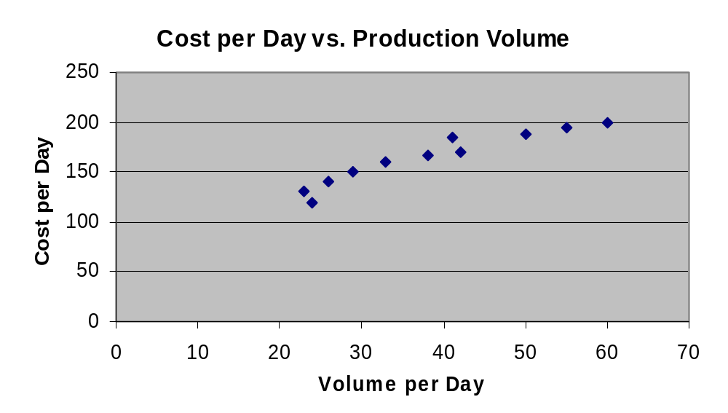
Scatter Diagram Example
Volume per day | Cost per day
23 | 131
24 | 120
26 | 140
29 | 151
33 | 160
38 | 167
41 | 185
42 | 170
50 | 188
55 | 195
60 | 200

Slide 35
Time Series Plot
A Time Series Plot is used to study patterns in the values of a variable over time
The Time Series Plot:
  one variable is measured on the vertical axis and the time period is measured on the horizontal axis

Slide 36
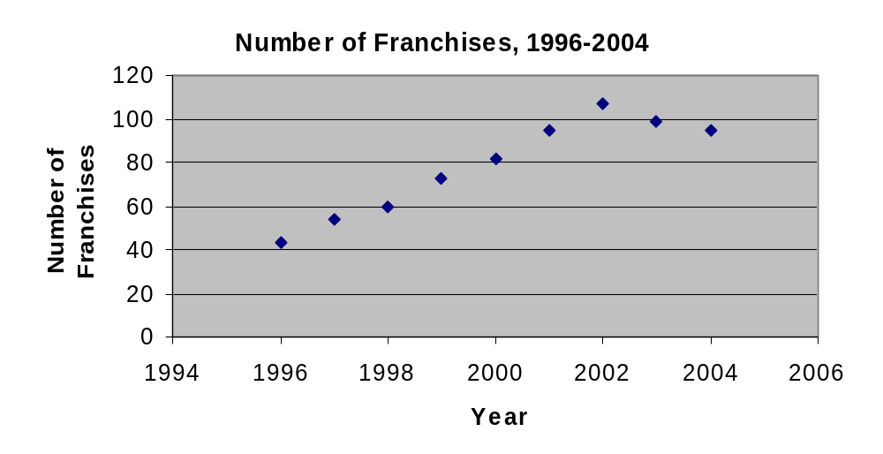
Scatter Diagram Example
Year | Number of Franchises
1996 | 43
1997 | 54
1998 | 60
1999 | 73
2000 | 82
2001 | 95
2002 | 107
2003 | 99
2004 | 95

Slide 37
Misusing Graphs and Ethical Issues
Guidelines for good graphs:
Do not distort the data
Avoid unnecessary adornments (no “chart junk”)
Use a scale for each axis on a two-dimensional graph
The vertical axis scale should begin at zero
Properly label all axes
The graph should contain a title
Use the simplest graph for a given set of data

Slide 38
Chapter Summary
Data in raw form are usually not easy to use for decision making -- Some type of organization is needed:
    ♦ Table ♦ Graph
Techniques reviewed in this chapter:
  Bar charts, pie charts, and Pareto diagrams
  Ordered array and stem-and-leaf display
  Frequency distributions, histograms and polygons
  Cumulative distributions and ogives
  Contingency tables and side-by-side bar charts
  Scatter diagrams and time series plots

