Slide 1
Business Statistics, A First Course
4th Edition
Chapter 3
Numerical Descriptive Measures

Slide 2
Learning Objectives
In this chapter, you learn:
To describe the properties of central tendency, variation, and shape in numerical data
To calculate descriptive summary measures for a population
To calculate the coefficient of variation and Z-scores
To construct and interpret a box-and-whisker plot
To calculate the covariance and the coefficient of correlation

Slide 3
Chapter Topics
Measures of central tendency, variation, and shape
  Mean, median, mode, geometric mean
  Quartiles
  Range, interquartile range, variance and standard deviation, coefficient of variation, Z-scores
  Symmetric and skewed distributions
Population summary measures
  Mean, variance, and standard deviation
  The empirical rule and Chebyshev rule

Slide 4
Chapter Topics
(continued)
Five number summary and box-and-whisker plot
Covariance and coefficient of correlation
Pitfalls in numerical descriptive measures and ethical issues

Slide 5
Summary Measures
Describing Data Numerically
Central Tendency
Quartiles
Variation
Shape
Arithmetic Mean
Range
Skewness
Median
Interquartile Range
Mode
Variance
Geometric Mean
Standard Deviation
Coefficient of Variation

Slide 6
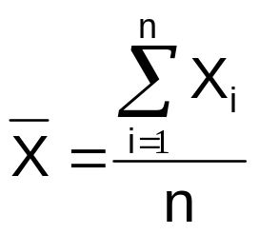

Measures of Central Tendency
Overview
Central Tendency
Arithmetic Mean
Median
Mode
Geometric Mean
Midpoint of ranked values
Most frequently observed value

Slide 7
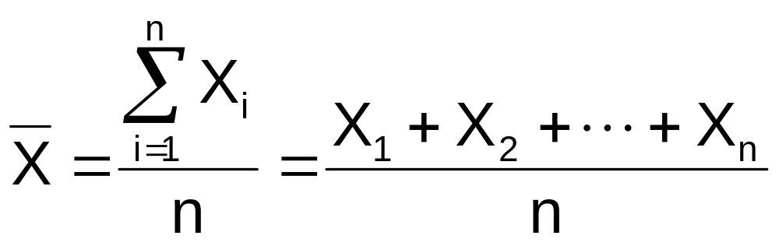
Arithmetic Mean
The arithmetic mean (sample mean) is the most common measure of central tendency
  For a sample of size n:
Sample size
Observed values

Slide 8
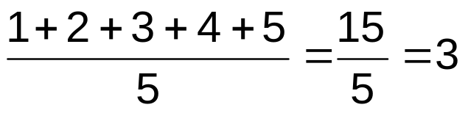
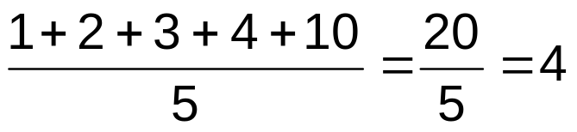
Arithmetic Mean
(continued)
The most common measure of central tendency
Mean = sum of values divided by the number of values
Affected by extreme values (outliers)
0 1 2 3 4 5 6 7 8 9 10
0 1 2 3 4 5 6 7 8 9 10
Mean = 3
Mean = 4

Slide 9
Median
In an ordered array, the median is the “middle” number (50% above, 50% below)
Not affected by extreme values
0 1 2 3 4 5 6 7 8 9 10
0 1 2 3 4 5 6 7 8 9 10
Median = 3
Median = 3

Slide 10

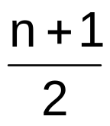
Finding the Median
The location of the median:
  If the number of values is odd, the median is the middle number
  If the number of values is even, the median is the average of the two middle numbers
Note that is not the value of the median, only the position of the median in the ranked data

Slide 11
Mode
A measure of central tendency
Value that occurs most often
Not affected by extreme values
Used for either numerical or categorical (nominal) data
There may be no mode
There may be several modes
0 1 2 3 4 5 6 7 8 9 10 11 12 13 14
0 1 2 3 4 5 6
No Mode
Mode = 9

Slide 12
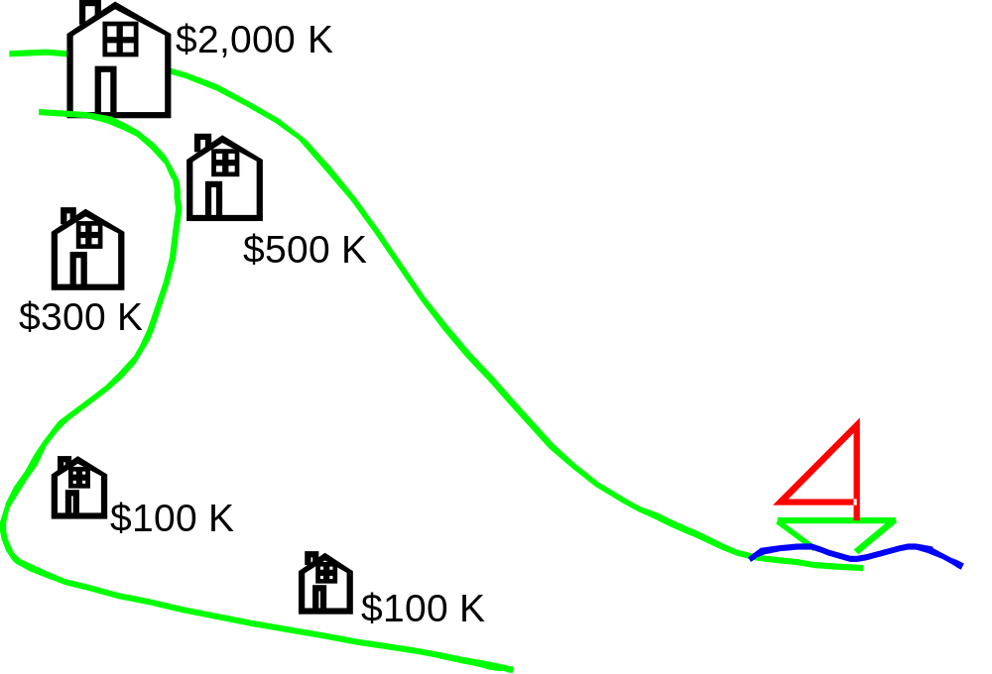

Review Example
Five houses on a hill by the beach
House Prices:
$2,000,000
500,000
300,000
100,000
100,000

Slide 13
Review Example:
Summary Statistics
House Prices:
$2,000,000
500,000
300,000
100,000
100,000
Sum $3,000,000
Mean: ($3,000,000/5)
= $600,000
Median: middle value of ranked data
= $300,000
Mode: most frequent value
= $100,000

Slide 14
Which measure of location is the “best”?
Mean is generally used, unless extreme values (outliers) exist
Then median is often used, since the median is not sensitive to extreme values.
  Example: Median home prices may be reported for a region – less sensitive to outliers

Slide 15
Quartiles
Quartiles split the ranked data into 4 segments with an equal number of values per segment
25%
25%
25%
25%
Q1
Q2
Q3
The first quartile, Q₁, is the value for which 25% of the observations are smaller and 75% are larger
Q₂ is the same as the median (50% are smaller, 50% are larger)
Only 25% of the observations are greater than the third quartile

Slide 16
Quartile Formulas
Find a quartile by determining the value in the appropriate position in the ranked data, where
First quartile position: Q₁ = (n+1)/4
Second quartile position: Q₂ = (n+1)/2 (the median position)
Third quartile position: Q₃ = 3(n+1)/4
where n is the number of observed values

Slide 17
Quartiles
Example: Find the first quartile
Sample Data in Ordered Array: 11 12 13 16 16 17 18 21 22
(n = 9)
Q₁ is in the (9+1)/4 = 2.5 position of the ranked data
so use the value half way between the 2nd and 3rd values,
so Q₁ = 12.5
Q₁ and Q₃ are measures of noncentral location
Q₂ = median, a measure of central tendency

Slide 18
Quartiles
(continued)
Example:
Sample Data in Ordered Array: 11 12 13 16 16 17 18 21 22
(n = 9)
Q₁ is in the (9+1)/4 = 2.5 position of the ranked data,
so Q₁ = 12.5
Q₂ is in the (9+1)/2 = 5th position of the ranked data,
so Q₂ = median = 16
Q₃ is in the 3(9+1)/4 = 7.5 position of the ranked data,
so Q₃ = 19.5

Slide 19
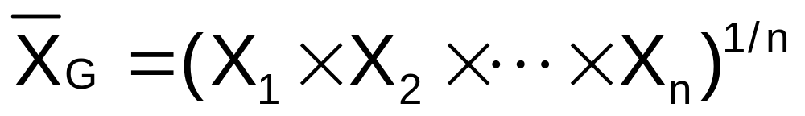
Geometric Mean
Geometric mean
  Used to measure the rate of change of a variable over time
Geometric mean rate of return
  Measures the status of an investment over time
  Where R_{i} is the rate of return in time period i

Slide 20
Example
An investment of $100,000 declined to $50,000 at the end of year one and rebounded to $100,000 at end of year two:
50% decrease 100% increase
The overall two-year return is zero, since it started and ended at the same level.

Slide 21
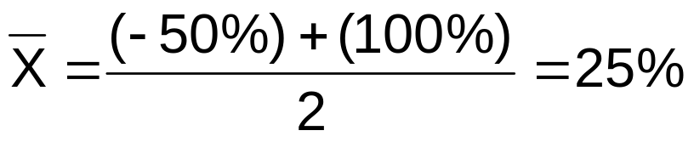
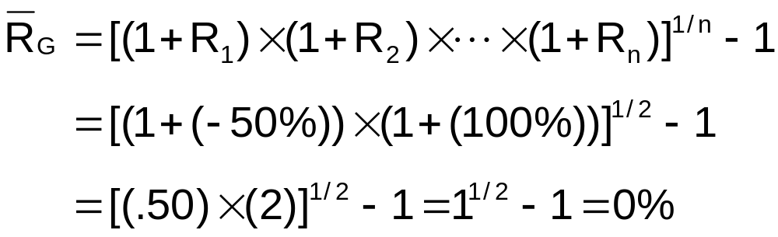
Example
(continued)
Use the 1-year returns to compute the arithmetic mean and the geometric mean:
Arithmetic mean rate of return:
Misleading result
Geometric mean rate of return:
More accurate result

Slide 22
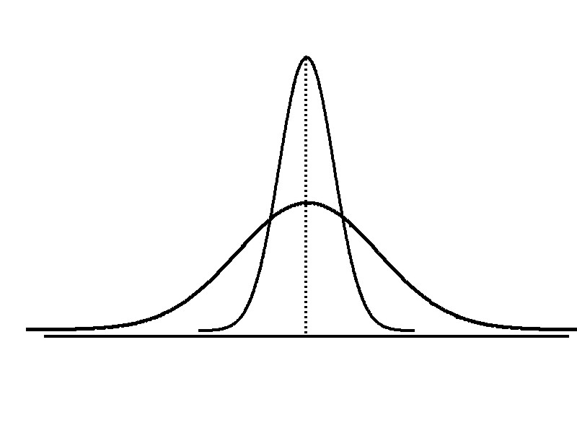
Measures of Variation
Variation
Range
Interquartile
Range
Variance
Standard Deviation
Coefficient of Variation
Measures of variation give information on the spread or variability of the data values.
Same center,
different variation

Slide 23
Range
Simplest measure of variation
Difference between the largest and the smallest values in a set of data:
Range = X_{largest} – X_{smallest}
Example:
0 1 2 3 4 5 6 7 8 9 10 11 12 13 14
Range = 14 - 1 = 13

Slide 24
Disadvantages of the Range
Ignores the way in which data are distributed
Sensitive to outliers
7 8 9 10 11 12
7 8 9 10 11 12
Range = 12 - 7 = 5
Range = 12 - 7 = 5
1,1,1,1,1,1,1,1,1,1,1,2,2,2,2,2,2,2,2,3,3,3,3,4,5
Range = 5 - 1 = 4
1,1,1,1,1,1,1,1,1,1,1,2,2,2,2,2,2,2,2,3,3,3,3,4,120
Range = 120 - 1 = 119

Slide 25
Interquartile Range
Can eliminate some outlier problems by using the interquartile range
Eliminate some high- and low-valued observations and calculate the range from the remaining values
Interquartile range = 3rd quartile – 1st quartile
= Q₃ – Q₁

Slide 26
Interquartile Range
Example:
Median
(Q2)
X
X
Q1
Q3
minimum
maximum
25% 25% 25% 25%
12 30 45 57 70
Interquartile range
= 57 – 30 = 27

Slide 27
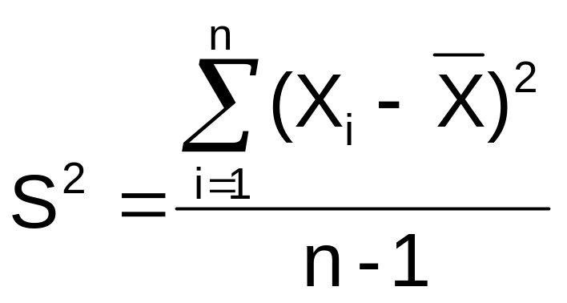

Variance
Average (approximately) of squared deviations of values from the mean
  Sample variance:
Where
= mean
n = sample size
X_{i} = i^{th} value of the variable X

Slide 28
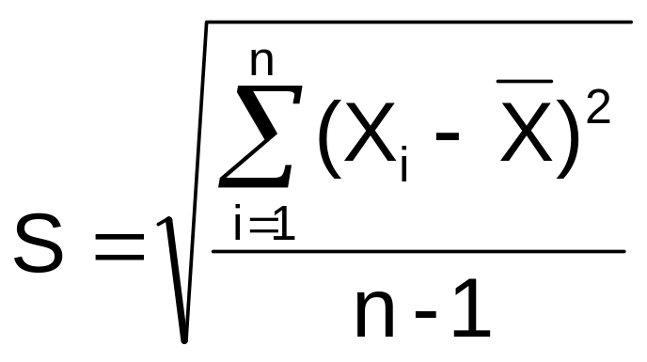
Standard Deviation
Most commonly used measure of variation
Shows variation about the mean
Is the square root of the variance
Has the same units as the original data
  Sample standard deviation:

Slide 29
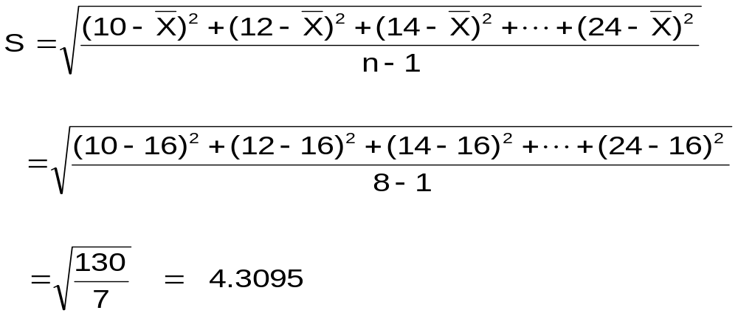
Calculation Example:
Sample Standard Deviation
Sample
Data (X_{i}) : 10 12 14 15 17 18 18 24
n = 8 Mean = X = 16
A measure of the “average” scatter around the mean

Slide 30
Measuring variation
Small standard deviation
Large standard deviation

Slide 31
Comparing Standard Deviations
Data A
Mean = 15.5
S = 3.338
11 12 13 14 15 16 17 18 19 20 21
Data B
Mean = 15.5
S = 0.926
11 12 13 14 15 16 17 18 19 20 21
Data C
Mean = 15.5
S = 4.567
11 12 13 14 15 16 17 18 19 20 21

Slide 32
Advantages of Variance and Standard Deviation
Each value in the data set is used in the calculation
Values far from the mean are given extra weight
(because deviations from the mean are squared)

Slide 33
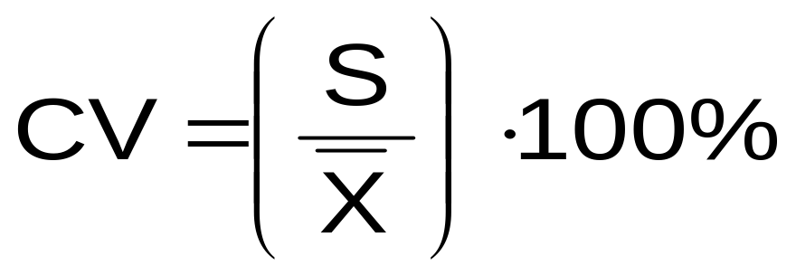
Coefficient of Variation
Measures relative variation
Always in percentage (%)
Shows variation relative to mean
Can be used to compare two or more sets of data measured in different units

Slide 34
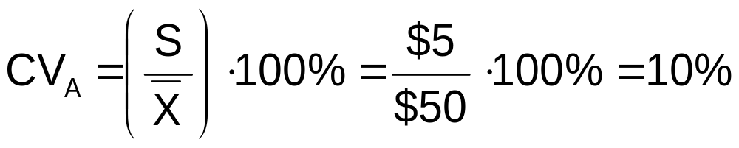
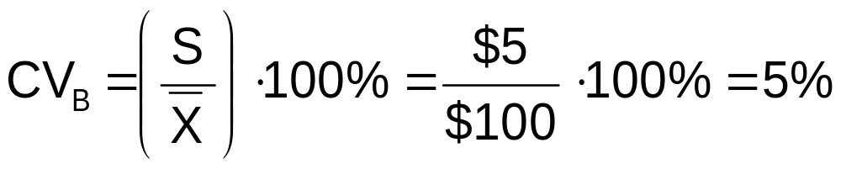
Comparing Coefficient of Variation
Stock A:
  Average price last year = $50
  Standard deviation = $5
Stock B:
  Average price last year = $100
  Standard deviation = $5
Both stocks have the same standard deviation, but stock B is less variable relative to its price

Slide 35
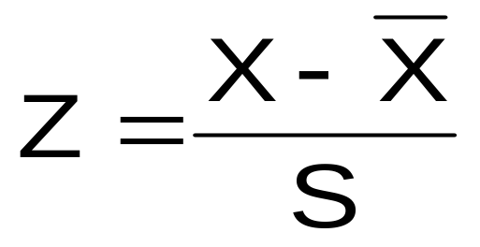
Z Scores
A measure of distance from the mean (for example, a Z-score of 2.0 means that a value is 2.0 standard deviations from the mean)
The difference between a value and the mean, divided by the standard deviation
A Z score above 3.0 or below -3.0 is considered an outlier

Slide 36
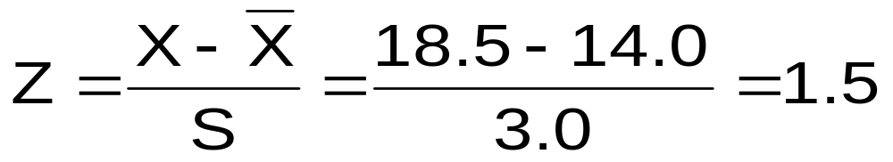
Z Scores
(continued)
Example:
If the mean is 14.0 and the standard deviation is 3.0, what is the Z score for the value 18.5?
The value 18.5 is 1.5 standard deviations above the mean
(A negative Z-score would mean that a value is less than the mean)

Slide 37
Shape of a Distribution
Describes how data are distributed
Measures of shape
  Symmetric or skewed
Left-Skewed
Symmetric
Right-Skewed
Mean < Median
Mean = Median
Median < Mean

Slide 38
Using Microsoft Excel
Descriptive Statistics can be obtained from Microsoft® Excel
  Use menu choice:
  tools / data analysis / descriptive statistics
  Enter details in dialog box

Slide 39
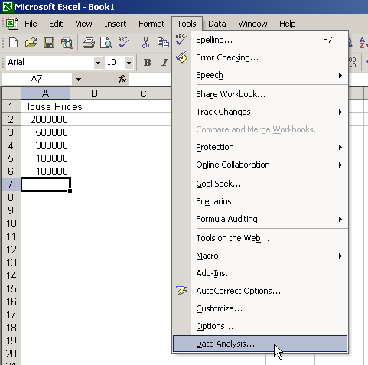
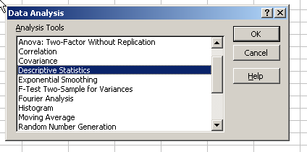
Using Excel
  Use menu choice:
  tools / data analysis / descriptive statistics

Slide 40
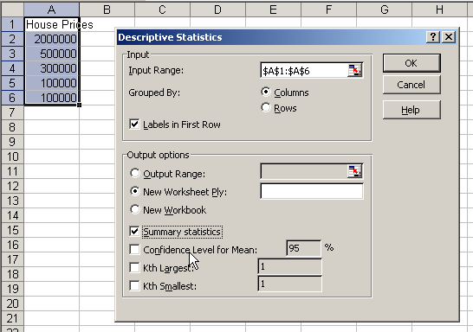
Using Excel
(continued)
Enter dialog box details
Check box for summary statistics
Click OK

Slide 41
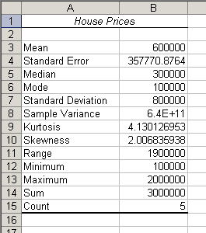
Excel output
Microsoft Excel
descriptive statistics output,
using the house price data:
House Prices:
$2,000,000
500,000
300,000
100,000
100,000

Slide 42
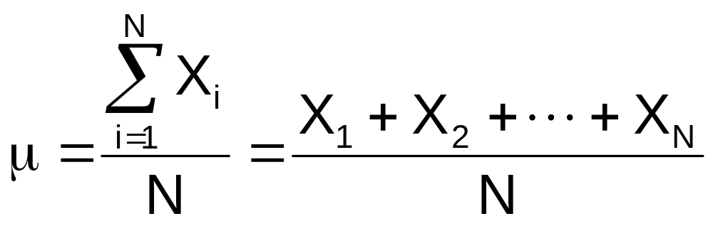
Numerical Measures for a Population
Population summary measures are called parameters
The population mean is the sum of the values in the population divided by the population size, N
Where
μ = population mean
N = population size
X_{i} = i^{th} value of the variable X

Slide 43
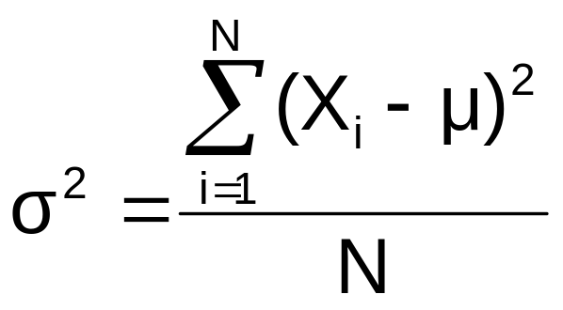
Population Variance
Average of squared deviations of values from the mean
  Population variance:
Where
μ = population mean
N = population size
X_{i} = i^{th} value of the variable X

Slide 44
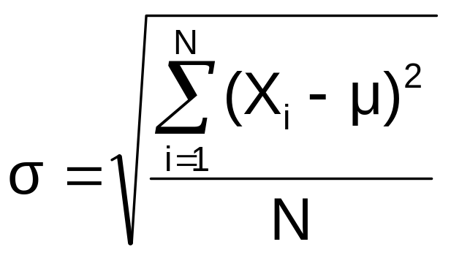
Population Standard Deviation
Most commonly used measure of variation
Shows variation about the mean
Is the square root of the population variance
Has the same units as the original data
  Population standard deviation:

Slide 45
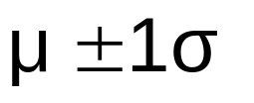


The Empirical Rule
If the data distribution is approximately bell-shaped, then the interval:
contains about 68% of the values in the population or the sample
68%

Slide 46
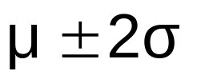
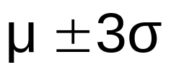


The Empirical Rule
contains about 95% of the values in
the population or the sample
contains about 99.7% of the values in the population or the sample
95%
99.7%

Slide 47
Chebyshev Rule
Regardless of how the data are distributed, at least (1 - 1/k²) x 100% of the values will fall within k standard deviations of the mean (for k > 1)
  Examples:
(1 - 1/1²) x 100% = 0% ……..... k=1 (μ ± 1σ)
(1 - 1/2²) x 100% = 75% …........ k=2 (μ ± 2σ)
(1 - 1/3²) x 100% = 89% ………. k=3 (μ ± 3σ)
At least
within

Slide 48
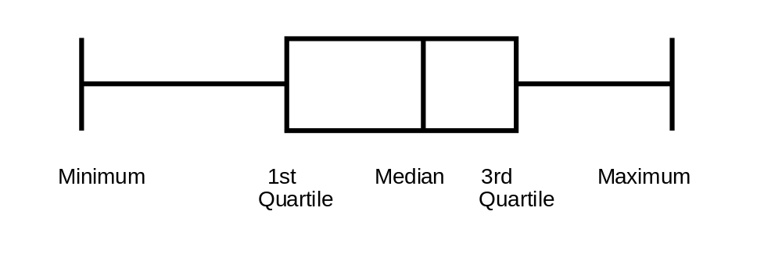
Exploratory Data Analysis
Box-and-Whisker Plot: A Graphical display of data using 5-number summary:
Minimum -- Q1 -- Median -- Q3 -- Maximum
Example:
25% 25% 25% 25%

Slide 49
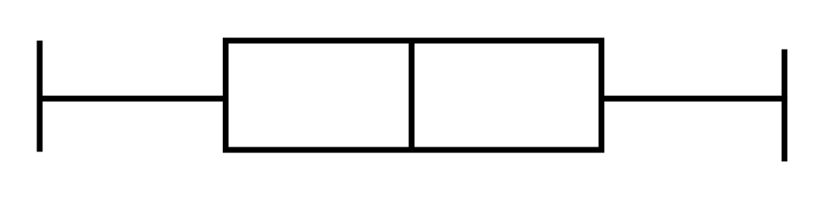
Shape of Box-and-Whisker Plots
The Box and central line are centered between the endpoints if data are symmetric around the median
A Box-and-Whisker plot can be shown in either vertical or horizontal format
Min Q₁ Median Q₃ Max

Slide 50
Distribution Shape and
Box-and-Whisker Plot
Left-Skewed
Symmetric
Right-Skewed
Q1
Q2
Q3
Q1
Q2
Q3
Q1
Q2
Q3

Slide 51
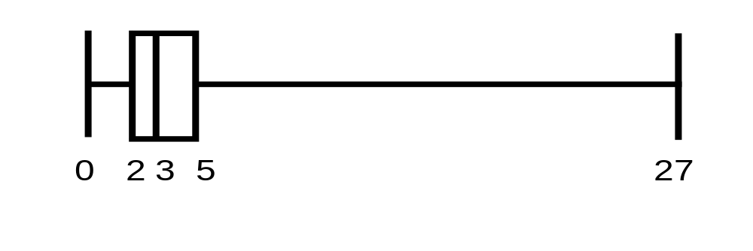
Box-and-Whisker Plot Example
Below is a Box-and-Whisker plot for the following data:
0 2 2 2 3 3 4 5 5 10 27
The data are right skewed, as the plot depicts
Min Q1 Q2 Q3 Max
0 2 3 5 27

Slide 52
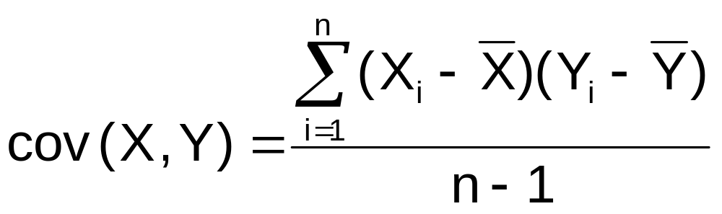
The Sample Covariance
The sample covariance measures the strength of the linear relationship between two variables (called bivariate data)
The sample covariance:
  Only concerned with the strength of the relationship
  No causal effect is implied

Slide 53
Interpreting Covariance
Covariance between two random variables:
cov(X,Y) > 0 X and Y tend to move in the same direction
cov(X,Y) < 0 X and Y tend to move in opposite directions
cov(X,Y) = 0 X and Y are independent

Slide 54
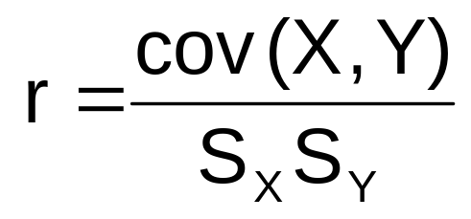
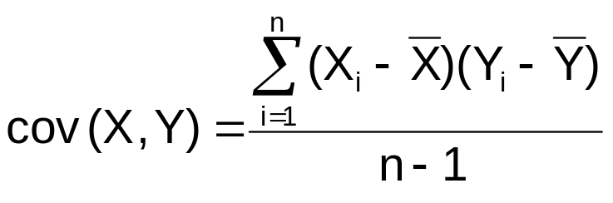
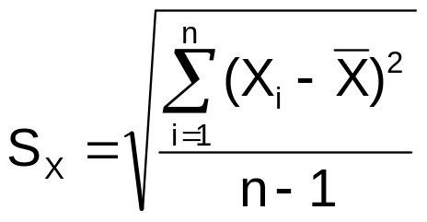

Coefficient of Correlation
Measures the relative strength of the linear relationship between two variables
Sample coefficient of correlation:
where

Slide 55
Features of
Correlation Coefficient, r
Unit free
Ranges between –1 and 1
The closer to –1, the stronger the negative linear relationship
The closer to 1, the stronger the positive linear relationship
The closer to 0, the weaker the linear relationship

Slide 56
Scatter Plots of Data with Various Correlation Coefficients
Y
Y
Y
X
X
X
r = -1
r = -.6
r = 0
Y
Y
Y
X
X
X
r = +1
r = +.3
r = 0

Slide 57
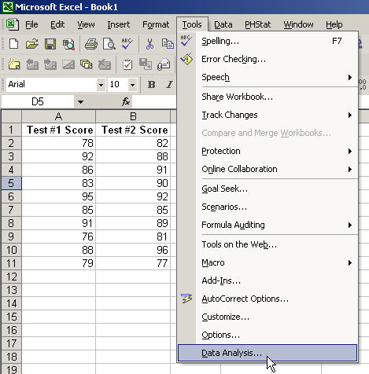
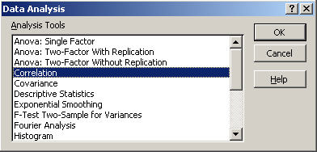
Using Excel to Find the Correlation Coefficient
Select
Tools/Data Analysis
Choose Correlation from the selection menu
Click OK . . .

Slide 58
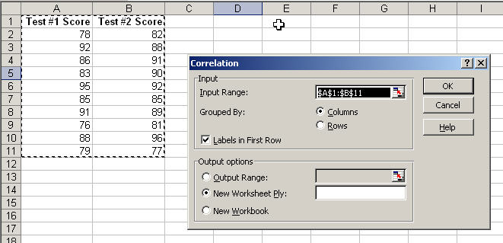

Using Excel to Find the Correlation Coefficient
(continued)
Input data range and select appropriate options
Click OK to get output

Slide 59
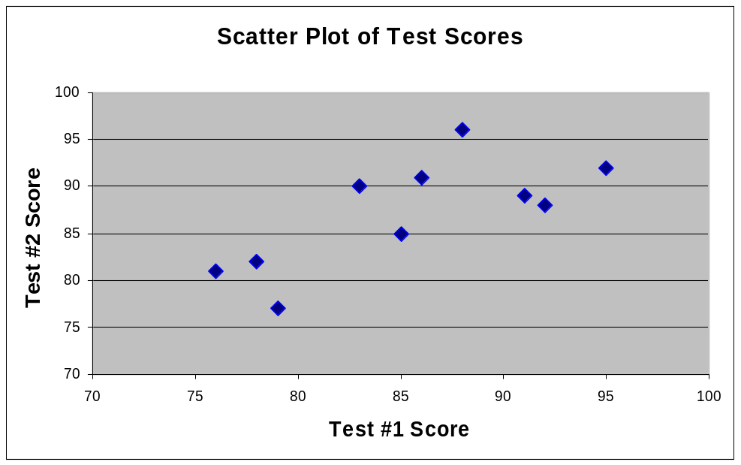
Interpreting the Result
r = .733
There is a relatively
strong positive linear
relationship between
test score #1
and test score #2
Students who scored high on the first test tended to score high on second test, and students who scored low on the first test tended to score low on the second test

Slide 60
Pitfalls in Numerical
Descriptive Measures
Data analysis is objective
  Should report the summary measures that best meet the assumptions about the data set
Data interpretation is subjective
  Should be done in fair, neutral and clear manner

Slide 61

Ethical Considerations
Numerical descriptive measures:
Should document both good and bad results
Should be presented in a fair, objective and neutral manner
Should not use inappropriate summary measures to distort facts

Slide 62
Chapter Summary
Described measures of central tendency
  Mean, median, mode, geometric mean
Discussed quartiles
Described measures of variation
  Range, interquartile range, variance and standard deviation, coefficient of variation, Z-scores
Illustrated shape of distribution
  Symmetric, skewed, box-and-whisker plots

Slide 63
Chapter Summary
(continued)
Discussed covariance and correlation coefficient
Addressed pitfalls in numerical descriptive measures and ethical considerations

