Slide 1
Business Statistics, A First Course
4th Edition
Chapter 4
Basic Probability

Slide 2
Learning Objectives
In this chapter, you learn:
Basic probability concepts and definitions
Conditional probability
To use Bayes’ Theorem to revise probabilities
Various counting rules

Slide 3
Important Terms
Probability – the chance that an uncertain event will occur (always between 0 and 1)
Event – Each possible outcome of a variable
Simple Event – an event that can be described by a single characteristic
Sample Space – the collection of all possible events

Slide 4
Assessing Probability
There are three approaches to assessing the probability of an uncertain event:
1. a priori classical probability
2. empirical classical probability
3. subjective probability
an individual judgment or opinion about the probability of occurrence

Slide 5

Sample Space
The Sample Space is the collection of all possible events
e.g. All 6 faces of a die:
e.g. All 52 cards of a bridge deck:

Slide 6
Events
Simple event
  An outcome from a sample space with one characteristic
  e.g., A red card from a deck of cards
Complement of an event A (denoted A’)
  All outcomes that are not part of event A
  e.g., All cards that are not diamonds
Joint event
  Involves two or more characteristics simultaneously
  e.g., An ace that is also red from a deck of cards

Slide 7
Visualizing Events
Contingency Tables
Tree Diagrams
Ace Not Ace Total
Black 2 24 26
Red 2 24 26
Total 4 48 52
2
24
2
24
Sample Space
Ace
Sample Space
Black Card
Full Deck
of 52 Cards
Not an Ace
Ace
Red Card
Not an Ace

Slide 8
Visualizing Events
Venn Diagrams
  Let A = aces
  Let B = red cards
A ∩ B = ace and red
A
B
A U B = ace or red

Slide 9
Mutually Exclusive Events
Mutually exclusive events
  Events that cannot occur together
example:
  A = queen of diamonds; B = queen of clubs
  Events A and B are mutually exclusive

Slide 10
Collectively Exhaustive Events
Collectively exhaustive events
  One of the events must occur
  The set of events covers the entire sample space
example:
A = aces; B = black cards;
C = diamonds; D = hearts
  Events A, B, C and D are collectively exhaustive (but not mutually exclusive – an ace may also be a heart)
  Events B, C and D are collectively exhaustive and also mutually exclusive

Slide 11

Probability
Probability is the numerical measure of the likelihood that an event will occur
The probability of any event must be between 0 and 1, inclusively
The sum of the probabilities of all mutually exclusive and collectively exhaustive events is 1
1
Certain
0 ≤ P(A) ≤ 1 For any event A
0.5
0
Impossible
If A, B, and C are mutually exclusive and collectively exhaustive

Slide 12
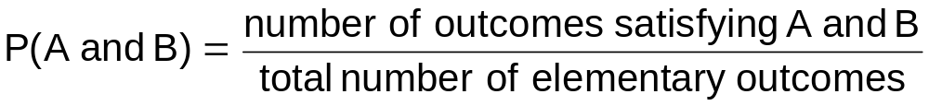
Computing Joint and
Marginal Probabilities
The probability of a joint event, A and B:
Computing a marginal (or simple) probability:
    Where B₁, B₂, …, B_{k} are k mutually exclusive and collectively exhaustive events

Slide 13
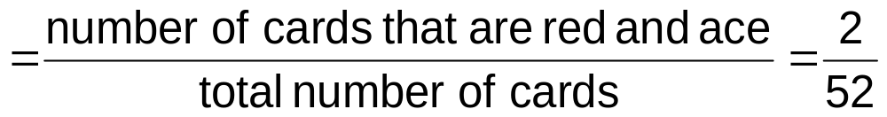
Joint Probability Example
P(Red and Ace)
Color
Type
Total
Red
Black
Ace
2
2
4
Non-Ace
24
24
48
Total
26
26
52

Slide 14
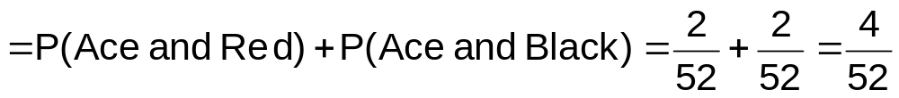
Marginal Probability Example
P(Ace)
Color
Type
Total
Red
Black
Ace
2
2
4
Non-Ace
24
24
48
Total
26
26
52

Slide 15
Joint Probabilities Using Contingency Table
Event
Event
B₁
B₂
Total
A₁
P(A₁ and B₁)
P(A₁ and B₂)
P(A₁)
A₂
P(A₂ and B₁)
P(A₂ and B₂)
P(A₂)
Total
P(B₁)
P(B₂)
1
Joint Probabilities
Marginal (Simple) Probabilities

Slide 16
General Addition Rule
General Addition Rule:
P(A or B) = P(A) + P(B) - P(A and B)
If A and B are mutually exclusive, then
P(A and B) = 0, so the rule can be simplified:
P(A or B) = P(A) + P(B)
For mutually exclusive events A and B

Slide 17
General Addition Rule Example
P(Red or Ace) = P(Red) +P(Ace) - P(Red and Ace)
= 26/52 + 4/52 - 2/52 = 28/52
Don’t count the two red aces twice!
Color
Type
Total
Red
Black
Ace
2
2
4
Non-Ace
24
24
48
Total
26
26
52

Slide 18
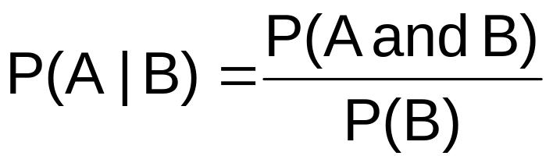
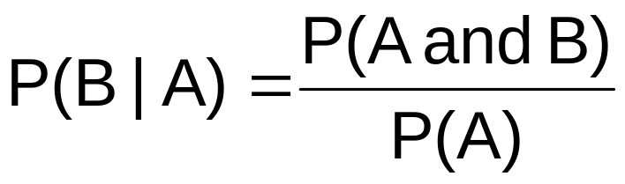
Computing Conditional Probabilities
A conditional probability is the probability of one event, given that another event has occurred:
The conditional probability of A given that B has occurred
The conditional probability of B given that A has occurred
Where P(A and B) = joint probability of A and B
P(A) = marginal probability of A
P(B) = marginal probability of B

Slide 19
Conditional Probability Example
Of the cars on a used car lot, 70% have air conditioning (AC) and 40% have a CD player (CD). 20% of the cars have both.
What is the probability that a car has a CD player, given that it has AC ?
i.e., we want to find P(CD | AC)

Slide 20
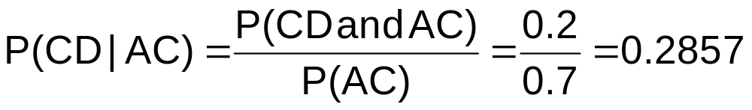
Conditional Probability Example
(continued)
Of the cars on a used car lot, 70% have air conditioning (AC) and 40% have a CD player (CD).
20% of the cars have both.
CD
No CD
Total
AC
0.2
0.5
0.7
No AC
0.2
0.1
0.3
Total
0.4
0.6
1.0

Slide 21
Conditional Probability Example
(continued)
Given AC, we only consider the top row (70% of the cars). Of these, 20% have a CD player. 20% of 70% is about 28.57%.
CD
No CD
Total
AC
0.2
0.5
0.7
No AC
0.2
0.1
0.3
Total
0.4
0.6
1.0

Slide 22




Using Decision Trees
Given AC or no AC:
Has CD
P(AC and CD) = 0.2
P(AC)= 0.7
Does not have CD
P(AC and CD’) = 0.5
Has AC
All
Cars
Does not have AC
Has CD
P(AC’ and CD) = 0.2
P(AC’)= 0.3
Does not have CD
P(AC’ and CD’) = 0.1

Slide 23



Using Decision Trees
(continued)
Given CD or no CD:
Has AC
P(CD and AC) = 0.2
P(CD)= 0.4
Does not have AC
P(CD and AC’) = 0.2
Has CD
All
Cars
Does not have CD
Has AC
P(CD’ and AC) = 0.5
P(CD’)= 0.6
Does not have AC
P(CD’ and AC’) = 0.1

Slide 24

Statistical Independence
Two events are independent if and only if:
Events A and B are independent when the probability of one event is not affected by the other event

Slide 25



Multiplication Rules
Multiplication rule for two events A and B:
Note: If A and B are independent, then
and the multiplication rule simplifies to

Slide 26
Marginal Probability
Marginal probability for event A:
  Where B₁, B₂, …, B_{k} are k mutually exclusive and collectively exhaustive events

Slide 27
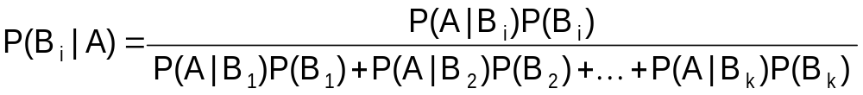
Bayes’ Theorem
Bayes’ theorem is used to revise previously calculated probabilities after new information is obtained
where:
B_{i} = i^{th} event of k mutually exclusive and collectively
exhaustive events
A = new event that might impact P(B_{i})

Slide 28

Bayes’ Theorem Example
A drilling company has estimated a 40% chance of striking oil for their new well.
A detailed test has been scheduled for more information. Historically, 60% of successful wells have had detailed tests, and 20% of unsuccessful wells have had detailed tests.
Given that this well has been scheduled for a detailed test, what is the probability
that the well will be successful?

Slide 29
Bayes’ Theorem Example
(continued)
Let S = successful well
U = unsuccessful well
P(S) = 0.4 , P(U) = 0.6 (prior probabilities)
Define the detailed test event as D
Conditional probabilities:
    P(D|S) = 0.6 P(D|U) = 0.2
Goal is to find P(S|D)

Slide 30
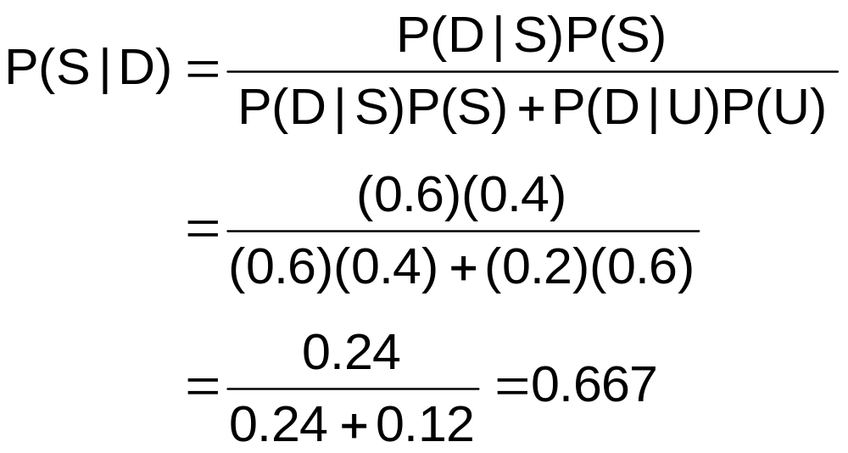
Bayes’ Theorem Example
(continued)
Apply Bayes’ Theorem:
So the revised probability of success, given that this well has been scheduled for a detailed test, is 0.667

Slide 31
Bayes’ Theorem Example
(continued)
Given the detailed test, the revised probability of a successful well has risen to 0.667 from the original estimate of 0.4
Event | Prior Prob. | Conditional Prob. | Joint Prob. | Revised Prob.
S (successful) | 0.4 | 0.6 | (0.4)(0.6) = 0.24 | 0.24/0.36 = 0.667
U (unsuccessful) | 0.6 | 0.2 | (0.6)(0.2) = 0.12 | 0.12/0.36 = 0.333
Sum = 0.36

Slide 32
Counting Rules
Rules for counting the number of possible outcomes
Counting Rule 1:
  If any one of k different mutually exclusive and collectively exhaustive events can occur on each of n trials, the number of possible outcomes is equal to
k^{n}

Slide 33
Counting Rules
(continued)
Counting Rule 2:
  If there are k₁ events on the first trial, k₂ events on the second trial, … and k_{n} events on the n^{th} trial, the number of possible outcomes is
  Example:
    You want to go to a park, eat at a restaurant, and see a movie. There are 3 parks, 4 restaurants, and 6 movie choices. How many different possible combinations are there?
    Answer: (3)(4)(6) = 72 different possibilities
(k₁)(k₂)…(k_{n})

Slide 34
Counting Rules
(continued)
Counting Rule 3:
  The number of ways that n items can be arranged in order is
  Example:
    Your restaurant has five menu choices for lunch. How many ways can you order them on your menu?
    Answer: 5! = (5)(4)(3)(2)(1) = 120 different possibilities
n! = (n)(n – 1)…(1)

Slide 35
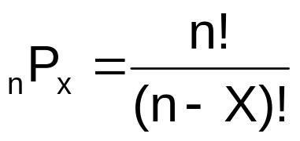
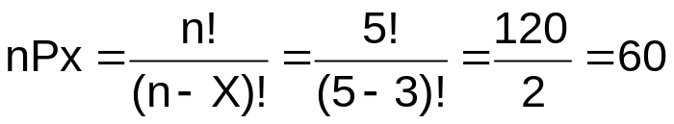
Counting Rules
(continued)
Counting Rule 4:
  Permutations: The number of ways of arranging X objects selected from n objects in order is
  Example:
    Your restaurant has five menu choices, and three are selected for daily specials. How many different ways can the specials menu be ordered?
    Answer: different possibilities

Slide 36
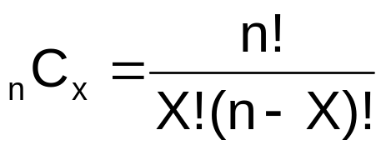
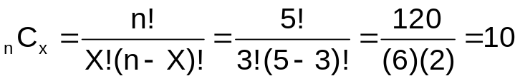
Counting Rules
(continued)
Counting Rule 5:
  Combinations: The number of ways of selecting X objects from n objects, irrespective of order, is
  Example:
    Your restaurant has five menu choices, and three are selected for daily specials. How many different special combinations are there, ignoring the order in which they are selected?
    Answer: different possibilities

Slide 37
Chapter Summary
Discussed basic probability concepts
  Sample spaces and events, contingency tables, simple probability, and joint probability
Examined basic probability rules
  General addition rule, addition rule for mutually exclusive events, rule for collectively exhaustive events
Defined conditional probability
  Statistical independence, marginal probability, decision trees, and the multiplication rule
Discussed Bayes’ theorem
Examined counting rules

