Slide 1
Business Statistics, A First Course
4th Edition
Chapter 5
Some Important Discrete Probability Distributions

Slide 2
Learning Objectives
In this chapter, you learn:
The properties of a probability distribution
To calculate the expected value, variance, and standard deviation of a probability distribution
To calculate probabilities from binomial and Poisson distributions
How to use the binomial and Poisson distributions to solve business problems

Slide 3
Introduction to Probability Distributions
Random Variable
  Represents a possible numerical value from an uncertain event
Random
Variables
Ch. 5
Discrete
Random Variable
Continuous
Random Variable
Ch. 6

Slide 4

Discrete Random Variables
Can only assume a countable number of values
  Examples:
  Roll a die twice
Let X be the number of times 4 comes up
(then X could be 0, 1, or 2 times)
  Toss a coin 5 times.
  Let X be the number of heads
  (then X = 0, 1, 2, 3, 4, or 5)

Slide 5
Discrete Probability Distribution
Experiment: Toss 2 Coins. Let X = # heads.
4 possible outcomes
Probability Distribution
T
T
X Value Probability
0 1/4 = 0.25
1 2/4 = 0.50
2 1/4 = 0.25
T
H
H
T
0.50
0.25
Probability
H
H
0 1 2 X

Slide 6
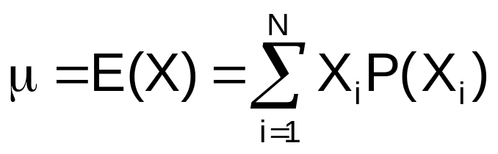
Discrete Random Variable
Summary Measures
Expected Value (or mean) of a discrete
distribution (Weighted Average)
  Example: Toss 2 coins,
  X = # of heads,
  compute expected value of X:
E(X) = (0 x 0.25) + (1 x 0.50) + (2 x 0.25)
= 1.0
X P(X)
0 0.25
1 0.50
2 0.25

Slide 7
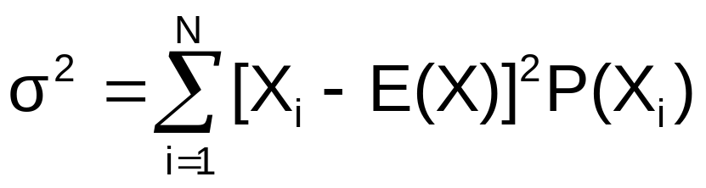
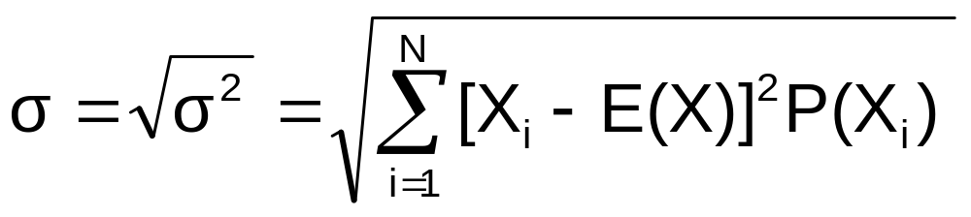
Discrete Random Variable
Summary Measures
(continued)
Variance of a discrete random variable
Standard Deviation of a discrete random variable
where:
E(X) = Expected value of the discrete random variable X
X_{i} = the i^{th} outcome of X
P(X_{i}) = Probability of the i^{th} occurrence of X

Slide 8
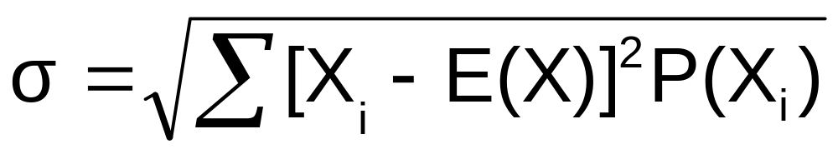
Discrete Random Variable
Summary Measures
(continued)
  Example: Toss 2 coins, X = # heads,
  compute standard deviation (recall E(X) = 1)
Possible number of heads = 0, 1, or 2

Slide 9
Probability Distributions
Probability Distributions
Ch. 5
Discrete
Probability Distributions
Continuous
Probability Distributions
Ch. 6
Binomial
Normal
Poisson

Slide 10
The Binomial Distribution
Probability Distributions
Discrete
Probability Distributions
Binomial
Poisson

Slide 11
Binomial Probability Distribution
A fixed number of observations, n
  e.g., 15 tosses of a coin; ten light bulbs taken from a warehouse
Two mutually exclusive and collectively exhaustive categories
  e.g., head or tail in each toss of a coin; defective or not defective light bulb
  Generally called “success” and “failure”
  Probability of success is p, probability of failure is 1 – p
Constant probability for each observation
  e.g., Probability of getting a tail is the same each time we toss the coin

Slide 12
Binomial Probability Distribution
(continued)
Observations are independent
  The outcome of one observation does not affect the outcome of the other
Two sampling methods
  Infinite population without replacement
  Finite population with replacement

Slide 13
Possible Binomial Distribution Settings
A manufacturing plant labels items as either defective or acceptable
A firm bidding for contracts will either get a contract or not
A marketing research firm receives survey responses of “yes I will buy” or “no I will not”
New job applicants either accept the offer or reject it

Slide 14
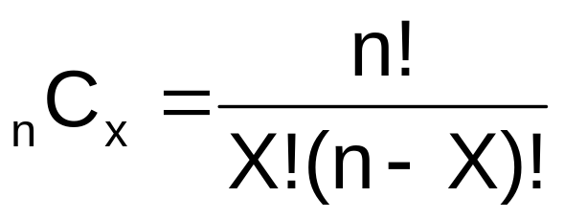
Rule of Combinations
The number of combinations of selecting X objects out of n objects is
where:
n! =(n)(n - 1)(n - 2) . . . (2)(1)
X! = (X)(X - 1)(X - 2) . . . (2)(1)
0! = 1 (by definition)

Slide 15
Binomial Distribution Formula
n
!
P(X)
=
p
X
n
−
X
(1-p)
X !
(
−
)
n
X
!
P(X) = probability of X successes in n trials,
with probability of success p on each trial
X = number of ‘successes’ in sample,
(X = 0, 1, 2, ..., n)
n = sample size (number of trials
or observations)
p = probability of “success”
Example: Flip a coin four times, let x = # heads:
n = 4
p = 0.5
1 - p = (1 - 0.5) = 0.5
X = 0, 1, 2, 3, 4

Slide 16
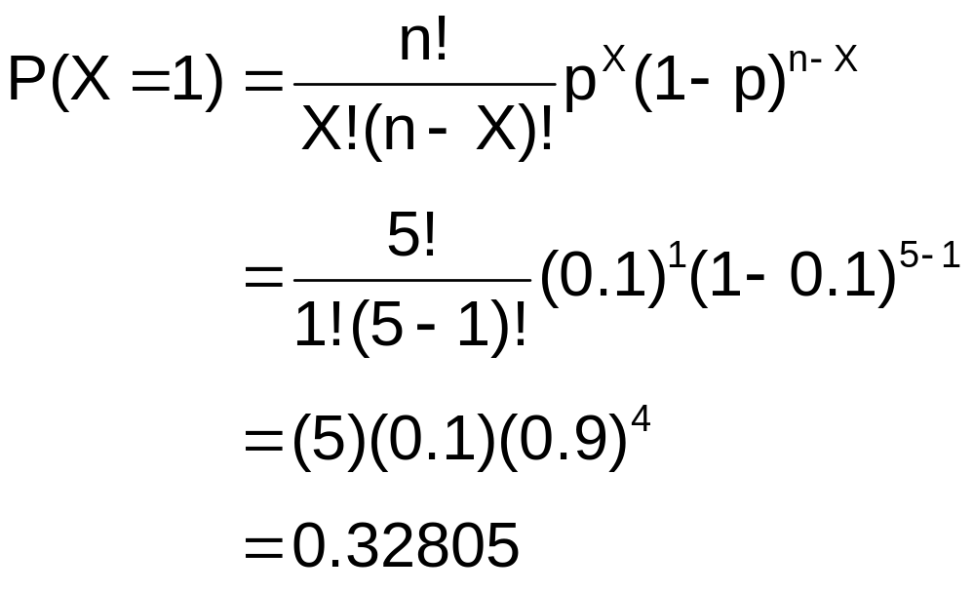
Example:
Calculating a Binomial Probability
What is the probability of one success in five observations if the probability of success is .1?
X = 1, n = 5, and p = 0.1

Slide 17
Binomial Distribution
The shape of the binomial distribution depends on the values of p and n
Mean
P(X)
n = 5 p = 0.1
.6
  Here, n = 5 and p = 0.1
.4
.2
0
X
0
1
2
3
4
5
P(X)
n = 5 p = 0.5
  Here, n = 5 and p = 0.5
.6
.4
.2
0
X
0
1
2
3
4
5

Slide 18
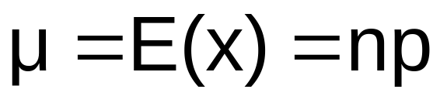
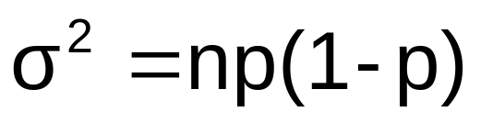
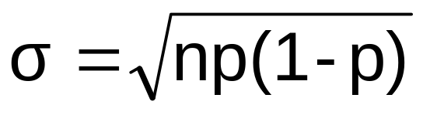
Binomial Distribution Characteristics
Mean
Variance and Standard Deviation
Where n = sample size
p = probability of success
(1 – p) = probability of failure

Slide 19

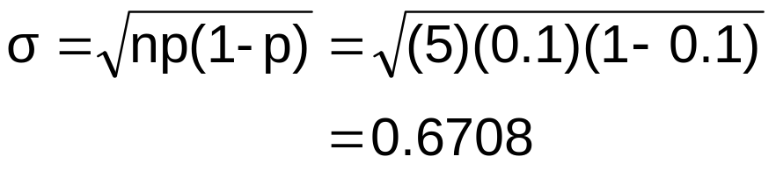

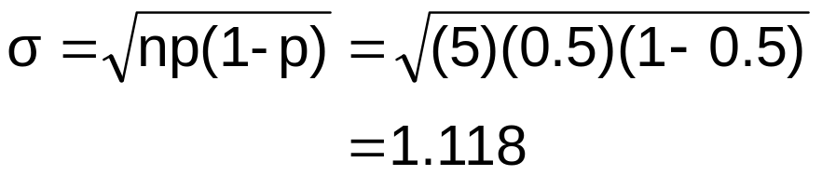
Binomial Characteristics
Examples
Mean
P(X)
n = 5 p = 0.1
.6
.4
.2
0
X
0
1
2
3
4
5
P(X)
n = 5 p = 0.5
.6
.4
.2
0
X
0
1
2
3
4
5

Slide 20
Using Binomial Tables
n = 10
x | … | p=.20 | p=.25 | p=.30 | p=.35 | p=.40 | p=.45 | p=.50
0 1 2 3 4 5 6 7 8 9 10 | … … … … … … … … … … … | 0.1074 0.2684 0.3020 0.2013 0.0881 0.0264 0.0055 0.0008 0.0001 0.0000 0.0000 | 0.0563 0.1877 0.2816 0.2503 0.1460 0.0584 0.0162 0.0031 0.0004 0.0000 0.0000 | 0.0282 0.1211 0.2335 0.2668 0.2001 0.1029 0.0368 0.0090 0.0014 0.0001 0.0000 | 0.0135 0.0725 0.1757 0.2522 0.2377 0.1536 0.0689 0.0212 0.0043 0.0005 0.0000 | 0.0060 0.0403 0.1209 0.2150 0.2508 0.2007 0.1115 0.0425 0.0106 0.0016 0.0001 | 0.0025 0.0207 0.0763 0.1665 0.2384 0.2340 0.1596 0.0746 0.0229 0.0042 0.0003 | 0.0010 0.0098 0.0439 0.1172 0.2051 0.2461 0.2051 0.1172 0.0439 0.0098 0.0010 | 10 9 8 7 6 5 4 3 2 1 0
 | … | p=.80 | p=.75 | p=.70 | p=.65 | p=.60 | p=.55 | p=.50 | x
Examples:
n = 10, p = 0.35, x = 3: P(x = 3|n =10, p = 0.35) = 0.2522
n = 10, p = 0.75, x = 2: P(x = 2|n =10, p = 0.75) = 0.0004

Slide 21
The Poisson Distribution
Probability Distributions
Discrete
Probability Distributions
Binomial
Poisson

Slide 22
The Poisson Distribution
Apply the Poisson Distribution when:
  You wish to count the number of times an event occurs in a given area of opportunity
  The probability that an event occurs in one area of opportunity is the same for all areas of opportunity
  The number of events that occur in one area of opportunity is independent of the number of events that occur in the other areas of opportunity
  The probability that two or more events occur in an area of opportunity approaches zero as the area of opportunity becomes smaller
  The average number of events per unit is λ (lambda)

Slide 23
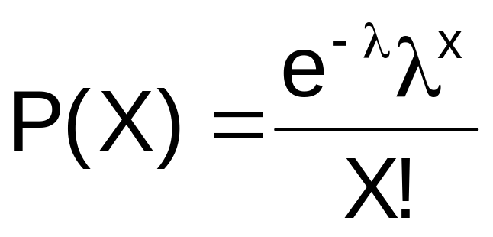
Poisson Distribution Formula
where:
X = number of events in an area of opportunity
λ = expected number of events
e = base of the natural logarithm system (2.71828...)

Slide 24
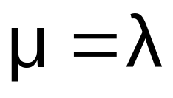
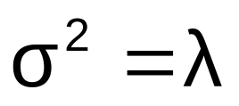
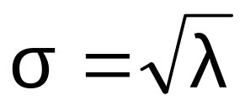
Poisson Distribution Characteristics
Mean
Variance and Standard Deviation
where λ = expected number of events

Slide 25
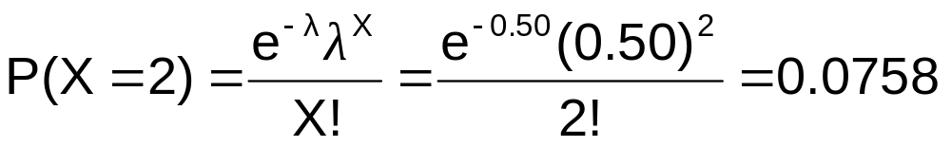
Using Poisson Tables
X | λ
 | 0.10 | 0.20 | 0.30 | 0.40 | 0.50 | 0.60 | 0.70 | 0.80 | 0.90
0 1 2 3 4 5 6 7 | 0.9048 0.0905 0.0045 0.0002 0.0000 0.0000 0.0000 0.0000 | 0.8187 0.1637 0.0164 0.0011 0.0001 0.0000 0.0000 0.0000 | 0.7408 0.2222 0.0333 0.0033 0.0003 0.0000 0.0000 0.0000 | 0.6703 0.2681 0.0536 0.0072 0.0007 0.0001 0.0000 0.0000 | 0.6065 0.3033 0.0758 0.0126 0.0016 0.0002 0.0000 0.0000 | 0.5488 0.3293 0.0988 0.0198 0.0030 0.0004 0.0000 0.0000 | 0.4966 0.3476 0.1217 0.0284 0.0050 0.0007 0.0001 0.0000 | 0.4493 0.3595 0.1438 0.0383 0.0077 0.0012 0.0002 0.0000 | 0.4066 0.3659 0.1647 0.0494 0.0111 0.0020 0.0003 0.0000
Example: Find P(X = 2) if λ = 0.50

Slide 26
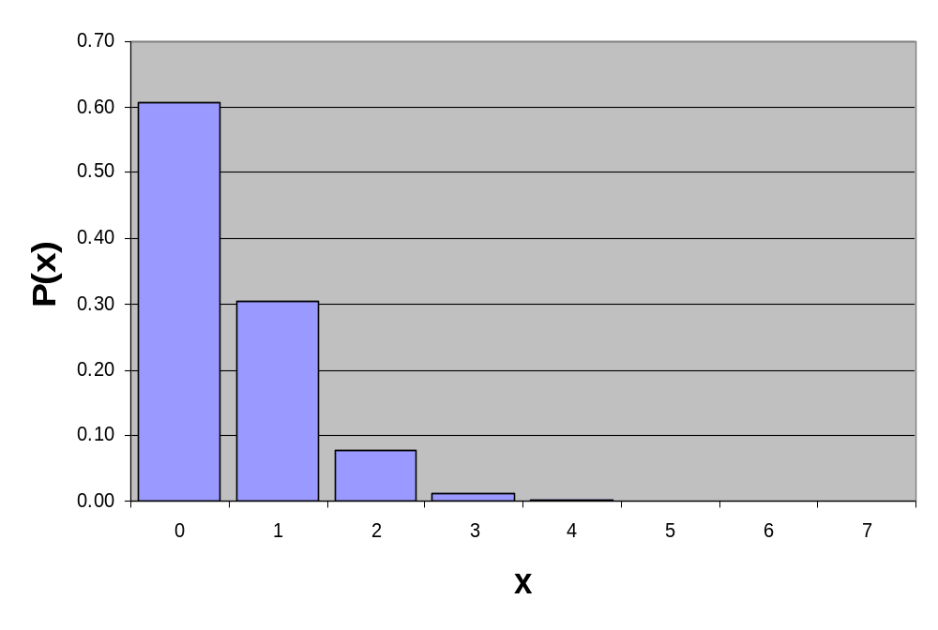
Graph of Poisson Probabilities
Graphically:
λ = 0.50
X | λ = 0.50
0 1 2 3 4 5 6 7 | 0.6065 0.3033 0.0758 0.0126 0.0016 0.0002 0.0000 0.0000
P(X = 2) = 0.0758

Slide 27
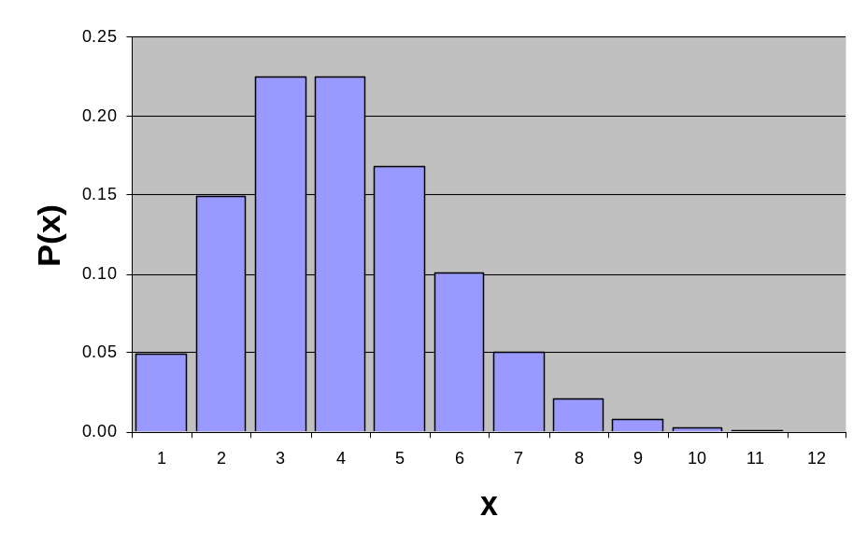
Poisson Distribution Shape
The shape of the Poisson Distribution depends on the parameter λ :
λ = 0.50
λ = 3.00

Slide 28
Chapter Summary
Addressed the probability of a discrete random variable
Discussed the Binomial distribution
Discussed the Poisson distribution

