Slide 1
Business Statistics
Chapter 6
The Normal Distribution
Business Statistics, A First Course (4e) © 2006 Prentice-Hall, Inc.
Chap 6-<number>

Slide 2
Probability Distributions
Probability Distributions
Ch. 5
Discrete
Probability Distributions
Continuous
Probability Distributions
Ch. 6
Binomial
Normal
Poisson
Business Statistics, A First Course (4e) © 2006 Prentice-Hall, Inc.
Chap 6-<number>

Slide 3
Learning Objectives
In this chapter, you learn:
To compute probabilities from the normal distribution
Finding the X value for a Known Probability
Business Statistics, A First Course (4e) © 2006 Prentice-Hall, Inc.
Chap 6-<number>

Slide 4
The Normal Distribution
Character:‘
Bell Shaped’
Symmetrical
Mean, Median and Mode
are Equal
The random variable has an infinite range:
+ ∞ to − ∞
f(X)
σ
X
μ
Mean
= Median
= Mode
Business Statistics, A First Course (4e) © 2006 Prentice-Hall, Inc.
Chap 6-<number>

Slide 5
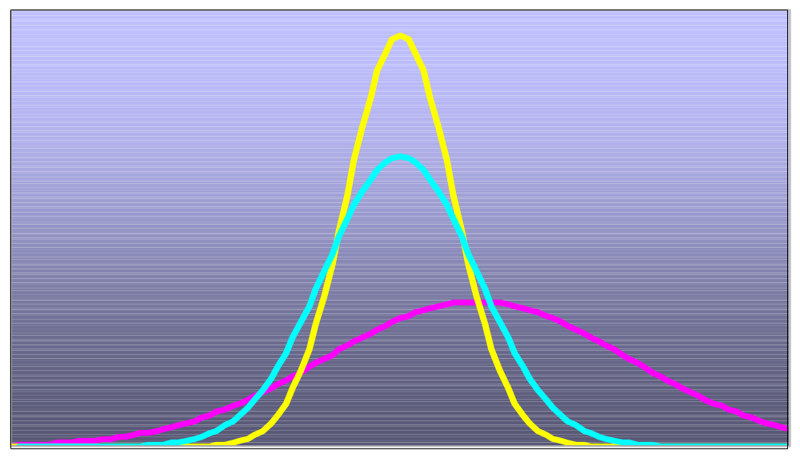
Many Normal Distributions
Location is determined by the mean, μ
Variability is determined by the standard deviation, σ
By varying the parameters μ and σ, we obtain different normal distributions
Business Statistics, A First Course (4e) © 2006 Prentice-Hall, Inc.
Chap 6-<number>

Slide 6
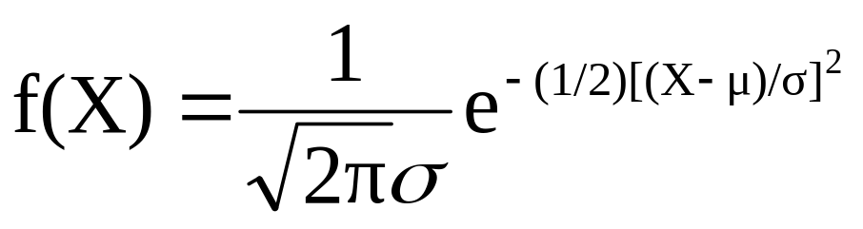

The Normal Probability
Density Function
The formula for the normal probability density function is
Where e = the mathematical constant approximated by 2.71828
π = the mathematical constant approximated by 3.14159
μ = the population mean
σ = the population standard deviation
X = any value of the continuous variable
Business Statistics, A First Course (4e) © 2006 Prentice-Hall, Inc.
Chap 6-<number>

Slide 7
Finding Normal Probabilities
Probability is the
area under the
curve!
Probability is measured by the area under the curve
f(X)
P
(
≤
≤
)
a
X
b
=
P
(
<
<
)
a
X
b
(Note that the probability of any individual value is zero)
a
b
X
Business Statistics, A First Course (4e) © 2006 Prentice-Hall, Inc.
Chap 6-<number>

Slide 8


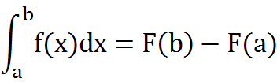
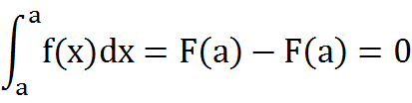
=
Newton-Leibniz
Business Statistics, A First Course (4e) © 2006 Prentice-Hall, Inc.
Chap 6-<number>

Slide 9
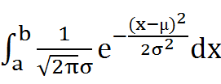
Integral form of normal probability
=
=
Business Statistics, A First Course (4e) © 2006 Prentice-Hall, Inc.
Chap 6-<number>

Slide 10

The Standardard
Normal Distribution
Also known as the “Z” distribution
Mean is 0
Standard Deviation is 1
f(Z)
1
Z
0
Values above the mean have positive Z-values, values below the mean have negative Z-values
Business Statistics, A First Course (4e) © 2006 Prentice-Hall, Inc.
Chap 6-<number>

Slide 11
The Standardized Normal
Any normal distribution (with any mean and standard deviation combination) can be transformed into the standardized normal distribution (Z)
Need to transform X units into Z units
Business Statistics, A First Course (4e) © 2006 Prentice-Hall, Inc.
Chap 6-<number>

Slide 12
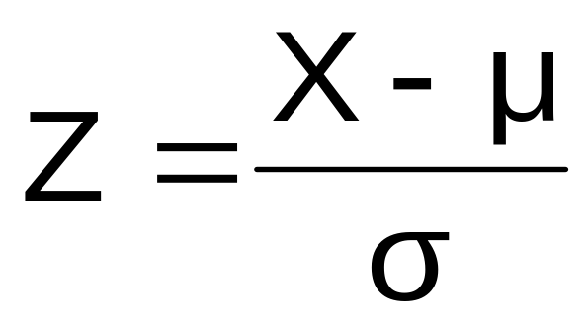
Translation to the Standardized Normal Distribution
Translate from X to the standardized normal (the “Z” distribution) by subtracting the mean of X and dividing by its standard deviation:
The Z distribution always has mean = 0 and standard deviation = 1
Business Statistics, A First Course (4e) © 2006 Prentice-Hall, Inc.
Chap 6-<number>

Slide 13
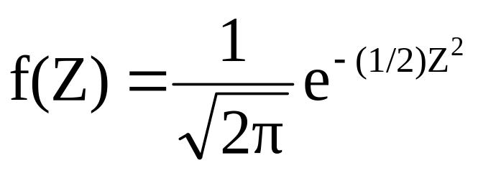
The Standardized Normal Probability Density Function
The formula for the standardized normal probability density function is
Where e = the mathematical constant approximated by 2.71828
π = the mathematical constant approximated by 3.14159
Z = any value of the standardized normal distribution
Business Statistics, A First Course (4e) © 2006 Prentice-Hall, Inc.
Chap 6-<number>

Slide 14
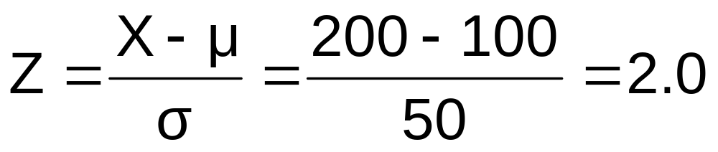
Example
If X is distributed normally with mean of 100 and standard deviation of 50, the Z value for X = 200 is
This says that X = 200 is two standard deviations (2 increments of 50 units) above the mean of 100.
Business Statistics, A First Course (4e) © 2006 Prentice-Hall, Inc.
Chap 6-<number>

Slide 15
Comparing X and Z units
100
200
X
(μ = 100, σ = 50)
0
2.0
Z
(μ = 0, σ = 1)
Note that the distribution is the same, only the scale has changed. We can express the problem in original units (X) or in standardized units (Z)
Business Statistics, A First Course (4e) © 2006 Prentice-Hall, Inc.
Chap 6-<number>

Slide 16


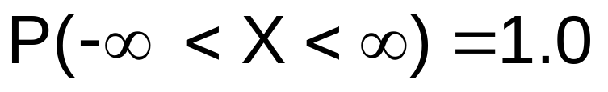
Probability as
Area Under the Curve
The total area under the curve is 1.0, and the curve is symmetric, so half is above the mean, half is below
f(X)
0.5
0.5
μ
X
Business Statistics, A First Course (4e) © 2006 Prentice-Hall, Inc.
Chap 6-<number>

Slide 17
Empirical Rules
What can we say about the distribution of values around the mean? There are some general rules:
f(X)
μ ± 1σ encloses about 68% of X’s 
σ
σ
X
μ-1σ
μ
μ+1σ
68.26%
Business Statistics, A First Course (4e) © 2006 Prentice-Hall, Inc.
Chap 6-<number>

Slide 18
The Empirical Rule
(continued)
μ ± 2σ covers about 95% of X’s
μ ± 3σ covers about 99.7% of X’s
2σ
2σ
3σ
3σ
μ
x
μ
x
95.44%
99.73%
Business Statistics, A First Course (4e) © 2006 Prentice-Hall, Inc.
Chap 6-<number>

Slide 19
The Standardized Normal Table
The Standardized Normal table in the textbook (Appendix table E.1) gives the probability between 0 and Z
0.9772
Example:
P(0<Z < 2.00) = 0.4772
0
2.00
Z
Business Statistics, A First Course (4e) © 2006 Prentice-Hall, Inc.
Chap 6-<number>

Slide 20
The Standardized Normal Table
(continued)
The column gives the value of Z to the second decimal point
Z 0.00 0.01 0.02 …
0.0
0.1
The row shows the value of Z to the first decimal point
.
.
.
The value within the table gives the probability
2.0
.4772
P(0<Z < 2.00) = 0.9772
2.0
Business Statistics, A First Course (4e) © 2006 Prentice-Hall, Inc.
Chap 6-<number>

Slide 21
General Procedure for Finding Probabilities
To find P(a < X < b) when X is distributed normally:
Draw the normal curve for the problem in
terms of X
Translate X-values to Z-values
Use the Standardized Normal Table
Business Statistics, A First Course (4e) © 2006 Prentice-Hall, Inc.
Chap 6-<number>

Slide 22
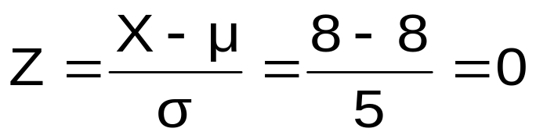
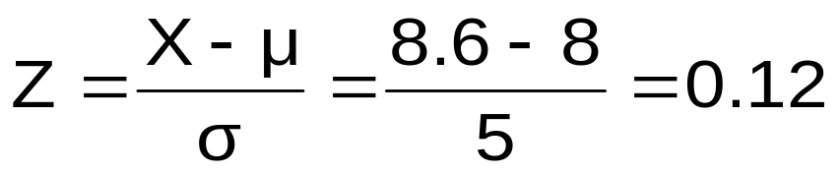
Probability Between
Two Values
Suppose X is normal with mean 8.0 and standard deviation 5.0. Find P(8 < X < 8.6)
Calculate Z-values:
8
8.6
X
0
0.12
Z
P(8 < X < 8.6)
= P(0 < Z < 0.12)
Business Statistics, A First Course (4e) © 2006 Prentice-Hall, Inc.
Chap 6-<number>

Slide 23
Solution: Finding P(0 < Z < 0.12)
P(8 < X < 8.6)
Standardized Normal Probability
Table (Portion)
= P(0 < Z < 0.12)
Z
.00
.01
.02
= 0.0478
0.0
.0000
.0040
.0080
0.0478
0.5000
0.1
.0398
.0438
.0478
0.2
.0793
.0832
.0871
0.3
.1179
.1217
.1255
Z
0.00
0.12
Business Statistics, A First Course (4e) © 2006 Prentice-Hall, Inc.
Chap 6-<number>

Slide 24
Finding Normal Probabilities
Suppose X is normal with mean 8.0 and standard deviation 5.0
Find P(X < 8.6)
X
8.0
8.6
Business Statistics, A First Course (4e) © 2006 Prentice-Hall, Inc.
Chap 6-<number>

Slide 25
Solution: Finding P(Z < 0.12)
Standardized Normal Probability
Table (Portion)
P(X < 8.6)
= P(Z < 0.12)=
Z
.00
.01
.02
.5478
0.0
.0000
.0040
.0080
0.1
.0398
.0438
.0478
0.2
.0793
.0832
.0871
Z
0.3
.1179
.1217
.1255
0.00
0.12
Business Statistics, A First Course (4e) © 2006 Prentice-Hall, Inc.
Chap 6-<number>

Slide 26
Upper Tail Probabilities
Suppose X is normal with mean 8.0 and standard deviation 5.0.
Now Find P(X > 8.6)
X
8.0
8.6
Business Statistics, A First Course (4e) © 2006 Prentice-Hall, Inc.
Chap 6-<number>

Slide 27
Upper Tail Probabilities
(continued)
Now Find P(X > 8.6)…
P(X > 8.6) = P(Z > 0.12) = 1.0 - P(Z ≤ 0.12)
= 1.0 - 0.5478 = 0.4522
0.5478
1.000
1.0 - 0.5478 = 0.4522
Z
Z
0
0
0.12
0.12
Business Statistics, A First Course (4e) © 2006 Prentice-Hall, Inc.
Chap 6-<number>

Slide 28
Probabilities in the Lower Tail
Suppose X is normal with mean 8.0 and standard deviation 5.0.
Now Find P(7.4 < X < 8)
X
8.0
7.4
Business Statistics, A First Course (4e) © 2006 Prentice-Hall, Inc.
Chap 6-<number>

Slide 29
Probabilities in the Lower Tail
(continued)
Now Find P(7.4 < X < 8)…
P(7.4 < X < 8)
= P(-0.12 < Z < 0)
= 0.0478
0.0478
0.4522
The Normal distribution is symmetric, so this probability is the same as P(0 < Z < 0.12)
7.4
8.0
X
-0.12
0
Z
Business Statistics, A First Course (4e) © 2006 Prentice-Hall, Inc.
Chap 6-<number>

Slide 30
Finding the X value for a Known Probability
(continued)
Example:
Suppose X is normal with mean 8.0 and standard deviation 5.0.
Now find the X value so that only 20% of all values are below this X
0.2000
?
8.0
X
?
0
Z
Business Statistics, A First Course (4e) © 2006 Prentice-Hall, Inc.
Chap 6-<number>

Slide 31
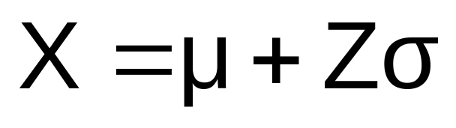
Finding the X value for a Known Probability
Steps to find the X value for a known probability:
1. Find the Z value for the known probability
2. Convert to X units using the formula:
Business Statistics, A First Course (4e) © 2006 Prentice-Hall, Inc.
Chap 6-<number>

Slide 32
Find the Z value for
20% in the Lower Tail
1. Find the Z value for the known probability
Standardized Normal Probability
Table (Portion)
20% area in the lower tail is consistent with a Z value of -0.84
Z
…
.03
.04
.05
0.9
…
.2673
.2704
.2734
0.3000
0.8
…
.2967
.2995
.3023
0.7
…
.3238
.3264
.3289
?
8.0
X
-0.84
0
Z
Business Statistics, A First Course (4e) © 2006 Prentice-Hall, Inc.
Chap 6-<number>

Slide 33
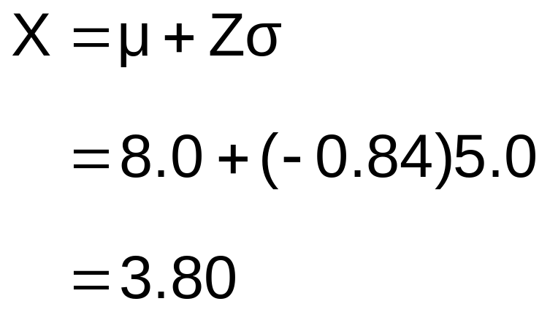
Finding the X value
2. Convert to X units using the formula:
0.2000
3.80
8.0
X
-0.84
0
Z
So 20% of the values from a distribution with mean 8.0 and standard deviation 5.0 are less than 3.80
Business Statistics, A First Course (4e) © 2006 Prentice-Hall, Inc.
Chap 6-<number>

Slide 34
Evaluating Normality
Not all continuous random variables are normally distributed
It is important to evaluate how well the data set is approximated by a normal distribution
Business Statistics, A First Course (4e) © 2006 Prentice-Hall, Inc.
Chap 6-<number>

Slide 35
Evaluating Normality
(continued)
Construct charts or graphs
  For small- or moderate-sized data sets, do stem-and-leaf display and box-and-whisker plot look symmetric?
  For large data sets, does the histogram or polygon appear bell-shaped?
Compute descriptive summary measures
  Do the mean, median and mode have similar values?
  Is the interquartile range approximately 1.33 σ?
  Is the range approximately 6 σ?
Business Statistics, A First Course (4e) © 2006 Prentice-Hall, Inc.
Chap 6-<number>

Slide 36

Assessing Normality
(continued)
Observe the distribution of the data set
  Do approximately 2/3 of the observations lie within mean 1 standard deviation?
  Do approximately 80% of the observations lie within mean 1.28 standard deviations?
  Do approximately 95% of the observations lie within mean 2 standard deviations?
Evaluate normal probability plot
  Is the normal probability plot approximately linear with positive slope?
Business Statistics, A First Course (4e) © 2006 Prentice-Hall, Inc.
Chap 6-<number>

Slide 37
The Normal Probability Plot
Normal probability plot
  Arrange data into ordered array
  Find corresponding standardized normal quantile values
  Plot the pairs of points with observed data values on the vertical axis and the standardized normal quantile values on the horizontal axis
  Evaluate the plot for evidence of linearity
Business Statistics, A First Course (4e) © 2006 Prentice-Hall, Inc.
Chap 6-<number>

Slide 38
The Normal Probability Plot
(continued)
A normal probability plot for data from a normal distribution will be approximately linear:
X
90
60
30
-2
-1
0
1
2
Z
Business Statistics, A First Course (4e) © 2006 Prentice-Hall, Inc.
Chap 6-<number>

Slide 39
Normal Probability Plot
(continued)
Left-Skewed
Right-Skewed
X
90
X
90
60
60
30
30
-2
-1
0
1
2
Z
-2
-1
0
1
2
Z
Nonlinear plots indicate a deviation from normality
Business Statistics, A First Course (4e) © 2006 Prentice-Hall, Inc.
Chap 6-<number>

Slide 40
Chapter Summary
Presented the normal distribution as a key continuous distribution
Found normal probabilities using formulas and tables
Examined how to recognize when a distribution is approximately normal
Business Statistics, A First Course (4e) © 2006 Prentice-Hall, Inc.
Chap 6-<number>

