Slide 1
Business Statistics, A First Course
4th Edition
Chapter 7
Sampling Distributions

Slide 2
Learning Objectives
In this chapter, you learn:
The concept of the sampling distribution
To compute probabilities related to the sample mean and the sample proportion
The importance of the Central Limit Theorem
To distinguish between different survey sampling methods
To evaluate survey worthiness and survey errors

Slide 3
Sampling Distributions
Sampling Distributions
Sampling Distribution of the Mean
Sampling Distribution of the Proportion

Slide 4
Sampling Distributions
A sampling distribution is a distribution of all of the possible values of a statistic for a given size sample selected from a population

Slide 5



Developing a
Sampling Distribution
Assume there is a population …
Population size N=4
Random variable, X,
is age of individuals
Values of X: 18, 20,
22, 24 (years)
D
A
B
C

Slide 6
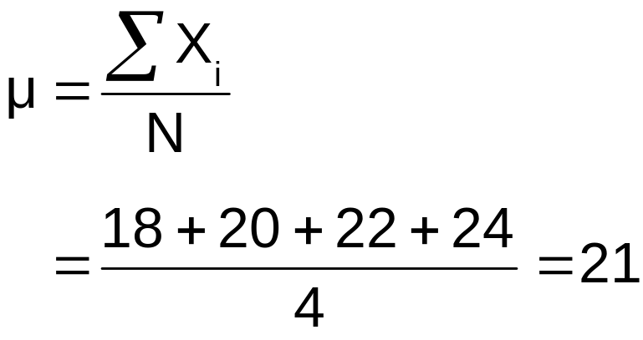
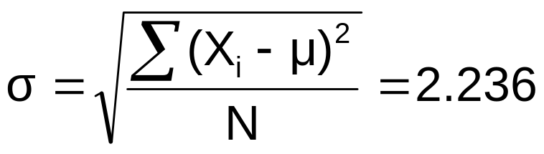
Developing a
Sampling Distribution
(continued)
Summary Measures for the Population Distribution:
P(x)
.3
.2
.1
0
18 19 20 21 22 23 24
A B C D
x
Uniform Distribution

Slide 7
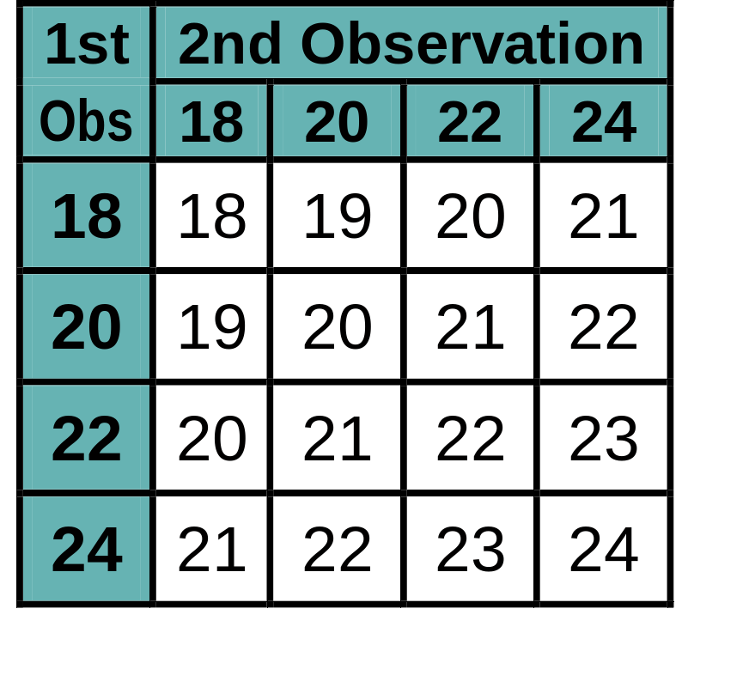
Now consider all possible samples of size n=2
Developing a
Sampling Distribution
(continued)
16 Sample Means
1st Obs | 2nd Observation
 | 18 | 20 | 22 | 24
18 | 18,18 | 18,20 | 18,22 | 18,24
20 | 20,18 | 20,20 | 20,22 | 20,24
22 | 22,18 | 22,20 | 22,22 | 22,24
24 | 24,18 | 24,20 | 24,22 | 24,24
16 possible samples (sampling with replacement)

Slide 8
Sampling Distribution of All Sample Means
Developing a
Sampling Distribution
(continued)
16 Sample Means
Sample Means Distribution
_
P(X)
.3
.2
.1
0
_
18 19 20 21 22 23 24
X
(no longer uniform)

Slide 9
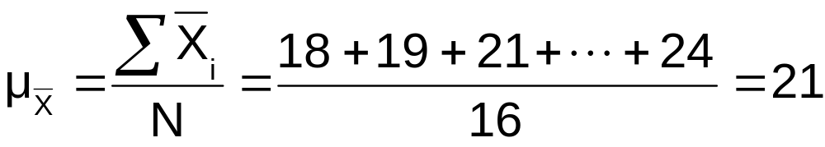
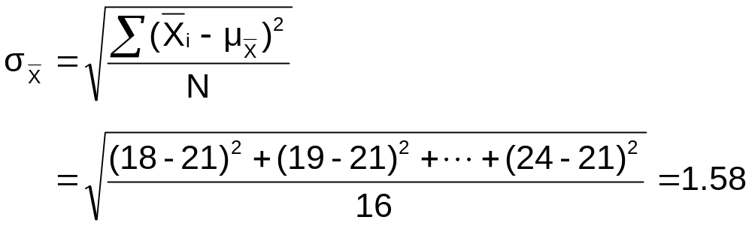
Summary Measures of this Sampling Distribution:
Developing a
Sampling Distribution
(continued)

Slide 10
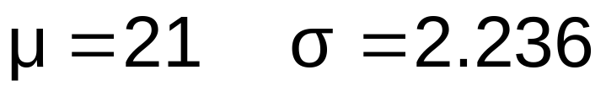
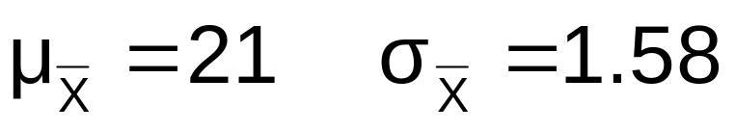
Comparing the Population with its Sampling Distribution
Population
N = 4
Sample Means Distribution
n = 2
_
P(X)
P(X)
.3
.3
.2
.2
.1
.1
0
0
_
18 19 20 21 22 23 24
A B C D
X
18 19 20 21 22 23 24
X

Slide 11
Sampling Distribution of the Mean
Sampling Distributions
Sampling Distribution of the Mean
Sampling Distribution of the Proportion

Slide 12
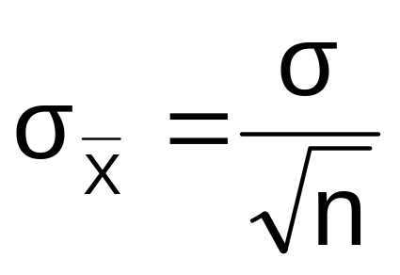
Standard Error of the Mean
Different samples of the same size from the same population will yield different sample means
A measure of the variability in the mean from sample to sample is given by the Standard Error of the Mean:
(This assumes that sampling is with replacement or
sampling is without replacement from an infinite population)
Note that the standard error of the mean decreases as the sample size increases

Slide 13

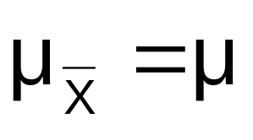
If the Population is Normal
If a population is normal with mean μ and standard deviation σ, the sampling distribution of is also normally distributed with
and

Slide 14

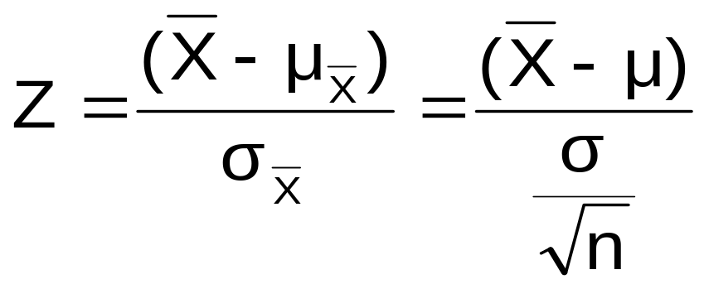



Z-value for Sampling Distribution of the Mean
Z-value for the sampling distribution of :
where: = sample mean
= population mean
= population standard deviation
n = sample size

Slide 15
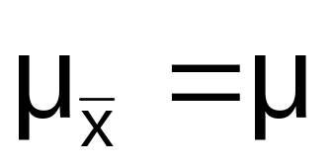


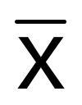

Sampling Distribution Properties
Normal Population Distribution
(i.e. is unbiased )
Sampling Distribution is also normal
(and has the same
mean)

Slide 16


Sampling Distribution Properties
(continued)
  As n increases,
  decreases
Larger sample size
Smaller sample size

Slide 17
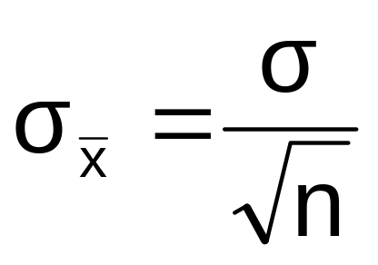
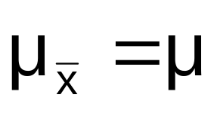
If the Population is not Normal
We can apply the Central Limit Theorem:
  Even if the population is not normal,
  …sample means from the population will be approximately normal as long as the sample size is large enough.
  Properties of the sampling distribution:
  and

Slide 18
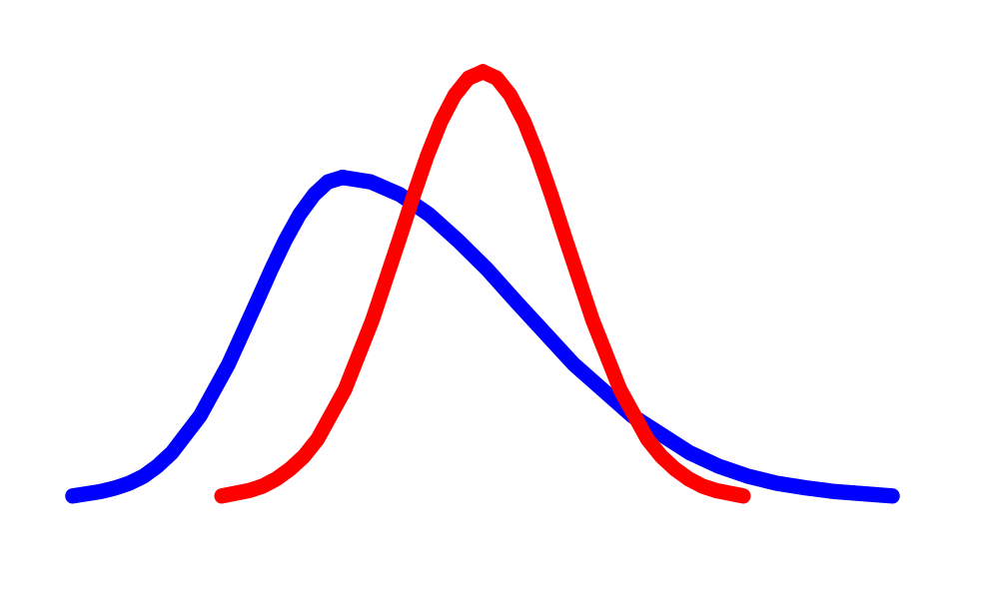
Central Limit Theorem
the sampling distribution becomes almost normal regardless of shape of population
As the sample size gets large enough…
n↑

Slide 19


If the Population is not Normal
(continued)
Population Distribution
Sampling distribution properties:
Central Tendency
Variation
Sampling Distribution
(becomes normal as n increases)
Larger sample size
Smaller sample size

Slide 20
How Large is Large Enough?
For most distributions, n > 30 will give a sampling distribution that is nearly normal
For fairly symmetric distributions, n > 15
For normal population distributions, the sampling distribution of the mean is always normally distributed

Slide 21
Example
Suppose a population has mean μ = 8 and standard deviation σ = 3. Suppose a random sample of size n = 36 is selected.
What is the probability that the sample mean is between 7.8 and 8.2?

Slide 22


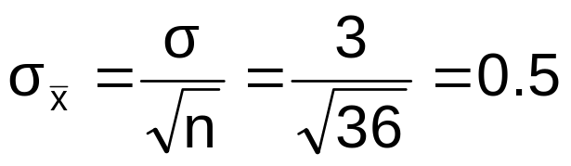
Example
(continued)
Solution:
Even if the population is not normally distributed, the central limit theorem can be used (n > 30)
… so the sampling distribution of is approximately normal
… with mean = 8
…and standard deviation

Slide 23
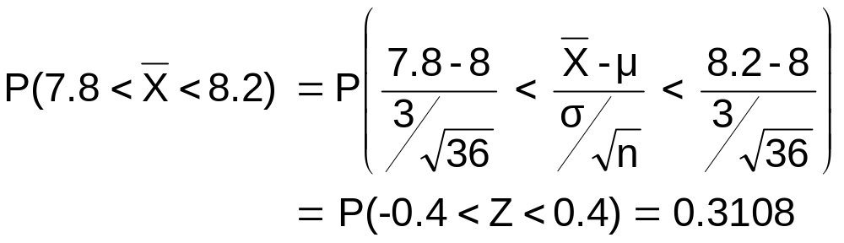



Example
(continued)
Solution (continued):
Population Distribution
Sampling Distribution
Standard Normal Distribution
.1554 +.1554
?
?
?
?
?
?
?
?
?
?
Sample
Standardize
?
?
7.8 8.2
-0.4 0.4
Z
X

Slide 24
Sampling Distribution of the Proportion
Sampling Distributions
Sampling Distribution of the Mean
Sampling Distribution of the Proportion

Slide 25
Population Proportions
π = the proportion of the population having
some characteristic
Sample proportion ( p ) provides an estimate
of π:
0 ≤ p ≤ 1
p has a binomial distribution
(assuming sampling with replacement from a finite population or without replacement from an infinite population)

Slide 26
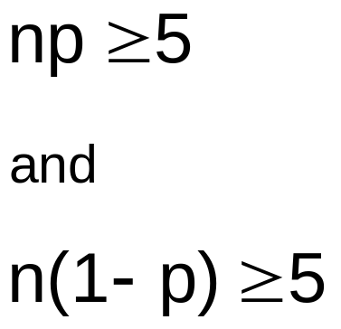
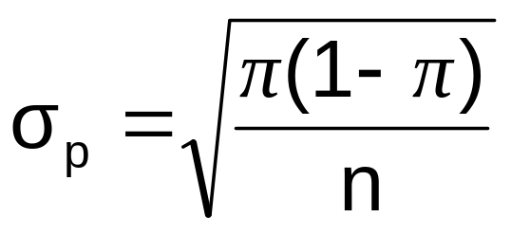
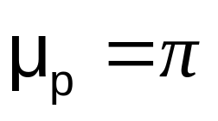
Sampling Distribution of p
Approximated by a
normal distribution if:
  where
  and
Sampling Distribution
P( p)
.3
.2
.1
0
0 . 2 .4 .6 8 1
p
(where π = population proportion)

Slide 27
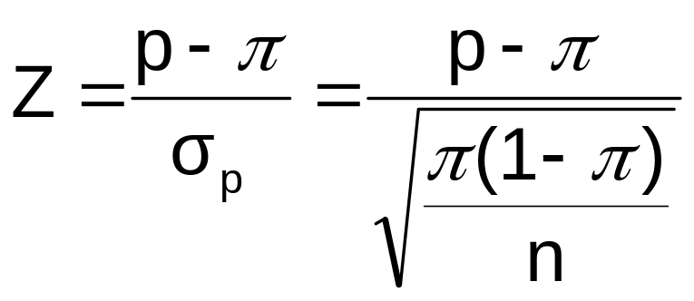
Z-Value for Proportions
Standardize p to a Z value with the formula:

Slide 28
Example
If the true proportion of voters who support Proposition A is π = 0.4, what is the probability that a sample of size 200 yields a sample proportion between 0.40 and 0.45?
i.e.: if π = 0.4 and n = 200, what is
P(0.40 ≤ p ≤ 0.45) ?

Slide 29
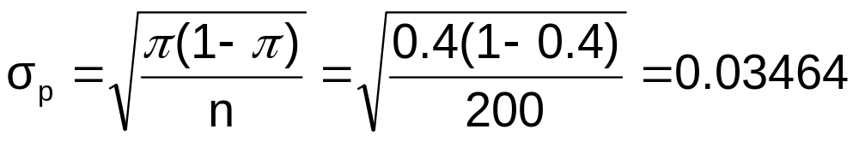

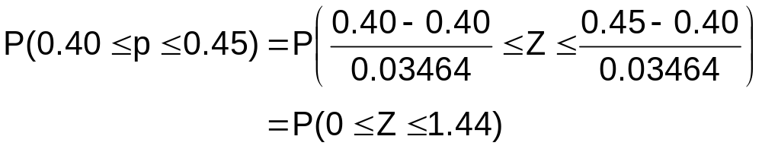
Example
(continued)
if π = 0.4 and n = 200, what is
P(0.40 ≤ p ≤ 0.45) ?
Find :
Convert to standard normal:

Slide 30
Example
(continued)
if π = 0.4 and n = 200, what is
P(0.40 ≤ p ≤ 0.45) ?
Use cumulative standard normal table:
P(0 ≤ Z ≤ 1.44) = P(Z ≤1.44) – P(Z < 0)
= 0.9251  0.5000 = 0.4251
Standardized
Normal Distribution
Sampling Distribution
0.4251
Standardize
0.40
0.45
p
0
1.44
Z

Slide 31
Reasons for Drawing a Sample
Less time consuming than a census
Less costly to administer than a census
Less cumbersome and more practical to administer than a census of the targeted population

Slide 32
Types of Samples Used
Nonprobability Sample
  Items included are chosen without regard to their probability of occurrence
Probability Sample
  Items in the sample are chosen on the basis of known probabilities

Slide 33
Types of Samples Used
(continued)
Samples
Non-Probability Samples
Probability Samples
Simple
Random
Stratified
Judgement
Chunk
Systematic
Cluster
Quota
Convenience

Slide 34
Probability Sampling
Items in the sample are chosen based on known probabilities
Probability Samples
Simple
Random
Systematic
Stratified
Cluster

Slide 35
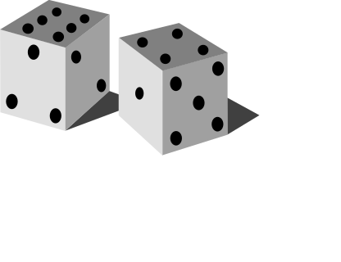
Simple Random Samples
Every individual or item from the frame has an equal chance of being selected
Selection may be with replacement or without replacement
Samples obtained from table of random numbers or computer random number generators

Slide 36
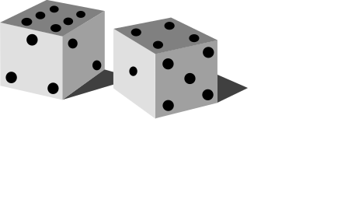
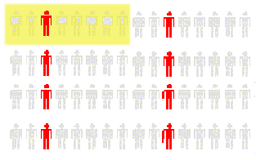
Systematic Samples
Decide on sample size: n
Divide frame of N individuals into groups of k individuals: k=N/n
Randomly select one individual from the 1st group
Select every k^{th} individual thereafter
N = 64
n = 8
k = 8
First Group

Slide 37
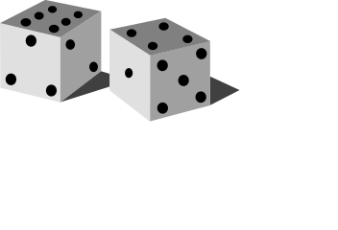
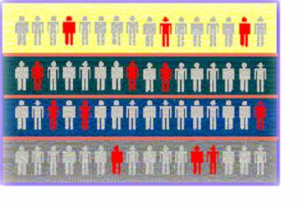

Stratified Samples
Divide population into two or more subgroups (called strata) according to some common characteristic
A simple random sample is selected from each subgroup, with sample sizes proportional to strata sizes
Samples from subgroups are combined into one
Population
Divided
into 4
strata
Sample

Slide 38
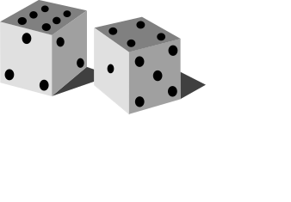
Cluster Samples
Population is divided into several “clusters,” each representative of the population
A simple random sample of clusters is selected
  All items in the selected clusters can be used, or items can be chosen from a cluster using another probability sampling technique
Population divided into 16 clusters.
Randomly selected clusters for sample

Slide 39
Advantages and Disadvantages
Simple random sample and systematic sample
  Simple to use
  May not be a good representation of the population’s underlying characteristics
Stratified sample
  Ensures representation of individuals across the entire population
Cluster sample
  More cost effective
  Less efficient (need larger sample to acquire the same level of precision)

Slide 40
Evaluating Survey Worthiness
What is the purpose of the survey?
Is the survey based on a probability sample?
Coverage error – appropriate frame?
Nonresponse error – follow up
Measurement error – good questions elicit good responses
Sampling error – always exists

Slide 41
Types of Survey Errors
Coverage error or selection bias
  Exists if some groups are excluded from the frame and have no chance of being selected
Nonresponse error or bias
  People who do not respond may be different from those who do respond
Sampling error
  Variation from sample to sample will always exist
Measurement error
  Due to weaknesses in question design, respondent error, and interviewer’s effects on the respondent

Slide 42
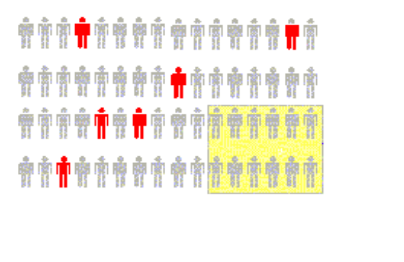

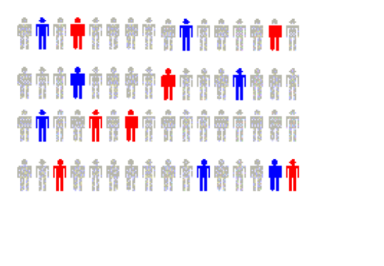

Types of Survey Errors
(continued)
Coverage error
Non response error
Sampling error
Measurement error
Excluded from frame
Follow up on nonresponses
Random differences from sample to sample
Bad or leading question

Slide 43
Chapter Summary
Introduced sampling distributions
Described the sampling distribution of the mean
  For normal populations
  Using the Central Limit Theorem
Described the sampling distribution of a proportion
Calculated probabilities using sampling distributions
Described different types of samples and sampling techniques
Examined survey worthiness and types of survey errors

