Slide 1
Business Statistics, A First Course
4th Edition
Chapter 8
Confidence Interval Estimation

Slide 2
The operations manager of a large production plant would like to estimate the average amount of time a worker takes to assemble a new electronic component. After observing a number of workers assembling similar devices, she noted that the shortest time taken was 10 minutes, while the longest time taken was 22 minutes. How large a sample of workers should she take if she wishes to estimate the mean assembly time to within 20 seconds? Assume that the confidence level is to be 99%. (Hint: a conservative estimate of σis the range divided by 4.)

Slide 3
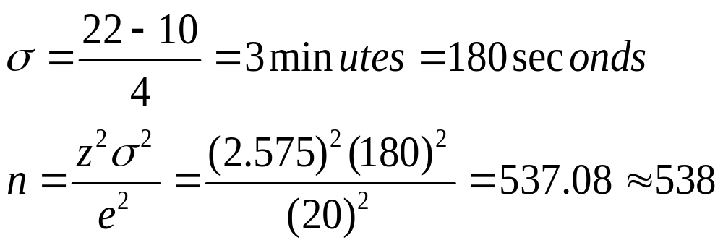

Slide 4
Learning Objectives
In this chapter, you learn:
To construct and interpret confidence interval estimates for the mean and the proportion
How to determine the sample size necessary to develop a confidence interval for the mean or proportion

Slide 5
Confidence Intervals
Content of this chapter
Confidence Intervals for the Population Mean, μ
  when Population Standard Deviation σ is Known
  when Population Standard Deviation σ is Unknown
Confidence Intervals for the Population Proportion, π
Determining the Required Sample Size

Slide 6
Point and Interval Estimates
A point estimate is a single number,
a confidence interval provides additional information about variability
Lower
Confidence
Limit
Upper
Confidence
Limit
Point Estimate
Width of
confidence interval

Slide 7
Point Estimates
We can estimate a
Population Parameter …
with a Sample
Statistic
(a Point Estimate)
Mean
μ
X
Proportion
π
p

Slide 8
Confidence Intervals
How much uncertainty is associated with a point estimate of a population parameter?
An interval estimate provides more information about a population characteristic than does a point estimate
Such interval estimates are called confidence intervals

Slide 9
Confidence Interval Estimate
An interval gives a range of values:
  Takes into consideration variation in sample statistics from sample to sample
  Based on observations from 1 sample
  Gives information about closeness to unknown population parameters
  Stated in terms of level of confidence
    Can never be 100% confident

Slide 10
Estimation Process
Random Sample
I am 95% confident that μ is between 40 & 60.
Population
Mean
X = 50
(mean, μ, is unknown)
Sample

Slide 11
General Formula
The general formula for all confidence intervals is:
Point Estimate ± (Critical Value)(Standard Error)

Slide 12
Confidence Level
Confidence Level
  Confidence for which the interval will contain the unknown population parameter
A percentage (less than 100%)

Slide 13
Confidence Level, (1-α)
(continued)
Suppose confidence level = 95%
Also written (1 - α) = 0.95
A relative frequency interpretation:
  In the long run, 95% of all the confidence intervals that can be constructed will contain the unknown true parameter
A specific interval either will contain or will not contain the true parameter
  No probability involved in a specific interval

Slide 14
Confidence Intervals
Confidence
Intervals
Population
Mean
Population
Proportion
σ Known
σ Unknown

Slide 15
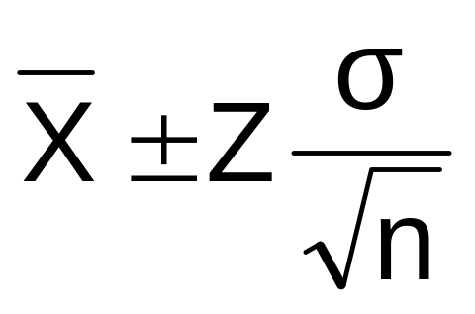


Confidence Interval for μ
(σ Known)
Assumptions
  Population standard deviation σ is known
  Population is normally distributed
  If population is not normal, use large sample
Confidence interval estimate:
where is the point estimate
Z is the normal distribution critical value for a probability of α/2 in each tail
is the standard error

Slide 16
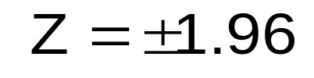

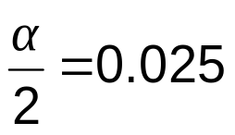
Finding the Critical Value, Z
Consider a 95% confidence interval:
Z units:
Z= -1.96
0
Z= 1.96
X units:
Lower
Confidence
Limit
Upper
Confidence
Limit
Point Estimate
Point Estimate

Slide 17

Common Levels of Confidence
Commonly used confidence levels are 90%, 95%, and 99%
Confidence Coefficient,
Confidence Level
Z value
80%
90%
95%
98%
99%
99.8%
99.9%
0.80
0.90
0.95
0.98
0.99
0.998
0.999
1.28
1.645
1.96
2.33
2.58
3.08
3.27

Slide 18



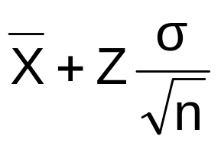
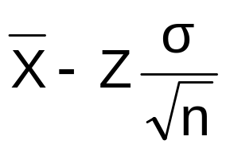
Intervals and Level of Confidence
Sampling Distribution of the Mean
x
Intervals extend from
to
x₁
x₂
(1-)x100%
of intervals constructed contain μ;
()x100% do not.
Confidence Intervals

Slide 19

Example
A sample of 11 circuits from a large normal population has a mean resistance of 2.20 ohms. We know from past testing that the population standard deviation is 0.35 ohms.
Determine a 95% confidence interval for the true mean resistance of the population.

Slide 20
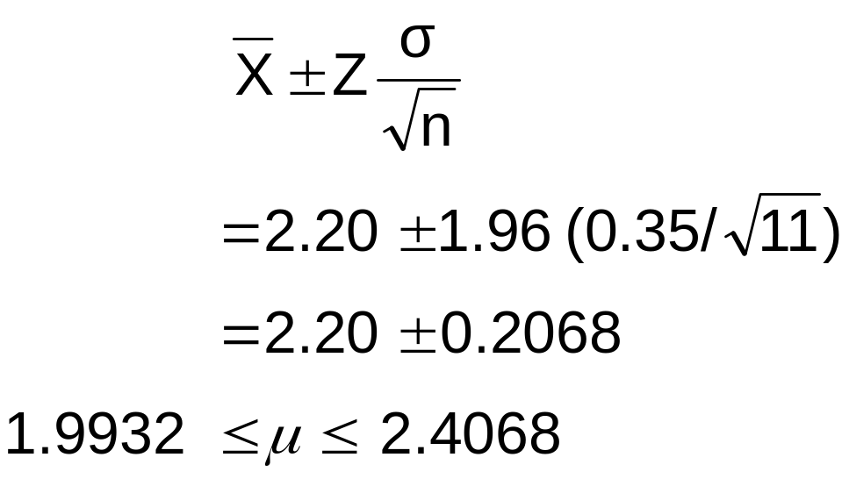
Example
(continued)
A sample of 11 circuits from a large normal population has a mean resistance of 2.20 ohms. We know from past testing that the population standard deviation is 0.35 ohms.
Solution:

Slide 21
Interpretation
We are 95% confident that the true mean resistance is between 1.9932 and 2.4068 ohms
Although the true mean may or may not be in this interval, 95% of intervals formed in this manner will contain the true mean

Slide 22
Confidence Intervals
Confidence
Intervals
Population
Mean
Population
Proportion
σ Known
σ Unknown

Slide 23
Confidence Interval for μ
(σ Unknown)
If the population standard deviation σ is unknown, we can substitute the sample standard deviation, S
This introduces extra uncertainty, since S is variable from sample to sample
So we use the t distribution instead of the normal distribution

Slide 24
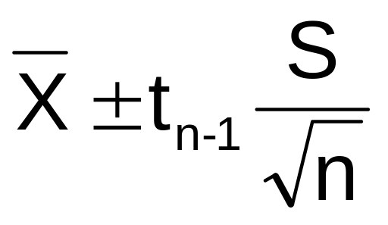
Confidence Interval for μ
(σ Unknown)
(continued)
Assumptions
  Population standard deviation is unknown
  Population is normally distributed
  If population is not normal, use large sample
Use Student’s t Distribution
Confidence Interval Estimate:
(where t is the critical value of the t distribution with n -1 degrees of freedom and an area of α/2 in each tail)

Slide 25
Student’s t Distribution
The t is a family of distributions
The t value depends on degrees of freedom (d.f.)
  Number of observations that are free to vary after sample mean has been calculated
d.f. = n - 1

Slide 26
Degrees of Freedom (df)
  Idea: Number of observations that are free to vary
  after sample mean has been calculated
  Example: Suppose the mean of 3 numbers is 8.0
    Let X₁ = 7
    Let X₂ = 8
    What is X₃?
If the mean of these three values is 8.0,
then X₃ must be 9
(i.e., X₃ is not free to vary)
Here, n = 3, so degrees of freedom = n – 1 = 3 – 1 = 2
(2 values can be any numbers, but the third is not free to vary for a given mean)

Slide 27
Student’s t Distribution
Note: t Z as n increases
Standard Normal
(t with df = ∞)
t (df = 13)
t-distributions are bell-shaped and symmetric, but have ‘fatter’ tails than the normal
t (df = 5)
t
0

Slide 28
Student’s t Table
Upper Tail Area
Let: n = 3
df = n - 1 = 2
 = 0.10
/2 = 0.05
df
.25
.10
.05
1
1.000
3.078
6.314
2
0.817
1.886
2.920
3
0.765
1.638
2.353
/2 = 0.05
The body of the table contains t values, not probabilities
0
2.920
t

Slide 29
t distribution values
With comparison to the Z value
Confidence t t t Z
Level (10 d.f.) (20 d.f.) (30 d.f.) ____
0.80 1.372 1.325 1.310 1.28
0.90 1.812 1.725 1.697 1.645
0.95 2.228 2.086 2.042 1.96
0.99 3.169 2.845 2.750 2.58
Note: t Z as n increases

Slide 30
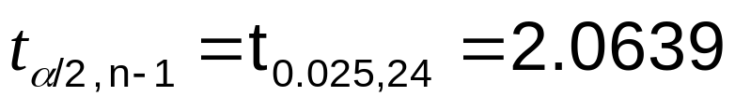
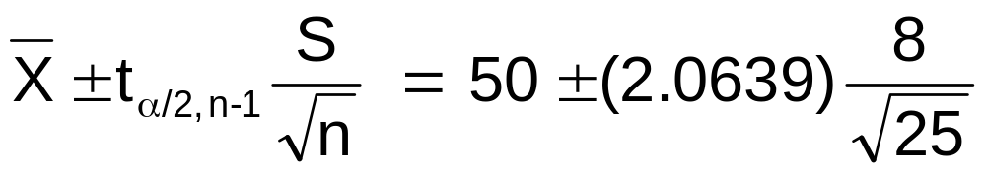
Example
A random sample of n = 25 taken from a normal population has X = 50 and S = 8. Form a 95% confidence interval for μ
  d.f. = n – 1 = 24, so
  The confidence interval is
46.698 ≤ μ ≤ 53.302

Slide 31
Confidence Intervals
Confidence
Intervals
Population
Mean
Population
Proportion
σ Known
σ Unknown

Slide 32
Confidence Intervals for the
Population Proportion, π
An interval estimate for the population proportion ( π ) can be calculated by adding and subtracting an allowance for uncertainty to the sample proportion ( p )

Slide 33
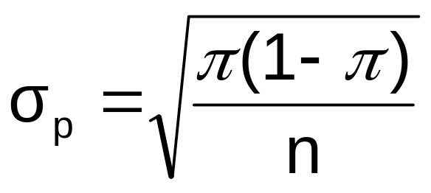
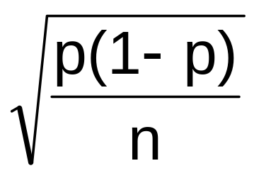
Confidence Intervals for the
Population Proportion, π
(continued)
Recall that the distribution of the sample proportion is approximately normal if the sample size is large, with standard deviation
We will estimate this with sample data:

Slide 34
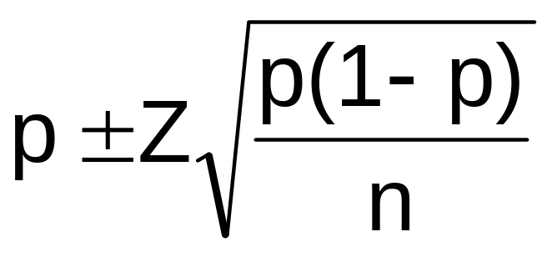
Confidence Interval Endpoints
Upper and lower confidence limits for the population proportion are calculated with the formula
where
  Z is the standard normal value for the level of confidence desired
  p is the sample proportion
  n is the sample size

Slide 35

Example
A random sample of 100 people shows that 25 are left-handed.
Form a 95% confidence interval for the true proportion of left-handers

Slide 36
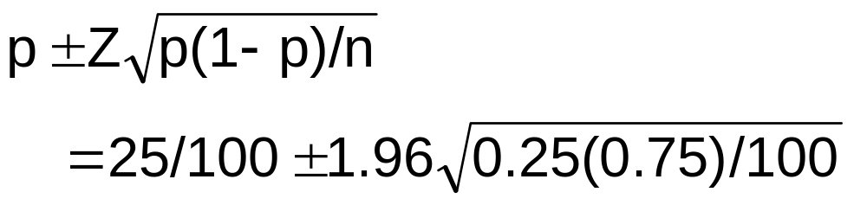
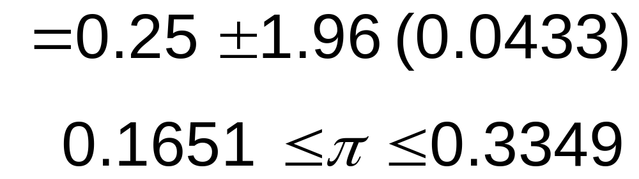
Example
(continued)
A random sample of 100 people shows that 25 are left-handed. Form a 95% confidence interval for the true proportion of left-handers.

Slide 37
Interpretation
We are 95% confident that the true percentage of left-handers in the population is between
16.51% and 33.49%.
Although the interval from 0.1651 to 0.3349 may or may not contain the true proportion, 95% of intervals formed from samples of size 100 in this manner will contain the true proportion.

Slide 38
Determining Sample Size
Determining
Sample Size
For the
Mean
For the
Proportion

Slide 39
Sampling Error
The required sample size needed to estimate a population parameter to within a selected margin of error (e) using a specified level of confidence (1 - α) can be computed
The margin of error is also called sampling error
  the amount of imprecision in the estimate of the population parameter
  the amount added and subtracted to the point estimate to form the confidence interval

Slide 40

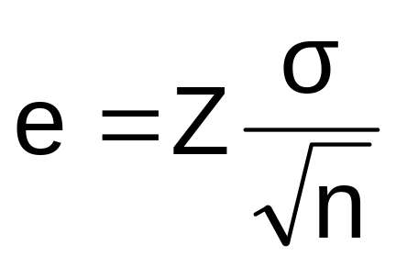


Determining Sample Size
Determining
Sample Size
For the
Mean
Sampling error (margin of error)

Slide 41
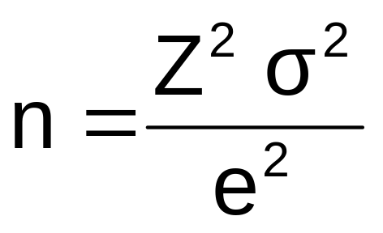
Determining Sample Size
(continued)
Determining
Sample Size
For the
Mean
Now solve for n to get

Slide 42
Determining Sample Size
(continued)
To determine the required sample size for the mean, you must know:
  The desired level of confidence (1 - α), which determines the critical Z value
  The acceptable sampling error, e
  The standard deviation, σ

Slide 43
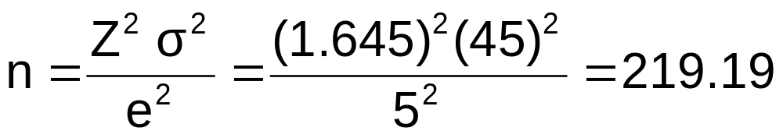
Required Sample Size Example
If σ = 45, what sample size is needed to estimate the mean within ± 5 with 90% confidence?
So the required sample size is n = 220
(Always round up)

Slide 44
If σ is unknown
If unknown, σ can be estimated when using the required sample size formula
  Use a value for σ that is expected to be at least as large as the true σ
  Select a pilot sample and estimate σ with the sample standard deviation, S

Slide 45
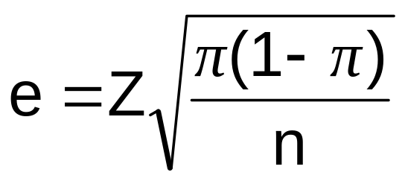
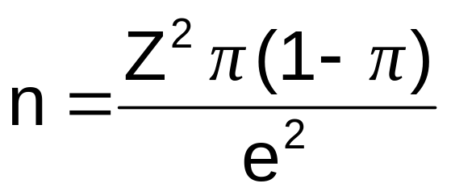
Determining Sample Size
(continued)
Determining
Sample Size
For the
Proportion
Now solve for n to get

Slide 46
Determining Sample Size
(continued)
To determine the required sample size for the proportion, you must know:
  The desired level of confidence (1 - α), which determines the critical Z value
  The acceptable sampling error, e
  The true proportion of “successes”, π
    π can be estimated with a pilot sample, if necessary (or conservatively use π = 0.5)

Slide 47
Required Sample Size Example
How large a sample would be necessary to estimate the true proportion defective in a large population within ±3%, with 95% confidence?
(Assume a pilot sample yields p = 0.12)

Slide 48
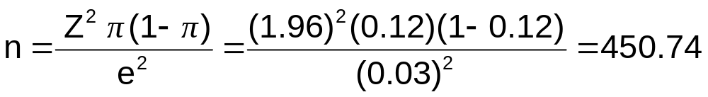
Required Sample Size Example
(continued)
Solution:
For 95% confidence, use Z = 1.96
e = 0.03
p = 0.12, so use this to estimate π
So use n = 451

Slide 49
Ethical Issues
A confidence interval estimate (reflecting sampling error) should always be included when reporting a point estimate
The level of confidence should always be reported
The sample size should be reported
An interpretation of the confidence interval estimate should also be provided

Slide 50
Chapter Summary
Introduced the concept of confidence intervals
Discussed point estimates
Developed confidence interval estimates
Created confidence interval estimates for the mean (σ known)
Determined confidence interval estimates for the mean (σ unknown)
Created confidence interval estimates for the proportion

Slide 51
Chapter Summary
(continued)
Determined required sample size for mean and proportion settings
Addressed ethical issues for confidence interval estimation

