Slide 1
Business Statistics, A First Course
4th Edition
Chapter 10
Two-Sample Tests and
One-Way ANOVA

Slide 2
Learning Objectives
In this chapter, you learn hypothesis testing procedures to test:
  The means of two independent populations
  The means of two related populations
  The proportions of two independent populations
  The variances of two independent populations
  The means of more than two populations

Slide 3
Chapter Overview
Two-Sample Tests
One-Way Analysis
of Variance (ANOVA)
Population Means,
Independent Samples
F-test
Means,
Related Samples
Tukey-Kramer
test
Population
Proportions
Population
Variances

Slide 4
Two-Sample Tests
Two-Sample Tests
Population Means, Independent Samples
Means, Related Samples
Population Proportions
Population Variances
Examples:
Mean 1 vs. independent Mean 2
Same population before vs. after treatment
Proportion 1 vs. Proportion 2
Variance 1 vs.
Variance 2

Slide 5
Difference Between Two Means
Population means, independent samples
*
Goal: Test hypothesis or form a confidence interval for the difference between two population means, μ₁ – μ₂
σ₁ and σ₂ known
The point estimate for the difference is
σ₁ and σ₂ unknown, assumed equal
X₁ – X₂
σ₁ and σ₂ unknown, not assumed equal

Slide 6
Independent Samples
Different data sources
  Unrelated
  Independent
    Sample selected from one population has no effect on the sample selected from the other population
Use the difference between 2 sample means
Use Z test, a pooled-variance t test, or a separate-variance t test
Population means, independent samples
*
σ₁ and σ₂ known
σ₁ and σ₂ unknown, assumed equal
σ₁ and σ₂ unknown, not assumed equal

Slide 7
Difference Between Two Means
Population means, independent samples
*
σ₁ and σ₂ known
Use a Z test statistic
Use S_{p} to estimate unknown σ , use a t test statistic and pooled standard deviation
σ₁ and σ₂ unknown, assumed equal
σ₁ and σ₂ unknown, not assumed equal
Use S₁ and S₂ to estimate unknown σ₁ and σ₂, use a separate-variance t test

Slide 8
σ₁ and σ₂ Known
Population means, independent samples
Assumptions:
Samples are randomly and
independently drawn
Population distributions are
normal or both sample sizes
are ≥ 30
Population standard
deviations are known
*
σ₁ and σ₂ known
σ₁ and σ₂ unknown, assumed equal
σ₁ and σ₂ unknown, not assumed equal

Slide 9
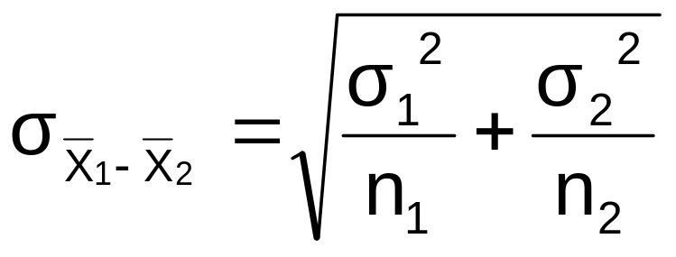
σ₁ and σ₂ Known
(continued)
When σ₁ and σ₂ are known and both populations are normal or both sample sizes are at least 30, the test statistic is a Z-value…
Population means, independent samples
*
σ₁ and σ₂ known
…and the standard error of
X₁ – X₂ is
σ₁ and σ₂ unknown, assumed equal
σ₁ and σ₂ unknown, not assumed equal

Slide 10
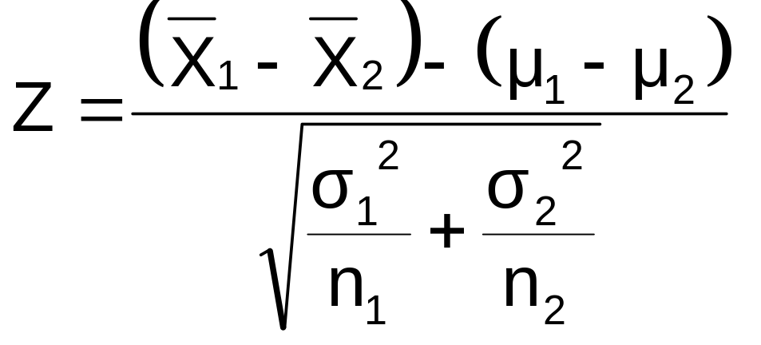
σ₁ and σ₂ Known
(continued)
Population means, independent samples
The test statistic for
μ₁ – μ₂ is:
*
σ₁ and σ₂ known
σ₁ and σ₂ unknown, assumed equal
σ₁ and σ₂ unknown, not assumed equal

Slide 11
Hypothesis Tests for
Two Population Means
Two Population Means, Independent Samples
Lower-tail test:
H₀: μ₁ ≥ μ₂
H₁: μ₁ < μ₂
i.e.,
H₀: μ₁ – μ₂ ≥ 0
H₁: μ₁ – μ₂ < 0
Upper-tail test:
H₀: μ₁ ≤ μ₂
H₁: μ₁ > μ₂
i.e.,
H₀: μ₁ – μ₂ ≤ 0
H₁: μ₁ – μ₂ > 0
Two-tail test:
H₀: μ₁ = μ₂
H₁: μ₁ ≠ μ₂
i.e.,
H₀: μ₁ – μ₂ = 0
H₁: μ₁ – μ₂ ≠ 0

Slide 12
Hypothesis tests for μ₁ – μ₂
Two Population Means, Independent Samples
Lower-tail test:
H₀: μ₁ – μ₂ ≥ 0
H₁: μ₁ – μ₂ < 0
Upper-tail test:
H₀: μ₁ – μ₂ ≤ 0
H₁: μ₁ – μ₂ > 0
Two-tail test:
H₀: μ₁ – μ₂ = 0
H₁: μ₁ – μ₂ ≠ 0
α
α
α/2
α/2
-z_{α}
z_{α}
-z_{α/2}
z_{α/2}
Reject H₀ if Z < -Z_{α}
Reject H₀ if Z > Z_{α}
Reject H₀ if Z < -Z_{α/2}
or Z > Z_{α/2}

Slide 13
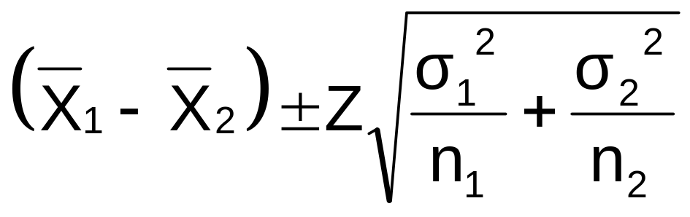
Confidence Interval, σ₁ and σ₂ Known
Population means, independent samples
The confidence interval for
μ₁ – μ₂ is:
*
σ₁ and σ₂ known
σ₁ and σ₂ unknown, assumed equal
σ₁ and σ₂ unknown, not assumed equal

Slide 14
σ₁ and σ₂ Unknown,
Assumed Equal
Population means, independent samples
Assumptions:
Samples are randomly and
independently drawn
Populations are normally
distributed or both sample
sizes are at least 30
Population variances are
unknown but assumed equal
σ₁ and σ₂ known
*
σ₁ and σ₂ unknown, assumed equal
σ₁ and σ₂ unknown, not assumed equal

Slide 15
σ₁ and σ₂ Unknown,
Assumed Equal
(continued)
Forming interval estimates:
The population variances
are assumed equal, so use
the two sample variances
and pool them to
estimate the common σ²
the test statistic is a t value
with (n₁ + n₂ – 2) degrees
of freedom
Population means, independent samples
σ₁ and σ₂ known
*
σ₁ and σ₂ unknown, assumed equal
σ₁ and σ₂ unknown, not assumed equal

Slide 16
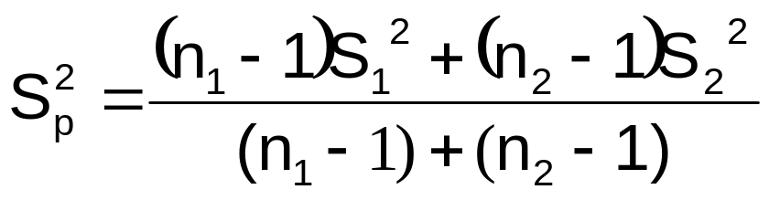
σ₁ and σ₂ Unknown,
Assumed Equal
(continued)
Population means, independent samples
The pooled variance is
σ₁ and σ₂ known
*
σ₁ and σ₂ unknown, assumed equal
σ₁ and σ₂ unknown, not assumed equal

Slide 17
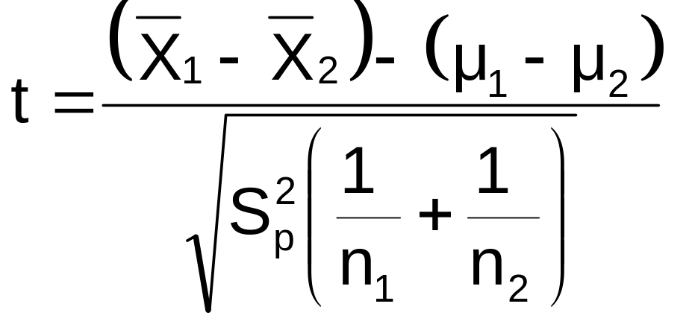
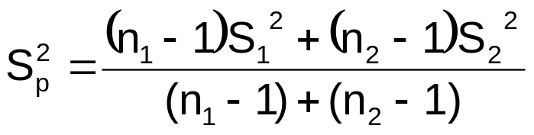
σ₁ and σ₂ Unknown,
Assumed Equal
(continued)
The test statistic for
μ₁ – μ₂ is:
Population means, independent samples
σ₁ and σ₂ known
*
σ₁ and σ₂ unknown, assumed equal
Where t has (n₁ + n₂ – 2) d.f.,
and
σ₁ and σ₂ unknown, not assumed equal

Slide 18
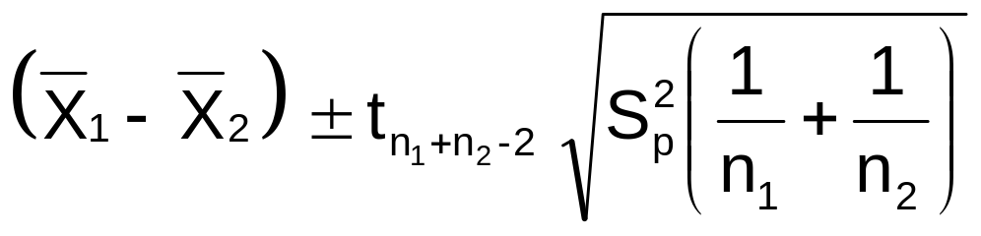
Confidence Interval, σ₁ and σ₂ Unknown
Population means, independent samples
The confidence interval for
μ₁ – μ₂ is:
σ₁ and σ₂ known
*
σ₁ and σ₂ unknown, assumed equal
Where
σ₁ and σ₂ unknown, not assumed equal

Slide 19

Pooled-Variance t Test: Example
You are a financial analyst for a brokerage firm. Is there a difference in dividend yield between stocks listed on the NYSE & NASDAQ? You collect the following data:
NYSE NASDAQ
Number 21 25
Sample mean 3.27 2.53
Sample std dev 1.30 1.16
Assuming both populations are
approximately normal with equal variances, is
there a difference in average
yield (α = 0.05)?

Slide 20
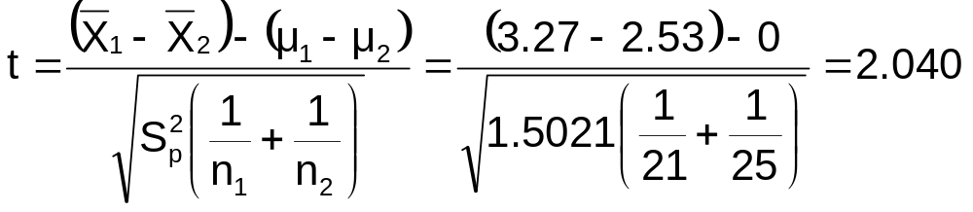
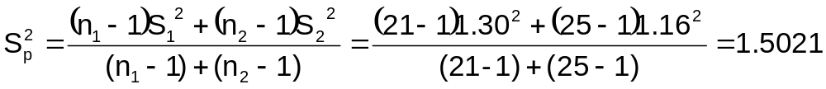
Calculating the Test Statistic
The test statistic is:

Slide 21
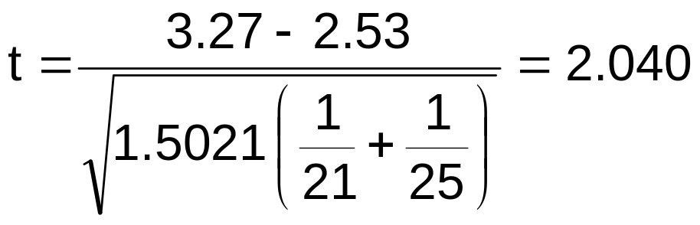
Solution
H₀: μ₁ - μ₂ = 0 i.e. (μ₁ = μ₂)
H₁: μ₁ - μ₂ ≠ 0 i.e. (μ₁ ≠ μ₂)
α = 0.05
df = 21 + 25 - 2 = 44
Critical Values: t = ± 2.0154
Test Statistic:
Reject H₀
Reject H₀
.025
.025
-2.0154
0
2.0154
t
2.040
Decision:
Conclusion:
Reject H₀ at α = 0.05
There is evidence of a difference in means.

Slide 22
σ₁ and σ₂ Unknown,
Not Assumed Equal
Population means, independent samples
Assumptions:
Samples are randomly and
independently drawn
Populations are normally
distributed or both sample
sizes are at least 30
Population variances are
unknown but cannot be
assumed to be equal
σ₁ and σ₂ known
σ₁ and σ₂ unknown, assumed equal
*
σ₁ and σ₂ unknown, not assumed equal

Slide 23
σ₁ and σ₂ Unknown,
Not Assumed Equal
(continued)
Population means, independent samples
Forming the test statistic:
The population variances
are not assumed equal, so
include the two sample
variances in the computation
of the t-test statistic
the test statistic is a t value
(statistical software is generally
used to do the necessary
computations)
σ₁ and σ₂ known
σ₁ and σ₂ unknown, assumed equal
*
σ₁ and σ₂ unknown, not assumed equal

Slide 24
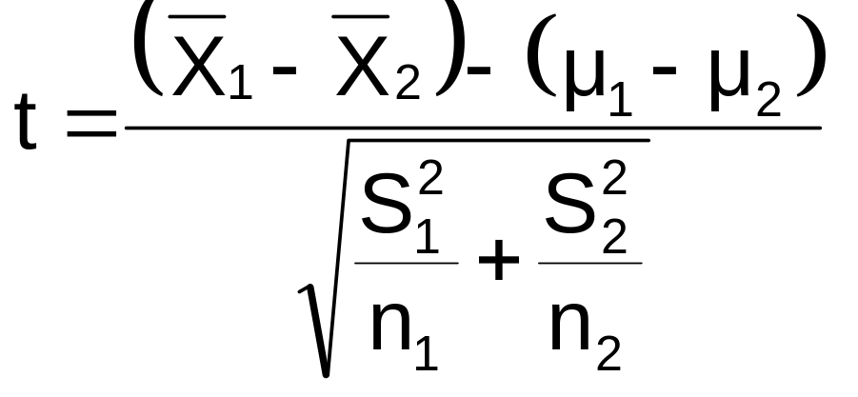
σ₁ and σ₂ Unknown,
Not Assumed Equal
(continued)
Population means, independent samples
The test statistic for
μ₁ – μ₂ is:
σ₁ and σ₂ known
σ₁ and σ₂ unknown, assumed equal
*
σ₁ and σ₂ unknown, not assumed equal

Slide 25
Related Populations
Tests Means of 2 Related Populations
      Paired or matched samples
      Repeated measures (before/after)
      Use difference between paired values:
Eliminates Variation Among Subjects
Assumptions:
  Both Populations Are Normally Distributed
  Or, if not Normal, use large samples
Related samples
  D_{i} = X_{1i} - X_{2i}

Slide 26
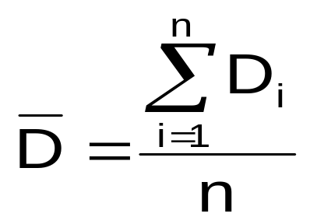
Mean Difference, σ_{D} Known
The i^{th} paired difference is D_{i} , where
Related samples
  D_{i} = X_{1i} - X_{2i}
The point estimate for the population mean paired difference is D :
Suppose the population standard deviation of the difference scores, σ_{D}, is known
n is the number of pairs in the paired sample

Slide 27
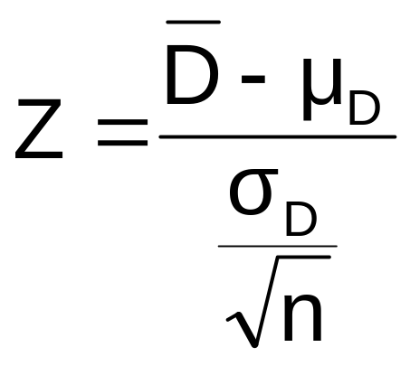
Mean Difference, σ_{D} Known
(continued)
The test statistic for the mean difference is a Z value:
Paired samples
Where
μ_{D} = hypothesized mean difference
σ_{D} = population standard dev. of differences
n = the sample size (number of pairs)

Slide 28
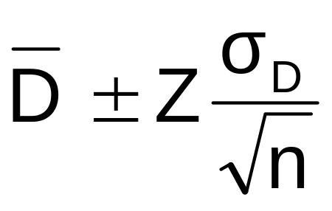
Confidence Interval, σ_{D} Known
The confidence interval for μ_{D} is
Paired samples
Where
n = the sample size
(number of pairs in the paired sample)

Slide 29
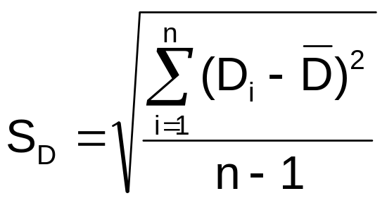
Mean Difference, σ_{D} Unknown
If σ_{D} is unknown, we can estimate the unknown population standard deviation with a sample standard deviation:
Related samples
The sample standard deviation is

Slide 30
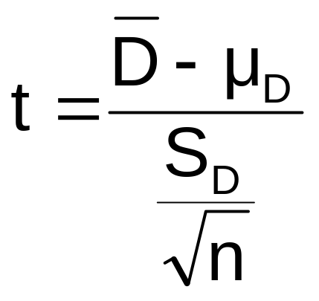
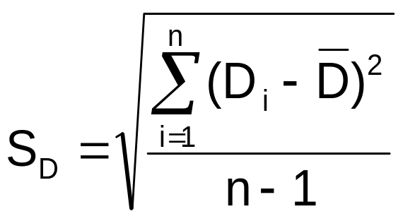
Mean Difference, σ_{D} Unknown
(continued)
Use a paired t test, the test statistic for D is now a t statistic, with n-1 d.f.:
Paired samples
Where t has n - 1 d.f.
and S_{D} is:

Slide 31
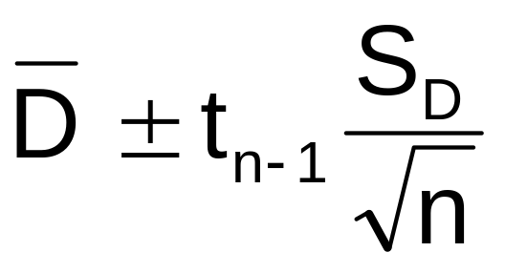
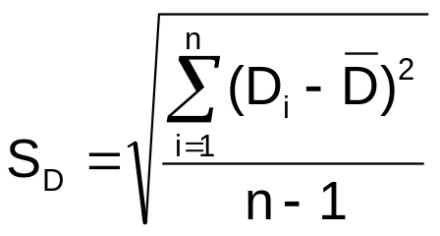
Confidence Interval, σ_{D} Unknown
The confidence interval for μ_{D} is
Paired samples
where

Slide 32
Hypothesis Testing for
Mean Difference, σ_{D} Unknown
Paired Samples
Lower-tail test:
H₀: μ_{D} ≥ 0
H₁: μ_{D} < 0
Upper-tail test:
H₀: μ_{D} ≤ 0
H₁: μ_{D} > 0
Two-tail test:
H₀: μ_{D} = 0
H₁: μ_{D} ≠ 0
α
α
α/2
α/2
-t_{α}
t_{α}
-t_{α/2}
t_{α/2}
Reject H₀ if t < -t_{α}
Reject H₀ if t > t_{α}
Reject H₀ if t < -t_{α/2}
or t > t_{α/2}
Where t has n - 1 d.f.

Slide 33
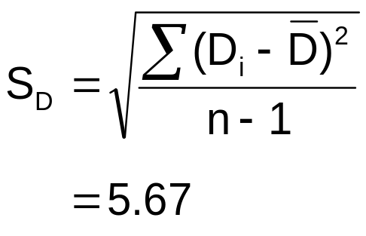
Paired t Test Example
Assume you send your salespeople to a “customer service” training workshop. Has the training made a difference in the number of complaints? You collect the following data:
Number of Complaints: (2) - (1)
Salesperson Before (1) After (2) Difference, D_{i}
C.B. 6 4 - 2
T.F. 20 6 -14
M.H. 3 2 - 1
R.K. 0 0 0
M.O. 4 0 - 4
-21
Σ
D_{i}
D =
n
= -4.2

Slide 34
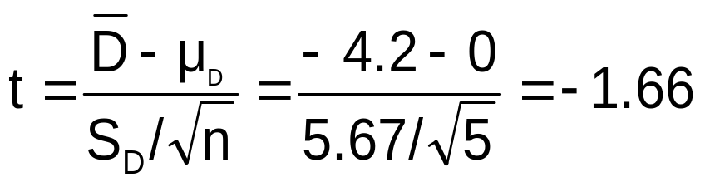
Paired t Test: Solution
Has the training made a difference in the number of complaints (at the 0.01 level)?
Reject
Reject
H₀: μ_{D} = 0
H₁: μ_{D} ≠ 0
α/2
α/2
α = .01
D =
- 4.2
- 4.604 4.604
- 1.66
Critical Value = ± 4.604 d.f. = n - 1 = 4
Decision: Do not reject H₀
(t stat is not in the reject region)
Test Statistic:
Conclusion: There is not a significant change in the number of complaints.

Slide 35
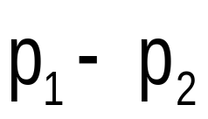
Two Population Proportions
Goal: test a hypothesis or form a confidence interval for the difference between two population proportions, π₁ – π₂
Population proportions
Assumptions:
n₁ π₁ ≥ 5 , n₁(1- π₁) ≥ 5
n₂ π₂ ≥ 5 , n₂(1- π₂) ≥ 5
The point estimate for the difference is

Slide 36
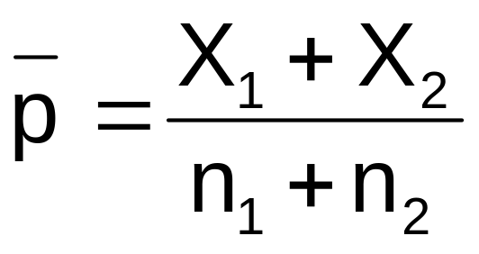
Two Population Proportions
Since we begin by assuming the null hypothesis is true, we assume π₁ = π₂ and pool the two sample estimates
Population proportions
The pooled estimate for the overall proportion is:
where X₁ and X₂ are the numbers from samples 1 and 2 with the characteristic of interest

Slide 37
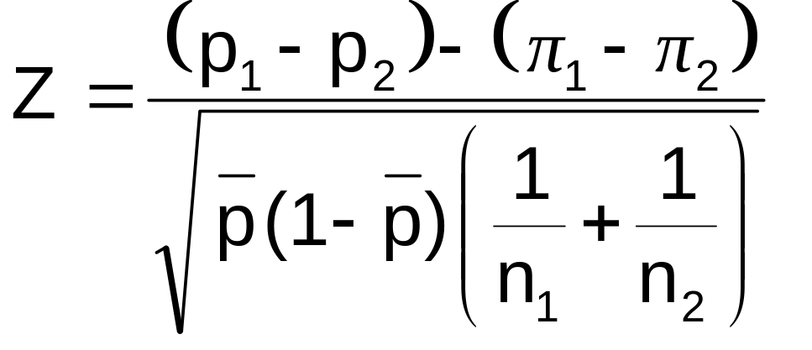
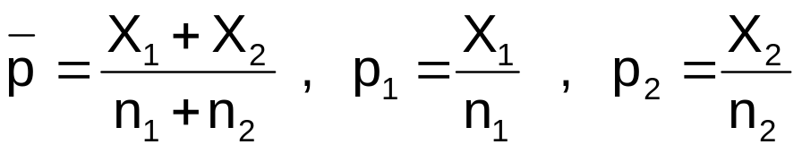
Two Population Proportions
(continued)
The test statistic for
p₁ – p₂ is a Z statistic:
Population proportions
where

Slide 38
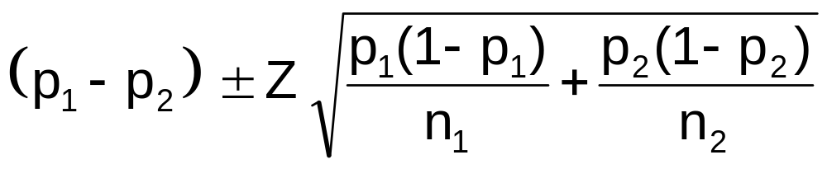
Confidence Interval for
Two Population Proportions
Population proportions
The confidence interval for
π₁ – π₂ is:

Slide 39
Hypothesis Tests for
Two Population Proportions
Population proportions
Lower-tail test:
H₀: π₁ ≥ π₂
H₁: π₁ < π₂
i.e.,
H₀: π₁ – π₂ ≥ 0
H₁: π₁ – π₂ < 0
Upper-tail test:
H₀: π₁ ≤ π₂
H₁: π₁ > π₂
i.e.,
H₀: π₁ – π₂ ≤ 0
H₁: π₁ – π₂ > 0
Two-tail test:
H₀: π₁ = π₂
H₁: π₁ ≠ π₂
i.e.,
H₀: π₁ – π₂ = 0
H₁: π₁ – π₂ ≠ 0

Slide 40
Hypothesis Tests for
Two Population Proportions
(continued)
Population proportions
Lower-tail test:
H₀: π₁ – π₂ ≥ 0
H₁: π₁ – π₂ < 0
Upper-tail test:
H₀: π₁ – π₂ ≤ 0
H₁: π₁ – π₂ > 0
Two-tail test:
H₀: π₁ – π₂ = 0
H₁: π₁ – π₂ ≠ 0
α
α
α/2
α/2
-z_{α}
z_{α}
-z_{α/2}
z_{α/2}
Reject H₀ if Z < -Z_{α}
Reject H₀ if Z > Z_{α}
Reject H₀ if Z < -Z_{α/2}
or Z > Z_{α/2}

Slide 41

Example:
Two population Proportions
Is there a significant difference between the proportion of men and the proportion of women who will vote Yes on Proposition A?
In a random sample, 36 of 72 men and 31 of 50 women indicated they would vote Yes
Test at the .05 level of significance

Slide 42
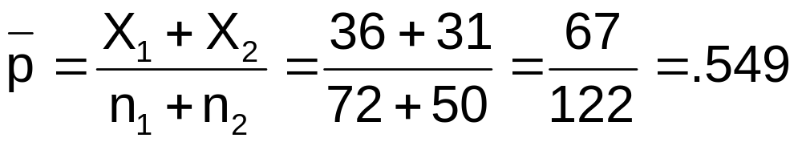
Example:
Two population Proportions
(continued)
The hypothesis test is:
H₀: π₁ – π₂ = 0 (the two proportions are equal)
H₁: π₁ – π₂ ≠ 0 (there is a significant difference between proportions)
The sample proportions are:
  Men: p₁ = 36/72 = .50
  Women: p₂ = 31/50 = .62
The pooled estimate for the overall proportion is:

Slide 43
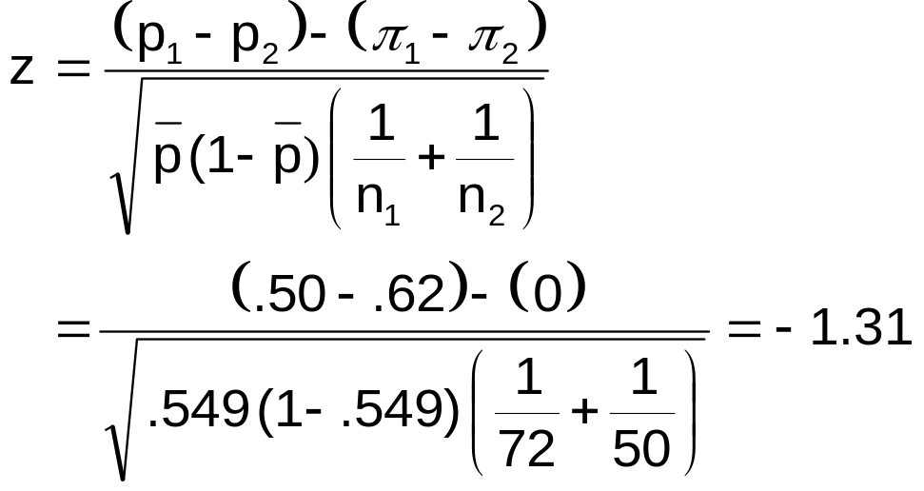
Example:
Two population Proportions
(continued)
Reject H₀
Reject H₀
The test statistic for π₁ – π₂ is:
.025
.025
-1.96
1.96
-1.31
Decision: Do not reject H₀
Conclusion: There is not significant evidence of a difference in proportions who will vote yes between men and women.
Critical Values = ±1.96
For α = .05

Slide 44
Hypothesis Tests for Variances
*
Tests for Two
Population
Variances
H₀: σ₁² = σ₂²
H₁: σ₁² ≠ σ₂²
Two-tail test
F test statistic
H₀: σ₁² ≥ σ₂²
H₁: σ₁² < σ₂²
Lower-tail test
H₀: σ₁² ≤ σ₂²
H₁: σ₁² > σ₂²
Upper-tail test

Slide 45
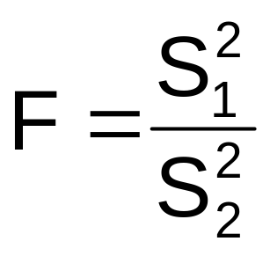


Hypothesis Tests for Variances
(continued)
Tests for Two
Population
Variances
The F test statistic is:
*
F test statistic
= Variance of Sample 1
n₁ - 1 = numerator degrees of freedom
= Variance of Sample 2
n₂ - 1 = denominator degrees of freedom

Slide 46
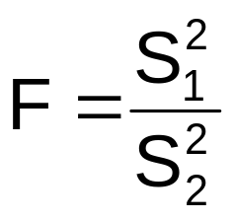
The F Distribution
The F critical value is found from the F table
There are two appropriate degrees of freedom: numerator and denominator
In the F table,
  numerator degrees of freedom determine the column
  denominator degrees of freedom determine the row
where df₁ = n₁ – 1 ; df₂ = n₂ – 1

Slide 47
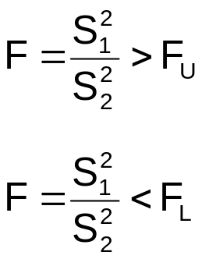
Finding the Rejection Region
H₀: σ₁² ≥ σ₂²
H₁: σ₁² < σ₂²
H₀: σ₁² = σ₂²
H₁: σ₁² ≠ σ₂²
α
α/2
0
F
α/2
F_{L}
Do not
reject H₀
Reject
H₀
0
F
Reject H₀ if F < F_{L}
F_{L}
F_{U}
Reject
H₀
Do not
reject H₀
Reject H₀
H₀: σ₁² ≤ σ₂²
H₁: σ₁² > σ₂²
rejection region for a two-tail test is:
α
0
F
Do not
reject H₀
F_{U}
Reject H₀
Reject H₀ if F > F_{U}

Slide 48
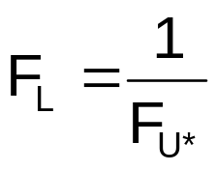
Finding the Rejection Region
(continued)
H₀: σ₁² = σ₂²
H₁: σ₁² ≠ σ₂²
α/2
α/2
0
F
F_{L}
F_{U}
Reject
H₀
Do not
reject H₀
Reject H₀
To find the critical F values:
1. Find F_{U} from the F table for n₁ – 1 numerator and n₂ – 1 denominator degrees of freedom
2. Find F_{L} using the formula:
Where F_{U*} is from the F table with n₂ – 1 numerator and n₁ – 1 denominator degrees of freedom (i.e., switch the d.f. from F_{U})

Slide 49
F Test: An Example
You are a financial analyst for a brokerage firm. You want to compare dividend yields between stocks listed on the NYSE & NASDAQ. You collect the following data:
NYSE NASDAQ
Number 21 25
Mean 3.27 2.53
Std dev 1.30 1.16
Is there a difference in the variances between the NYSE & NASDAQ at the α = 0.05 level?

Slide 50
F Test: Example Solution
Form the hypothesis test:
  H₀: σ²₁ – σ²₂ = 0 (there is no difference between variances)
  H₁: σ²₁ – σ²₂ ≠ 0 (there is a difference between variances)
Find the F critical values for α = 0.05:
  Numerator:
    n₁ – 1 = 21 – 1 = 20 d.f.
  Denominator:
    n₂ – 1 = 25 – 1 = 24 d.f.
  F_{U} = F_{.025, 20, 24} = 2.33
  Numerator:
    n₂ – 1 = 25 – 1 = 24 d.f.
  Denominator:
    n₁ – 1 = 21 – 1 = 20 d.f.
  F_{L} = 1/F_{.025, 24, 20} = 1/2.41
  = 0.415
F_{U}:
F_{L}:

Slide 51
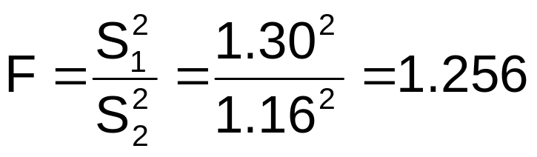
F Test: Example Solution
(continued)
The test statistic is:
H₀: σ₁² = σ₂²
H₁: σ₁² ≠ σ₂²
α/2 = .025
α/2 = .025
0
F
Reject H₀
Do not
reject H₀
Reject H₀
F = 1.256 is not in the rejection region, so we do not reject H₀
F_{U}=2.33
F_{L}=0.43
Conclusion: There is not sufficient evidence of a difference in variances at α = .05

Slide 52
Two-Sample Tests in EXCEL
For independent samples:
Independent sample Z test with variances known:
  Tools | data analysis | z-test: two sample for means
Pooled variance t test:
  Tools | data analysis | t-test: two sample assuming equal variances
Separate-variance t test:
  Tools | data analysis | t-test: two sample assuming unequal variances
For paired samples (t test):
  Tools | data analysis | t-test: paired two sample for means
For variances:
F test for two variances:
  Tools | data analysis | F-test: two sample for variances

Slide 53
One-Way Analysis of Variance
One-Way Analysis of Variance (ANOVA)
F-test
Tukey-Kramer
test

Slide 54
General ANOVA Setting
Investigator controls one or more independent variables
  Called factors (or treatment variables)
  Each factor contains two or more levels (or groups or categories/classifications)
Observe effects on the dependent variable
  Response to levels of independent variable
Experimental design: the plan used to collect the data

Slide 55
One-Way Analysis of Variance
Evaluate the difference among the means of three or more groups
  Examples: Accident rates for 1st, 2nd, and 3rd shift
  Expected mileage for five brands of tires
Assumptions
  Populations are normally distributed
  Populations have equal variances
  Samples are randomly and independently drawn

Slide 56
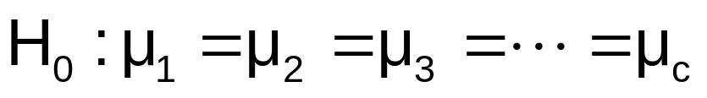
Hypotheses of One-Way ANOVA
  All population means are equal
  i.e., no treatment effect (no variation in means among groups)
  At least one population mean is different
  i.e., there is a treatment effect
  Does not mean that all population means are different (some pairs may be the same)

Slide 57
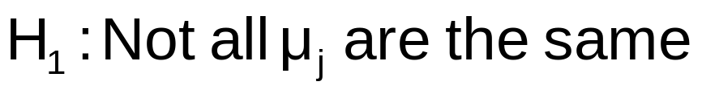
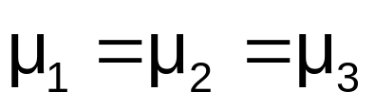
One-Way ANOVA
All Means are the same:
The Null Hypothesis is True
(No Treatment Effect)

Slide 58
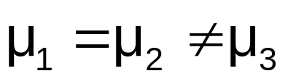
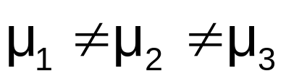
One-Way ANOVA
(continued)
At least one mean is different:
The Null Hypothesis is NOT true
(Treatment Effect is present)
or

Slide 59
Partitioning the Variation
Total variation can be split into two parts:
SST = SSA + SSW
SST = Total Sum of Squares
(Total variation)
SSA = Sum of Squares Among Groups
(Among-group variation)
SSW = Sum of Squares Within Groups
(Within-group variation)

Slide 60
Partitioning the Variation
(continued)
SST = SSA + SSW
Total Variation = the aggregate dispersion of the individual data values across the various factor levels (SST)
Among-Group Variation = dispersion between the factor sample means (SSA)
Within-Group Variation = dispersion that exists among the data values within a particular factor level (SSW)

Slide 61
Partition of Total Variation
Total Variation (SST)
d.f. = n – 1
Variation Due to Factor (SSA)
+
Variation Due to Random Sampling (SSW)
=
d.f. = c – 1
d.f. = n – c
Commonly referred to as:
Sum of Squares Between
Sum of Squares Among
Sum of Squares Explained
Among Groups Variation
Commonly referred to as:
Sum of Squares Within
Sum of Squares Error
Sum of Squares Unexplained
Within-Group Variation

Slide 62
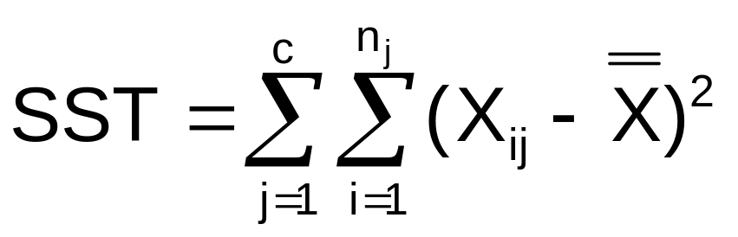

Total Sum of Squares
SST = SSA + SSW
Where:
SST = Total sum of squares
c = number of groups (levels or treatments)
n_{j} = number of observations in group j
X_{ij} = i^{th} observation from group j
X = grand mean (mean of all data values)

Slide 63
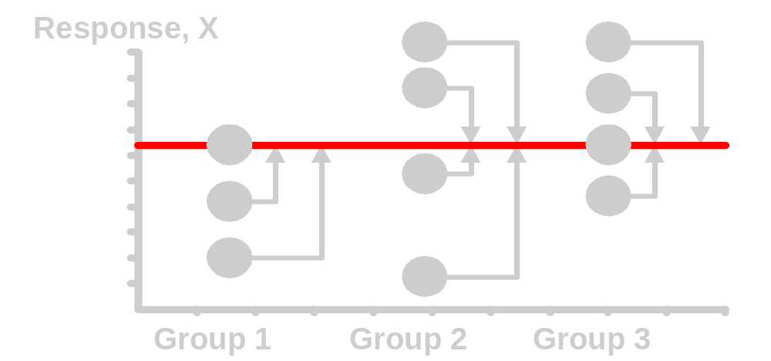
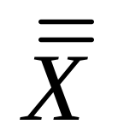
Total Variation
(continued)

Slide 64
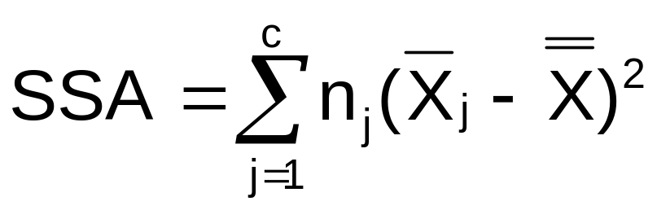
Among-Group Variation
SST = SSA + SSW
Where:
SSA = Sum of squares among groups
c = number of groups
n_{j} = sample size from group j
X_{j} = sample mean from group j
X = grand mean (mean of all data values)

Slide 65
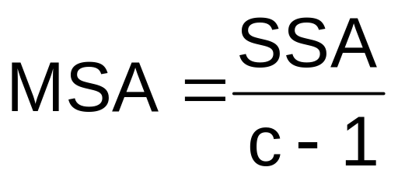


Among-Group Variation
(continued)
Variation Due to
Differences Among Groups
Mean Square Among = SSA/degrees of freedom

Slide 66
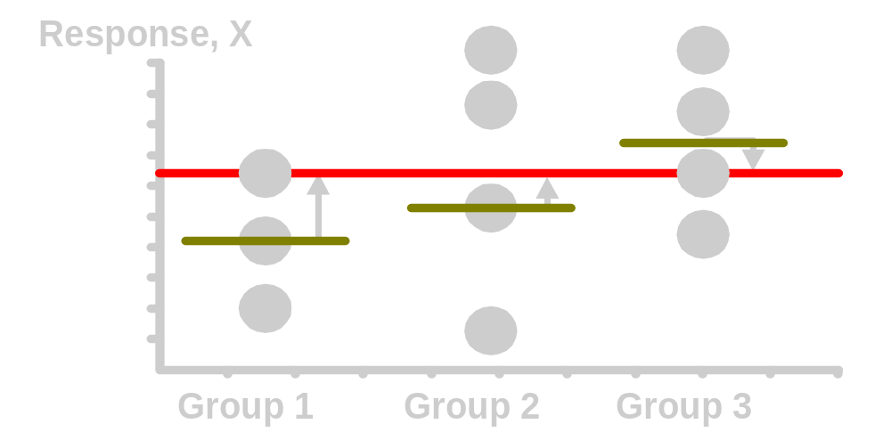
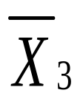
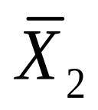
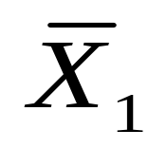
Among-Group Variation
(continued)

Slide 67
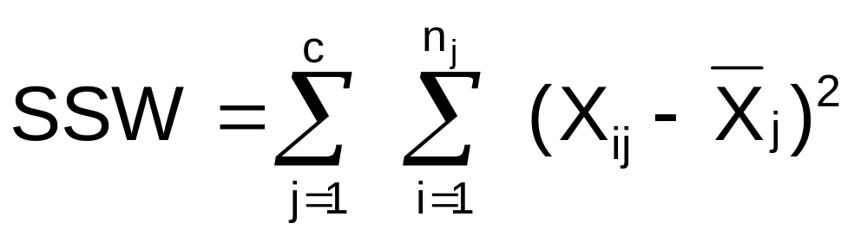
Within-Group Variation
SST = SSA + SSW
Where:
SSW = Sum of squares within groups
c = number of groups
n_{j} = sample size from group j
X_{j} = sample mean from group j
X_{ij} = i^{th} observation in group j

Slide 68
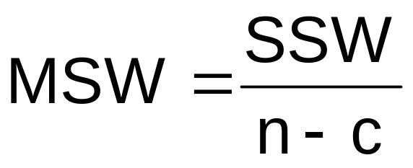

Within-Group Variation
(continued)
Summing the variation within each group and then adding over all groups
Mean Square Within = SSW/degrees of freedom

Slide 69
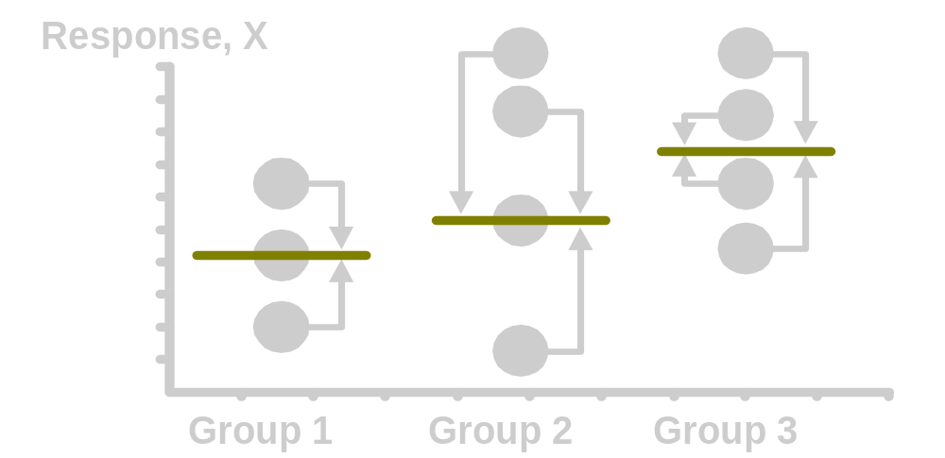

Within-Group Variation
(continued)

Slide 70


Obtaining the Mean Squares

Slide 71
One-Way ANOVA Table
Source of Variation
SS
df
MS
(Variance)
F ratio
Among Groups
SSA
MSA
SSA
c - 1
MSA =
F =
c - 1
MSW
Within Groups
SSW
SSW
n - c
MSW =
n - c
SST =
SSA+SSW
Total
n - 1
c = number of groups
n = sum of the sample sizes from all groups
df = degrees of freedom

Slide 72

One-Way ANOVA
F Test Statistic
H₀: μ₁= μ₂ = … = μ_{c}
H₁: At least two population means are different
Test statistic
    MSA is mean squares among groups
    MSW is mean squares within groups
Degrees of freedom
  df₁ = c – 1 (c = number of groups)
  df₂ = n – c (n = sum of sample sizes from all populations)

Slide 73
Interpreting One-Way ANOVA
F Statistic
The F statistic is the ratio of the among estimate of variance and the within estimate of variance
  The ratio must always be positive
  df₁ = c -1 will typically be small
  df₂ = n - c will typically be large
Decision Rule:
Reject H₀ if F > F_{U}, otherwise do not reject H₀
α = .05
0
Do not
reject H₀
Reject H₀
F_{U}

Slide 74


One-Way ANOVA
F Test Example
You want to see if three different golf clubs yield different distances. You randomly select five measurements from trials on an automated driving machine for each club. At the 0.05 significance level, is there a difference in mean distance?
Club 1 Club 2 Club 3
254 234 200
263 218 222
241 235 197
237 227 206
251 216 204

Slide 75

One-Way ANOVA Example: Scatter Diagram
Distance
Club 1 Club 2 Club 3
254 234 200
263 218 222
241 235 197
237 227 206
251 216 204
270
260
250
240
230
220
210
200
190
•
•
•
•
•
•
•
•
•
•
•
•
•
•
•
1 2 3
Club

Slide 76

One-Way ANOVA Example Computations
Club 1 Club 2 Club 3
254 234 200
263 218 222
241 235 197
237 227 206
251 216 204
X₁ = 249.2
X₂ = 226.0
X₃ = 205.8
X = 227.0
n₁ = 5
n₂ = 5
n₃ = 5
n = 15
c = 3
SSA = 5 (249.2 – 227)² + 5 (226 – 227)² + 5 (205.8 – 227)² = 4716.4
SSW = (254 – 249.2)² + (263 – 249.2)² +…+ (204 – 205.8)² = 1119.6
MSA = 4716.4 / (3-1) = 2358.2
MSW = 1119.6 / (15-3) = 93.3

Slide 77

One-Way ANOVA Example Solution
H₀: μ₁ = μ₂ = μ₃
H₁: μ_{j} not all equal
α = 0.05
df₁= 2 df₂ = 12
Test Statistic:
Decision:
Conclusion:
Critical Value:
F_{U} = 3.89
Reject H₀ at α = 0.05
α = .05
There is evidence that at least one μ_{j} differs from the rest
0
Do not
reject H₀
Reject H₀
F = 25.275
F_{U} = 3.89

Slide 78
One-Way ANOVA
Excel Output
EXCEL: tools | data analysis | ANOVA: single factor
SUMMARY
Groups | Count | Sum | Average | Variance
Club 1 | 5 | 1246 | 249.2 | 108.2
Club 2 | 5 | 1130 | 226 | 77.5
Club 3 | 5 | 1029 | 205.8 | 94.2
ANOVA
Source of Variation | SS | df | MS | F | P-value | F crit
Between Groups | 4716.4 | 2 | 2358.2 | 25.275 | 4.99E-05 | 3.89
Within Groups | 1119.6 | 12 | 93.3
Total | 5836.0 | 14

Slide 79
The Tukey-Kramer Procedure
Tells which population means are significantly different
  e.g.: μ₁ = μ₂ ≠ μ₃
  Done after rejection of equal means in ANOVA
Allows pair-wise comparisons
  Compare absolute mean differences with critical range
μ
=
μ
μ
x
1
2
3

Slide 80

Tukey-Kramer Critical Range
where:
Q_{U} = Value from Studentized Range Distribution with c and n - c degrees of freedom for the desired level of α (see appendix E.8 table)
MSW = Mean Square Within
n_{j} and n_{j’} = Sample sizes from groups j and j’

Slide 81


The Tukey-Kramer Procedure: Example
1. Compute absolute mean differences:
Club 1 Club 2 Club 3
254 234 200
263 218 222
241 235 197
237 227 206
251 216 204
2. Find the Q_{U} value from the table in appendix E.8 with
c = 3 and (n – c) = (15 – 3) = 12 degrees of freedom for the desired level of α (α = 0.05 used here):

Slide 82


The Tukey-Kramer Procedure: Example
(continued)
3. Compute Critical Range:
4. Compare:
5. All of the absolute mean differences are greater than critical range. Therefore there is a significant difference between each pair of means at 5% level of significance. Thus, with 95% confidence we can conclude that the mean distance for club 1 is greater than club 2 and 3, and club 2 is greater than club 3.

Slide 83
Chapter Summary
Compared two independent samples
  Performed Z test for the difference in two means
  Performed pooled variance t test for the difference in two means
  Performed separate-variance t test for difference in two means
  Formed confidence intervals for the difference between two means
Compared two related samples (paired samples)
  Performed paired sample Z and t tests for the mean difference
  Formed confidence intervals for the mean difference

Slide 84
Chapter Summary
(continued)
Compared two population proportions
  Formed confidence intervals for the difference between two population proportions
  Performed Z-test for two population proportions
Performed F tests for the difference between two population variances
Used the F table to find F critical values
Described one-way analysis of variance
  The logic of ANOVA
  ANOVA assumptions
  F test for difference in c means
  The Tukey-Kramer procedure for multiple comparisons

