Slide 1
Business Statistics, A First Course
4th Edition
Chapter 11
Chi-Square Tests

Slide 2
Learning Objectives
In this chapter, you learn:
How and when to use the chi-square test for contingency tables
How to use the Marascuilo procedure for determining pairwise differences when evaluating more than two proportions

Slide 3
Contingency Tables
Contingency Tables
Useful in situations involving multiple population proportions
Used to classify sample observations according to two or more characteristics
Also called a cross-classification table.

Slide 4
Contingency Table Example
Left-Handed vs. Gender
Dominant Hand: Left vs. Right
Gender: Male vs. Female
2 categories for each variable, so
called a 2 x 2 table
Suppose we examine a sample of
size 300

Slide 5
Contingency Table Example
(continued)
Sample results organized in a contingency table:
Gender | Hand Preference
 | Left | Right
Female | 12 | 108 | 120
Male | 24 | 156 | 180
 | 36 | 264 | 300
sample size = n = 300:
120 Females, 12 were left handed
180 Males, 24 were left handed

Slide 6
χ² Test for the Difference Between Two Proportions
H₀: π₁ = π₂ (Proportion of females who are left
handed is equal to the proportion of
males who are left handed)
H₁: π₁ ≠ π₂ (The two proportions are not the same –
Hand preference is not independent
of gender)
If H₀ is true, then the proportion of left-handed females should be the same as the proportion of left-handed males
The two proportions above should be the same as the proportion of left-handed people overall

Slide 7
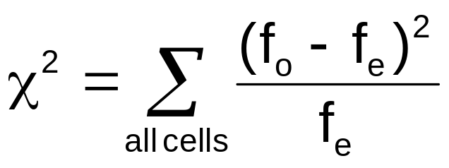
The Chi-Square Test Statistic
The Chi-square test statistic is:
where:
f_{o} = observed frequency in a particular cell
f_{e} = expected frequency in a particular cell if H₀ is true
χ² for the 2 x 2 case has 1 degree of freedom
(Assumed: each cell in the contingency table has expected frequency of at least 5)

Slide 8
Decision Rule
The χ² test statistic approximately follows a chi-square distribution with one degree of freedom
Decision Rule:
If χ² > χ²_{U}, reject H₀, otherwise, do not reject H₀
α
0
χ²
Do not
reject H₀
Reject H₀
χ²_{U}

Slide 9
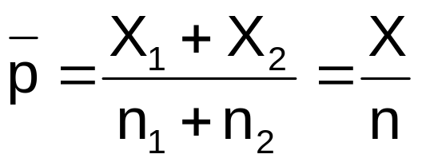
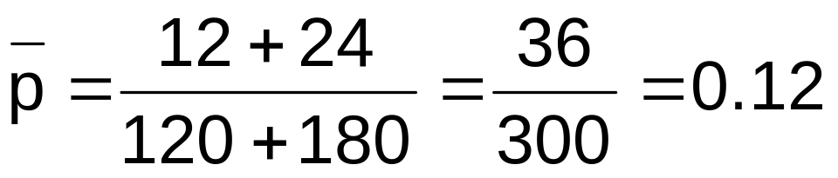
Computing the
Average Proportion
The average proportion is:
120 Females, 12 were left handed
180 Males, 24 were left handed
Here:
i.e., the proportion of left handers overall is 0.12, that is, 12%

Slide 10
Finding Expected Frequencies
To obtain the expected frequency for left handed females, multiply the average proportion left handed (p) by the total number of females
To obtain the expected frequency for left handed males, multiply the average proportion left handed (p) by the total number of males
If the two proportions are equal, then
P(Left Handed | Female) = P(Left Handed | Male) = .12
i.e., we would expect (.12)(120) = 14.4 females to be left handed
(.12)(180) = 21.6 males to be left handed

Slide 11
Observed vs. Expected Frequencies
Gender | Hand Preference
 | Left | Right
Female | Observed = 12 Expected = 14.4 | Observed = 108 Expected = 105.6 | 120
Male | Observed = 24 Expected = 21.6 | Observed = 156 Expected = 158.4 | 180
 | 36 | 264 | 300

Slide 12
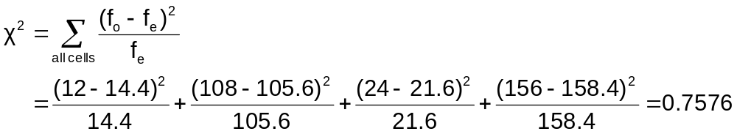
The Chi-Square Test Statistic
Gender | Hand Preference
 | Left | Right
Female | Observed = 12 Expected = 14.4 | Observed = 108 Expected = 105.6 | 120
Male | Observed = 24 Expected = 21.6 | Observed = 156 Expected = 158.4 | 180
 | 36 | 264 | 300
The test statistic is:

Slide 13
Decision Rule
Decision Rule:
If χ² > 3.841, reject H₀, otherwise, do not reject H₀
Here,
χ² = 0.7576 < χ²_{U} = 3.841,
so we do not reject H₀ and conclude that there is not sufficient evidence that the two proportions are different at α = 0.05
α
0
χ²
Do not
reject H₀
Reject H₀
χ²_{U}=3.841

Slide 14
χ² Test for Differences Among
More Than Two Proportions
Extend the χ² test to the case with more than two independent populations:
H₀: π₁ = π₂ = … = π_{c}
H₁: Not all of the π_{j} are equal (j = 1, 2, …, c)

Slide 15
The Chi-Square Test Statistic
The Chi-square test statistic is:
where:
f_{o} = observed frequency in a particular cell of the 2 x c table
f_{e} = expected frequency in a particular cell if H₀ is true
χ² for the 2 x c case has (2-1)(c-1) = c - 1 degrees of freedom
(Assumed: each cell in the contingency table has expected frequency of at least 1)

Slide 16
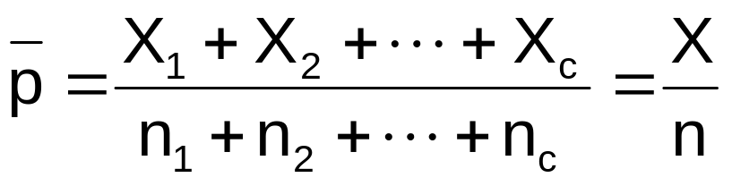
Computing the
Overall Proportion
The overall proportion is:
Expected cell frequencies for the c categories are calculated as in the 2 x 2 case, and the decision rule is the same:
Decision Rule:
If χ² > χ²_{U}, reject H₀, otherwise, do not reject H₀
Where χ²_{U} is from the chi-square distribution with c – 1 degrees of freedom

Slide 17
The Marascuilo Procedure
Used when the null hypothesis of equal proportions is rejected
Enables you to make comparisons between all pairs
Start with the observed differences, p_{j} – p_{j’}, for all pairs (for j ≠ j’) . . .
. . .then compare the absolute difference to a calculated critical range

Slide 18
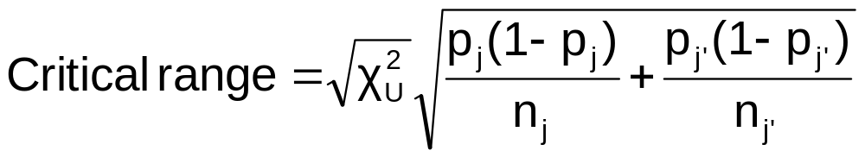
The Marascuilo Procedure
(continued)
Critical Range for the Marascuilo Procedure:
    (Note: the critical range is different for each pairwise comparison)
A particular pair of proportions is significantly different if
| p_{j} – p_{j’}| > critical range for j and j’

Slide 19

Marascuilo Procedure Example
A University is thinking of switching to a trimester academic calendar. A random sample of 100 administrators, 50 students, and 50 faculty members were surveyed
Opinion Administrators Students Faculty
Favor 63 20 37
Oppose 37 30 13
Totals 100 50 50
At the 0.01 level of significance, is there evidence that the groups differ in attitude? If so, how?

Slide 20
Marascuilo Procedure Example
H₀: π₁ = π₂ = … = π_{c}
H₁: Not all of the π_{j} are equal (j = 1, 2, …, c)
Data
Level of Significance | 0.01
Number of Rows | 2
Number of Columns | 3
Degrees of Freedom | 2
Results
Critical Value | 9.210351
Chi-Square Test Statistic | 12.79167
p-Value | 0.001668
Reject the null hypothesis
Expected Cell Frequencies:
Opinion Admin. Students Faculty
Favor 60 30 30
Oppose 40 20 20
Totals 100 50 50
The test statistic is greater than the critical value, so H₀ is rejected.

Slide 21
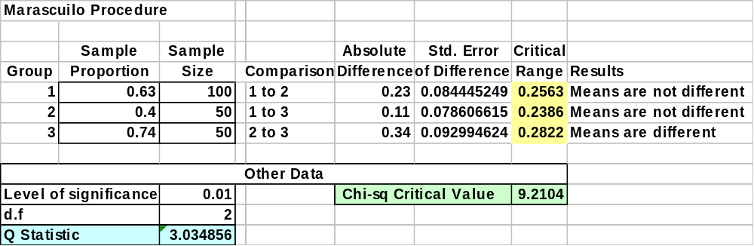
Marascuilo Procedure: Solution
Excel Output:
compare
At the 0.01 level of significance, there is evidence of a difference in attitude between students and faculty

Slide 22
χ² Test of Independence
Similar to the χ² test for equality of more than two proportions, but extends the concept to contingency tables with r rows and c columns
H₀: The two categorical variables are independent
(i.e., there is no relationship between them)
H₁: The two categorical variables are dependent
(i.e., there is a relationship between them)

Slide 23
χ² Test of Independence
(continued)
The Chi-square test statistic is:
where:
f_{o} = observed frequency in a particular cell of the r x c table
f_{e} = expected frequency in a particular cell if H₀ is true
χ² for the r x c case has (r-1)(c-1) degrees of freedom
(Assumed: each cell in the contingency table has expected frequency of at least 1)

Slide 24
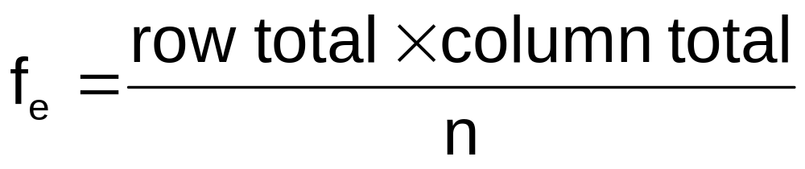
Expected Cell Frequencies
Expected cell frequencies:
Where:
row total = sum of all frequencies in the row
column total = sum of all frequencies in the column
n = overall sample size

Slide 25
Decision Rule
The decision rule is
If χ² > χ²_{U}, reject H₀, otherwise, do not reject H₀
Where χ²_{U} is from the chi-square distribution with (r – 1)(c – 1) degrees of freedom

Slide 26
Example
The meal plan selected by 200 students is shown below:
Class Standing | Number of meals per week |  |  | Total
 | 20/week | 10/week | none
Fresh. | 24 | 32 | 14 | 70
Soph. | 22 | 26 | 12 | 60
Junior | 10 | 14 | 6 | 30
Senior | 14 | 16 | 10 | 40
Total | 70 | 88 | 42 | 200

Slide 27
Example
(continued)
The hypothesis to be tested is:
H₀: Meal plan and class standing are independent
(i.e., there is no relationship between them)
H₁: Meal plan and class standing are dependent
(i.e., there is a relationship between them)

Slide 28
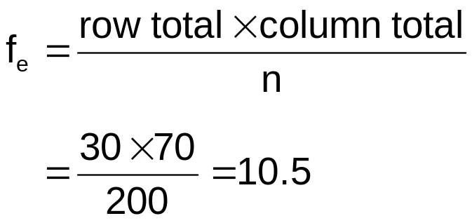
Example:
Expected Cell Frequencies
(continued)
Observed:
Class Standing | Number of meals per week |  |  | Total
 | 20/wk | 10/wk | none
Fresh. | 24 | 32 | 14 | 70
Soph. | 22 | 26 | 12 | 60
Junior | 10 | 14 | 6 | 30
Senior | 14 | 16 | 10 | 40
Total | 70 | 88 | 42 | 200
Expected cell frequencies if H₀ is true:
Class Standing | Number of meals per week |  |  | Total
 | 20/wk | 10/wk | none
Fresh. | 24.5 | 30.8 | 14.7 | 70
Soph. | 21.0 | 26.4 | 12.6 | 60
Junior | 10.5 | 13.2 | 6.3 | 30
Senior | 14.0 | 17.6 | 8.4 | 40
Total | 70 | 88 | 42 | 200
Example for one cell:

Slide 29
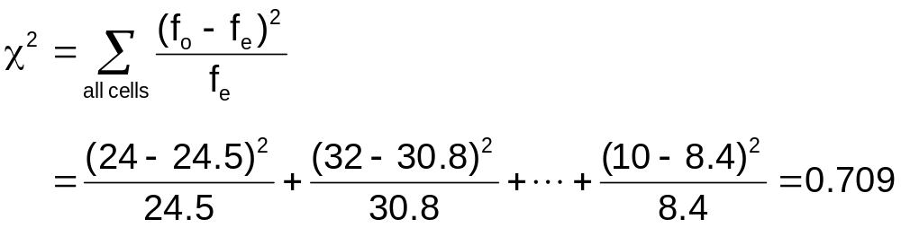
Example: The Test Statistic
(continued)
The test statistic value is:
χ²_{U} = 12.592 for α = 0.05 from the chi-square distribution with (4 – 1)(3 – 1) = 6 degrees of freedom

Slide 30
Example:
Decision and Interpretation
(continued)
Decision Rule:
If χ² > 12.592, reject H₀, otherwise, do not reject H₀
Here,
χ² = 0.709 < χ²_{U} = 12.592,
so do not reject H₀
Conclusion: there is not sufficient evidence that meal plan and class standing are related at α = 0.05
α
0
χ²
Do not
reject H₀
Reject H₀
χ²_{U}=12.592

Slide 31
Chapter Summary
Developed and applied the χ² test for the difference between two proportions
Developed and applied the χ² test for differences in more than two proportions
Examined the χ² test for independence

