Slide 1
Business Statistics, A First Course
4th Edition
Chapter 12
Simple Linear Regression

Slide 2
Learning Objectives
In this chapter, you learn:
How to use regression analysis to predict the value of a dependent variable based on an independent variable
The meaning of the regression coefficients b₀ and b₁
How to evaluate the assumptions of regression analysis and know what to do if the assumptions are violated
To make inferences about the slope and correlation coefficient
To estimate mean values and predict individual values

Slide 3
Correlation vs. Regression
A scatter diagram can be used to show the relationship between two variables
Correlation analysis is used to measure strength of the association (linear relationship) between two variables
  Correlation is only concerned with strength of the relationship
  No causal effect is implied with correlation
  Scatter diagrams were first presented in Ch. 2
  Correlation was first presented in Ch. 3

Slide 4
Introduction to
Regression Analysis
Regression analysis is used to:
  Predict the value of a dependent variable based on the value of at least one independent variable
  Explain the impact of changes in an independent variable on the dependent variable
Dependent variable: the variable we wish to predict
or explain
Independent variable: the variable used to explain the dependent variable

Slide 5
Simple Linear Regression Model
Only one independent variable, X
Relationship between X and Y is described by a linear function
Changes in Y are assumed to be caused by changes in X

Slide 6
Types of Relationships
Linear relationships
Curvilinear relationships
Y
Y
X
X
Y
Y
X
X

Slide 7
Types of Relationships
(continued)
Strong relationships
Weak relationships
Y
Y
X
X
Y
Y
X
X

Slide 8
Types of Relationships
(continued)
No relationship
Y
X
Y
X

Slide 9
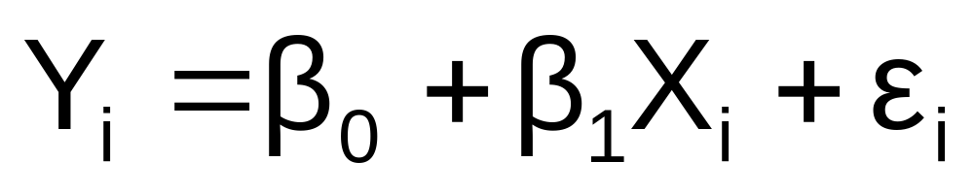
Simple Linear Regression Model
Population Slope
Coefficient
Random Error term
Population
Y intercept
Independent Variable
Dependent Variable
Linear component
Random Error
component

Slide 10
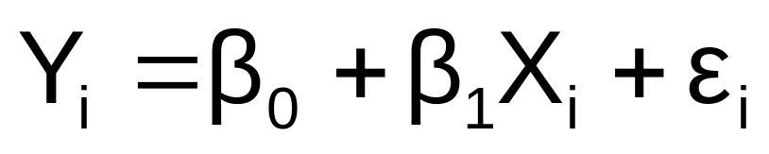
Simple Linear Regression Model
(continued)
Y
Observed Value of Y for X_{i}
ε_{i}
Slope = β₁
Predicted Value of Y for X_{i}
Random Error for this X_{i} value
Intercept = β₀
X_{i}
X

Slide 11
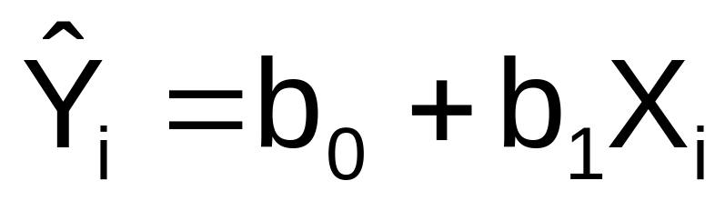
Simple Linear Regression Equation (Prediction Line)
The simple linear regression equation provides an estimate of the population regression line
Estimated (or predicted) Y value for observation i
Estimate of the regression
intercept
Estimate of the regression slope
Value of X for observation i
The individual random error terms e_{i} have a mean of zero

Slide 12

Least Squares Method
b₀ and b₁ are obtained by finding the values of b₀ and b₁ that minimize the sum of the squared differences between Y and :

Slide 13
Finding the Least Squares Equation
The coefficients b₀ and b₁ , and other regression results in this chapter, will be found using Excel or Minitab
Formulas are shown in the text for those who are interested

Slide 14
Interpretation of the
Slope and the Intercept
b₀ is the estimated average value of Y when the value of X is zero
b₁ is the estimated change in the average value of Y as a result of a one-unit change in X

Slide 15

Simple Linear Regression Example
A real estate agent wishes to examine the relationship between the selling price of a home and its size (measured in square feet)
A random sample of 10 houses is selected
  Dependent variable (Y) = house price in $1000s
  Independent variable (X) = square feet

Slide 16
Sample Data for House Price Model
House Price in $1000s (Y) | Square Feet (X)
245 | 1400
312 | 1600
279 | 1700
308 | 1875
199 | 1100
219 | 1550
405 | 2350
324 | 2450
319 | 1425
255 | 1700

Slide 17
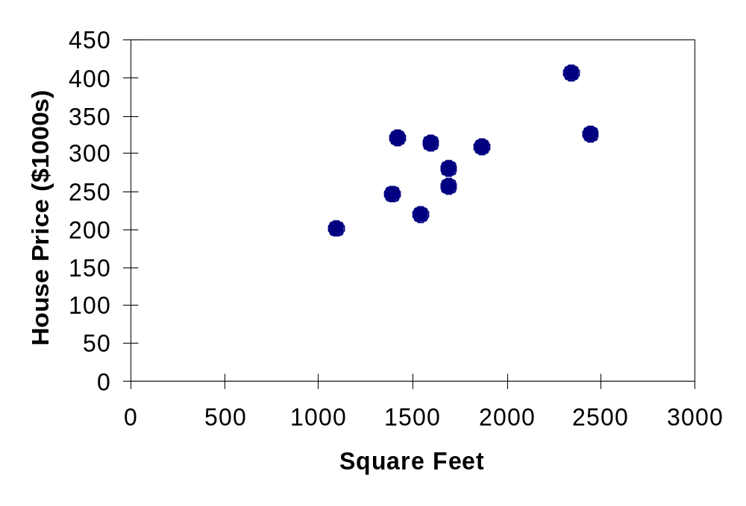
Graphical Presentation
House price model: scatter plot

Slide 18
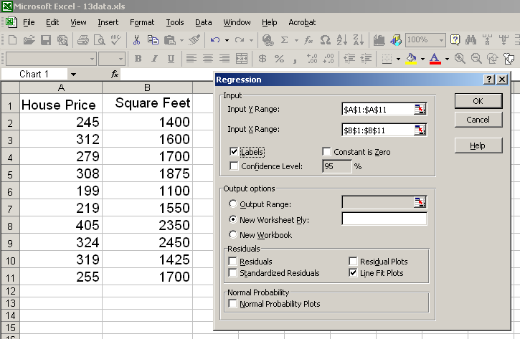
Regression Using Excel
Tools / Data Analysis / Regression

Slide 19
Excel Output
Regression Statistics
Multiple R | 0.76211
R Square | 0.58082
Adjusted R Square | 0.52842
Standard Error | 41.33032
Observations | 10
ANOVA | df | SS | MS | F | Significance F
Regression | 1 | 18934.9348 | 18934.9348 | 11.0848 | 0.01039
Residual | 8 | 13665.5652 | 1708.1957
Total | 9 | 32600.5000
 | Coefficients | Standard Error | t Stat | P-value | Lower 95% | Upper 95%
Intercept | 98.24833 | 58.03348 | 1.69296 | 0.12892 | -35.57720 | 232.07386
Square Feet | 0.10977 | 0.03297 | 3.32938 | 0.01039 | 0.03374 | 0.18580
The regression equation is:

Slide 20
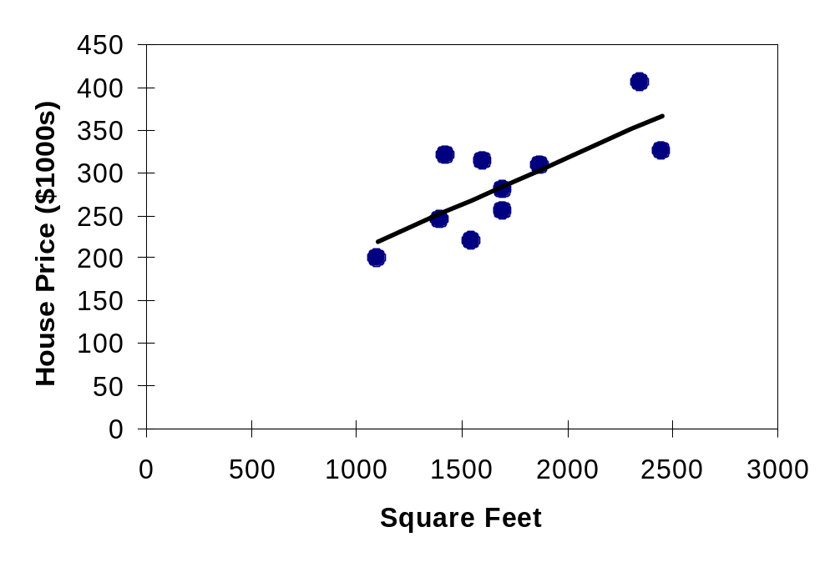
Graphical Presentation
House price model: scatter plot and regression line
Slope
= 0.10977
Intercept
= 98.248

Slide 21
Interpretation of the
Intercept, b₀
b₀ is the estimated average value of Y when the value of X is zero (if X = 0 is in the range of observed X values)
  Here, no houses had 0 square feet, so b₀ = 98.24833 just indicates that, for houses within the range of sizes observed, $98,248.33 is the portion of the house price not explained by square feet

Slide 22
Interpretation of the
Slope Coefficient, b₁
b₁ measures the estimated change in the average value of Y as a result of a one-unit change in X
  Here, b₁ = .10977 tells us that the average value of a house increases by .10977($1000) = $109.77, on average, for each additional one square foot of size

Slide 23
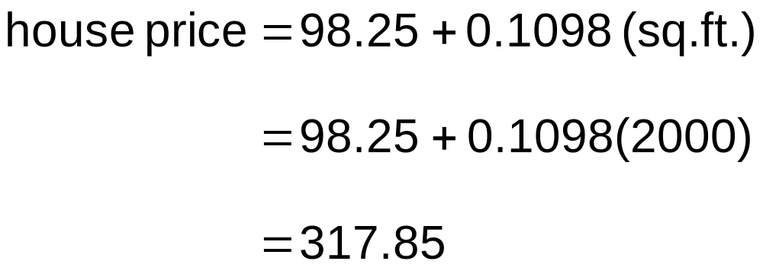
Predictions using
Regression Analysis
Predict the price for a house with 2000 square feet:
The predicted price for a house with 2000 square feet is 317.85($1,000s) = $317,850

Slide 24
Interpolation vs. Extrapolation
When using a regression model for prediction, only predict within the relevant range of data
Relevant range for interpolation
Do not try to extrapolate beyond the range of observed X’s

Slide 25
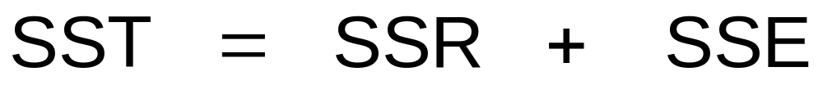
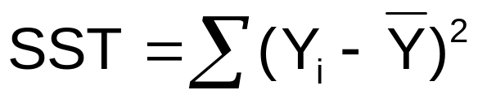
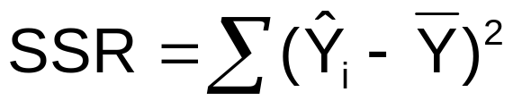
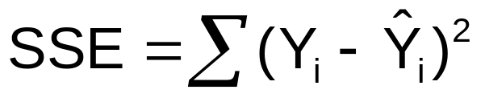

Measures of Variation
Total variation is made up of two parts:
Total Sum of Squares
Regression Sum of Squares
Error Sum of Squares
where:
= Average value of the dependent variable
Y_{i} = Observed values of the dependent variable
_{i} = Predicted value of Y for the given X_{i} value

Slide 26
Measures of Variation
(continued)
SST = total sum of squares
  Measures the variation of the Y_{i} values around their mean Y
SSR = regression sum of squares
  Explained variation attributable to the relationship between X and Y
SSE = error sum of squares
  Variation attributable to factors other than the relationship between X and Y

Slide 27
Measures of Variation
(continued)
Y
Y_{i}
∧
∧
SSE = ∑(Y_{i} - Y_{i} )²
Y
_
SST = ∑(Y_{i} - Y)²
∧
Y
_
∧
_
SSR = ∑(Y_{i} - Y)²
_
Y
Y
X
X_{i}

Slide 28
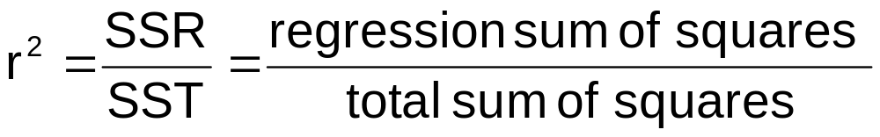
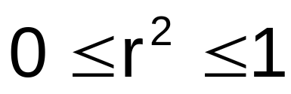
Coefficient of Determination, r²
The coefficient of determination is the portion of the total variation in the dependent variable that is explained by variation in the independent variable
The coefficient of determination is also called r-squared and is denoted as r²
note:

Slide 29
Examples of Approximate r² Values
Y
r² = 1
Perfect linear relationship between X and Y:
100% of the variation in Y is explained by variation in X
X
r² = 1
Y
X
r² = 1

Slide 30
Examples of Approximate r² Values
Y
0 < r² < 1
Weaker linear relationships between X and Y:
Some but not all of the variation in Y is explained by variation in X
X
Y
X

Slide 31
Examples of Approximate r² Values
r² = 0
Y
No linear relationship between X and Y:
The value of Y does not depend on X. (None of the variation in Y is explained by variation in X)
X
r² = 0

Slide 32
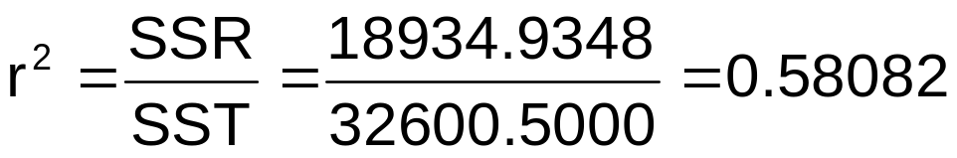
Excel Output
Regression Statistics
Multiple R | 0.76211
R Square | 0.58082
Adjusted R Square | 0.52842
Standard Error | 41.33032
Observations | 10
ANOVA | df | SS | MS | F | Significance F
Regression | 1 | 18934.9348 | 18934.9348 | 11.0848 | 0.01039
Residual | 8 | 13665.5652 | 1708.1957
Total | 9 | 32600.5000
 | Coefficients | Standard Error | t Stat | P-value | Lower 95% | Upper 95%
Intercept | 98.24833 | 58.03348 | 1.69296 | 0.12892 | -35.57720 | 232.07386
Square Feet | 0.10977 | 0.03297 | 3.32938 | 0.01039 | 0.03374 | 0.18580
58.08% of the variation in house prices is explained by variation in square feet

Slide 33
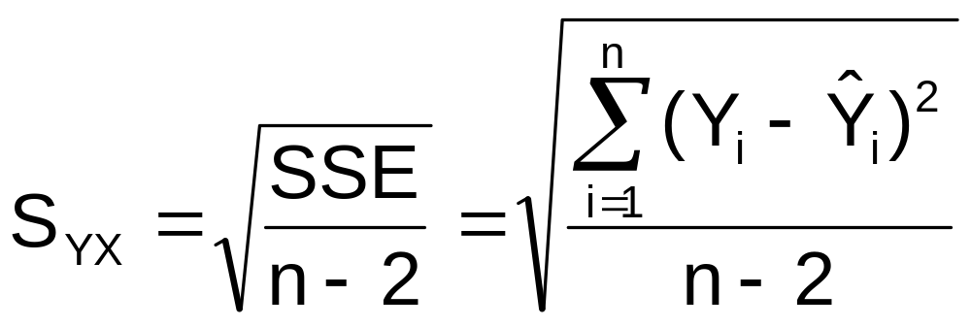
Standard Error of Estimate
The standard deviation of the variation of observations around the regression line is estimated by
Where
SSE = error sum of squares
n = sample size

Slide 34
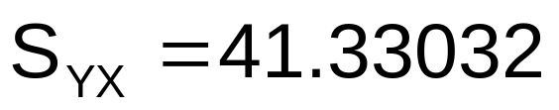
Excel Output
Regression Statistics
Multiple R | 0.76211
R Square | 0.58082
Adjusted R Square | 0.52842
Standard Error | 41.33032
Observations | 10
ANOVA | df | SS | MS | F | Significance F
Regression | 1 | 18934.9348 | 18934.9348 | 11.0848 | 0.01039
Residual | 8 | 13665.5652 | 1708.1957
Total | 9 | 32600.5000
 | Coefficients | Standard Error | t Stat | P-value | Lower 95% | Upper 95%
Intercept | 98.24833 | 58.03348 | 1.69296 | 0.12892 | -35.57720 | 232.07386
Square Feet | 0.10977 | 0.03297 | 3.32938 | 0.01039 | 0.03374 | 0.18580

Slide 35


Comparing Standard Errors
S_{YX} is a measure of the variation of observed Y values from the regression line
Y
Y
X
X
The magnitude of S_{YX} should always be judged relative to the size of the Y values in the sample data
i.e., S_{YX} = $41.33K is moderately small relative to house prices in the $200 - $300K range

Slide 36
Assumptions of Regression
Use the acronym LINE:
Linearity
  The underlying relationship between X and Y is linear
Independence of Errors
  Error values are statistically independent
Normality of Error
  Error values (ε) are normally distributed for any given value of X
Equal Variance (Homoscedasticity)
  The probability distribution of the errors has constant variance

Slide 37
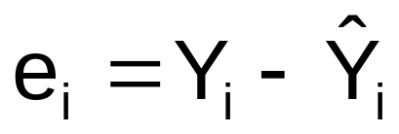
Residual Analysis
The residual for observation i, e_{i}, is the difference between its observed and predicted value
Check the assumptions of regression by examining the residuals
  Examine for linearity assumption
  Evaluate independence assumption
  Evaluate normal distribution assumption
  Examine for constant variance for all levels of X (homoscedasticity)
Graphical Analysis of Residuals
  Can plot residuals vs. X

Slide 38

Residual Analysis for Linearity
Y
Y
x
x
residuals
x
x
residuals
Not Linear
✓
Linear

Slide 39

Residual Analysis for Independence
Not Independent
✓
Independent
residuals
X
residuals
X
residuals
X

Slide 40
Residual Analysis for Normality
A normal probability plot of the residuals can be used to check for normality:
Percent
100
0
-3 -2 -1 0 1 2 3
Residual

Slide 41

Residual Analysis for
Equal Variance
Y
Y
x
x
residuals
x
x
residuals
✓
Non-constant variance
Constant variance

Slide 42
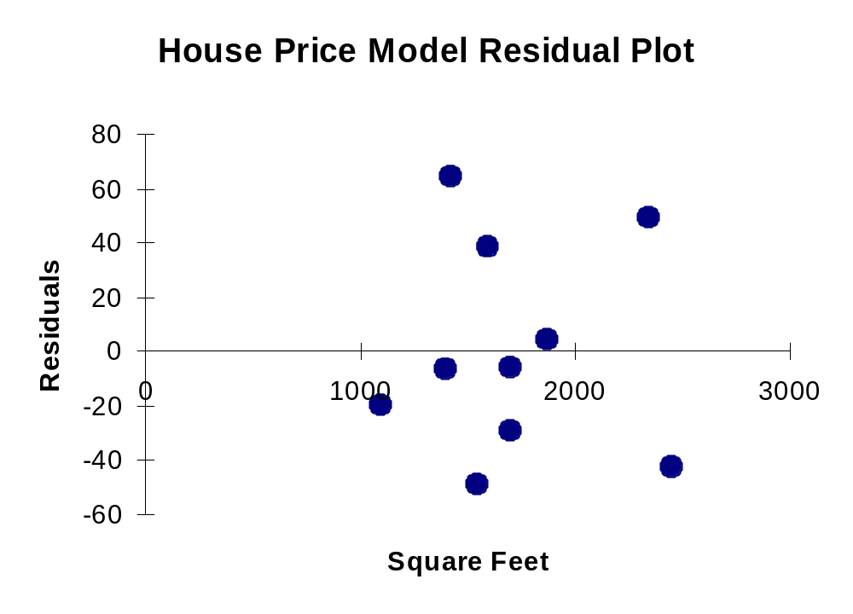
Excel Residual Output
RESIDUAL OUTPUT
 | Predicted House Price | Residuals
1 | 251.92316 | -6.923162
2 | 273.87671 | 38.12329
3 | 284.85348 | -5.853484
4 | 304.06284 | 3.937162
5 | 218.99284 | -19.99284
6 | 268.38832 | -49.38832
7 | 356.20251 | 48.79749
8 | 367.17929 | -43.17929
9 | 254.6674 | 64.33264
10 | 284.85348 | -29.85348
Does not appear to violate
any regression assumptions

Slide 43
Measuring Autocorrelation:
The Durbin-Watson Statistic
Used when data are collected over time to detect if autocorrelation is present
Autocorrelation exists if residuals in one time period are related to residuals in another period

Slide 44
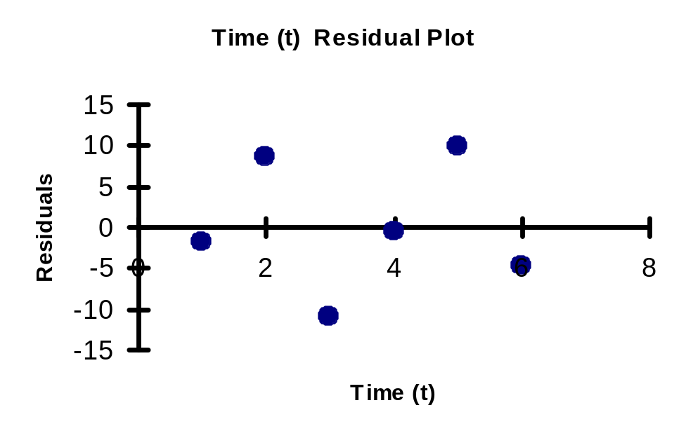
Autocorrelation
Autocorrelation is correlation of the errors (residuals) over time
Here, residuals show a cyclic pattern, not random. Cyclical patterns are a sign of positive autocorrelation
Violates the regression assumption that residuals are random and independent

Slide 45
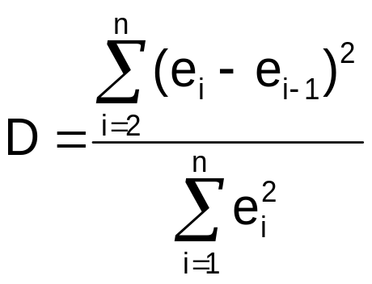
The Durbin-Watson Statistic
The Durbin-Watson statistic is used to test for autocorrelation
H₀: residuals are not correlated
H₁: positive autocorrelation is present
The possible range is 0 ≤ D ≤ 4
D should be close to 2 if H₀ is true
D less than 2 may signal positive autocorrelation, D greater than 2 may signal negative autocorrelation

Slide 46
Testing for Positive Autocorrelation
H₀: positive autocorrelation does not exist
H₁: positive autocorrelation is present
Calculate the Durbin-Watson test statistic = D
(The Durbin-Watson Statistic can be found using Excel or Minitab)
Find the values d_{L} and d_{U} from the Durbin-Watson table
(for sample size n and number of independent variables k)
Decision rule: reject H₀ if D < d_{L}
Reject H₀
Inconclusive
Do not reject H₀
0
d_{L}
d_{U}
2

Slide 47
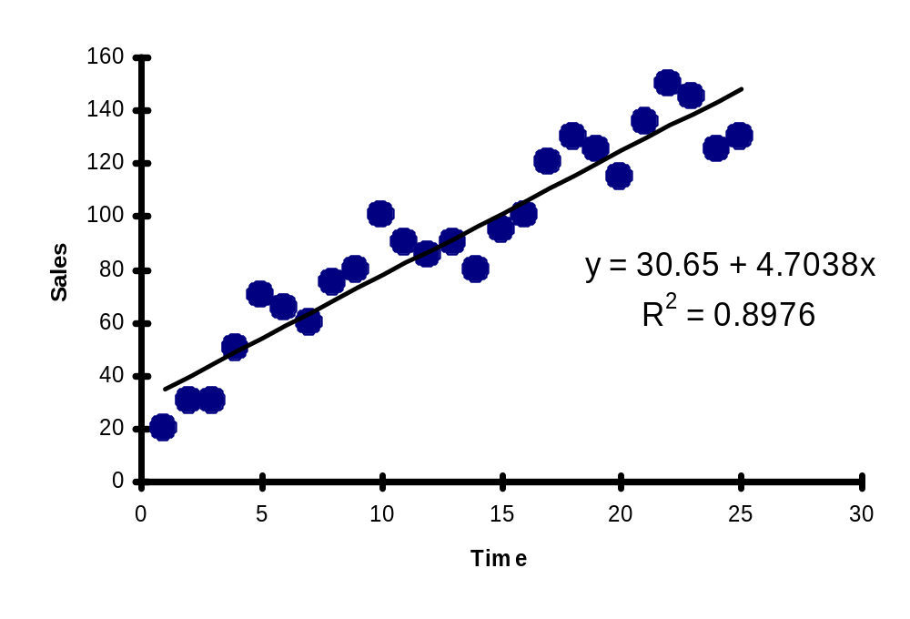
Testing for Positive Autocorrelation
(continued)
Suppose we have the following time series data:
Is there autocorrelation?

Slide 48
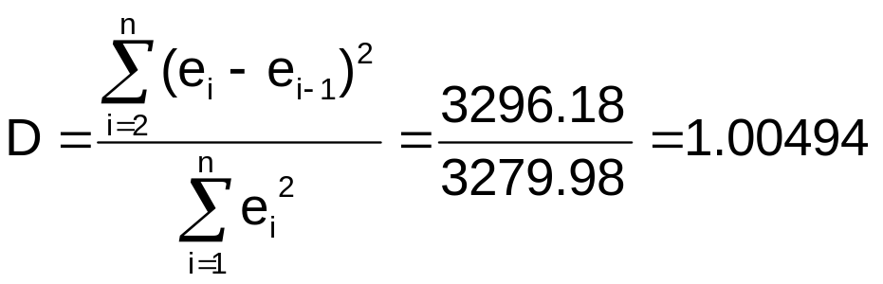
Testing for Positive Autocorrelation
(continued)
Example with n = 25:
Excel/PHStat output:
Durbin-Watson Calculations
Sum of Squared Difference of Residuals | 3296.18
Sum of Squared Residuals | 3279.98
Durbin-Watson Statistic | 1.00494

Slide 49
Testing for Positive Autocorrelation
(continued)
Here, n = 25 and there is k = 1 one independent variable
Using the Durbin-Watson table, d_{L} = 1.29 and d_{U} = 1.45
D = 1.00494 < d_{L} = 1.29, so reject H₀ and conclude that significant positive autocorrelation exists
Therefore the linear model is not the appropriate model to forecast sales
Decision: reject H₀ since
D = 1.00494 < d_{L}
Reject H₀
Inconclusive
Do not reject H₀
0
d_{L}=1.29
d_{U}=1.45
2

Slide 50
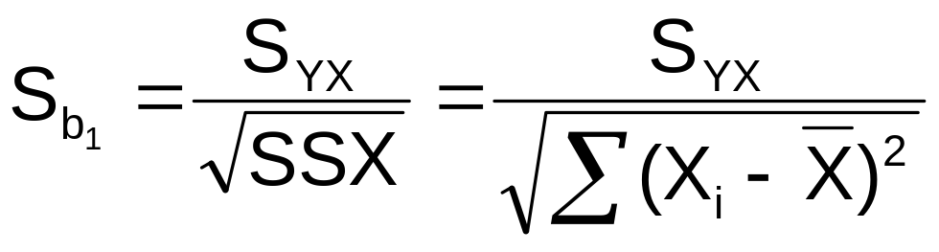
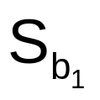
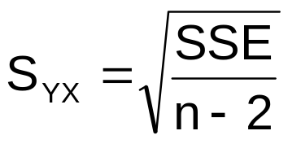
Inferences About the Slope
The standard error of the regression slope coefficient (b₁) is estimated by
where:
= Estimate of the standard error of the least squares slope
= Standard error of the estimate

Slide 51
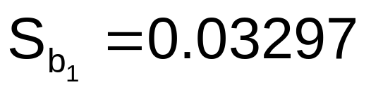
Excel Output
Regression Statistics
Multiple R | 0.76211
R Square | 0.58082
Adjusted R Square | 0.52842
Standard Error | 41.33032
Observations | 10
ANOVA | df | SS | MS | F | Significance F
Regression | 1 | 18934.9348 | 18934.9348 | 11.0848 | 0.01039
Residual | 8 | 13665.5652 | 1708.1957
Total | 9 | 32600.5000
 | Coefficients | Standard Error | t Stat | P-value | Lower 95% | Upper 95%
Intercept | 98.24833 | 58.03348 | 1.69296 | 0.12892 | -35.57720 | 232.07386
Square Feet | 0.10977 | 0.03297 | 3.32938 | 0.01039 | 0.03374 | 0.18580

Slide 52


Comparing Standard Errors of the Slope
is a measure of the variation in the slope of regression lines from different possible samples
Y
Y
X
X

Slide 53
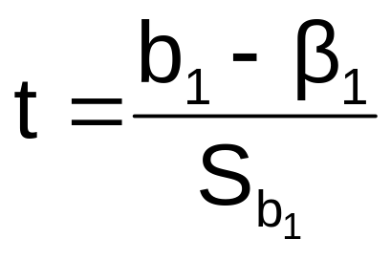

Inference about the Slope: t Test
t test for a population slope
  Is there a linear relationship between X and Y?
Null and alternative hypotheses
  H₀: β₁ = 0 (no linear relationship)
  H₁: β₁ ≠ 0 (linear relationship does exist)
Test statistic
where:
b₁ = regression slope
coefficient
β₁ = hypothesized slope
S_{b} = standard
error of the slope
1

Slide 54
Inference about the Slope: t Test
(continued)
Simple Linear Regression Equation:
House Price in $1000s (y) | Square Feet (x)
245 | 1400
312 | 1600
279 | 1700
308 | 1875
199 | 1100
219 | 1550
405 | 2350
324 | 2450
319 | 1425
255 | 1700
The slope of this model is 0.1098
Does square footage of the house affect its sales price?

Slide 55
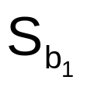
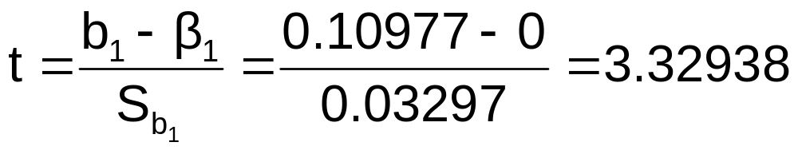
Inferences about the Slope: t Test Example
b₁
H₀: β₁ = 0
H₁: β₁ ≠ 0
From Excel output:
 | Coefficients | Standard Error | t Stat | P-value
Intercept | 98.24833 | 58.03348 | 1.69296 | 0.12892
Square Feet | 0.10977 | 0.03297 | 3.32938 | 0.01039
t

Slide 56
Inferences about the Slope: t Test Example
(continued)
Test Statistic: t = 3.329
b₁
t
H₀: β₁ = 0
H₁: β₁ ≠ 0
From Excel output:
 | Coefficients | Standard Error | t Stat | P-value
Intercept | 98.24833 | 58.03348 | 1.69296 | 0.12892
Square Feet | 0.10977 | 0.03297 | 3.32938 | 0.01039
d.f. = 10-2 = 8
Decision:
Conclusion:
Reject H₀
α/2=.025
α/2=.025
There is sufficient evidence that square footage affects house price
Reject H₀
Do not reject H₀
Reject H₀
-t_{α/2}
t_{α/2}
0
-2.3060
2.3060
3.329

Slide 57
Inferences about the Slope: t Test Example
(continued)
P-value = 0.01039
P-value
H₀: β₁ = 0
H₁: β₁ ≠ 0
From Excel output:
 | Coefficients | Standard Error | t Stat | P-value
Intercept | 98.24833 | 58.03348 | 1.69296 | 0.12892
Square Feet | 0.10977 | 0.03297 | 3.32938 | 0.01039
This is a two-tail test, so the p-value is
P(t > 3.329)+P(t < -3.329) = 0.01039
(for 8 d.f.)
Decision: P-value < α so
Conclusion:
Reject H₀
There is sufficient evidence that square footage affects house price

Slide 58
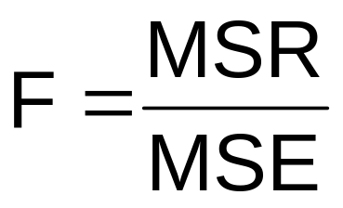
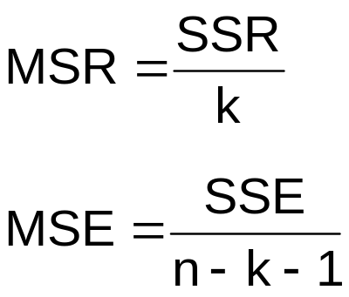
F Test for Significance
F Test statistic:
where
where F follows an F distribution with k numerator and (n – k - 1) denominator degrees of freedom
(k = the number of independent variables in the regression model)

Slide 59
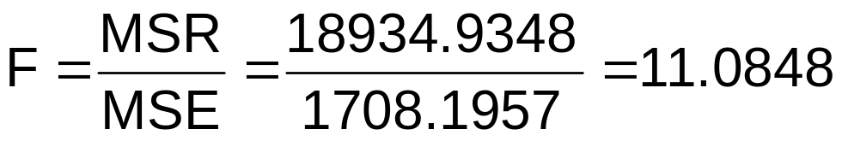
Excel Output
Regression Statistics
Multiple R | 0.76211
R Square | 0.58082
Adjusted R Square | 0.52842
Standard Error | 41.33032
Observations | 10
ANOVA | df | SS | MS | F | Significance F
Regression | 1 | 18934.9348 | 18934.9348 | 11.0848 | 0.01039
Residual | 8 | 13665.5652 | 1708.1957
Total | 9 | 32600.5000
 | Coefficients | Standard Error | t Stat | P-value | Lower 95% | Upper 95%
Intercept | 98.24833 | 58.03348 | 1.69296 | 0.12892 | -35.57720 | 232.07386
Square Feet | 0.10977 | 0.03297 | 3.32938 | 0.01039 | 0.03374 | 0.18580
With 1 and 8 degrees of freedom
P-value for the F Test

Slide 60
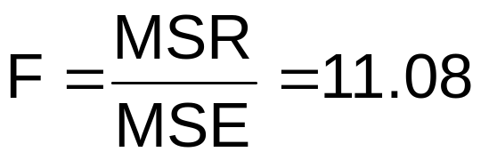
F Test for Significance
(continued)
H₀: β₁ = 0
H₁: β₁ ≠ 0
α = .05
df₁= 1 df₂ = 8
Test Statistic:
Decision:
Conclusion:
Critical Value:
F_{α} = 5.32
Reject H₀ at α = 0.05
α = .05
There is sufficient evidence that house size affects selling price
0
F
Do not
reject H₀
Reject H₀
F_{.05} = 5.32

Slide 61
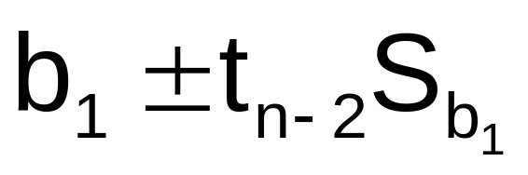
Confidence Interval Estimate for the Slope
Confidence Interval Estimate of the Slope:
d.f. = n - 2
Excel Printout for House Prices:
 | Coefficients | Standard Error | t Stat | P-value | Lower 95% | Upper 95%
Intercept | 98.24833 | 58.03348 | 1.69296 | 0.12892 | -35.57720 | 232.07386
Square Feet | 0.10977 | 0.03297 | 3.32938 | 0.01039 | 0.03374 | 0.18580
At 95% level of confidence, the confidence interval for the slope is (0.0337, 0.1858)

Slide 62
Confidence Interval Estimate for the Slope
(continued)
 | Coefficients | Standard Error | t Stat | P-value | Lower 95% | Upper 95%
Intercept | 98.24833 | 58.03348 | 1.69296 | 0.12892 | -35.57720 | 232.07386
Square Feet | 0.10977 | 0.03297 | 3.32938 | 0.01039 | 0.03374 | 0.18580
Since the units of the house price variable is $1000s, we are 95% confident that the average impact on sales price is between $33.70 and $185.80 per square foot of house size
This 95% confidence interval does not include 0.
Conclusion: There is a significant relationship between house price and square feet at the .05 level of significance

Slide 63
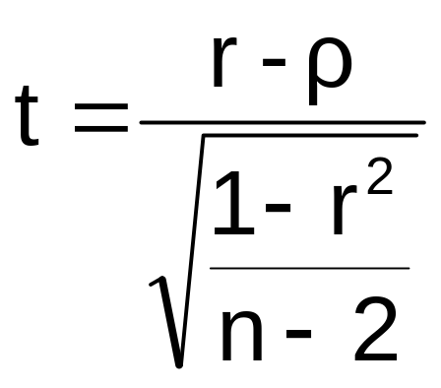
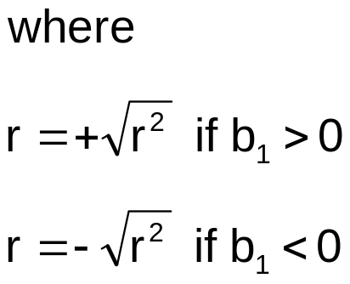
t Test for a Correlation Coefficient
Hypotheses
  H₀: ρ = 0 (no correlation between X and Y)
  H₁: ρ ≠ 0 (correlation exists)
Test statistic
  (with n – 2 degrees of freedom)

Slide 64
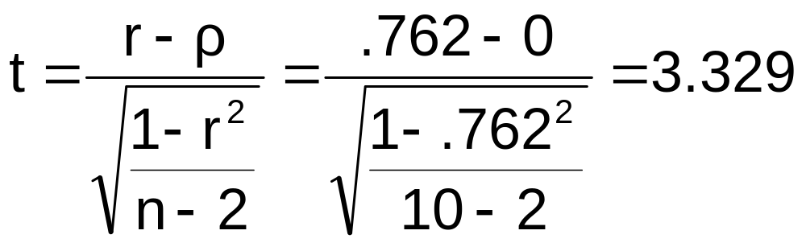
Example: House Prices
Is there evidence of a linear relationship between square feet and house price at the .05 level of significance?
H₀: ρ = 0 (No correlation)
H₁: ρ ≠ 0 (correlation exists)
α =.05 , df = 10 - 2 = 8

Slide 65
Example: Test Solution
Decision:
Reject H₀
Conclusion:
There is evidence of a linear association at the 5% level of significance
d.f. = 10-2 = 8
α/2=.025
α/2=.025
Reject H₀
-t_{α/2}
Do not reject H₀
t_{α/2}
Reject H₀
0
-2.3060
2.3060
3.329

Slide 66
Estimating Mean Values and Predicting Individual Values
Goal: Form intervals around Y to express uncertainty about the value of Y for a given X_{i}
Confidence Interval for the mean of Y, given X_{i}
Y
∧
Y
∧
Y = b₀+b₁X_{i}
Prediction Interval for an individual Y, given X_{i}
X_{i}
X

Slide 67
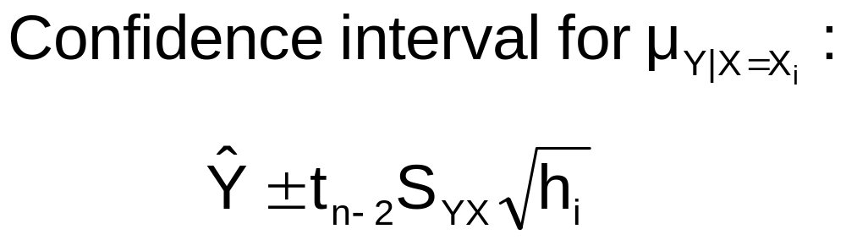
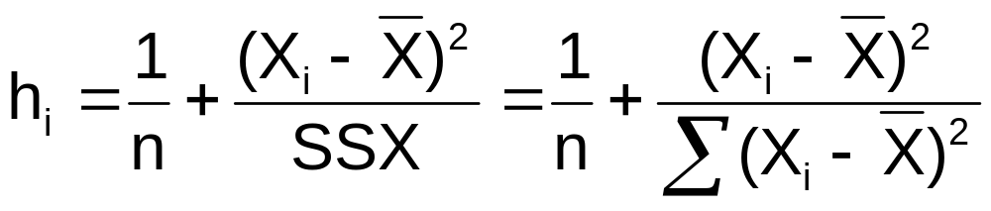
Confidence Interval for the Average Y, Given X
Confidence interval estimate for the
mean value of Y given a particular X_{i}
Size of interval varies according to distance away from mean, X

Slide 68
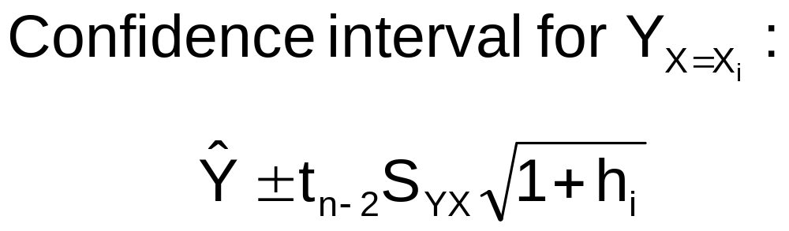
Prediction Interval for an Individual Y, Given X
Confidence interval estimate for an
Individual value of Y given a particular X_{i}
This extra term adds to the interval width to reflect the added uncertainty for an individual case

Slide 69
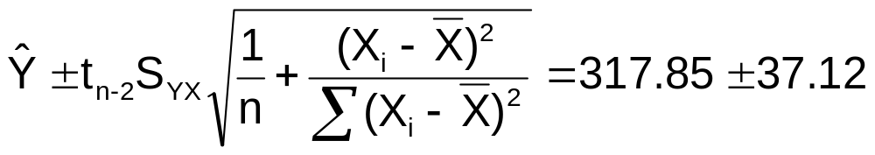
Estimation of Mean Values: Example
Confidence Interval Estimate for μ_{Y|X=X}
i
Find the 95% confidence interval for the mean price of 2,000 square-foot houses
∧
Predicted Price Y_{i} = 317.85 ($1,000s)
The confidence interval endpoints are 280.66 and 354.90, or from $280,660 to $354,900

Slide 70
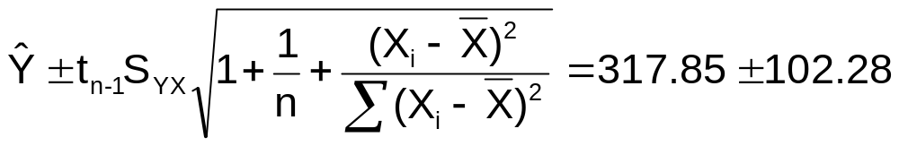
Estimation of Individual Values: Example
Prediction Interval Estimate for Y_{X=X}
i
Find the 95% prediction interval for an individual house with 2,000 square feet
∧
Predicted Price Y_{i} = 317.85 ($1,000s)
The prediction interval endpoints are 215.50 and 420.07, or from $215,500 to $420,070

Slide 71
Finding Confidence and
Prediction Intervals in Excel
In Excel, use
PHStat | regression | simple linear regression …
  Check the
  “confidence and prediction interval for X=”
  box and enter the X-value and confidence level desired

Slide 72
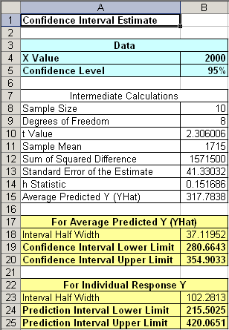
Finding Confidence and
Prediction Intervals in Excel
(continued)
Input values
∧
Y
Confidence Interval Estimate for μ_{Y|X=Xi}
Prediction Interval Estimate for Y_{X=Xi}

Slide 73
Pitfalls of Regression Analysis
Lacking an awareness of the assumptions underlying least-squares regression
Not knowing how to evaluate the assumptions
Not knowing the alternatives to least-squares regression if a particular assumption is violated
Using a regression model without knowledge of the subject matter
Extrapolating outside the relevant range

Slide 74
Strategies for Avoiding the Pitfalls of Regression
Start with a scatter diagram of X vs. Y to observe possible relationship
Perform residual analysis to check the assumptions
  Plot the residuals vs. X to check for violations of assumptions such as homoscedasticity
  Use a histogram, stem-and-leaf display, box-and-whisker plot, or normal probability plot of the residuals to uncover possible non-normality

Slide 75
Strategies for Avoiding the Pitfalls of Regression
(continued)
If there is violation of any assumption, use alternative methods or models
If there is no evidence of assumption violation, then test for the significance of the regression coefficients and construct confidence intervals and prediction intervals
Avoid making predictions or forecasts outside the relevant range

Slide 76
Chapter Summary
Introduced types of regression models
Reviewed assumptions of regression and correlation
Discussed determining the simple linear regression equation
Described measures of variation
Discussed residual analysis
Addressed measuring autocorrelation

Slide 77
Chapter Summary
(continued)
Described inference about the slope
Discussed correlation -- measuring the strength of the association
Addressed estimation of mean values and prediction of individual values
Discussed possible pitfalls in regression and recommended strategies to avoid them

