Slide 1
Business Statistics, A First Course
4th Edition
Chapter 13
Multiple Regression

Slide 2
Learning Objectives
In this chapter, you learn:
How to develop a multiple regression model
How to interpret the regression coefficients
How to determine which independent variables to include in the regression model
How to use categorical variables in a regression model
How to use quadratic terms in a regression model

Slide 3
The Multiple Regression Model
Idea: Examine the linear relationship between
1 dependent (Y) & 2 or more independent variables (X_{i})
Multiple Regression Model with k Independent Variables:
Y-intercept
Population slopes
Random Error

Slide 4
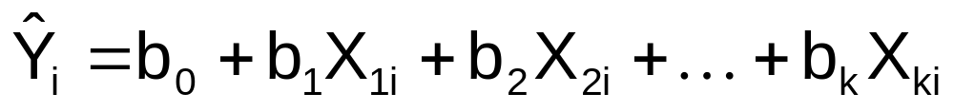
Multiple Regression Equation
The coefficients of the multiple regression model are estimated using sample data
Multiple regression equation with k independent variables:
Estimated
(or predicted)
value of Y
Estimated
intercept
Estimated slope coefficients
In this chapter we will always use Excel to obtain the regression slope coefficients and other regression summary measures.

Slide 5
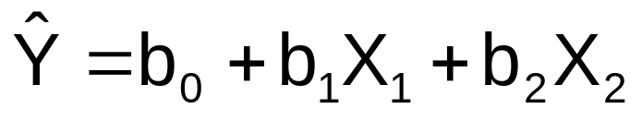
Multiple Regression Equation
(continued)
Two variable model
Y
Slope for variable X₁
X₂
Slope for variable X₂
X₁

Slide 6

Example:
2 Independent Variables
A distributor of frozen desert pies wants to evaluate factors thought to influence demand
  Dependent variable: Pie sales (units per week)
  Independent variables: Price (in $)
    Advertising ($100’s)
Data are collected for 15 weeks

Slide 7
Pie Sales Example
Week | Pie Sales | Price ($) | Advertising ($100s)
1 | 350 | 5.50 | 3.3
2 | 460 | 7.50 | 3.3
3 | 350 | 8.00 | 3.0
4 | 430 | 8.00 | 4.5
5 | 350 | 6.80 | 3.0
6 | 380 | 7.50 | 4.0
7 | 430 | 4.50 | 3.0
8 | 470 | 6.40 | 3.7
9 | 450 | 7.00 | 3.5
10 | 490 | 5.00 | 4.0
11 | 340 | 7.20 | 3.5
12 | 300 | 7.90 | 3.2
13 | 440 | 5.90 | 4.0
14 | 450 | 5.00 | 3.5
15 | 300 | 7.00 | 2.7
Multiple regression equation:
Sales = b₀ + b₁ (Price)
+ b₂ (Advertising)

Slide 8
Multiple Regression Output
Regression Statistics
Multiple R | 0.72213
R Square | 0.52148
Adjusted R Square | 0.44172
Standard Error | 47.46341
Observations | 15
ANOVA | df | SS | MS | F | Significance F
Regression | 2 | 29460.027 | 14730.013 | 6.53861 | 0.01201
Residual | 12 | 27033.306 | 2252.776
Total | 14 | 56493.333
 | Coefficients | Standard Error | t Stat | P-value | Lower 95% | Upper 95%
Intercept | 306.52619 | 114.25389 | 2.68285 | 0.01993 | 57.58835 | 555.46404
Price | -24.97509 | 10.83213 | -2.30565 | 0.03979 | -48.57626 | -1.37392
Advertising | 74.13096 | 25.96732 | 2.85478 | 0.01449 | 17.55303 | 130.70888

Slide 9
The Multiple Regression Equation
where
Sales is in number of pies per week
Price is in $
Advertising is in $100’s.
b₁ = -24.975: sales will decrease, on average, by 24.975 pies per week for each $1 increase in selling price, net of the effects of changes due to advertising
b₂ = 74.131: sales will increase, on average, by 74.131 pies per week for each $100 increase in advertising, net of the effects of changes due to price

Slide 10
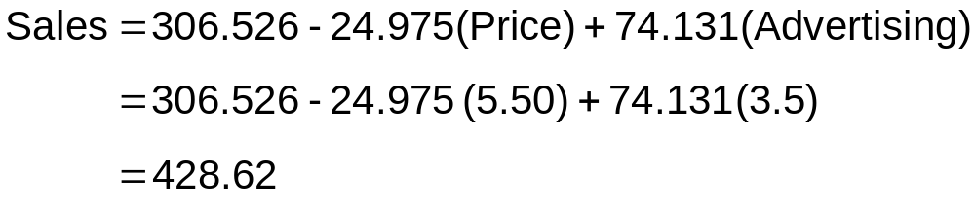
Using The Equation to Make Predictions
Predict sales for a week in which the selling price is $5.50 and advertising is $350:
Note that Advertising is in $100’s, so $350 means that X₂ = 3.5
Predicted sales is 428.62 pies

Slide 11
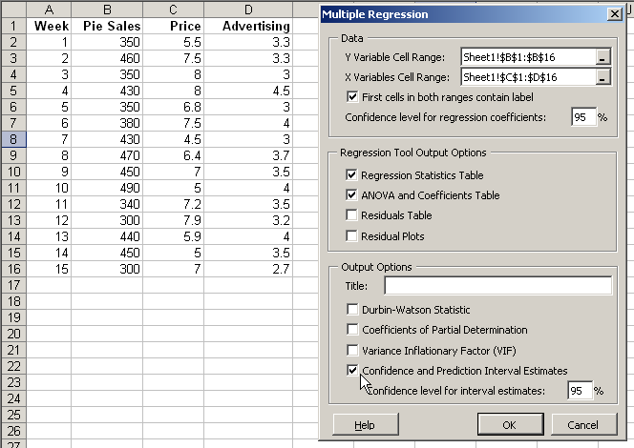
Predictions in Excel using PHStat
PHStat | regression | multiple regression …
Check the “confidence and prediction interval estimates” box

Slide 12
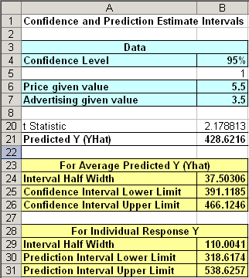
Predictions in PHStat
(continued)
Input values
<
Predicted Y value
Confidence interval for the mean Y value, given these X’s
<
Prediction interval for an individual Y value, given these X’s
<

Slide 13
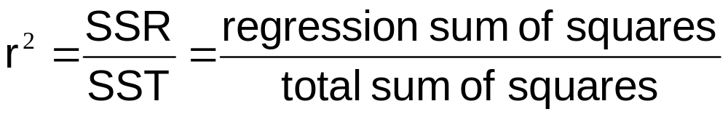
Coefficient of
Multiple Determination
Reports the proportion of total variation in Y explained by all X variables taken together

Slide 14
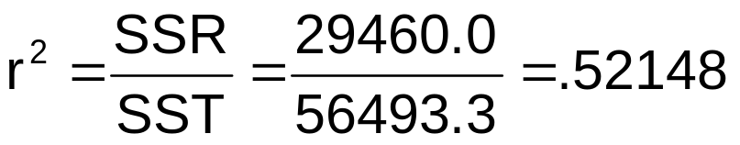
Multiple Coefficient of
Determination
(continued)
Regression Statistics
Multiple R | 0.72213
R Square | 0.52148
Adjusted R Square | 0.44172
Standard Error | 47.46341
Observations | 15
ANOVA | df | SS | MS | F | Significance F
Regression | 2 | 29460.027 | 14730.013 | 6.53861 | 0.01201
Residual | 12 | 27033.306 | 2252.776
Total | 14 | 56493.333
 | Coefficients | Standard Error | t Stat | P-value | Lower 95% | Upper 95%
Intercept | 306.52619 | 114.25389 | 2.68285 | 0.01993 | 57.58835 | 555.46404
Price | -24.97509 | 10.83213 | -2.30565 | 0.03979 | -48.57626 | -1.37392
Advertising | 74.13096 | 25.96732 | 2.85478 | 0.01449 | 17.55303 | 130.70888
52.1% of the variation in pie sales is explained by the variation in price and advertising

Slide 15
Adjusted r²
r² never decreases when a new X variable is added to the model
  This can be a disadvantage when comparing models
What is the net effect of adding a new variable?
  We lose a degree of freedom when a new X variable is added
  Did the new X variable add enough explanatory power to offset the loss of one degree of freedom?

Slide 16
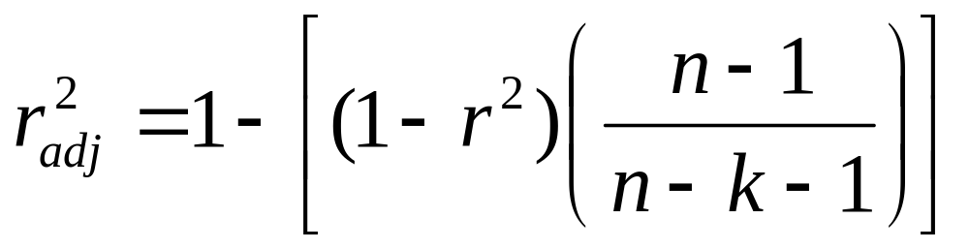
Adjusted r²
(continued)
Shows the proportion of variation in Y explained by all X variables adjusted for the number of X variables used
  (where n = sample size, k = number of independent variables)
  Penalize excessive use of unimportant independent variables
  Smaller than r²
  Useful in comparing among models

Slide 17
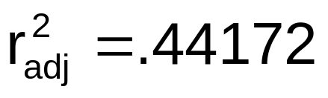
Adjusted r²
(continued)
Regression Statistics
Multiple R | 0.72213
R Square | 0.52148
Adjusted R Square | 0.44172
Standard Error | 47.46341
Observations | 15
ANOVA | df | SS | MS | F | Significance F
Regression | 2 | 29460.027 | 14730.013 | 6.53861 | 0.01201
Residual | 12 | 27033.306 | 2252.776
Total | 14 | 56493.333
 | Coefficients | Standard Error | t Stat | P-value | Lower 95% | Upper 95%
Intercept | 306.52619 | 114.25389 | 2.68285 | 0.01993 | 57.58835 | 555.46404
Price | -24.97509 | 10.83213 | -2.30565 | 0.03979 | -48.57626 | -1.37392
Advertising | 74.13096 | 25.96732 | 2.85478 | 0.01449 | 17.55303 | 130.70888
44.2% of the variation in pie sales is explained by the variation in price and advertising, taking into account the sample size and number of independent variables

Slide 18
Is the Model Significant?
F Test for Overall Significance of the Model
Shows if there is a linear relationship between all of the X variables considered together and Y
Use F-test statistic
Hypotheses:
  H₀: β₁ = β₂ = … = β_{k} = 0 (no linear relationship)
  H₁: at least one β_{i} ≠ 0 (at least one independent
  variable affects Y)

Slide 19
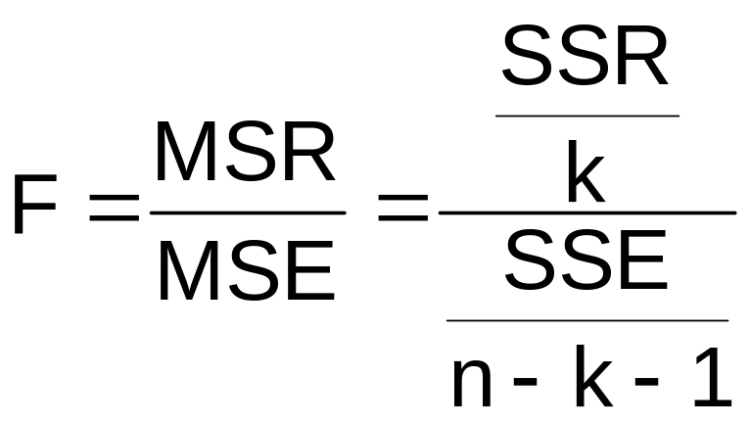
F Test for Overall Significance
Test statistic:
where F has (numerator) = k and
(denominator) = (n – k - 1)
degrees of freedom

Slide 20
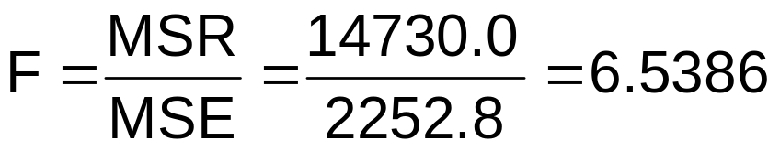
F Test for Overall Significance
(continued)
Regression Statistics
Multiple R | 0.72213
R Square | 0.52148
Adjusted R Square | 0.44172
Standard Error | 47.46341
Observations | 15
ANOVA | df | SS | MS | F | Significance F
Regression | 2 | 29460.027 | 14730.013 | 6.53861 | 0.01201
Residual | 12 | 27033.306 | 2252.776
Total | 14 | 56493.333
 | Coefficients | Standard Error | t Stat | P-value | Lower 95% | Upper 95%
Intercept | 306.52619 | 114.25389 | 2.68285 | 0.01993 | 57.58835 | 555.46404
Price | -24.97509 | 10.83213 | -2.30565 | 0.03979 | -48.57626 | -1.37392
Advertising | 74.13096 | 25.96732 | 2.85478 | 0.01449 | 17.55303 | 130.70888
With 2 and 12 degrees of freedom
P-value for the F Test

Slide 21
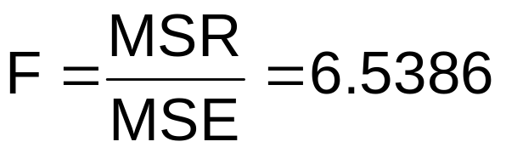
F Test for Overall Significance
(continued)
H₀: β₁ = β₂ = 0
H₁: β₁ and β₂ not both zero
α = .05
df₁= 2 df₂ = 12
Test Statistic:
Decision:
Conclusion:
Critical Value:
F_{α} = 3.885
Since F test statistic is in the rejection region (p-value < .05), reject H₀
α = .05
0
F
There is evidence that at least one independent variable affects Y
Do not
reject H₀
Reject H₀
F_{.05} = 3.885

Slide 22
Residuals in Multiple Regression
Two variable model
Y
Sample observation
Y_{i}
Residual = e_{i} = (Y_{i} – Y_{i})
<
<
Y_{i}
x_{2i}
X₂
x_{1i}
<
The best fit equation, Y ,
is found by minimizing the
sum of squared errors, Σe²
X₁

Slide 23
Multiple Regression Assumptions
Errors (residuals) from the regression model:
<
e_{i} = (Y_{i} – Y_{i})
Assumptions:
The errors are normally distributed
Errors have a constant variance
The model errors are independent

Slide 24
Residual Plots Used in Multiple Regression
These residual plots are used in multiple regression:
  Residuals vs. Y_{i}
  Residuals vs. X_{1i}
  Residuals vs. X_{2i}
  Residuals vs. time (if time series data)
<
Use the residual plots to check for violations of regression assumptions

Slide 25
Are Individual Variables Significant?
Use t tests of individual variable slopes
Shows if there is a linear relationship between the variable X_{j} and Y
Hypotheses:
  H₀: β_{j} = 0 (no linear relationship)
  H₁: β_{j} ≠ 0 (linear relationship does exist
  between X_{j} and Y)

Slide 26
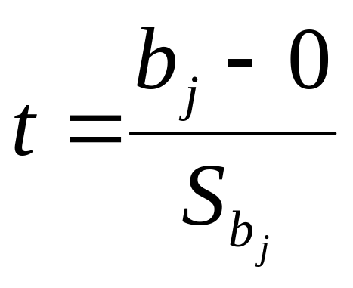
Are Individual Variables Significant?
(continued)
  H₀: β_{j} = 0 (no linear relationship)
  H₁: β_{j} ≠ 0 (linear relationship does exist
  between x_{j} and y)
  Test Statistic:
  (df = n – k – 1)

Slide 27
Are Individual Variables Significant?
(continued)
Regression Statistics
Multiple R | 0.72213
R Square | 0.52148
Adjusted R Square | 0.44172
Standard Error | 47.46341
Observations | 15
ANOVA | df | SS | MS | F | Significance F
Regression | 2 | 29460.027 | 14730.013 | 6.53861 | 0.01201
Residual | 12 | 27033.306 | 2252.776
Total | 14 | 56493.333
 | Coefficients | Standard Error | t Stat | P-value | Lower 95% | Upper 95%
Intercept | 306.52619 | 114.25389 | 2.68285 | 0.01993 | 57.58835 | 555.46404
Price | -24.97509 | 10.83213 | -2.30565 | 0.03979 | -48.57626 | -1.37392
Advertising | 74.13096 | 25.96732 | 2.85478 | 0.01449 | 17.55303 | 130.70888
t-value for Price is t = -2.306, with p-value .0398
t-value for Advertising is t = 2.855, with p-value .0145

Slide 28
Inferences about the Slope: t Test Example
From Excel output:
H₀: β_{i} = 0
H₁: β_{i} ≠ 0
 | Coefficients | Standard Error | t Stat | P-value
Price | -24.97509 | 10.83213 | -2.30565 | 0.03979
Advertising | 74.13096 | 25.96732 | 2.85478 | 0.01449
d.f. = 15-2-1 = 12
= .05
t_{α/2} = 2.1788
The test statistic for each variable falls in the rejection region (p-values < .05)
Decision:
Conclusion:
α/2=.025
α/2=.025
Reject H₀ for each variable
There is evidence that both Price and Advertising affect pie sales at α = .05
Reject H₀
Do not reject H₀
Reject H₀
-t_{α/2}
t_{α/2}
0
-2.1788
2.1788

Slide 29
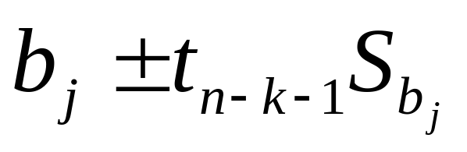
Confidence Interval Estimate for the Slope
Confidence interval for the population slope β_{j}
where t has
(n – k – 1) d.f.
 | Coefficients | Standard Error
Intercept | 306.52619 | 114.25389
Price | -24.97509 | 10.83213
Advertising | 74.13096 | 25.96732
Here, t has
(15 – 2 – 1) = 12 d.f.
Example: Form a 95% confidence interval for the effect of changes in price (X₁) on pie sales:
-24.975 ± (2.1788)(10.832)
So the interval is (-48.576 , -1.374)
(This interval does not contain zero, so price has a significant effect on sales)

Slide 30
Confidence Interval Estimate for the Slope
(continued)
Confidence interval for the population slope β_{i}
 | Coefficients | Standard Error | … | Lower 95% | Upper 95%
Intercept | 306.52619 | 114.25389 | … | 57.58835 | 555.46404
Price | -24.97509 | 10.83213 | … | -48.57626 | -1.37392
Advertising | 74.13096 | 25.96732 | … | 17.55303 | 130.70888
Example: Excel output also reports these interval endpoints:
Weekly sales are estimated to be reduced by between 1.37 to 48.58 pies for each increase of $1 in the selling price

Slide 31
Using Dummy Variables
A dummy variable is a categorical explanatory variable with two levels:
  yes or no, on or off, male or female
  coded as 0 or 1
Regression intercepts are different if the variable is significant
Assumes equal slopes for other variables

Slide 32
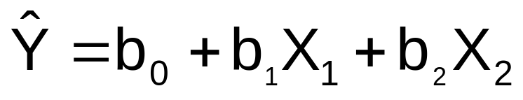
Dummy-Variable Example
Let:
Y = pie sales
X₁ = price
X₂ = holiday (X₂ = 1 if a holiday occurred during the week) (X₂ = 0 if there was no holiday that week)

Slide 33
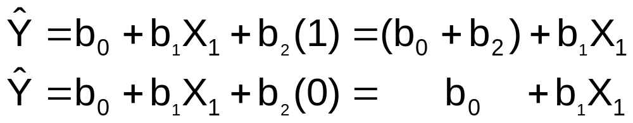
Dummy-Variable Example
(continued)
Holiday
No Holiday
Different intercept
Same slope
Y (sales)
If H₀: β₂ = 0 is rejected, then
“Holiday” has a significant effect on pie sales
b₀ + b₂
b₀
Holiday (X₂ = 1)
No Holiday (X₂ = 0)
X₁ (Price)

Slide 34
Interpreting the Dummy Variable Coefficient
Example:
Sales: number of pies sold per week
Price: pie price in $
Holiday:
1 If a holiday occurred during the week
0 If no holiday occurred
b₂ = 15: on average, sales were 15 pies greater in weeks with a holiday than in weeks without a holiday, given the same price

Slide 35
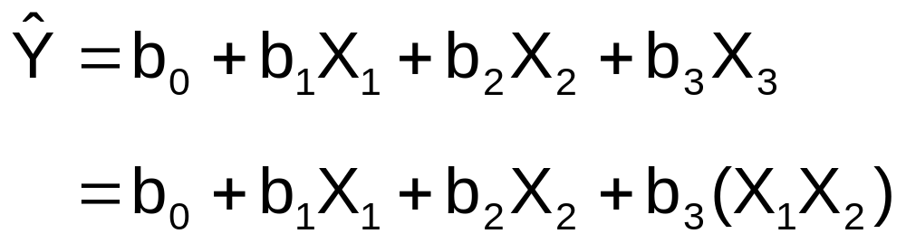
Interaction Between Independent Variables
Hypothesizes interaction between pairs of X variables
  Response to one X variable may vary at different levels of another X variable
Contains cross-product term

Slide 36
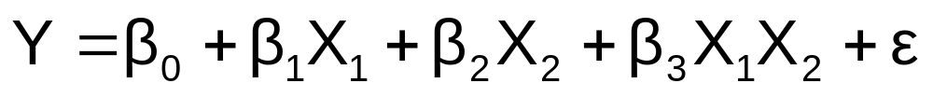
Effect of Interaction
Given:
Without interaction term, effect of X₁ on Y is measured by β₁
With interaction term, effect of X₁ on Y is measured by β₁ + β₃ X₂
Effect changes as X₂ changes

Slide 37

Interaction Example
Suppose X₂ is a dummy variable and the estimated regression equation is
= 1 + 2X₁ + 3X₂ + 4X₁X₂
Y
12
X₂ = 1:
Y = 1 + 2X₁ + 3(1) + 4X₁(1) = 4 + 6X₁
8
4
X₂ = 0:
Y = 1 + 2X₁ + 3(0) + 4X₁(0) = 1 + 2X₁
0
X₁
0
0.5
1
1.5
Slopes are different if the effect of X₁ on Y depends on X₂ value

Slide 38
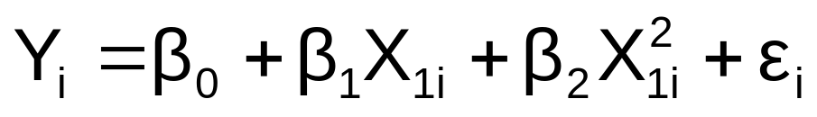
Nonlinear Relationships
The relationship between the dependent variable and an independent variable may not be linear
Can review the scatter diagram to check for non-linear relationships
Example: Quadratic model
  The second independent variable is the square of the first variable

Slide 39

Quadratic Regression Model
Model form:
where:
β₀ = Y intercept
β₁ = regression coefficient for linear effect of X on Y
β₂ = regression coefficient for quadratic effect on Y
ε_{i} = random error in Y for observation i

Slide 40

Linear vs. Nonlinear Fit
Y
Y
X
X
residuals
X
X
residuals
Linear fit does not give random residuals
Nonlinear fit gives random residuals
✓

Slide 41
Quadratic Regression Model
Quadratic models may be considered when the scatter diagram takes on one of the following shapes:
Y
Y
Y
Y
X₁
X₁
X₁
X₁
β₁ < 0
β₁ > 0
β₁ < 0
β₁ > 0
β₂ > 0
β₂ > 0
β₂ < 0
β₂ < 0
β₁ = the coefficient of the linear term
β₂ = the coefficient of the squared term

Slide 42
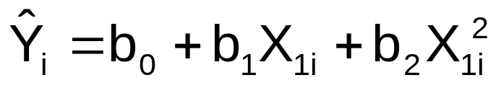

Testing the Overall
Quadratic Model
Estimate the quadratic model to obtain the regression equation:
Test for Overall Relationship
  H₀: β₁ = β₂ = 0 (no overall relationship between X and Y)
  H₁: β₁ and/or β₂ ≠ 0 (there is a relationship between X and Y)
  F-test statistic =

Slide 43
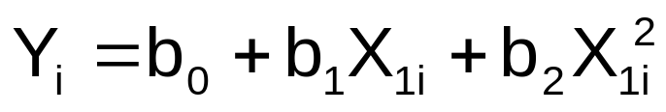
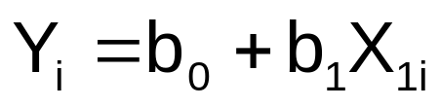
Testing for Significance: Quadratic Effect
Testing the Quadratic Effect
  Compare quadratic regression equation
with the linear regression equation

Slide 44
Testing for Significance: Quadratic Effect
(continued)
Testing the Quadratic Effect
  Consider the quadratic regression equation
Hypotheses
    (The quadratic term does not improve the model)
    (The quadratic term improves the model)
H₀: β₂ = 0
H₁: β₂ ≠ 0

Slide 45
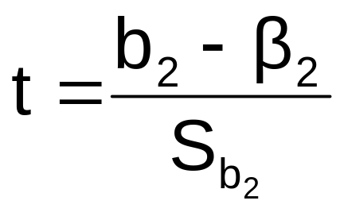

Testing for Significance: Quadratic Effect
(continued)
Testing the Quadratic Effect
Hypotheses
    (The quadratic term does not improve the model)
    (The quadratic term improves the model)
The test statistic is
H₀: β₂ = 0
H₁: β₂ ≠ 0
where:
b₂ = squared term slope
coefficient
β₂ = hypothesized slope (zero)
S_{b} = standard error of the slope
2

Slide 46
Testing for Significance: Quadratic Effect
(continued)
Testing the Quadratic Effect
Compare r² from simple regression to
adjusted r² from the quadratic model
If adj. r² from the quadratic model is larger than the r² from the simple model, then the quadratic model is a better model

Slide 47
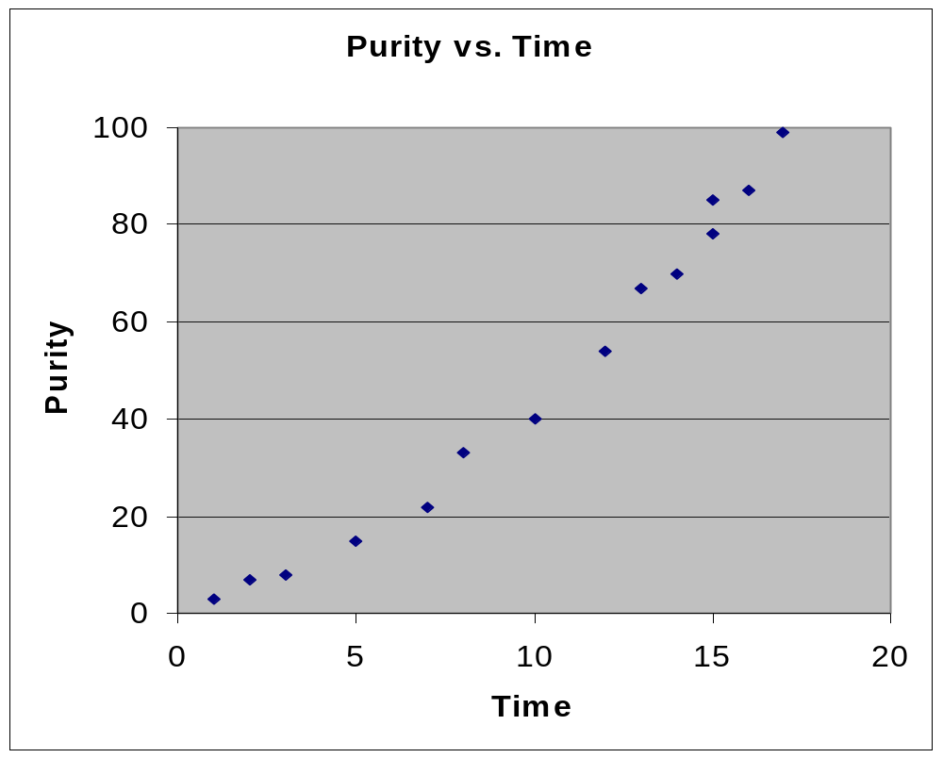
Example: Quadratic Model
Purity | Filter Time
3 | 1
7 | 2
8 | 3
15 | 5
22 | 7
33 | 8
40 | 10
54 | 12
67 | 13
70 | 14
78 | 15
85 | 15
87 | 16
99 | 17
Purity increases as filter time increases:

Slide 48
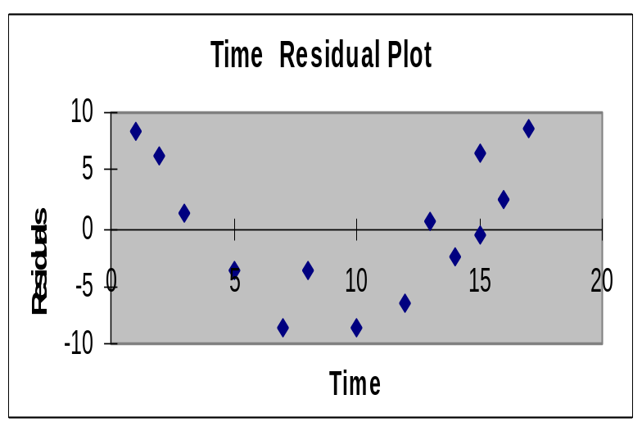
Example: Quadratic Model
(continued)
Simple regression results:
Y = -11.283 + 5.985 Time
^
 | Coefficients | Standard Error | t Stat | P-value
Intercept | -11.28267 | 3.46805 | -3.25332 | 0.00691
Time | 5.98520 | 0.30966 | 19.32819 | 2.078E-10
t statistic, F statistic, and r² are all high, but the residuals are not random:
Regression Statistics
R Square | 0.96888
Adjusted R Square | 0.96628
Standard Error | 6.15997
F | Significance F
373.57904 | 2.0778E-10

Slide 49
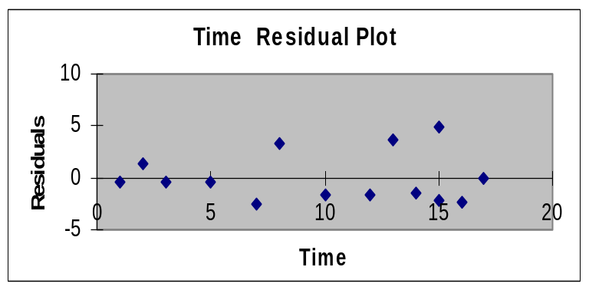
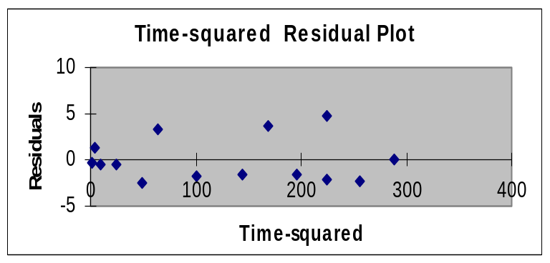
Example: Quadratic Model
(continued)
Quadratic regression results:
Y = 1.539 + 1.565 Time + 0.245 (Time)²
^
 | Coefficients | Standard Error | t Stat | P-value
Intercept | 1.53870 | 2.24465 | 0.68550 | 0.50722
Time | 1.56496 | 0.60179 | 2.60052 | 0.02467
Time-squared | 0.24516 | 0.03258 | 7.52406 | 1.165E-05
Regression Statistics
R Square | 0.99494
Adjusted R Square | 0.99402
Standard Error | 2.59513
F | Significance F
1080.7330 | 2.368E-13
The quadratic term is significant and improves the model: adj. r² is higher and S_{YX} is lower, residuals are now random

Slide 50
Chapter Summary
Developed the multiple regression model
Tested the significance of the multiple regression model
Discussed adjusted r²
Discussed using residual plots to check model assumptions
Tested individual regression coefficients
Used dummy variables
Evaluated interaction effects
Developed the quadratic regression model

