Slide 1
Business Statistics, A First Course
4th Edition
Chapter 14
Statistical Applications in Quality and Productivity Management

Slide 2
Learning Objectives
In this chapter, you learn:
The basic themes of quality management and Deming’s 14 points
The basic aspects of Six Sigma Management
How to construct various control charts
Which control charts to use for a particular type of data

Slide 3
Chapter Overview
Quality Management and Tools for Improvement
Philosophy of Quality
Tools for Quality Improvement
Deming’s 14 Points
Control Charts
Six Sigma® Management
p chart
R chart
X chart

Slide 4
Total Quality Management
Primary focus is on process improvement
Most variation in a process is due to the system, not the individual
Teamwork is integral to quality management
Customer satisfaction is a primary goal
Organization transformation is necessary
Fear must be removed from organizations
Higher quality costs less, not more

Slide 5
Deming’s 14 Points
1. Create a constancy of purpose toward improvement
  become more competitive, stay in business, and provide jobs
2. Adopt the new philosophy
  Better to improve now than to react to problems later
3. Stop depending on inspection to achieve quality -- build in quality from the start
  Inspection to find defects at the end of production is too late
4. Stop awarding contracts on the basis of low bids
  Better to build long-run purchaser/supplier relationships

Slide 6
Deming’s 14 Points
(continued)
5. Improve the system continuously to improve quality and thus constantly reduce costs
6. Institute training on the job
  Workers and managers must know the difference between common cause and special cause variation
7. Institute leadership
  Know the difference between leadership and supervision
8. Drive out fear so that everyone may work effectively.
9. Break down barriers between departments so that people can work as a team.

Slide 7
Deming’s 14 Points
(continued)
10. Eliminate slogans and targets for the workforce
  They can create adversarial relationships
11. Eliminate quotas and management by numerical goals
12. Remove barriers to pride of workmanship
13. Institute a vigorous program of education and self-improvement
14. Make the transformation everyone’s job

Slide 8
The Shewhart-Deming Cycle
Plan
The
Shewhart-
Deming
Cycle
Act
Do
The key is a continuous cycle of improvement
Study

Slide 9
Six Sigma Management
A method for breaking a process into a series of steps:
The goal is to reduce defects and produce near perfect results
The Six Sigma approach allows for a shift of as much as 1.5 standard deviations, so is essentially a ±4.5 standard deviation goal
The mean of a normal distribution ±4.5 standard deviations includes all but 3.4 out of a million

Slide 10
The Six Sigma DMAIC Model
DMAIC represents
Define -- define the problem to be solved; list costs, benefits, and impact to customer
Measure – need consistent measurements for each Critical-to-Quality characteristic
Analyze – find the root causes of defects
Improve – use experiments to determine importance of each Critical-to-Quality variable
Control – maintain gains that have been made

Slide 11
Theory of Control Charts
A process is a repeatable series of steps leading to a specific goal
Control Charts are used to monitor variation in a measured value from a process
Inherent variation refers to process variation that exists naturally. This variation can be reduced but not eliminated

Slide 12
Theory of Control Charts
(continued)
Control charts indicate when changes in data are due to:
  Special or assignable causes
    Fluctuations not inherent to a process
    Represents problems to be corrected
    Data outside control limits or trend
  Chance or common causes
    Inherent random variations
    Consist of numerous small causes of random variability

Slide 13
Process Variation
Total Process Variation
Common Cause Variation
Special Cause Variation
=
+
Variation is natural; inherent in the world around us
No two products or service experiences are exactly the same
With a fine enough gauge, all things can be seen to differ

Slide 14
Total Process Variation
Total Process Variation
Common Cause Variation
Special Cause Variation
=
+
Variation is often due to differences in:
People
Machines
Materials
Methods
Measurement
Environment

Slide 15
Common Cause Variation
Total Process Variation
Common Cause Variation
Special Cause Variation
=
+
Common cause variation
naturally occurring and expected
the result of normal variation in materials, tools, machines, operators, and the environment

Slide 16
Special Cause Variation
Total Process Variation
Common Cause Variation
Special Cause Variation
=
+
Special cause variation
abnormal or unexpected variation
has an assignable cause
variation beyond what is considered inherent to the process

Slide 17
Control Limits
Forming the Upper control limit (UCL) and the Lower control limit (LCL):
UCL = Process Mean + 3 Standard Deviations
LCL = Process Mean – 3 Standard Deviations
UCL
+3σ
Process Mean
- 3σ
LCL
time

Slide 18
Control Chart Basics
Special Cause Variation:
Range of unexpected variability
UCL
Common Cause Variation: range of expected variability
+3σ
Process Mean
- 3σ
LCL
time
UCL = Process Mean + 3 Standard Deviations
LCL = Process Mean – 3 Standard Deviations

Slide 19
Process Variability
Special Cause of Variation:
A measurement this far from the process mean is very unlikely if only expected variation is present
UCL
±3σ → 99.7% of process values should be in this range
Process Mean
LCL
time
UCL = Process Mean + 3 Standard Deviations
LCL = Process Mean – 3 Standard Deviations

Slide 20
Using Control Charts
Control Charts are used to check for process control
H₀: The process is in control
    i.e., variation is only due to common causes
H₁: The process is out of control
    i.e., special cause variation exists
If the process is found to be out of control, steps should be taken to find and eliminate the special causes of variation

Slide 21
In-control Process
A process is said to be in control when the control chart does not indicate any out-of-control condition
  Contains only common causes of variation
    If the common causes of variation is small, then control chart can be used to monitor the process
    If the common causes of variation is too large, you need to alter the process

Slide 22
Process In Control
Process in control: points are randomly distributed around the center line and all points are within the control limits
UCL
Process Mean
LCL
time

Slide 23
Process Not in Control
Out-of-control conditions:
One or more points outside control limits
8 or more points in a row on one side of the center line
8 or more points moving in the same direction

Slide 24
Process Not in Control
One or more points outside control limits
Eight or more points in a row on one side of the center line
UCL
UCL
Process Mean
Process Mean
LCL
LCL
Eight or more points moving in the same direction
UCL
Process Mean
LCL

Slide 25
Out-of-control Processes
When the control chart indicates an out-of-control condition (a point outside the control limits or exhibiting trend, for example)
  Contains both common causes of variation and special causes of variation
  The special causes of variation must be identified
    If detrimental to the quality, special causes of variation must be removed
    If increases quality, special causes must be incorporated into the process design

Slide 26
Statistical Process Control Charts
Statistical Process Control Charts
X chart and R chart
p chart
Used for proportions (attribute data)
Used for measured numeric data

Slide 27
p Chart
Control chart for proportions
  Is an attribute chart
Shows proportion of nonconforming items
  Example -- Computer chips: Count the number of defective chips and divide by total chips inspected
    Chip is either defective or not defective
    Finding a defective chip can be classified a “success”

Slide 28
p Chart
(continued)
Used with equal or unequal sample sizes (subgroups) over time
  Unequal sizes should not differ by more than ±25% from average sample sizes
  Easier to develop with equal sample sizes
Should have np > 5 and n(1 - p) > 5

Slide 29
Creating a p Chart
Calculate subgroup proportions
Graph subgroup proportions
Compute average proportion
Compute the upper and lower control limits
Add centerline and control limits to graph

Slide 30
p Chart Example
Subgroup number | Sample size | Number of successes | Sample Proportion, p_{s}
1 2 3 … | 150 150 150 | 15 12 17 … | .1000 .0800 .1133 …
 |  |  | Average subgroup proportion = p

Slide 31
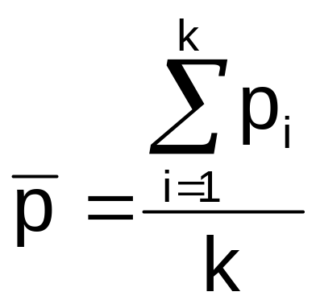
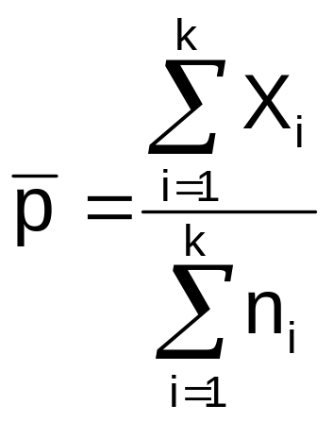
Average of Subgroup Proportions
The average of subgroup proportions = p
If equal sample sizes:
If unequal sample sizes:
where:
p_{i} = sample proportion
for subgroup i
k = number of subgroups
of size n
where:
X_{i} = the number of nonconforming
items in sample i
Σn_{i} = total number of items
sampled in k samples

Slide 32
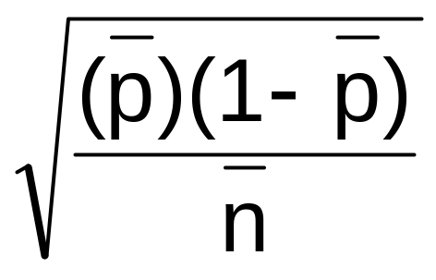
Computing Control Limits
The upper and lower control limits for a p chart are
The standard deviation for the subgroup proportions is
UCL = Average Proportion + 3 Standard Deviations
LCL = Average Proportion – 3 Standard Deviations

Slide 33
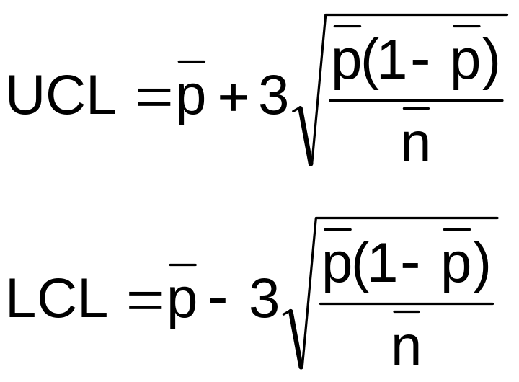
Computing Control Limits
(continued)
The upper and lower control limits for the p chart are
Proportions are never negative, so if the calculated lower control limit is negative, set LCL = 0

Slide 34

p Chart Example
You are the manager of a 500-room hotel. You want to achieve the highest level of service. For seven days, you collect data on the readiness of 200 rooms. Is the process in control?

Slide 35
p Chart Example:
Hotel Data
# Not
Day # Rooms Ready Proportion
1 200 16 0.080
2 200 7 0.035
3 200 21 0.105
4 200 17 0.085
5 200 25 0.125
6 200 19 0.095
7 200 16 0.080

Slide 36
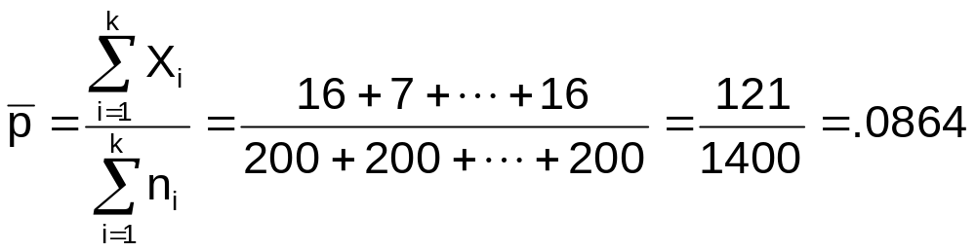
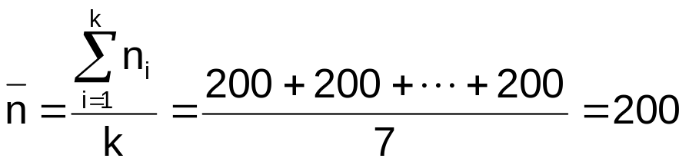
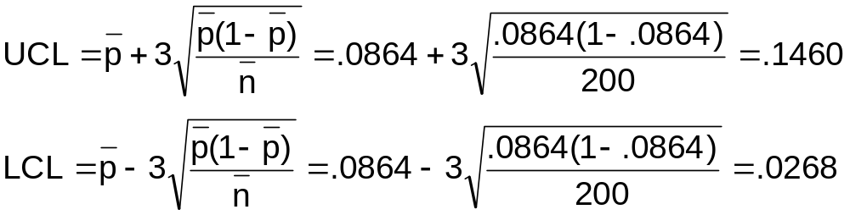
p Chart
Control Limits Solution

Slide 37
p Chart
Control Chart Solution
P
0.15
UCL = .1460
_
0.10
p = .0864
0.05
LCL = .0268
0.00
1
2
3
4
5
6
7
Day
_
Individual points are distributed around p without any pattern. The process is in control. Any improvement in the process must come from reduction of common-cause variation, which is the responsibility of management.

Slide 38
Understanding Process Variability:
Red Bead Experiment
The experiment:
From a box with 20% red beads and 80% white beads, have “workers” scoop out 50 beads
Tell the workers their job is to get white beads
10 red beads out of 50 (20%) is the expected value. Scold workers who get more than 10, praise workers who get less than 10
Some workers will get better over time, some will get worse

Slide 39
Morals of the
Red Bead Experiment
Variation is an inherent part of any process.
The system is primarily responsible for worker performance.
Only management can change the system.
Some workers will always be above average, and some will be below.
Setting unrealistic goals is detrimental to a firm’s well-being.
UCL
proportion
p
LCL
Subgroup number

Slide 40
R chart and X chart
Used for measured numeric data from a process
Start with at least 20 subgroups of observed values
Subgroups usually contain 3 to 6 observations each
For the process to be in control, both the R chart and the X-bar chart must be in control

Slide 41

Example: Subgroups
Process measurements:
 |  |  |  |  | Subgroup measures
Subgroup number | Individual measurements (subgroup size = 4) |  |  |  | Mean, X | Range, R
1 2 3 … | 15 12 17 … | 17 16 21 … | 15 9 18 … | 11 15 20 … | 14.5 13.0 19.0 … | 6 7 4 …
 |  |  |  |  | Mean subgroup mean = | Mean subgroup range = R

Slide 42
The R Chart
Monitors dispersion (variability) in a process
  The characteristic of interest is measured on a numerical scale
  Is a variables control chart
Shows the sample range over time
  Range = difference between smallest and largest values in the subgroup

Slide 43
Steps to create an R chart
Find the mean of the subgroup ranges (the center line of the R chart)
Compute the upper and lower control limits for the R chart
Use lines to show the center and control limits on the R chart
Plot the successive subgroup ranges as a line chart

Slide 44
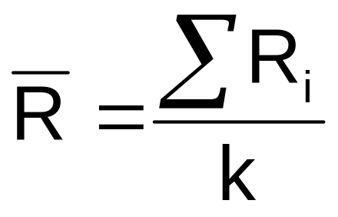
Average of Subgroup Ranges
Mean of subgroup ranges:
where:
R_{i} = i^{th} subgroup range
k = number of subgroups

Slide 45
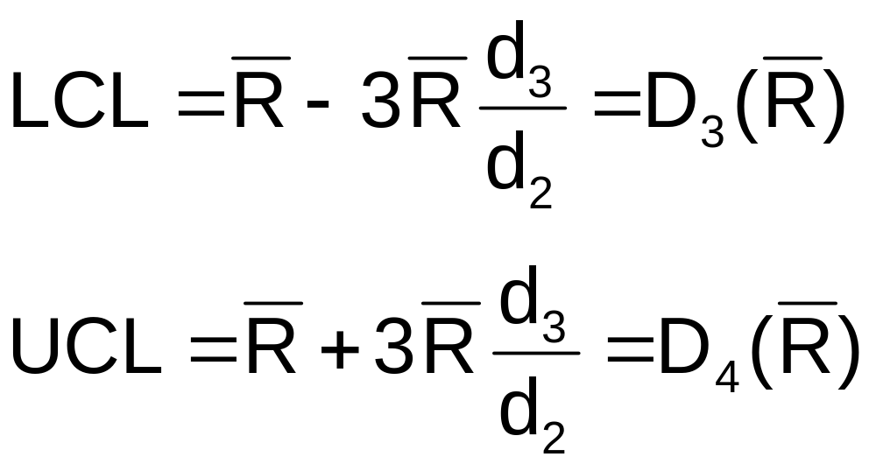
R Chart Control Limits
The upper and lower control limits for an
R chart are
where:
d₂ and d₃ are taken from the table
(Appendix Table E.10) for subgroup size = n

Slide 46

R Chart Example
You are the manager of a 500-room hotel. You want to analyze the time it takes to deliver luggage to the room. For 7 days, you collect data on 5 deliveries per day. Is the variation in the process in control?

Slide 47
R Chart Example:
Subgroup Data
Day | Subgroup Size | SubgroupMean | Subgroup Range
1 2 3 4 5 6 7 | 5 5 5 5 5 5 5 | 5.32 6.59 4.89 5.70 4.07 7.34 6.79 | 3.85 4.27 3.28 2.99 3.61 5.04 4.22

Slide 48
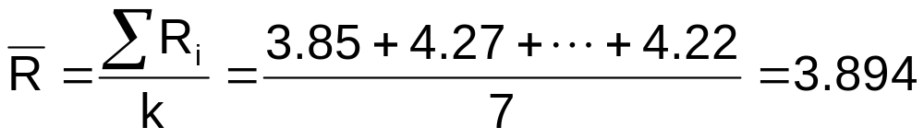
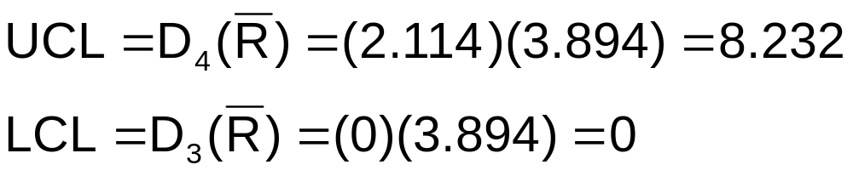
R Chart Center and
Control Limits
D₄ and D₃ are from Table E.10 (n = 5)

Slide 49
R Chart
Control Chart Solution
Minutes
8
UCL = 8.232
6
_
4
R = 3.894
2
0
LCL = 0
1
2
3
4
5
6
7
Day
Conclusion: Variation is in control

Slide 50
The X Chart
Shows the means of successive subgroups over time
Monitors process mean
Must be preceded by examination of the R chart to make sure that the variation in the process is in control

Slide 51

Steps to create an X chart
Compute the mean of the subgroup means (the center line of the chart)
Compute the upper and lower control limits for the chart
Graph the subgroup means
Add the center line and control limits to the graph

Slide 52
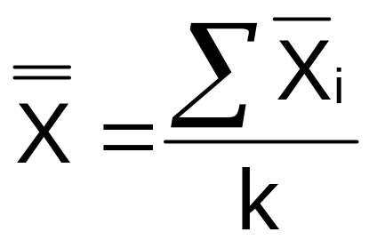
Mean of Subgroup
Means
Mean of subgroup means:
where:
X_{i} = i^{th} subgroup mean
k = number of subgroups

Slide 53
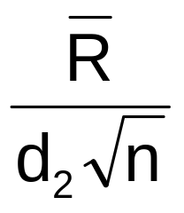
Computing Control Limits
The upper and lower control limits for an X chart are generally defined as
Use to estimate the standard deviation of the process mean, where d₂
is from appendix Table E.10
UCL = Process Mean + 3 Standard Deviations
LCL = Process Mean – 3 Standard Deviations

Slide 54
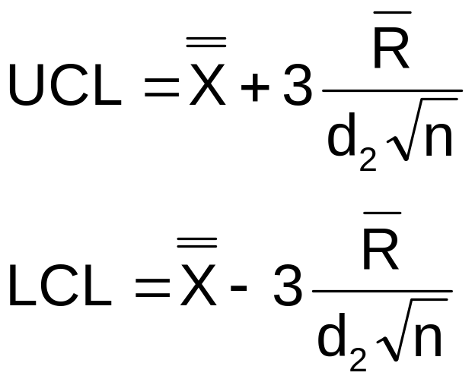
Computing Control Limits
(continued)
The upper and lower control limits for an X chart are generally defined as
so
UCL = Process Mean + 3 Standard Deviations
LCL = Process Mean – 3 Standard Deviations

Slide 55
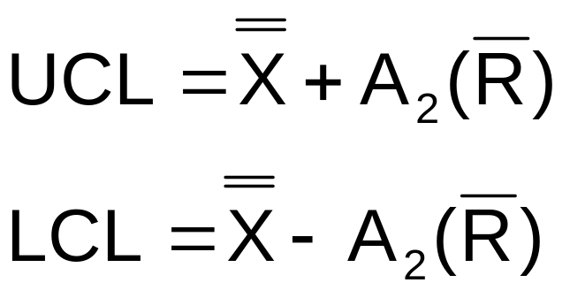
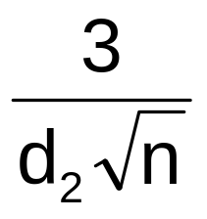
Computing Control Limits
(continued)
Simplify the control limit calculations by using
where A₂ =

Slide 56
X Chart Example
You are the manager of a 500-room hotel. You want to analyze the time it takes to deliver luggage to the room. For seven days, you collect data on five deliveries per day. Is the process mean in control?

Slide 57
X Chart Example:
Subgroup Data
Day | Subgroup Size | SubgroupMean | Subgroup Range
1 2 3 4 5 6 7 | 5 5 5 5 5 5 5 | 5.32 6.59 4.89 5.70 4.07 7.34 6.79 | 3.85 4.27 3.28 2.99 3.61 5.04 4.22

Slide 58
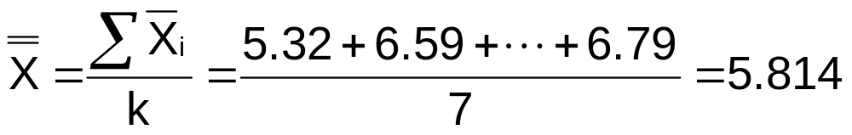
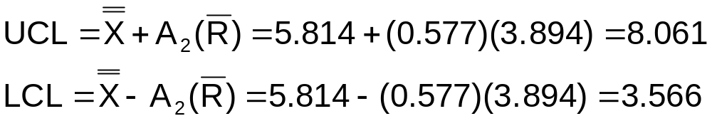
X Chart
Control Limits Solution
A₂ is from Table E.10 (n = 5)

Slide 59
X Chart
Control Chart Solution
Minutes
8
UCL = 8.061
_
_
6
X = 5.813
4
LCL = 3.566
2
0
1
2
3
4
5
6
7
Day
Conclusion: Process mean is in statistical control

Slide 60
Chapter Summary
Reviewed the philosophy of quality management
  Deming’s 14 points
Discussed Six Sigma Management
  Reduce defects to no more than 3.4 per million
  Uses DMAIC model for process improvement
Discussed the theory of control charts
  Common cause variation vs. special cause variation
Constructed and interpreted p charts
Constructed and interpreted X and R charts

