Slide 1
Week 8 Place
Marketing Channels: Delivering Customer Value

Slide 2
Marketing Channels: Delivering Customer Value
Topic Outline
Supply Chains and the Value Delivery Network
The Nature and Importance of Marketing Channels
Channel Behavior and Organization
Channel Design Decisions
Describe the major activities involved in the distribution of goods and services
Understand the major aspects of retailing
Explain the role of wholesalers, agents and brokers in the distribution channel
Notes:
Companies rarely work alone in creating value for customers and building profitable customer relationships. Instead, most are only a single link in a larger supply chain and marketing channel. As such, a firm’s success depends not only on how well it performs but also on how well its entire marketing channel competes with competitors’ channels. The first part of this chapter explores the nature of marketing channels and the marketer’s channel design and management decisions. We then examine physical distribution—or logistics—an area that is growing dramatically in importance and sophistication. In the next chapter, we’ll look more closely at two major channel intermediaries: retailers and wholesalers.

Slide 3
Supply Chains and the
Value Delivery Network
Supply Chain Partners
Upstream partners include raw material suppliers, components, parts, information, finances, and expertise to create a product or service
Downstream partners include the marketing channels or distribution channels that look toward the customer, including retailers and wholesalers
Copyright ©2014 by Pearson Education, Inc. All rights reserved
Notes:
Producing a product or service and making it available to buyers requires building relationships not only with customers but also with key suppliers and resellers in the company’s supply chain. This supply chain consists of upstream and downstream partners. Upstream from the company is the set of firms that supply the raw materials, components, parts, information, finances, and expertise needed to create a product or service. Marketers, however, have traditionally focused on the downstream side of the supply chain—the marketing channels (or distribution channels) that look toward the customer. Downstream marketing channel partners, such as wholesalers and retailers, form a vital link between the firm and its customers.

Slide 4
Supply Chains and the
Value Delivery Network
Supply Chain Views
Supply chain “make and sell” view includes the firm’s raw materials, productive inputs, and factory capacity
Demand chain “sense and respond” view suggests that planning starts with the needs of the target customer, and the firm responds to these needs by organizing a chain of resources and activities with the goal of creating customer value
Copyright ©2014 by Pearson Education, Inc. All rights reserved
Notes:
The term supply chain may be too limited, as it takes a make-and-sell view of the business. It suggests that raw materials, productive inputs, and factory capacity should serve as the starting point for market planning. A better term would be demand chain because it suggests a sense-and-respond view of the market. Under this view, planning starts by identifying the needs of target customers, to which the company responds by organizing a chain of resources and activities with the goal of creating customer value.

Slide 5
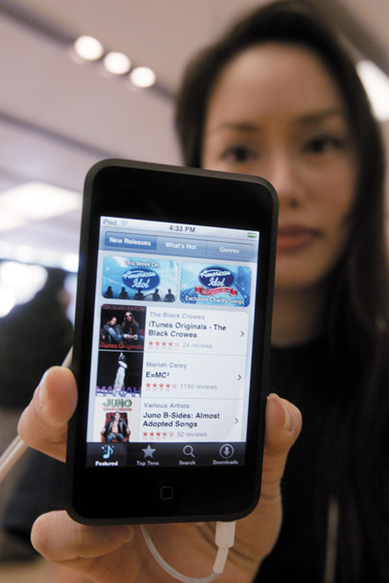
Supply Chains and the
Value Delivery Network
Value Delivery Network
Value delivery network is the firm’s suppliers, distributors, and ultimately customers who partner with each other to improve the performance of the entire system
Copyright ©2014 by Pearson Education, Inc. All rights reserved
Notes:
Yet, even a demand chain view of a business may be too limited because it takes a step-by-step, linear view of purchase-production-consumption activities. Instead, most large companies today are engaged in building and managing a complex, continuously evolving value delivery network. As defined in Chapter 2, a value delivery network is made up of the company, suppliers, distributors, and, ultimately, customers who “partner” with each other to improve the performance of the entire system.

Slide 6
The Nature and Importance of Marketing Channels
How Channel Members Add Value
Intermediaries offer producers greater efficiency in making goods available to target markets. Through their contacts, experience, specialization, and scale of operations, intermediaries usually offer the firm more than it can achieve on its own.
Copyright ©2014 by Pearson Education, Inc. All rights reserved
Notes:
Few producers sell their goods directly to final users. Instead, most use intermediaries to bring their products to market. They try to forge a marketing channel (or distribution channel)—a set of interdependent organizations that help make a product or service available for use or consumption by the consumer or business user.
A company’s channel decisions directly affect every other marketing decision. Pricing depends on whether the company works with national discount chains, uses high-quality specialty stores, or sells directly to consumers online. The firm’s sales force and communications decisions depend on how much persuasion, training, motivation, and support its channel partners need. Whether a company develops or acquires certain new products may depend on how well those products fit the capabilities of its channel members.
Companies often pay too little attention to their distribution channels—sometimes with damaging results. In contrast, many companies have used imaginative distribution systems to gain a competitive advantage. Enterprise Rent-A-Car revolutionized the car-rental business by setting up off-airport rental offices. Apple turned the retail music business on its head by selling music for the iPod via the Internet on iTunes. FedEx’s creative and imposing distribution system made it a leader in express package delivery. And Amazon.com forever changed the face of retailing and became the Walmart of the Internet by selling anything and everything without using physical stores.
Distribution channel decisions often involve long-term commitments to other firms. For example, companies such as Ford, McDonald’s, or HP can easily change their advertising, pricing, or promotion programs. They can scrap old products and introduce new ones as market tastes demand. But when they set up distribution channels through contracts with franchisees, independent dealers, or large retailers, they cannot readily replace these channels with company-owned stores or Internet sites if the conditions change. Therefore, management must design its channels carefully, with an eye on both today’s likely selling environment and tomorrow’s as well.

Slide 7
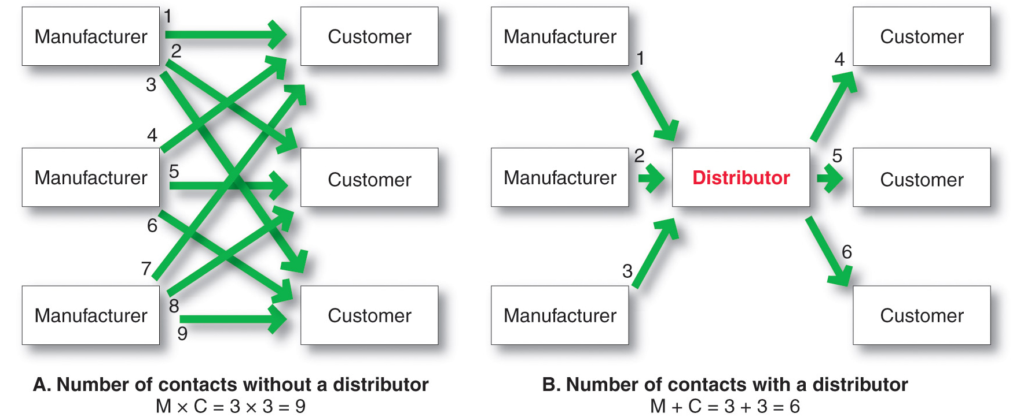
The Nature and Importance of Marketing Channels
How Channel Members Add Value
Copyright ©2014 by Pearson Education, Inc. All rights reserved
Notes:
Figure 12.1 shows how using intermediaries can provide economies. Figure 12.1A shows three manufacturers, each using direct marketing to reach three customers. This system requires nine different contacts. Figure 12.1B shows the three manufacturers working through one distributor, which contacts the three customers. This system requires only six contacts. In this way, intermediaries reduce the amount of work that must be done by both producers and consumers.
From the economic system’s point of view, the role of marketing intermediaries is to transform the assortments of products made by producers into the assortments wanted by consumers. Producers make narrow assortments of products in large quantities, but consumers want broad assortments of products in small quantities. Marketing channel members buy large quantities from many producers and break them down into the smaller quantities and broader assortments desired by consumers.

Slide 8
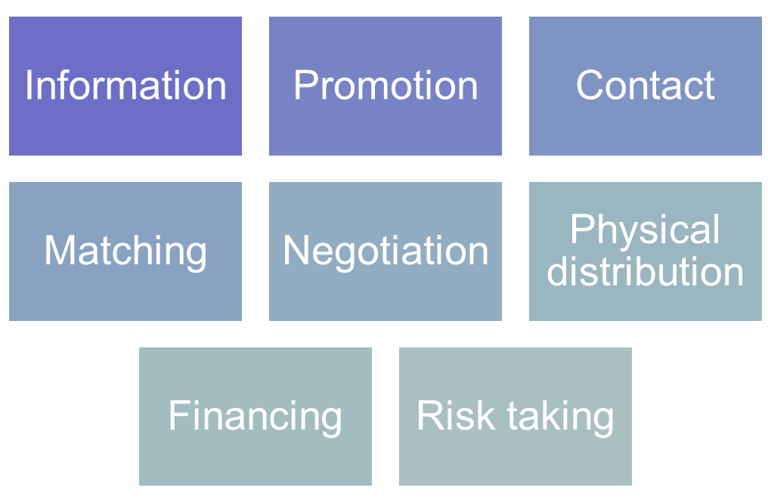
The Nature and Importance of Marketing Channels
How Channel Members Add Value
Copyright ©2014 by Pearson Education, Inc. All rights reserved
Notes:
Note to Instructor
In making products and services available to consumers, channel members add value by bridging the major time, place, and possession gaps that separate goods and services from those who use them. Members of the marketing channel perform many key functions.
Channels perform the following functions:
Information: Gathering and distributing marketing research and intelligence information about actors and forces in the marketing environment needed for planning and aiding exchange.
Promotion: Developing and spreading persuasive communications about an offer.
Contact: Finding and communicating with prospective buyers.
Matching: Shaping and fitting the offer to the buyer’s needs, including activities such as manufacturing, grading, assembling, and packaging.
Negotiation: Reaching an agreement on price and other terms of the offer so that ownership or possession can be transferred.
Physical distribution: Transporting and storing goods.
Financing: Acquiring and using funds to cover the costs of the channel work.
Risk taking: Assuming the risks of carrying out the channel work
The question is not whether these functions need to be performed—they must be—but rather who will perform them. To the extent that the manufacturer performs these functions, its costs go up; therefore, its prices must be higher. When some of these functions are shifted to intermediaries, the producer’s costs and prices may be lower, but the intermediaries must charge more to cover the costs of their work. In dividing the work of the channel, the various functions should be assigned to the channel members who can add the most value for the cost.

Slide 9

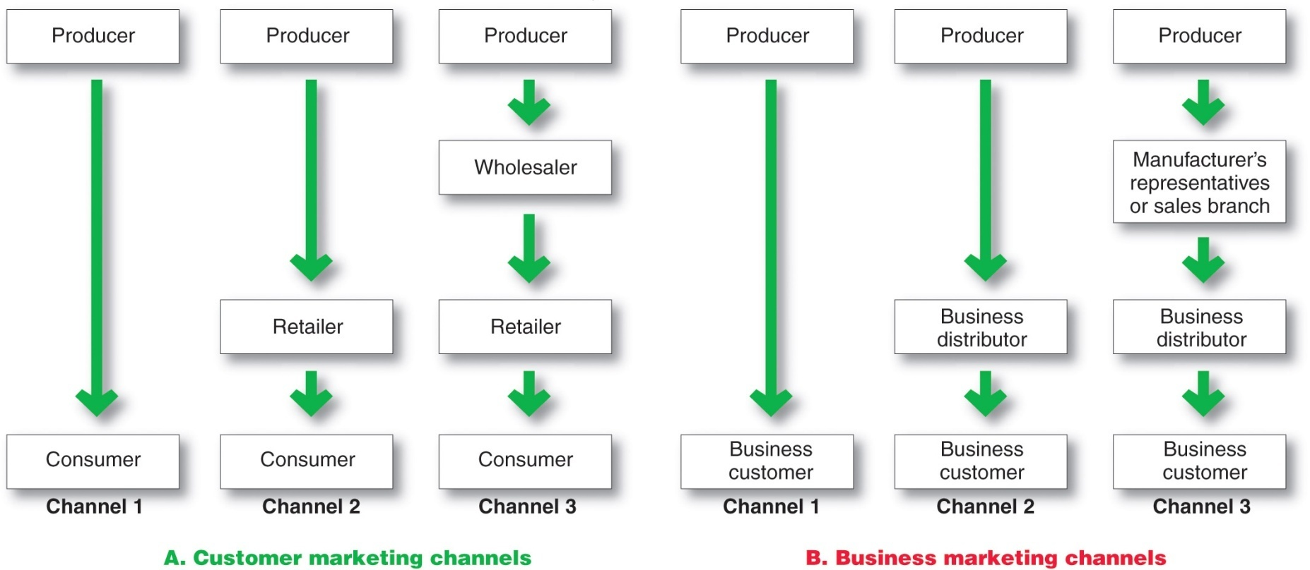
The Nature and Importance of Marketing Channels
Number of Channel Levels
Copyright ©2014 by Pearson Education, Inc. All rights reserved
Notes:
Note to Instructor
Channel 1, called a direct marketing channel, has no intermediary levels; the company sells directly to consumers.
The remaining channels in Figure 12.2A are indirect marketing channels, containing one or more intermediaries.
Figure 12.2B shows some common business distribution channels. The business marketer can use its own sales force to sell directly to business customers. Or it can sell to various types of intermediaries, who in turn sell to these customers.
Companies can design their distribution channels to make products and services available to customers in different ways. Each layer of marketing intermediaries that performs some work in bringing the product and its ownership closer to the final buyer is a channel level. Because both the producer and the final consumer perform some work, they are part of every channel.
The number of intermediary levels indicates the length of a channel. Figure 12.2 shows both consumer and business channels of different lengths. Figure 12.2A shows several common consumer distribution channels. Channel 1, called a direct marketing channel, has no intermediary levels—the company sells directly to consumers. For example, Mary Kay Cosmetics and Amway sell their products door-to-door, through home and office sales parties, and on the Internet; companies ranging from GEICO insurance to Omaha Steaks sell directly to customers via the Internet and telephone. The remaining channels in Figure 12.2A are indirect marketing channels, containing one or more intermediaries.
Figure 12.2B shows some common business distribution channels. The business marketer can use its own sales force to sell directly to business customers. Or it can sell to various types of intermediaries, who in turn sell to these customers. Although consumer and business marketing channels with even more levels can sometimes be found, these are less common. From the producer’s point of view, a greater number of levels means less control and greater channel complexity.
Movie icon links to a video of Hasbro managers discussing marketing and distribution channels, and reasons for using a variety of channels. It also discusses importance of logistics.

Slide 10
The Nature and Importance of Marketing Channels
Number of Channel Levels
Connected by types of flows:
Physical flow of products
Flow of ownership
Payment flow
Information flow
Promotion flow
Copyright ©2014 by Pearson Education, Inc. All rights reserved
Notes:
Moreover, all the institutions in the channel are connected by several types of flows. These include the physical flow of products, the flow of ownership, the payment flow, the information flow, and the promotion flow. These flows can make even channels with only one or a few levels very complex.

Slide 11
Channel Behavior and Organization
Channel Behavior
Marketing channel consists of firms that have partnered for their common good with each member playing a specialized role
Channel conflict refers to disagreement over goals, roles, and rewards by channel members
Horizontal conflict
Vertical conflict
Copyright ©2014 by Pearson Education, Inc. All rights reserved
Notes:
Distribution channels are more than simple collections of firms tied together by various flows. They are complex behavioral systems in which people and companies interact to accomplish individual, company, and channel goals. Some channel systems consist of only informal interactions among loosely organized firms. Others consist of formal interactions guided by strong organizational structures. Moreover, channel systems do not stand still—new types of intermediaries emerge and whole new channel systems evolve. Here we look at channel behavior and how members organize to do the work of the channel.
Channel Behavior
A marketing channel consists of firms that have partnered for their common good. Each channel member depends on the others. For example, a Ford dealer depends on Ford to design cars that meet customer needs. In turn, Ford depends on the dealer to attract customers, persuade them to buy Ford cars, and service the cars after the sale. Each Ford dealer also depends on other dealers to provide good sales and service that will uphold the brand’s reputation. In fact, the success of individual Ford dealers depends on how well the entire Ford marketing channel competes with the channels of other auto manufacturers.
Each channel member plays a specialized role in the channel. For example, the role of Samsung is to produce electronics products that consumers will like and create demand through national advertising. Best Buy’s role is to display these Samsung products in convenient locations, answer buyers’ questions, and complete sales. The channel will be most effective when each member assumes the tasks it can do best.
Ideally, because the success of individual channel members depends on the overall channel’s success, all channel firms should work together smoothly. They should understand and accept their roles, coordinate their activities, and cooperate to attain overall channel goals. However, individual channel members rarely take such a broad view. Cooperating to achieve overall channel goals sometimes means giving up individual company goals. Although channel members depend on one another, they often act alone in their own short-run best interests. They often disagree on who should do what and for what rewards. Such disagreements over goals, roles, and rewards generate channel conflict.
Horizontal conflict occurs among firms at the same level of the channel. For instance, some Ford dealers in Chicago might complain that other dealers in the city steal sales from them by pricing too low or advertising outside their assigned territories. Or Holiday Inn franchisees might complain about other Holiday Inn operators overcharging guests or giving poor service, hurting the overall Holiday Inn image.
Vertical conflict, conflict between different levels of the same channel, is even more common. KFC and its franchisees came into conflict over the company’s decision to emphasize grilled chicken and sandwiches over the brand’s traditional fried chicken.

Slide 12
Channel Behavior and Organization
Conventional Distributions Systems
Conventional distribution systems consist of one or more independent producers, wholesalers, and retailers. Each seeks to maximize its own profits, and there is little control over the other members and no formal means for assigning roles and resolving conflict.
Copyright ©2014 by Pearson Education, Inc. All rights reserved
Notes:
Conventional distribution channels have lacked leadership and power, often resulting in damaging conflict and poor performance.

Slide 13
Channel Behavior and Organization
Vertical Marketing Systems
Vertical marketing systems (VMSs) provide channel leadership and consist of producers, wholesalers, and retailers acting as a unified system and consist of:
Corporate marketing systems
Contractual marketing systems
Administered marketing systems
Copyright ©2014 by Pearson Education, Inc. All rights reserved
Notes:
For the channel as a whole to perform well, each channel member’s role must be specified, and channel conflict must be managed. The channel will perform better if it includes a firm, agency, or mechanism that provides leadership and has the power to assign roles and manage conflict.
A vertical marketing system (VMS) consists of producers, wholesalers, and retailers acting as a unified system. One channel member owns the others, has contracts with them, or wields so much power that they must all cooperate. The VMS can be dominated by the producer, the wholesaler, or the retailer.

Slide 14
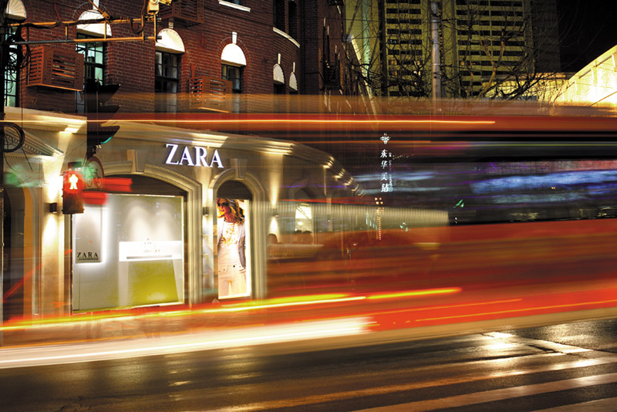
Channel Behavior and Organization
Vertical Marketing Systems
Corporate vertical marketing system integrates successive stages of production and distribution under single ownership
The secret to zara’s success is its control over almost every supply chain
Copyright ©2014 by Pearson Education, Inc. All rights reserved
Notes:
Corporate VMS
A corporate VMS integrates successive stages of production and distribution under single ownership. Coordination and conflict management are attained through regular organizational channels.

Slide 15
Channel Behavior and Organization
Vertical Marketing Systems
Contractual vertical marketing system consists of independent firms at different levels of production and distribution who join together through contracts to obtain more economies or sales impact than each could achieve alone. The most common form is the franchise organization.
Copyright ©2014 by Pearson Education, Inc. All rights reserved
Notes:
Contractual VMS
A contractual VMS consists of independent firms at different levels of production and distribution who join together through contracts to obtain more economies or sales impact than each could achieve alone. Channel members coordinate their activities and manage conflict through contractual agreements.

Slide 16
Channel Behavior and Organization
Vertical Marketing Systems
Franchise organization links several stages in the production distribution process
  Manufacturer-sponsored retailer franchise system e.g. Ford and its dealers
  Manufacturer-sponsored wholesaler franchise system e.g. Coca-Cola licenses bottlers
  Service firm-sponsored retailer franchise system
  e.g. auto-rental business
Copyright ©2014 by Pearson Education, Inc. All rights reserved
Notes:
The franchise organization is the most common type of contractual relationship. In this system, a channel member called a franchisor links several stages in the production-distribution process. In the United States alone, some 3,000 franchisors and 825,000 franchise outlets account for more than $2.1 trillion of economic output. Industry analysts estimate that a new franchise outlet opens somewhere in the United States every eight minutes and that about one out of every 12 retail business outlets is a franchised business. Almost every kind of business has been franchised—from motels and fast-food restaurants to dental centers and dating services, from wedding consultants and handyman services to fitness centers and funeral homes.
There are three types of franchises. The first type is the manufacturer-sponsored retailer franchise system—for example, Ford and its network of independent franchised dealers. The second type is the manufacturer-sponsored wholesaler franchise system—Coca-Cola licenses bottlers (wholesalers) in various world markets who buy Coca-Cola syrup concentrate and then bottle and sell the finished product to retailers locally. The third type is the service-firm-sponsored retailer franchise system—for example, Burger King and its nearly 12,300 franchisee-operated restaurants around the world. Other examples can be found in everything from auto rentals (Hertz, Avis), apparel retailers (The Athlete’s Foot, Plato’s Closet), and motels (Holiday Inn, Ramada Inn) to supplemental education (Huntington Learning Center, Kumon) and personal services (Great Clips, Massage Envy, Mr. Handyman).
The fact that most consumers cannot tell the difference between contractual and corporate VMSs shows how successfully the contractual organizations compete with corporate chains.

Slide 17
Channel Behavior and Organization
Vertical Marketing Systems
  Administered vertical marketing system has a few dominant channel members without common ownership. Leadership comes from size and power.
  In turn, large retailers such as Walmart, Home Depot, and Barnes & Noble can exert strong influence on the many manufacturers that supply the products they sell.
Copyright ©2014 by Pearson Education, Inc. All rights reserved
Notes:
In an administered VMS, leadership is assumed not through common ownership or contractual ties but through the size and power of one or a few dominant channel members. Manufacturers of a top brand can obtain strong trade cooperation and support from resellers. For example, GE, P&G, and Kraft can command unusual cooperation from many resellers regarding displays, shelf space, promotions, and price policies. In turn, large retailers such as Walmart, Home Depot, and Barnes & Noble can exert strong influence on the many manufacturers that supply the products they sell.
For example, with commodity prices increasing, many consumer goods manufacturers want to pass these costs along to Walmart and other retailers in the form of higher prices. However, Walmart wants to hold the line on its own costs and prices in order to maintain its low-price positioning with customers in tighter times. This creates push and pull between Walmart and its suppliers, a tussle in which Walmart—the biggest grocery seller in the United States—usually gets its way. Take Clorox Company, for instance. Although the company’s strong consumer brand preference gives in significant negotiating power, Walmart simply holds more cards. Sales to Walmart make up 26 percent of Clorox’s sales, so maintaining a strong relationships with the giant retailer is crucial.

Slide 18
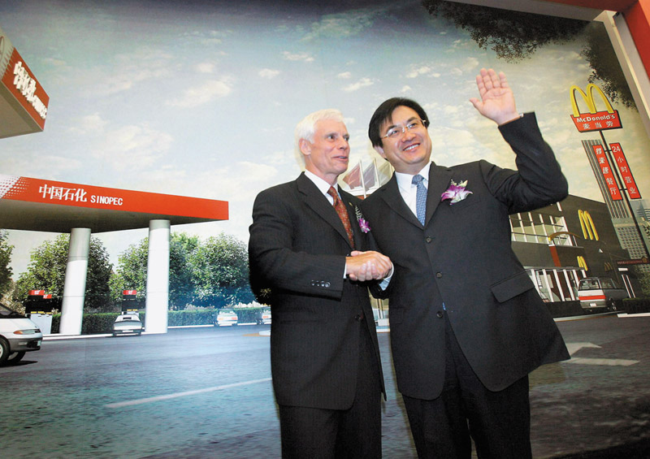
Channel Behavior and Organization
Horizontal Marketing System
  Horizontal marketing systems are when two or more companies at one level join together to follow a new marketing opportunity. Companies combine financial, production, or marketing resources to accomplish more than any one company could alone.
  Exam McDonld’s now places “express” versions of its restaurants in Walmart store.
Copyright ©2014 by Pearson Education, Inc. All rights reserved
Notes:
Note to Instructor
Discussion Question
Can you think of an example where two companies join for a horizontal marketing system.
Students might notice that McDonald’s is in Wal-Mart or their gas station also has a coffee franchise.
Horizontal Marketing Systems
Another channel development is the horizontal marketing system, in which two or more companies at one level join together to follow a new marketing opportunity. By working together, companies can combine their financial, production, or marketing resources to accomplish more than any one company could alone.
Companies might join forces with competitors or noncompetitors. They might work with each other on a temporary or permanent basis, or they may create a separate company. For example, Walmart—famous for squeezing costs out of its supply chain—wants to team with PepsiCo’s Frito-Lay unit to buy potatoes jointly for a lower price than either company could get alone. That would help both companies to earn more on the spuds and chips they sell in Walmart’s stores. Walmart also partners with McDonald’s to place “express” versions of McDonald’s restaurants in Walmart stores. McDonald’s benefits from Walmart’s heavy store traffic, and Walmart keeps hungry shoppers from needing to go elsewhere to eat.
Competitors Microsoft and Yahoo! have joined forces to create a horizontal Internet search alliance. Until 2020, Microsoft’s Bing will power Yahoo! searches. In turn, Yahoo! will sell premium search advertising services for both companies. The collaboration, dubbed Bingahoo by industry insiders, has proven beneficial. Because one advertising purchase brings results on both Bing and Yahoo!, advertisers have more incentive to use the combined platform. In the first year, total ad spending climbed 44 percent, making the two companies together a stronger challenger to industry leader Google.

Slide 19

Channel Behavior and Organization
Multichannel Distribution Systems
Hybrid Marketing Channels
  Multichannel Distribution systems (Hybrid marketing channels) are when a single firm sets up two or more marketing channels to reach one or more customer segments
Copyright ©2014 by Pearson Education, Inc. All rights reserved
Notes:
Multichannel Distribution Systems
In the past, many companies used a single channel to sell to a single market or market segment. Today, with the proliferation of customer segments and channel possibilities, more and more companies have adopted multichannel distribution systems. Such multichannel marketing occurs when a single firm sets up two or more marketing channels to reach one or more customer segments.
Link goes to peapod.com. Peapod reaches customer segments via the website; it also reaches people via their mobile devices. An additional method used to reach customer segments is via its affiliate program.

Slide 20
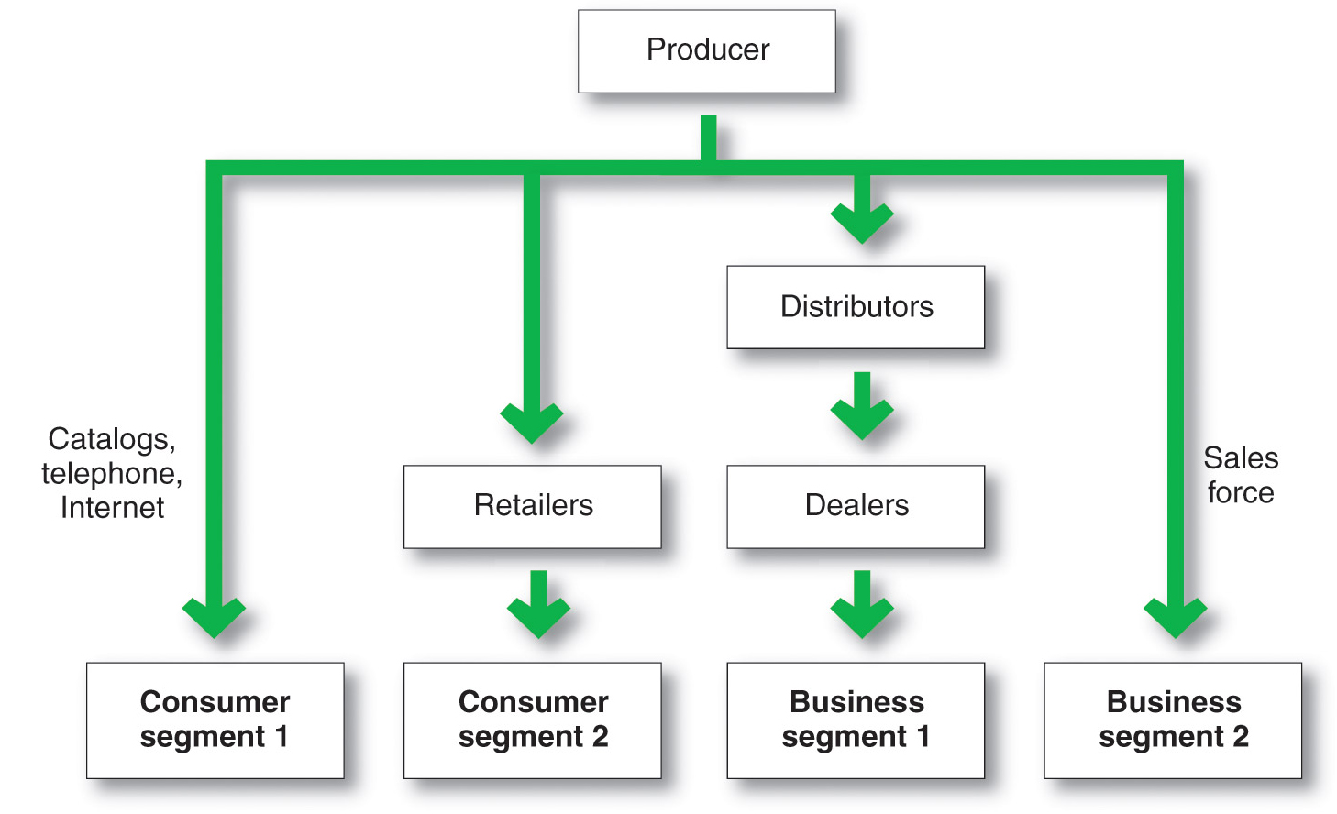
Channel Behavior and Organization
Multichannel Distribution System
Copyright ©2014 by Pearson Education, Inc. All rights reserved
Notes:
Multichannel distribution systems offer many advantages to companies facing large and complex markets. With each new channel, the company expands its sales and market coverage and gains opportunities to tailor its products and services to the specific needs of diverse customer segments. But such multichannel systems are harder to control, and they generate conflict as more channels compete for customers and sales. For example, when John Deere began selling selected consumer products through Lowe’s home improvement stores, many of its dealers complained loudly. To avoid such conflicts in its Internet marketing channels, the company routes all of its website sales to John Deere dealers.
Figure 12.4 shows a multichannel marketing system. In the figure, the producer sells directly to consumer segment 1 using catalogs, telemarketing, and the Internet and reaches consumer segment 2 through retailers. It sells indirectly to business segment 1 through distributors and dealers and to business segment 2 through its own sales force.
These days, almost every large company and many small ones distribute through multiple channels.

Slide 21
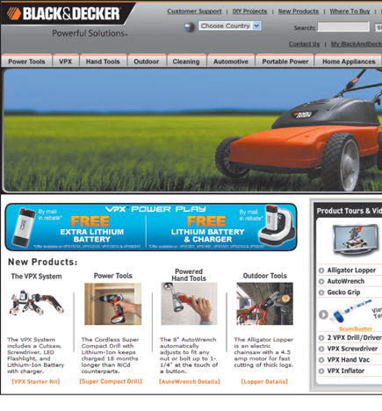
Channel Behavior and Organization
Changing Channel Organization
Disintermediation occurs when product or service producers cut out intermediaries and go directly to final buyers, or when radically new types of channel intermediaries displace traditional ones
Copyright ©2014 by Pearson Education, Inc. All rights reserved
Notes:
Changes in technology and the explosive growth of direct and online marketing are having a profound impact on the nature and design of marketing channels. One major trend is toward disintermediation—a big term with a clear message and important consequences. Disintermediation occurs when product or service producers cut out intermediaries and go directly to final buyers or when radically new types of channel intermediaries displace traditional ones.
Thus, in many industries, traditional intermediaries are dropping by the wayside. For example, Southwest, JetBlue, and other airlines sell tickets directly to final buyers, cutting travel agents from their marketing channels altogether. In other cases, new forms of resellers are displacing traditional intermediaries, as is the case with online marketers taking business from traditional brick-and-mortar retailers. For example, online music download services such as iTunes and Amazon MP3 have pretty much put traditional music-store retailers out of business. And Amazon.com almost single-handedly bankrupted the nation’s number two bookseller, Borders, in less than 10 years, and it has recently forced highly successful store retailers such as Best Buy to dramatically rethink their entire operating models. In fact, many retailing experts question whether stores like Best Buy can compete in the long run against online rivals.
Disintermediation presents both opportunities and problems for producers and resellers. Channel innovators who find new ways to add value in the channel can displace traditional resellers and reap the rewards. In turn, traditional intermediaries must continue to innovate to avoid being swept aside. For example, superstore booksellers Borders and Barnes & Noble pioneered huge book selections and low prices, sending most small independent bookstores into ruin. Then, along came Amazon.com, which threatened even the largest brick-and-mortar bookstores through online book sales. Now, both offline and online sellers of physical books are being threatened by digital book downloads and e-readers. Rather than being threatened by these digital developments, however, Amazon.com is leading them with its highly successful Kindle e‑readers. By contrast, Barnes & Noble—the giant that helped put so many independent bookstores out of business—is a latecomer to e-books with its Nook e‑reader and now finds itself locked in a battle for survival.
Like resellers, to remain competitive, product and service producers must develop new channel opportunities, such as the Internet and other direct channels. However, developing these new channels often brings them into direct competition with their established channels, resulting in conflict. To ease this problem, companies often look for ways to make going direct a plus for the entire channel. For example, guitar and amp maker Fender knows that many customers would prefer to buy its guitars, amps, and accessories online. But selling directly through its website would create conflicts with retail partners, from large chains such as Guitar Center, Sam Ash, and Best Buy to small shops scattered throughout the world, such as the Musician’s Junkyard in Windsor, Vermont, or Freddy for Music in Amman, Jordan. So Fender’s website provides detailed information about the company’s products, but you can’t buy a new Fender Stratocaster or Acoustasonic guitar there. Instead, the Fender website refers you to its resellers’ websites and stores. Thus, Fender’s direct marketing helps both the company and its channel partners.

Slide 22
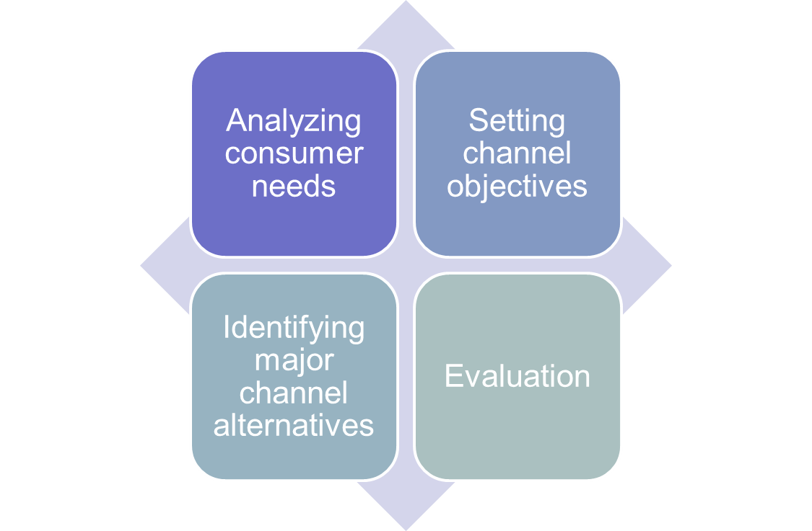
Channel Design Decisions
Copyright ©2014 by Pearson Education, Inc. All rights reserved
Notes:
Note to Instructor
Discussion Questions
How might customer needs differ? Ask them how their needs on purchasing a book might differ from their parents? How does this translate to channel issues?
It will come down to analyzing customer needs in terms of:
Distance to travel
In person versus online
Breadth of assortment
Customer service

Slide 23
Channel Design Decisions
Analyzing Consumer Needs
Find out what target consumers want from the channel
What segments to serve
Best channels to use
Minimize the cost of meeting customer service requirements
Copyright ©2014 by Pearson Education, Inc. All rights reserved
Notes:
Analyzing Consumer Needs
As noted previously, marketing channels are part of the overall customer-value delivery network. Each channel member and level adds value for the customer. Thus, designing the marketing channel starts with finding out what target consumers want from the channel. Do consumers want to buy from nearby locations or are they willing to travel to more distant and centralized locations? Would customers rather buy in person, by phone, or online? Do they value breadth of assortment or do they prefer specialization? Do consumers want many add-on services (delivery, installation, repairs), or will they obtain these services elsewhere? The faster the delivery, the greater the assortment provided, and the more add-on services supplied, the greater the channel’s service level.
Providing the fastest delivery, the greatest assortment, and the most services may not be possible or practical, however. The company and its channel members may not have the resources or skills needed to provide all the desired services. Also, providing higher levels of service results in higher costs for the channel and higher prices for consumers. For example, your local independent hardware store probably provides more personalized service, a more convenient location, and less shopping hassle than the nearest huge Home Depot or Lowe’s store. But it may also charge higher prices. The company must balance consumer needs not only against the feasibility and costs of meeting these needs but also against customer price preferences. The success of discount retailing shows that consumers will often accept lower service levels in exchange for lower prices.
.

Slide 24
Channel Design Decisions
Setting Channel Objectives
Determine targeted levels of customer service
Balance consumer needs not only against the feasibility and costs of meeting these needs but also against customer price preferences
Copyright ©2014 by Pearson Education, Inc. All rights reserved
Notes:
Setting Channel Objectives
Companies should state their marketing channel objectives in terms of targeted levels of customer service. Usually, a company can identify several segments wanting different levels of service. The company should decide which segments to serve and the best channels to use in each case. In each segment, the company wants to minimize the total channel cost of meeting customer-service requirements.
The company’s channel objectives are also influenced by the nature of the company, its products, its marketing intermediaries, its competitors, and the environment. For example, the company’s size and financial situation determine which marketing functions it can handle itself and which it must give to intermediaries. Companies selling perishable products, for example, may require more direct marketing to avoid delays and too much handling.
In some cases, a company may want to compete in or near the same outlets that carry competitors’ products. For example, Maytag wants its appliances displayed alongside competing brands to facilitate comparison shopping. In other cases, companies may avoid the channels used by competitors. Mary Kay Cosmetics, for example, sells directly to consumers through its corps of more than two million independent beauty consultants in more than 35 markets worldwide rather than going head-to-head with other cosmetics makers for scarce positions in retail stores. GEICO primarily markets auto and homeowner’s insurance directly to consumers via the telephone and the Internet rather than through agents.
Finally, environmental factors such as economic conditions and legal constraints may affect channel objectives and design. For example, in a depressed economy, producers will want to distribute their goods in the most economical way, using shorter channels and dropping unneeded services that add to the final price of the goods.

Slide 25
Channel Design Decisions
Identifying Major Alternatives
Types of intermediaries
Number of marketing intermediaries
Responsibilities of channel members
Copyright ©2014 by Pearson Education, Inc. All rights reserved
Notes:
Note to Instructor
Identifying Major Alternatives
When the company has defined its channel objectives, it should next identify its major channel alternatives in terms of the types of intermediaries, the number of intermediaries, and the responsibilities of each channel member. Types of intermediaries refers to channel members available to carry out channel work. Examples include the company sales force, manufacturer’s agency, and industrial distributors.
Using many types of resellers in a channel provides both benefits and drawbacks. For example, by selling through retailers and value-added resellers in addition to its own direct channels, Dell can reach more and different kinds of buyers. However, the new channels will be more difficult to manage and control. In addition, the direct and indirect channels will compete with each other for many of the same customers, causing potential conflict. In fact, Dell often finds itself “stuck in the middle,” with its direct sales reps complaining about competition from retail stores, whereas its value-added resellers complain that the direct sales reps are undercutting their business.

Slide 26
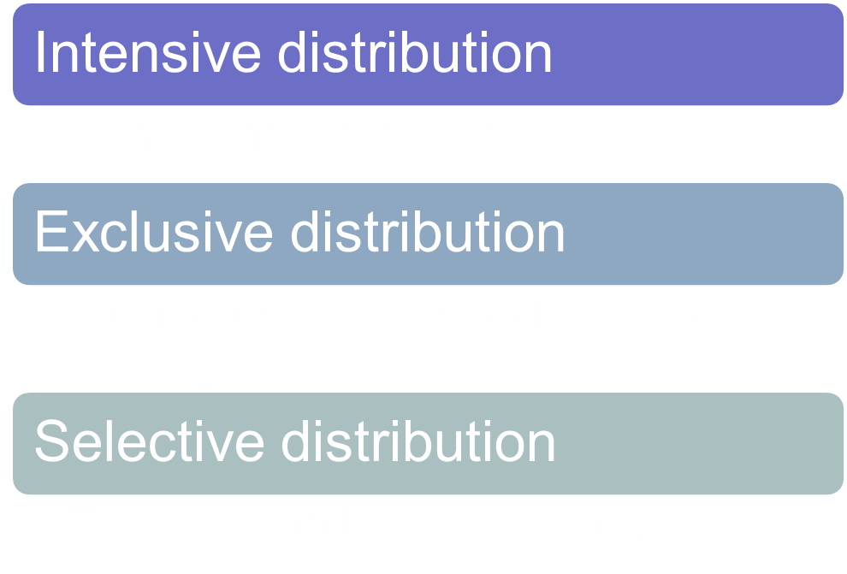
Channel Design Decisions
Identifying Major Alternatives
Copyright ©2014 by Pearson Education, Inc. All rights reserved
Notes:
Number of Marketing Intermediaries
Companies must also determine the number of channel members to use at each level. Three strategies are available: intensive distribution, exclusive distribution, and selective distribution. Producers of convenience products and common raw materials typically seek intensive distribution—a strategy in which they stock their products in as many outlets as possible. These products must be available where and when consumers want them. For example, toothpaste, candy, and other similar items are sold in millions of outlets to provide maximum brand exposure and consumer convenience. Kraft, Coca-Cola, Kimberly-Clark, and other consumer-goods companies distribute their products in this way.
<ex12.08>
By contrast, some producers purposely limit the number of intermediaries handling their products. The extreme form of this practice is exclusive distribution, in which the producer gives only a limited number of dealers the exclusive right to distribute its products in their territories. Exclusive distribution is often found in the distribution of luxury brands. For example, exclusive Bentley automobiles are typically sold by only a handful of authorized dealers in any given market area. However, some shopping goods producers also practice exclusive distribution. For instance, outdoor power equipment maker STIHL doesn’t sell its chain saws, blowers, hedge trimmers, and other products through mass merchandisers such as Lowe’s, Home Depot, or Sears. Instead, it sells only through a select corps of independent hardware and lawn and garden dealers. By granting exclusive distribution, STIHL gains stronger dealer selling support. Exclusive distribution also enhances the STIHL brand’s image and allows for higher markups resulting from greater value-added dealer service.
Between intensive and exclusive distribution lies selective distribution—the use of more than one but fewer than all of the intermediaries who are willing to carry a company’s products. Most television, furniture, and home appliance brands are distributed in this manner. For example, Whirlpool and GE sell their major appliances through dealer networks and selected large retailers. By using selective distribution, they can develop good working relationships with selected channel members and expect a better-than-average selling effort. Selective distribution gives producers good market coverage with more control and less cost than does intensive distribution.
The producer and the intermediaries need to agree on the terms and responsibilities of each channel member. They should agree on price policies, conditions of sale, territory rights, and the specific services to be performed by each party. The producer should establish a list price and a fair set of discounts for the intermediaries. It must define each channel member’s territory, and it should be careful about where it places new resellers.
Mutual services and duties need to be spelled out carefully, especially in franchise and exclusive distribution channels. For example, McDonald’s provides franchisees with promotional support, a record-keeping system, training at Hamburger University, and general management assistance. In turn, franchisees must meet company standards for physical facilities and food quality, cooperate with new promotion programs, provide requested information, and buy specified food products.

Slide 27
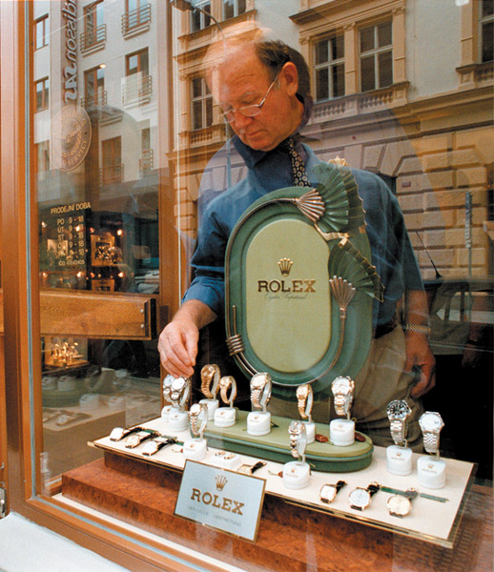
Channel Design Decisions
Evaluating the Major Alternatives
Each alternative should be evaluated against:
  Economic criteria
  Control
  Adaptability criteria
Copyright ©2014 by Pearson Education, Inc. All rights reserved
Notes:
Note to Instructor
Using economic criteria, a company compares the likely sales, costs, and profitability of different channel alternatives.
The company must also consider control issues. Using intermediaries usually means giving them some control over the marketing of the product, and some intermediaries take more control than others. Other things being equal, the company prefers to keep as much control as possible.
Finally, the company must apply adaptability criteria. Channels often involve long-term commitments, yet the company wants to keep the channel flexible so that it can adapt to environmental changes.

Slide 28
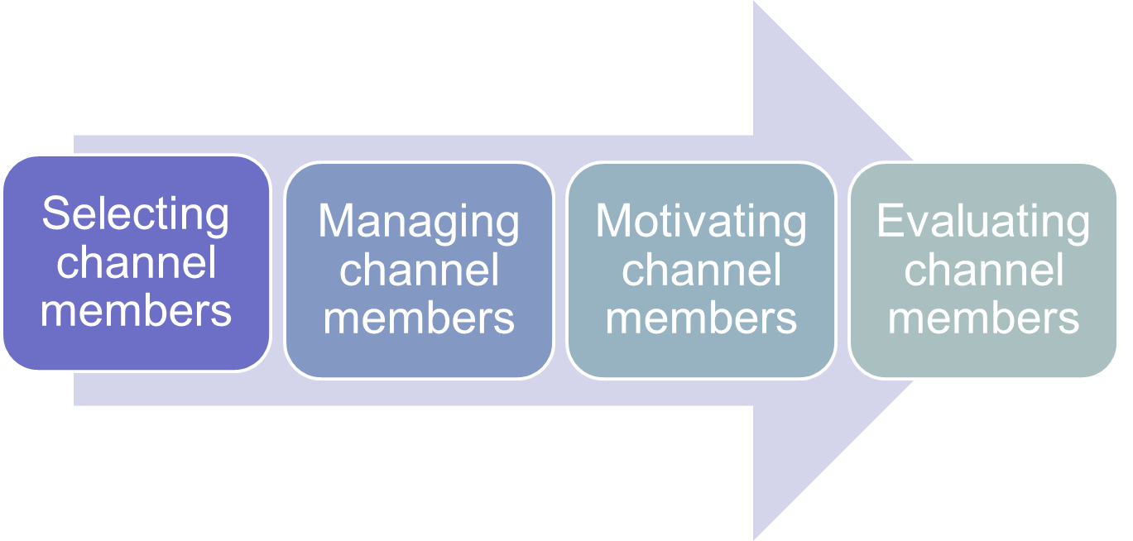
Channel Management Decisions
Copyright ©2014 by Pearson Education, Inc. All rights reserved
Notes:
Note to Instructor
Discussion Question
If you were a manufacturer, how would you select channel members?
Most likely they will look at years in business, profitability, and other products served. In managing channel members companies practice Partner relationship management (PRM) and supply chain management (SCM) to develop long term relationships.
Discussion Question
How do you motivate and evaluate channel members?
Some students might have worked in stores where the salespeople were given rewards for excellent sales or service.
Once the company has reviewed its channel alternatives and determined the best channel design, it must implement and manage the chosen channel. Marketing channel management calls for selecting, managing, and motivating individual channel members and evaluating their performance over time.
Selecting Channel Members
Producers vary in their ability to attract qualified marketing intermediaries. Some producers have no trouble signing up channel members. For example, when Toyota first introduced its Lexus line in the United States, it had no trouble attracting new dealers. In fact, it had to turn down many would-be resellers.
At the other extreme are producers who have to work hard to line up enough qualified intermediaries. For example, when Timex first tried to sell its inexpensive watches through regular jewelry stores, most jewelry stores refused to carry them. The company then managed to get its watches into mass-merchandise outlets. This turned out to be a wise decision because of the rapid growth of mass merchandising.
Even established brands may have difficulty gaining and keeping their desired distribution, especially when dealing with powerful resellers. For example, you won’t find P&G’s Pampers diapers in a Costco store. After P&G declined to manufacture Costco’s Kirkland store brand diapers a few years ago, Costco gave Pampers the boot and now only carries Huggies and its own Kirkland brand (manufactured by Huggies maker Kimberly-Clark). The removal by Costco, the number-two diaper retailer after Walmart, has cost P&G an estimated $150 million to $200 million in annual sales.
When selecting intermediaries, the company should determine what characteristics distinguish the better ones. It will want to evaluate each channel member’s years in business, other lines carried, location, growth and profit record, cooperativeness, and reputation.
Managing and Motivating Channel Members
Once selected, channel members must be continuously managed and motivated to do their best. The company must sell not only through the intermediaries but also to and with them. Most companies see their intermediaries as first-line customers and partners. They practice strong partner relationship management to forge long-term partnerships with channel members. This creates a value delivery system that meets the needs of both the company and its marketing partners.
In managing its channels, a company must convince suppliers and distributors that they can succeed better by working together as a part of a cohesive value delivery system. Thus, P&G works closely with Target to create superior value for final consumers. The two jointly plan merchandising goals and strategies, inventory levels, and advertising and promotion programs. Similarly, Toyota works to create supplier satisfaction, which in turn helps to create greater customer satisfaction. Whether its heavy-equipment manufacturer Caterpillar partnering with its network of large dealers or cosmetics maker L’Oréal building mutually beneficial relationships with its large network of suppliers, companies must work in close harmony with others in the channel to find better ways to bring value to customers (see Real Marketing 12.1).
Many companies are now installing integrated high-tech partnership relationship management (PRM) systems to coordinate their whole-channel marketing efforts. Just as they use CRM software systems to help manage relationships with important customers, companies can now use PRM and supply chain management (SCM) software to help recruit, train, organize, manage, motivate, and evaluate relationships with channel partners.
Evaluating Channel Members
The company must regularly check channel member performance against standards such as sales quotas, average inventory levels, customer delivery time, treatment of damaged and lost goods, cooperation in company promotion and training programs, and services to the customer. The company should recognize and reward intermediaries who are performing well and adding good value for consumers. Those who are performing poorly should be assisted or, as a last resort, replaced.
Finally, companies need to be sensitive to the needs of their channel partners. Those who treat their partners poorly risk not only losing their support but also causing some legal problems. The next section describes various rights and duties pertaining to companies and other channel members.

Slide 29
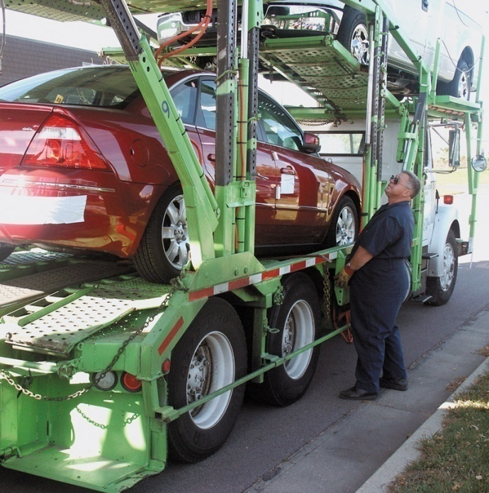
Marketing Logistics and Supply Chain Management
Nature and Importance of Marketing Logistics
Marketing logistics (physical distribution) involves planning, implementing, and controlling the physical flow of goods, services, and related information from points of origin to points of consumption to meet consumer requirements at a profit
Copyright ©2014 by Pearson Education, Inc. All rights reserved
Notes:
In today’s global marketplace, selling a product is sometimes easier than getting it to customers. Companies must decide on the best way to store, handle, and move their products and services so that they are available to customers in the right assortments, at the right time, and in the right place. Logistics effectiveness has a major impact on both customer satisfaction and company costs. Here we consider the nature and importance of logistics management in the supply chain, the goals of the logistics system, major logistics functions, and the need for integrated supply chain management.

Slide 30
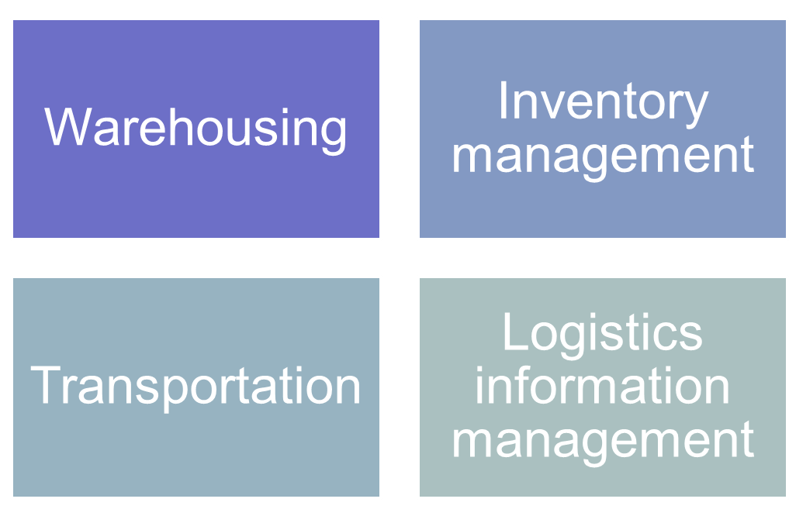
Marketing Logistics and Supply Chain Management
Major Logistics Functions
Copyright ©2014 by Pearson Education, Inc. All rights reserved
Notes:
Discussion Question
What is the importance of logistics?
Their responses should include:
Competitive advantage by giving customers better service at lower prices.
Cost savings to the company and its customers.
Product variety requires improved logistics.
Information technology has created opportunities for distribution efficiency.
The logistics manager’s task is to coordinate the activities of suppliers, purchasing agents, marketers, channel members, and customers. These activities include forecasting, information systems, purchasing, production planning, order processing, inventory, warehousing, and transportation planning.
Companies today are placing greater emphasis on logistics for several reasons. First, companies can gain a powerful competitive advantage by using improved logistics to give customers better service or lower prices. Second, improved logistics can yield tremendous cost savings to both a company and its customers. As much as 20 percent of an average product’s price is accounted for by shipping and transport alone. This far exceeds the cost of advertising and many other marketing costs. American companies spend $1.1 trillion each year—about 7.7 percent of GDP—to wrap, bundle, load, unload, sort, reload, and transport goods. That’s more than the national GDPs of all but 13 countries worldwide.
Shaving off even a small fraction of logistics costs can mean substantial savings. For example, Walmart recently undertook a program of logistics improvements through more efficient sourcing, better inventory management, and greater supply chain productivity that will reduce supply chain costs by 5 to15 percent over the next five years—that’s a whopping $4 billion to $12 billion.
Third, the explosion in product variety has created a need for improved logistics management. For example, in 1916 the typical Piggly Wiggly grocery store carried only 605 items. Today, a Piggly Wiggly carries a bewildering stock of between 20,000 and 35,000 items, depending on store size. A Walmart Supercenter store carries more than 100,000 products, 30,000 of which are grocery products. Ordering, shipping, stocking, and controlling such a variety of products presents a sizable logistics challenge.
Improvements in information technology have also created opportunities for major gains in distribution efficiency. Today’s companies are using sophisticated supply chain management software, Internet-based logistics systems, point-of-sale scanners, RFID tags, satellite tracking, and electronic transfer of order and payment data. Such technology lets them quickly and efficiently manage the flow of goods, information, and finances through the supply chain.
Finally, more than almost any other marketing function, logistics affects the environment and a firm’s environmental sustainability efforts. Transportation, warehousing, packaging, and other logistics functions are typically the biggest supply chain contributors to the company’s environmental footprint. At the same time, they also provide one of the most fertile areas for cost savings. In other words, developing a green supply chain is not only environmentally responsible but can also be profitable. Here’s a simple example:
Consumer package goods maker SC Johnson made a seemingly simple but smart—and profitable—change in the way it packs its trucks. Under the old system, a load of its Ziploc products filled a truck trailer before reaching the maximum weight limit. In contrast, a load of Windex glass cleaner hit the maximum weight before the trailer was full. By strategically mixing the two products, SC Johnson found it could send the same amount of products with 2,098 fewer shipments, while burning 168,000 fewer gallons of diesel fuel and eliminating 1,882 tons of greenhouse gasses. Says the company’s director of environmental issues, “Loading a truck may seem simple, but making sure that a truck is truly full is a science. Consistently hitting a trailer’s maximum weight provided a huge opportunity to reduce our energy consumption, cut our greenhouse gas emissions, and save money [in the bargain.]” “Sustainability shouldn’t be about Washington jamming green stuff down your throat,” concludes one supply chain expert. “This is a lot about money, about reducing costs.”
See supply chain facts from “Fast Facts on the Global Supply Chain,” CSCMP, http://cscmp.org/press/fastfacts.asp, accessed September 2012.
William B. Cassidy, “Walmart Squeezes Costs from Supply Chain,” Journal of Commerce, January 5, 2010; and “Walmart Vows to ‘Drive Unnecessary Costs Out of Supply Chain’,” Procurement Leaders, January 24, 2011, www.procurementleaders.com/news/latestnews/0401-walmart-drives-supply-chain/.
Andy Brack, “Piggly Wiggly Center Offers Info-Packed Field Trip,” Charleston Currents, January 4, 2010, www.charlestoncurrents.com/issue/10_issues/10.0104.html; and information from http://en.wikipedia.org/wiki/Piggly_wiggly and http://walmartstores.com, accessed September 2012.
Bill Mongrelluzzo, “Supply Chain Expert Sees Profits in Sustainability,” Journal of Commerce, March 11, 2010, www.joc.com/logistics-economy/sustainability-can-lead-profits-says-expert. SC Johnson example from “SC Johnson Reduces Greenhouse Gasses by the Truckload,” CRS Press Release, www.csrwire.com/press_releases/22882-SC-Johnson-Reduces-Greenhouse-Gases-by-the-Truckload. Also see Leon Kaye, “Environmental Leaders,” Sustainable Industries, April 4, 2012, http://sustainableindustries.com/articles/2012/04/johnson-controls?page=2.
The goal of marketing logistics should be to provide a targeted level of customer service at the least cost. A company must first research the importance of various distribution services to customers and then set desired service levels for each segment. The objective is to maximize profits, not sales. Therefore, the company must weigh the benefits of providing higher levels of service against the costs. Some companies offer less service than their competitors and charge a lower price. Other companies offer more service and charge higher prices to cover higher costs.

Slide 31
Marketing Logistics and Supply Chain Management
Warehousing Decisions
How many
What types
Where to locate
Warehouses
Distribution centers
Copyright ©2014 by Pearson Education, Inc. All rights reserved
Notes:
Warehousing
Production and consumption cycles rarely match, so most companies must store their goods while they wait to be sold. For example, Snapper, Toro, and other lawn mower manufacturers run their factories all year long and store up products for the heavy spring and summer buying seasons. The storage function overcomes differences in needed quantities and timing, ensuring that products are available when customers are ready to buy them.
A company must decide on how many and what types of warehouses it needs and where they will be located. The company might use either storage warehouses or distribution centers. Storage warehouses store goods for moderate to long periods. In contrast, distribution centers are designed to move goods rather than just store them. They are large and highly automated warehouses designed to receive goods from various plants and suppliers, take orders, fill them efficiently, and deliver goods to customers as quickly as possible.
For example, Home Depot operates 19 giant Rapid Deployment Centers (RDCs)—huge, highly mechanized distribution centers that supply almost all of the daily needs of Home Depot's 2,250 stores around the country The RDC in Westfield, Massachusetts, covers 657,000 square feet under a single roof (13 football fields) and serves some 115 Home Depot stores throughout New England. Nothing is stored at the RDCs. Instead, they are “pass-through” centers at which product shipments are received from suppliers, processed, and efficiently redistributed to individual Home Depot stores. The RDCs provide a maximum 72-hour turnaround from the time products reach the center until their delivery to stores, where 80 percent go directly to the sales floor. With such rapid and accurate delivery, individual Home Depot stores can improve merchandise availability to customers while at the same time carrying less in-store stock and reducing inventory costs.
Like almost everything else these days, warehousing has seen dramatic changes in technology in recent years. Outdated materials-handling methods are steadily being replaced by newer, computer-controlled systems requiring few employees. Computers and scanners read orders and direct lift trucks, electric hoists, or robots to gather goods, move them to loading docks, and issue invoices. For example, office supplies retailer Staples now employs “a team of super-retrievers—in day-glo orange—that keep its warehouse humming”:
Imagine a team of employees that works 16 hours a day, seven days a week. They never call in sick or show up late. They demand no benefits, require no health insurance, and receive no paychecks. And they never complain. Sounds like a bunch of robots, huh? They are, in fact, robots—and they’re dramatically changing the way Staples delivers notepads, pens, and paper clips to its customers. Every day, at Staples’ huge Chambersburg, Pennsylvania, distribution center, 150 robots resemble a well-trained breed of working dogs, say, golden retrievers. When orders come in, the robots retrieve racks with the appropriate items and carry them to picking stations, then wait patiently as humans pull the correct products and place them in boxes. When orders are filled, the robots neatly park the racks back among the rest. The robots pretty much take care of themselves. When they run low on power, they head to battery-charging terminals, or, as warehouse personnel say, “They get themselves a drink of water.” The robots now run 50 percent of the Chambersburg facility, where average daily output is up 60 percent since they arrived on the scene.

Slide 32
Marketing Logistics and Supply Chain Management
Inventory Management
Just-in-time systems
RFID
  Knowing exact product location
  “Smart” products could make the entire supply chain—which accounts for nearly 75 percent of a product’s cost—intelligent and automated.
Smart shelves
  Placing orders automatically
Copyright ©2014 by Pearson Education, Inc. All rights reserved
Notes:
Inventory Management
Inventory management also affects customer satisfaction. Here, managers must maintain the delicate balance between carrying too little inventory and carrying too much. With too little stock, the firm risks not having products when customers want to buy. To remedy this, the firm may need costly emergency shipments or production. Carrying too much inventory results in higher-than-necessary inventory-carrying costs and stock obsolescence. Thus, in managing inventory, firms must balance the costs of carrying larger inventories against resulting sales and profits.
Many companies have greatly reduced their inventories and related costs through just-in-time logistics systems. With such systems, producers and retailers carry only small inventories of parts or merchandise, often enough for only a few days of operations. New stock arrives exactly when needed, rather than being stored in inventory until being used. Just-in-time systems require accurate forecasting along with fast, frequent, and flexible delivery so that new supplies will be available when needed. However, these systems result in substantial savings in inventory-carrying and handling costs.
Marketers are always looking for new ways to make inventory management more efficient. In the not-too-distant future, handling inventory might even become fully automated. For example, in Chapter 3 we discussed RFID or “smart tag” technology, by which small transmitter chips are embedded in or placed on products and packaging for everything from flowers and razors to tires. “Smart” products could make the entire supply chain—which accounts for nearly 75 percent of a product’s cost—intelligent and automated.
Companies using RFID know, at any time, exactly where a product is located physically within the supply chain. “Smart shelves” would not only tell them when it’s time to reorder but also place the order automatically with their suppliers. Such exciting new information technology are revolutionizing distribution as we know it. Many large and resourceful marketing companies, such as Walmart, P&G, Kraft, IBM, and HP are investing heavily to make the full use of RFID technology a reality.

Slide 33
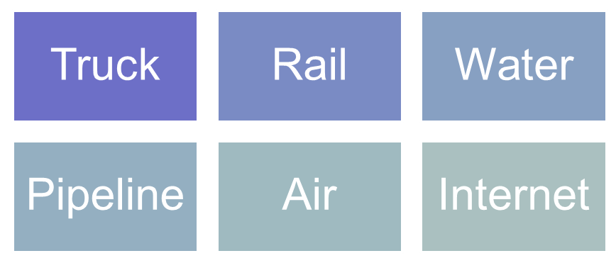
Marketing Logistics and Supply Chain Management
Major Logistics Functions
Transportation affects the pricing of products, delivery performance, and condition of the goods when they arrive
Copyright ©2014 by Pearson Education, Inc. All rights reserved
Notes:
Transportation
The choice of transportation carriers affects the pricing of products, delivery performance, and the condition of goods when they arrive—all of which will affect customer satisfaction. In shipping goods to its warehouses, dealers, and customers, the company can choose among five main transportation modes: truck, rail, water, pipeline, and air, along with an alternative mode for digital products—the Internet.
<ex12.13>
Trucks have increased their share of transportation steadily and now account for 40 percent of total cargo ton-miles moved in the United States. U.S. trucks travel more than 431 billion miles a year—more than double the distance traveled 25 years ago—carrying 8.7 billion tons of freight. According to the American Trucking Association, 80 percent of U.S. communities depend solely on trucks for their goods and commodities. Trucks are highly flexible in their routing and time schedules, and they can usually offer faster service than railroads. They are efficient for short hauls of high-value merchandise. Trucking firms have evolved in recent years to become full-service providers of global transportation services. For example, large trucking firms now offer everything from satellite tracking, Internet-based shipment management, and logistics planning software to cross-border shipping operations.
Railroads account for 40 percent of the total cargo ton-miles moved. They are one of the most cost-effective modes for shipping large amounts of bulk products—coal, sand, minerals, and farm and forest products—over long distances. In recent years, railroads have increased their customer services by designing new equipment to handle special categories of goods, providing flatcars for carrying truck trailers by rail (piggyback), and providing in-transit services such as the diversion of shipped goods to other destinations en route and the processing of goods en route.
Water carriers, which account for less than 5 percent of the cargo ton-miles, transport large amounts of goods by ships and barges on U.S. coastal and inland waterways. Although the cost of water transportation is very low for shipping bulky, low-value, nonperishable products such as sand, coal, grain, oil, and metallic ores, water transportation is the slowest mode and may be affected by the weather. Pipelines, which account for less than 1 percent of the cargo ton-miles, are a specialized means of shipping petroleum, natural gas, and chemicals from sources to markets. Most pipelines are used by their owners to ship their own products.
Although air carriers transport less than 1 percent of the cargo ton-miles of the nation’s goods, they are an important transportation mode. Airfreight rates are much higher than rail or truck rates, but airfreight is ideal when speed is needed or distant markets have to be reached. Among the most frequently airfreighted products are perishables (such as fresh fish, cut flowers) and high-value, low-bulk items (technical instruments, jewelry). Companies find that airfreight also reduces inventory levels, packaging costs, and the number of warehouses needed.
The Internet carries digital products from producer to customer via satellite, cable, phone wire, or wireless signal. Software firms, the media, music and video companies, and education all make use of the Internet to transport digital products. The Internet holds the potential for lower product distribution costs. Whereas planes, trucks, and trains move freight and packages, digital technology moves information bits.
Shippers also use intermodal transportation—combining two or more modes of transportation. Twelve percent of the total cargo ton-miles are moved via multiple modes. Piggyback describes the use of rail and trucks; fishyback, water and trucks; trainship, water and rail; and airtruck, air and trucks. Combining modes provides advantages that no single mode can deliver. Each combination offers advantages to the shipper. For example, not only is piggyback cheaper than trucking alone, but it also provides flexibility and convenience.
In choosing a transportation mode for a product, shippers must balance many considerations: speed, dependability, availability, capacity, cost, and others. Thus, if a shipper needs speed, air and truck are the prime choices. If the goal is low cost, then water or rail might be best.

Slide 34
Marketing Logistics and Supply Chain Management
Logistics Information Management
Logistics information management is the management of the flow of information, including customer orders, billing, inventory levels, and customer data
EDI (electronic data interchange)
VMI (vendor-managed inventory)
Copyright ©2014 by Pearson Education, Inc. All rights reserved
Notes:
Logistics Information Management
Companies manage their supply chains through information. Channel partners often link up to share information and make better joint logistics decisions. From a logistics perspective, flows of information, such as customer transactions, billing, shipment and inventory levels, and even customer data, are closely linked to channel performance. Companies need simple, accessible, fast, and accurate processes for capturing, processing, and sharing channel information.
Information can be shared and managed in many ways, but most sharing takes place through electronic data interchange (EDI), the digital exchange of data between organizations, which primarily is transmitted via the Internet. Walmart, for example, requires EDI links with its more than 100,000 suppliers through its Retail Link sales data system. If new suppliers don’t have EDI capability, Walmart will work with them to find and implement the needed tools.
In some cases, suppliers might actually be asked to generate orders and arrange deliveries for their customers. Many large retailers—such as Walmart and Home Depot—work closely with major suppliers such as P&G or Moen to set up vendor-managed inventory (VMI) systems or continuous inventory replenishment systems. Using VMI, the customer shares real-time data on sales and current inventory levels with the supplier. The supplier then takes full responsibility for managing inventories and deliveries. Some retailers even go so far as to shift inventory and delivery costs to the supplier. Such systems require close cooperation between the buyer and seller.

Slide 35
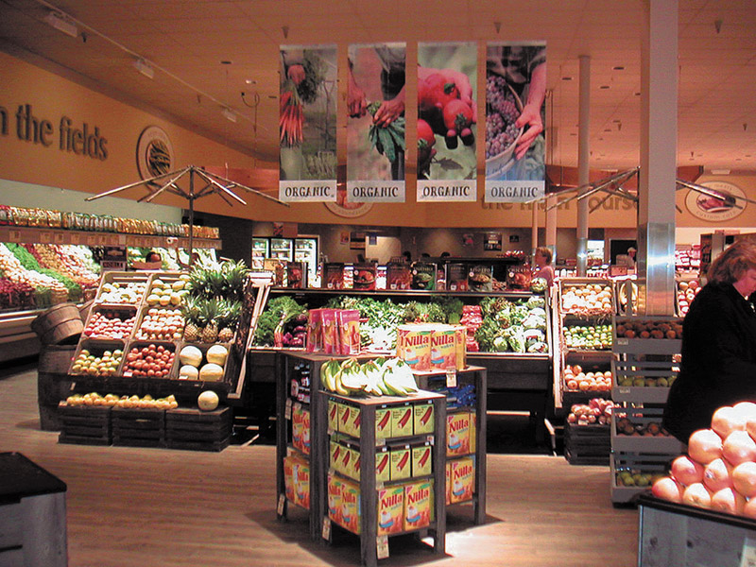
Retailing
Retailing includes all the activities in selling products or services directly to final consumers for their personal, non-business use
Retailers are businesses whose sales come primarily from retailing
Copyright ©2014 by Pearson Education, Inc. All rights reserved
Notes:
Retailing includes all the activities involved in selling products or services directly to final consumers for their personal, nonbusiness use. Many institutions—manufacturers, wholesalers, and retailers—do retailing. But most retailing is done by retailers, businesses whose sales come primarily from retailing.
Retailing plays a very important role in most marketing channels. Last year, retailers accounted for more than $4.6 trillion of sales to final consumers. They play an important role in connecting brands to consumers in what marketing agency OgilvyAction calls “the last mile”—the final stop in the consumer’s path to purchase. It’s the “distance a consumer travels between an attitude and an action,” explains OgilvyAction’s CEO. Some 40 percent of all consumer decisions are made in or near the store. Thus, retailers “reach consumers at key moments of truth, ultimately [influencing] their actions at the point of purchase.”
In fact, many marketers are now embracing the concept of shopper marketing, using point-of-purchase promotions and advertising to extend brand equity to “the last mile” and encourage favorable point-of-purchase decisions. Shopper marketing involves focusing the entire marketing process—from product and brand development to logistics, promotion, and merchandising—toward turning shoppers into buyers at the point of sale.
Of course, every well-designed marketing effort focuses on customer buying behavior. What differentiates the concept of shopper marketing is the suggestion that these efforts should be coordinated around the shopping process itself. For example, P&G follows a “store back” concept, in which all marketing ideas need to be effective at the store-shelf level and work back from there. The strategy builds around what P&G calls the “First Moment of Truth”—the critical 3 to 7 seconds that a shopper considers a product on a store shelf. “We are now brand-building from the eyes of the consumer toward us,” says a P&G executive.

Slide 36
Retailing
First Moment of Truth
No longer takes place only in stores
Growth of digital shopping
Combining in-store and digital shopping
Shopping mobile
Copyright ©2014 by Pearson Education, Inc. All rights reserved
Notes:
The dramatic growth of digital shopping, or combined digital and in-store shopping, has added a new dimension to shopper marketing. The “last mile” or “first moment of truth” no longer takes place only in stores. Most consumers now make at least some of their purchases online, without even setting foot into a retail store. Alternatively, they may research a purchase on the Internet before—or even during—a store visit. For example, it’s not uncommon to see a consumer looking at new TVs in a Best Buy while at the same time using a mobile app to check product reviews and prices at Amazon.com. Thus, shopper marketing isn’t just about in-store buying these days. Influencing consumers’ buying decisions as they shop involves efforts aimed at in-store, online, and mobile shopping .
Although most retailing is still done in retail stores, in recent years direct and online retailing have been growing much faster than store retailing.

Slide 37
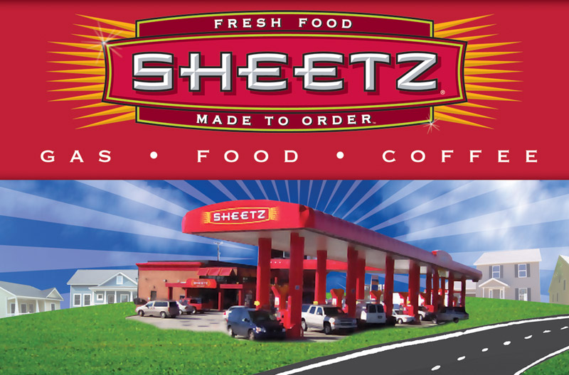
Retailing
Types of Retailers
Are classified by
Amount of service
Self-service
Limited service
Full service
Copyright ©2014 by Pearson Education, Inc. All rights reserved
Notes:
Retail stores come in all shapes and sizes—from your local hairstyling salon or family-owned restaurant to national specialty chain retailers such as REI or Williams-Sonoma to megadiscounters such as Costco or Walmart. The most important types of retail stores are described in Table 13.1 and discussed in the following sections. They can be classified in terms of several characteristics, including the amount of service they offer, the breadth and depth of their product lines, the relative prices they charge, and how they are organized.
Self-service retailers serve customers who are willing to perform their own locate-compare-select process to save money. They include: Wal-Mart and Supermarkets.
Limited service retailers provide more sales assistance because they carry more shopping goods about which customers need more information. Examples include Sears and JC Penney.
Full-service retailers assist customers in every phase of the shopping process, resulting in higher costs that are passed on to the customer as higher prices. Includes department stores and specialty stores

Slide 38
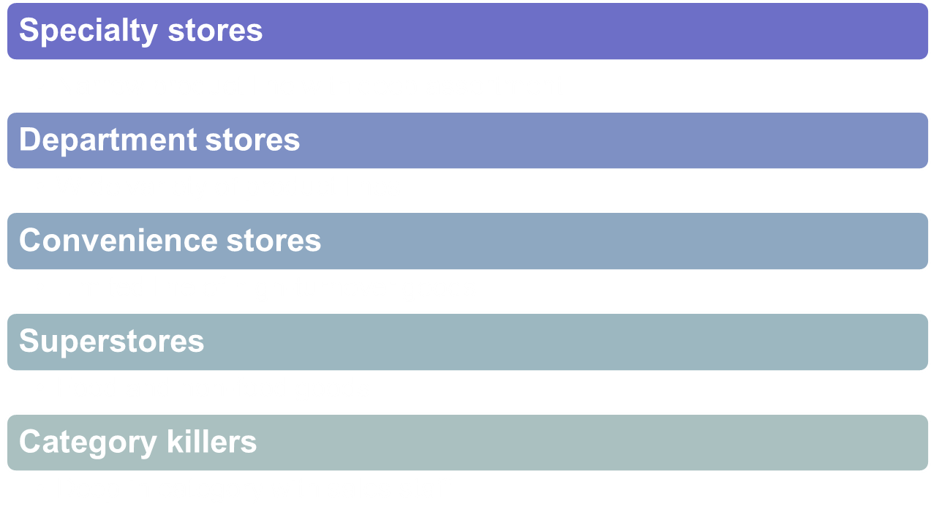
Retailing
Product Line
Copyright ©2014 by Pearson Education, Inc. All rights reserved
Notes:
Discussion Question
What are examples of these types of stores?
It might be difficult, depending on their geographic region, to find examples of superstores. Ask them where they would rather shop for a computer, a department store like Wal-Mart or a category killer like Best Buy? Why?
Product Line
Retailers can also be classified by the length and breadth of their product assortments. Some retailers, such as specialty stores, carry narrow product lines with deep assortments within those lines. Today, specialty stores are flourishing. The increasing use of market segmentation, market targeting, and product specialization has resulted in a greater need for stores that focus on specific products and segments.
By contrast, department stores carry a wide variety of product lines. In recent years, department stores have been squeezed between more focused and flexible specialty stores on the one hand and more efficient, lower-priced discounters on the other. In response, many have added promotional pricing to meet the discount threat. Others have stepped up the use of store brands and single-brand designer shops to compete with specialty stores. Still others are trying catalog, telephone, and online selling. Service remains the key differentiating factor. Retailers such as Nordstrom, Saks, Neiman Marcus, and other high-end department stores are doing well by emphasizing exclusive merchandise and high-quality service.
Supermarkets are the most frequently visited type of retail store. Today, however, they are facing slow sales growth because of slower population growth and an increase in competition from discounters (Walmart, Costco, and Dollar General) on the one hand and specialty food stores (Whole Foods Market, Trader Joe’s, Sprouts) on the other. Supermarkets also have been hit hard by the rapid growth of out-of-home eating over the past two decades. In fact, supermarkets’ share of the groceries and food market plunged from 66 percent in 2002 to less than 62 percent in 2009. Meanwhile, during the same time period, supercenters boosted their market share from 15.6 percent to 20.6 percent.
In the battle for “share of stomachs,” some supermarkets have moved upscale, providing improved store environments and higher-quality food offerings, such as from-scratch bakeries, gourmet deli counters, natural foods, and fresh seafood departments. Others, however, are attempting to compete head-on with food discounters such as Costco and Walmart by cutting costs, establishing more-efficient operations, and lowering prices. Publix, the nation’s largest employee-owned supermarket chain, has done this successfully:
Despite recent belt-tightening by consumers, while other Southeast grocery chains have struggled, Publix has grown steadily and profitably. The $27 billion chain has opened and acquired more new stores than any other supermarket during the past five years, and it boasts the second-highest annualized sales per square foot in the industry, behind only Whole Foods. Publix’s success comes from its focus on helping customers get the most out of today’s tighter food budgets. Even as its own costs soared due to higher commodity and transportation costs, the grocer launched Publix Essentials, a program that lowered prices by as much as 20 percent on staples such as milk, bread, and laundry detergent. In addition, Publix began a Savings Made Easy program that offers Meal Deal and Thrifty Tips advice to customers trying to stretch their shopping dollars. “In today’s economy, Publix is working hard to help,” says the chain. “In addition to lowering prices on groceries you need most, we’re giving you simple strategies for saving.” Says one retail consultant, “Publix is always at its best when the economy is at its worst.” Customers seem to agree. According to the American Customer Satisfaction Index (ACSI), for the 18th consecutive year, Publix is the highest-ranking supermarket for customer satisfaction.
Convenience stores are small stores that carry a limited line of high-turnover convenience goods. After several years of stagnant sales, these stores are now experiencing growth. Many convenience store chains have tried to expand beyond their primary market of young, blue-collar men by redesigning their stores to attract female shoppers. They are shedding the image of a “truck stop” where men go to buy gas, beer, cigarettes, or shriveled hotdogs on a roller grill and are instead offering freshly prepared foods and cleaner, safer, more-upscale environments.
Whether it’s for road warriors, construction workers, or soccer moms, Sheetz offers “a mecca for people on the go”—fast, friendly service and quality products in clean and convenient locations. “We really care about our customers,” says the company. “If you need to refuel your car or refresh your body, . . . Sheetz has what you need, when you need it. And, we’re here 24/7/365.” Sheetz certainly isn’t your run-of-the-mill convenience store operation. The average Sheetz store is nearly twice the size of the average 7-Eleven. Stores offer up a menu of made-to-order cold and toasted subs, sandwiches, and salads, along with hot fries, onion rings, chicken fingers, and burgers—all ordered through touch-screen terminals. Locations feature Sheetz Bros. Coffeez, a full-service espresso bar staffed by a trained barista. Frozen fruit smoothies round out the menu. To help make paying easier, Sheetz was the first chain in the nation to install system-wide MasterCard PayPass, allowing customers to quickly tap their credit cards and go. Sheetz also partnered with M&T Bank to offer ATM services at any Sheetz without a surcharge. Some analysts say that Sheetz aims to become the Walmart of convenience stores, and it just might get there.
Superstores are much larger than regular supermarkets and offer a large assortment of routinely purchased food products, nonfood items, and services. Walmart, Target, Meijer, and other discount retailers offer supercenters, very large combination food and discount stores. Whereas a traditional grocery store brings in about $466,000 a week in sales, a supercenter brings in about $1.5 million a week. Walmart, which opened its first supercenter in 1988, now has more than 3,000 supercenters in North America and is opening new ones at a rate of about 140 per year.
Recent years have also seen the rapid growth of superstores that are actually giant specialty stores, the so-called category killers (for example, Best Buy, Home Depot, and PetSmart). They feature stores the size of airplane hangars that carry a very deep assortment of a particular line. Category killers are found in a wide range of categories, including electronics, home-improvement products, books, baby gear, toys, linens and towels, party goods, sporting goods, and even pet supplies.
Finally, for many retailers, the product line is actually a service. Service retailers include hotels and motels, banks, airlines, restaurants, colleges, hospitals, movie theaters, tennis clubs, bowling alleys, repair services, hair salons, and dry cleaners. Service retailers in the United States are growing faster than product retailers. /.

Slide 39
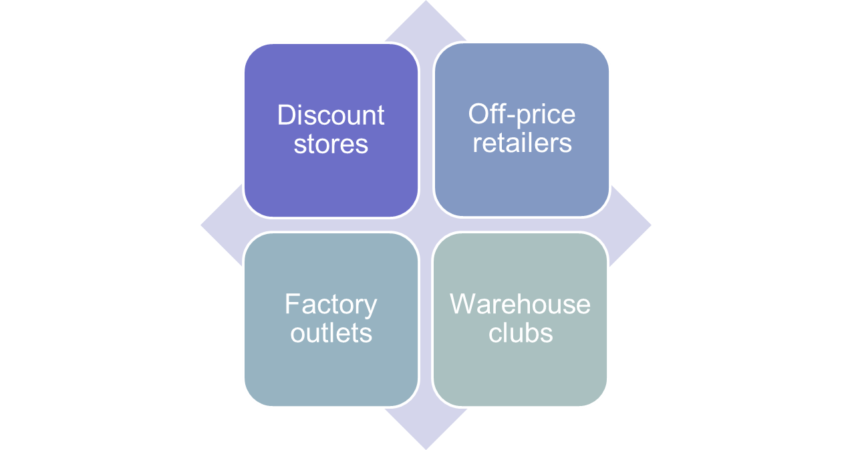
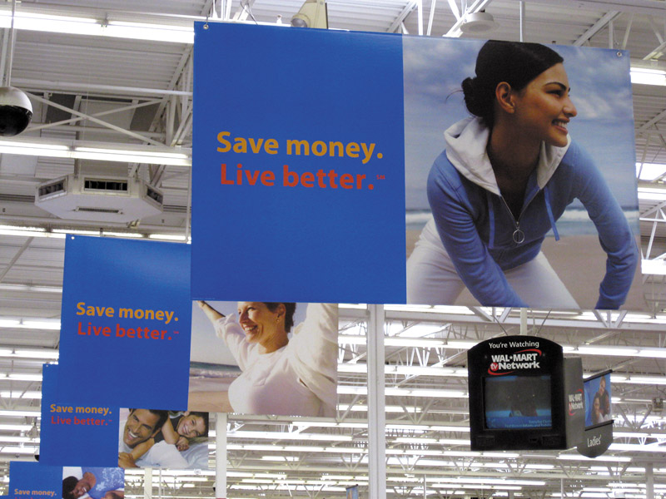
Retailing
Types of Retailers
Relative Prices
Copyright ©2014 by Pearson Education, Inc. All rights reserved
Notes:
Note to Instructor
Relative Prices
Retailers can also be classified according to the prices they charge (see Table 13.1). Most retailers charge regular prices and offer normal-quality goods and customer service. Others offer higher-quality goods and service at higher prices. Retailers that feature low prices are discount stores and “off-price” retailers.
Discount Stores. A discount store (for example, Target, Kmart, or Walmart) sells standard merchandise at lower prices by accepting lower margins and selling higher volume. The early discount stores cut expenses by offering few services and operating in warehouse-like facilities in low-rent, heavily traveled districts. Today’s discounters have improved their store environments and increased their services, while at the same time keeping prices low through lean, efficient operations.
Leading “big-box” discounters, such as Walmart, Costco, and Target, now dominate the retail scene. However, even “small-box” discounters are thriving in the current economic environment. For example, dollar stores are now today’s fastest-growing retail format. Back in the day, dollar stores sold mostly odd-lot assortments of novelties, factory overruns, closeouts, and outdated merchandise—most priced at $1. Not anymore. Dollar General, the nation’s largest small-box discount retailer, makes a powerful value promise for the times: “Save time. Save money. Every day”:
Dollar General’s slogan isn’t just for show. It’s a careful statement of the store’s value promise. “Our goal is to provide our customers a better life, and we think our customers are best served when we keep it real and keep it simple. We make shopping for everyday needs simpler and hassle-free by offering a carefully edited assortment of the most popular brands at low everyday prices in small, convenient locations.”
Dollar General’s slimmed-down product line and smaller stores (you could fit more than 25 Dollar General stores inside the average Walmart supercenter) add up to a quick trip—the average customer is in and out of the store in less than 10 minutes. And its prices on the popular brand-name products it carries are an estimated 20 to 40 percent lower than grocery store prices. Put it all together, and things are sizzling right now at Dollar General. Moreover, the fast-growing retailer is well positioned for the future. We “see signs of a new consumerism,” says Dollar General’s CEO, as people shift where they shop, switch to lower-cost brands, and stay generally more frugal.” Convenience and low prices, it seems, never go out of style.
Off-Price Retailers. As the major discount stores traded up, a new wave of off-price retailers moved in to fill the ultralow-price, high-volume gap. Ordinary discounters buy at regular wholesale prices and accept lower margins to keep prices down. By contrast, off-price retailers buy at less-than-regular wholesale prices and charge consumers less than retail. Off-price retailers can be found in all areas, from food, clothing, and electronics to no-frills banking and discount brokerages.
The three main types of off-price retailers are independents, factory outlets, and warehouse clubs. Independent off-price retailers either are independently owned and run or are divisions of larger retail corporations. Although many off-price operations are run by smaller independents, most large off-price retailer operations are owned by bigger retail chains. Examples include store retailers such as TJ Maxx and Marshalls, which are owned by TJX Companies, and online sellers such as Overstock.com.
Factory outlets—manufacturer-owned and operated stores by firms such as J. Crew, Gap, Levi Strauss, and others—sometimes group together in factory outlet malls and value-retail centers. At these centers, dozens of outlet stores offer prices as much as 50 percent below retail on a wide range of mostly surplus, discounted, or irregular goods. Whereas outlet malls consist primarily of manufacturers’ outlets, value-retail centers combine manufacturers’ outlets with off-price retail stores and department store clearance outlets.
The malls in general are now moving upscale—and even dropping factory from their descriptions. A growing number of outlet malls now feature luxury brands such as Coach, Polo Ralph Lauren, Dolce&Gabbana, Giorgio Armani, Burberry, and Versace. As consumers become more value-minded, even upper-end retailers are accelerating their factory outlet strategies, placing more emphasis on outlets such as Nordstrom Rack, Neiman Marcus Last Call, Bloomingdale’s Outlets, and Saks Off 5th. Many companies now regard outlets not simply as a way of disposing of problem merchandise but as an additional way of gaining business for fresh merchandise. The combination of highbrow brands and lowbrow prices found at outlets provides powerful shopper appeal, especially in thriftier times.
Warehouse clubs (also known as wholesale clubs or membership warehouses), such as Costco, Sam’s Club, and BJ’s, operate in huge, drafty, warehouse-like facilities and offer few frills. However, they offer ultralow prices and surprise deals on selected branded merchandise. Warehouse clubs have grown rapidly in recent years. These retailers appeal not only to low-income consumers seeking bargains on bare-bones products but also to all kinds of customers shopping for a wide range of goods, from necessities to extravagances.
Web link goes to premiumoutlets.com. Review the list of stores, the different kinds of companies using this type of outlet for selling product.

Slide 40
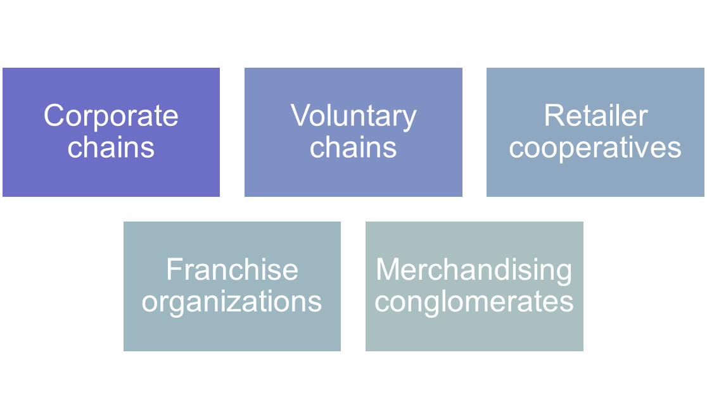
Retailing
Types of Retailers
Organizational Approach
Copyright ©2014 by Pearson Education, Inc. All rights reserved
Notes:
Organizational Approach
Although many retail stores are independently owned, others band together under some form of corporate or contractual organization. Table 13.2 describes four major types of retail organizations—corporate chains, voluntary chains, retailer cooperatives, and franchise organizations.

Slide 41
Retailing
Types of Retailers
Organizational Approach
Corporate chains are two or more outlets that are commonly owned and controlled
Size allows them to buy in large quantities at lower prices and gain promotional economies
  Sears
  CVS
Copyright ©2014 by Pearson Education, Inc. All rights reserved
Notes:
Corporate chains are two or more outlets that are commonly owned and controlled. They have many advantages over independents. Their size allows them to buy in large quantities at lower prices and gain promotional economies. They can hire specialists to deal with areas such as pricing, promotion, merchandising, inventory control, and sales forecasting.

Slide 42
Retailing
Types of Retailers
Organizational Approach
Voluntary chains are wholesale-sponsored groups of independent retailers that engage in group buying and common merchandising
IGA
Western Auto
Copyright ©2014 by Pearson Education, Inc. All rights reserved
Notes:
The great success of corporate chains caused many independents to band together in one of two forms of contractual associations. One is the voluntary chain—a wholesaler-sponsored group of independent retailers that engages in group buying and common merchandising. Examples include the Independent Grocers Alliance (IGA), Western Auto, and Do-It Best hardwares.

Slide 43
Retailing
Types of Retailers
Organizational Approach
Retailer cooperatives is a group of independent retailers that band together to set up a joint-owned, central wholesale operation and conduct joint merchandising and promotion effort
Ace Hardware
Associated Grocers
Copyright ©2014 by Pearson Education, Inc. All rights reserved
Notes:
The other type of contractual association is the retailer cooperative—a group of independent retailers that bands together to set up a jointly owned, central wholesale operation and conduct joint merchandising and promotion efforts. Examples are Associated Grocers and Ace Hardware. These organizations give independents the buying and promotion economies they need to meet the prices of corporate chains.

Slide 44
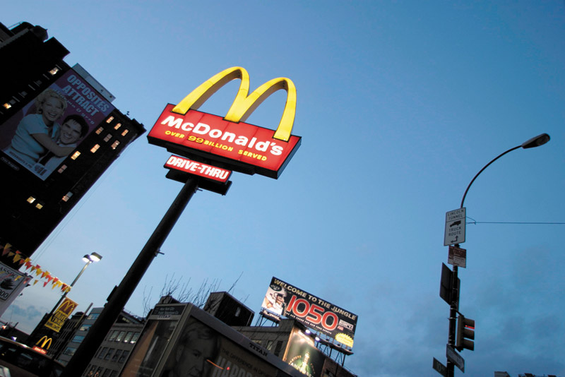
Retailing
Types of Retailers
Organizational Approach
Franchise organizations are based on some unique product or service; on a method of doing business; or on the trade name, good will, or patent that the franchisor has developed
Copyright ©2014 by Pearson Education, Inc. All rights reserved
Notes:
Another form of contractual retail organization is a franchise. The main difference between franchise organizations and other contractual systems (voluntary chains and retail cooperatives) is that franchise systems are normally based on some unique product or service; a method of doing business; or the trade name, goodwill, or patent that the franchisor has developed. Franchising has been prominent in fast-food restaurants, motels, health and fitness centers, auto sales and service dealerships, and real estate agencies.
However, franchising covers a lot more than just burger joints and fitness centers. Franchises have sprung up to meet just about any need. For example, Mad Science Group franchisees put on science programs for schools, scout troops, and birthday parties. And Mr. Handyman provides repair services for homeowners while Merry Maids tidies up their houses.
Franchises now command 40 percent of all retail sales in the United States. These days, it’s nearly impossible to stroll down a city block or drive on a city street without seeing a McDonald’s, Subway, Jiffy Lube, or Holiday Inn. One of the best-known and most successful franchisers, McDonald’s, now has more than 33,000 stores in 119 countries, including almost 14,000 in the United States. It serves 68 million customers a day and racks up more than $85 billion in annual systemwide sales. More than 80 percent of McDonald’s restaurants worldwide are owned and operated by franchisees. Gaining fast is Subway, one of the fastest-growing franchise restaurants, with systemwide sales of $16.2 billion and more than 36,000 shops in 99 countries, including nearly 25,000 in the United States.

Slide 45
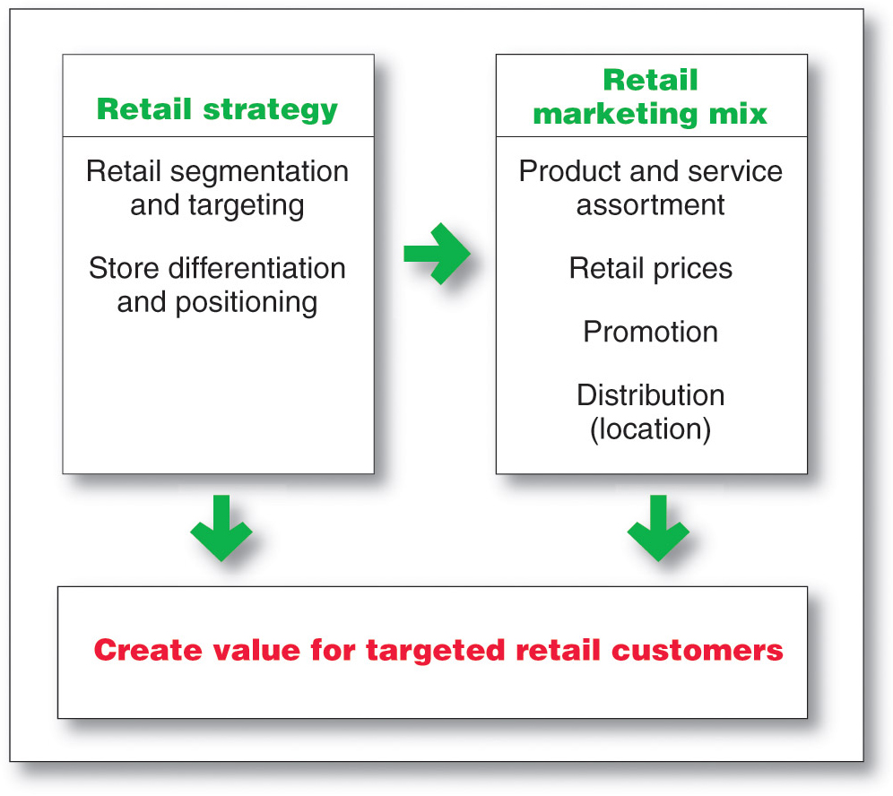
Retailing
Retailer Marketing Decisions
Copyright ©2014 by Pearson Education, Inc. All rights reserved
Notes:
Retailers are always searching for new marketing strategies to attract and hold customers. In the past, retailers attracted customers with unique product assortments and more or better services. Today, the assortments and services of various retailers are looking more and more alike. You can find most consumer brands not only in department stores but also in mass-merchandise discount stores, off-price discount stores, and all on the Internet. Thus, it’s now more difficult for any one retailer to offer exclusive merchandise.
Service differentiation among retailers has also eroded. Many department stores have trimmed their services, whereas discounters have increased theirs. In addition, customers have become smarter and more price sensitive. They see no reason to pay more for identical brands, especially when service differences are shrinking. For all these reasons, many retailers today are rethinking their marketing strategies.
As shown in Figure 13.1, retailers face major marketing decisions about segmentation and targeting, store differentiation and positioning, and the retail marketing mix.

Slide 46
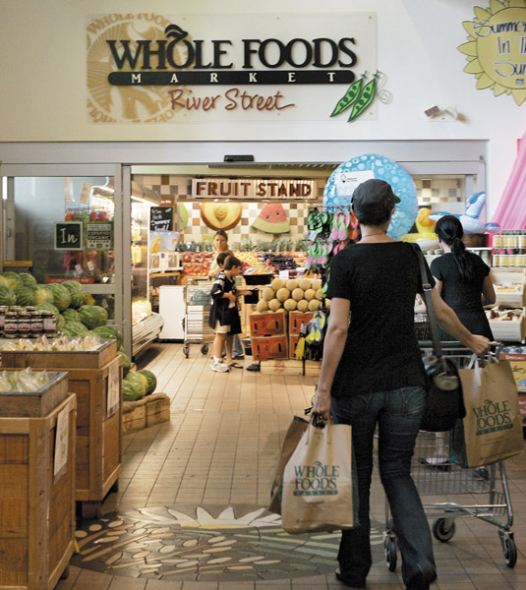
Retailing
Retailer Marketing Decisions
Segmentation targeting, differentiation, and positioning involves the definition and profile of the market so the other retail marketing decisions can be made
Copyright ©2014 by Pearson Education, Inc. All rights reserved
Notes:
Segmentation, Targeting, Differentiation, and Positioning Decisions
Retailers must first segment and define their target markets and then decide how they will differentiate and position themselves in these markets. Should the store focus on upscale, midscale, or downscale shoppers? Do target shoppers want variety, depth of assortment, convenience, or low prices? Until they define and profile their markets, retailers cannot make consistent decisions about product assortment, services, pricing, advertising, store décor, or any of the other decisions that must support their positions.
Too many retailers, even big ones, fail to clearly define their target markets and positions. For example, what market does Sears target? For what is the department store known? What is its value proposition versus, say, Walmart on one hand and Macy’s or Nordstrom on the other? If you’re having trouble answering those questions, you’re not alone—so is Sears’ management
By contrast, successful retailers define their target markets well and position themselves strongly. For example, Trader Joe’s positions itself strongly with its “cheap gourmet” value proposition. Walmart is strongly positioned on low prices and what those always low prices mean to its customers. And highly successful outdoor products retailer Bass Pro Shops positions itself powerfully as being “as close to the Great Outdoors as you can get indoors!”
With solid targeting and positioning, a retailer can compete effectively against even the largest and strongest competitors. For example, compare little Five Guys Burger and Fries to giant McDonald’s. Five Guys has less than 1,000 stores and $1 billion in sales; McDonald’s has more than 33,000 stores worldwide and sales of $85 billion. How does this smaller burger chain compete with Big Mac? It doesn’t—at least not directly. Five Guys succeeds by carefully positioning itself away from McDonald’s:
Five Guys’ menu is limited—really limited. Aside from hamburgers, the chain has only hot dogs and grilled cheese or veggie sandwiches (which hardly anyone buys). You won’t find salads or breakfasts or Chicken McBites at Five Guys, or even a chocolate milk shake. But what you can get at Five Guys you simply can’t get at McDonald’s—such as a mouthwatering Five Guys cheeseburger consisting of two patties and 840 gluttonous calories, piled high with cheese, lettuce, tomatoes, pickles, jalapenos, grilled mushrooms, or any of 11 free toppings, made to order with all-fresh ingredients and buried under an absurdly large serving of just-cooked hand-cut fries. The chain claims that there are more than 250,000 ways to order a Five Guys burger, recently crowned Zagat’s “Best Burger.” What’s more it’s all very fresh—there are no freezers in any Five Guys locations, just coolers. The small burger joint’s unique offerings and generous portions set it apart, allowing it to charge more than regular fast-food places.
Five Guys can’t match McDonald’s massive economies of scale, incredible volume purchasing power, ultraefficient logistics, diverse menu, and low prices. But then again, it doesn’t even try. By positioning itself away from McDonald’s and other large competitors, Five Guys has become one of the nation’s fastest-growing fast-casual restaurant chains.

Slide 47
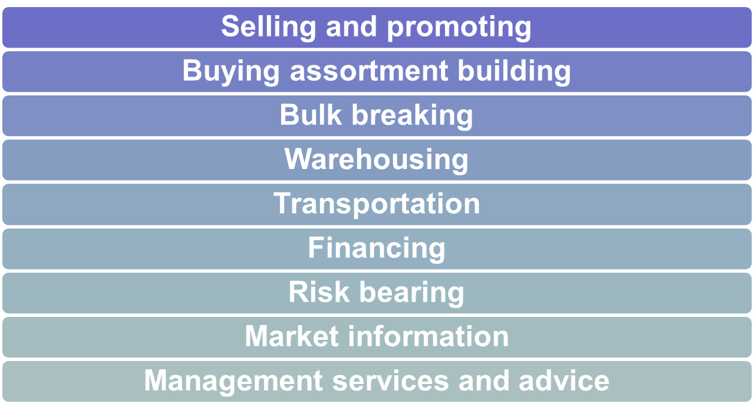
Wholesaling
Wholesaling includes all activities involved in selling goods and services to those buying for resale or business use
Copyright ©2014 by Pearson Education, Inc. All rights reserved
Notes:
includes all the activities involved in selling goods and services to those buying them for resale or business use. Firms engaged primarily in wholesaling activities are called wholesalers.
Wholesalers buy mostly from producers and sell mostly to retailers, industrial consumers, and other wholesalers. As a result, many of the nation’s largest and most important wholesalers are largely unknown to final consumers. For example, you may never have heard of Grainger, even though it’s very well known and much valued by its more than 2 million business and institutional customers in 157 countries. Wholesalers add value by performing one or more of the these channel functions.

Slide 48
Wholesaling
Wholesaling
Selling and promoting involves the wholesaler’s sales force helping the manufacturer reach many smaller customers at lower cost
Buying assortment building involves the selection of items and building of assortments needed by their customers, saving the customers work
Copyright ©2014 by Pearson Education, Inc. All rights reserved
Notes:
Selling and promoting: Wholesalers’ sales forces help manufacturers reach many small customers at a low cost. The wholesaler has more contacts and is often more trusted by the buyer than the distant manufacturer.
Buying and assortment building: Wholesalers can select items and build assortments needed by their customers, thereby saving much work.

Slide 49
Wholesaling
Wholesaling
Bulk breaking involves the wholesaler buying in larger quantity and breaking into smaller lots for its customers
Warehousing involves the wholesaler holding inventory, reducing its customers’ inventory cost and risk
Copyright ©2014 by Pearson Education, Inc. All rights reserved
Notes:
Bulk breaking: Wholesalers save their customers money by buying in carload lots and breaking bulk (breaking large lots into small quantities).
Warehousing: Wholesalers hold inventories, thereby reducing the inventory costs and risks of suppliers and customers.

Slide 50
Wholesaling
Wholesaling
Transportation involves the wholesaler providing quick delivery due to its proximity to the buyer
Financing involves the wholesaler providing credit and financing suppliers by ordering earlier and paying on time
Copyright ©2014 by Pearson Education, Inc. All rights reserved
Notes:
Transportation: Wholesalers can provide quicker delivery to buyers because they are closer to buyers than are producers.
Financing: Wholesalers finance their customers by giving credit, and they finance their suppliers by ordering early and paying bills on time.

Slide 51
Wholesaling
Wholesaling
Risk bearing involves the wholesaler absorbing risk by taking title and bearing the cost of theft, damage, spoilage, and obsolescence
Market information involves the wholesaler providing information to suppliers and customers about competitors, new products, and price developments
Copyright ©2014 by Pearson Education, Inc. All rights reserved
Notes:
Risk bearing: Wholesalers absorb risk by taking title and bearing the cost of theft, damage, spoilage, and obsolescence.
Market information: Wholesalers give information to suppliers and customers about competitors, new products, and price developments.

Slide 52
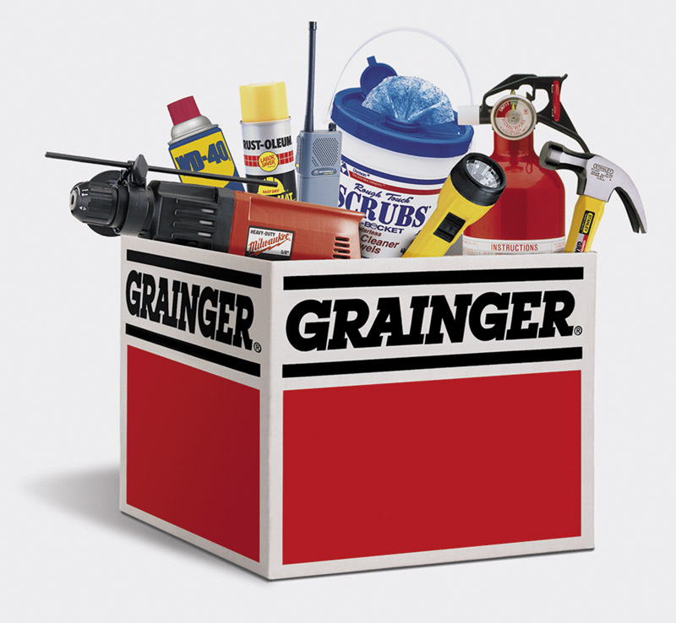
Wholesaling
Wholesaling
Management services and advice involves wholesalers helping retailers train their sales clerks, improve store layouts, and set up accounting and inventory control systems
Copyright ©2014 by Pearson Education, Inc. All rights reserved
Notes:
Management services and advice: Wholesalers often help retailers train their salesclerks, improve store layouts and displays, and set up accounting and inventory control systems.

Slide 53
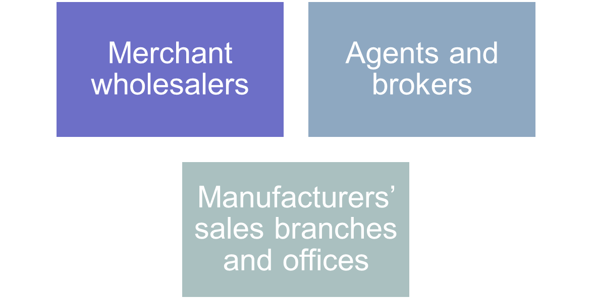
Wholesaling
Types of Wholesalers
Copyright ©2014 by Pearson Education, Inc. All rights reserved
Notes:
Types of Wholesalers
Wholesalers fall into three major groups (see Table 13.3): merchant wholesalers, brokers and agents, and manufacturers’ and retailers’ branches and offices.

Slide 54
Wholesaling
Types of Wholesalers
Merchant wholesalers is the largest group of wholesalers and include:
Full-service wholesalers who provide a full set of services
Limited service wholesalers who provide few services and specialized functions
Copyright ©2014 by Pearson Education, Inc. All rights reserved
Notes:
Types of Wholesalers
Merchant wholesalers are the largest single group of wholesalers, accounting for roughly 50 percent of all wholesaling. Merchant wholesalers include two broad types: full-service wholesalers and limited-service wholesalers. Full-service wholesalers provide a full set of services, whereas the various limited-service wholesalers offer fewer services to their suppliers and customers. The different types of limited-service wholesalers perform varied specialized functions in the distribution channel.

Slide 55
Wholesaling
Types of Wholesalers
Brokers and agents do not take title, perform a few functions, and specialize by product line or customer type
Brokers bring buyers and sellers together and assist in negotiations
Agents represent buyers or sellers
Copyright ©2014 by Pearson Education, Inc. All rights reserved
Notes:
Brokers and agents differ from merchant wholesalers in two ways: They do not take title to goods, and they perform only a few functions. Like merchant wholesalers, they generally specialize by product line or customer type. A broker brings buyers and sellers together and assists in negotiation. Agents represent buyers or sellers on a more permanent basis. Manufacturers’ agents (also called manufacturers’ representatives) are the most common type of agent wholesaler.

Slide 56
Wholesaling
Types of Wholesalers
Manufacturers’ sales branches and offices is a form of wholesaling by sellers or buyers themselves rather than through independent wholesalers
Copyright ©2014 by Pearson Education, Inc. All rights reserved
Notes:
The third major type of wholesaling is that done in manufacturers’ sales branches and offices by sellers or buyers themselves rather than through independent wholesalers.

Slide 57
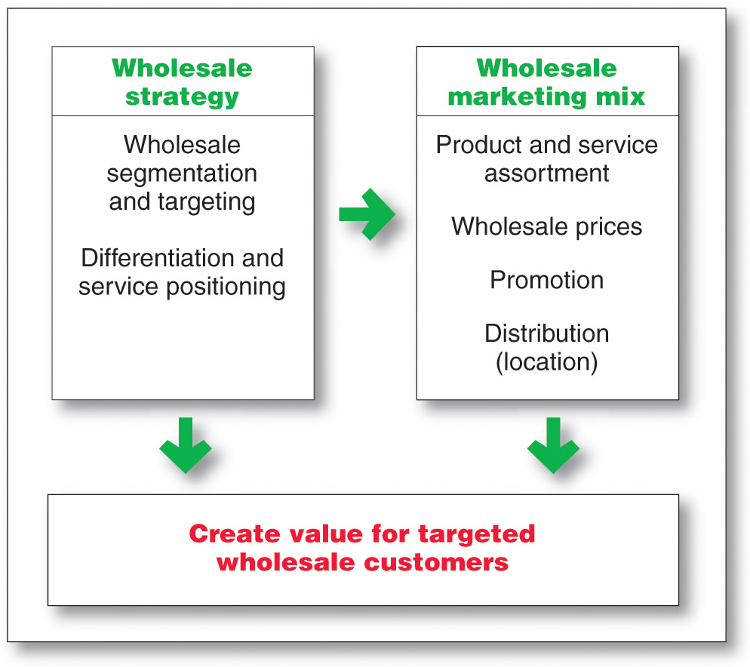
Wholesaling
Wholesaler Marketing Decisions
Copyright ©2014 by Pearson Education, Inc. All rights reserved
Notes:
Wholesaler Marketing Decisions
Wholesalers now face growing competitive pressures, more-demanding customers, new technologies, and more direct-buying programs on the part of large industrial, institutional, and retail buyers. As a result, they have taken a fresh look at their marketing strategies. As with retailers, their marketing decisions include choices of segmentation and targeting, differentiation and positioning, and the marketing mix—product and service assortments, price, promotion, and distribution

Slide 58
Wholesaling
Wholesaler Marketing Decisions
Segmentation, targeting, differentiation, positioning decisions
Size of customer
Type of customer
Need for service
Copyright ©2014 by Pearson Education, Inc. All rights reserved
Notes:
Segmentation, Targeting, Differentiation, and Positioning Decisions
Like retailers, wholesalers must segment and define their target markets and differentiate and position themselves effectively—they cannot serve everyone. They can choose a target group by size of customer (for example, large retailers only), type of customer (convenience stores only), the need for service (customers who need credit), or other factors. Within the target group, they can identify the more profitable customers, design stronger offers, and build better relationships with them. They can propose automatic reordering systems, establish management-training and advisory systems, or even sponsor a voluntary chain. They can discourage less-profitable customers by requiring larger orders or adding service charges to smaller ones.

Slide 59
Retailing
Retailing Trends and Developments
Growth of Non-store Retailing
Direct
Online
Mobile
Copyright ©2014 by Pearson Education, Inc. All rights reserved
Notes:
Note to Instructor
Discussion Question
What percent of your purchases are online? Why is it low for some types of products?
It might be surprising to see that for certain categories it is very high but for others it remains low. You can ask why they differ by category. It might include shipping costs, need to try the product, size, impulse purchase, etc.
Growth of Direct and Online Retailing
Most consumers still make a majority of their purchases the old-fashioned way: They go to the store, find what they want, wait patiently in line to plunk down their cash or credit cards, and bring home the goods. However, consumers now have a broad array of nonstore alternatives, including direct and online shopping. As we’ll discuss in Chapter 17, direct and online marketing are currently the fastest-growing forms of marketing.
Today, thanks to advanced technologies, easier-to-use and enticing online sites and mobile apps, improved online services, and the increasing sophistication of search technologies, online retailing is thriving. In fact, although it currently accounts for only about 8 percent of total U.S. retail sales, online buying is growing at a much brisker pace than retail buying as a whole. Last year’s U.S. online retail sales reached an estimated $194.3 billion, up 16 percent over the previous year, and will reach an estimated $279 billion by 2015.
Retailer online sites and mobile apps also influence a large amount of in-store buying. One recent survey revealed that more than 60 percent of shoppers say they look for deals online before at least half of all shopping trips. What’s more, to the dismay of store retailers, many shoppers now check out merchandise at brick-and-mortar store showrooms before buying it online—a process called showrooming. Today, half of shoppers who buy products online first check them out at a traditional store. Large retailers such as Target, Walmart, and Best Buy have been hardest hit by showrooming and are busy devising strategies designed to thwart such shopping behavior (see Real Marketing 13.2).
Thus, it’s no longer a matter of customers deciding whether to shop in the store or shop online. Increasingly, customers are merging store, online, and mobile outlets into a single shopping process. The Internet and digital devices have spawned a whole new breed of shopper and way of shopping. Whether shopping for cars, homes, electronics, consumer products, or medical care, many people just can’t buy anything unless they first look it up online and get the lowdown. And they’ve gotten used to buying anywhere, anytime—whether it’s in the store, online, or even online while in the store.
All types of retailers now employ direct and online channels. The Web and mobile online sales of large brick-and-mortar retailers, such as Walmart, Target, Staples, and Best Buy, are increasing rapidly. Many large online-only retailers—Amazon.com, Zappos.com, online travel companies such as Travelocity.com and Expedia.com, and others—have made it big on the Internet. At the other extreme, hordes of niche marketers have used the Internet to reach new markets and expand their sales.
Still, much of the anticipated growth in online sales will go to multichannel retailers—the click-and-brick marketers who can successfully merge the virtual and physical worlds. In a recent ranking of the top-20 online retail sites, 70 percent were owned by store-based retail chains. For example, thanks largely to rapid growth in online sales, upscale home products retailer Williams-Sonoma now captures more than 40 percent of its total revenues from its direct-to-consumer channel. Like many retailers, Williams-Sonoma has discovered that many of its best customers visit and shop both online and offline. Beyond just offering online shopping, the retailer engages customers through online communities, social media, mobile apps, a blog, and special online programs.

Slide 60
Retailing
Retailing Trends and Developments
New Retail Forms and Shortening Retail Life Cycles
Growing importance of retail technology provides better forecasts, inventory control, electronic ordering, transfer of information, scanning, online transaction processing, improved merchandise handling systems, and the ability to connect with customers
Copyright ©2014 by Pearson Education, Inc. All rights reserved
Notes:
Growing Importance of Retail Technology
Retail technologies have become critically important as competitive tools. Progressive retailers are using advanced IT and software systems to produce better forecasts, control inventory costs, interact electronically with suppliers, send information between stores, and even sell to customers within stores. They have adopted sophisticated systems for checkout scanning, RFID inventory tracking, merchandise handling, information sharing, and customer interactions.
Perhaps the most startling advances in retail technology concern the ways in which retailers are connecting with consumers. Today’s customers have gotten used to the speed and convenience of buying online and to the control that the Internet gives them over the buying process. The Internet lets consumers shop when they like and where they like, with instant access to gobs of information about competing products and prices. No real-world store can do all that.
Increasingly, however, retailers are attempting to meet these new consumer expectations by bringing online-style technologies into their stores. Many retailers now routinely use technologies ranging from touch-screen kiosks, mobile hand-held shopping assistants, and customer-loyalty apps to interactive dressing-room mirrors and virtual sales associates. For example, Eastern Mountain Sports uses an iPad app to assist in outfitting shoppers for their next adventure with items available both in the store and on the company’s website. “No longer are we constrained by square footage as to what we can sell,” says an EMS marketer.
According to one retailing executive, the future of technology in retailing lies in merging the online and offline shopping experiences. “It’s not as though there’s a physical retail world and an online retail world, and as one grows, the other declines,” he says. “They’re increasingly integrated.” For example, consider this futuristic shopping scenario.
It’s a snowy Saturday in Chicago, but Amy, age 28, needs resort wear for an upcoming Caribbean vacation. She starts shopping from her couch via videoconference with her personal concierge at Danella, one of her favorite retailers. Based their conversation and on Amy’s past buying at the store, the concierge recommends several items, superimposing photos of them onto Amy’s avatar. Amy toggles to another browser tab to research customer reviews and prices, returns to buy one item from Danella online, and then drives to the store to try on other selected items. At the store, a sales associate greets Amy by name and walks her to a dressing room stocked with her online choices—plus some matching shoes. She likes the shoes, so she scans the bar code into her smartphone and finds the same pair for $30 less at another store. The sales associate quickly offers to match the price.
As Amy tries things on, she uses an interactive mirror that lets her scan matching items and project them onto her body. Finally, selections in hand, she checks out using her smartphone. As she heads for the door, a life-size screen recognizes her and shows a special offer on an irresistible summer-weight top. Amy checks her budget online, smiles, and uses her phone to scan the customized QR code on the screen. The item will be shipped to her home overnight.
This functional scenario is neither as futuristic nor as fanciful as it might seem. All the technology is already available and will soon be found everywhere. The future belongs to retailers who can blend various in-store and online technologies into a seamless shopping experience.

Slide 61
Retailing
Trends and Developments
Green Retailing
Environmentally sustainable practices
  Store design, construction, operations
  Product assortment
  Recycling made easier
  Package and distribution
Copyright ©2014 by Pearson Education, Inc. All rights reserved
Notes:
Green Retailing
Today’s retailers are increasingly adopting environmentally sustainable practices. They are greening up their stores and operations, promoting more environmentally responsible products, launching programs to help customers be more responsible, and working with channel partners to reduce their environmental impact.
At the most basic level, most large retailers are making their stores more environmentally friendly through sustainable building design, construction, and operations. For example, all new Kohl’s stores are constructed with recycled and regionally sourced building materials, water-efficient landscaping and plumbing fixtures, and ENERGY STAR-rated roofs that reduce energy usage. Inside, new stores use occupancy sensor lighting for stockrooms, dressing rooms, and offices; energy management systems to control heating and cooling; and a recycling program for cardboard boxes, packaging, hangers. “Kohl’s cares,” says the store. “From large-scale initiatives like constructing environmentally friendly buildings to everyday practices like recycling hangers, we’re taking big steps to ensure we leave a smaller footprint.”
Retailers are also greening up their product assortments. For example, Safeway offers its own Bright Green line of home care products, featuring cleaning and laundry soaps made with biodegradable and naturally derived ingredients, energy-efficient light bulbs, and paper products made from 100 percent recycled content. Such products can both boost sales and lift the retailer’s image as a responsible company.
Many retailers have also launched programs that help consumers make more environmentally responsible decisions. Staples’ EcoEasy program “makes it easier to make a difference” by helping to customers identify green products sold in its stores and to recycle printer cartridges, mobile phones, computers, and other office technology products. Staples recycles some 30 million printer cartridges and ten million pounds of old technology each year.
Finally, many large retailers are joining forces with suppliers and distributors to create more sustainable products, packaging, and distribution systems. For example, Amazon.com works closely with the producers of many of the products it sells to reduce and simplify their packaging. And beyond its own substantial sustainability initiatives, Walmart wields its huge buying power to urge its army of suppliers to improve their environmental impact and practices. The retailer has even developed a worldwide Sustainable Product Index, by which it rates suppliers. It plans to translate the index into a simple rating for consumers to help them make more sustainable buying choices.
Green retailing yields both top- and bottom-line benefits. Sustainable practices lift a retailer’s top line by attracting consumers looking to support environmentally friendly sellers and products. They also help the bottom line by reducing costs. For example, Amazon.com’s reduced-packaging efforts increase customer convenience and eliminate “wrap rage” while at the same time saving packaging costs. And Kohl’s earth-friendly environmentally friendly buildings not only appeal to customers and helps save the planet but also cost less to operate.

Slide 62
Wholesaling
Trends in Wholesaling
Need for greater efficiency
Added- value customer relationships
Increase in customer demand for more services
Increase use of technology to boost productivity
Copyright ©2014 by Pearson Education, Inc. All rights reserved
Notes:
Trends in Wholesaling
Today’s wholesalers face considerable challenges. The industry remains vulnerable to one of its most enduring trends—the need for ever-greater efficiency. Recent economic conditions have led to demands for even lower prices and the winnowing out of suppliers who are not adding value based on cost and quality. Progressive wholesalers constantly watch for better ways to meet the changing needs of their suppliers and target customers. They recognize that their only reason for existence comes from adding value, which occurs by increasing the efficiency and effectiveness of the entire marketing channel.
As with other types of marketers, the goal is to build value-adding customer relationships. McKesson provides an example of progressive, value-adding wholesaling. The company is a diversified health care services provider and the nation’s leading wholesaler of pharmaceuticals, health and beauty care, home health care, and medical supply and equipment products. To survive, especially in a tight economic environment, McKesson has to be more cost effective than manufacturers’ sales branches. Thus, the company has built efficient automated warehouses, established direct computer links with drug manufacturers, and created extensive online supply management and accounts receivable systems for customers. It offers retail pharmacists a wide range of online resources, including supply-management assistance, catalog searches, real-time order tracking, and an account-management system. It has also created solutions such as automated pharmaceutical-dispensing machines that assist pharmacists by reducing costs and improving accuracy. Retailers can even use the McKesson systems to maintain prescription histories and medical profiles on their customers.

Slide 63
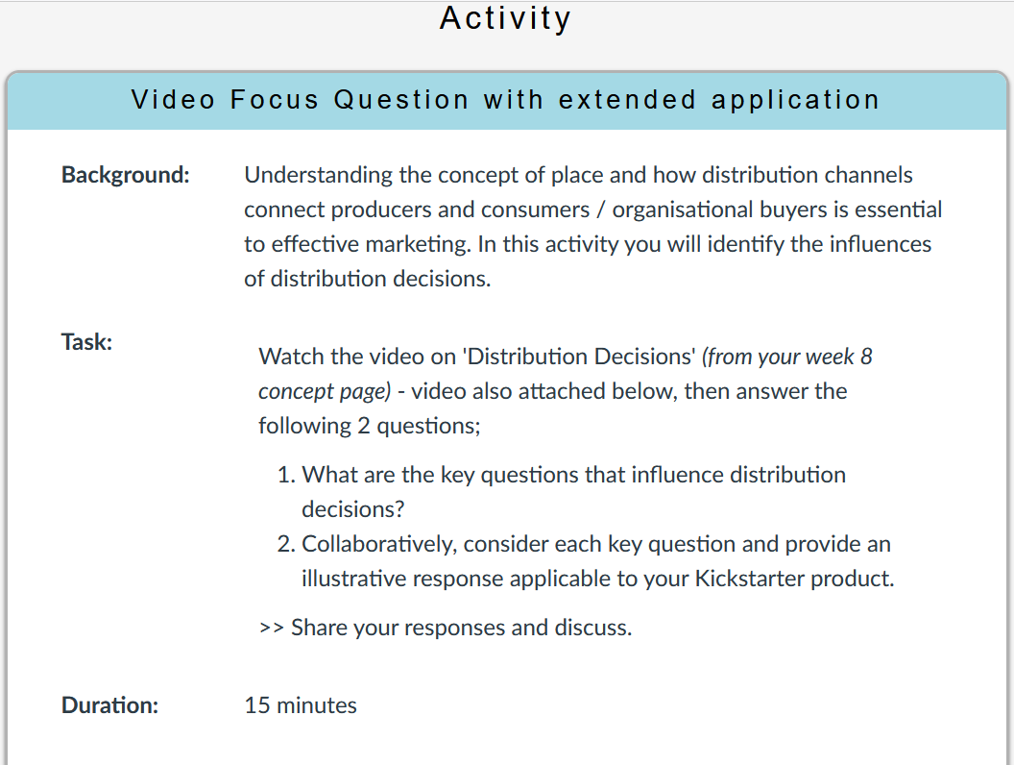
Tutorial A

Slide 64
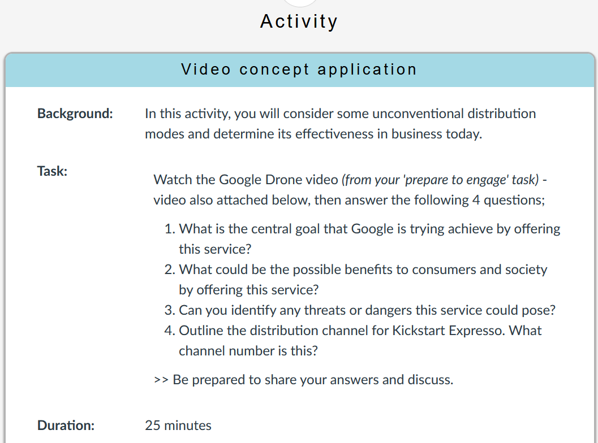
Tutorial B

Slide 65
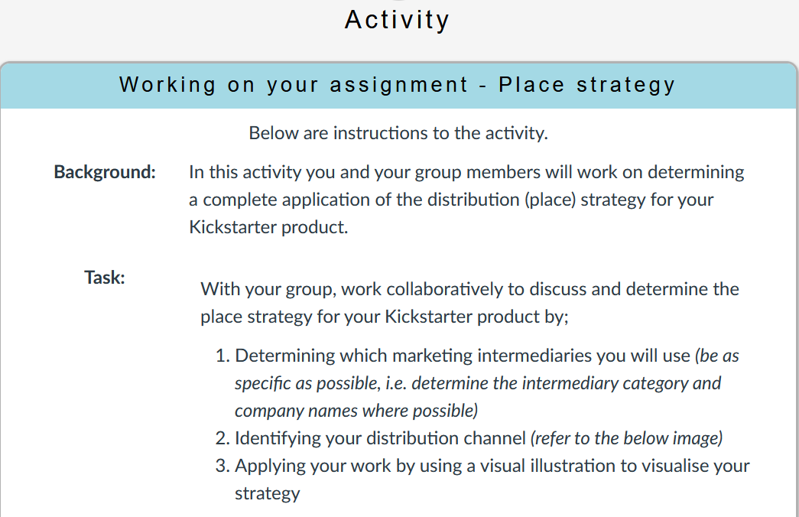
After class

Slide 66
