Slide 2
SVM Calculation for deutron

Slide 3
Introduction
J^{π}=1⁺
N
P
Isospin=0
S-wave or D-wave
Consider s-wave only
2-body problem (1-body?)
Direct
Diagonalize the matrix
S.V.M
B_{deut}=2.2245 [MeV]

Slide 5
fbs.inp
2 ! number of particles
1.,1. ! masses of particles
0,0 ! charges of particles
1 ! no. of isospin configurations
1.,1,2 ! coefficient, projections of the isospin
4 ! no. of spin configurations
1.,1,2 ! coefficient, projections of the spin
1.,2,1
0.,2,2
0.,1,1
41.47,-16981,2,1 ! hbar**2/m , iran, ico, ibf
5,10,14 ! M0 , K0, K
0.0001,7. ! bmin, bmax

Slide 6

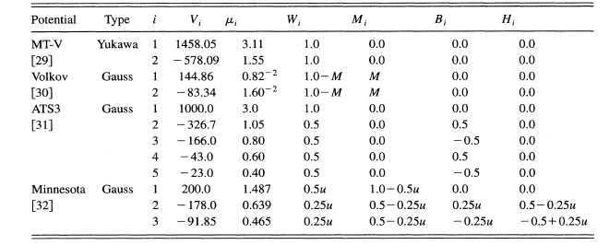
pot.inp
1 ! ipcon
0,4 ! N_{t},N₀
1 ! ipcon
0,1 ! N_{t},N₀

Slide 7
MT-V | SVM (K.Varga) | SVM-present
E (MeV) | -0.4107 | -0.4103
<r²>^{1/2} (fm) | 3.743 | 3.794
Volkov | SVM (K.Varga) | SVM-present
E (MeV) | -0.545 | -0.5413
<r²>^{1/2} (fm) | 3.44 | 3.355
ATS3 | SVM (K.Varga) | SVM-present
E (MeV) | -2.216 | -2.2157
<r²>^{1/2} (fm) | 1.94 | 1.936
Minnesota | SVM (K.Varga) | SVM-present
E (MeV) | -2.202 | -2.2022
<r²>^{1/2} (fm) | 1.952 | 1.9499

Slide 8
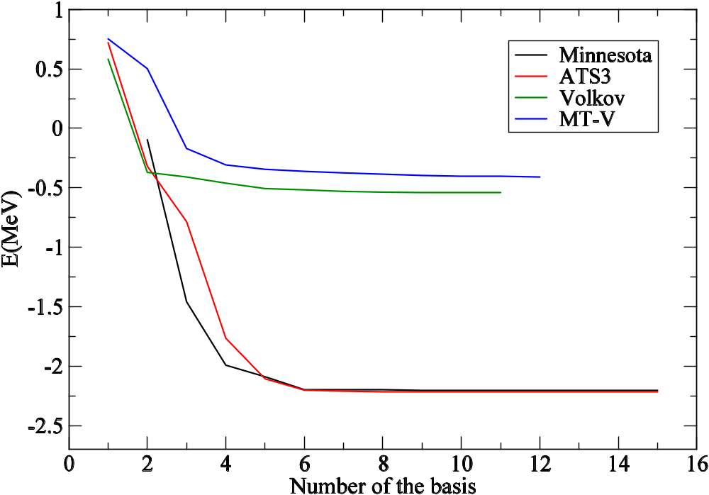
Energy Convergence

Slide 9
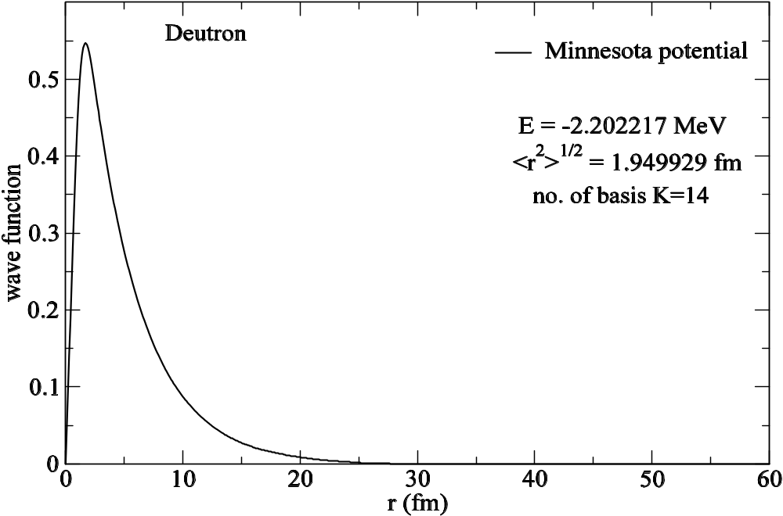
Radial wave function

Slide 10
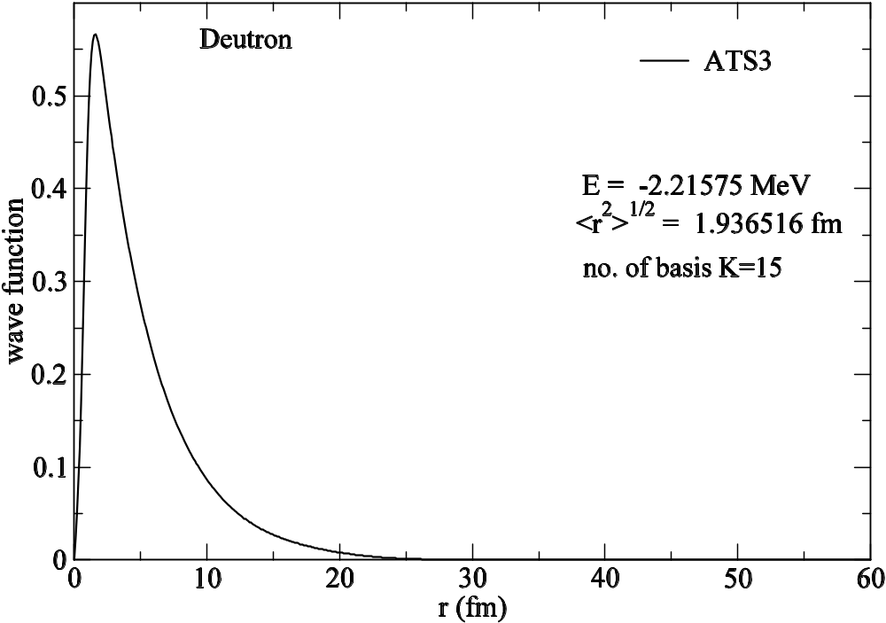

Slide 11
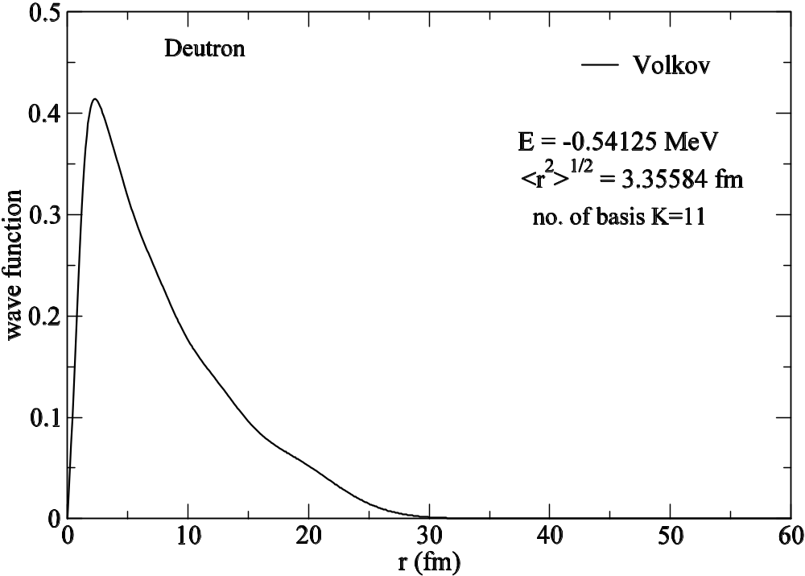

Slide 12
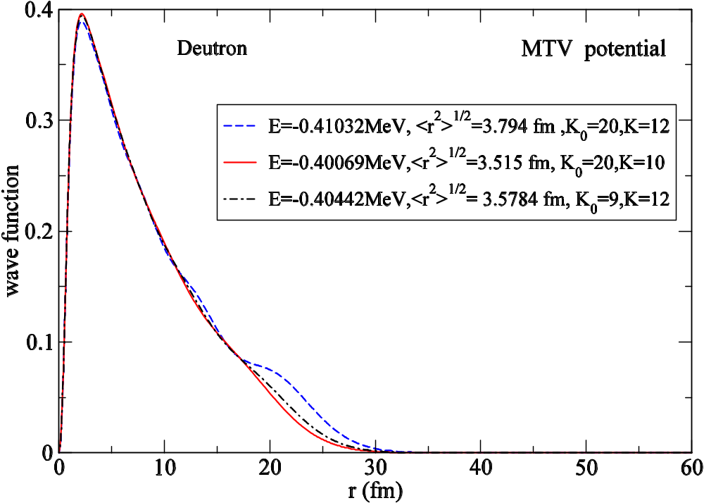

Slide 13
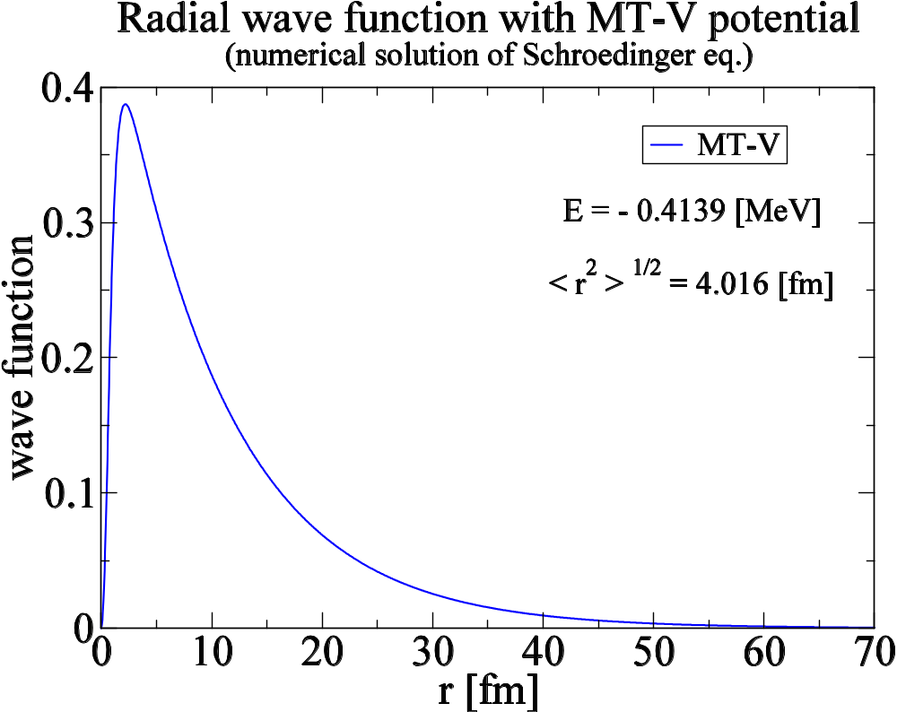
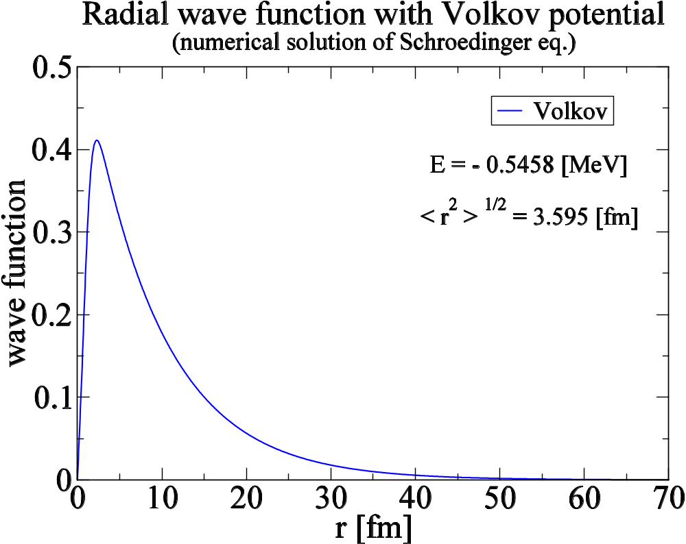

Slide 15
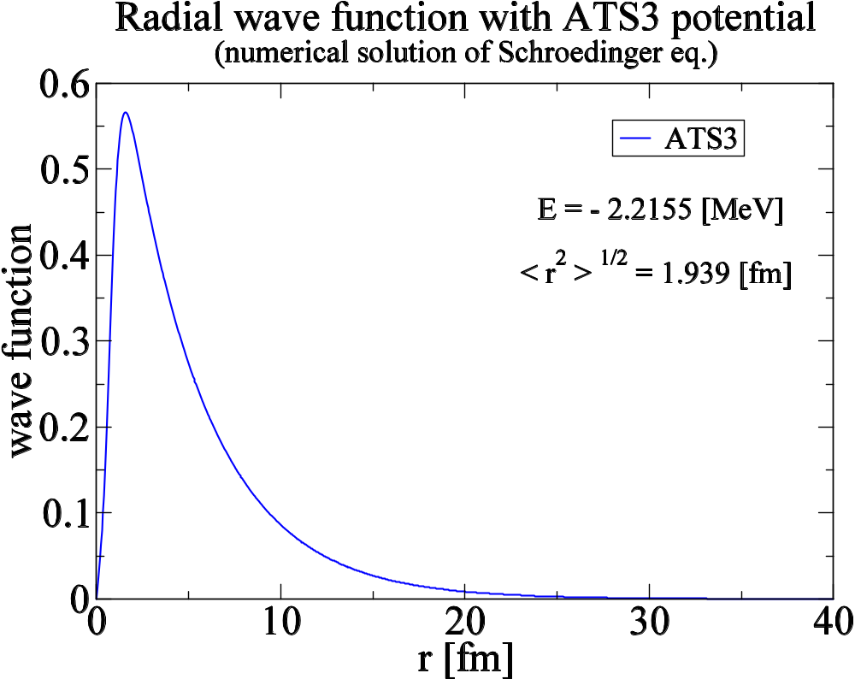

Slide 16
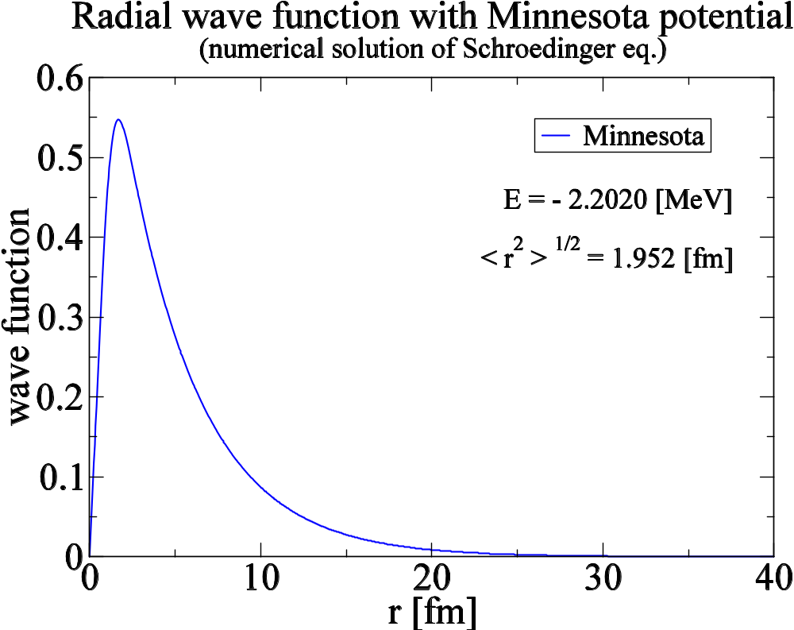

Slide 17
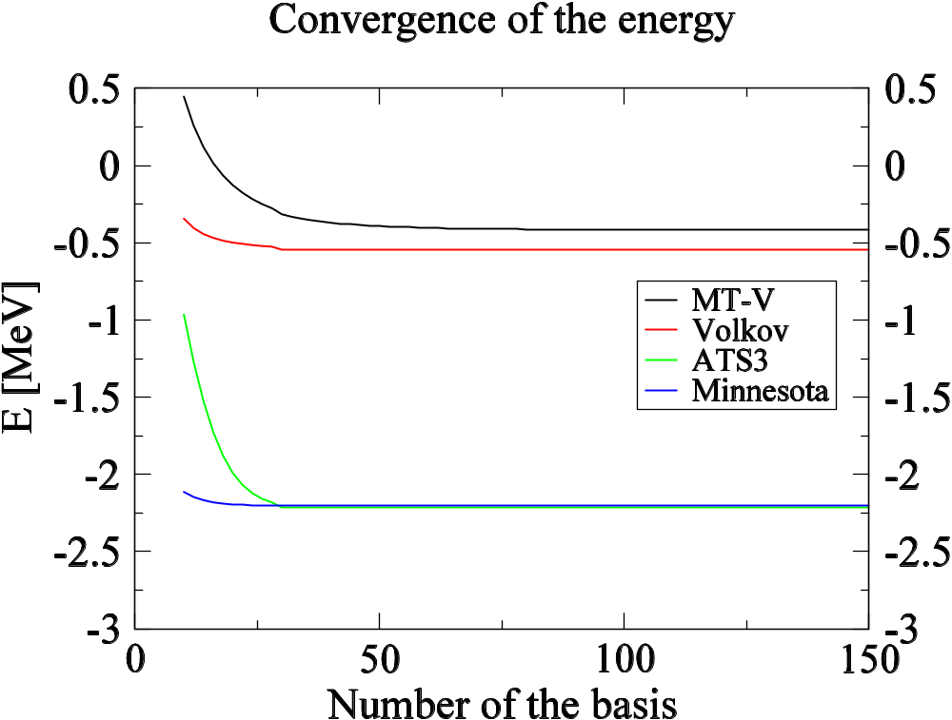

Slide 18
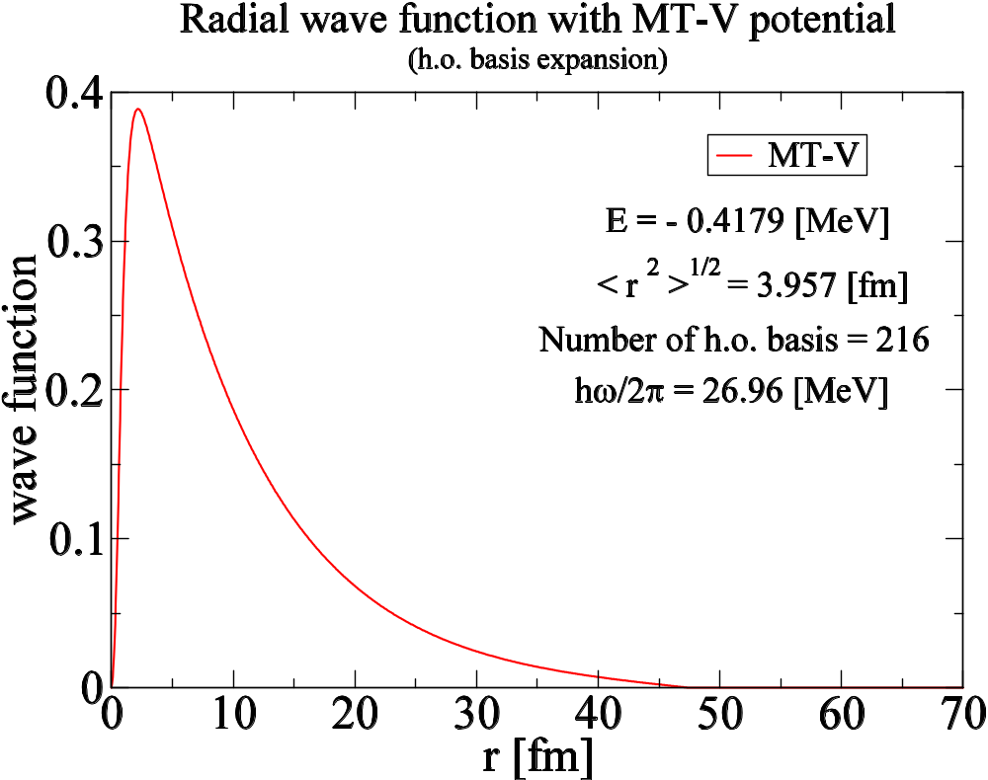

Slide 19
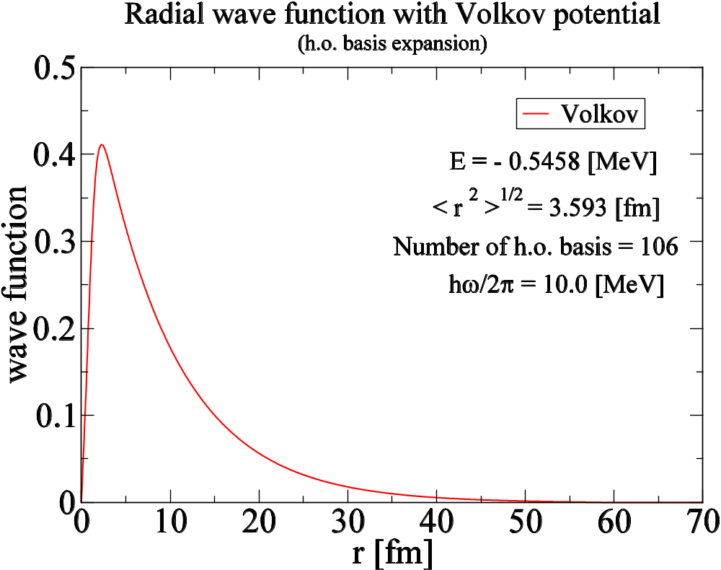

Slide 20
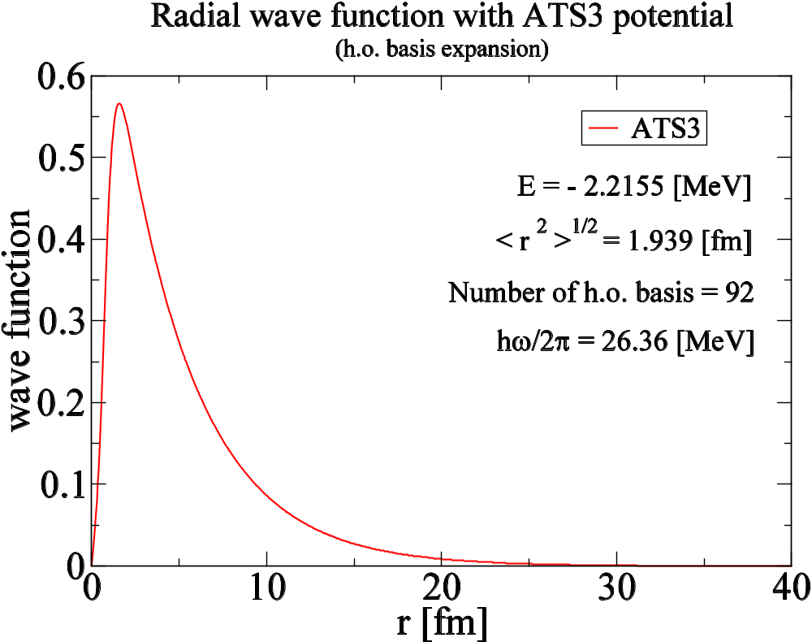

Slide 21
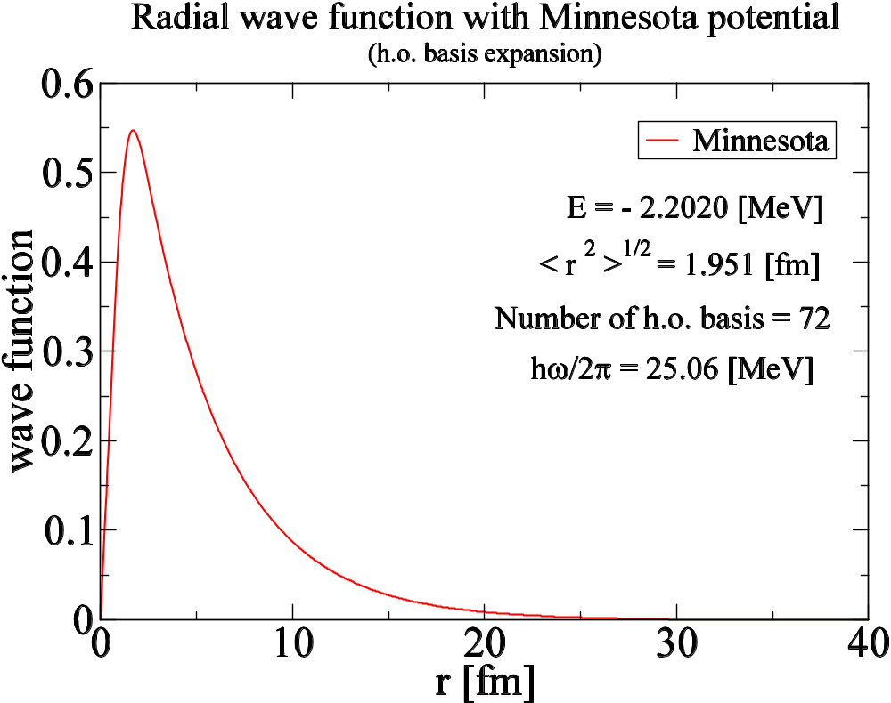

Slide 22
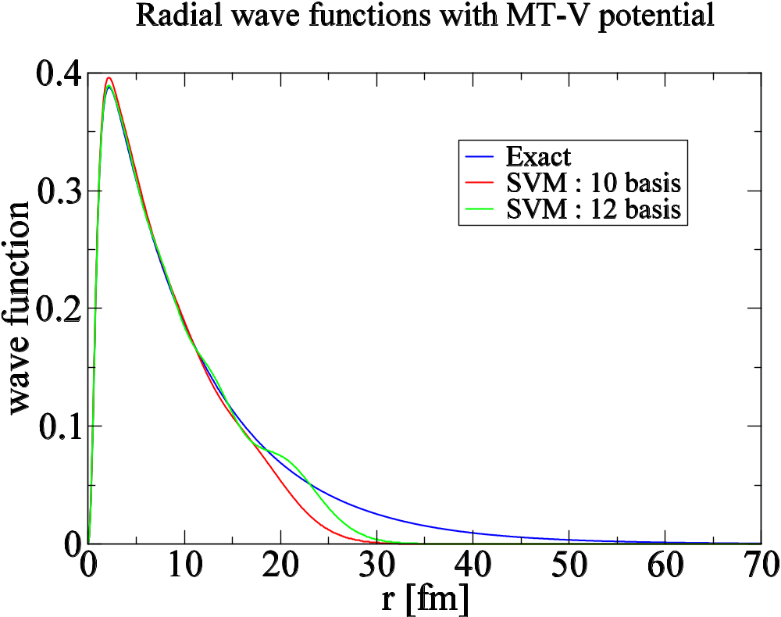

Slide 23
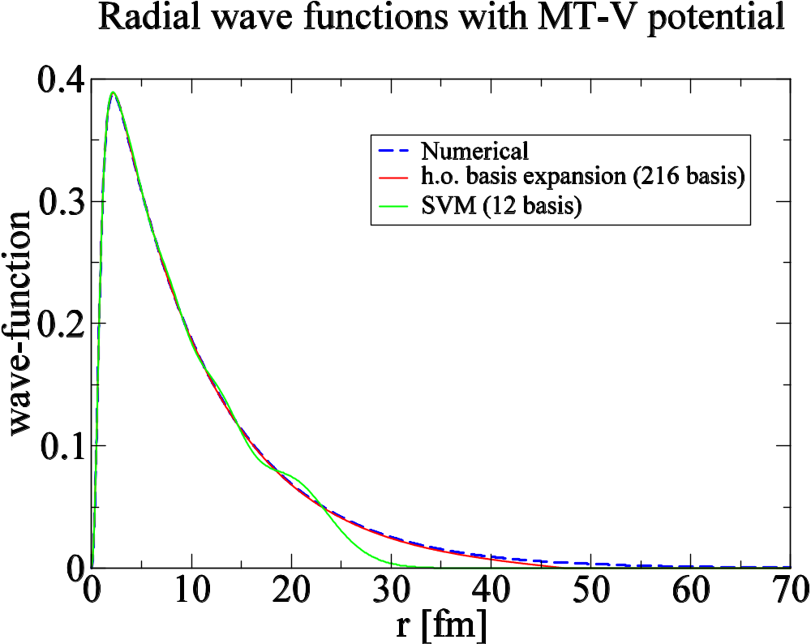

Slide 24
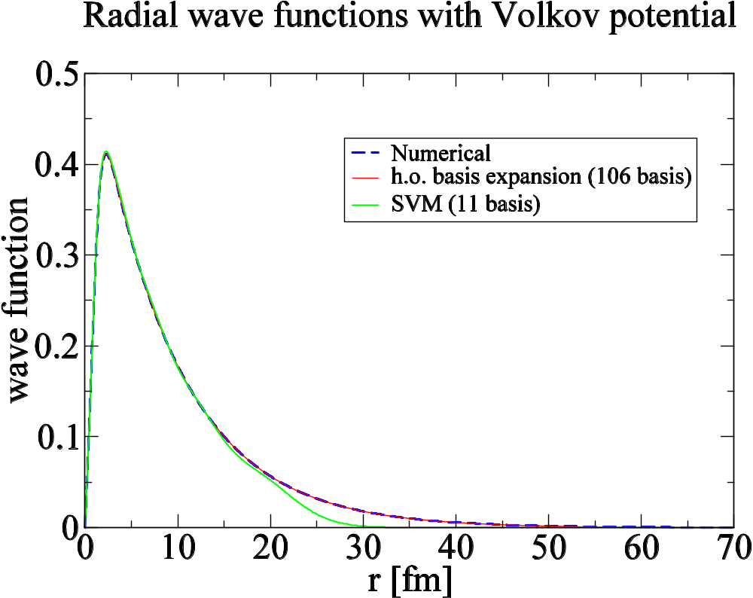

Slide 25
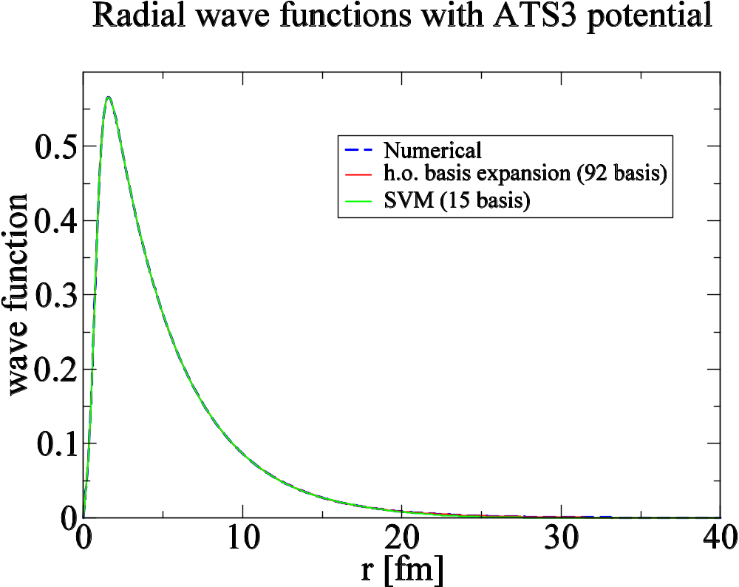

Slide 26
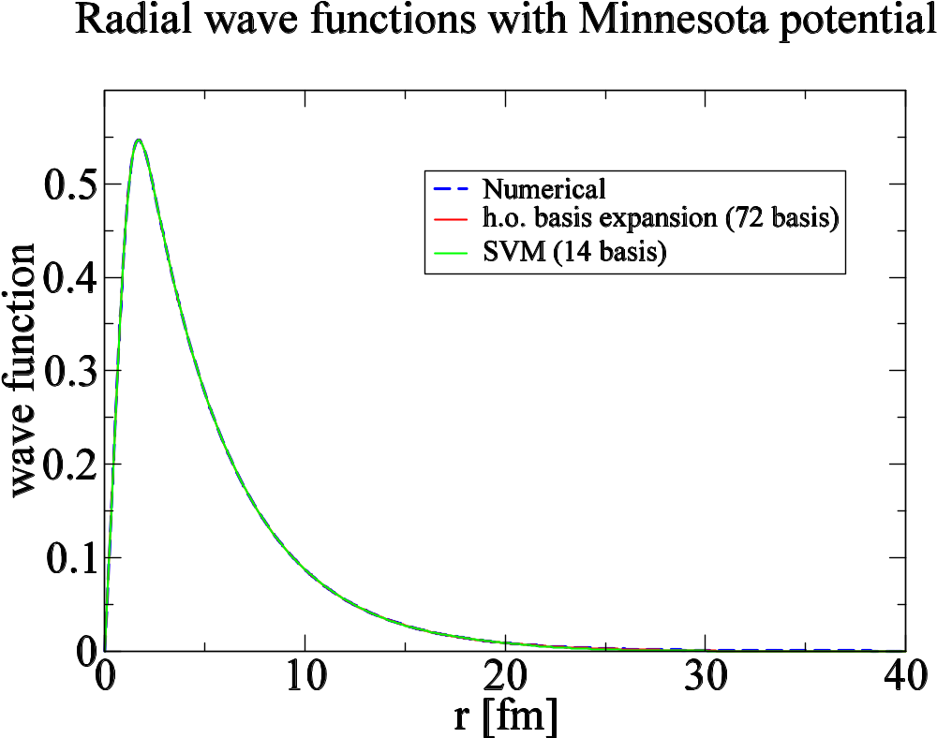

Slide 27
Binding Energy (MeV)
MT-V
Volkov
ATS3
Minnesota
Numerical
-0.4139
-0.5458
-2.2155
-2.2020
h.o. basis
-0.4179
-0.5458
-2.2155
-2.2020
SVM
-0.4103
-0.5413
-2.2158
-2.2022
Exp.
-2.2245
MeV

Slide 28
rms radii (fm)
MT-V
Volkov
ATS3
Minnesota
Numerical
4.016
3.595
1.939
1.952
h.o. basis
3.957
3.953
1.939
1.951
SVM
3.795
3.356
1.937
1.950
Exp.
1.96 fm

