Slide 2
Introduction
J^{π}=1⁺
N
P
Isospin=0
S-wave or D-wave
Consider s-wave only
2-body problem (1-body?)
Direct
Diagonalize the matrix
S.V.M
B_{deut}=2.2245 [MeV]

Slide 4
SVM Calculation for deutron

Slide 5
fbs.inp
2 ! number of particles
1.,1. ! masses of particles
0,0 ! charges of particles
1 ! no. of isospin configurations
1.,1,2 ! coefficient, projections of the isospin
2 ! no. of spin configurations
1.,1,1 ! coefficient, projections of the spin
1.,2,2
41.47,-16981,2,1 ! hbar**2/m , iran, ico, ibf
5,10,14 ! M0 , K0, K
0.0001,7. ! bmin, bmax

Slide 6

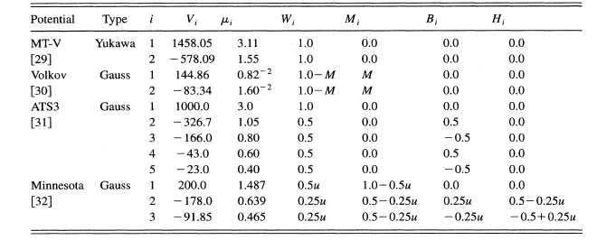
pot.inp
1 ! ipcon
0,4 ! N_{t},N₀
1 ! ipcon
0,1 ! N_{t},N₀

Slide 7
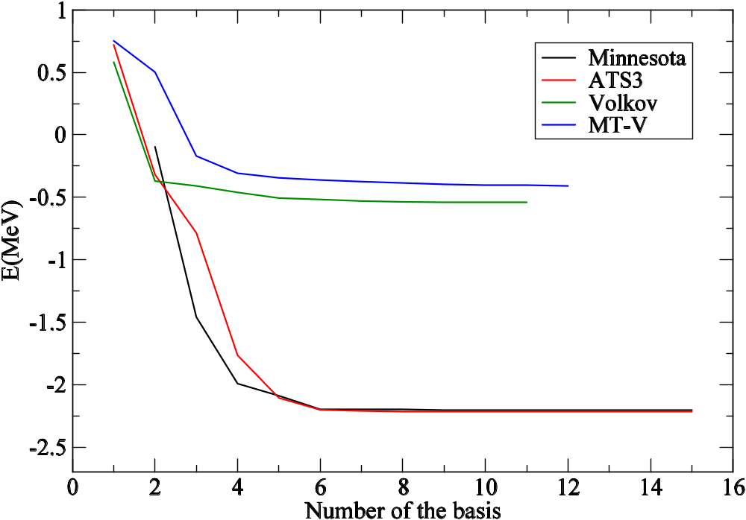
Energy Convergence

Slide 8
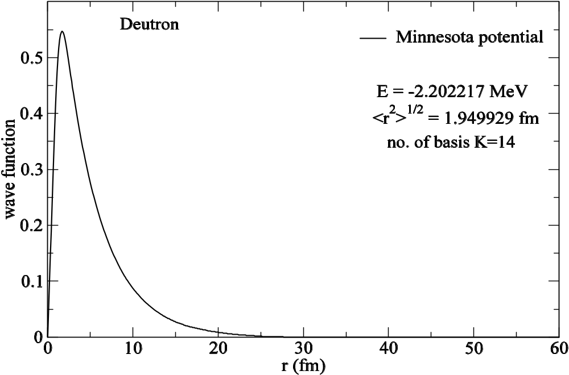
Radial wave function
Minnesota | SVM (K.Varga) | SVM-present
E (MeV) | -2.202 | -2.2022
<r²>^{1/2} (fm) | 1.952 | 1.9499

Slide 9
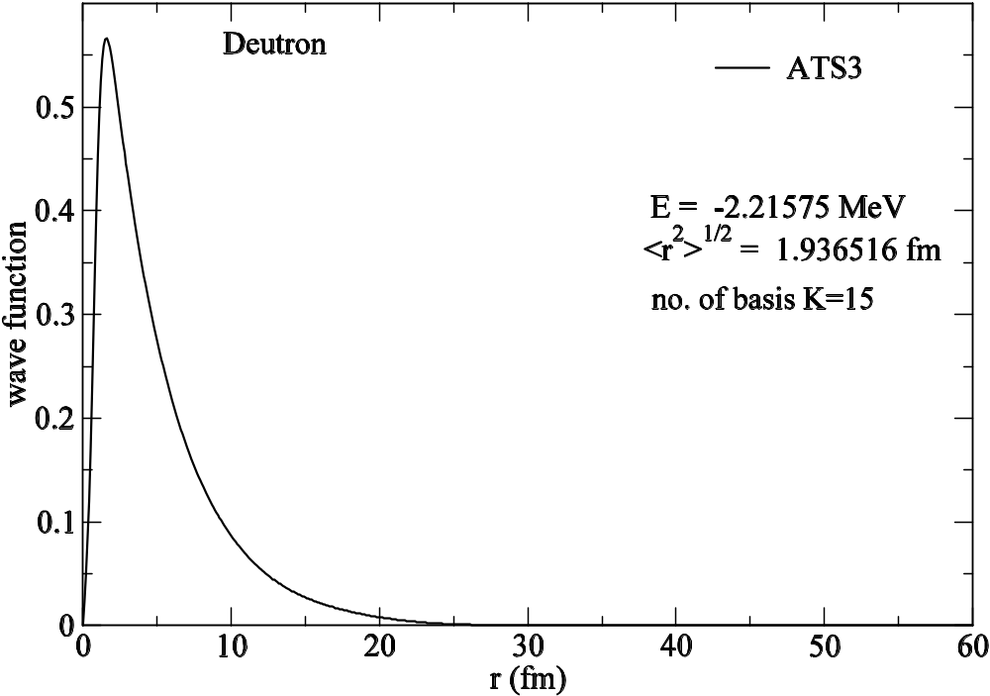
ATS3 | SVM (K.Varga) | SVM-present
E (MeV) | -2.216 | -2.2157
<r²>^{1/2} (fm) | 1.94 | 1.936

Slide 10
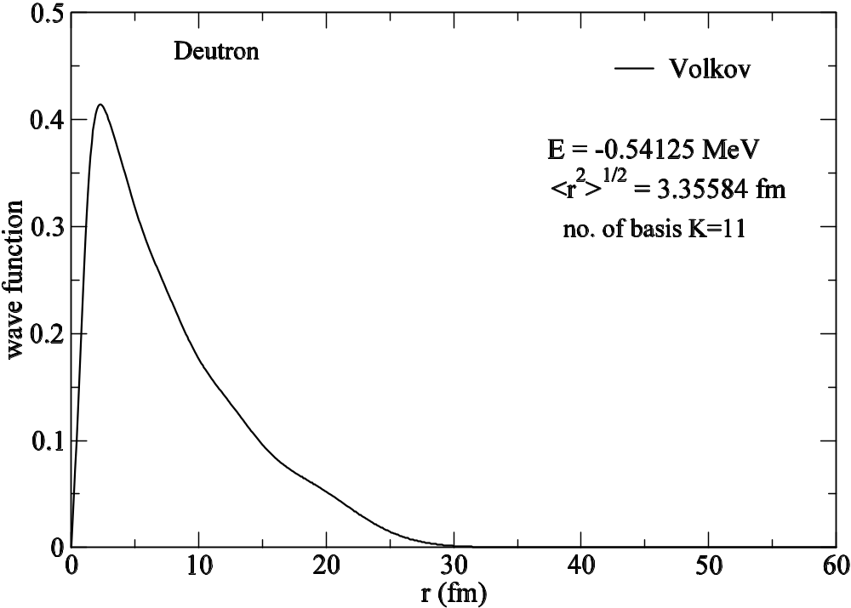
Volkov | SVM (K.Varga) | SVM-present
E (MeV) | -0.545 | -0.5413
<r²>^{1/2} (fm) | 3.44 | 3.355

Slide 11
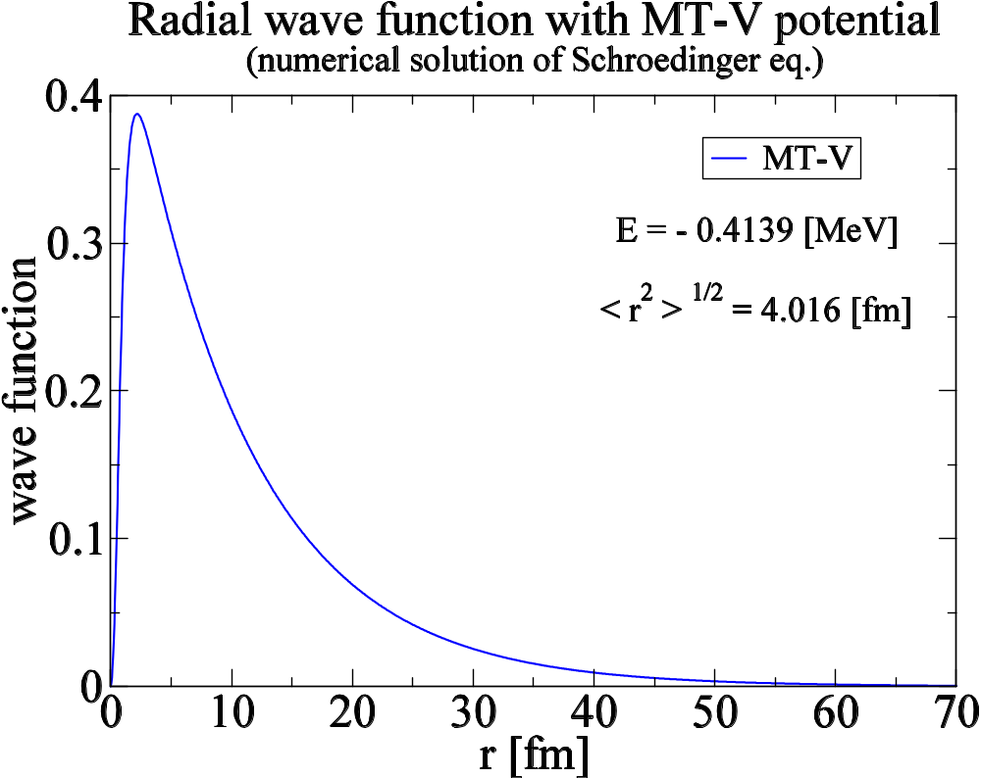
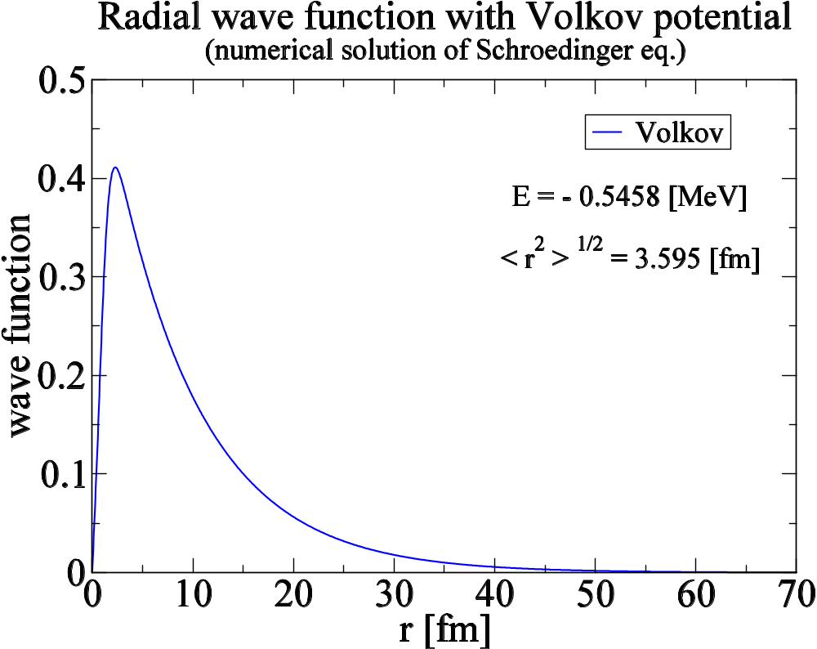

Slide 13
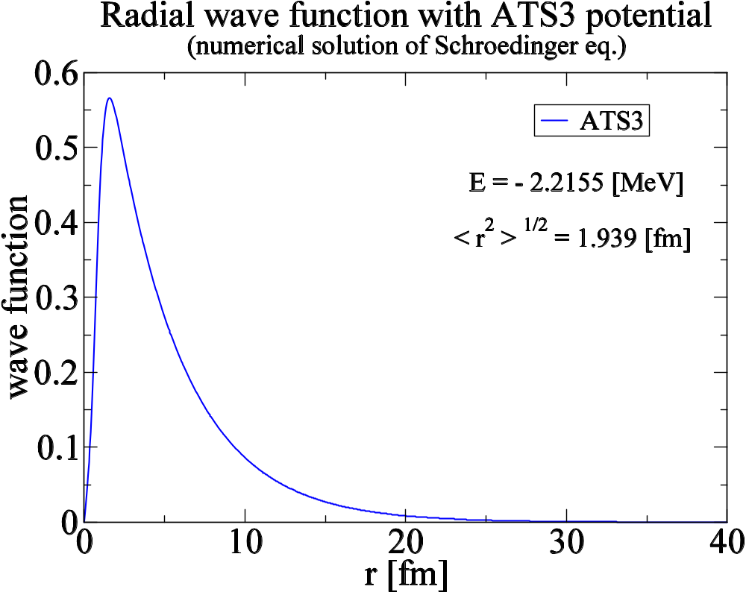

Slide 14
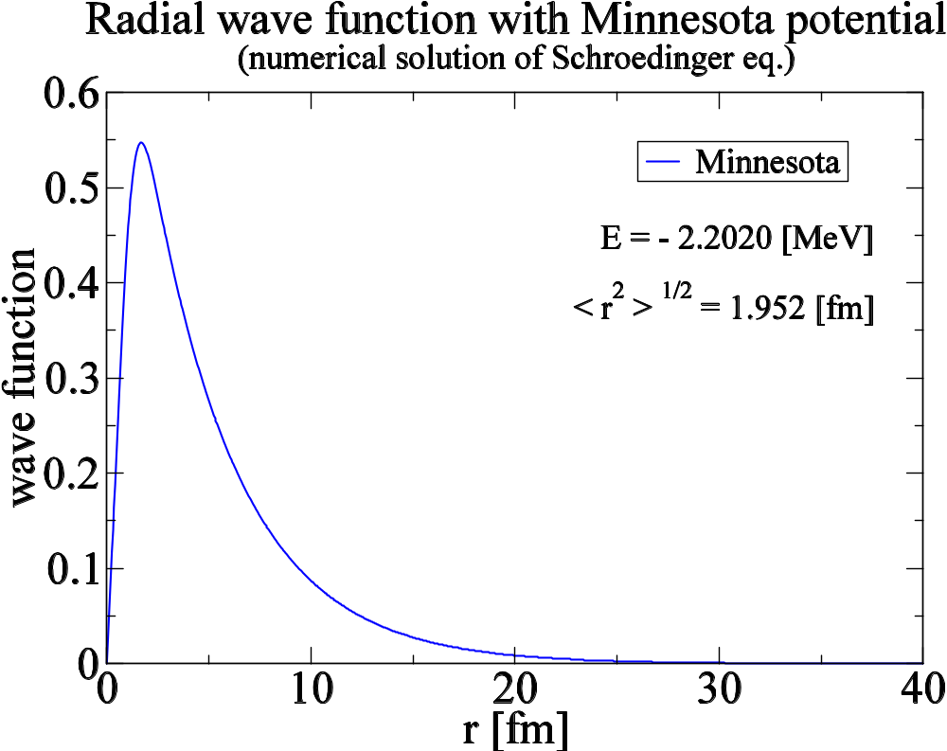

Slide 15
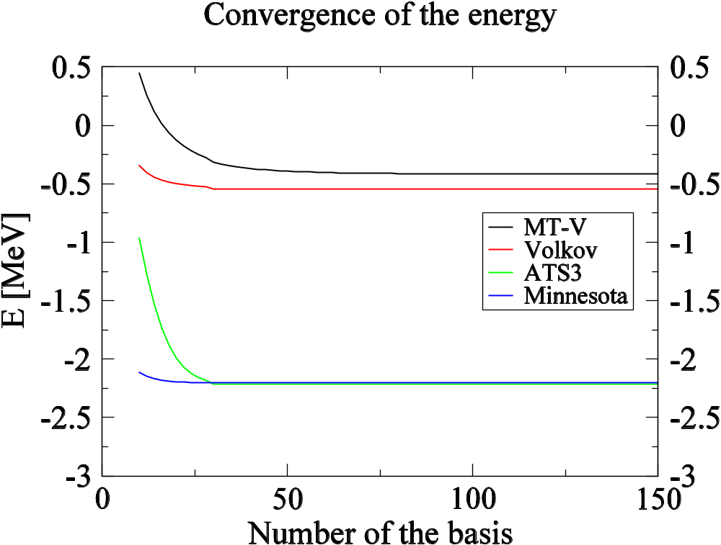

Slide 16
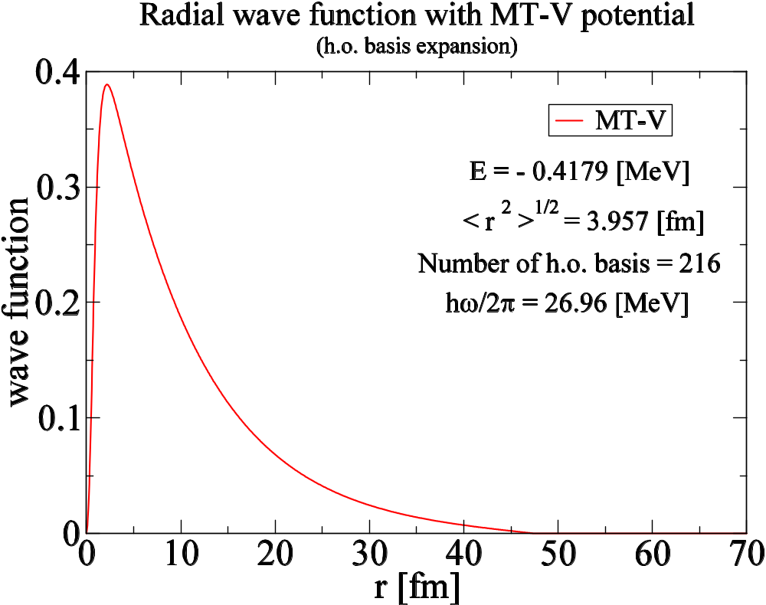

Slide 17
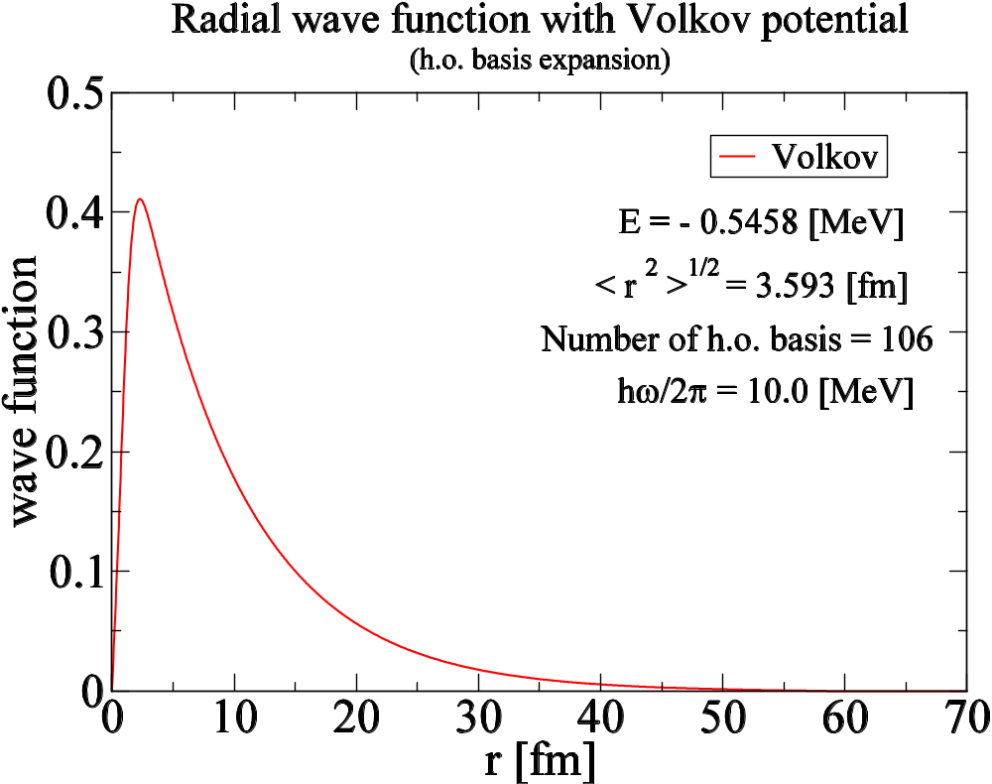

Slide 20
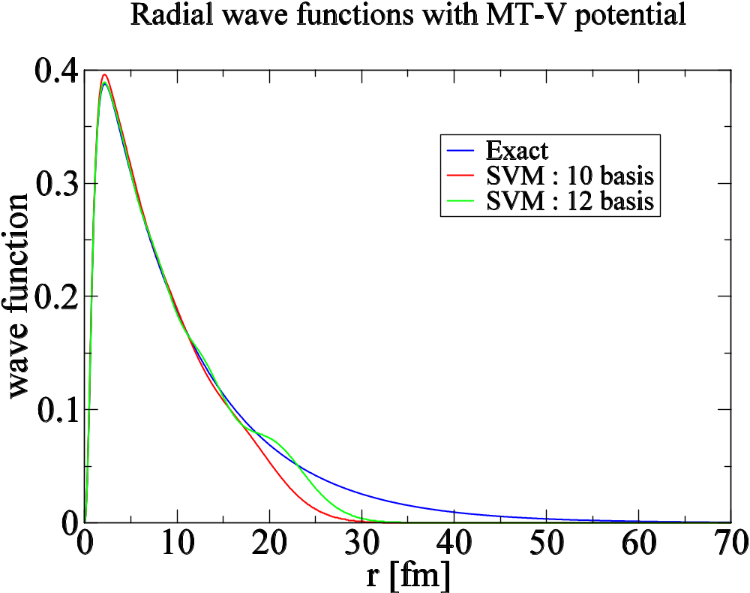

Slide 21
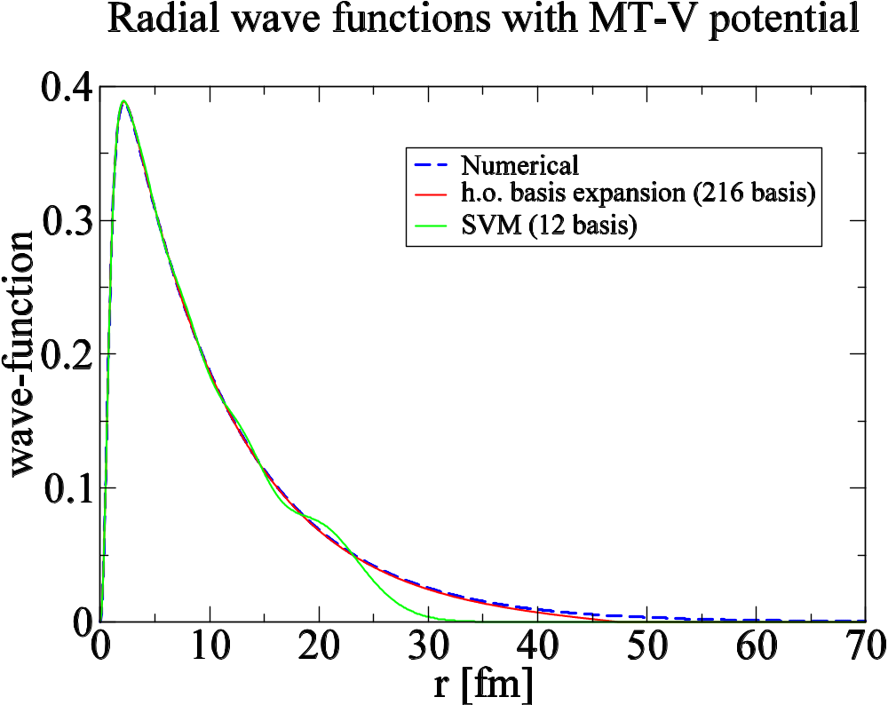

Slide 22
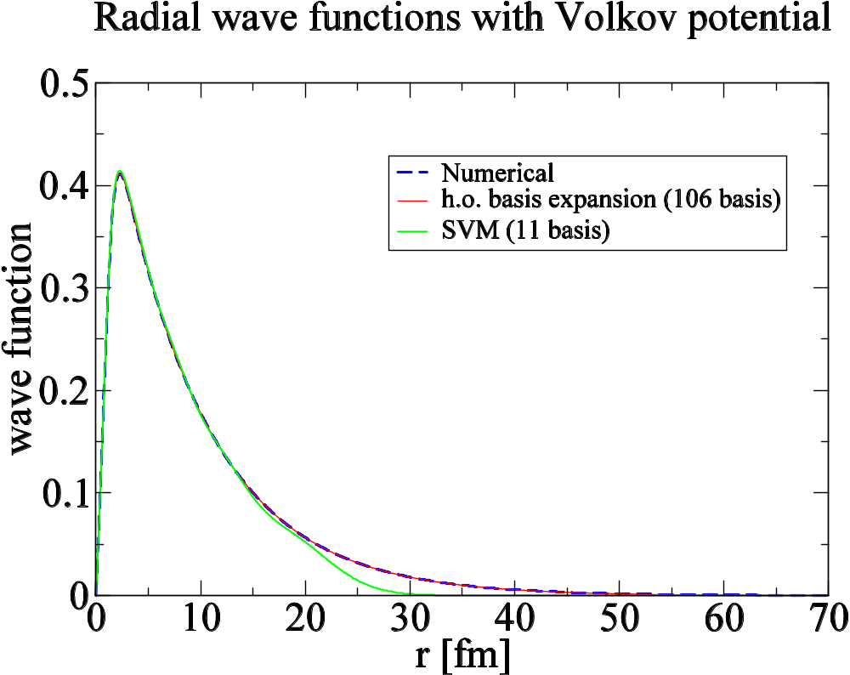

Slide 23
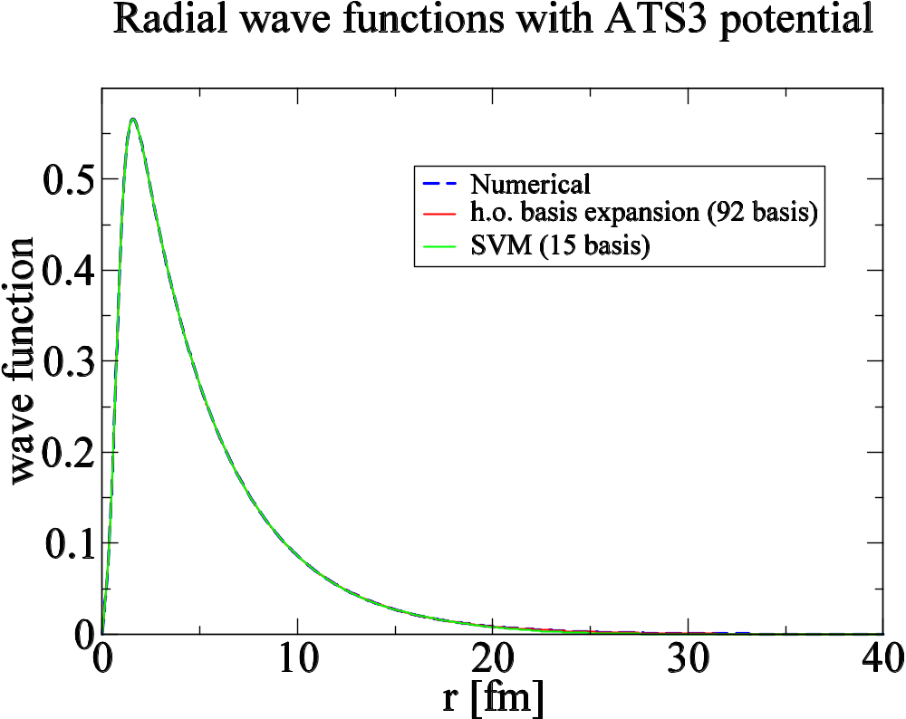

Slide 24
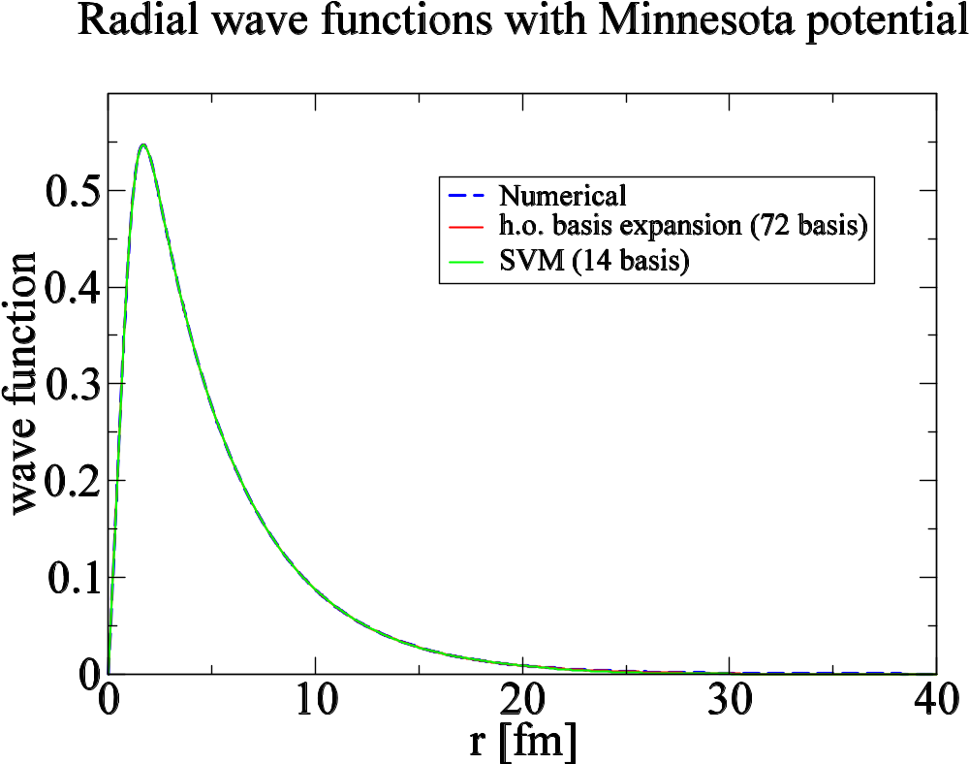

Slide 25
Binding Energy (MeV)
MT-V
Volkov
ATS3
Minnesota
Numerical
-0.4139
-0.5458
-2.2155
-2.2020
h.o. basis
-0.4179
-0.5458
-2.2155
-2.2020
SVM
-0.4103
-0.5413
-2.2158
-2.2022
Exp.
-2.2245
MeV

Slide 26
rms radii (fm)
MT-V
Volkov
ATS3
Minnesota
Numerical
4.016
3.595
1.939
1.952
h.o. basis
3.957
3.953
1.939
1.951
SVM
3.795
3.356
1.937
1.950
Exp.
1.96 fm

