Slide 1
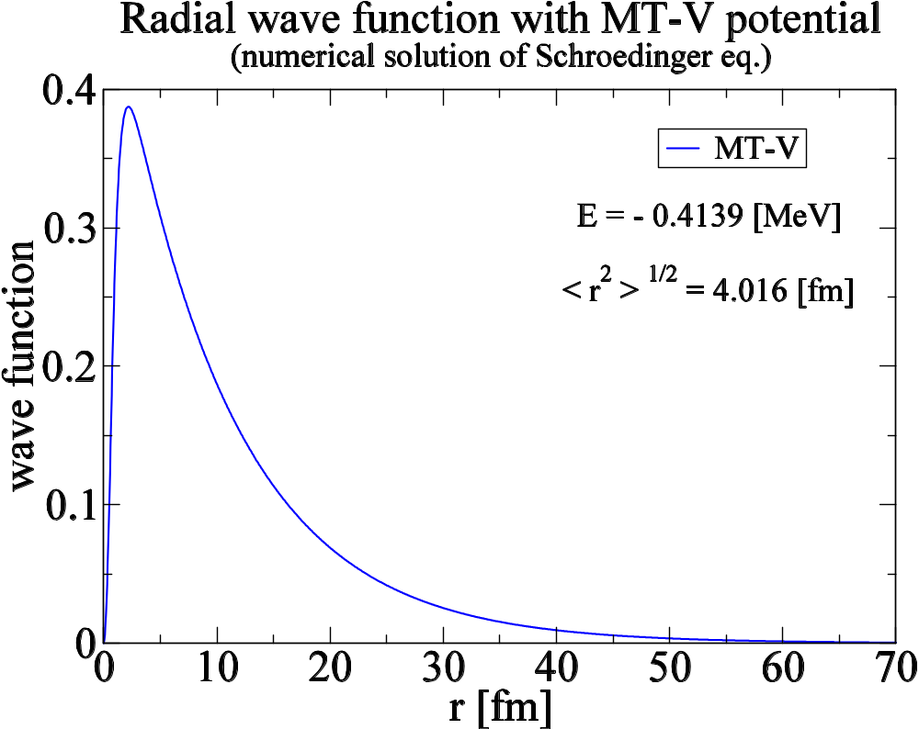
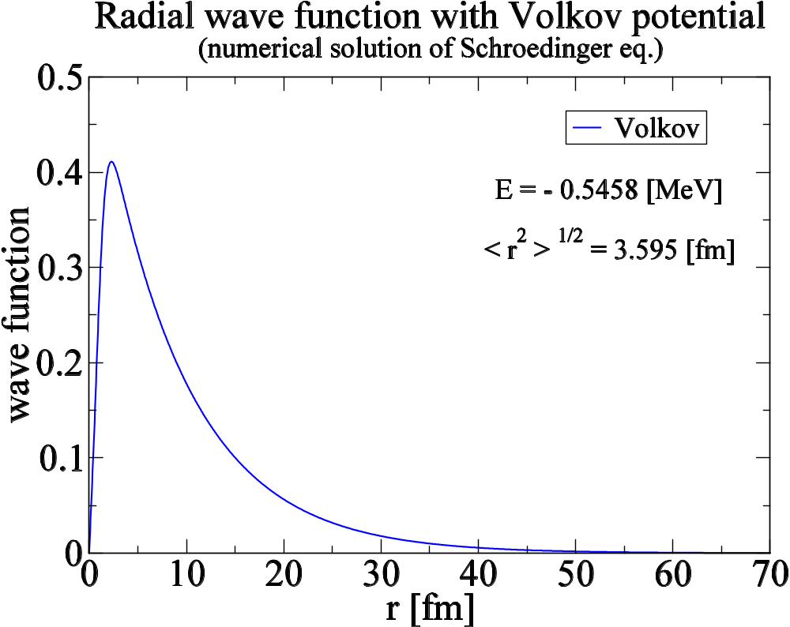

Slide 3
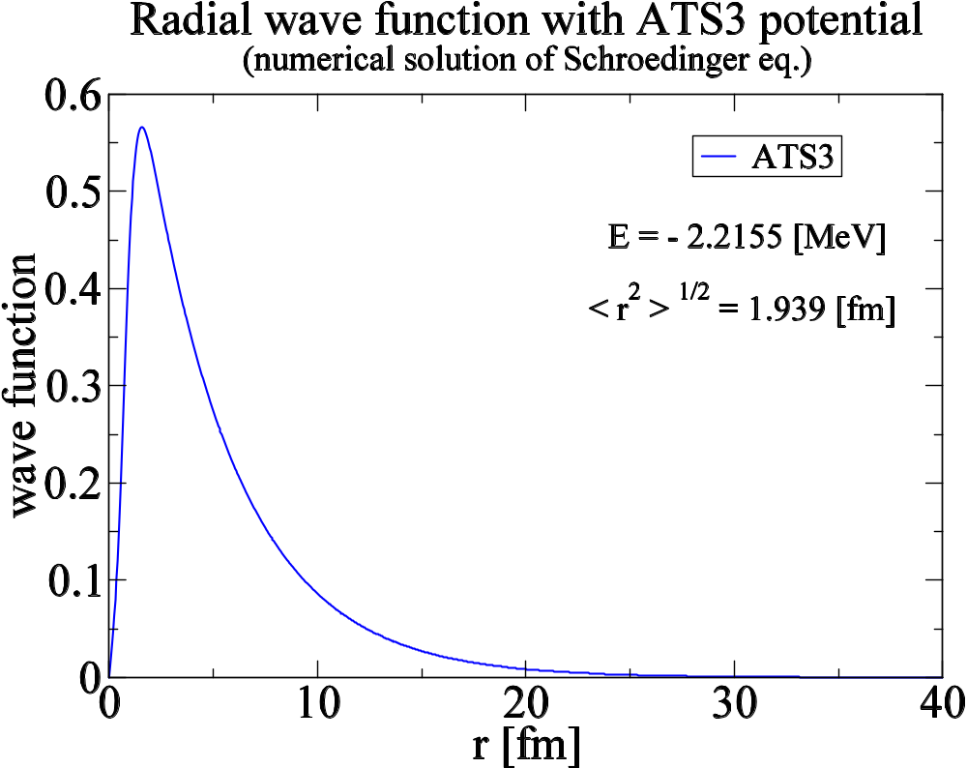

Slide 4
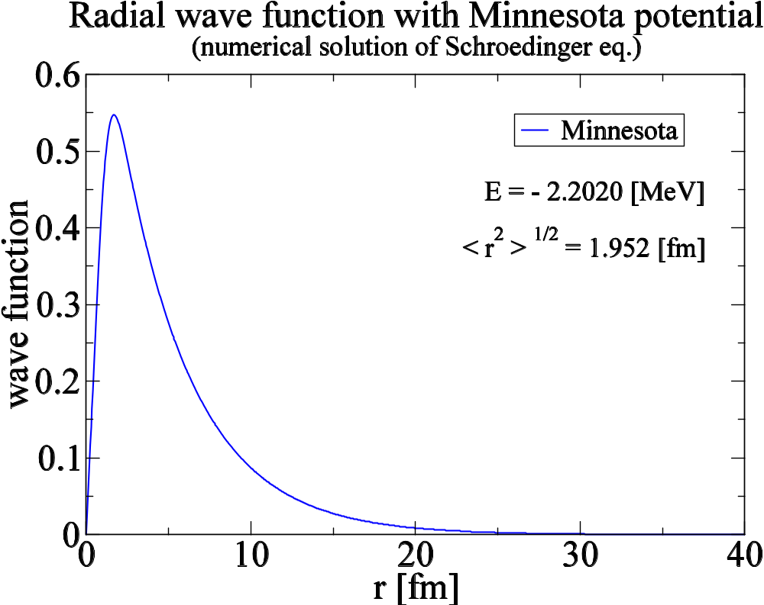

Slide 5
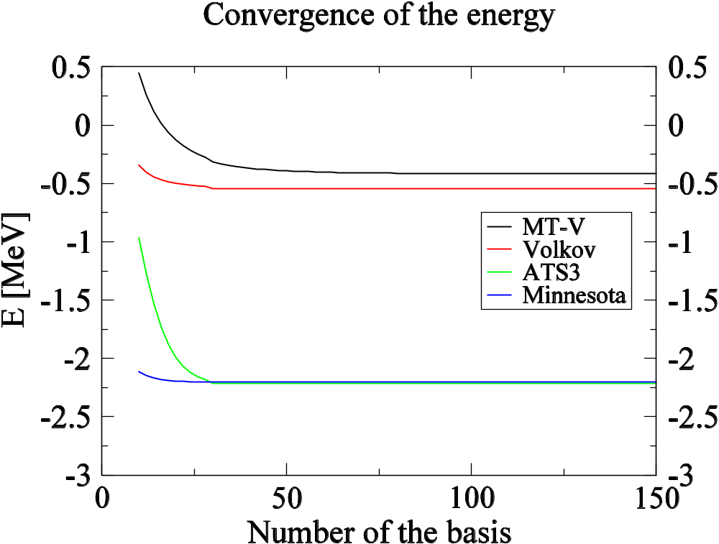

Slide 6
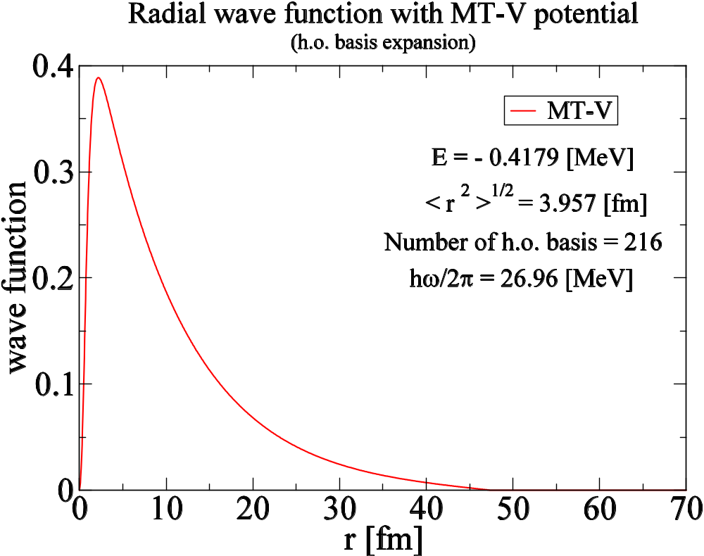

Slide 7
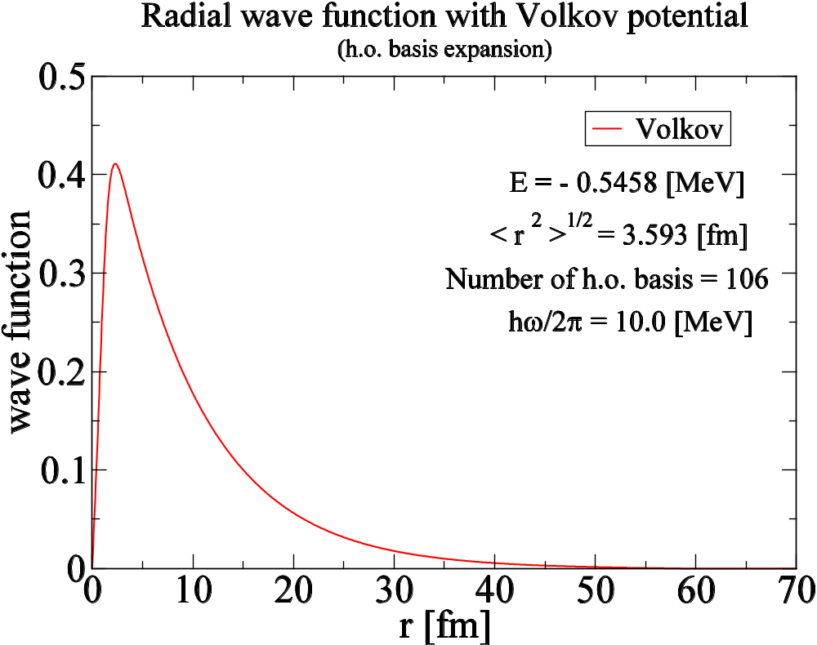

Slide 8
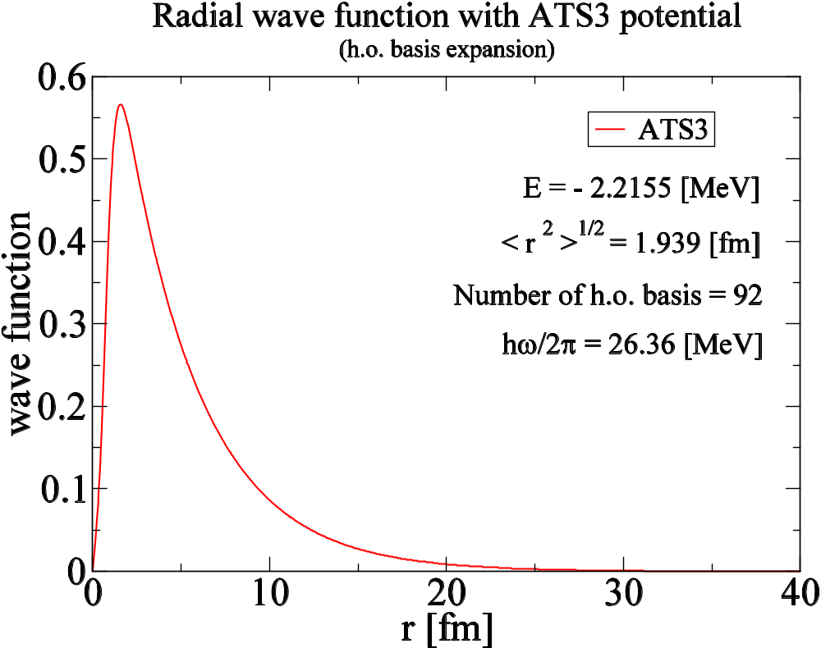

Slide 9
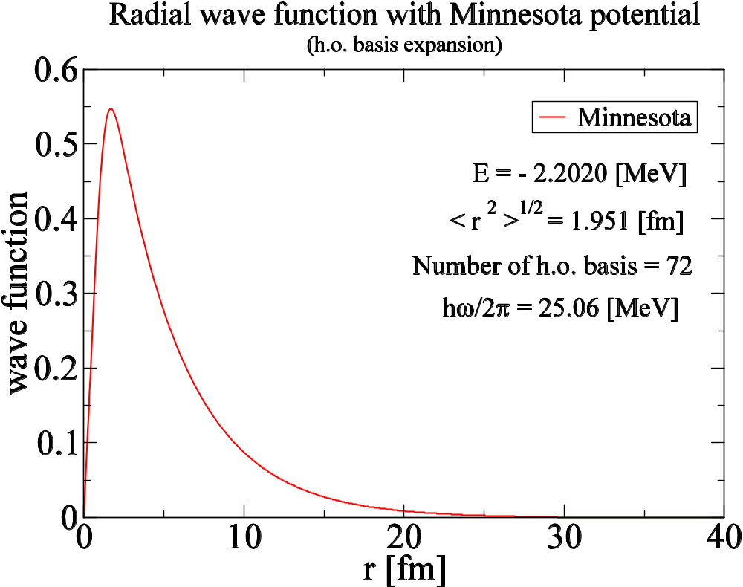

Slide 10
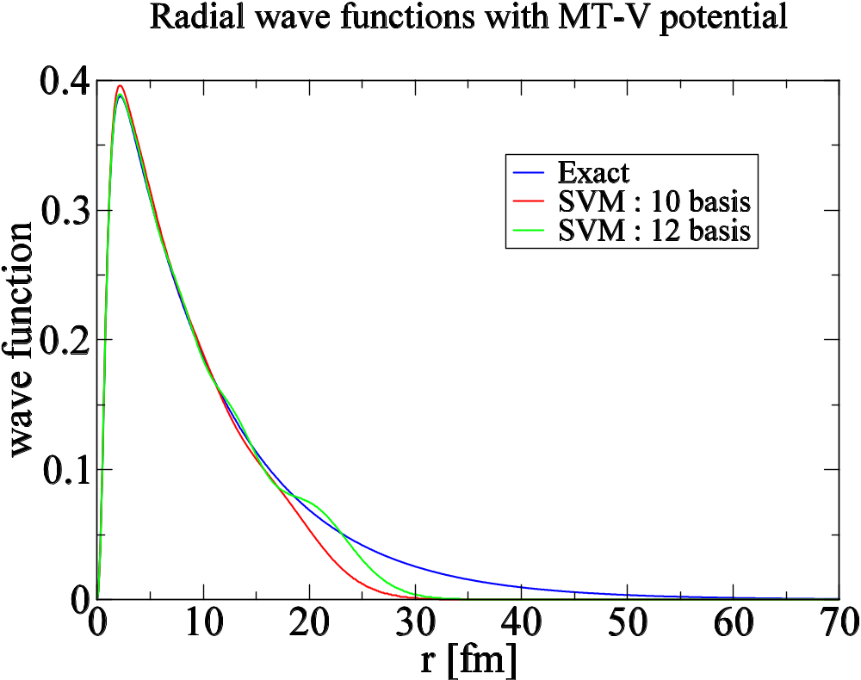

Slide 11
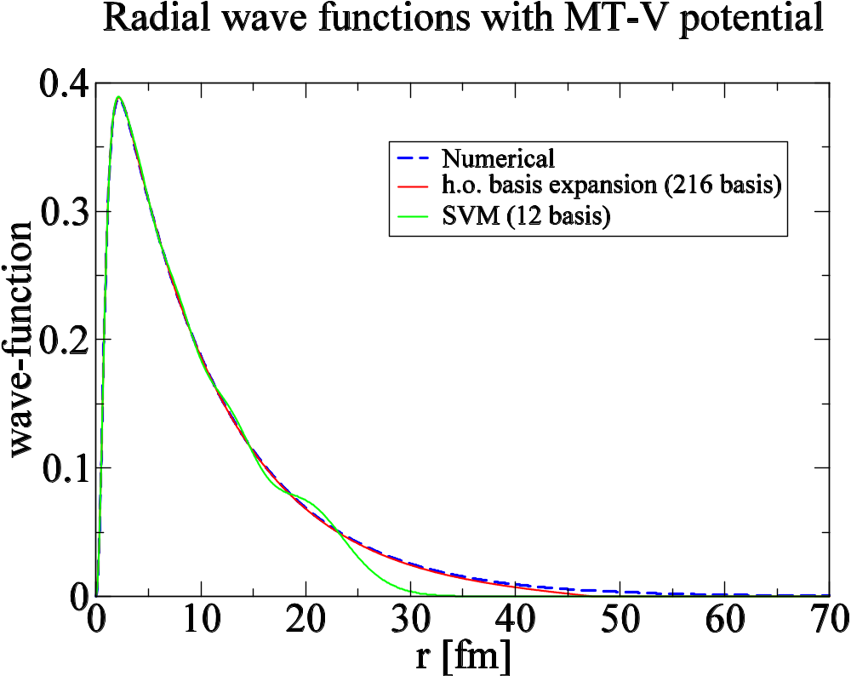

Slide 12
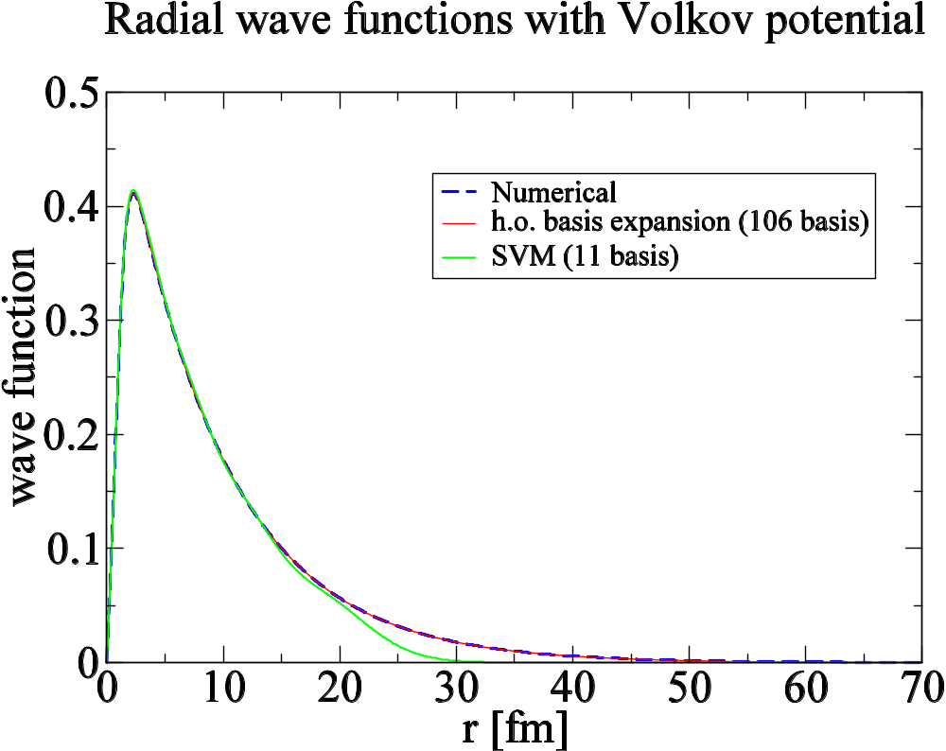

Slide 13
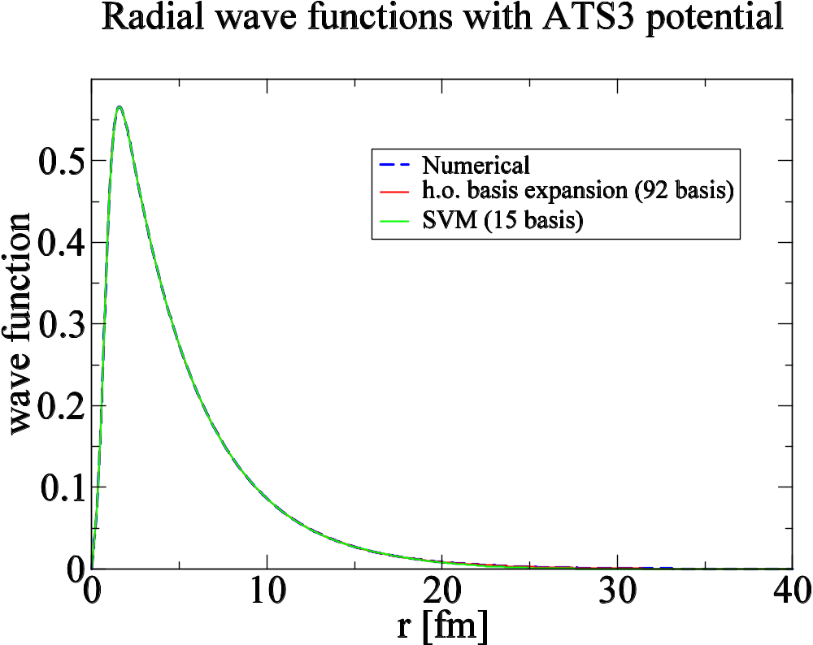

Slide 14
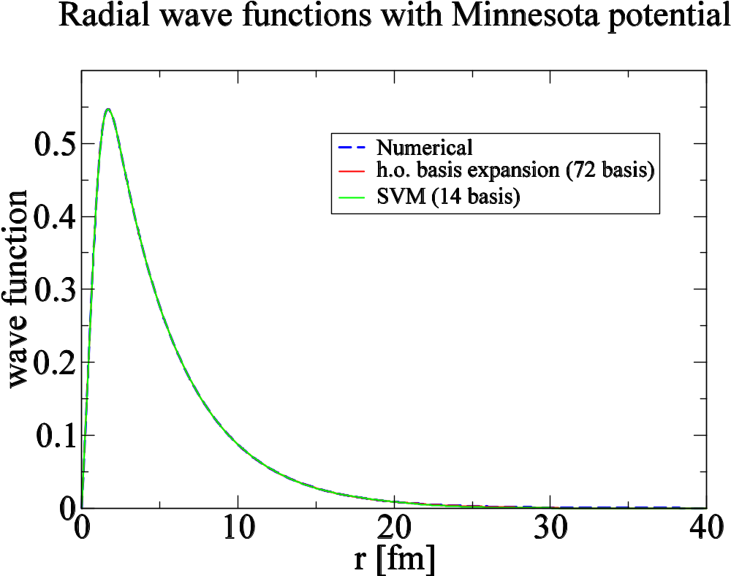

Slide 15
Binding Energy (MeV)
MT-V
Volkov
ATS3
Minnesota
Numerical
-0.4139
-0.5458
-2.2155
-2.2020
h.o. basis
-0.4179
-0.5458
-2.2155
-2.2020
SVM
-0.4103
-0.5413
-2.2158
-2.2022
Exp.
-2.2245
MeV

Slide 16
rms radii (fm)
MT-V
Volkov
ATS3
Minnesota
Numerical
4.016
3.595
1.939
1.952
h.o. basis
3.957
3.953
1.939
1.951
SVM
3.795
3.356
1.937
1.950
Exp.
1.96 fm

