Slide 1
Singular Value Decomposition

Slide 2
Singular Value Decomposition
A = (orthogonal) (diagonal) (orthogonal)

Slide 3

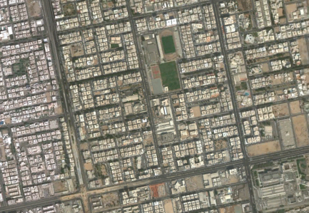
Applications of the SVD
Image processing
Suppose a satellite takes a picture, and wants to send it to earth. The picture may contain 1000 by 1000 "pixels"—little squares each with a definite color. We can code the colors, in a range between black and white, and send back 1,000,000 numbers
picture
matrix

Slide 4
Applications of the SVD: Image processing
It is better to find the essential information in the 1000 by 1000 matrix, and send only that.
Typically, some are significant and others are extremely small.
If we keep 60 and throw away 940, then we send only the corresponding 60 columns of U, and V.
If only 60 terms are kept, we send 60 times 2000 numbers instead of a million.
The other 940 columns are multiplied by small singular values that are being ignored. In fact, we can do the matrix multiplication as columns times rows:

Slide 5

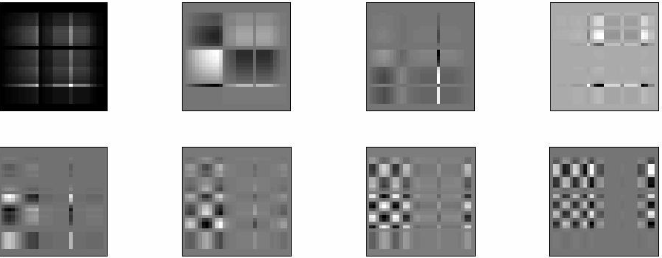
Applications of the SVD: Image processing
The SVD of a 32-times-32 digital image A is computed
Slide taken from https://faculty.kfupm.edu.sa/MATH/ffairag/math590_111/notes/svd2.ppt

Slide 6

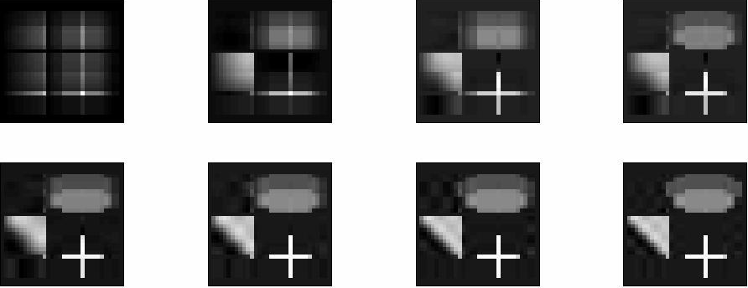
Applications of the SVD: Image processing
Slide taken from https://faculty.kfupm.edu.sa/MATH/ffairag/math590_111/notes/svd2.ppt

Slide 7
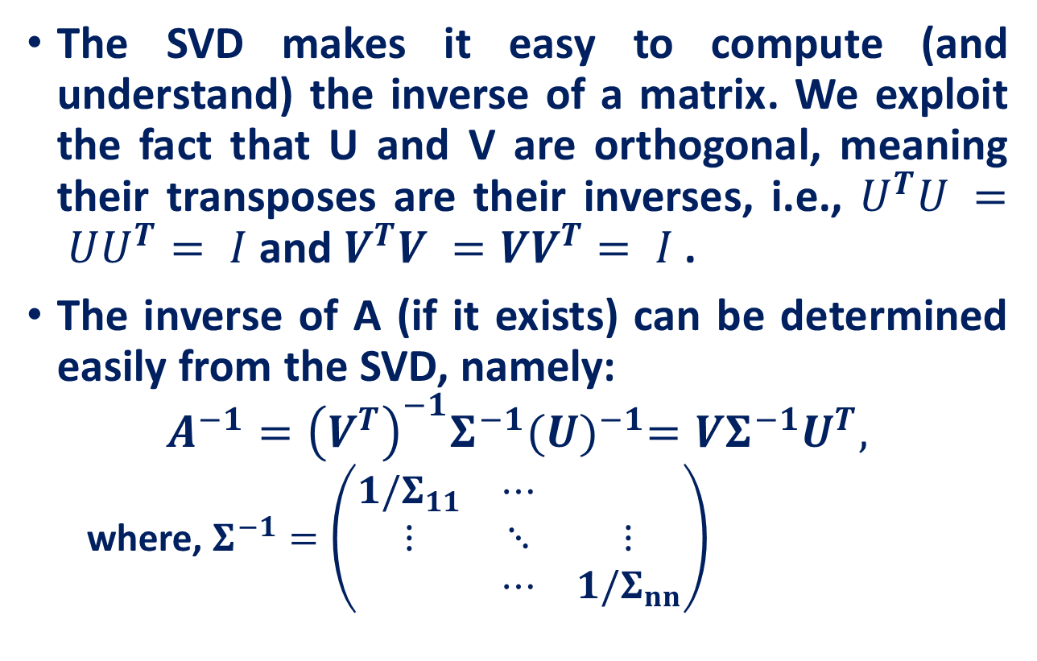
Inverses
The SVD makes it easy to compute (and understand) the inverse of a matrix. We exploit the fact that U and V are orthogonal, meaning their transposes are their inverses, i.e., $U^{T}U = UU^{T}= I$ and $V^{T}V =VV^{T}= I$ .
The inverse of A (if it exists) can be determined easily from the SVD, namely:
$$A^{−1}={\left(V^{T}\right)}^{−1}Σ^{−1}{(U)}^{−1}=VΣ^{−1}U^{T},$$
where, $Σ^{−1}=\left(\begin{matrix}1/Σ_{11} & ⋯ & \\ ⋮ & ⋱ & ⋮ \\ & ⋯ & 1/Σ_{nn}\end{matrix}\right)$
For orthogonal matrix X: (X)⁻¹=(X)^{T}

Slide 8
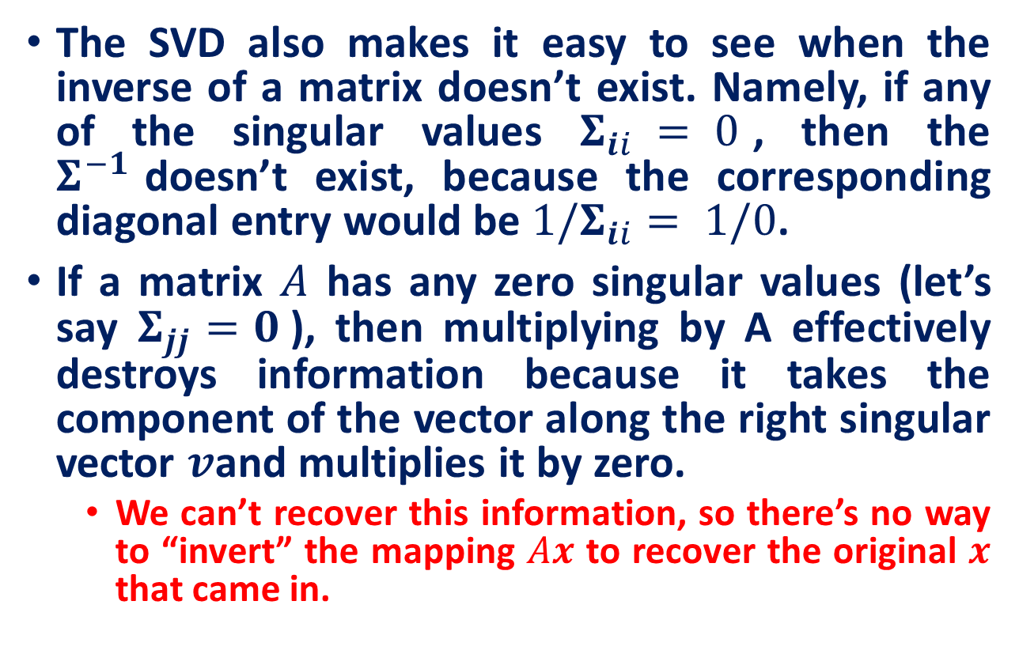
Pseudo-inverse
The SVD also makes it easy to see when the inverse of a matrix doesn’t exist. Namely, if any of the singular values $Σ_{ii} = 0$, then the $Σ^{−1}$doesn’t exist, because the corresponding diagonal entry would be $1/Σ_{ii}= 1/0$.
If a matrix $A$ has any zero singular values (let’s say $Σ_{jj}=0$), then multiplying by A effectively destroys information because it takes the component of the vector along the right singular vector $v$and multiplies it by zero.
We can’t recover this information, so there’s no way to “invert” the mapping $Ax$ to recover the original $x$ that came in.

Slide 9
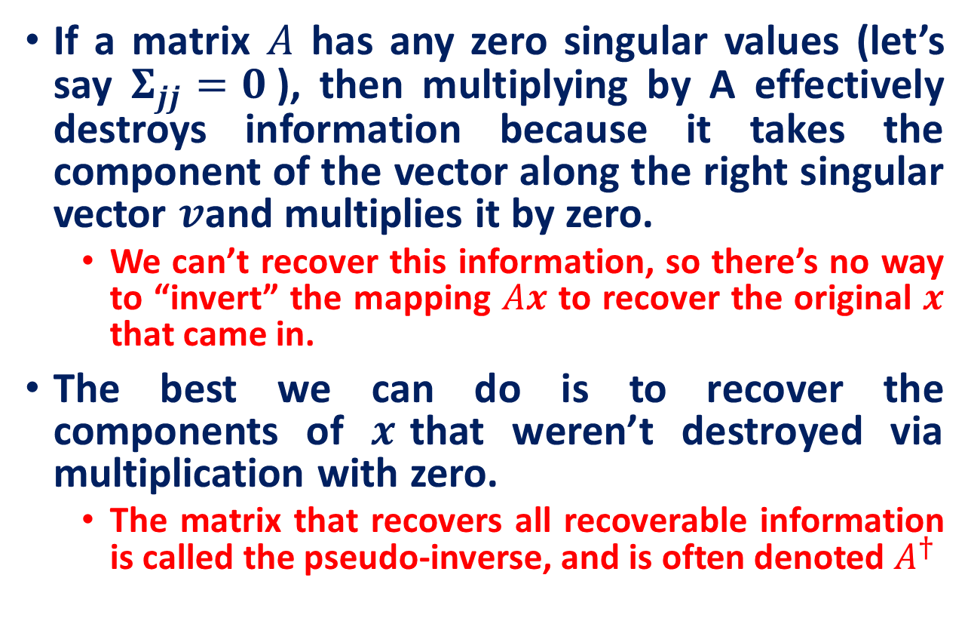
Pseudo-inverse
If a matrix $A$ has any zero singular values (let’s say $Σ_{jj}=0$), then multiplying by A effectively destroys information because it takes the component of the vector along the right singular vector $v$and multiplies it by zero.
We can’t recover this information, so there’s no way to “invert” the mapping $Ax$ to recover the original $x$ that came in.
The best we can do is to recover the components of $x$that weren’t destroyed via multiplication with zero.
The matrix that recovers all recoverable information is called the pseudo-inverse, and is often denoted $A^{†}$

Slide 10
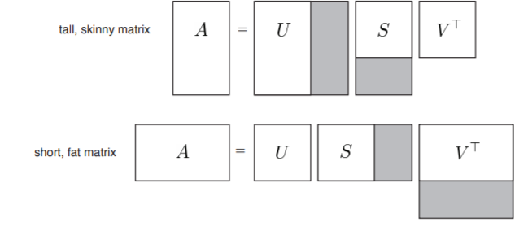

SVD of non-square matrix
If $A$ is $m×n$ non-square matrix, then $U$ is $m × m$ and V is $n × n$, and S is $m×n$is non-square and therefore has only $min⁡(m, n)$non-zero singular values. Such matrices are (obviously) non-intertible, though we can compute their pseudo-inverses using the formula above.

Slide 11
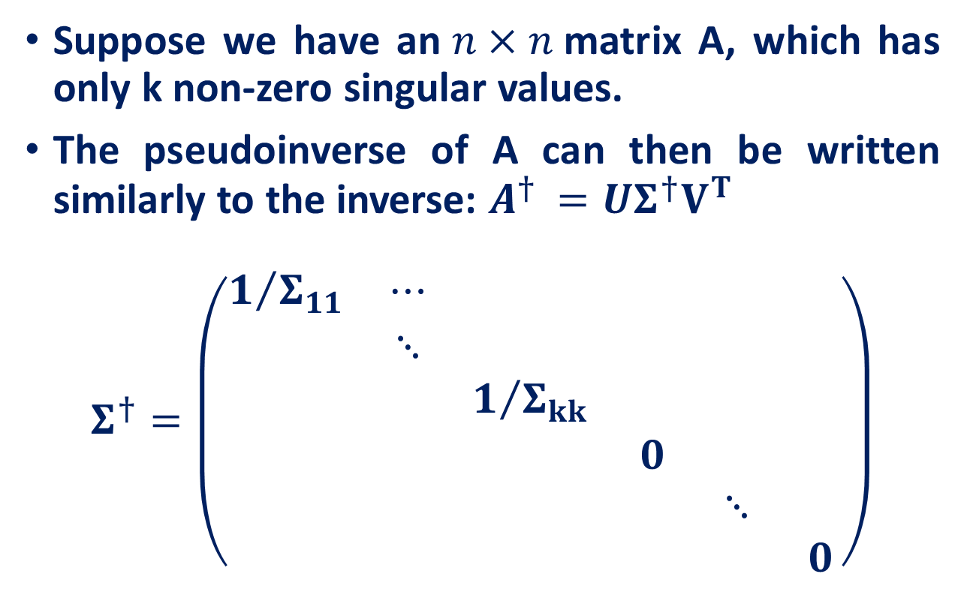
Pseudo-inverse
Suppose we have an$n×n$matrix A, which has only k non-zero singular values.
The pseudoinverse of A can then be written similarly to the inverse: $A^{† }=UΣ^{†}V^{T}$
$$Σ^{†}=\left(\begin{matrix}1/{Σ_{11}} & ⋯ & & & & \\ & ⋱ & & & & \\ & & 1/{Σ_{kk}} & & & \\ & & & 0 & & \\ & & & & ⋱ & \\ & & & & & 0\end{matrix}\right)$$

Slide 12
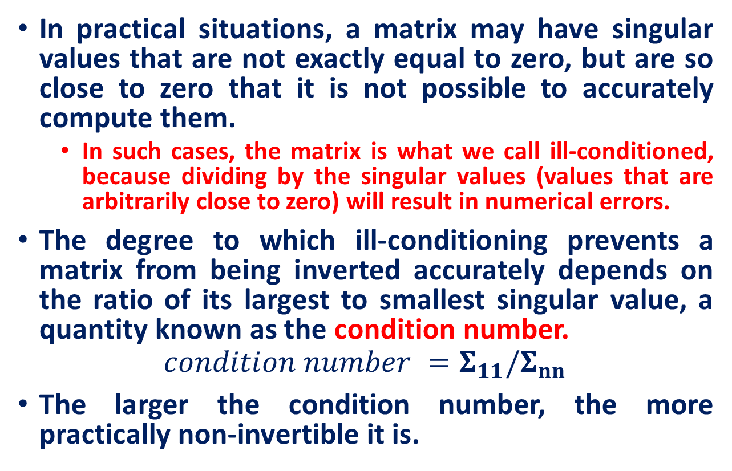
Inverses: Condition number
In practical situations, a matrix may have singular values that are not exactly equal to zero, but are so close to zero that it is not possible to accurately compute them.
In such cases, the matrix is what we call ill-conditioned, because dividing by the singular values (values that are arbitrarily close to zero) will result in numerical errors.
The degree to which ill-conditioning prevents a matrix from being inverted accurately depends on the ratio of its largest to smallest singular value, a quantity known as the condition number.
$$condition number =Σ_{11}/Σ_{nn}$$
The larger the condition number, the more practically non-invertible it is.

Slide 13
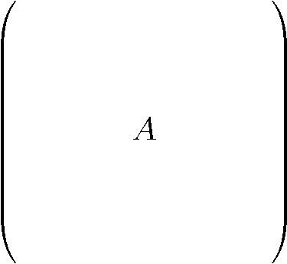
Document matrices
d terms
(e.g., theorem, proof, etc.)
n documents
A_{ij} = frequency of the j-th term in the i-th document
Find a subset of the terms that accurately clusters the documents

Slide 14
SVD Example
retrieval
CS Concept
MD-Concept
doc-to-concept similarity matrix
inf.
lung
data
brain
‘strength’ of CS-concept
CS
=
x
x
MD
CS Concept
MD-Concept
term-to-concept similarity matrix

Slide 15
SVD - Interpretation #1
U: document-to-concept similarity matrix
V: term-to-concept sim. matrix
$Σ$: its diagonal elements: ‘strength’ of each concept
Q: if A is the document-to-term matrix, what is A^{T} A?
term-to-term ([m x m]) similarity matrix
Q: if A is the document-to-term matrix, what is A A^{T}?
document-to-document ([n x n]) similarity matrix

Slide 16
SVD - Interpretation #2
Q: how exactly is dim. reduction done?
set the smallest eigenvalues to zero:
=
x
x

Slide 17
SVD - Interpretation #2
~
x
x

Slide 18
SVD - Interpretation #2
~
x
x
~

Slide 19
Social-network matrices
d groups
(e.g., BU group, opera, etc.)
n users
A_{ij} = partiticipation of the i-th user in the j-th group
Find a subset of the groups that accurately clusters social-network users

Slide 20
Recommendation systems
d products
n customers
A_{ij} = frequency of the j-th product is bought by the i-th customer
Find a subset of the products that accurately describe the behavior or the customers

Slide 21
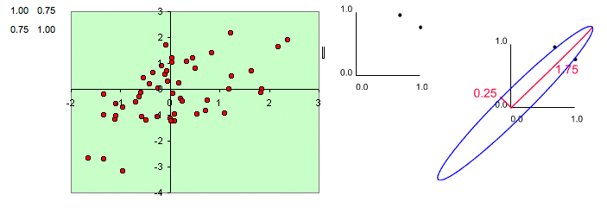
Geometrical Interpretation: Eigenvalues and Eigenvectors
Consider a covariance matrix, A, i.e., A = 1/n S S^{T} for some S
Ellipse: major axis as the larger eigenvalue and the minor axis as the smaller eigenvalue
Eigen Decomposition and Singular Value Decomposition, Mani Thomas

Slide 22
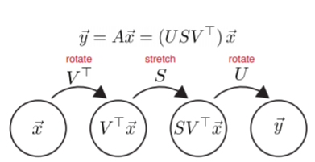
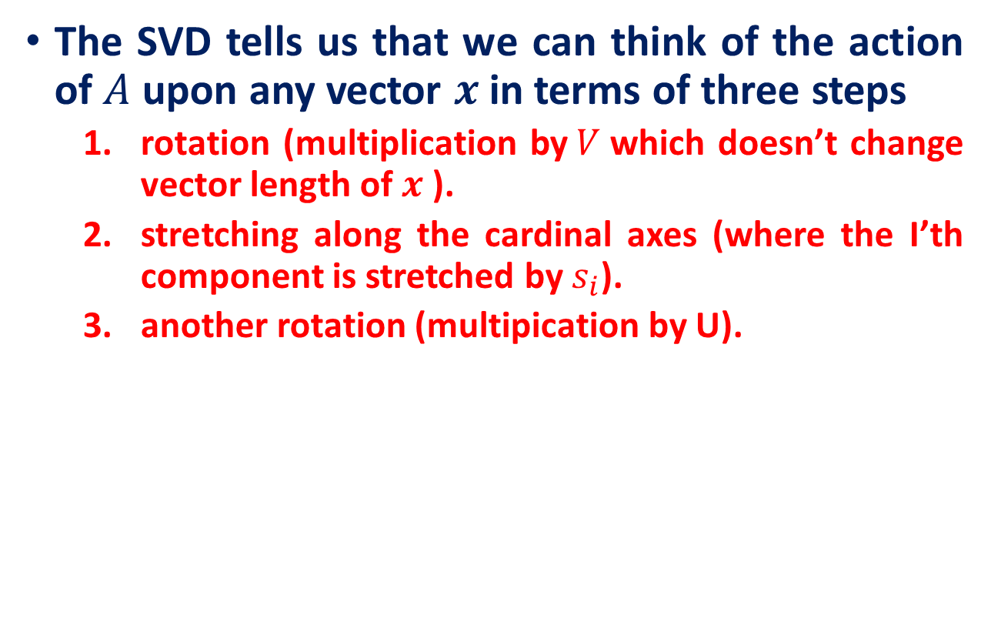
SVD - Interpretation #3
The SVD tells us that we can think of the action of $A$ upon any vector $x$in terms of three steps
rotation (multiplication by$V$which doesn’t change vector length of $x$ ).
stretching along the cardinal axes (where the I’th component is stretched by $s_{i}$).
another rotation (multipication by U).

Slide 23
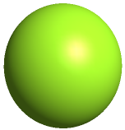









SVD - Interpretation #3
A linear (non-singular) transform A always takes hyper-spheres to hyper-ellipses.
$$\begin{matrix}2 \\ 3\end{matrix}$$
A
$$\begin{matrix}1 \\ 2\end{matrix}$$
$$A=\left[\begin{matrix}1 & 2 \\ 2 & 3\end{matrix}\right]$$
$$\begin{matrix}0 \\ 1\end{matrix}$$
A
$$\begin{matrix}−1 \\ 0\end{matrix}$$
$$\begin{matrix}1 \\ 0\end{matrix}$$
$$\begin{matrix} 0 \\ −1\end{matrix}$$
$$\begin{matrix}−1 \\ −2\end{matrix}$$
$$\begin{matrix}−2 \\ −3\end{matrix}$$

Slide 24
SVD - Interpretation #3
Thus, one good way to understand what A does is to find which vectors are mapped to the “main axes” of the ellipsoid.
A
A

Slide 25
SVD - Interpretation #3
In this case A is just a scaling matrix.
The eigen decomposition of A tells us which orthogonal axes it scales, and by how much:
1
1
λ₁
A
λ₂

Slide 26
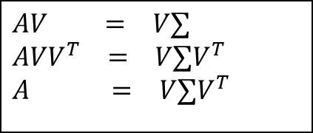
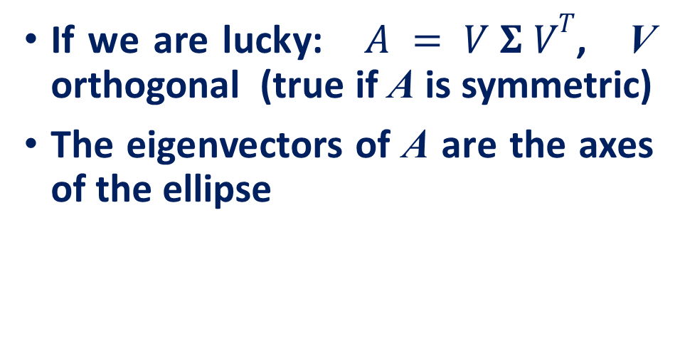
Geometric analysis of linear transformations
If we are lucky: $A = V Σ VT$, V orthogonal (true if A is symmetric)
The eigenvectors of A are the axes of the ellipse
$$AV = V∑$$
$$AVV^{T} = V∑V^{T}$$
$$A = V∑V^{T}$$
A

Slide 27
SVD - Interpretation #3
In general A will also contain rotations, not just scales:
1
1
σ₂
σ₁
A
orthonormal
orthonormal

Slide 28
SVD - Interpretation #3
In general A will also contain rotations, not just scales:
1
1
σ₂
σ₁
A

Slide 29
Singular value decomposition (SVD)
For any $m× n$ matrix A, the following decomposition always exists:
$A=UΣV^{T}, A∈ℝ^{m×n}$
Where,
$U$ is $m×m$ orthogonal matrix i.e., $UU^{T}=U^{T}U=I_{m}$
$V$ is $n× n$ and orthogonal matrix i.e., $VV^{T}=V^{T}V=I_{n}$
$Σ$ is $m× n$ and diagonal with nonnegative entries on the diagonal – called singular values.
Columns of $U$are the eigenvectors of $AA^{T}$ (called the left singular vectors).
Columns of $V$are the eigenvectors of $A^{T}A$ (called the right singular vectors).
The non - zero singular values are the positive square roots of non - zero eigenvalues of $A^{T}A$ or $AA^{T}$

Slide 30
Singular value decomposition (Computation)

Slide 31
Singular value decomposition (SVD)
If only $r < min⁡(m, n)$singular values are nonzero, the SVD can be represented in reduced form as follows:
$$A=UΣV^{T}, A∈ℝ^{m×n}$$
$$U∈ℝ^{m×r}$$
$$V∈ℝ^{n×r}$$
$$Σ∈ℝ^{r×r}$$

Slide 32
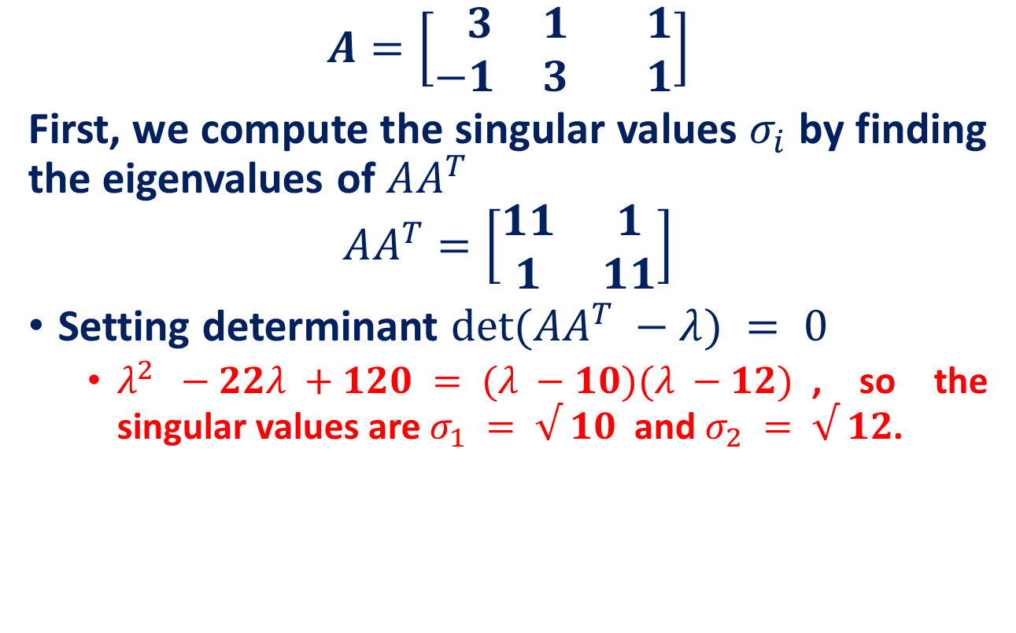
SVD Example
$$A=\left[\begin{matrix} 3 & 1 & 1 \\ −1 & 3 & 1\end{matrix}\right]$$
First, we compute the singular values $σ_{i}$ by finding the eigenvalues of $AA^{T}$
$$AA^{T}=\left[\begin{matrix}11 & 1 \\ 1 & 11\end{matrix}\right]$$
Setting determinant $det⁡(AA^{T} −λ) = 0$
$λ^{2} −22λ +120 = (λ −10)(λ −12)$, so the singular values are $σ_{1} = √ 10$and $σ_{2} = √ 12$.

Slide 33
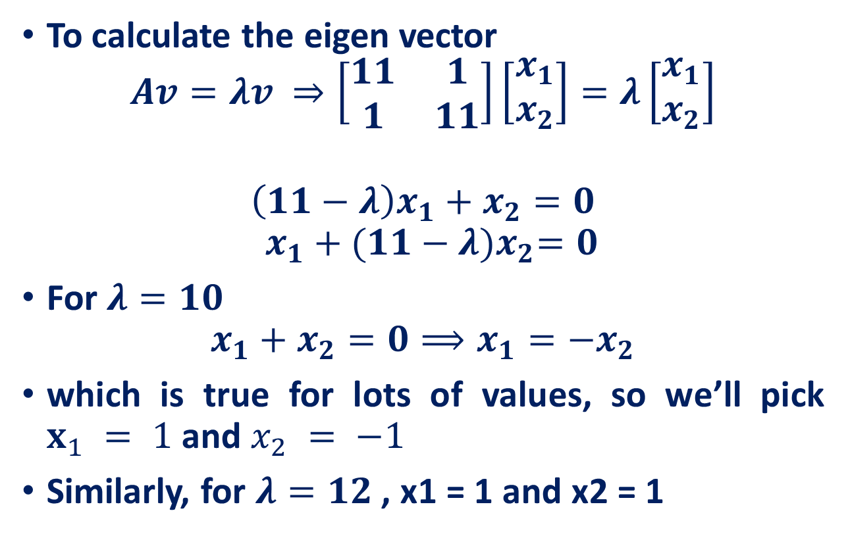
SVD Example
To calculate the eigen vector
$$Av=λv ⇒\left[\begin{matrix}11 & 1 \\ 1 & 11\end{matrix}\right]\left[\begin{matrix}x_{1} \\ x_{2}\end{matrix}\right]=λ\left[\begin{matrix}x_{1} \\ x_{2}\end{matrix}\right]$$
$$\left(11−λ\right)x_{1}+x_{2}=0$$
$${ x}_{1} +{ (11−λ)x}_{2}=0$$
For $λ=10$
$$x_{1}+x_{2}=0⟹x_{1}=−x_{2}$$
which is true for lots of values, so we’ll pick $x_{1} = 1$and $x_{2} = −1$
Similarly, for $λ=12$, x1 = 1 and x2 = 1

Slide 34
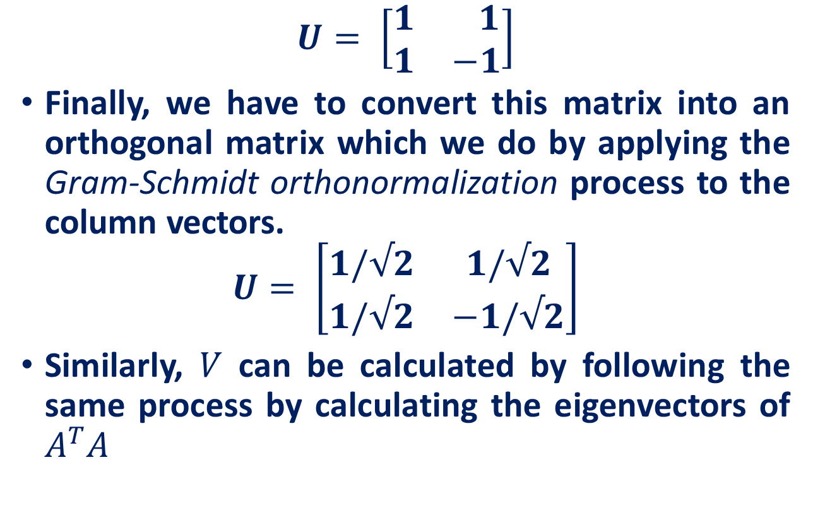
SVD Example
$$U= \left[\begin{matrix}1 & 1 \\ 1 & −1\end{matrix}\right]$$
Finally, we have to convert this matrix into an orthogonal matrix which we do by applying the Gram-Schmidt orthonormalization process to the column vectors.
$$U= \left[\begin{matrix}1/√2 & 1/√2 \\ 1/√2 & −1/√2\end{matrix}\right]$$
Similarly, $V$ can be calculated by following the same process by calculating the eigenvectors of $A^{T}A$

Slide 35
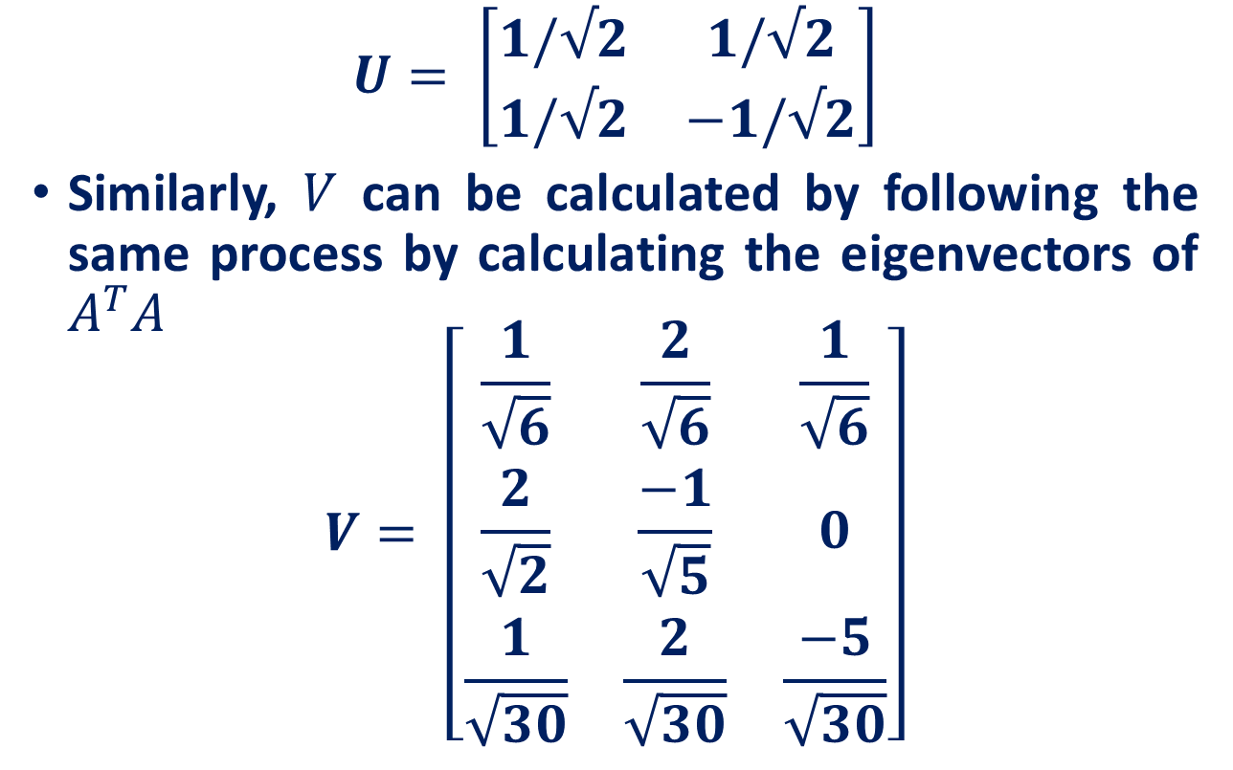
SVD Example
$$U= \left[\begin{matrix}1/√2 & 1/√2 \\ 1/√2 & −1/√2\end{matrix}\right]$$
Similarly, $V$ can be calculated by following the same process by calculating the eigenvectors of $A^{T}A$
$$V= \left[\begin{matrix}\frac{1}{\sqrt{6}} & \frac{2}{\sqrt{6}} & \frac{1}{\sqrt{6}} \\ \frac{2}{\sqrt{2}} & \frac{−1}{\sqrt{5}} & 0 \\ \frac{1}{\sqrt{30}} & \frac{2}{\sqrt{30}} & \frac{−5}{\sqrt{30}}\end{matrix}\right]$$

Slide 36
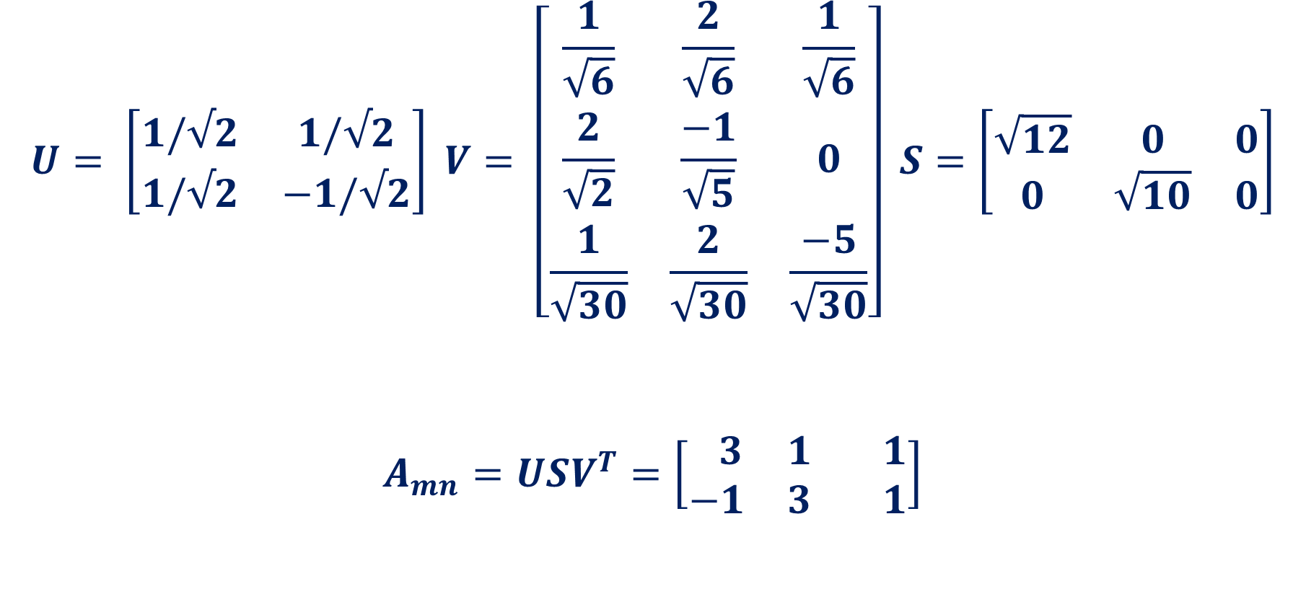
SVD Example
$$U= \left[\begin{matrix}1/√2 & 1/√2 \\ 1/√2 & −1/√2\end{matrix}\right] V= \left[\begin{matrix}\frac{1}{\sqrt{6}} & \frac{2}{\sqrt{6}} & \frac{1}{\sqrt{6}} \\ \frac{2}{\sqrt{2}} & \frac{−1}{\sqrt{5}} & 0 \\ \frac{1}{\sqrt{30}} & \frac{2}{\sqrt{30}} & \frac{−5}{\sqrt{30}}\end{matrix}\right] S=\left[\begin{matrix}\sqrt{12} & 0 & 0 \\ 0 & \sqrt{10} & 0\end{matrix}\right]$$
$$A_{mn}=USV^{T}=\left[\begin{matrix} 3 & 1 & 1 \\ −1 & 3 & 1\end{matrix}\right]$$

Slide 37
SVD and Rank-k approximations
A
=
U
Σ
V^{T}
features
sig.
significant
=
noise
noise
significant
noise
objects

Slide 38
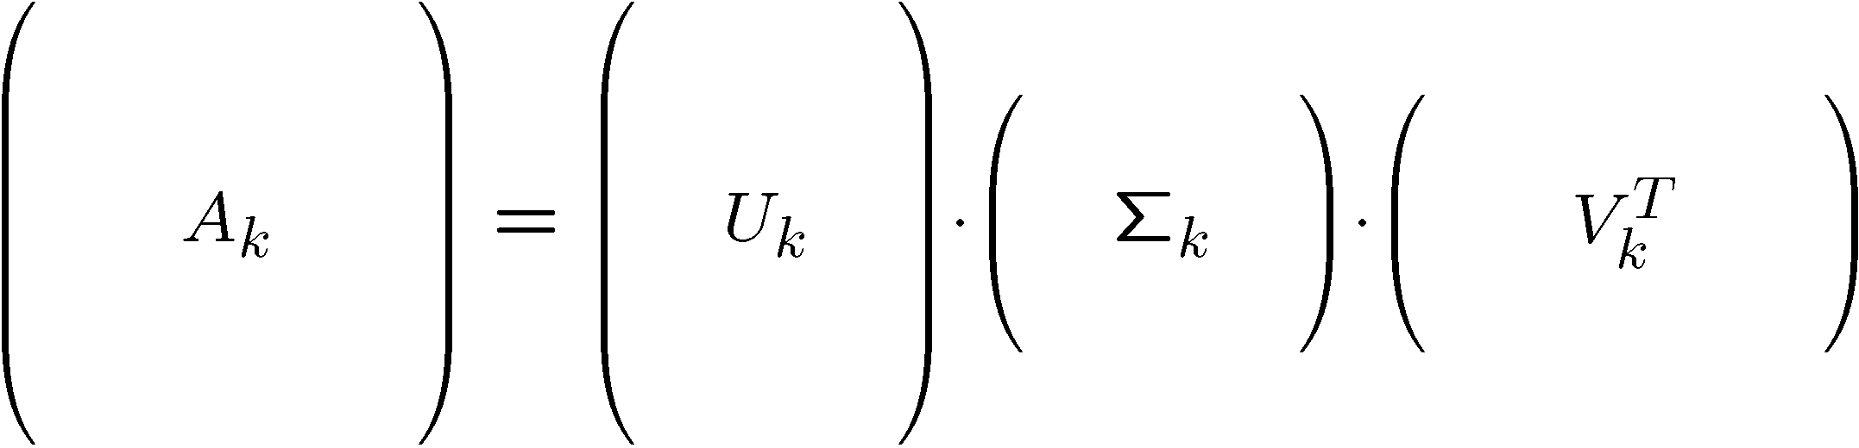
Rank-k approximations ($A_{k}$)
$U_{k} (V_{k})$: Orthogonal matrix containing the top k left (right) singular vectors of A.
$Σ_{k}$: diagonal matrix containing the top k singular values of A
$A_{k}$ is an approximation of A
n x d
n x k
k x k
k x d
Is $A_{k}$ the best approximation of $A$ ?

Slide 39





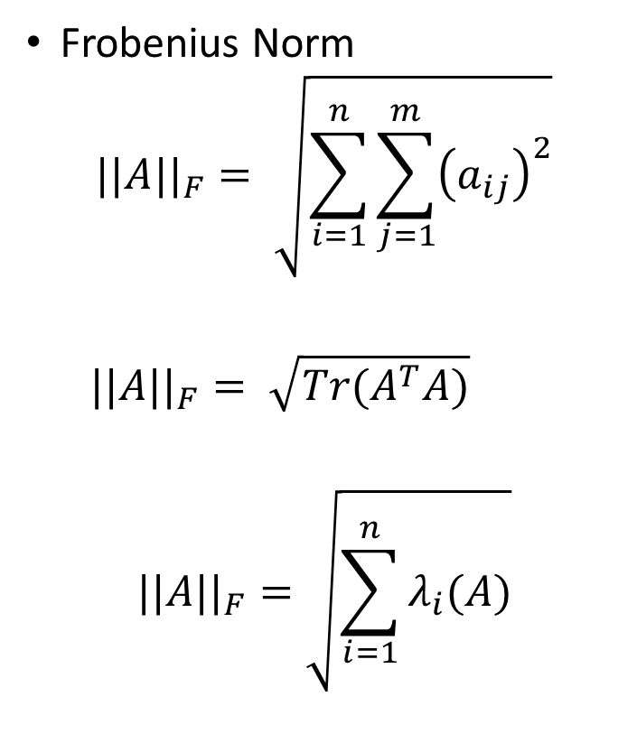

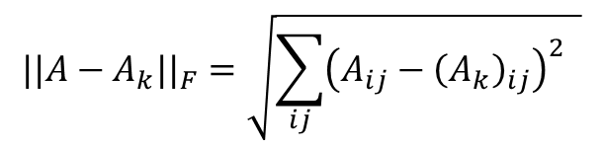
Best Rank-k approximations ($A_{k}$): Eckart-Young theorem
Frobenius Norm
$$||A||_{F}= \sqrt{\sum_{i=1}^{n}{\sum_{j=1}^{m}{{\left(a_{ij}\right)}^{2}}}}$$
$$||A||_{F}= \sqrt{Tr(A^{T}A)}$$
$$||A||_{F}=\sqrt{\sum_{i=1}^{n}{λ_{i}(A)}}$$
Let A and B be any $m×n$ matrices, with B having rank k. Then
$$||A−A_{k}||_{F}≤||A−B||_{F}$$
RANK 3
RANK 3
RANK 3
1 | 2 | 3
5 | 6 | 7
3 | 5 | 4
0 | 2 | 1
5 | 4 | 7
1 | 5 | 2
3 | 0 | 3
5 | 9 | 7
3 | 1 | 4
$$A$$
$$A_{k}$$
$$B$$
$$||A−A_{k}||_{F}=\sqrt{\sum_{ij}{{\left(A_{ij}−{\left(A_{k}\right)}_{ij}\right)}^{2} }}$$
$$=\sqrt{1^{2}+0^{2}+2^{2}+0^{2}+2^{2}+0^{2}+2^{2}+0^{2}+2^{2}}=\sqrt{17}=4.1231$$
$$λ_{i}\text{is} \text{the} \text{ith} \text{non}\text{-}\text{zero} \text{eigenvalues} \text{of} A^{∗}A, A^{∗}conjugate transpose$$
$$||A−B||_{F}=\sqrt{\sum_{ij}{{\left(A_{ij}−B_{ij}\right)}^{2} }}=\sqrt{{\left(−2\right)}^{2}+2^{2}+0^{2}+0^{2}+{\left(−3\right)}^{2}+0^{2}+0^{2}+4^{2}+0^{2}}=\sqrt{33}=5.7446$$

Slide 40



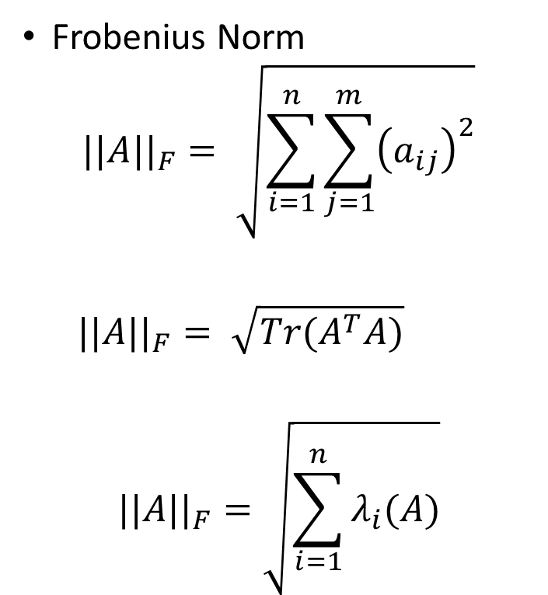




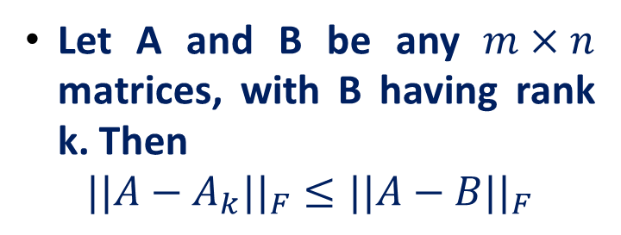

Best Rank-k approximations ($A_{k}$): Eckart-Young theorem
Frobenius Norm
$$||A||_{F}= \sqrt{\sum_{i=1}^{n}{\sum_{j=1}^{m}{{\left(a_{ij}\right)}^{2}}}}$$
$$||A||_{F}= \sqrt{Tr(A^{T}A)}$$
$$||A||_{F}=\sqrt{\sum_{i=1}^{n}{λ_{i}(A)}}$$
Let A and B be any $m×n$ matrices, with B having rank k. Then
$$||A−A_{k}||_{F}≤||A−B||_{F}$$
RANK 3
RANK 3
RANK 3
1 | 2 | 3
5 | 6 | 7
3 | 5 | 4
0 | 2 | 1
5 | 4 | 7
1 | 5 | 2
3 | 0 | 3
5 | 9 | 7
3 | 1 | 4
$$A$$
$$A_{k}$$
$$B$$
1 | 0 | 2
0 | 2 | 0
2 | 0 | 2
$$A−A_{k}=$$
$$\sqrt{Tr( {\left(A−A_{k}\right)}^{T}\left(A−A_{k}\right))}=$$
$$\sqrt{5+4+8}=\sqrt{17}$$
$$λ_{i}\text{is} \text{the} \text{ith} \text{non}\text{-}\text{zero} \text{eigenvalues} \text{of} A^{∗}A, A^{∗}conjugate transpose$$
$$=||A−A_{k}||_{F}$$

Slide 41


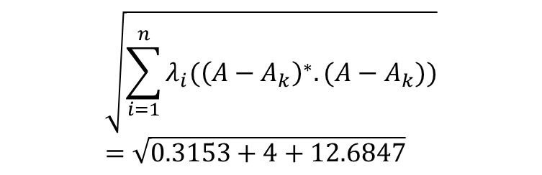
Best Rank-k approximations ($A_{k}$): Eckart-Young theorem
Frobenius Norm
$$||A||_{F}= \sqrt{\sum_{i=1}^{n}{\sum_{j=1}^{m}{{\left(a_{ij}\right)}^{2}}}}$$
$$||A||_{F}= \sqrt{Tr(A^{T}A)}$$
$$||A||_{F}=\sqrt{\sum_{i=1}^{n}{λ_{i}(A)}}$$
Let A and B be any $m×n$ matrices, with B having rank k. Then
$$||A−A_{k}||_{F}≤||A−B||_{F}$$
RANK 3
RANK 3
RANK 3
1 | 2 | 3
5 | 6 | 7
3 | 5 | 4
0 | 2 | 1
5 | 4 | 7
1 | 5 | 2
3 | 0 | 3
5 | 9 | 7
3 | 1 | 4
$$A$$
$$A_{k}$$
$$B$$
1 | 0 | 2
0 | 2 | 0
2 | 0 | 2
$$\sqrt{\sum_{i=1}^{n}{λ_{i}({\left(A−A_{k}\right)}^{∗}.(A−A_{k}))}}=\sqrt{0.3153+4+12.6847}$$
$$A−A_{k}=$$
$$λ_{i}\text{is} \text{the} \text{ith} \text{non}\text{-}\text{zero} \text{eigenvalues} \text{of} A^{∗}A, A^{∗}conjugate transpose$$
$$=\sqrt{17}$$
$$=||A−A_{k}||_{F}$$

Slide 42
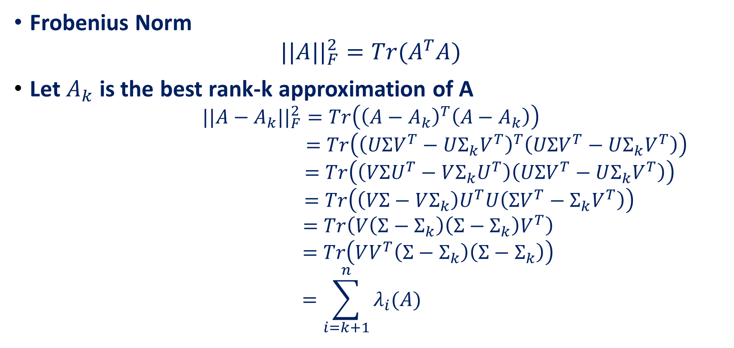
Best Rank-k approximations ($A_{k}$): Eckart-Young theorem
Frobenius Norm
$$||A||_{F}^{2}=Tr(A^{T}A)$$
Let $A_{k}$ is the best rank-k approximation of A
$$||A−A_{k}||_{F}^{2}=Tr\left({\left(A−A_{k}\right)}^{T}\left(A−A_{k}\right)\right)$$
$$=Tr\left({\left(UΣV^{T}−UΣ_{k}V^{T}\right)}^{T}\left(UΣV^{T}−UΣ_{k}V^{T}\right)\right)$$
$$=Tr\left(\left(VΣU^{T}−VΣ_{k}U^{T}\right)\left(UΣV^{T}−UΣ_{k}V^{T}\right)\right)$$
$$=Tr\left(\left(VΣ−VΣ_{k}\right)U^{T}U\left(ΣV^{T}−Σ_{k}V^{T}\right)\right)$$
$$=Tr\left(V\left(Σ−Σ_{k}\right)\left(Σ−Σ_{k}\right)V^{T}\right)$$
$$=Tr\left(VV^{T}\left(Σ−Σ_{k}\right)\left(Σ−Σ_{k}\right)\right)$$
$$=\sum_{i=k+1}^{n}{λ_{i}(A)}$$

Slide 43
Power method for computing the SVD
Suppose that $A$ is $n × n$and that the eigenvalues are ordered:
$$λ_{1}≥λ_{2}≥λ_{3}≥…≥λ_{n}$$
Determining $λ_{1}$
Start with any nonzero vector $x_{0}$ and then iterate
$$x_{k+1}=\frac{Ax_{k}}{||Ax_{k}||_{F}}$$
Repeat Until $||x_{k+1}−x_{k}||$ is less than some small, chosen constant
Let $x$ be $x_{k}$ for that value of $k$ at which convergence is obtained.
To obtain the corresponding eigenvalue we simply compute $λ_{1} =x^{T}Ax$, which is the equation $Mx =λx$solved for $λ$, since $x$ is a unit vector.

Slide 44
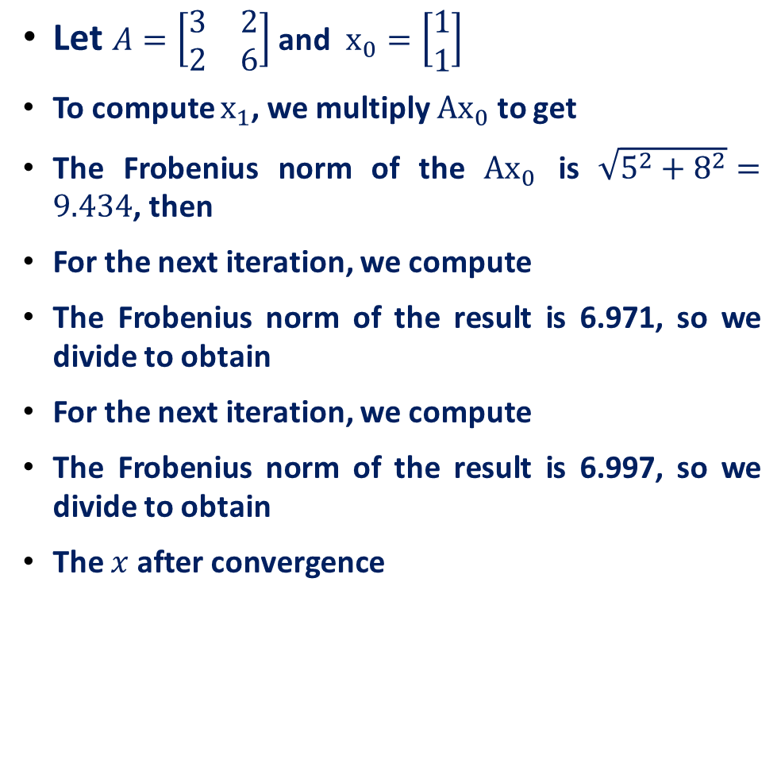
Power method for computing the SVD
Let $A=\left[\begin{matrix}3 & 2 \\ 2 & 6\end{matrix}\right]$ and $x_{0}=\left[\begin{matrix}1 \\ 1\end{matrix}\right]$
To compute $x_{1}$, we multiply ${Ax}_{0}$ to get
The Frobenius norm of the ${Ax}_{0}$ is $\sqrt{5^{2}+8^{2}}=9.434$, then
For the next iteration, we compute
The Frobenius norm of the result is 6.971, so we divide to obtain
For the next iteration, we compute
The Frobenius norm of the result is 6.997, so we divide to obtain
The $x$ after convergence
$$\left[\begin{matrix}3 & 2 \\ 2 & 6\end{matrix}\right]\left[\begin{matrix}1 \\ 1\end{matrix}\right]=\left[\begin{matrix}5 \\ 8\end{matrix}\right]$$
$$x_{1}=\left[\begin{matrix}5/9.434 \\ 8/9.434\end{matrix}\right]=\left[\begin{matrix}0.534 \\ 0.848\end{matrix}\right]$$
$$\left[\begin{matrix}3 & 2 \\ 2 & 6\end{matrix}\right]\left[\begin{matrix}0.534 \\ 0.848\end{matrix}\right]=\left[\begin{matrix}3.286 \\ 6.148\end{matrix}\right]$$
$$x_{2}=\left[\begin{matrix}3.286/\text{6.971} \\ 6.148/\text{6.971}\end{matrix}\right]=\left[\begin{matrix}0.471 \\ 0.882\end{matrix}\right]$$
$$\left[\begin{matrix}3 & 2 \\ 2 & 6\end{matrix}\right]\left[\begin{matrix}0.471 \\ 0.882\end{matrix}\right]=\left[\begin{matrix}3.177 \\ 6.234\end{matrix}\right]$$
$$x_{3}=\left[\begin{matrix}3.177/6.997 \\ 6.234/6.997\end{matrix}\right]=\left[\begin{matrix}0.454 \\ 0.891\end{matrix}\right]$$
$$x =\left[\begin{matrix}0.447 \\ 0.894\end{matrix}\right]$$

Slide 45
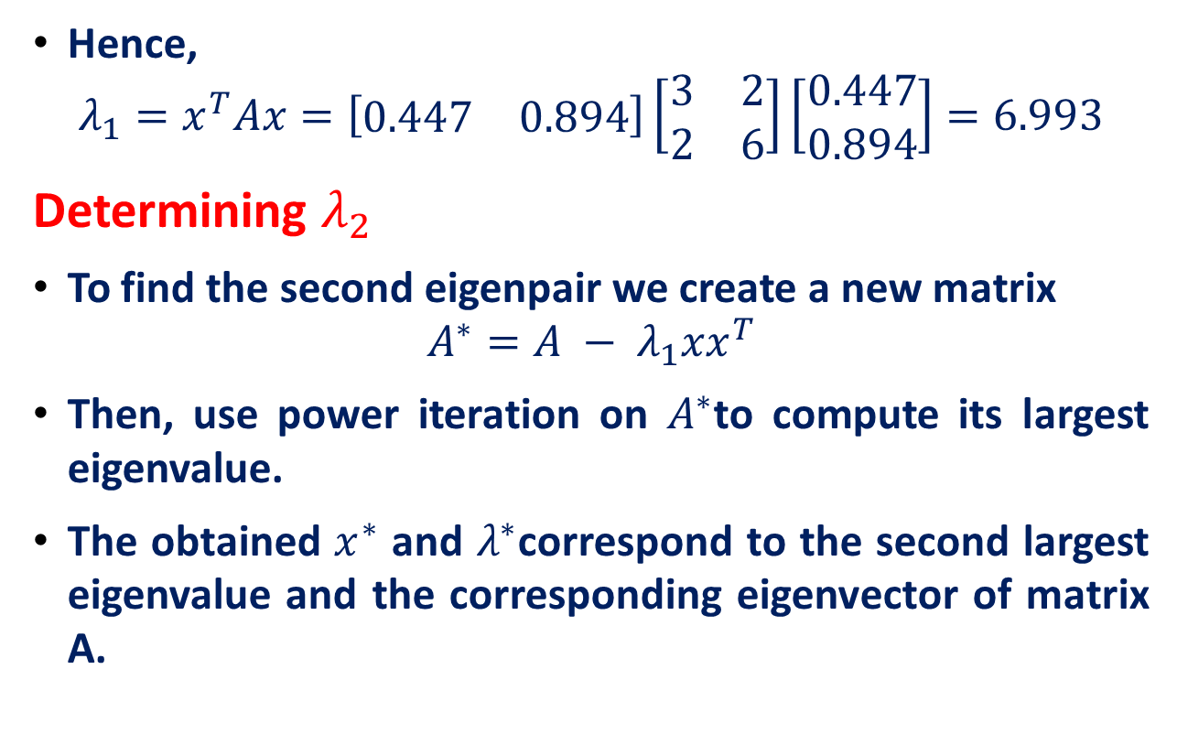
Power method for computing the SVD
Hence,
$$λ_{1}=x^{T}Ax=\left[\begin{matrix}0.447 & 0.894\end{matrix}\right]\left[\begin{matrix}3 & 2 \\ 2 & 6\end{matrix}\right]\left[\begin{matrix}0.447 \\ 0.894\end{matrix}\right]=6.993$$
Determining $λ_{2}$
To find the second eigenpair we create a new matrix
$$A^{∗}=A − λ_{1}{xx}^{T}$$
Then, use power iteration on $A^{∗}$to compute its largest eigenvalue.
The obtained $x^{∗}$ and $λ^{∗}$correspond to the second largest eigenvalue and the corresponding eigenvector of matrix A.

Slide 46
Reference
Feature Extraction, K. Ramachandra Murthy
Singular Value Decomposition Tutorial Kirk Baker
Eigen Decomposition and Singular Value Decomposition, Based on the slides by Mani Thomas Modified and extended by Longin Jan Latecki
Statistical Modeling and Analysis of Neural Data (NEU 560) Princeton University, Spring 2018 Jonathan Pillow

