Slide 1
Generative Models
Naive Bayes

Slide 2
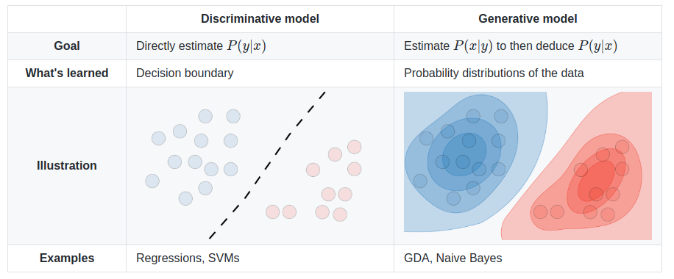

Slide 3
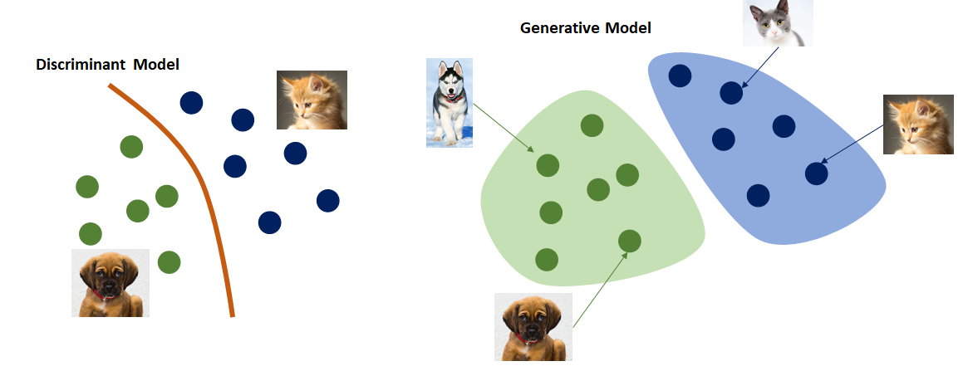

Slide 4
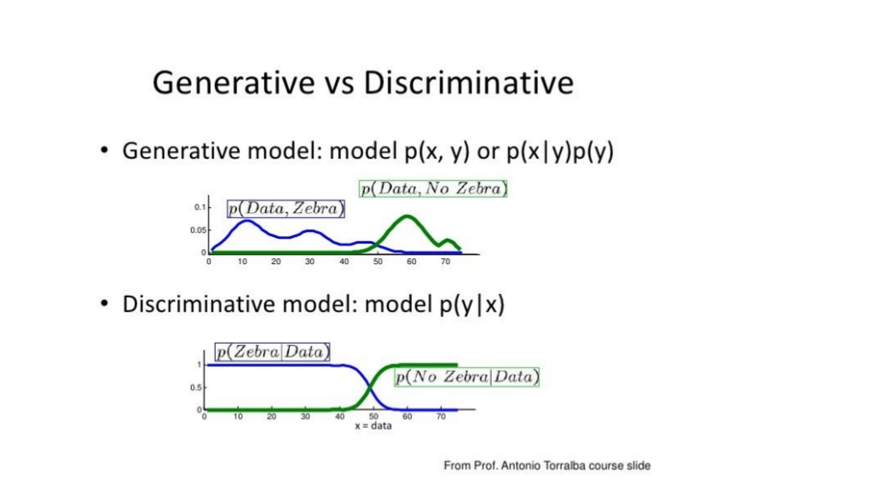

Slide 5
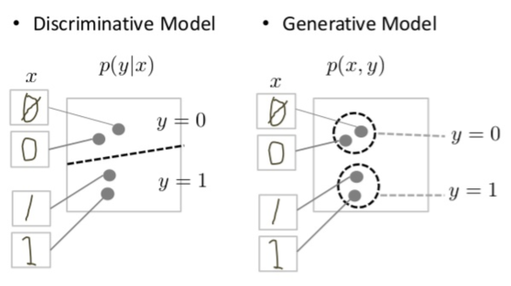

Slide 6
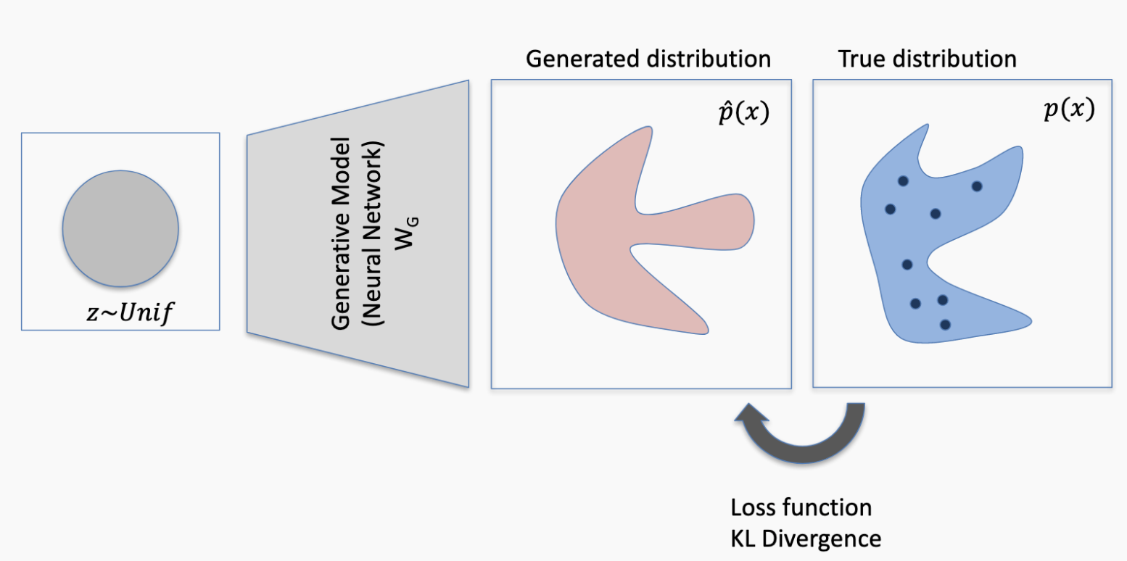

Slide 7
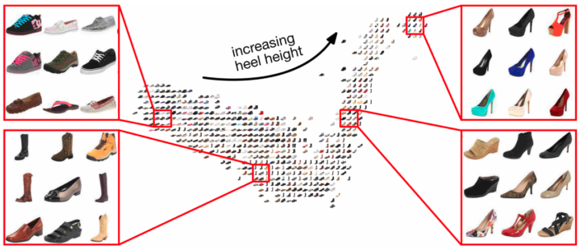
GAN

Slide 8


NB
p(x,y_{i})
GAN
Naive Bayes
The simplest generative model

Slide 9
NB used as a classifier

Slide 10
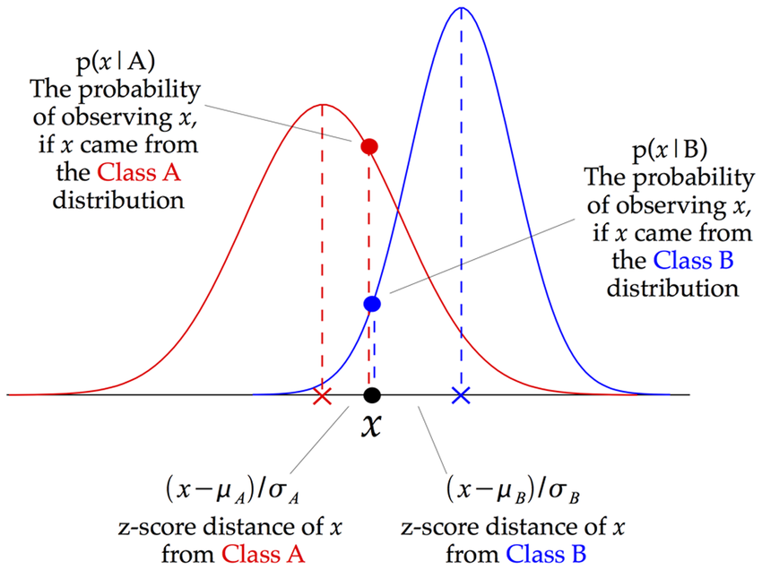
NB Classifier:
argmax of posteriors

Slide 11
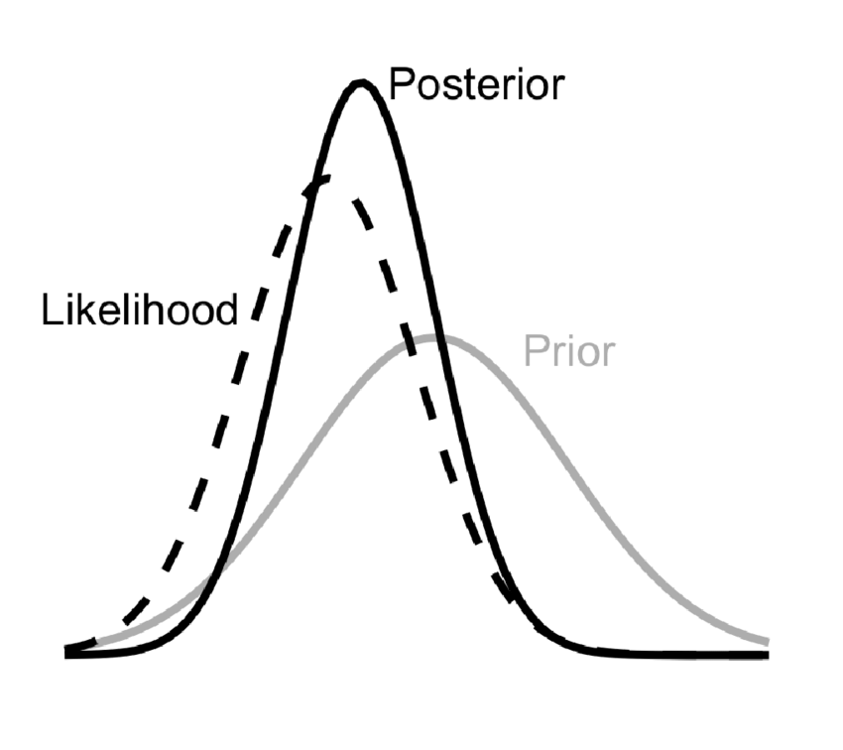
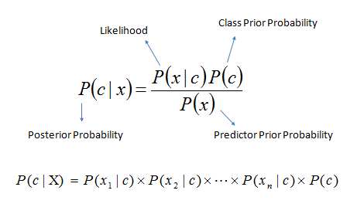
Interpretation: posterior is the updated prior given the likelihood of new data
NB independence assumption

Slide 12

Calculation of joint distribution of several variables using conditional probabilities (Chain rule)
For two variables
For multiple variables
Difficult to model: needs many data examples
For independent variables (Naive Bayes assumption)

Slide 13
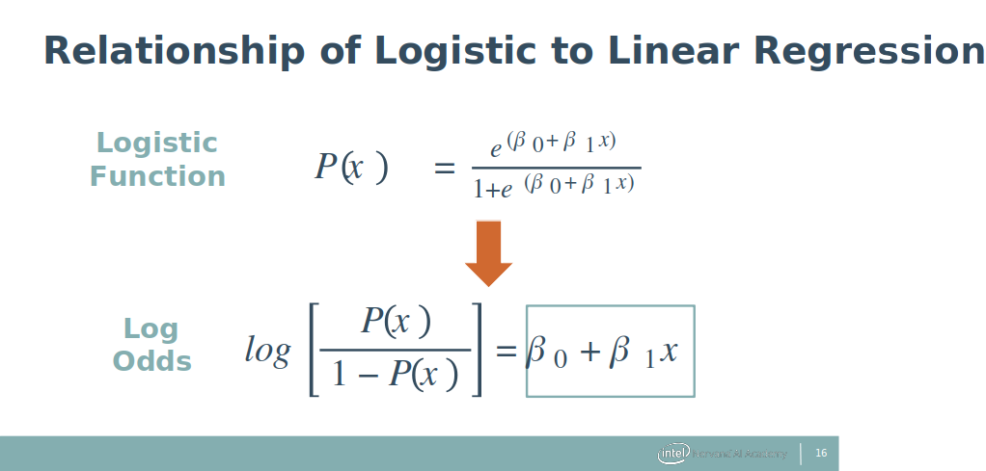
Relation with Logistic regression: the log odds model

Slide 14
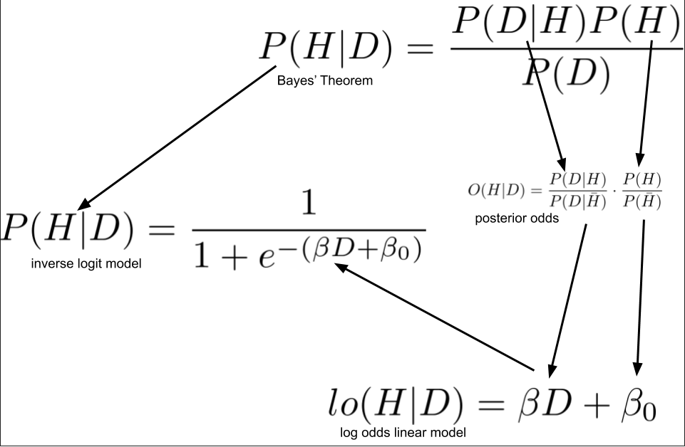
Relation with Logistic regression:

Slide 15
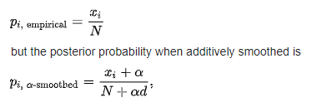
Laplace smoothing
Controls bias vs variance
High smoothing → uniform priors (high bias)
Use CV to find optimal 𝝰
d = number of classes
𝝰 = smoothing factor
Sanity check:
𝝰 → inf => p → 1/d (random guess)

