Slide 1
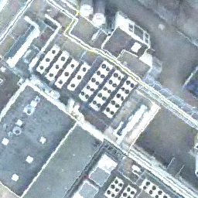
SPATIALLY RELIABLE
Green-roof
segmentation
A GIS-aware U-Net study in Berlin PLZ 12357
Pitch & first findings · semantic segmentation · 2016 RGB aerial imagery
TU Berlin · Shuai Shao

Slide 2
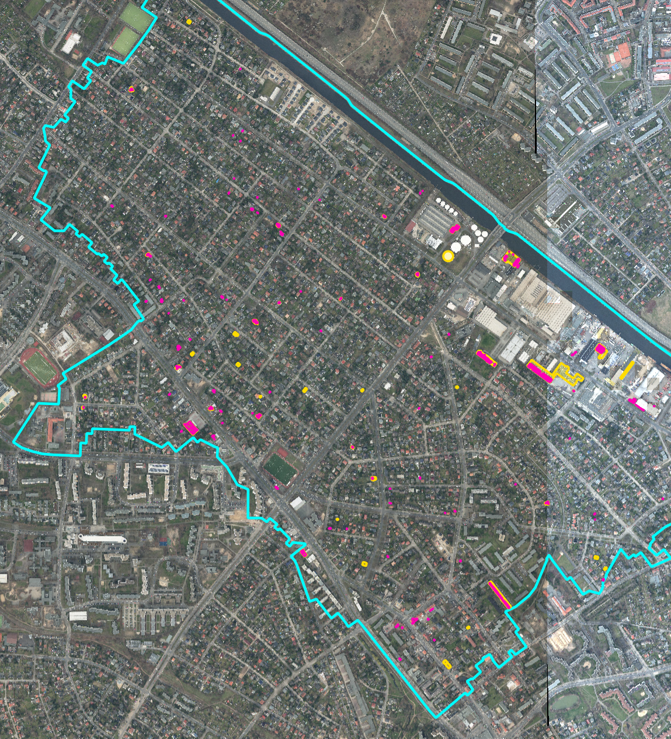
GREEN-ROOF MAPPING
Primitive polygon label
What can we see by the overview?
Pink-partial roof label
Yellow – entire roof label
Blue border-zone 12357
02

Slide 3
FIRST FINDINGS
Only 0.60% of pixels represent green roofs
643,038
foreground pixels
106.5 M
total pixels
0.6001%
foreground share
Implication: overlap metrics must be paired with negative-scene false-positive analysis.
Source: class-balance analysis for PLZ 12357
08

Slide 4

GREEN-ROOF MAPPING
Green-roof mapping is a rare-object segmentation task
0.60%
of all pixels are green-roof labels
11.1%
of tiles contain any positive pixel
pixel mask
RGB tile
Source: processed PLZ 12357 dataset summary
02

Slide 5
GREEN-ROOF MAPPING
The main gap is credible evaluation, not a lack of models
01
02
03
Label geometry
Spatial dependence
Extreme class imbalance
Vector polygons must align exactly with 256 × 256 image pixels.
Neighbouring tiles are visually similar; random splitting can overstate generalization.
Most pixels and tiles are negative, so naive training and accuracy-based evaluation can be misleading
Research gap
The pipeline therefore focuses on GIS-aligned preprocessing, spatially independent splitting, and class-aware sampling for robust training and evaluation.
Literature context: spatial blocking and semantic-segmentation baselines
03

Slide 6
GREEN-ROOF MAPPING
Research questions for reliable green-roof mapping
RQ1
How do different semantic segmentation models compare for green-roof mapping under spatially grouped evaluation?
RQ2
Does removing negative-only training tiles improve overlap—or increase false-positive predictions?
Contribution
GIS-aware labels
Spatial blocks
Controlled ablation
Subgroup error analysis
Decision criterion: reliable area-wide mapping, not performance on positive examples alone.
04

Slide 7
GREEN-ROOF MAPPING
GREEN-ROOF MAPPING
A ResNet50 U-Net provides a transparent baseline
Model family
Core idea
Why relevant
U-Net
Encoder–decoder + skip connections
Precise localization; strong baseline
SELECTED
SegFormer
Hierarchical Transformer + MLP
Global context; efficient scaling
LATER
Why this baseline
Pretrained ResNet50 features + an interpretable decoder; suitable for a small, imbalanced first experiment.
Sources: Ronneberger et al. 2015; Xie et al. 2021
05

Slide 8
PROPOSED METHOD
GIS preprocessing turns roof polygons into aligned masks
1
XYZ tile
z / x / y key
2
Tile bounds
mercantile.xy_bounds
3
Intersect labels
Shapely in EPSG:3857
4
Pixel transform
rasterio.from_bounds
5
Rasterize
256 × 256 mask
Coordinate contract
Images and labels meet in EPSG:3857; rasterization then maps metre-based tile bounds directly to the 256 × 256 pixel grid.
Vector I/O: GeoPandas / pyshp · Geometry: Shapely · CRS: pyproj · Raster labels: Rasterio
Source: project preprocessing modules and rasterized mask
06
Notes:
Walk left to right. XYZ already defines the image grid. Mercantile gives each tile's Web Mercator bounds. Green-roof polygons are loaded, validated and transformed to EPSG:3857. Shapely selects intersections; Rasterio maps the intersecting geometry into the exact 256 by 256 mask.

Slide 9
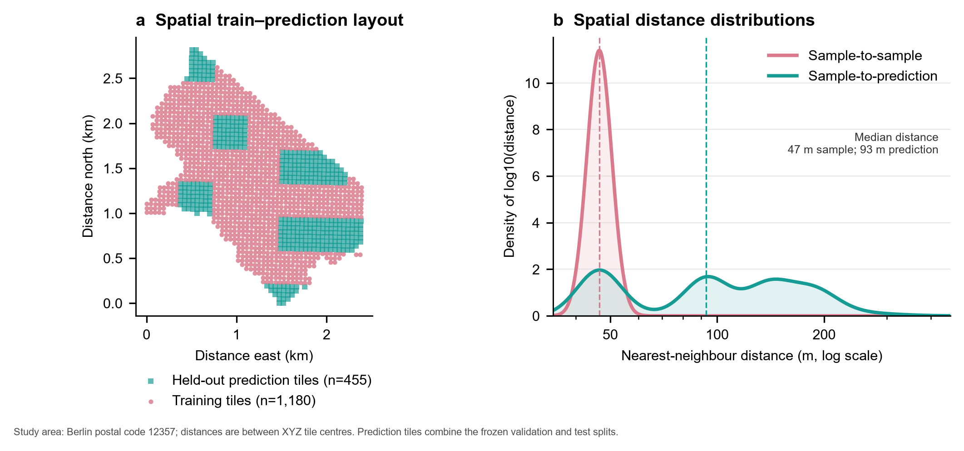
PROPOSED METHOD
Spatial blocks keep neighbouring tiles in the same split
8 × 8
XYZ tiles per split block
2.0×
median held-out distance
Train 1,180
Validation 203
Test 252
No block ID appears in more than one split; validation and test remain geographically separated from training.
Source: frozen manifests and spatial-distance analysis (EPSG:25833 distances)
07

Slide 10
SPATIAL SPLIT
Foreground-rich blocks are assigned first
STEP 1
Shuffle blocks with seed 42, then sort them by foreground-pixel count from high to low.
STEP 2
For each block, score train, validation and test; assign the block to the highest-scoring split.
Method properties
Positive-rich first
Whole-block placement
Deterministic seed
Greedy—not global
Ordering reduces the risk that large green-roof blocks accumulate in one split.
A3

Slide 11
SPATIAL SPLIT
The split score prioritizes foreground balance
Target ratios
Train 70% · Validation 15% · Test 15%
TILE COUNT
FOREGROUND PIXELS
0.35 × tile shortfall
+
0.65 × pixel shortfall
Normalized shortfall from the target number of tiles.
Normalized shortfall from the target green-roof pixel mass.
scoreₛ = 0.35 Δtiles,s + 0.65 Δpixels,s · highest score receives the whole block
A2

Slide 12
SPATIAL SPLIT
The frozen split is balanced—but not exactly constrained
Hard constraint
38 blocks assigned once · 28 / 5 / 5 · no overlap
Tile share
72.17% / 12.42% / 15.41%
Positive tiles
71.43% / 12.09% / 16.48%
Foreground pixels
68.41% / 16.35% / 15.25%
Tile counts
1,180 / 203 / 252
Interpretation
Positive-tile balance is indirect, not optimized
Order: train / validation / test · target ratio: 70 / 15 / 15%
A4

Slide 13
EXPERIMENT DESIGN
One frozen split isolates the effect of negative training scenes
Shared protocol
Same U-Net · same optimizer budget · same augmentations · same full validation set
ALL-TILE
POSITIVE-ONLY
590 positive + 590 negative
VS
1180 positive samples
Balanced per epoch
1180 samples / epoch
Every batch=2 positive + 2 negative
Positive tiles sampled with replacement
No negative-only training scenes
Only the training sampler changes; validation composition and labels do not.
09
Notes:
This is a controlled ablation. Both runs see 1,180 samples per epoch, identical validation images and the same synchronized flips and 90-degree rotations.

Slide 14
FIRST MODEL RESULTS
All-tile training performs better after threshold calibration
CALIBRATED ON VALIDATION
0.05
all-tile threshold
0.95
positive-only threshold
Dice advantage
+5.33 percentage points
Validation only · 203 tiles · test set untouched
10
Notes:
The very different selected thresholds—0.05 versus 0.95—also signal a calibration problem.

Slide 15
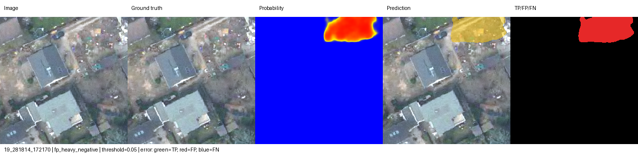
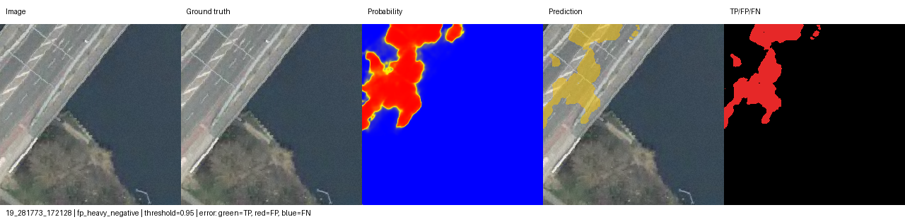
ERROR ANALYSIS
Positive-only training spreads false positives across more scenes
ALL-TILE
10 / 181 negative scenes
POSITIVE-ONLY
65 / 181 negative scenes
False-positive pixels
31,962
29,839
all-tile
positive-only
Positive-only produces slightly fewer FP pixels—but contaminates 6.5× more negative scenes.
Diagnostic panels show image · truth · probability · prediction · TP/FP/FN
11

Slide 16
CONCLUSION
Current evidence favors negative-aware training
SUPPORTED NOW
NOT YET CLAIMED
Including negative scenes improves validation Dice and reduces the number of contaminated negative tiles.
Final test performance, more-Berlin transfer and cross-year generalization remain unknown.
Next
Lock the decision threshold
Evaluate the untouched test set once
Compare other model
For area-wide green-roof mapping, learning absence is as important as learning appearance.
12

Slide 17
Q&A APPENDIX
Evidence behind
the first findings
Data provenance · calibration · augmentation · subgroups · spatial diagnostics
A

Slide 18
APPENDIX
Dataset provenance and frozen split
Study area
Berlin PLZ 12357
Imagery
RGB orthophotos, 2016
Tiles
1,635 at z=19, 256 × 256
Labels
983 source polygons; 969 intersect area
Split
1,180 / 203 / 252
Blocks
28 / 5 / 5; no overlap
14

Slide 19
APPENDIX
Threshold calibration changes the comparison
Training
Fixed threshold
Fixed Dice
Selected threshold
Selected Dice
All-tile
0.50
44.06%
0.05
47.54%
Positive-only
0.50
41.59%
0.95
42.21%
Interpretation
The threshold gap suggests different output-score; compare models only under a declared threshold protocol.
15

Slide 20
APPENDIX
Augmentation preserves image–mask alignment
50%
50%
0 / 90 / 180 / 270°
horizontal flip
vertical flip
rotation
Synchronization
Every geometric transform is applied identically to the RGB tile and its mask.
Validation: no augmentation
16

Slide 21
APPENDIX
APPENDIX
All-tile training also wins on positive tiles
Metric
All-tile
Positive-only
Difference
Positive-tile Dice
56.53%
50.01%
+6.52 pp
Positive-tile precision
74.68%
71.74%
+2.94 pp
Positive-tile recall
45.47%
38.39%
+7.08 pp
Negative scenes with FP
10 / 181
65 / 181
−55 scenes
17

Slide 22
APPENDIX
Spatial separation is measurable but still local
47 m
train-to-train median
93 m
held-out-to-train median
336 m
maximum held-out distance
Boundary: this diagnoses the frozen PLZ split; it does not prove transfer across Berlin or across years.
18

Slide 23
SPATIAL SPLIT
An 8 × 8 block is the indivisible split unit
01
02
03
Tile coordinates
Spatial block
Atomic assignment
block_x = (x − min_x) // 8
block_y = (y − min_y) // 8
Neighbouring XYZ tiles share one block ID; boundary blocks may contain fewer than 64 tiles.
Every block enters train, validation or test as a whole.
Hard constraint
No block ID appears in more than one split.
Source: spatial_split.py · 8 × 8 XYZ-tile blocks
A1

Slide 24
APPENDIX
APPENDIX
Main limitations define the next experiments
01
Small geography
02
Temporal mismatch
One Berlin postcode; limited roof and vegetation diversity.
Current PLZ boundary applied to 2016 imagery and labels.
03
Calibration
04
Sampling design
Optimal validation thresholds differ strongly between runs.
All-tile batches are balanced, not reality
05
Model scope
06
External validity
Only one architecture family has been trained so far.
No cross-year or more-Berlin evaluation yet.
Next Step: freeze threshold → test once → add DeepLabv3+ → expand geography / year.
19

