Slide 1
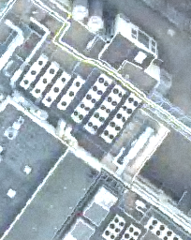
SPATIALLY RELIABLE
Green-roof
segmentation
A GIS-aware U-Net study in Berlin PLZ 12357
Pitch & first findings · semantic segmentation · 2016 RGB aerial imagery
TU Berlin · Computational Engineering Science
Notes:
Open with the task: mapping green-roof area at pixel level from aerial imagery. The study is deliberately restricted to Berlin postcode 12357 so that the first experiment is small, reproducible, and spatially auditable. The displayed RGB tile is selected by the PLZ-filtered training manifest; its image bytes remain in the immutable orthophoto source tree.
[Sources]
- E:/Artificial_Intelligence_in_water/project/data/processed/green_roofs_2016_plz12357/manifests/train.csv
- E:/Artificial_Intelligence_in_water/project/data/green_roofs/green_roofs/orthophotos_2016/12357/19/281806/172161.png
- E:/Artificial_Intelligence_in_water/project/code/presentation/PITCH_PLAN.md

Slide 2

GREEN-ROOF MAPPING
Green-roof mapping is a rare-object segmentation task
0.60%
of all pixels are green-roof labels
11.1%
of tiles contain any positive pixel
pixel mask
The model must detect small roof regions while rejecting vegetation, shadows and roof materials elsewhere.
RGB tile
Source: processed PLZ 12357 dataset summary
02
Notes:
Define the task as semantic segmentation: every pixel receives a green-roof or background label. Both imbalance figures are calculated after the PLZ 12357 centre-point filter: 182 of 1,635 selected tiles are positive, and 0.6001% of their pixels are foreground. The displayed RGB tile is referenced by the filtered training manifest; only its image bytes remain in the immutable orthophoto source tree.
[Sources]
- E:/Artificial_Intelligence_in_water/project/data/processed/green_roofs_2016_plz12357/dataset_summary.json
- E:/Artificial_Intelligence_in_water/project/data/processed/green_roofs_2016_plz12357/class_balance_analysis/class_balance_summary.json
- E:/Artificial_Intelligence_in_water/project/data/processed/green_roofs_2016_plz12357/manifests/train.csv
- E:/Artificial_Intelligence_in_water/project/data/green_roofs/green_roofs/orthophotos_2016/12357/19/281806/172161.png
- E:/Artificial_Intelligence_in_water/project/data/processed/green_roofs_2016_plz12357/masks/19/281806/172161.png

Slide 3
GREEN-ROOF MAPPING
The main gap is credible evaluation, not a lack of models
01
02
03
Label geometry
Spatial dependence
Negative scenes
Vector polygons must align exactly with 256 × 256 image pixels.
Neighbouring tiles are visually similar; random splitting can overstate generalization.
A city-wide mapper sees mostly absence, so false positives dominate usability.
Research gap
A useful model must be GIS-aligned, spatially evaluated and trained to recognize absence.
Literature context: spatial blocking and semantic-segmentation baselines
03
Notes:
The proposal is not another architecture race. The methodological gap is whether the complete workflow yields credible spatial evidence. Spatially structured data violate the independence assumption of ordinary random cross-validation; block-based evaluation is therefore the safer baseline.
[Sources]
- https://doi.org/10.1111/ecog.02881
- https://lmb.informatik.uni-freiburg.de/Publications/2015/RFB15a/

Slide 4
GREEN-ROOF MAPPING
We test whether negative scenes are necessary
RQ1
How effectively can a ResNet50 U-Net segment green roofs under spatially grouped evaluation?
RQ2
Does removing negative-only training tiles improve overlap—or increase false-positive predictions?
Contribution
GIS-aware labels
Spatial blocks
Controlled ablation
Subgroup error analysis
Decision criterion: reliable area-wide mapping, not performance on positive examples alone.
04
Notes:
State both research questions. RQ2 is the controlled experiment already completed on validation data. Stress that the same frozen validation set is used for both models.
[Sources]
- E:/Artificial_Intelligence_in_water/project/code/configs/unet_plz12357_all.toml
- E:/Artificial_Intelligence_in_water/project/code/configs/unet_plz12357_positive_only.toml

Slide 5
GREEN-ROOF MAPPING
GREEN-ROOF MAPPING
A ResNet50 U-Net provides a transparent baseline
Model family
Core idea
Why relevant
U-Net
Encoder–decoder + skip connections
Precise localization; strong baseline
SELECTED
DeepLabv3+
Atrous context + decoder
Multi-scale context; sharper boundaries
NEXT
SegFormer
Hierarchical Transformer + MLP
Global context; efficient scaling
LATER
Why this baseline
Pretrained ResNet50 features + an interpretable decoder; suitable for a small, imbalanced first experiment.
Sources: Ronneberger et al. 2015; Chen et al. 2018; Xie et al. 2021
05
Notes:
U-Net is chosen because its encoder–decoder structure and skip connections offer a clear baseline for pixel localization. ResNet50 supplies pretrained visual features. DeepLabv3+ and SegFormer remain suitable follow-up baselines once the data and evaluation protocol are stable.
[Sources]
- https://lmb.informatik.uni-freiburg.de/Publications/2015/RFB15a/
- https://openaccess.thecvf.com/content_ECCV_2018/papers/Liang-Chieh_Chen_Encoder-Decoder_with_Atrous_ECCV_2018_paper.pdf
- https://papers.nips.cc/paper/2021/hash/64f1f27bf1b4ec22924fd0acb550c235-Abstract.html

Slide 6
PROPOSED METHOD
GIS preprocessing turns roof polygons into aligned masks
1
XYZ tile
z / x / y key
2
Tile bounds
mercantile.xy_bounds
3
Intersect labels
Shapely in EPSG:3857
4
Pixel transform
rasterio.from_bounds
5
Rasterize
256 × 256 mask
Coordinate contract
Images and labels meet in EPSG:3857; rasterization then maps metre-based tile bounds directly to the 256 × 256 pixel grid.
Vector I/O: GeoPandas / pyshp · Geometry: Shapely · CRS: pyproj · Raster labels: Rasterio
Source: project preprocessing modules and rasterized mask
06
Notes:
Walk left to right. XYZ already defines the image grid. Mercantile gives each tile's Web Mercator bounds. Green-roof polygons are loaded, validated and transformed to EPSG:3857. Shapely selects intersections; Rasterio maps the intersecting geometry into the exact 256 by 256 mask. The example tile is included by the PLZ-filtered training manifest.
[Sources]
- E:/Artificial_Intelligence_in_water/project/code/src/green_roofs/tiles.py
- E:/Artificial_Intelligence_in_water/project/code/src/green_roofs/labels.py
- E:/Artificial_Intelligence_in_water/project/code/src/green_roofs/rasterization.py
- E:/Artificial_Intelligence_in_water/project/data/processed/green_roofs_2016_plz12357/manifests/train.csv
- E:/Artificial_Intelligence_in_water/project/data/green_roofs/green_roofs/orthophotos_2016/12357/19/281806/172161.png
- E:/Artificial_Intelligence_in_water/project/data/processed/green_roofs_2016_plz12357/masks/19/281806/172161.png

Slide 7
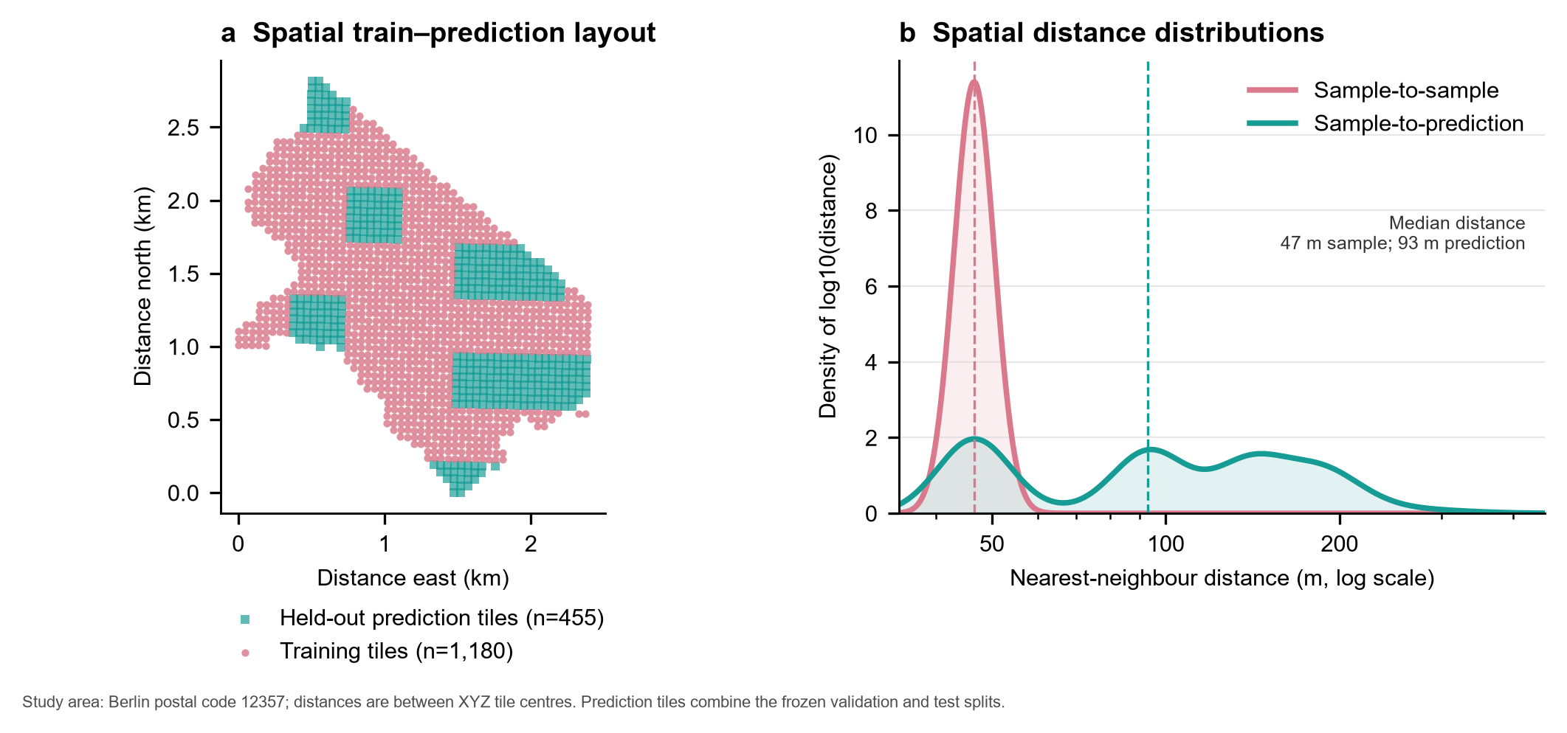
PROPOSED METHOD
Spatial blocks keep neighbouring tiles in the same split
8 × 8
XYZ tiles per split block
2.0×
median held-out distance
Train 1,180
Validation 203
Test 252
No block ID appears in more than one split; validation and test remain geographically separated from training.
Source: frozen manifests and spatial-distance analysis (EPSG:25833 distances)
07
Notes:
First the current official postcode boundary selects tiles by centre point. Then 8 by 8 tile blocks—not individual tiles—are assigned to train, validation and test. The diagnostic shows a 47 m median nearest-neighbour distance within training and 93 m from held-out tiles to training. This is a proxy for spatial separation, not a guarantee of city-wide deployment performance.
[Sources]
- E:/Artificial_Intelligence_in_water/project/data/processed/green_roofs_2016_plz12357/dataset_summary.json
- E:/Artificial_Intelligence_in_water/project/data/processed/green_roofs_2016_plz12357/spatial_distance_analysis/spatial_distance_summary.json
- E:/Artificial_Intelligence_in_water/project/data/processed/green_roofs_2016_plz12357/spatial_distance_analysis/spatial_distance_distribution.png
- https://doi.org/10.1111/ecog.02881

Slide 8
FIRST FINDINGS
Only 0.60% of pixels represent green roofs
643,038
foreground pixels
107.15 M
total pixels
0.6001%
foreground share
Implication: overlap metrics must be paired with negative-scene false-positive analysis.
Source: class-balance analysis for PLZ 12357
08
Notes:
The dataset contains 1,635 tiles. Only 182 are positive and 1,453 contain no green-roof pixels. Across all tiles, only 643,038 of 107,151,360 pixels are foreground. Accuracy would therefore be misleading; Dice, IoU, precision, recall and negative-scene false positives are used instead.
[Sources]
- E:/Artificial_Intelligence_in_water/project/data/processed/green_roofs_2016_plz12357/class_balance_analysis/class_balance_summary.json

Slide 9
EXPERIMENT DESIGN
One frozen split isolates the effect of negative training scenes
Shared protocol
Same U-Net · same optimizer budget · same augmentations · same full validation set
ALL-TILE
POSITIVE-ONLY
590 positive + 590 negative
VS
1180 positive samples
Balanced per epoch
1180 samples / epoch
Positive tiles sampled with replacement
No negative-only training scenes
Only the training sampler changes; validation prevalence and labels do not.
09
Notes:
This is a controlled ablation. Both runs see 1,180 samples per epoch, identical validation images and the same synchronized flips and 90-degree rotations. The all-tile strategy balances 590 positive with 590 negative scenes; positive-only repeats positive examples to match the optimizer-step budget.
[Sources]
- E:/Artificial_Intelligence_in_water/project/code/configs/unet_plz12357_all.toml
- E:/Artificial_Intelligence_in_water/project/code/configs/unet_plz12357_positive_only.toml
- E:/Artificial_Intelligence_in_water/project/runs/unet_plz12357_all/history.csv
- E:/Artificial_Intelligence_in_water/project/runs/unet_plz12357_positive_only/history.csv

Slide 10
FIRST MODEL RESULTS
All-tile training performs better after threshold calibration
CALIBRATED ON VALIDATION
0.05
all-tile threshold
0.95
positive-only threshold
Dice advantage
+5.33 percentage points
Validation only · 203 tiles · test set untouched
10
Notes:
At independently selected validation thresholds, the all-tile model reaches Dice 0.475 and IoU 0.312, versus 0.422 and 0.268 for positive-only training. The very different selected thresholds—0.05 versus 0.95—also signal a calibration problem. These are validation results, not final test results.
[Sources]
- E:/Artificial_Intelligence_in_water/project/runs/unet_plz12357_all/validation_analysis/validation_summary.json
- E:/Artificial_Intelligence_in_water/project/runs/unet_plz12357_positive_only/validation_analysis/validation_summary.json

Slide 11
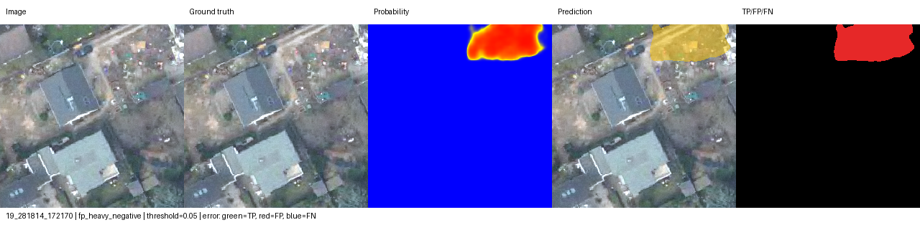
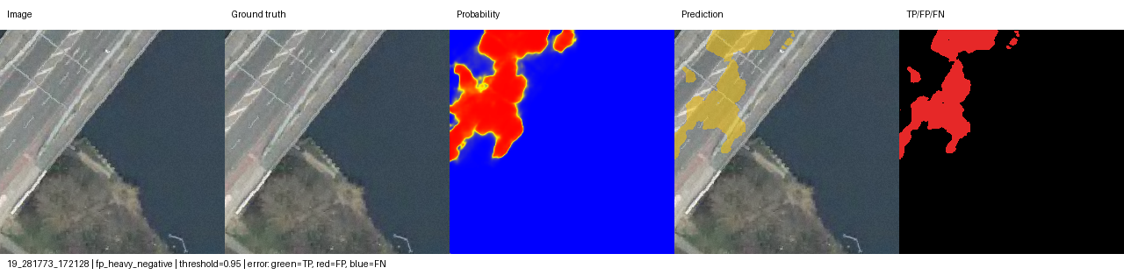
ERROR ANALYSIS
Positive-only training spreads false positives across more scenes
ALL-TILE
10 / 181 negative scenes
POSITIVE-ONLY
65 / 181 negative scenes
False-positive pixels
31,962
29,839
all-tile
positive-only
Positive-only produces slightly fewer FP pixels—but contaminates 6.5× more negative scenes.
Diagnostic panels show image · truth · probability · prediction · TP/FP/FN
11
Notes:
The pixel totals alone would hide the deployment risk. Positive-only training produces slightly fewer false-positive pixels, but at least one false positive appears in 65 of 181 negative validation tiles, compared with 10 of 181 for all-tile training. In area-wide mapping, spatial spread of false alarms matters.
[Sources]
- E:/Artificial_Intelligence_in_water/project/runs/unet_plz12357_all/validation_analysis/validation_summary.json
- E:/Artificial_Intelligence_in_water/project/runs/unet_plz12357_positive_only/validation_analysis/validation_summary.json
- E:/Artificial_Intelligence_in_water/project/runs/unet_plz12357_all/validation_analysis/diagnostics/fp_heavy_negative_01_19_281814_172170.png
- E:/Artificial_Intelligence_in_water/project/runs/unet_plz12357_positive_only/validation_analysis/diagnostics/fp_heavy_negative_01_19_281773_172128.png

Slide 12
CONCLUSION
Current evidence favors negative-aware training
SUPPORTED NOW
NOT YET CLAIMED
Including negative scenes improves validation Dice and reduces the number of contaminated negative tiles.
Final test performance, full-Berlin transfer and cross-year generalization remain unknown.
Next
Lock the decision threshold
Evaluate the untouched test set once
Compare one stronger baseline
For area-wide green-roof mapping, learning absence is as important as learning appearance.
All findings are validation-stage evidence; test remains untouched
12
Notes:
Close on the evidence boundary. The validation study supports keeping negative scenes in training. The next defensible step is to freeze the threshold and evaluate the test set once. Full-Berlin and temporal transfer require separate experiments.
[Sources]
- E:/Artificial_Intelligence_in_water/project/runs/unet_plz12357_all/validation_analysis/validation_summary.json
- E:/Artificial_Intelligence_in_water/project/runs/unet_plz12357_positive_only/validation_analysis/validation_summary.json
- E:/Artificial_Intelligence_in_water/project/code/presentation/PITCH_PLAN.md

Slide 13
Q&A APPENDIX
Evidence behind
the first findings
Data provenance · calibration · augmentation · subgroups · spatial diagnostics
A
Notes:
Use only if questions arise.
[Sources]
- E:/Artificial_Intelligence_in_water/project/code/presentation/PITCH_PLAN.md

Slide 14
APPENDIX
Dataset provenance and frozen split
Study area
Berlin PLZ 12357
Imagery
RGB orthophotos, 2016
Tiles
1,635 at z=19, 256 × 256
Labels
983 source polygons; 969 intersect area
Split
1,180 / 203 / 252
Blocks
28 / 5 / 5; no overlap
Current official postcode boundary; historical 2016 PLZ geometry not verified
14
Notes:
The postcode restriction is based on the current official boundary. That is a known temporal provenance limitation because the imagery and labels are from 2016.
[Sources]
- E:/Artificial_Intelligence_in_water/project/data/processed/green_roofs_2016_plz12357/dataset_summary.json
- E:/Artificial_Intelligence_in_water/project/annotation/green_roofs_2016/berlin_plz_12357.gpkg

Slide 15
APPENDIX
Threshold calibration changes the comparison
Training
Fixed threshold
Fixed Dice
Selected threshold
Selected Dice
All-tile
0.50
44.06%
0.05
47.54%
Positive-only
0.50
41.59%
0.95
42.21%
Interpretation
The threshold gap suggests different probability calibration; compare models only under a declared threshold protocol.
15
Notes:
At threshold 0.5, all-tile Dice is 0.441 and positive-only Dice is 0.416. Validation-based threshold selection raises them to 0.475 and 0.422. Because threshold selection uses validation data, the final threshold must be frozen before test evaluation.
[Sources]
- E:/Artificial_Intelligence_in_water/project/runs/unet_plz12357_all/history.csv
- E:/Artificial_Intelligence_in_water/project/runs/unet_plz12357_positive_only/history.csv
- E:/Artificial_Intelligence_in_water/project/runs/unet_plz12357_all/validation_analysis/threshold_metrics.csv
- E:/Artificial_Intelligence_in_water/project/runs/unet_plz12357_positive_only/validation_analysis/threshold_metrics.csv

Slide 16
APPENDIX
Augmentation preserves image–mask alignment
50%
50%
0 / 90 / 180 / 270°
horizontal flip
vertical flip
rotation
Synchronization
Every geometric transform is applied identically to the RGB tile and its mask.
Validation: no augmentation
16
Notes:
The current training augmentation is deliberately simple and label-safe: independent 50% horizontal and vertical flips plus a random right-angle rotation. The image and mask always receive the same transform. Validation is deterministic.
[Sources]
- E:/Artificial_Intelligence_in_water/project/code/src/green_roofs/transforms.py
- E:/Artificial_Intelligence_in_water/project/code/configs/unet_plz12357_all.toml
- E:/Artificial_Intelligence_in_water/project/code/configs/unet_plz12357_positive_only.toml

Slide 17
APPENDIX
APPENDIX
All-tile training also wins on positive tiles
Metric
All-tile
Positive-only
Difference
Positive-tile Dice
56.53%
50.01%
+6.51 pp
Positive-tile IoU
39.40%
33.35%
+6.05 pp
Positive-tile precision
74.68%
71.74%
+2.94 pp
Positive-tile recall
45.47%
38.39%
+7.09 pp
Negative scenes with FP
10 / 181
65 / 181
−55 scenes
Validation subgroup analysis; selected thresholds 0.05 and 0.95
17
Notes:
The advantage of all-tile training is not caused only by including negative tiles in the aggregate metric. It also performs better on the 22 positive validation tiles across Dice, IoU, precision and recall.
[Sources]
- E:/Artificial_Intelligence_in_water/project/runs/unet_plz12357_all/validation_analysis/validation_summary.json
- E:/Artificial_Intelligence_in_water/project/runs/unet_plz12357_positive_only/validation_analysis/validation_summary.json

Slide 18
APPENDIX
Spatial separation is measurable but still local
47 m
train-to-train median
93 m
held-out-to-train median
336 m
maximum held-out distance
Boundary: this diagnoses the frozen PLZ split; it does not prove transfer across Berlin or across years.
18
Notes:
The nearest-neighbour diagnostic uses tile centres transformed to ETRS89 / UTM zone 33N. It verifies that held-out tiles are farther from training on average, but the entire study area is still a small local postcode region.
[Sources]
- E:/Artificial_Intelligence_in_water/project/data/processed/green_roofs_2016_plz12357/spatial_distance_analysis/spatial_distance_summary.json
- E:/Artificial_Intelligence_in_water/project/data/processed/green_roofs_2016_plz12357/spatial_distance_analysis/spatial_distance_distribution.png

Slide 19
APPENDIX
APPENDIX
Main limitations define the next experiments
01
Small geography
02
Temporal mismatch
One Berlin postcode; limited roof and vegetation diversity.
Current PLZ boundary applied to 2016 imagery and labels.
03
Calibration
04
Sampling design
Optimal validation thresholds differ strongly between runs.
All-tile batches are balanced, not prevalence-matched.
05
Model scope
06
External validity
Only one architecture family has been trained so far.
No cross-year or full-Berlin evaluation yet.
Recommended sequence: freeze threshold → test once → add DeepLabv3+ → expand geography / year.
19
Notes:
These limitations are not footnotes; they define the next experiments. The current result is a validation-stage method finding, not a deployment-ready Berlin map.
[Sources]
- E:/Artificial_Intelligence_in_water/project/code/presentation/PITCH_PLAN.md
- E:/Artificial_Intelligence_in_water/project/data/processed/green_roofs_2016_plz12357/dataset_summary.json

