Slide 1

UIU CampusConnect
Campus Social & Academic Networking Platform
Project Management Report

Slide 2
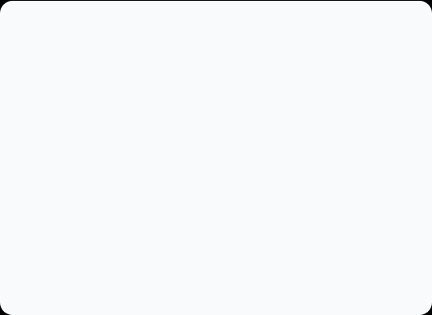
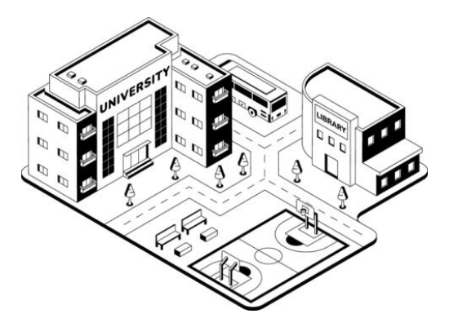
Project Overview
UIU CampusConnect is a university-focused digital platform that brings social networking, academic communication, campus notices, events, and administrative functions into one shared environment.
•
Objective: Create a secure, useful digital ecosystem.
•
Goal: Reduce fragmentation across university communication and community activities.
•
Mechanism: Provide role-based authentication, personalised feeds, and secure messaging.

Slide 3
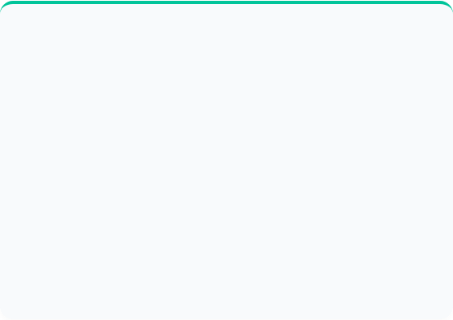

Methodology: Agile Scrum
Why Agile Scrum?
Key Advantages
UIU CampusConnect contains many interconnected modules and will likely require changes based on user feedback. A sprint-based approach allows the team to release usable features incrementally.
• Flexible response to changing requirements.
• Frequent feedback reduces risk of building unwanted features.
• Early delivery of modules provides visible progress.
We can test functionality with stakeholders and adjust priorities without waiting for the entire platform to be fully completed.
• Continuous testing helps identify defects earlier.

Slide 4

Scrum Application
Activity | Application to UIU CampusConnect
Product Backlog | Collect and prioritise platform requirements such as authentication, feed, messaging, events and clubs.
Sprint Planning | Select a realistic group of high-priority backlog items for the next sprint.
Dev Sprint | Design, code, integrate and test the selected CampusConnect features.
Sprint Review | Demonstrate completed functionality to stakeholders and collect feedback.
Release Increment | Deploy stable, tested functionality and update the backlog based on learning.

Slide 5


Vision & Scope
Vision Statement
To create a unified digital campus ecosystem that connects students, faculty, university officials and campus organisations through social interaction, academic collaboration, communication and community services.
Primary Objectives
•
Provide a campus-specific social environment.
•
Support academic interaction between students & faculty.
•
Centralise events, clubs, notices and community activities.

Slide 6









Core Functional Areas I
User Management
Social Networking
Communication
Registration, role-based authentication, permissions, user profiles, and comprehensive privacy controls for all members.
Campus feed, personalised content views, posts, media sharing, reactions, comments, interactive polls, and saved items.
User connections, following mechanisms, private direct messaging, and real-time platform notifications.

Slide 7
Core Functional Areas II
Academic Support Faculty profiles, office hours, research info, academic resources, and section announcements.
Official Communication Authorised university notices with intelligent targeting, priority flags, and filtering.
Event Management Event publishing, registration, capacity tracking, and modern QR/token-based attendee check-in.
Clubs & Groups Club directory, membership requests, course/batch groups, shared files, and event galleries.
Community Services Peer-to-peer campus marketplace and integrated lost-and-found functionality.
Search & Moderation Global search, content reporting, moderation centre, and secure administrator controls.

Slide 8
Out-of-Scope Items
The following items are explicitly excluded from the current project scope to maintain focus on networking and communication core features:
Full LMS Replacement The platform will not replace the university's primary Learning Management System.
Online Examination System No native support for taking exams, grading, or online proctoring.
Video-Conferencing No built-in live video streaming or real-time online classes.
ERP or Finance System No university-wide resource planning or financial accounting integration.
Payment Gateways Direct financial transaction processing and payments are excluded.

Slide 9

Major Stakeholders
Stakeholder | Primary Interest / Responsibility
Students | Primary users of social, academic, event, club and community features.
Faculty Members | Academic users with specialised profile and communication needs.
University Officials | Publish authorised notices and academic announcements.
Club Executives | Manage club membership, events and content generation.
Project Manager | Controls scope, schedule, risks, communication and delivery.
University Admin | Provides governance, approval and institutional support.

Slide 10
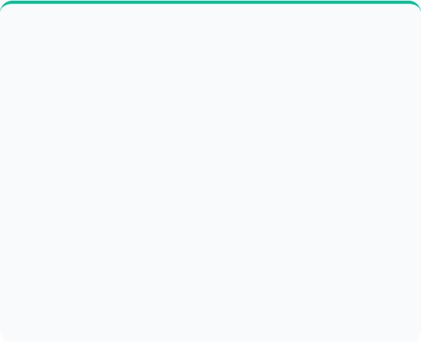
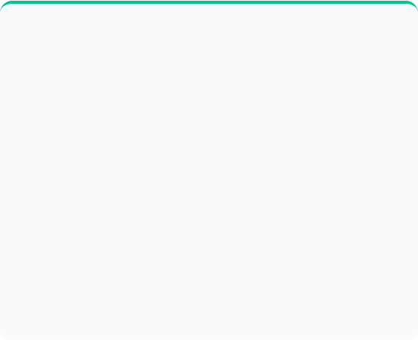
Risk Management Overview
Probability & Impact Scales
The RMMM Concept
Risk is evaluated using a 1–5 scale for both Probability (likelihood of occurrence) and Impact (severity of effect).
Risk Mitigation: Actions taken before a risk occurs to reduce its probability or impact (e.g., security testing).
•
1 = Rare / Very Low Effect
Risk Monitoring: Ongoing tracking of risk indicators so emerging problems are detected early.
•
3 = Possible / Moderate Effect
Risk Management: Planned response after a risk occurs (e.g., restoring database from backup).
•
5 = Almost Certain / Severe Effect
Priority = Probability × Impact

Slide 11

Top Project Risks
Risk Description | Score | Mitigation Strategy
Scope Creep Frequent changes in requirements | 25 Critical | Maintain a prioritised product backlog; approve major changes through PM and stakeholders.
Schedule Delays Development takes longer than planned | 20 Critical | Use sprint planning, realistic deadlines, dependency tracking, and weekly progress reviews.
Performance at Scale High usage reduces performance | 16 High | Conduct load testing, optimise database queries, and scale infrastructure when required.
Low Adoption Users do not adopt the platform | 16 High | Involve users early, collect feedback, provide training, and execute awareness campaigns.
Security Vulnerabilities Data exposure or breaches | 15 High | Implement role-based access, secure coding, input validation, and security penetration testing.

Slide 12
Work Breakdown Structure
2. Req. Analysis
4. Development
Collection of user, functional, and non-functional requirements.
Iterative agile coding of all core modules, networking features, and admin panels.
The WBS breaks the project into clear work packages across the main phases. This structure supports scheduling, resource allocation and progress tracking.
1. Initiation
3. System Design
Project charter creation, stakeholder identification, and feasibility analysis.
System architecture, database schema, UI/UX prototyping, and security design.

Slide 13









WBS: Development Phase
Social & Comms
Academic & Events
Clubs & Admin
4.1 & 4.2: Authentication, roles, profiles, campus feed, post interactions, connections, and private messaging systems.
4.4 & 4.5: Faculty profiles, official notices, event creation, registration flows, and QR code check-in mechanics.
4.6 & 4.8: Club directory, group file exchange, marketplace, moderation tools, reporting, and master admin dashboard.

Slide 14

Conclusion
UIU CampusConnect requires disciplined project management due to its broad functional scope.
•
Agile Scrum provides a practical framework to deliver incremental, testable releases.
•
The Vision & Scope establishes strict boundaries to avoid feature creep.
•
The Risk Plan & RMMM ensures we are prepared for technical and operational challenges.
•
The WBS translates the vision into executable, trackable work packages.

Slide 15

Questions?
Thank you for your time and attention.

