Slide 1

Karshakamitra
A Complete Application for Farmers

Slide 2

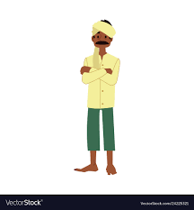
The Problem.
Many agricultural schemes are available currently for the farmers but unfortunately there is lack of awareness among the farming community regarding all the schemes available for them.
An online tool or app is required for providing awareness of the available schemes and making the application process easier for farmers

Slide 3

The Solution.
Karshakamitra is a mobile application for farmers which helps them to seek every aspect on farming. It also include an admin app for agricultural department for verifying, approving and collecting all data related.

Slide 4
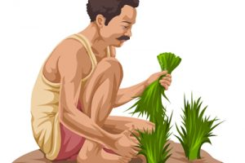
Our Target Sector.
Farmers
Kerala Region (In the Initial Level)

Slide 5
So how do we do
connect to the real
Farmers?
Yeah we can see.

Slide 6

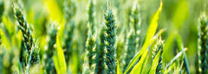
The Schemes.
Grants • Insurance • Loan • Services •
Instruments and equipment
Trainings and workshops
Market • Support
* Schemes - PDF.

Slide 7

The Features.
User friendly app (Malayalam)
Recommendations based on crop
Live tracking of schemes
Realtime Notifications
Help line

Slide 8
Our Interfaces.
Farmers Interface (User)
Admin Interface (Managing)

Slide 9
How do we connect the
Schemes?
An admin application is for agricultural officers for verifying and approving various schemes applied by a farmer.

Slide 10

The Financials.
Database and server costs and management are the main deal.
(For large scale implementation approximately 10K -15K to run servers per month)

Slide 11
Thank You.
(With a little help from your smart phone)
Krishnanand VP
Ziyad C
Salih PU
Shuaib Abubakker Bapputy Haji

