Slide 1
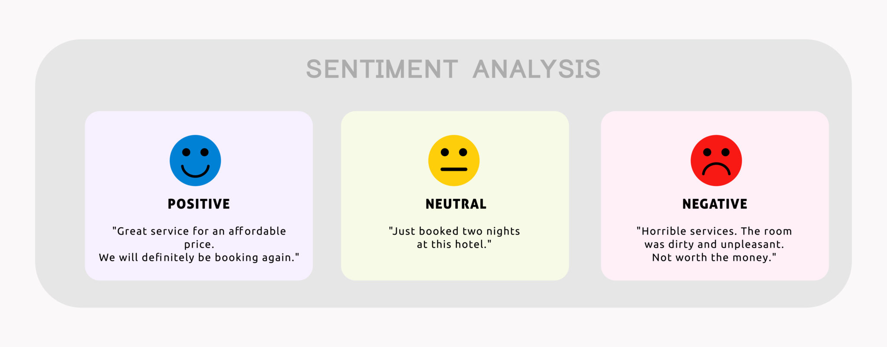
HW #3: Programming part
You are to implement Naïve Bayes classifier for sentiment analysis.
Given a future sentence, classify it into {positive, neural, negative}
[https://www.google.com/url?sa=i&url=https%3A%2F%2Fexpressanalytics.com%2Fblog%2Fsentiment-analysis%2F&psig=AOvVaw3U15cCn18rmNLqtHS-vVij&ust=1635486309530000&source=images&cd=vfe&ved=0CAwQjhxqFwoTCLCBybaz7PMCFQAAAAAdAAAAABAT]

Slide 2
HW #3: Programming part
You are to implement Naïve Bayes classifier for sentiment analysis.
Given a future sentence, classify it into {positive, neural, negative}
In the homework, we use {1, 0, -1} to represent each class: in total, 3 classes
Training labeled data:
training_set: a list of sentences
training_labels: the list of class labels
You can extract the n-th sentence by training_set[n] (n starts from 0)
E.g., training_set[100] = [“i”, “go”, “to”, “school”]
You can extract the m-th word of the n-th sentence by training_set[n][m]
E.g., training_set[100] [0] = “i”
You can extract the n-th sentence’s label by training_labels[n]
We have tokenized the words in training_set (e.g., “I” becomes “i”)

Slide 3
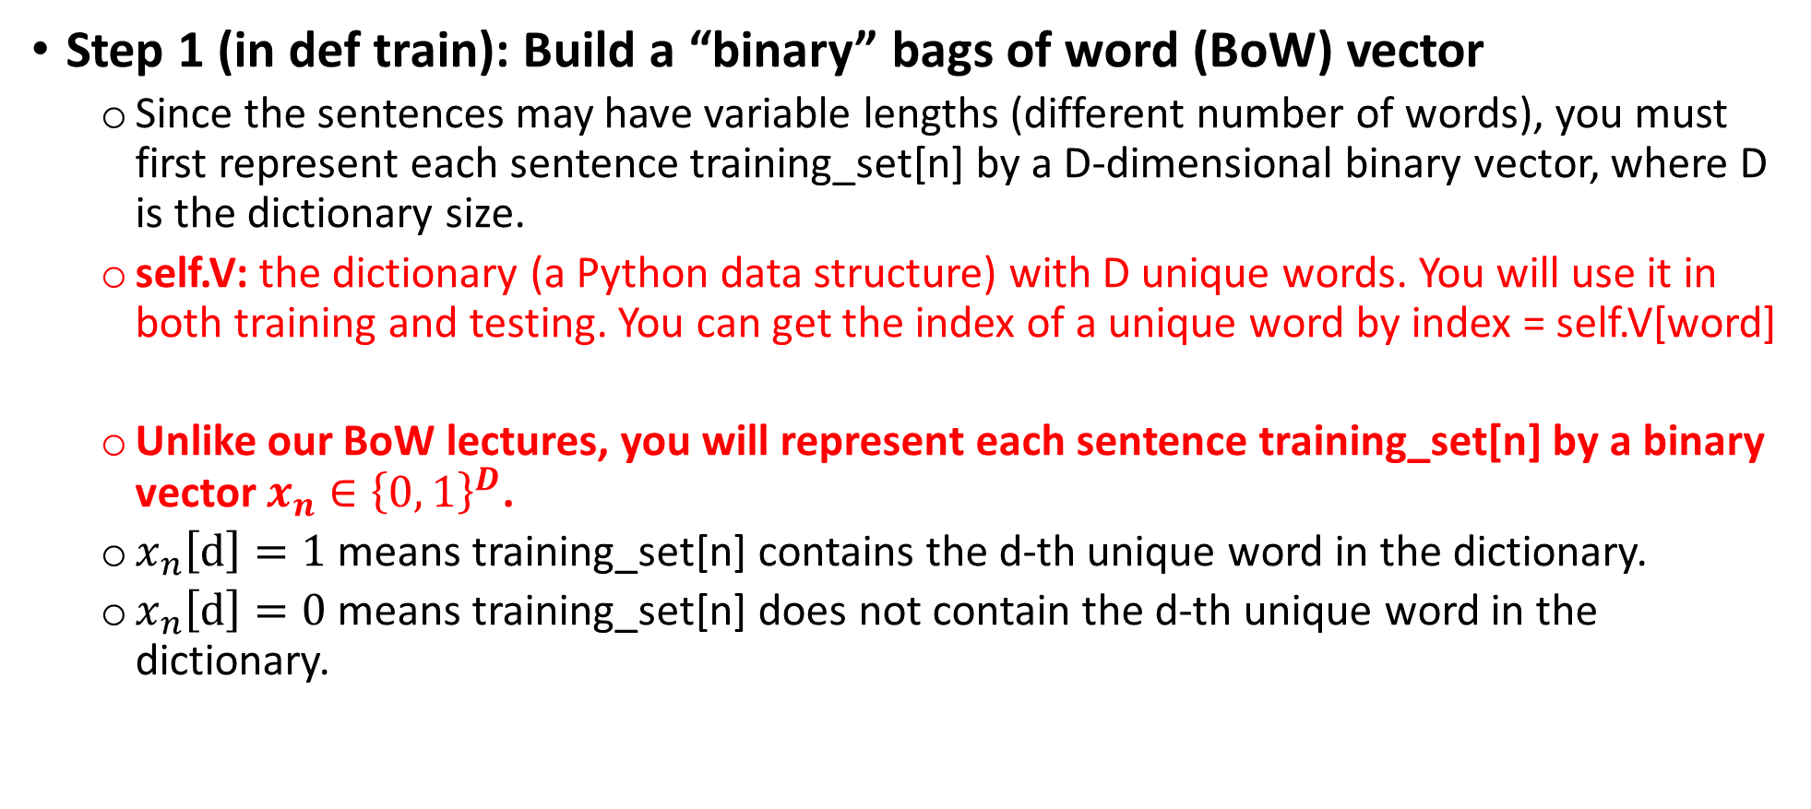
Important steps of HW #3
Step 1 (in def train): Build a “binary” bags of word (BoW) vector
Since the sentences may have variable lengths (different number of words), you must first represent each sentence training_set[n] by a D-dimensional binary vector, where D is the dictionary size.
self.V: the dictionary (a Python data structure) with D unique words. You will use it in both training and testing. You can get the index of a unique word by index = self.V[word]
Unlike our BoW lectures, you will represent each sentence training_set[n] by a binary vector $x_{n}∈{\left\{0, 1\right\}}^{D}$.
$x_{n}\left[d\right]=1$ means training_set[n] contains the d-th unique word in the dictionary.
$x_{n}\left[d\right]=0$ means training_set[n] does not contain the d-th unique word in the dictionary.

Slide 4
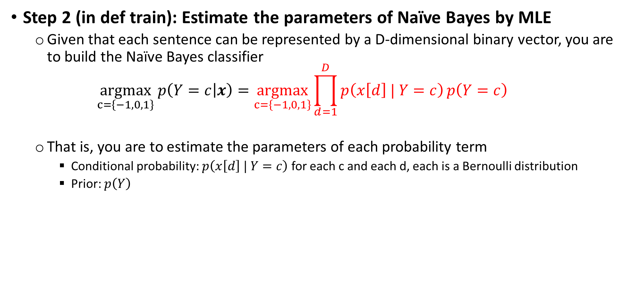
Important steps of HW #3
Step 2 (in def train): Estimate the parameters of Naïve Bayes by MLE
Given that each sentence can be represented by a D-dimensional binary vector, you are to build the Naïve Bayes classifier
$$\underset{c=\left\{−1,0,1\right\}}{argmax} p\left(Y=c | x\right)=\underset{c=\left\{−1,0,1\right\}}{argmax}\prod_{d=1}^{D}{p\left(x\left[d\right] | Y=c\right)}p\left(Y=c\right)$$
That is, you are to estimate the parameters of each probability term
Conditional probability: $p\left(x\left[d\right] | Y=c\right)$ for each c and each d, each is a Bernoulli distribution
Prior: $p\left(Y\right)$

Slide 5
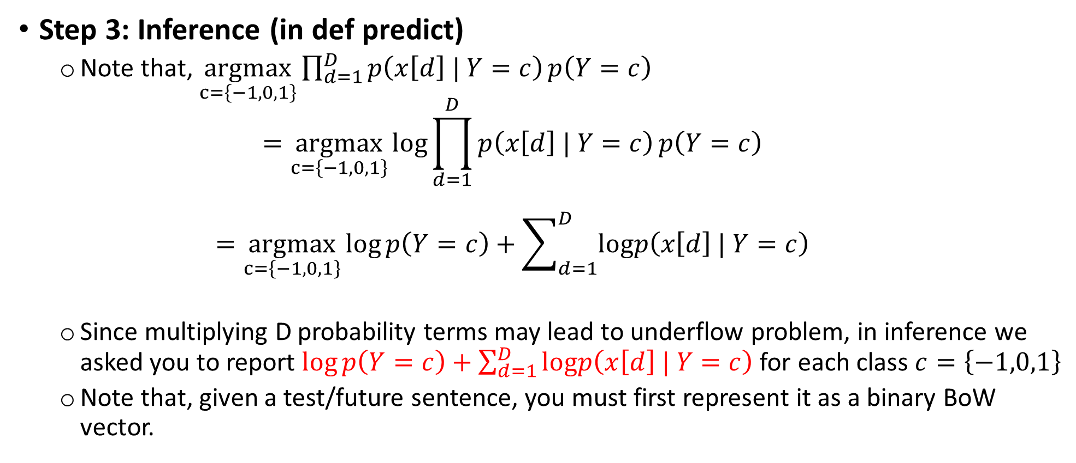
Important steps of HW #3
Step 3: Inference (in def predict)
Note that, $\underset{c=\left\{−1,0,1\right\}}{argmax}\prod_{d=1}^{D}{p\left(x\left[d\right] | Y=c\right)}p\left(Y=c\right)$ $=\underset{c=\left\{−1,0,1\right\}}{argmax}\log{\prod_{d=1}^{D}{p\left(x\left[d\right] | Y=c\right)}p\left(Y=c\right)}$ $=\underset{c=\left\{−1,0,1\right\}}{argmax}\log{p\left(Y=c\right)}+\sum_{d=1}^{D}{logp\left(x\left[d\right] | Y=c\right)}$
Since multiplying D probability terms may lead to underflow problem, in inference we asked you to report $\log{p\left(Y=c\right)}+\sum_{d=1}^{D}{logp\left(x\left[d\right] | Y=c\right)}$ for each class $c=\left\{−1,0,1\right\}$
Note that, given a test/future sentence, you must first represent it as a binary BoW vector.

