Slide 1
Capstone Project
Shuai
2019/09/29

Slide 2
Introduction and Business problem
In this project, I aim to provide suggestions to the contractor about where to open a new restaurant in New York City. It is essential for people to select a good place for food business to avoid losing money. We will use the New York City Foursquare location data to help the decision-making. We will take several factors into account, such as common venues and venue types.

Slide 3
Data
We will download the New York City Foursquare location data, same as the dataset we used in our lab session. We will get the venue names, venue types, neighborhood, Borough, and other related information in the dataset.

Slide 4
Methodology
geopy.geocoders
Folium
Clustering: kmeans
The clustering can tell us the distribution of each type of venues and imply the popular places for stating a new food business
I will focus on the restaurant-related venues and then give suggestions for the people who want to open a new restaurant nearby

Slide 5
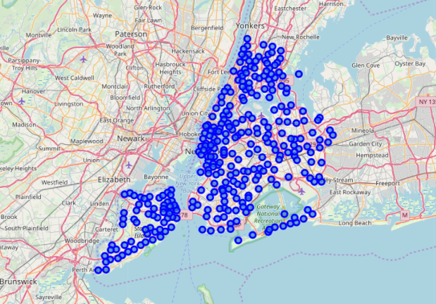
Results
New York City
Each blue dot represents one neighborhood
In total:
5 boroughs (Bronx, Manhattan, Brooklyn, Queens, and Staten Island)
306 neighborhoods

Slide 6
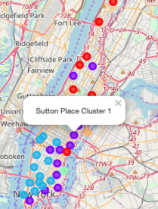
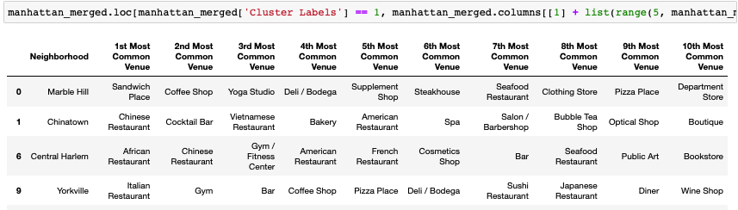
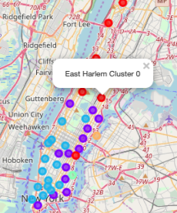
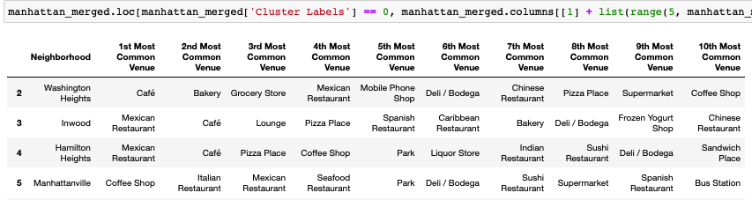
Manhattan
cluster 0 and 1 neighborhoods have most common venues related to restaurant, and they are located in the north and east part of the borough.

Slide 7
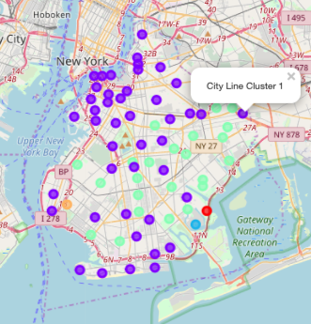
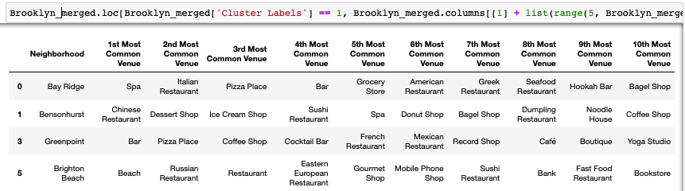
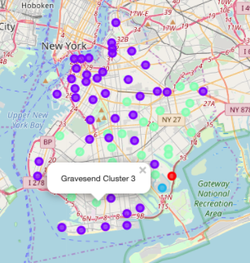
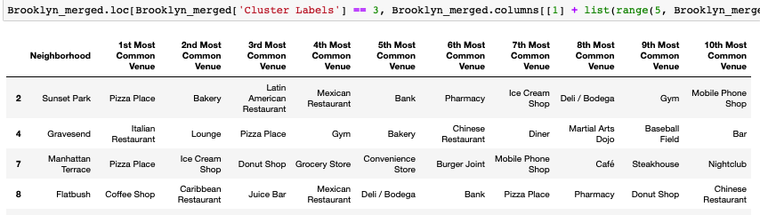
Brooklyn
cluster 1 and 3 neighborhoods have the most of the venues and most of them relate to food business. They are covering the entire of Brooklyn. Those restaurants are also in the neighborhood with most coffee shops, supermarkets, parks, plazas, etc. People who want to start a restaurant nearby may consider to take advantage of these environment to appeal more customers.

Slide 8
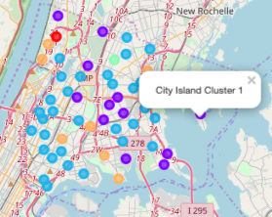
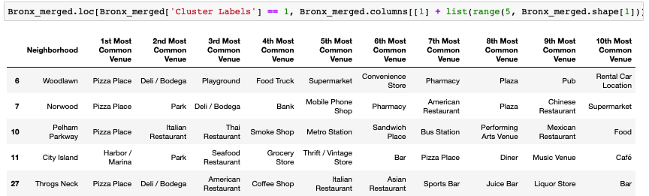
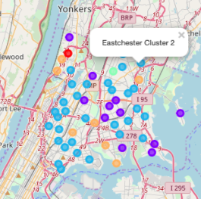
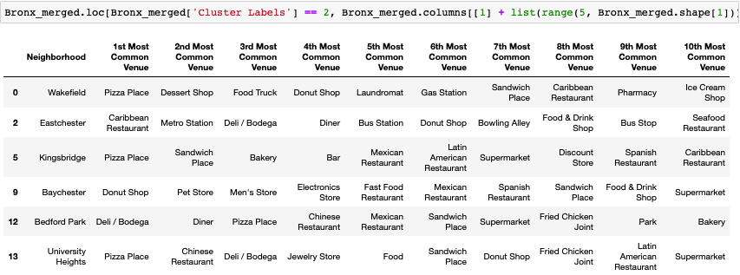
Bronx
cluster 1 and 2 neighborhoods have the most venues related to food. Cluster 1 neighborhoods have more pizza and Italian food, while cluster 2 neighborhoods include more diverse restaurant and have nearby entertainment places. These two clusters are distributed around the Bronx, and people may consider to open different types of restaurants in different places based on this discovery.

Slide 9
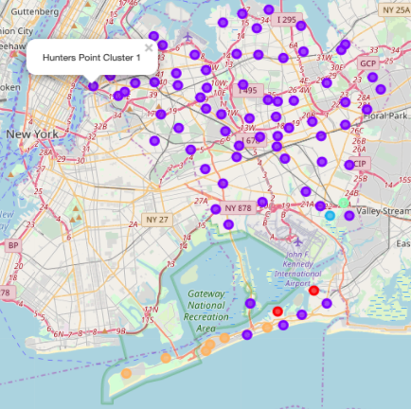
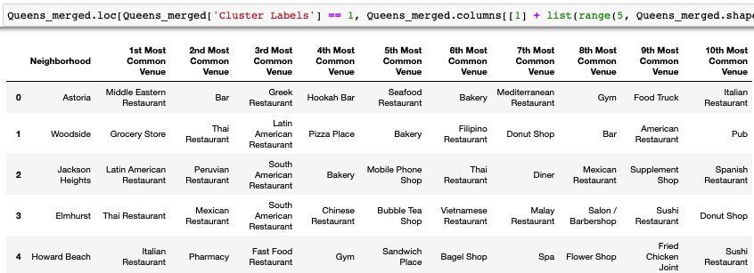
Queens
cluster 1 have most number of neighborhoods, however, not many top venues are food-related. Cluster 1 has more restaurant venues than the other clusters though. Most of them are entertainment places. It is striking to see that Queens borough does not have a major area for food business yet. This may be related to life environment, population and safety around.

Slide 10
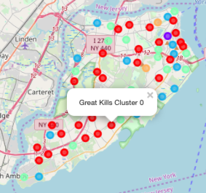
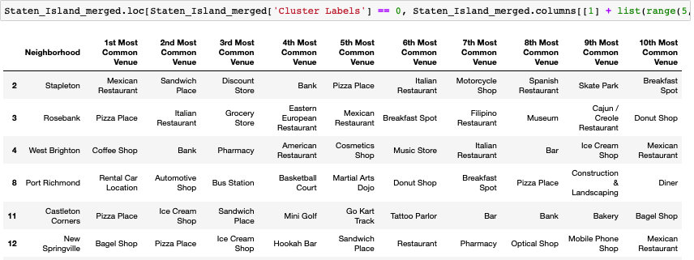
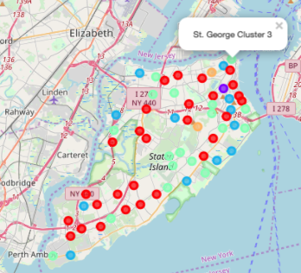
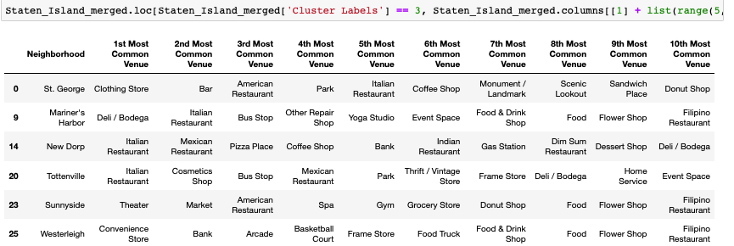
Staten Island
cluster 0 and 3 neighborhoods contain more food business, and they are mostly located in the north and south of the island. Cluster 0 has more types of food than cluster 3.

Slide 11
Discussion and conclusion
From the above analysis of the 5 boroughs in New York City, we identified some common and specific patterns in the boroughs. Manhattan, Brooklyn, Bronx, and Staten Island all have a big cluster of venues within the restaurant types, and these venues are generally located in most area of the borough. These suggest that in the entire New York city, food business is really popular and widely distributed in each area. The people who want to open a new restaurant should also consider the demand and competition here.

Slide 12
Discussion and conclusion
There are lots of food business in Manhattan, Brooklyn, Bronx, and Staten Island, and some of them are located in a centered area, while some are distributed widely in the borough. This study helps the people who want to open a restaurant to understand how the other restaurants, or food business are distributed in each area, and what else venues are around them. This will give their ideas and suggestions to select the right place.
In the future, we can improve the analysis by including more population data, and their demographical data, economic data, and so on. This may provide a better suggestion.

