Slide 1
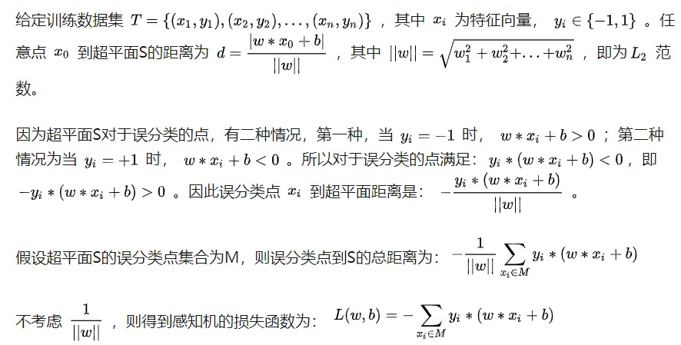
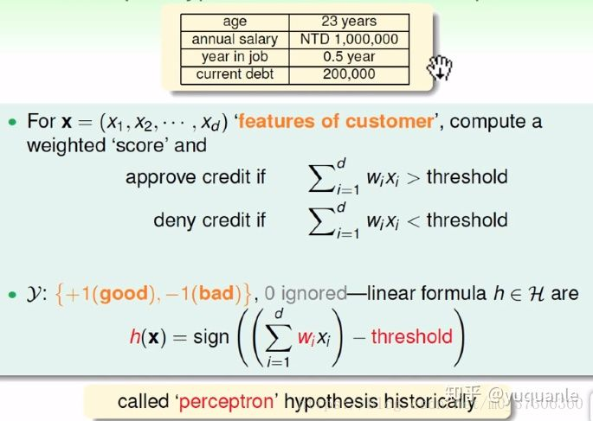
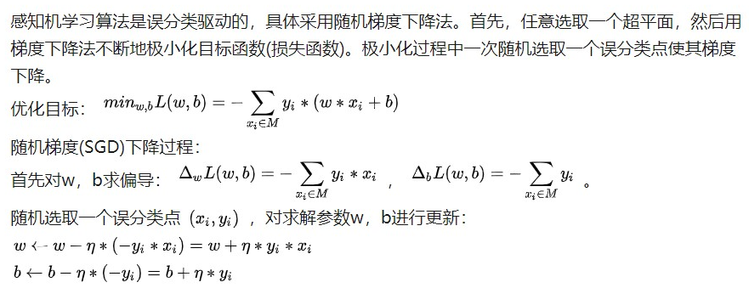
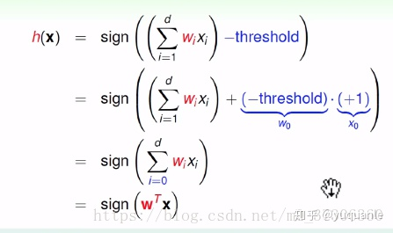
Background - Perceptron
Reference: https://zhuanlan.zhihu.com/p/72040253

Slide 2
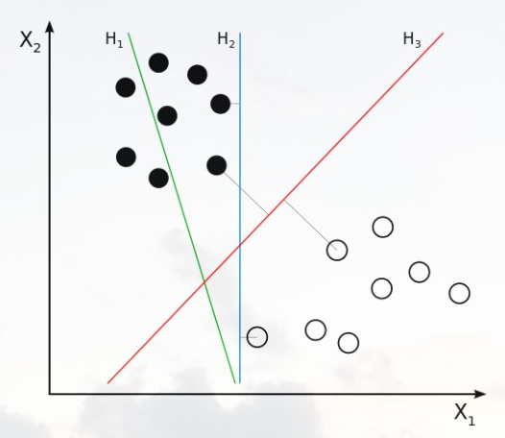
Support Vector Machine
Divide the n dimension data with a n-1 dimension plane, which represents the largest separation, or margin, between the two classes.
Reference: https://zhuanlan.zhihu.com/p/49331510

