Slide 1
Factorisation Attacks Against RSA
Group 3
Yuqing Liu; Shuai Wang; Wenjun Zhou
Notes:
Hello everyone, we are group 3.
We are glad to introduce Factorization Attacks against RSA today. We know the security of RSA is close to a large number n. If we can factor it and get to know the two large primes of n, it is easy to compute the private key and thus crack RSA. Attacking in this way is Factorization attack.

Slide 2
Outline
Introduction
Continued Fraction Factorization Algorithm
Shor’s Algorithm
Quadratic Sieve Algorithm
Conclusion
Factorisation Attacks against RSA – Group 3
Notes:
In this presentation, we are going to talk about three factorization algorithms and finally give the conclusion for them. The reason why we choose these three algorithms for our presentation is because they are milestones, mark different stages for factorization. The first one I am going to talk about is continued fraction factorization algorithm.

Slide 3
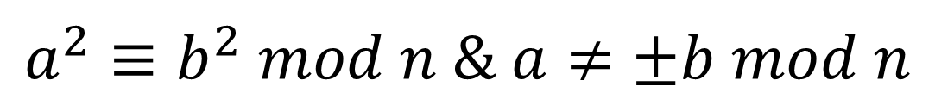
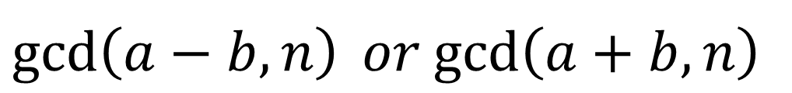
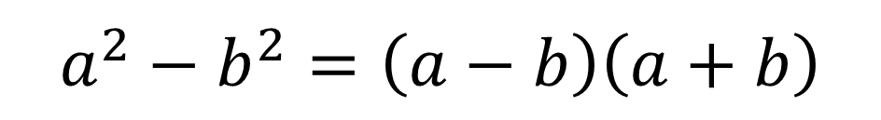
Continued Fraction Factorization (CFF)
Fermat Method
n =
$$a^{2}−b^{2}=\left(a−b\right)\left(a+b\right)$$
p
q
$$a^{2}≡b^{2} mod n \& a≠±b mod n$$
$\gcd\left(a−b,n\right) or$ $\gcd\left(a+b,n\right)$
Factorisation Attacks against RSA – Group 3
Notes:
We all familiar with this formula.
Given a large number n, if we can find such a and b. We actually have found its factors x, y.
One way to find such a and b can be trying all square numbers that are larger than n and test whether the difference between the square number and n is also a square number.
However, CFF bring us a more efficient way to find such a pair of a and b.
According to Fermat theorem, if a squared is congruent to b squared but a is not congruent to b or minus b, then either the gcd of the difference and n or the gcd of the sum and n is a non-trivial factor of n. Therefore, with CFF, instead of test every square number lager than n, we create pairs of square numbers that satisfy this formula to find the factors. This effectively improves the efficiency of factorization.

Slide 4
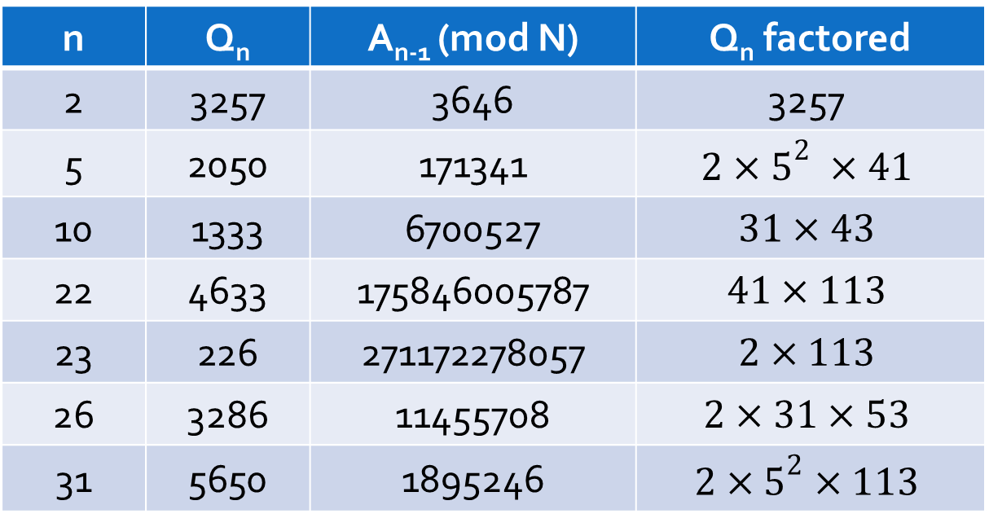
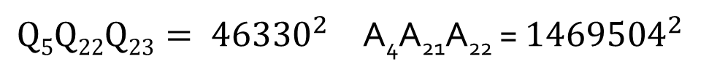

Continued Fraction Factorization (CFF)
$$13,290,059$$
n | Q_{n} | A_{n-1} (mod N) | Q_{n} factored
2 | 3257 | 3646 | $$\text{3257}$$
5 | 2050 | 171341 | $$2×5^{2} ×41$$
10 | 1333 | 6700527 | $$31×43$$
22 | 4633 | 175846005787 | $$41×113$$
23 | 226 | 271172278057 | $$2×113$$
26 | 3286 | 11455708 | $$2×31×53$$
31 | 5650 | 1895246 | $$2×5^{2}×113$$
$Q5Q22Q23= {46330}^{2}$ A₄A₂₁A₂₂ = ${1469504}^{2}$
$$n \text{∈} \left(46330, 1469504\right); gcd\left(n, 13290059\right)=4261$$
Factorisation Attacks against RSA – Group 3
Notes:
When Brillhart and Morrison first came up with this method in 1975, they also gave an example in their paper to factor 13290059. Qn and An are all generate from continued fraction of square root of n in different expansion. Once Q and A generated, we can just pick several from all these generated Qs and make a square number. In this example we find that when Q5, Q22 and Q23 multiply together, the result is a square number. Also multiply their corresponding A, then there is a good possibility that gcd of these two number is a factor of 13290059. For this example, 4261 is indeed a factor of it. This method CFF is the fastest way used between 1970 and 1985. It is able to factor a number with 39 digits. However, another great method emerged which has much better performance. Then my teammate will introduce this method to you.

Slide 5
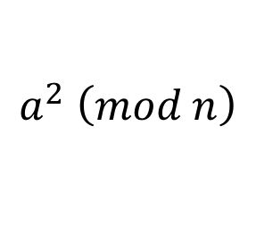
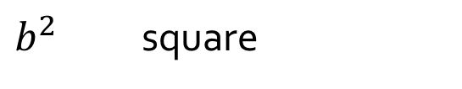
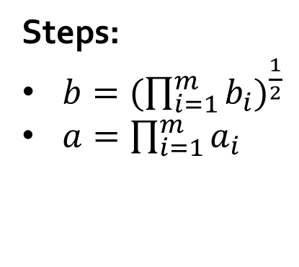
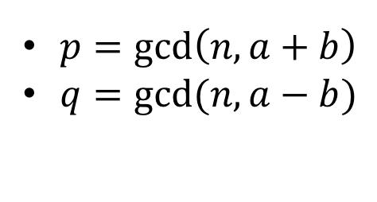

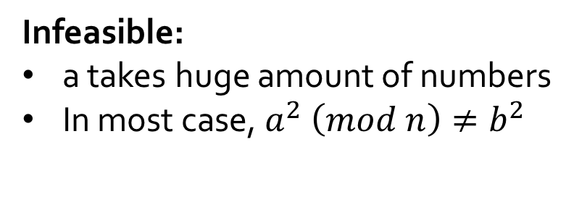
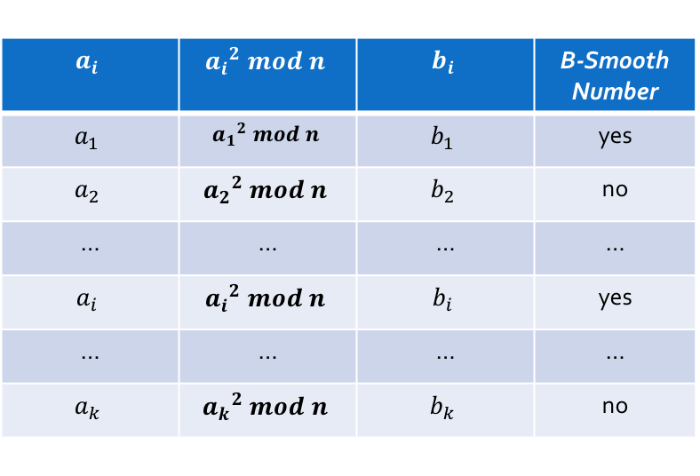
Quadratic Sieve Algorithm (QS)
$$a^{2} \left(mod n\right)$$
$b^{2}$ square
Infeasible:
a takes huge amount of numbers
In most case, $a^{2} \left(mod n\right)≠b^{2}$
Changes:
Steps:
$b={(\prod_{i=1}^{m}{b_{i}})}^{\frac{1}{2}}$
$a=\prod_{i=1}^{m}{a_{i}}$
$$a_{i}$$ | $${a_{i}}^{2} mod n$$ | $$b_{i}$$ | B-Smooth Number
$$a_{1}$$ | $${a_{1}}^{2} mod n$$ | $$b_{1}$$ | yes
$$a_{2}$$ | $${a_{2}}^{2} mod n$$ | $$b_{2}$$ | no
… | … | … | …
$$a_{i}$$ | $${a_{i}}^{2} mod n$$ | $$b_{i}$$ | yes
… | … | … | …
$$a_{k}$$ | $${a_{k}}^{2} mod n$$ | $$b_{k}$$ | no
$p=\gcd\left(n, a+b\right)$
$q=gcd⁡(n, a−b)$
$$n=p∙q$$
Factorisation Attacks against RSA – Group 3
Notes:
Thank you Yuqing! Good morning, everyone! Let’s talk about another factorization algorithm which is called Quadratic Sieve Algorithm. We can just call it QS.
QS is also based on Fermat’s method. As Yuqing mentioned early.
This method takes infeasible time to find such a and b. Because the number n is often a large prime number, a has to try huge amount of numbers to compute a square mod n, then check whether the result is a perfect square or not. And, in most case, the result is not a square.
Facing the two problems, QS improved the method:
Firstly, a tries a small quantity of numbers rather than all of possible a.
Secondly, we expect the result of ai square mod n is a B-Smooth number rather than a square. A number is said to be a B-Smooth number if all of its prime factors are less than or equal to B.
We can choose a sequence of such B-Smooth numbers to construct b. Multiply corresponding ai to construct a. So, we got a and b.
Compute the gcd(n, a+b) and gcd(n, a-b), which are p and q.
Well, now n has been successfully factored.

Slide 6
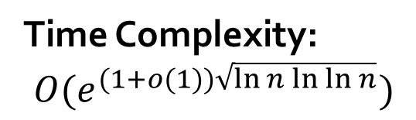
Quadratic Sieve Algorithm (QS)
Application:
RSA-100 by Arjen K. Lenstra in 1991.
Time Complexity:
$$O(e^{(1+o(1))\sqrt{\ln{n}\ln{\ln{n}}}})$$
Advantages:
General-purpose factorization algorithm
Fastest for integers under 100 decimal digits
Limitation:
Performs poor for integers above 100 decimal digits
Factorisation Attacks against RSA – Group 3
Notes:
Based on QS algorithm, RSA-100 has been successfully achieved by arjen K. Lenstra in 1991.
However, it still takes exponential time.
First, QS is a general-purpose factorization algorithm, which means the running time depends only on the size of the integer to be factored rather than some special structure or property.
Second, QS is still the fastest for integers under 100 decimal digits.
Third, the scheme of QS is simple.
However, when it has been used to factor integers above 100 decimal digits, it performs poor.
Next, let’s welcome wenjun to introduce shor’s algorithm.

Slide 7
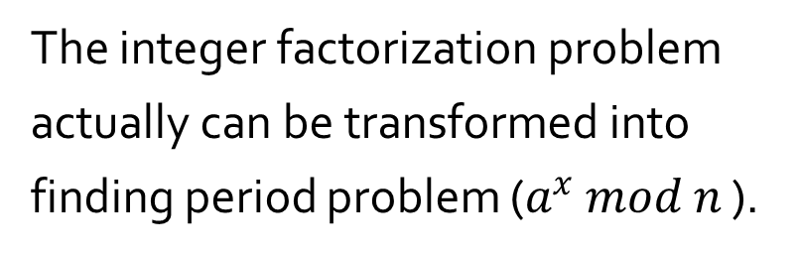
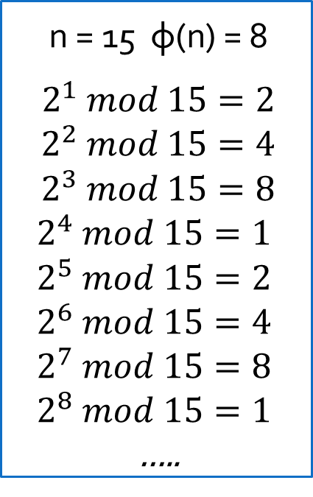
Shor’s Algorithm
n = 15 φ(n) = 8
$2^{1} mod 15=2$ $2^{2} mod 15=4$ $2^{3} mod 15=8$
$$2^{4} mod 15=1$$
$$2^{5} mod 15=2$$
$$2^{6} mod 15=4$$
$$2^{7} mod 15=8$$
$$2^{8} mod 15=1$$
…..
The integer factorization problem actually can be transformed into finding period problem ($a^{x} mod n$).
Shor’s algorithm contains two part:
Classical computation
Modular arithmetic
Quantum computation
Quantum parallelism
Quantum Fourier Transformation (QFT)
Pictures adapted from: https://en.wikipedia.org/wiki/Periodic_function#/media/File:Periodic_function_illustration.svg
Factorisation Attacks against RSA – Group 3
Notes:
What has quantum mechanics to do with factoring?
The Answer is Nothing!
But quantum mechanics has a lot to do with waves.
And waves have a lot to do with periodicity.
And being good at diagnosing periodicity has a lot to do with factoring.
ax modulo N for integers a that share no factors with N.
Periodic function

Slide 8
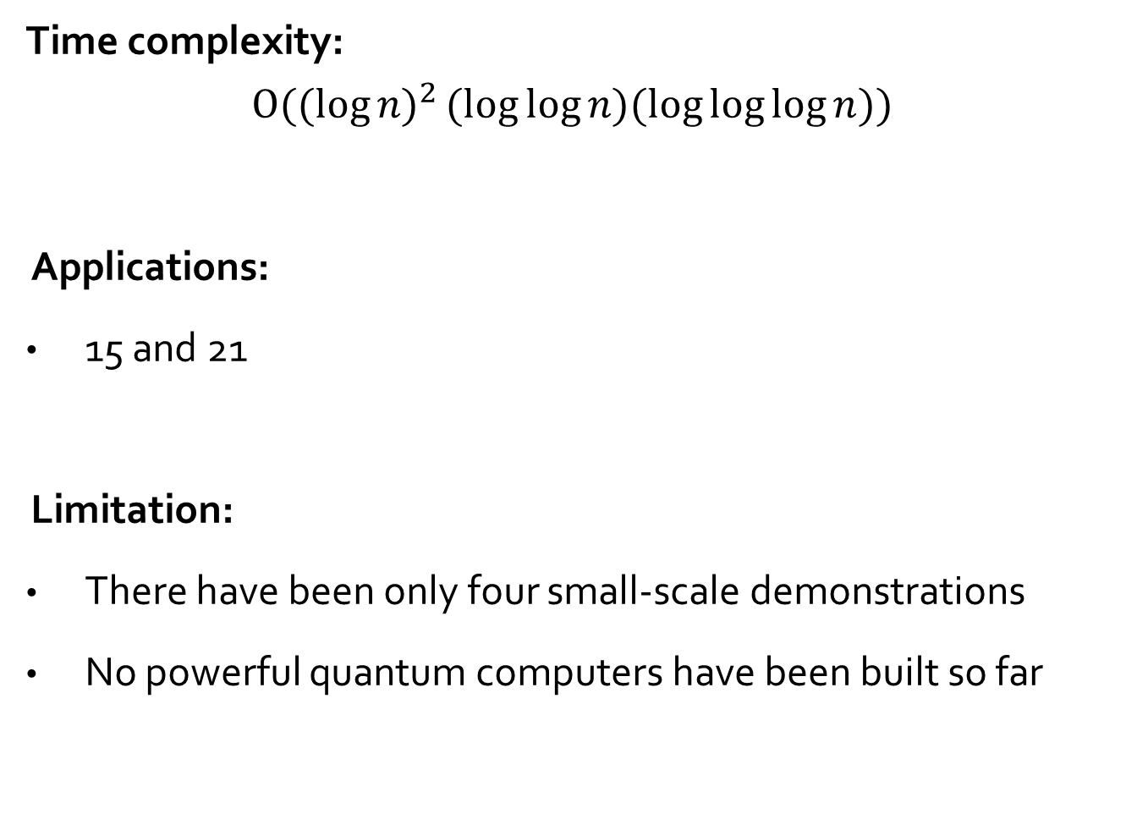
Shor’s Algorithm
Time complexity:
$$O({(log{n)}}^{2}(log{\log{n)(\log{\log{\log{n}}})}})$$
Applications:
15 and 21
Limitation:
There have been only four small-scale demonstrations
No powerful quantum computers have been built so far
Factorisation Attacks against RSA – Group 3
Notes:
15 is factorised in 2001 with 7 qubits
21 is factorised in 2012 with solid-state qubits
Factorization algorithm with polynomial complexity:

Slide 9
Conclusion
CFF is the fastest algorithm before QS
QS is the fastest for integers with less than 100 digits
CFF and QS have exponential time complexity
Shor’s algorithm has polynomial time complexity but only exists in theory
RSA can be considered relatively safe in a decade by using:
The standard implementation and
A long key (longer than 2048 bits)
Factorisation Attacks against RSA – Group 3
Notes:
Shor’s algorithm enables solving integer factorisation problem in polynomial time; however, it’s only theoretically possible.
It takes time to build a powerful quantum computer which can threaten RSA

Slide 10
References
[1] Smith, F. J. (2006). A brief history of factorization techniques. University of Washington.
[2] Wunderlich, M. C. (1979). A running time analysis of Brillhart's continued fraction factoring method. Number Theory Carbondale 1979. Springer Berlin Heidelberg.
[3] Dixon, J. D. (1981). Asymptotically fast factorization of integers. Mathematics of Computation, 36(153), 255-260.
[4] Pomerance, C. (1982). Analysis and comparison of some integer factoring algorithms. Computational Methods in Number Theory Part.
Factorisation Attacks against RSA – Group 3

