Slide 1
Graph Data Management
By
Group 43
Shuai Wang 830166
Shubham Bawa 936127
Atheena Shakthidharan 924244
Thu 10/05/2018
Notes:
Good afternoon, everyone !
We are group 43. My name is Shuai Wang, I have two excellent partners, Atheena and Shubham.
Today we will introduce you graph database and graph data management.

Slide 2
Agenda
Problems
Graph modeling
Graph DB vs. Relational DB
Real time applications
Graph data management
Future directions
Conclusion
References
Agenda
1/22
Notes:
Here is our agenda.
I will explain the problems that current databases encountered, and illustrate how graph database can solve these problems.
Then, Shubham will compare graph database with relational database using SQL and Cypher.
After that, we have Atheena to introduce some real time applications of graph database, and explain what is graph data management, and then point out the future direction of graph database. In the end, make the final conclusion.

Slide 3
Problems
Big Data + complex Relationships
Data becomes difficult to understand & expensive to query
Problems
2/22
Notes:
Nowadays, the most popular and dominant databases are relational databases, such as Oracle, MySQL, Microsoft SQLServer.
They store huge amount of data in tables. To represent relationships, such as one-to-one, one-to-many, many-to-many relationships, many fields tend to reference auto-generated numerical foreign keys. These fields make data in the tables difficult to understand. On the other hand, query becomes expensive due to lots of joins among tables. Furthermore, the size of data dramatically grows everyday and the relationships between data becomes more and more complicated. How can we make data easier to understand and cheaper to query?
Well, graph databases were created to solve these problems.

Slide 4
Graph modeling
Jack Loves Rose
Jack
Loves
Rose
Graph Modeling
3/22
Notes:
To understand how graph database works, we should firstly know how a graph models real world entities and relationships.
We start off with a very simple example.
Let’s say we have ”Jack Loves Rose”.
Jack and Rose are real world entities and “Loves” is a relationship between the two entities.

Slide 5
Graph modeling
Node and Relationship
LOVES
NODE
RELATIONSHIP
NODE
Jack
Rose
Graph Modeling
3/22
Notes:
In this case, we actually have two nodes for the two entities. One node representing Jack and the another representing Rose. And we have “LOVES” relationship between the two nodes.

Slide 6
Graph modeling
Relationship has Direction
LOVES
LOVES
Jack
Rose
RELATIONSHIP
Graph Modeling
3/22
Notes:
Now, relationships have directions. So Jack loves Rose. Fortunately, Rose loves Jack back.

Slide 7
Graph modeling
More Relationships
LOVES
LOVES
MARRIED WITH
Jack
Rose
Graph Modeling
3/22
Notes:
Of course, we can easily add more relationships among nodes. Such as Rose married with Jack.

Slide 8
Graph modeling
Properties of Node
name: “Jack”
born: Sep 6, 1994
language: Mandarin
LOVES
name: “Rose”
born: Aug 12, 1993
LOVES
MARRIED WITH
Jack
Rose
Graph Modeling
3/22
Notes:
Let’s add some properties to nodes. In this case, we want to store the name of Jack and the name of Rose and their birth date. But you can see here, we have a third property on Jack, which is language. This property only exists on Jack and that is okay. It means Jack can speak mandarin while Rose can not.

Slide 9
Graph modeling
Properties of Relationship
since: high school
name: “Jack”
born: Sep 6, 1994
language: Mandarin
LOVES
name: “Rose”
born: Aug 12, 1993
LOVES
MARRIED WITH
Jack
when: 2018
Rose
Graph Modeling
3/22
Notes:
Similarly, we can add properties to relationships as well. We can add simple properties as when jack started loving Rose and when Rose married with Jack. Such as Jack started loving Rose since high school, and Rose married with Jack in 2018.

Slide 10
Graph modeling
Labels of Nodes
:Person
since: high school
:Person
name: “Jack”
born: Sep 6, 1994
language: Mandarin
LOVES
name: “Rose”
born: Aug 12, 1993
LOVES
MARRIED WITH
Jack
when: 2018
Rose
Graph Modeling
3/22
Notes:
We also can have labels for our nodes. These labels are kind of types. It allows you to indicate what types of nodes are representing. In this case, both Jack and Rose are Person nodes.

Slide 11
Graph modeling
More Labels of Nodes
:Person
since: high school
:Person
name: “Jack”
born: Sep 6, 1994
language: Mandarin
LOVES
name: “Rose”
born: Aug 12, 1993
LOVES
MARRIED WITH
:Husband
:Wife
Jack
when: 2018
Rose
Graph Modeling
3/22
Notes:
And a single node can be added multiple labels. Such as Jack is husband while Rose is wife.
Okay, Let’s add more nodes and relationships.

Slide 12
Graph modeling
More Nodes and Relationships
:Person
since: high school
:Person
name: “Jack”
born: Sep 6, 1994
language: Mandarin
LOVES
name: “Rose”
born: Aug 12, 1993
LOVES
MARRIED WITH
:Husband
:Wife
Jack
when: 2018
Rose
BOUGHT
USES
cost: 1000 AUD
to: watch YouTube
name: “iPhone X”
designed: Apple
assembled: China
:Mobile Phone
Graph Modeling
3/22
Notes:
We added a mobile phone node, it’s an iPhone X, that was designed by Apple and assembled in China. Jack bought it in 1579 AUD. And Rose uses this iPhone X to watch YouTube.
Obviously, we can continue to add more nodes and relationship into this graph. This graph will become larger and larger, and containing more and more nodes and complex relationships.

Slide 13
Graph modeling
Easily Represent Relationships
Jack can speak mandarin, while Rose can’t.
Jack loves Rose since high school.
Rose loves Jack, too.
Rose married with Jack in 2018.
Jack spent 1579 AUD on buying an iPhone X, which was designed by Apple and assembled in China.
Rose uses the iPhone X to watch YouTube.
LOVES
LOVES
MARRIED WITH
Jack
Rose
BOUGHT
USES
Graph Modeling
3/22
Notes:
Graph database is easy to represent relationship.
Make our data easier to understand and cheaper to query.
Next, Shubham will compare graph database with relational database in more detail.
Shubham

Slide 14
Graph DB vs. Relational DB
Criteria | Graph Database | Relational Database
Number of Joins | No joins | Large number of Joins
Self Join | None | Numerous
Flexibility | Flexible schema and easy to extend | Schema is fixed and difficult to extend
Speed of running queries | Fast | Slow
Lines of code | Less | More
Graph DB vs. Relational DB
4/22
Notes:
We have made the comparison on the basis of various criteria
1. Number of Joins: Joins in databases add to the complexity greatly. Graph database does not involve any joins and it converts the join tables into relationships.
2. Self joins: Traversing relationships by repeatedly joining tables to themselves is very inefficient.
3. Flexibility: Flexible schema and easy to extend whereas in relational databases schema is fixed and difficult to extend.
4. Speed of running queries: Fast and Slow
5. Lines of Code: less and more which will be demonstrated in the following demo.

Slide 15
Demo
Demo case – Advanced Database Systems
Demo
5/22
Notes:
Now, I will be demonstrating to you how graph databases compare with relational databases with the help of a demo.
For the demo, we will be taking the case of our subject ‘ADS’ wherein there is our lecturer who teaches the subject. Groups of students in the subject and students who are members of these groups.
In order create this, I will be using Graph database as well as relational database to show how they differ from each other.

Slide 16
Demo
Graph database has been created using Cypher on Neo4j platform
Relational database has been created using SQL on MySQL workbench
Demo
6/22

Slide 17
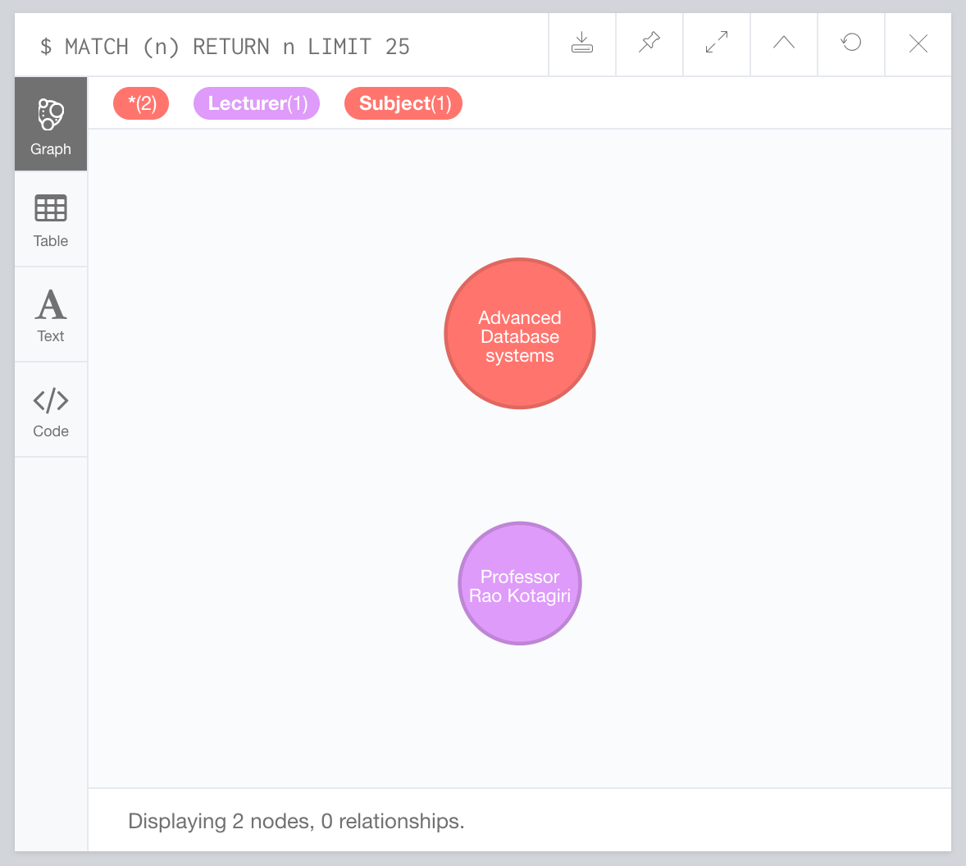
Create - Cypher
CREATE (ProfRao: Lecturer {name: 'Professor Rao Kotagiri' , teacherID: 123})
CREATE (ADS: Subject {title: 'Advanced Database systems' , subjectID: 234})
Demo
7/22
Notes:
First, we will create nodes in the the graph database using CREATE statement using Cypher.
As you can see from this slide, it creates a node with the label Lecturer with various properties such as title and teacher ID.
You can see the result on the right side of the slide where the red node represents the subject and the purple represents the lecturer.

Slide 18
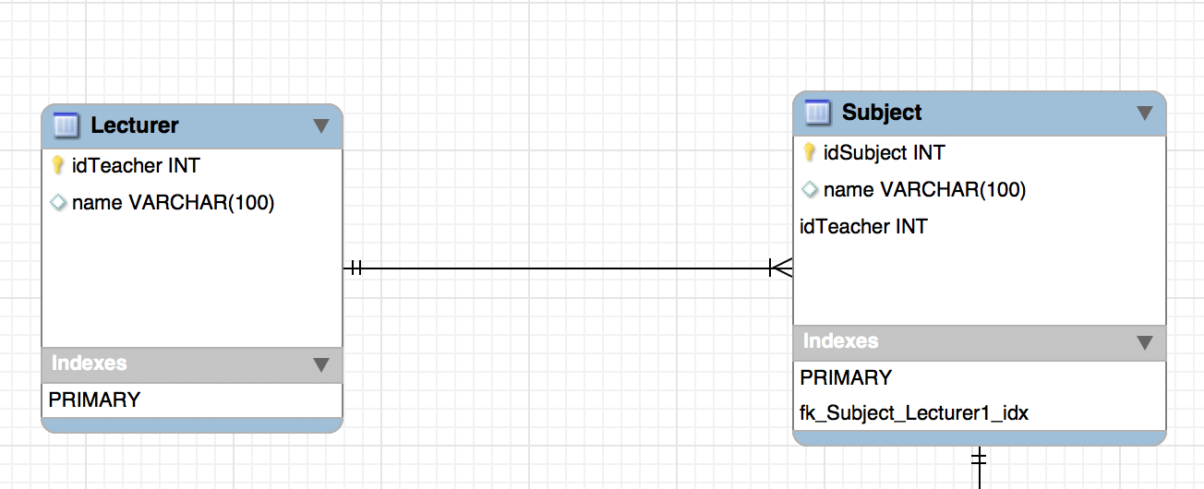
Create - SQL
CREATE TABLE IF NOT EXISTS `mydb`.`Lecturer` (
`idTeacher` INT NOT NULL,
`name` VARCHAR(100) NULL,
PRIMARY KEY (`idTeacher`)
)
ENGINE = InnoDB;
CREATE TABLE IF NOT EXISTS `mydb`.`Subject` (
`idSubject` INT NOT NULL,
`name` VARCHAR(100) NULL,
`idTeacher` INT NOT NULL,
PRIMARY KEY (`idSubject`, `idTeacher`),
INDEX `fk_Subject_Lecturer1_idx` (`idTeacher` ASC),
CONSTRAINT `fk_Subject_Lecturer1`
FOREIGN KEY (`idTeacher`)
REFERENCES `mydb`.`Lecturer` (`idTeacher`)
ON DELETE NO ACTION
ON UPDATE NO ACTION
)
ENGINE = InnoDB;
Demo
8/22
Notes:
In order to create a table in relational database, we will use the CREATE statement.
As you can see from the slide, we have created two tables Lecturer and Subject with various Attributes and for each attribute we have specified the data type and
Specified the keys as well.
Also you can see, the lines of code that are required to create a table are more in comparison to Graph databases.

Slide 19
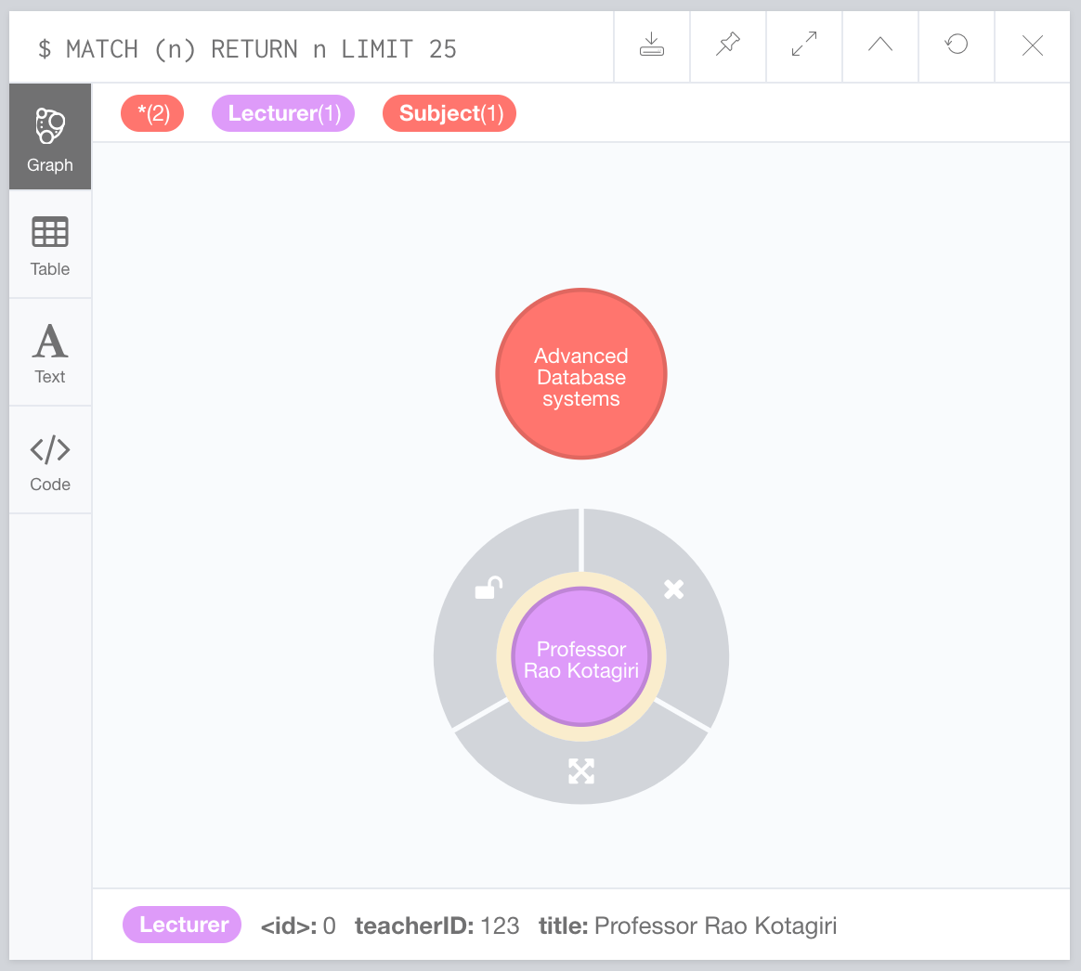
Insert - Cypher
CREATE (ProfRao: Lecturer {name: 'Professor Rao Kotagiri' , teacherID: 123})
CREATE (ADS: Subject {title: 'Advanced Database systems' , subjectID: 234})
Demo
9/22
Notes:
This slide show how we can insert properties in the GD.
You may also notice that the CREATE statement also inserts the values in the node at the time of creation of a node.
The values being of title and subjectID.
Whereas,….

Slide 20
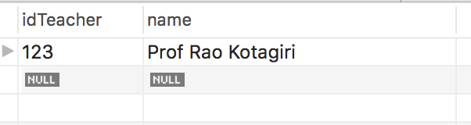
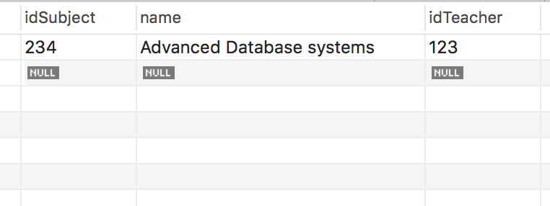
Insert - SQL
INSERT INTO Lecturer (idTeacher, name)
VALUES (123, 'Prof Rao Kotagiri');
INSERT INTO Subject (idSubject, name, idTeacher)
VALUES (234, 'Advanced Database Systems', 123);
Lecturer table
Subject table
Demo
10/22
Notes:
Whereas, in SQL, a separate statement has to be written in order to populate the tables in RD.
Which goes as Insert values into the table name, followed by the values.
Therefore, making the lines of code lengthier in SQL.

Slide 21
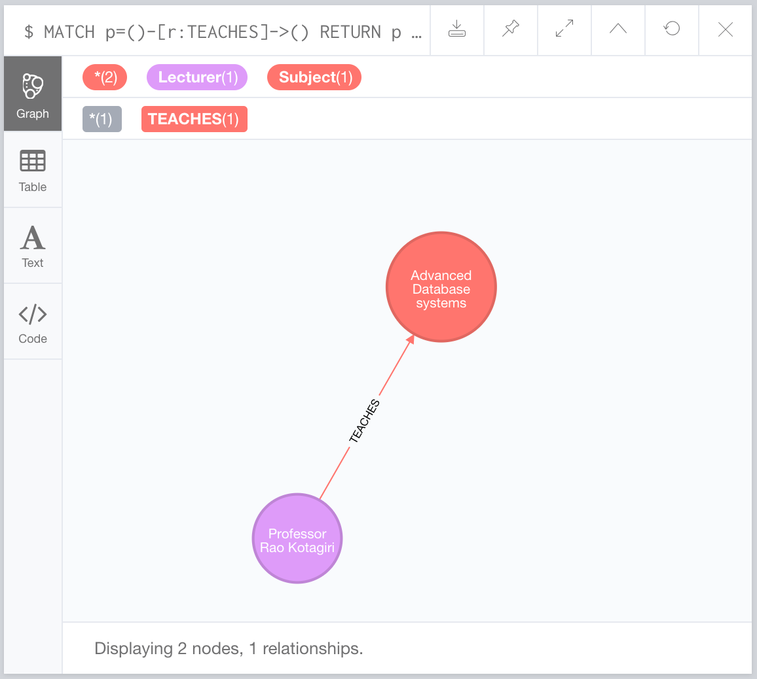
Relationships - Cypher
CREATE (ProfRao) -[:TEACHES]-> (ADS)
Demo
11/22
Notes:
In order to create relationships in Cypher. We need to write a single line of code.
To create a relationship, we use the CREATE statement followed by the node from which the relationship need to be created followed by
The name of the relationship i.e. Teaches in this case and then the node to which the relationship has to be created.
On the right, you can see that a relationship has been created from the Lecturer node to the Subject code of ‘Teaches’.

Slide 22
Relationships - SQL
CREATE TABLE IF NOT EXISTS `mydb`.`Lecturer` (
`idTeacher` INT NOT NULL,
`name` VARCHAR(100) NULL,
PRIMARY KEY (`idTeacher`)
)
ENGINE = InnoDB;
CREATE TABLE IF NOT EXISTS `mydb`.`Subject` (
`idSubject` INT NOT NULL,
`name` VARCHAR(100) NULL,
`idTeacher` INT NOT NULL,
PRIMARY KEY (`idSubject`, `idTeacher`),
INDEX `fk_Subject_Lecturer1_idx` (`idTeacher` ASC),
CONSTRAINT `fk_Subject_Lecturer1`
FOREIGN KEY (`idTeacher`)
REFERENCES `mydb`.`Lecturer` (`idTeacher`)
ON DELETE NO ACTION
ON UPDATE NO ACTION
)
ENGINE = InnoDB;
Demo
12/22
Notes:
Relationships in SQL need to written as well but herein, they are a bit difficult to write and lengthy as well.
For it, you need to have proper knowledge about the cardinalities of relationships such as 1-1, many – 1, 1 – many and many to many and also about the keys involved in the creation of a relationship.

Slide 23
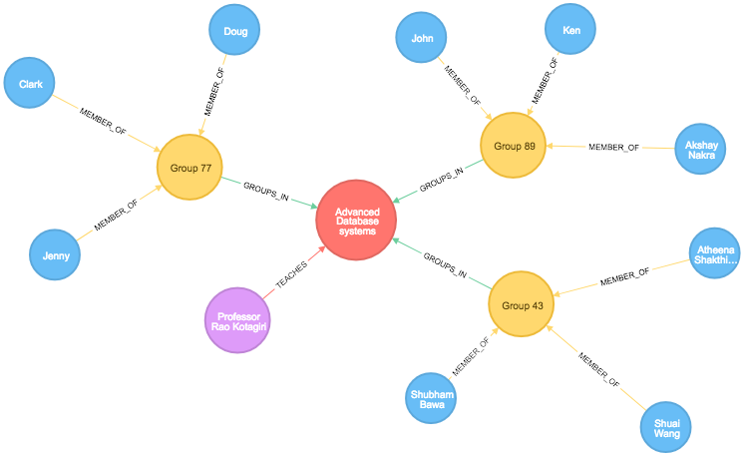
Model - Graph Database
Demo
13/22
Notes:
After using the CREATE statements to create the nodes and relationships for the Subject, lecturer groups and members. We get a Graph which displays all the information
Whereas, ..

Slide 24
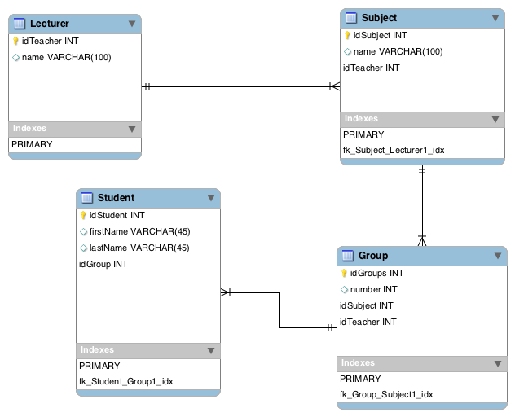
Model - Relational Database
Demo
14/22
Notes:
Whereas, in SQL after the creation and insertion for the Lecturer, subject, Student and Group. We get a ER diagram,

Slide 25
Model - Comparison
Graph Database
Relational Database
Demo
15/22
Notes:
Comparing the two models side by side, we can see that:
GD are more easier to understand, and not much prior knowledge is needed to understand what is happening in the mode.
Relationships between nodes in GD are easy to understand as well.. Whereas, in RD, it involved various cardinalities and keys which add to the complexity.
Also you can see that GD represents data in a more natural form.
To summarise GD are easier to code as they involve lesser lines of code and focus more on interconnectivity of data when compared to RD.
Next we have Atheena who will talk about the real time applications of graph databases and conclude our presentation.

Slide 26

Real World Applications
Real World Applications
16/22
Notes:
Moving on … lets understand where graphs are in the real world. Here are some important applications of graphs.
Recommendation engines : one of the more popular graph database use cases. Rather than taking a tabular view of transactions, retailers can pull together product, customer, inventory, supplier and social sentiment data into a graph database to spot patterns and make smarter recommendations. This system gives us one of the most important concepts of fb; the frnd-of-frnd recommendation
Enterprise customers can use graph databases to map entire communications or IT networks and start to run complex scenario testing to prepare for outages better.
connections between large data sets and identify patterns, a useful trait when it comes to spotting complex, modern fraud techniques. Neo4j says that it already counts a number of major banks using its graph services to aid fraud detection.

Slide 27
Graph Data Management
Distributed graph data management
Manage dynamically changing data
Low latency query processing
Algorithms
Hybrid replication policy by monitoring access patterns
Clustering
Make replication decision
Graph Data Management
17/22
Notes:
Moving on to Graph data management. It has become a fast area of research. Some researches concentrate on how large data can be managed in graphs effectively.
Here, we introduced two such proposals made.

Slide 28
Graph Data Management
Partition management
Self Evolving Distributed Graph management Environment
Two-level architecture
Complimentary primary partition
Secondary partition
Includes set of workload analysing algorithms
Graph Data Management
18/22
Notes:
Another important area research in gaph data management is the partitioning approach.
Privacy preservation strategies are another growing area of research.
Data anonymization is a type of info sanitzation by encrypting or remving persinally identifiable info from datasets so that the people who the data describes is anonymous.

Slide 29
Graph Data Management
Privacy preservation Strategies
Strategies proposed based on amount of data to be removed and amount of privacy preserved
Strategies based on anonymization:
Node anonymization
Edge anonymization
Partial edge removal anonymization
Cluster-Edge anonymization
Cluster-Edge anonymization with constraints
Graph Data Management
19/22

Slide 30
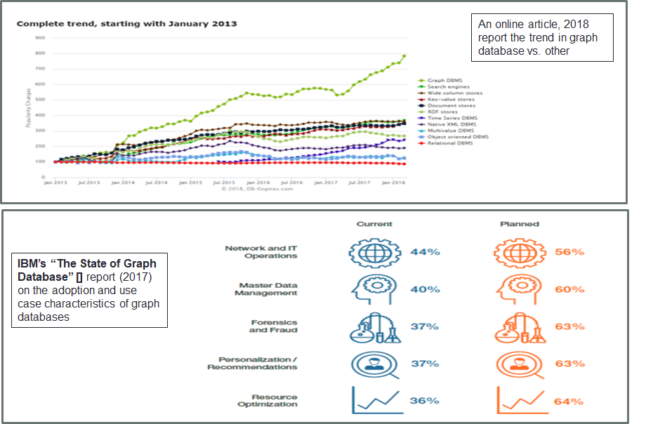
Future of Graph Database
Future of Graph Database
20/22
Notes:
It is predicted that graph database has become a growing trending and shows a bright future.

Slide 31
Conclusion
Graph Modeling
Easily to represent relationships
Data becoming easy to understand and cheaper to query
Graph database vs. relational database
Applies to many real world applications
Management of graph data aspects
Promising future of graph database
Conclusion
21/22

Slide 32
References
Angles, R., & Gutierrez, C. (2008). Survey of graph database models. ACM Computing Surveys (CSUR), 40(1), 1.
Angles, R., & Gutierrez, C. (2017). An introduction to Graph Data Management. arXiv preprint arXiv:1801.00036.
https://neo4j.com/
https://www.computerworlduk.com/galleries/data/7-most-popular-graph-database-use-cases-3658900/
https://www-01.ibm.com/common/ssi/cgi-bin/ssialias?htmlfid=IMM14205USEN&
https://www.zdnet.com/article/back-to-the-future-d
Zheleva, E., & Getoor, L. (2008). Preserving the privacy of sensitive relationships in graph data. In Privacy, security, and trust in KDD (pp. 153-171). Springer, Berlin, Heidelberg.oes-graph-database-success-hang-on-query-language/
Labouseur, A. G., Olsen, P. W., & Hwang, J. H. (2013). Scalable and Robust Management of Dynamic Graph Data. BD3@ VLDB, 1018, 43-48.
Mondal, J., & Deshpande, A. (2012, May). Managing large dynamic graphs efficiently. In Proceedings of the 2012 ACM SIGMOD International Conference on Management of Data(pp. 145-156). ACM.
Yang, S., Yan, X., Zong, B., & Khan, A. (2012, May). Towards effective partition management for large graphs. In Proceedings of the 2012 ACM SIGMOD International Conference on Management of Data (pp. 517-528). ACM.
References
22/22

Slide 33
Questions
Questions ?

