Slide 1
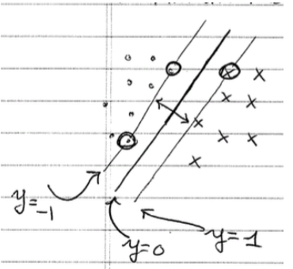
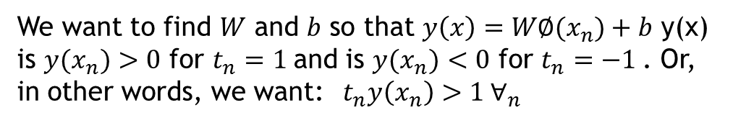
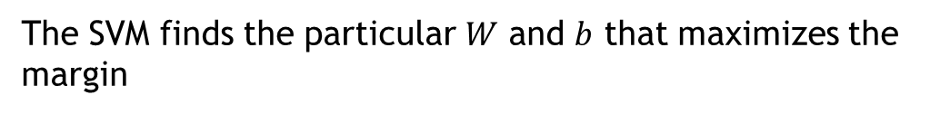


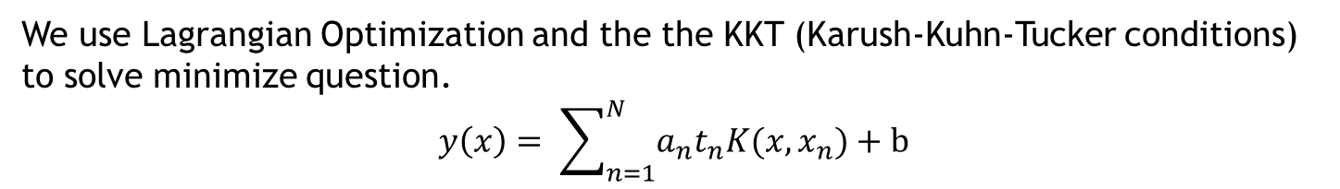
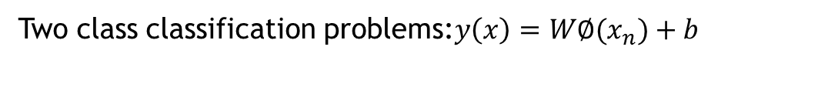
Support Vector Machine
Two class classification problems:$y\left(x\right)=W∅(x_{n})+b$
We want to find $W$ and $b$ so that $y\left(x\right)=W∅(x_{n})+b$ y(x) is $y(x_{n})$ $>0$ for $t_{n}=1$and is $y(x_{n})$ $<0$ for $t_{n}=−1$. Or, in other words, we want: $t_{n}y\left(x_{n}\right)>1 ∀_{n}$
The SVM finds the particular $W$ and $b$ that maximizes the margin
$arg \min_{w,b}{\frac{1}{2}{\left\|w\right\|}^{2} }$ such that $t_{n}w^{t}∅(x_{n})+b ≥1 ∀_{n}$
We use Lagrangian Optimization and the the KKT (Karush-Kuhn-Tucker conditions)
to solve minimize question.
$$y\left(x\right)= \sum_{n=1}^{N}{a_{n}t_{n}K(x,x_{n})}+b$$

Slide 2
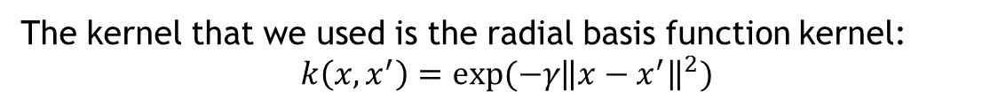
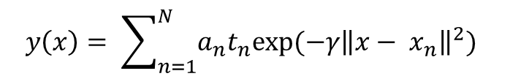
Support Vector Machine with rbf kernel
The kernel that we used is the radial basis function kernel:
$$k\left(x,x^{′}\right)=exp⁡(−γ{\left\|x−x^{′}\right\|}^{2})$$
$$y\left(x\right)= \sum_{n=1}^{N}{a_{n}t_{n}exp⁡(−γ{\left\|x− x_{n}\right\|}^{2}) }$$

Slide 3
Multiclass Classification Strategy
One vs the rest
[0,9]
0
[1,9]
1
[2,9]
2
[3,9]
3
[4,9]
4
[5,9]
5
[6,9]
6
[7,9]
7
[8,9]
8
9

Slide 4
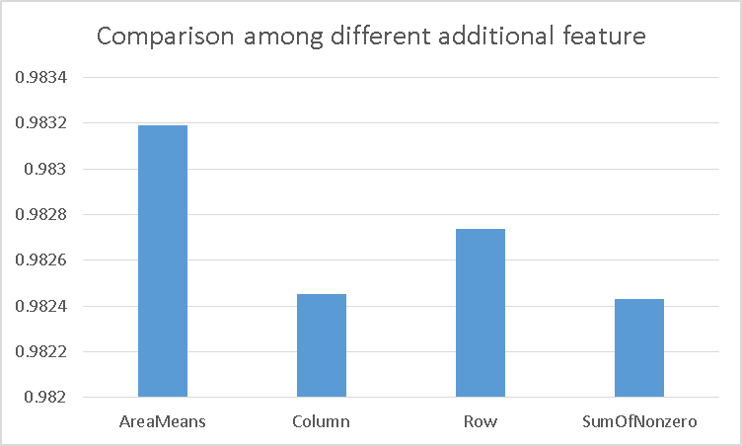
Results
3-fold cross-validation on training dataset with 42,000 samples

Slide 5
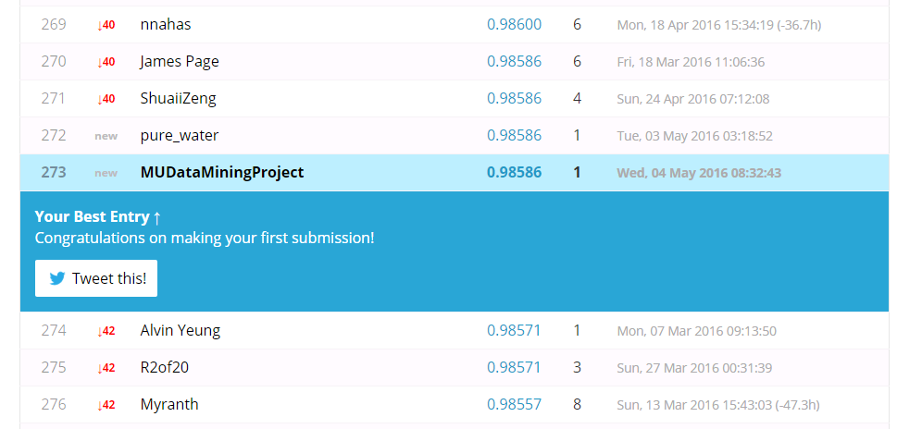
Results
Kaggle Rank: 273/1362 (Top 20%)

Slide 6
Future Work
1. We will try to add new feature to make our model better.
2. We also try other method, like deep learning, to do classification.

Slide 7
Thank You

