Slide 1
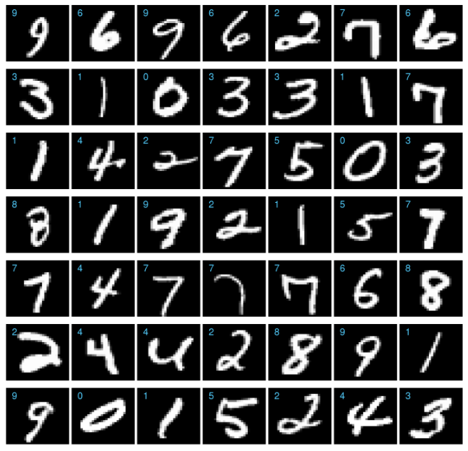
Handwritten Digit Classification
Suliang bu Zeng Shuai
Computer Science Department

Slide 2
Overview
Description of the competition
Data processing
Algorithm for classification
Result
Future work

Slide 3
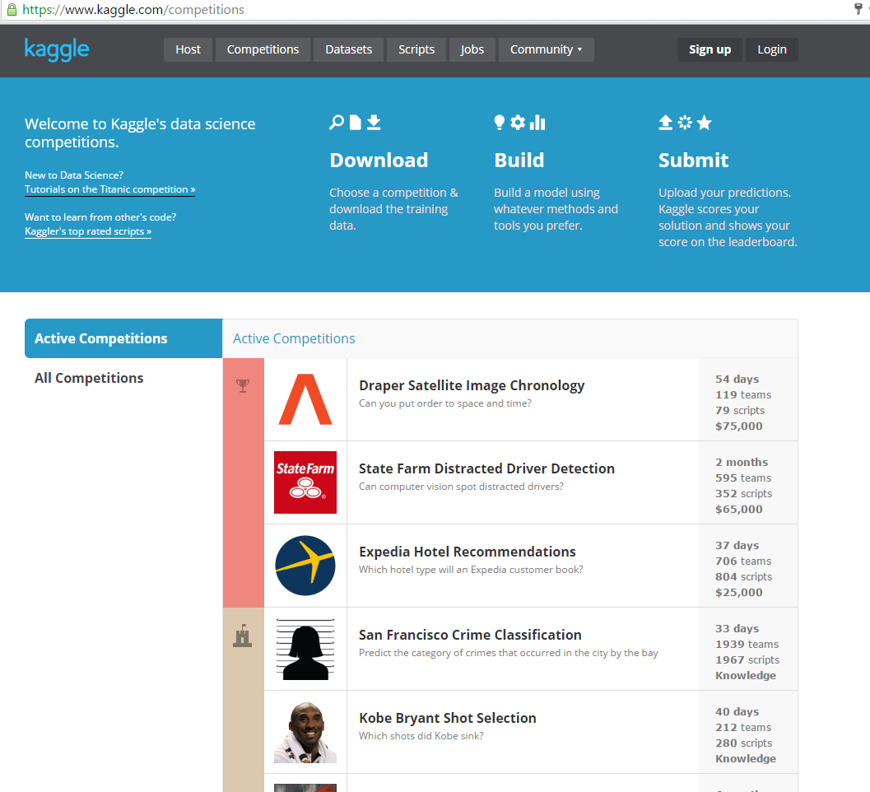
Competition
www.kaggle.com
Dataset:
MNIST dataset
How competitive:
> 1300 teams
> 1400 players
Notes:
Started: July 2012 UTC Ends: December 2016 UTC (1,620 total days)

Slide 4
Data processing
What is a training sample like?
28 * 28 image
Feature extraction
PCA
label | pixel0 | pixel1 | …… | Pixel783

Slide 5

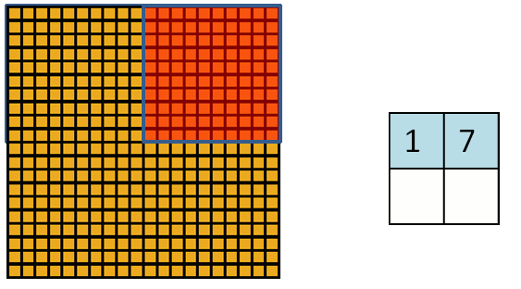
Feature extraction
Row
Column
Small square
All nonzero pixels

Slide 6
Principle Component Analysis
Procedure:
Calculate covariance
Calculate eigenvectors and saving them
Transformation
More than 800 dimensions ===> 80 dimensions

Slide 7
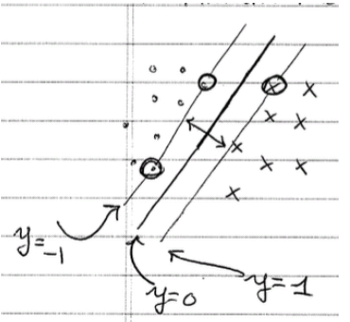
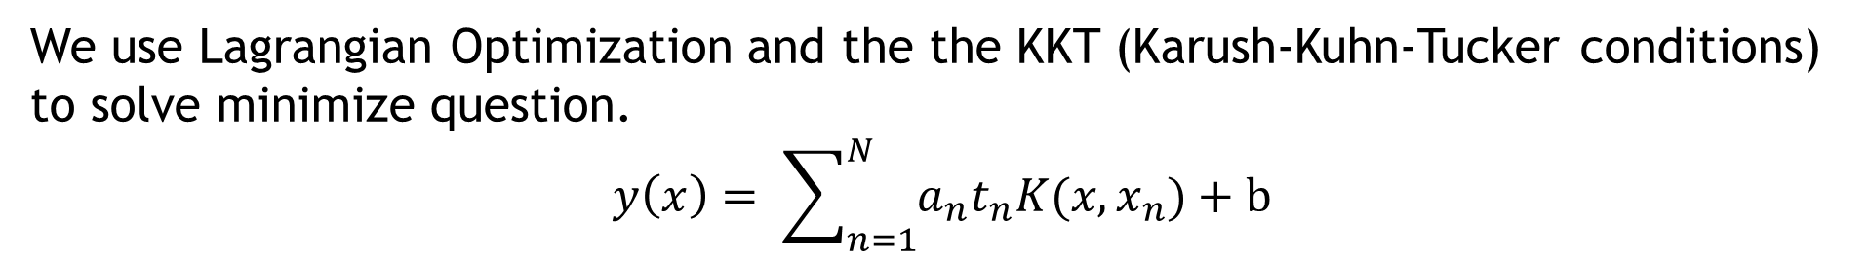
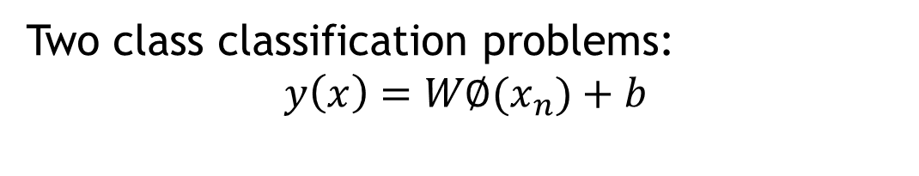

Support Vector Machine
Two class classification problems:
$$y\left(x\right)=W∅(x_{n})+b$$
we want:
$$t_{n}y\left(x_{n}\right)>1 ∀_{n}$$
The SVM finds $W$ and $b$ that maximizes the margin
$arg \min_{w,b}{\frac{1}{2}{\left\|w\right\|}^{2} }$ such that $t_{n}w^{t}∅(x_{n})+b ≥1 ∀_{n}$
We use Lagrangian Optimization and the the KKT (Karush-Kuhn-Tucker conditions)
to solve minimize question.
$$y\left(x\right)= \sum_{n=1}^{N}{a_{n}t_{n}K(x,x_{n})}+b$$

Slide 8


RBF kernel
radial basis function kernel:
$$k\left(x,x^{′}\right)=exp⁡(−γ{\left\|x−x^{′}\right\|}^{2})$$
$$y\left(x\right)= \sum_{n=1}^{N}{a_{n}t_{n}exp⁡(−γ{\left\|x− x_{n}\right\|}^{2}) }$$

Slide 9
Multiclass Classification Strategy
[0,9]
0
[1,9]
One vs the rest
1
[2,9]
2
[3,9]
3
[4,9]
4
[5,9]
5
[6,9]
6
[7,9]
7
[8,9]
8
9

Slide 10
Results
3-fold cross-validation on training dataset with 42,000 samples

Slide 11
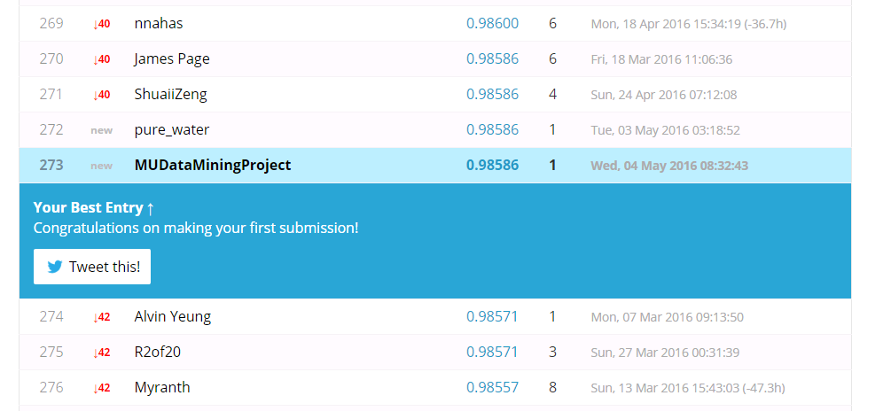
Ranking
Kaggle Rank: 273/1362 (Top 20%)

Slide 12
Future Work
Add new features
2. Try some other methods, like deep learning

Slide 13
Questions?

