Slide 1
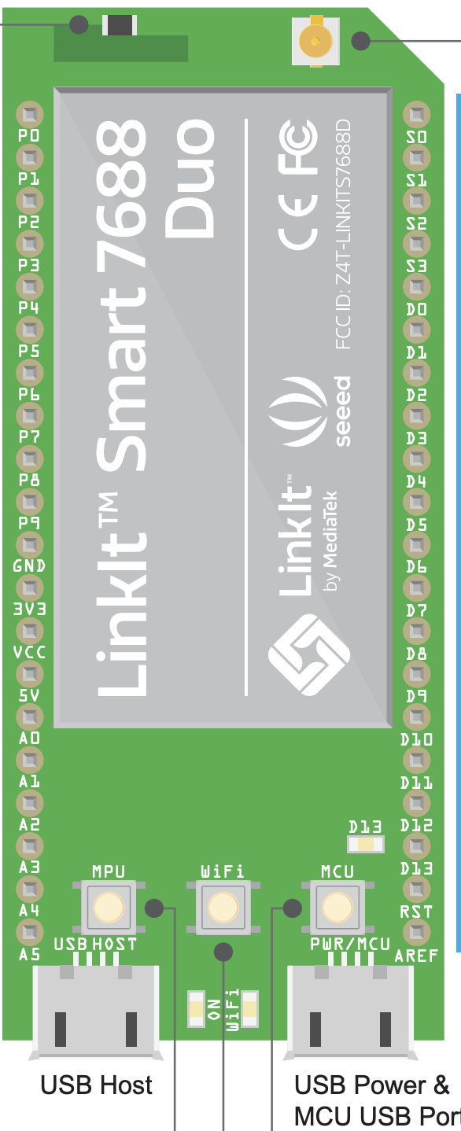

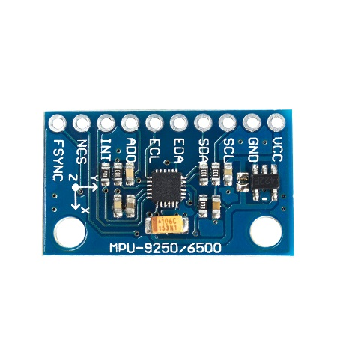
I2C
DATA BASE
LINKSMART 7688
MPU9250

Slide 2
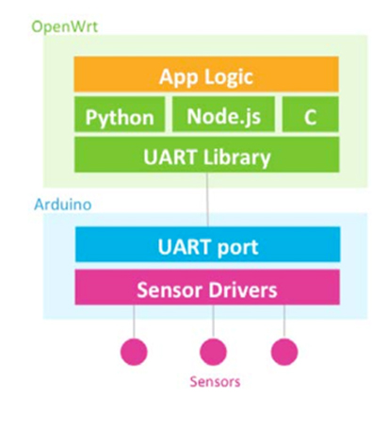
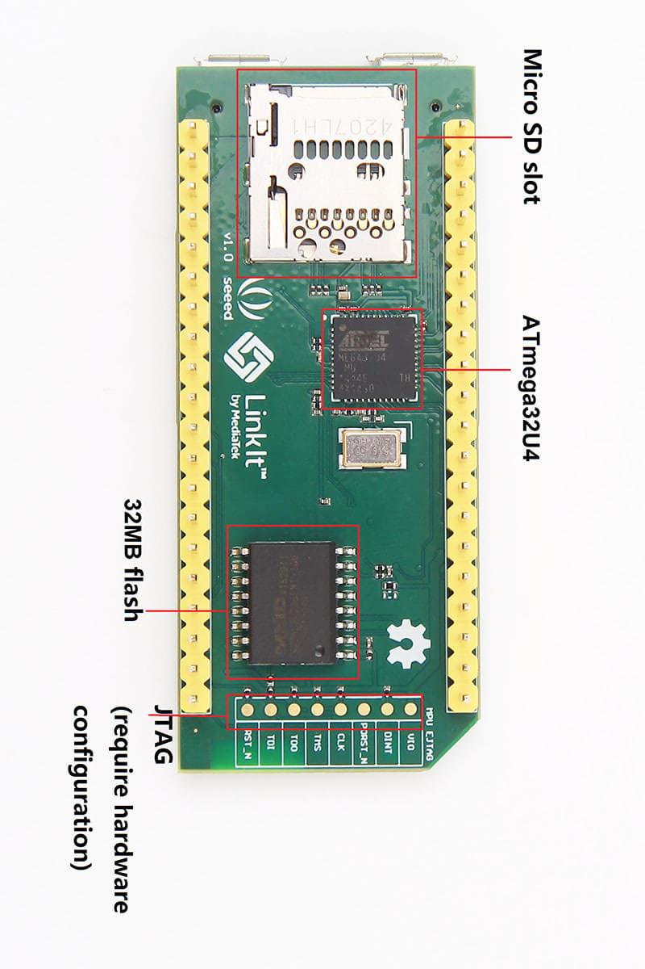

Slide 3
MCU | 資料庫 | 輸入頻率
linkit (atmega32u4) | X | 300Hz
linkit (atmega32u4) | MongoDB | 150Hz
arduino mega (I2C) | X | 400-500 Hz
arduino mega (SPI) | X | 300-400 Hz

