Slide 2


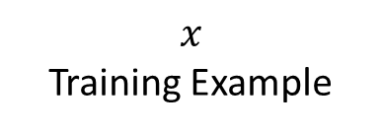



Soft label
Hard label
$$y^{∗}$$
$$y$$
$$1−λ$$
$$λ$$
Loss
$$\hat{y}$$
Source Model
Target Model
$$x$$
Training Example

Slide 3






Soft label
Teacher
Model
$$y^{∗}$$
$$1−λ$$
$$λ$$
Hard label
$$x$$
Loss
$$y$$
Student
Model
$$\hat{y}$$

Slide 4














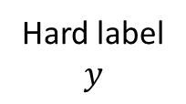

Labeled data
Unlabeled data
Fake Label:
Soft label
Hard label
$$y$$
$$y_{1}^{∗}$$
Source 1
$$λ_{2}$$
$$f_{1}^{∗}$$
Target
Prediction
$$λ_{1}$$
$$T$$
$$y_{2}^{∗}$$
$$λ_{3}$$
Target Model
Source 2
$$f_{2}^{∗}$$
Loss
$$\hat{y}$$
$$λ_{4}$$
Source 3
$$y_{3}^{∗}$$
$$f_{3}^{∗}$$
Input data
$$x$$

Slide 6

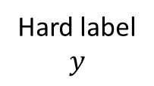
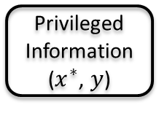

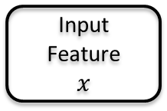




Privileged Information
($x_{}^{∗}$, $y$)
Hard label
$$y$$
Input Feature
$$x$$
$$λ$$
Student
Prediction
$$s$$
$$1−λ$$
$$T$$
Loss
Student Model
$$f_{}^{(t)}$$
$$\hat{y}$$

