Slide 2


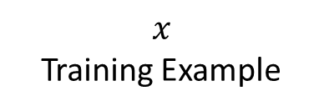



Soft label
Hard label
$$y^{∗}$$
$$y$$
$$1−λ$$
$$λ$$
Loss
$$\hat{y}$$
Source Model
Target Model
$$x$$
Training Example

Slide 3






Soft label
Teacher
Model
$$y^{∗}$$
$$1−λ$$
$$λ$$
Hard label
$$x$$
Loss
$$y$$
Student
Model
$$\hat{y}$$

Slide 4












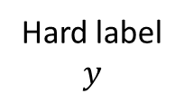

Soft label
Hard label
$$y$$
$$y_{1}^{∗}$$
Source 1
$$λ_{2}$$
$$f_{1}^{∗}$$
$$λ_{1}$$
$$T$$
$$y_{2}^{∗}$$
$$λ_{3}$$
Target Model
Source 2
$$f_{2}^{∗}$$
Loss
$$\hat{y}$$
$$λ_{4}$$
Source 3
$$y_{3}^{∗}$$
$$f_{3}^{∗}$$
Input data
$$x$$

Slide 6

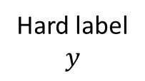
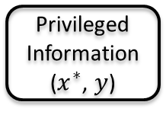

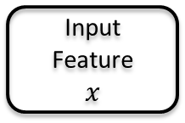



Privileged Information
($x_{}^{∗}$, $y$)
Hard label
$$y$$
Input Feature
$$x$$
$$s$$
$$λ$$
$$T$$
$$1−λ$$
Student Model
$$f_{}^{(t)}$$
Loss
$$\hat{y}$$

