Slide 1
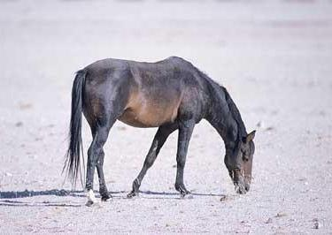
Prior
Prior
….
Prior

Slide 2
Positive
Transfer
No
Transfer
Performance
Negative
Transfer
Training size
Bad Transfer Model
Good Transfer Model

