Slide 1
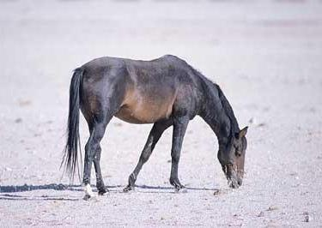
Prior
Prior
….
Prior

