Slide 1
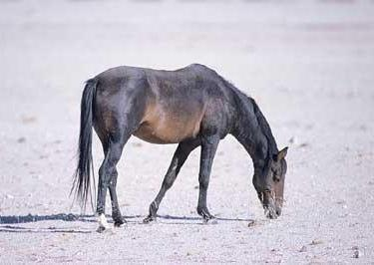
Prior
Prior
….
Prior

Slide 2
Positive
Transfer
No
Transfer
Performance
Negative
Transfer
Training size
Bad Transfer Model
Good Transfer Model

Slide 3

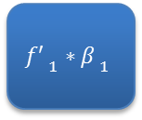



Binary Source Models
Target $f$
$${f′ }_{1}∗{β }_{1}$$
$${f′ }_{2}∗{β }_{2}$$
$${f′ }_{3}∗{β }_{3}$$
$${f′ }_{4}∗{β }_{4}$$
Target output
Auxiliary Bias
Final Prediction

Slide 4












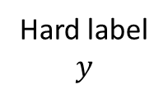

Hard label
$$y$$
$$y_{1}^{∗}$$
Source 1
$$λ_{2}$$
$$f_{1}^{∗}$$
$$λ_{1}$$
$$T$$
$$y_{2}^{∗}$$
$$λ_{3}$$
Target Model
Source 2
$$f_{2}^{∗}$$
Loss
$$\hat{y}$$
$$λ_{4}$$
Source 3
$$y_{3}^{∗}$$
$$f_{3}^{∗}$$
Input data
$$x$$

