Slide 1
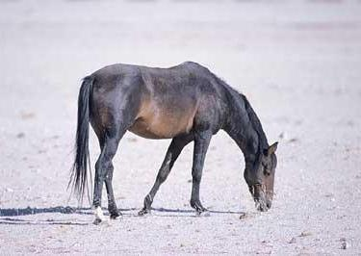
Prior
Prior
….
Prior

Slide 2
Positive
Transfer
No
Transfer
Performance
Negative
Transfer
Training size
Bad Transfer Model
Good Transfer Model

Slide 3

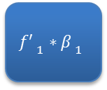



Binary Source Models
Target $f$
$${f′ }_{1}∗{β }_{1}$$
$${f′ }_{2}∗{β }_{2}$$
$${f′ }_{3}∗{β }_{3}$$
$${f′ }_{4}∗{β }_{4}$$
Target output
Auxiliary Bias
Final Prediction

Slide 4
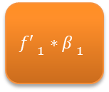
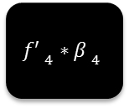
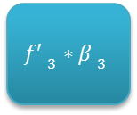
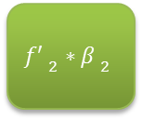
Binary Source Models
Target $f$
$${f′ }_{1}∗{β }_{1}$$
$${f′ }_{2}∗{β }_{2}$$
$${f′ }_{3}∗{β }_{3}$$
$${f′ }_{4}∗{β }_{4}$$
Target output
Auxiliary Bias
Final Prediction

Slide 5




w$x$ | $${f′}_{1}β_{11}$$ | $${f′}_{2}β_{12}$$ | $${f′}_{3}β_{13}$$ | … | $${f′}_{n}β_{1n}$$
$$Y_{1}$$
…..
…..
w$x$ | $${f′}_{1}β_{n1}$$ | $${f′}_{2}β_{n2}$$ | $${f′}_{3}β_{n3}$$ | … | $${f′}_{n}β_{nn}$$
$$Y_{n}$$

Slide 6




$$x$$ | $${f′}_{1}β_{11}$$ | $${f′}_{2}β_{12}$$ | $${f′}_{3}β_{13}$$ | … | $${f′}_{n}β_{1n}$$
$$φ_{1}(x)$$
…..
…..
$$x$$ | $${f′}_{1}β_{n1}$$ | $${f′}_{2}β_{n2}$$ | $${f′}_{3}β_{n3}$$ | … | $${f′}_{n}β_{nn}$$
$$φ_{n}(x)$$

