Slide 2
1 | 0 | 2 | 4 | 1
2 | 3 | 5 | 3 | 2
2 | 5 | 1 | 1 | 2
2 | 4 | 1 | 0 | 2
0 | 4 | 1 | 4 | 0
1 | 0 | 1
1 | 0 | 1
1 | 0 | 1
13 | 16 | 13
13 | 16 | 13
7 | 18 | 7

Slide 3
0 | 0 | 0 | 0 | 0 | 0 | 0
0 | 1 | 0 | 2 | 4 | 1 | 0
0 | 2 | 3 | 5 | 3 | 2 | 0
0 | 2 | 5 | 1 | 1 | 2 | 0
0 | 2 | 4 | 1 | 0 | 2 | 0
0 | 0 | 4 | 1 | 4 | 0 | 0
0 | 0 | 0 | 0 | 0 | 0 | 0
1 | 0 | 1
1 | 0 | 1
1 | 0 | 1
3 | 10 | 10 | 10 | 7
8 | 13 | 16 | 13 | 8
12 | 13 | 16 | 13 | 4
13 | 7 | 18 | 7 | 5
8 | 4 | 12 | 4 | 4

Slide 4
Max-Pooling
3 | 5
5 | 4
1 | 2 | 0 | 4
2 | 3 | 5 | 3
2 | 5 | 2 | 1
1 | 4 | 1 | 4
y
Average-Pooling
2 | 3
3 | 2
X

Slide 5
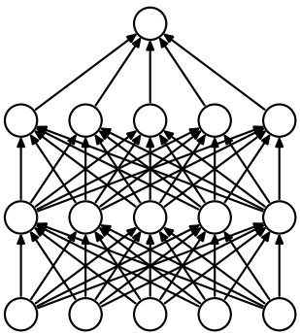

Slide 6
Loss
Last Layer for Source 1000 Nodes
(Removed for fine-tuning)
Last Layer for Target
101 Nodes
Forward
Error propagation for
fine-tune the whole net
Error propagation for
fine-tune the last layer

