Slide 1
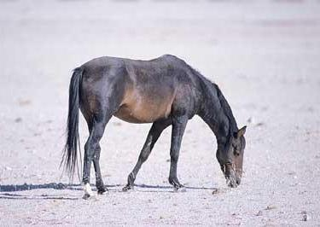
Prior
Prior
….
Prior

Slide 2
Positive
Transfer
No
Transfer
Performance
Negative
Transfer
Training size
Bad Transfer Model
Good Transfer Model

Slide 3

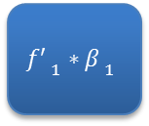



Binary Source Models
Target $f$
$${f′ }_{1}∗{β }_{1}$$
$${f′ }_{2}∗{β }_{2}$$
$${f′ }_{3}∗{β }_{3}$$
$${f′ }_{4}∗{β }_{4}$$
Target output
Auxiliary Bias
Final Prediction

Slide 4
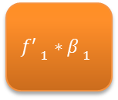
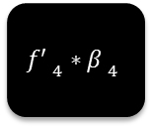
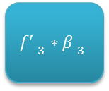
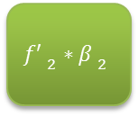
Binary Source Models
Target $f$
$${f′ }_{1}∗{β }_{1}$$
$${f′ }_{2}∗{β }_{2}$$
$${f′ }_{3}∗{β }_{3}$$
$${f′ }_{4}∗{β }_{4}$$
Target output
Auxiliary Bias
Final Prediction

Slide 5




w$x$ | $${f′}_{1}β_{11}$$ | $${f′}_{2}β_{12}$$ | $${f′}_{3}β_{13}$$ | … | $${f′}_{n}β_{1n}$$
$$Y_{1}$$
…..
…..
w$x$ | $${f′}_{1}β_{n1}$$ | $${f′}_{2}β_{n2}$$ | $${f′}_{3}β_{n3}$$ | … | $${f′}_{n}β_{nn}$$
$$Y_{n}$$

Slide 6




$$x$$ | $${f′}_{1}β_{11}$$ | $${f′}_{2}β_{12}$$ | $${f′}_{3}β_{13}$$ | … | $${f′}_{n}β_{1n}$$
$$φ_{1}(x)$$
…..
…..
$$x$$ | $${f′}_{1}β_{n1}$$ | $${f′}_{2}β_{n2}$$ | $${f′}_{3}β_{n3}$$ | … | $${f′}_{n}β_{nn}$$
$$φ_{n}(x)$$

Slide 7
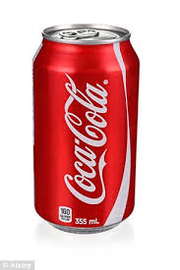
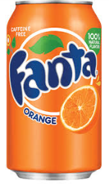
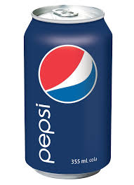
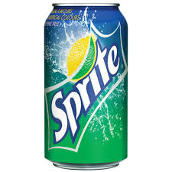


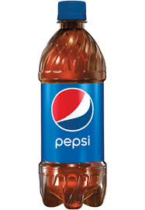

Effective Multiclass Transfer For Hypothesis Transfer Learning
Source
Target
Source
Model
Too Fewer to build
a good model alone.

Slide 8

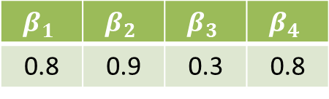
Effective Multiclass Transfer For Hypothesis Transfer Learning
Source
Model
Coke | Pepsi | Fanta | Sprite
0.4 | 0.1 | 0.2 | 0.3
X
Model from Target Data
$$β_{1}$$ | $$β_{2}$$ | $$β_{3}$$ | $$β_{4}$$
0.8 | 0.9 | 0.3 | 0.8
Coke | Pepsi | Fanta | Sprite
0.25 | 0.3 | 0.2 | 0.25
Coke | Pepsi | Fanta | Sprite
0.32 | 0.09 | 0.06 | 0.24
Coke | Pepsi | Fanta | Sprite
0. 57 | 0.39 | 0.26 | 0.49

Slide 9
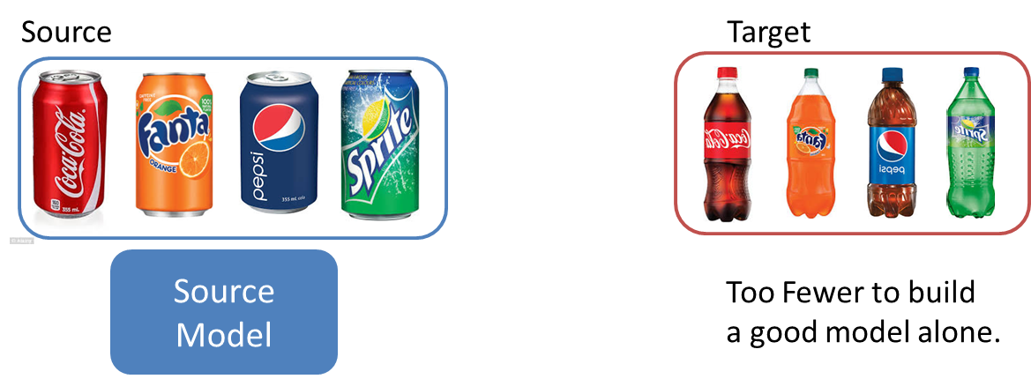
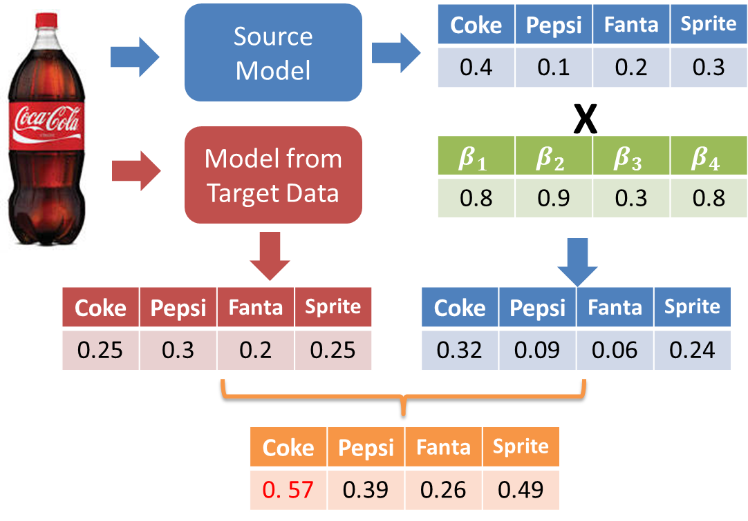
Task
Solution
Transfer
Parameter
Final output

Slide 10

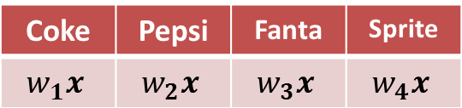
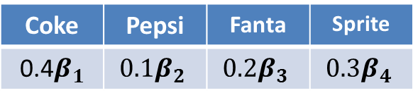
Source
Model
Coke | Pepsi | Fanta | Sprite
0.4 | 0.1 | 0.2 | 0.3
X
Model from Target Data
$$β_{1}$$ | $$β_{2}$$ | $$β_{3}$$ | $$β_{4}$$
Coke | Pepsi | Fanta | Sprite
$$w_{1}x$$ | $$w_{2}x$$ | $$w_{3}x$$ | $$w_{4}x$$
Coke | Pepsi | Fanta | Sprite
0.4$β_{1}$ | $${0.1β}_{2}$$ | $${0.2β}_{3}$$ | $${0.3β}_{4}$$
Coke | Pepsi | Fanta | Sprite
1 | 0 | 0 | 0

Slide 11
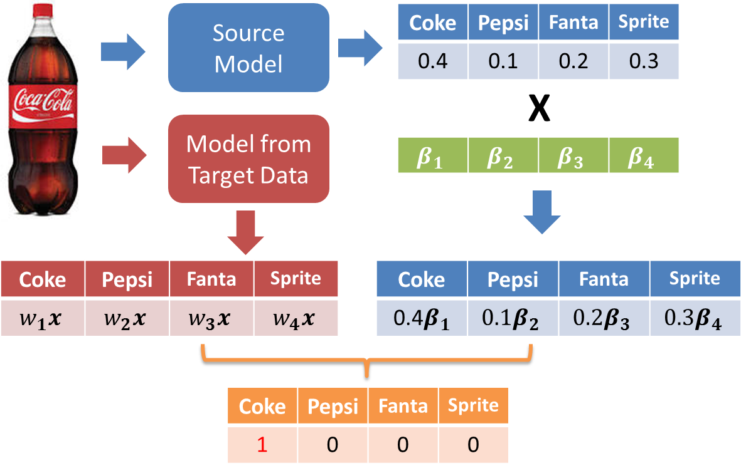
Task
Train
Test

