Slide 1
VISUAL TRANSFER LEARNING IN THE ABSENCE OF THE SOURCE DATA

Slide 2
Outlines
Introduction
Related work
Effective Multiclass Transfer For Hypothesis Transfer Learning (Submitted to PAKDD17)
Fast Generalized Distillation for Semi-supervised Domain Adaptation (Accepted by AAAI17)
Learning Food Recognition Model with Deep Representation (ICDM workshop paper)
Conclusion

Slide 3
Introduction
An Overview for visual transfer learning (VTL)
Stream of image recognition: preprocess, feature extraction and classification
Importance of transfer learning in Image recognition (learning from small number of data)
Limitation of the current work in VTL
The failure of the assumption: free availability of the source data
Source data can be private.
Privacy
Disclosure obligations
Will to share the data

Slide 4
Introduction
Our method:
Assume that only the source model is available and we can leverage the source knowledge from the source model only
Inductive Transfer Learning Scenario:
Learning new class: from A to B (different label)
Fine-tuning the deep learning model (chapter 3)
Domain adaptation: from A to A’ (same label different marginal distribution)
Supervised scenario (chapter 4)
Semi-supervised scenario (chapter 5)
Summary

Slide 5
Related Work
Classifiers for Image Recognition
SVMs, Softmax & CNN
An overview of VTL
Types of tasks: inductive, transductive & unsupervised transfer learning
Types of solutions: instance transfer, representation transfer & parameter transfer
Special Issues in Avoiding Negative Transfer
VTL without source data
Fine-tuning the Deep Net
Hypothesis transfer learning
Distillation for knowledge transfer

Slide 6
Effective Multiclass Transfer For Hypothesis Transfer Learning
Background:
Domain adaptation
Hypothesis transfer learning (HTL)
Previous HTL studies are limited to using the source model in SVMs
Auxiliary bias from source model
The output of the source model can be considered as the auxiliary bias to adjust the model trained from the target data
Extend HTL to more types of source model.

Slide 7
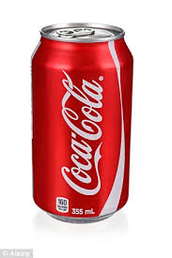
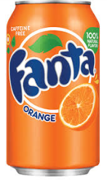
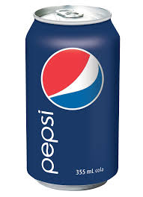
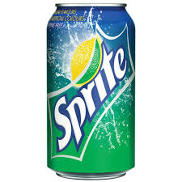


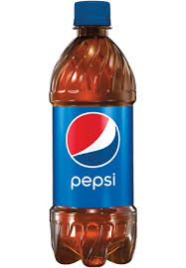

Effective Multiclass Transfer For Hypothesis Transfer Learning
Source
Target
A model built from
plenty of source data
Too Fewer to build
a good model alone.
Source
Model
Lousy Target
Model

Slide 8

Effective Multiclass Transfer For Hypothesis Transfer Learning
Source
Model
Coke | Pepsi | Fanta | Sprite
0.4 | 0.1 | 0.2 | 0.3
X
Lousy Target
Model
Transfer
parameter
0.8 | 0.9 | 0.3 | 0.8
Coke | Pepsi | Fanta | Sprite
0.25 | 0.3 | 0.2 | 0.25
Coke | Pepsi | Fanta | Sprite
0.32 | 0.09 | 0.06 | 0.24
How to learn
the transfer
parameter?
Coke | Pepsi | Fanta | Sprite
0. 57 | 0.39 | 0.26 | 0.49

Slide 9
Effective Multiclass Transfer For Hypothesis Transfer Learning
Bi-level optimization: find the best weighting strategy to balance the source and target.
Cross-validation based convex problem.
Low-level optimization problem: train SVMs for target model
High-level optimization problem: Cross-validation for transfer parameters optimization
Experiments
Dataset & Baseline methods
Transfer from Single Source Domain
Transfer from Multiple Source Domains
Summary

Slide 10
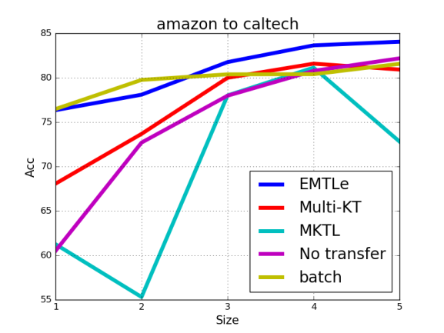
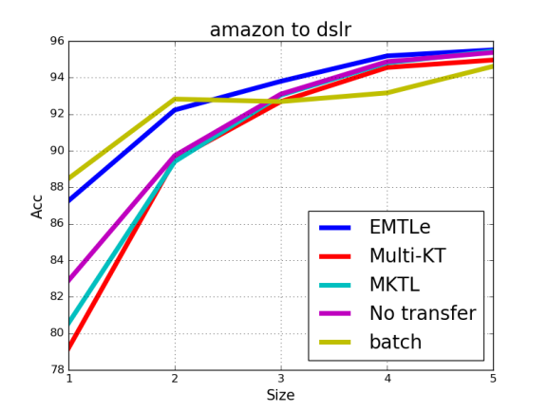
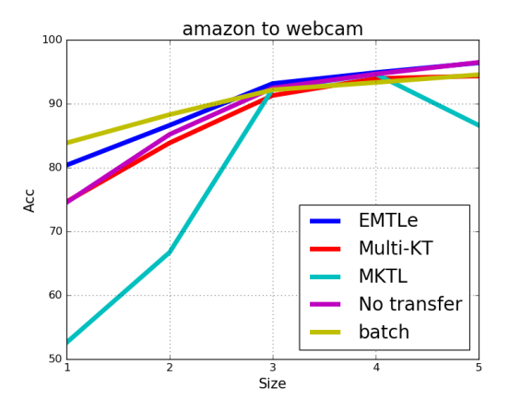
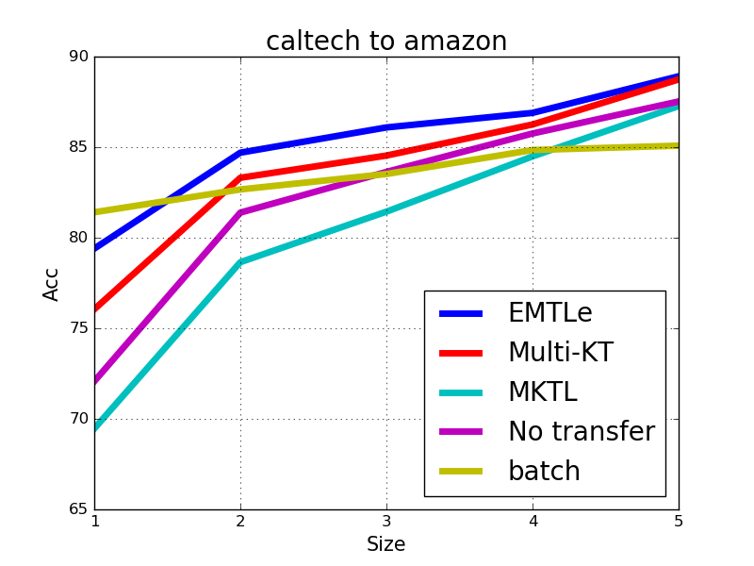
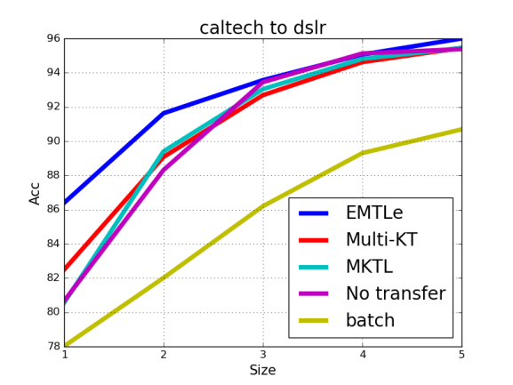
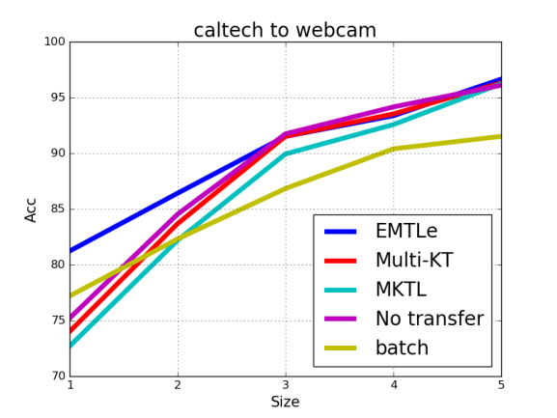
Results

Slide 11
Fast Generalized Distillation for Semi-supervised Domain Adaptation
Background:
Semi-supervised Domain Adaptation (SDA)
Issue in SDA:
How to effectively using the unlabeled data to transfer the source knowledge .
Two contributions:
Combined GD with SDA (a novel framework to solve SDA problem)
Proposed GDSDA-SVM (an effective solution of using GDSDA for real applications)
Generalized Distillation for Semi-supervised Domain Adaptation (GDSDA)
Provide a efficient framework to transfer the knowledge between different domains
Unlabeled data can also be effectively utilized in GDSDA

Slide 12
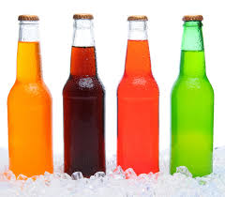
Fast Generalized Distillation for Semi-supervised Domain Adaptation
Source
Target
A model built from
plenty of source data
Source
Model
Lots of unlabeled data
And a few labeled ones
Key Issue: How to utilize the unlabeled data to help training

Slide 13
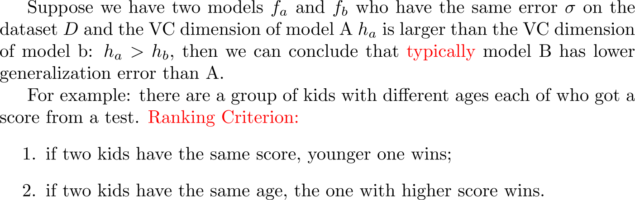
Why Distillation Can Work
Label for
target model
High Complexity
Target Training
Note: Distillation is an unsupervised process and doesn’t need the label of the data to train the target model.
Suppose the performance of the source model on the target task is A and the distilled target model is B. According to the distillation principle, the performance of the distilled target model B is better than A while A is more complex than B. (criterion 1)
Conclusion: A<B
Source
Model A
Source
Output
Target
Model B
Low Complexity

Slide 14
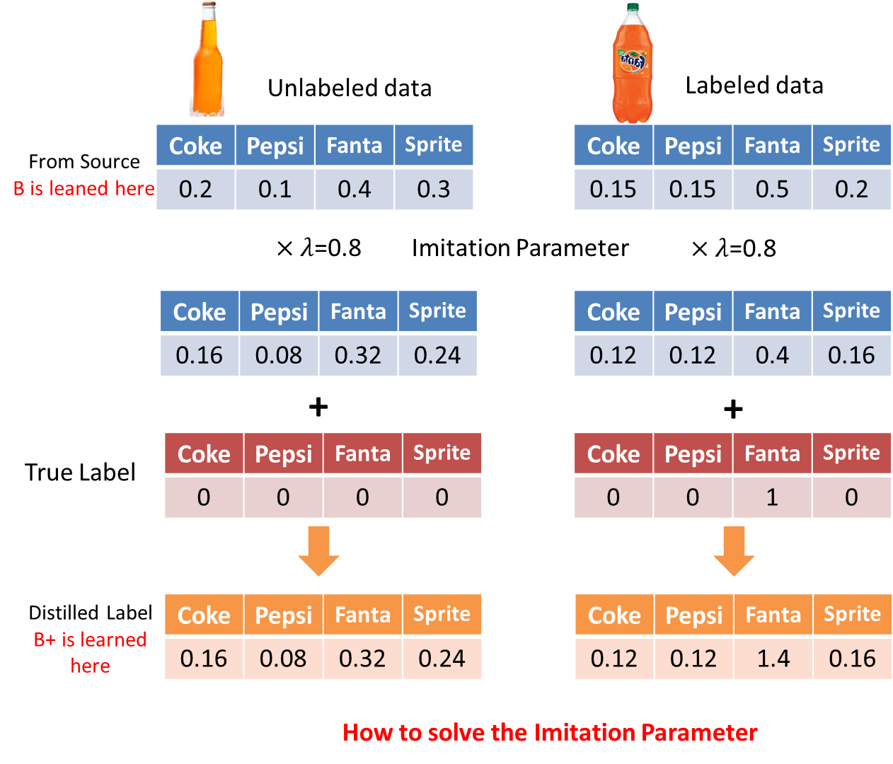
Semi-supervised Distillation
Suppose B is distilled from the source model A and we have another model called B+ who has the same complexity and is learned from the revised label from the target set:
We can see that B+ and B have same complexity and clearly, the error of B+ is equal or smaller than B. Therefore, the performance of B+ is no worse than B (criterion 2)
Conclusion: A<B<=B+

Slide 15
Fast Generalized Distillation for Semi-supervised Domain Adaptation
GDSDA-SVM
A effective application of GDSDA using SVM as the base classifier
Using Leave-one-out CV error to estimate the imitation parameter while previous studies are limited to either domain knowledge or brutal force search
Experiment
Single Source for Office datasets
Multi-Source for Office datasets
Summary

Slide 16
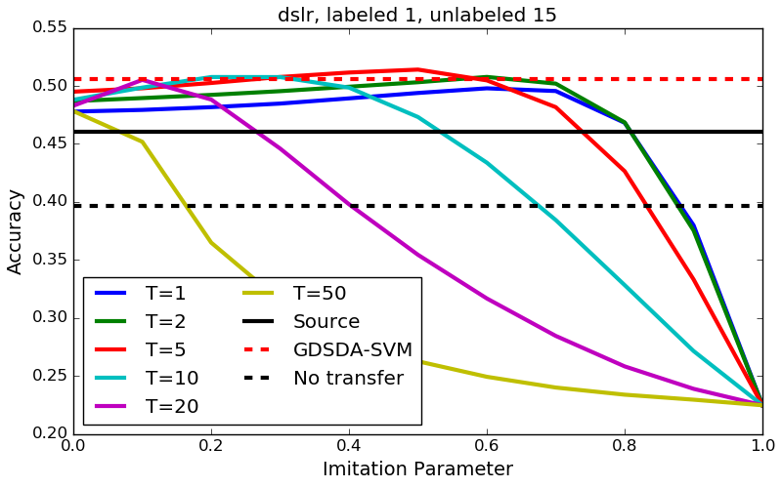
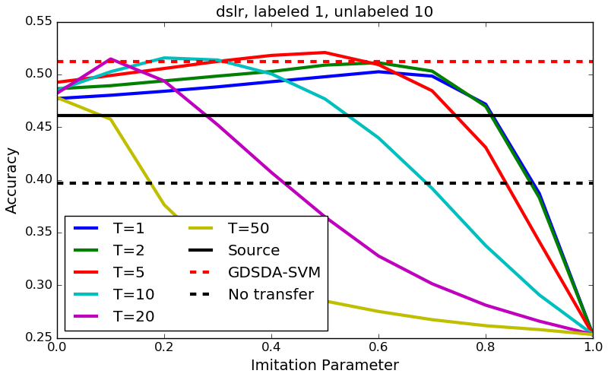
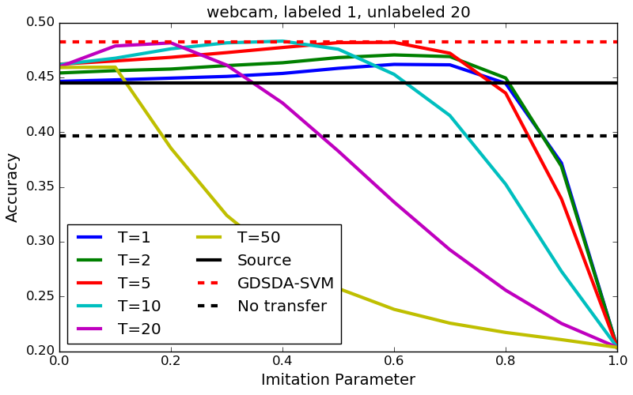
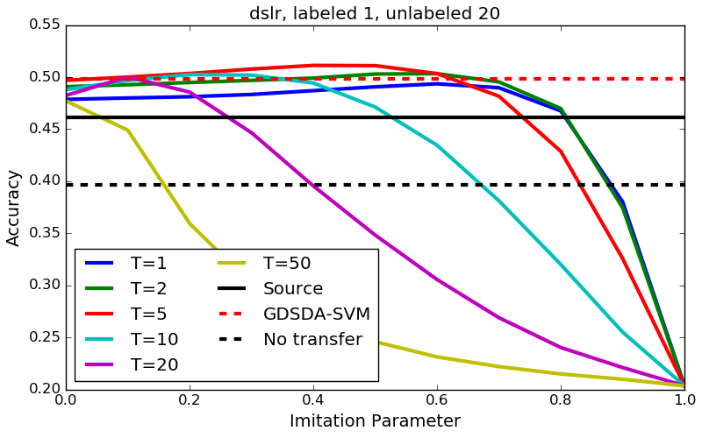
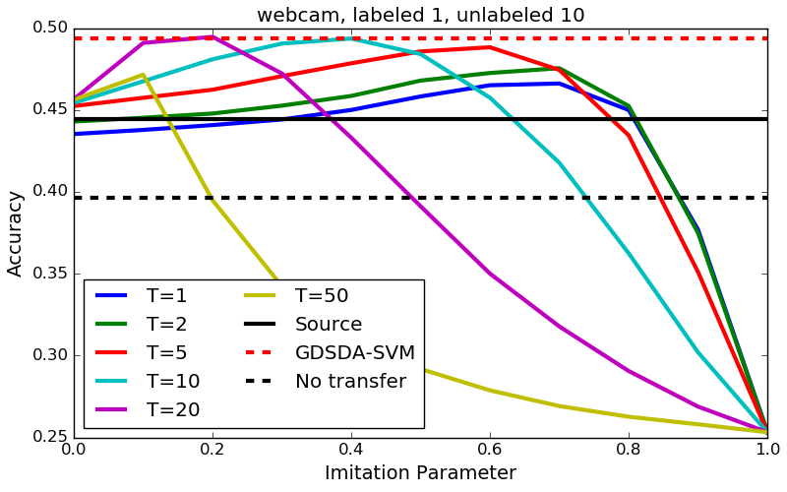
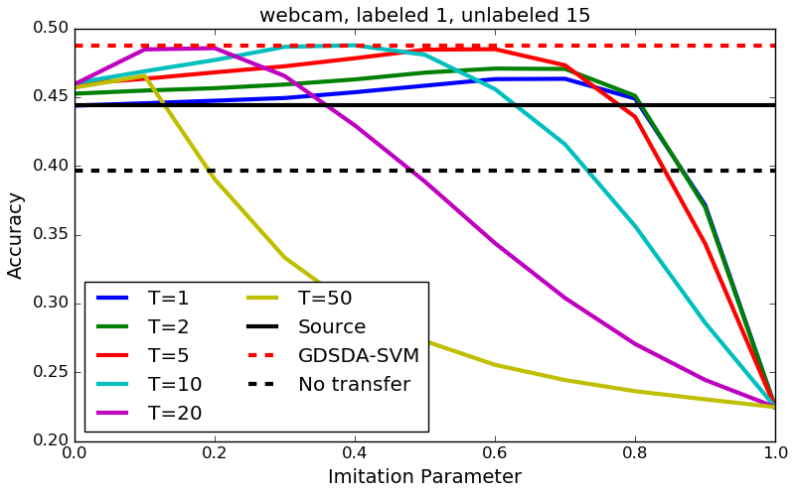
Fast Generalized Distillation for Semi-supervised Domain Adaptation

Slide 17
Learning Food Recognition Model with Deep Representation
Background
Fine-tuning the parameters of the source model for knowledge transfer
Fine-tuning the pre-trained model
Many features (especially the low-level ones) learned in Deep CNN are task independent and can be transferred to different tasks.
Deep CNNs can learn hierarchical features, from low-level to high level. High-level features can be learned from low-level ones with certain combination. By changing the combination of the low-level features, we can obtain new high-level ones

Slide 18

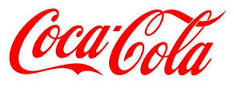
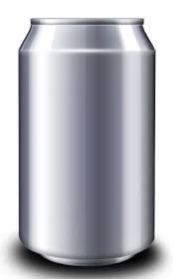

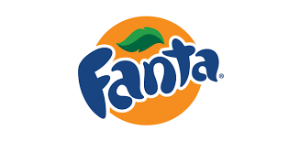
 |  | Low Level |  | High-Level
Pre-Trained Task
New Task

Slide 19
Learning Food Recognition Model with Deep Representation
Architecture of GoogLeNet
Layers
Datasets
Two food databases
Data augmentation
Experiment
Pre-training and Fine-tuning
Remove last layer for fine-tuning
Acc increase compared to previous methods
Learning across database
Knowledge transfer from one food database to another
Summary

Slide 20
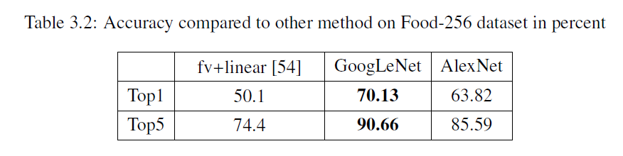
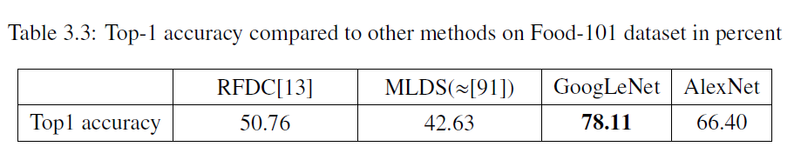
Learning Food Recognition Model with Deep Representation

Slide 21
Conclusion
The main purpose of this thesis is to investigate the visual transfer learning with the absence of the source data.
Provide 3 different methods to solve the problem in different transfer scenarios.
Feature work

