Slide 1
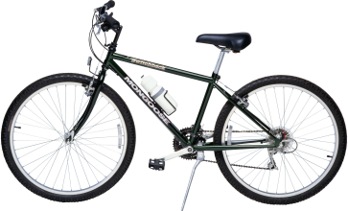
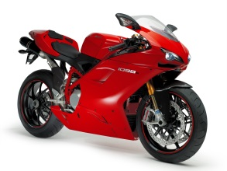






Bicycle model
$${f′}_{1}\left(x\right)$$
$$x$$
$$γ$$
$$\tilde{x}$$
$$x$$ | $$f^{′}\left(x\right)$$
$$\tilde{w}$$
$$w$$ | $$γ$$
$$f\left(x\right)=\tilde{w}\tilde{x}+b$$

Slide 2

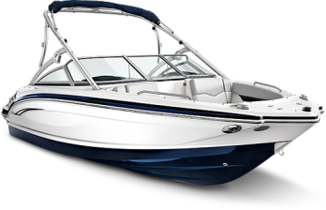









Bicycle model
$${f′}_{1}\left(x\right)$$
Scores From
Source Models
Truck model
$$x$$
$${f′}_{2}\left(x\right)$$
$${f′}_{1}\left(x\right)$$ | $${f′}_{2}\left(x\right)$$ | $${f′}_{3}\left(x\right)$$
Boat model
$${f′}_{3}\left(x\right)$$
Arguemented
Data $\tilde{x}$
$$x$$ | $${f′}_{1}\left(x\right)$$ | $${f′}_{2}\left(x\right)$$ | $${f′}_{3}\left(x\right)$$
Arguemented
Hyperplane $\tilde{w}$
$$w$$ | $$γ_{1}$$ | $$γ_{2}$$ | $$γ_{3}$$
Transfer Parameters
Transfer model:$f\left(x\right)=\tilde{w}\tilde{x}+b$

Slide 3











$$x$$
$${f′}_{1}\left(x\right)$$
$${f′}_{2}\left(x\right)$$
$${f′}_{3}\left(x\right)$$
Source model 1
Source model 2
Source model 3
Multi-adaptation
$${f′}_{1}\left(x\right)$$ | $${f′}_{2}\left(x\right)$$ | $${f′}_{3}\left(x\right)$$
$\hat{x}$=
$$φ(x)$$ | Auxiliary Features
$$φ(x)$$
$\hat{w}$=
$$w′′$$ | Transfer Parameters
$${f′}_{1}\left(x\right)$$
Single-adaptation
Target model:$f\left(x\right)=\hat{w}\hat{x}$

Slide 4
Auxiliary Feature
Positive Transfer
Original Data
Auxiliary Feature
Negative Transfer

Slide 5
Original Data
Auxiliary Feature
Auxiliary Feature
Positive Transfer
Negative Transfer

Slide 6
No Noise
Noise=0.3
Noise=0.5
Noise=0.8

Slide 7


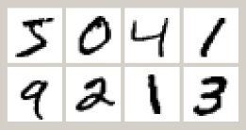
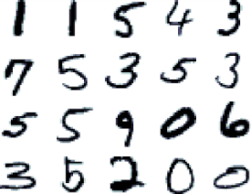
Large
test set
Transfer model
Small target
Training set
Original set
+ Noise
Source Models
Source Data: Even distributed

Slide 8




Noise rate 0
Noise Rate 1

