Slide 1



Financial Guardian: Financial Risk Prediction
——Final Project Report· 2025–2026 Autumn Semester
Team: Northlake
李尚泽-1120242314
许双博-1120243389
Notes:
Welcome everyone to our Big Data Mini‑Project Final Project Report. In this presentation we will walk through the work completed so far on a credit risk dataset. Our aim is to predict borrowers’ interest rates, classify their credit grade and discover meaningful customer segments. Over the past few weeks we have explored the raw data, engineered useful features, trained baseline models and even automated parts of the workflow using a LangGraph agent. Today we’ll share what we have achieved, what we learned along the way and where we’re heading next.

Slide 2
Agenda
1. INTRO
Project overview
4. AUTOMATION
Agent workflow (LangGraph)
2. METHODS
Methodology & pipeline
5. PROGRESS
Roles & progress
3. ANALYSES
Regression analysis Classification analysis
Clustering analysis Risk analysis
6. TEAM&SUMMARY
Summary
Page 0
Final Project Report
Notes:
Here’s an overview of what we’ll cover. We begin with a brief project overview describing the dataset and goals. Then we explain our methodology and pipeline, highlighting how we move from exploratory analysis to feature engineering and modelling. Separate sections present our regression, classification and clustering results. We’ll also introduce the LangGraph agent workflow that automates the process. After that we’ll discuss team contributions, summarise our progress and lessons learned, outline the next steps and potential risks, and conclude with key takeaways before opening the floor for questions.

Slide 3
Project Overview
bigdata_project ├─ src/ ├─ agent_flow/ ├─ artifacts/ ├─ reports/ ├─ data/ ├─ main.py
├─ llm_insights.py
├─ requirements.txt
└─ README.md
src/
Core modules for data preprocessing, feature engineering, and model training.(Builds and evaluates regression/classification pipelines.)
agent_flow/
Multi-agent workflow for automated orchestration and reporting.(Planner → Executor → Visualizer → Reporter.)
artifacts/
Stores all generated outputs — metrics, plots, and evaluation results.(Visual evidence for model performance.)
Entrypoints
Scripts to run and reproduce the project. (main.py, llm_insights.py, requirements.txt, README.md)
Project Overview
Page 1
Final Project Report
Notes:
This slide shows the overall structure of our bigdata_project.
The src folder is the core — it contains all the data processing, feature engineering, and model training code that builds our regression and classification pipelines.
The agent_flow directory automates everything. It uses multiple agents — a planner, executor, visualizer, and reporter — to run the workflow end to end and generate reports automatically.
Next, artifacts stores all the results, including metrics, plots, and model outputs. These files provide visual evidence for model performance.
The reports folder contains readable Markdown summaries produced by the system. They are designed for instructors to review our work and verify reproducibility.
The data folder holds a sample dataset, ensuring the same input and output format for testing and demonstration.
Finally, the entrypoint scripts, like main.py and llm_insights.py, make the entire project easy to rerun and reproduce with just one command.

Slide 4
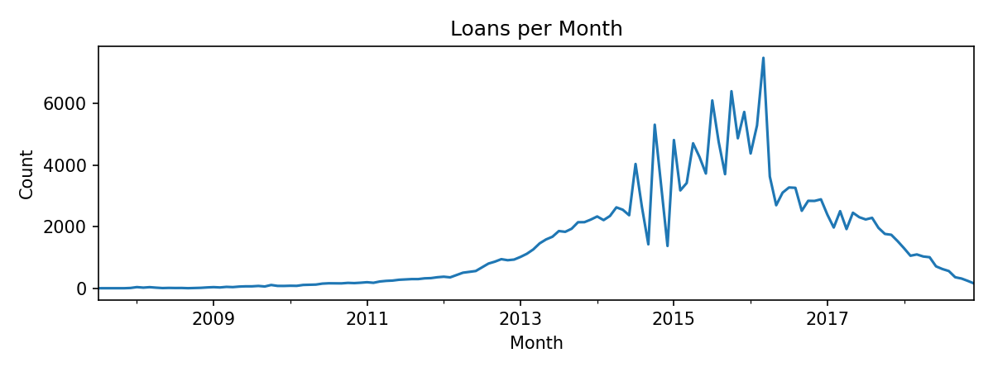
Project Overview
Dataset: historical loan records with borrower demographics, credit history and loan characteristics.
Objectives: predict interest rates (regression), classify credit grades, and discover customer segments (clustering)
Pipeline: perform EDA, engineer features, build models & evaluate results, then generate automated reports
Project Overview
Page 2
Final Project Report
Notes:
Our dataset consists of historic loan records capturing borrower demographics, credit histories and loan characteristics. From the outset our objectives were threefold: first to use regression to estimate the interest rate a borrower might receive; second to classify the credit grade assigned by lenders; and third to segment borrowers into similar groups through clustering. To achieve these goals we assembled a reproducible pipeline that starts with exploratory data analysis, continues through feature engineering, modelling and evaluation, and culminates in automatically generated reports. Understanding the raw data and the problem context provided a solid foundation for our modelling work.

Slide 5
Methodology & Pipeline
Main Content
EDA: explore distributions and temporal trends
Feature engineering: encode categorical, normalize continuous variables
Regression: histogram‑based gradient boosting to estimate interest rate
Classification: histogram‑based classifier to predict credit grade
Clustering: k‑means (PCA) to uncover customer segments
EDA
Report
Features
Regression
Classification
Clustering
Main Content of the Project
Page 3
Methodology & Pipeline
Final Project Report
Final Project Report
Notes:
We structured our workflow into several discrete stages. We began with exploratory data analysis to understand distributions, relationships and temporal trends in the data. Based on those insights we engineered features: categorical variables were one‑hot encoded and continuous variables were normalised. For the regression task we employed a histogram‑based gradient boosting model to predict interest rates. A similar gradient boosting classifier was used to assign credit grades. Finally, to explore unsupervised structure we applied k‑means clustering on a principal components representation. Each stage feeds into the next, and the entire pipeline is automated for repeatability.

Slide 6
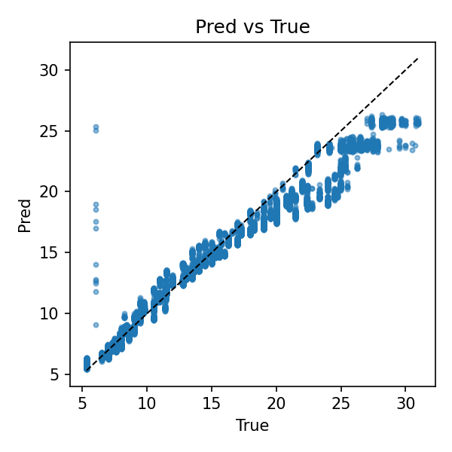
Regression Analysis
Predicting Interest Rate
 | Validation | Test
MAE | 0.7326 | 1.1081
RMSE | 1.1527 | 1.7732
R² | 0.9472 | 0.8961
Strong performance with high R² on validation and test. Low MAE(Mean Absolute Error) and RMSE(Root Mean Square Error) indicate accurate interest rate predictions.
Further tuning may reduce residual variance.
Regression Analysis: Predicting Interest Rate
Page 4
Final Project Report
Notes:
Let’s look at the regression results. The histogram‑based gradient boosting regressor achieved a mean absolute error of roughly 0.73 and a root mean squared error of 1.15 on the validation set. On the held‑out test set the MAE rises slightly to about 1.11 and the RMSE to 1.77.
Importantly, the coefficient of determination reaches 0.95 on validation and remains high at 0.90 on test. The scatter plot of predicted versus true interest rates shows points lying close to the diagonal, confirming that the model captures the underlying relationship well. These metrics indicate the approach provides accurate interest rate estimates for most borrowers.

Slide 7
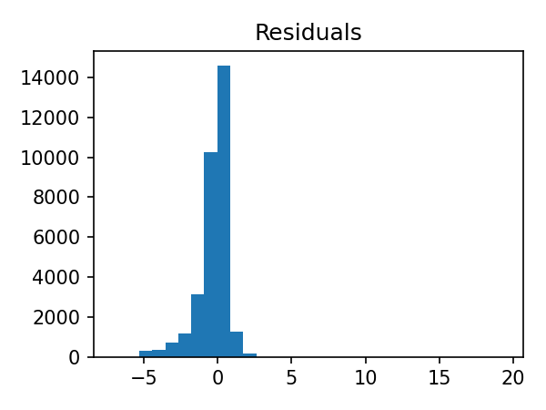
Regression Analysis
Diagnostics
• R² values of 0.947 (Val) and 0.896 (test) demonstrate excellent goodness‑of‑fit. • Residuals cluster tightly around zero, indicating low bias and homoscedasticity. • A few outliers and moderate skew suggest opportunities for further tuning.
Regression Analysis: Diagnostics
Page 5
Final Project Report
Notes:
To further assess our regressor we examined the residuals. Residuals are the differences between predicted and true values; ideally they should be centred on zero with no discernible pattern. In our case the residuals cluster tightly around zero and form an approximately symmetric distribution. A few outliers exist, and there is a slight skew towards negative values, but the variance remains small overall. The high R² values on both validation and test sets support the conclusion that our model fits the data well. Nevertheless, exploring alternate models and tuning hyperparameters may help reduce those outliers and further tighten the residual distribution.

Slide 8
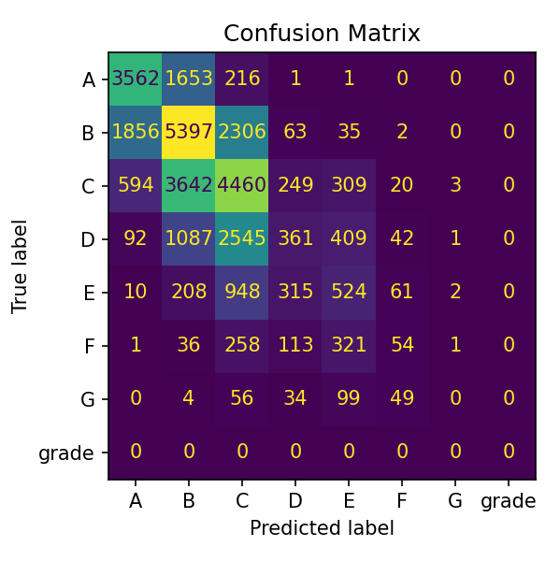
Classifications Results
 | Score
Accuracy | 0.5738
F1 Macro | 0.3831
F1 Weighted | 0.5513
AUC (ovr) | 0.8475
• Reasonable accuracy but macro F1 reveals class imbalance • Weighted F1 is higher, reflecting skewed label distribution • AUC of 0.848 indicates good discriminative power
Classification Results
Page 6
Final Project Report
Notes:
Turning to classification, we trained a histogram‑based gradient boosting classifier to predict a borrower’s credit grade. The model achieves an accuracy of about 57 per cent and a macro F1 score around 0.38; the weighted F1 score improves to 0.55 because the class distribution is highly imbalanced. The overall area under the ROC curve stands at roughly 0.85, indicating good discriminative power. Examining the confusion matrix reveals that the model tends to confuse adjacent grades, especially B and C, which is understandable given subtle differences among intermediate risk categories. Future work will address class imbalance to improve macro F1.

Slide 9
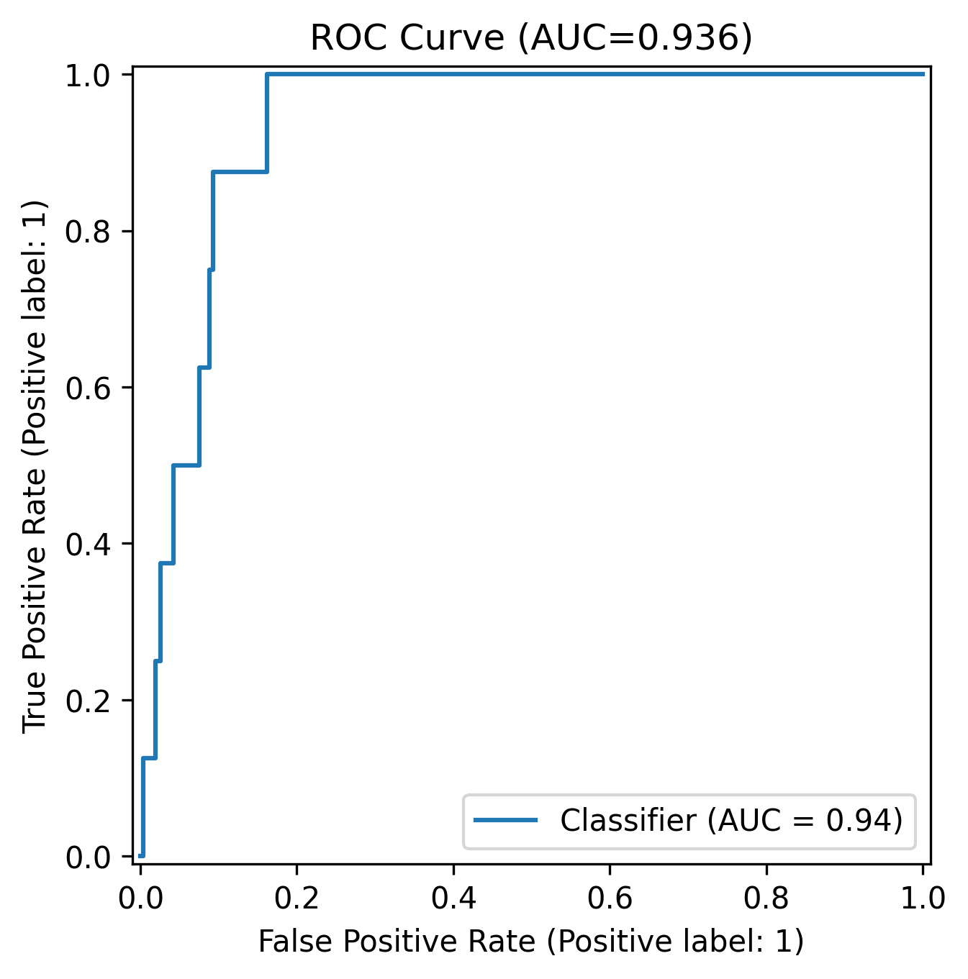
Classifications ROC & Insights
• ROC curve shows AUC = 0.936, indicating strong discrimination • Threshold chosen using Youden's J statistic to balance sensitivity & specificity • PR curve analysis highlights precision–recall trade‑offs in imbalanced data • Insights: high‑risk groups include younger borrowers with lower income; larger loans increase default risk; poor credit history strongly predicts defaults
Classification Results
Page 7
Final Project Report
Notes:
We also evaluated the classifier using ROC and precision‑recall curves. The ROC curve yields an impressive AUC of 0.936, suggesting the model separates positive and negative classes very well. We selected the classification threshold using Youden’s J statistic to balance sensitivity and specificity, and considered precision–recall trade‑offs due to the imbalanced classes. Beyond pure metrics, our analysis surfaced meaningful business insights: younger borrowers with lower incomes tend to default more frequently; larger loan amounts correlate with higher default risk; and borrowers with a history of late payments are significantly more likely to default. These findings can guide underwriting policies and targeted interventions

Slide 10
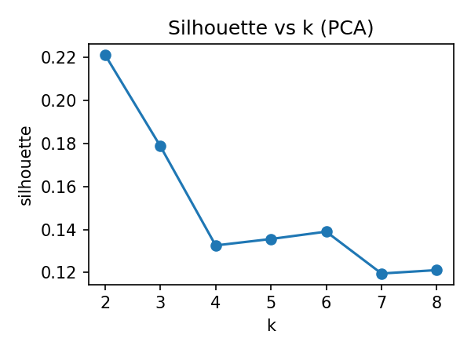
Clustering Analysis
Silhouette scores peak at k=2 (≈0.22), suggesting two distinct clusters Cluster 0: smaller loans (~$13K), moderate incomes (~$70K) and ~20 total accounts Cluster 1: larger loans (~$18K), higher incomes (~$92K) and ~35 total accounts Segmentation enables tailored risk strategies and product offerings
Clustering Analysis
Page 8
Final Project Report
Notes:
To uncover hidden segments we applied k‑means clustering after dimensionality reduction. Plotting the silhouette score across different cluster counts shows a clear peak around k equals 2, suggesting two well‑separated groups. Profiling these clusters reveals distinct characteristics. The first group comprises borrowers seeking smaller loans around thirteen thousand dollars, earning moderate incomes near seventy thousand and having roughly twenty total credit accounts. The second cluster contains borrowers with larger loans around eighteen thousand dollars, higher incomes near ninety thousand and about thirty‑five total accounts. Segmenting the population in this way allows lenders to tailor risk assessments and product offerings to each group’s profile.

Slide 11
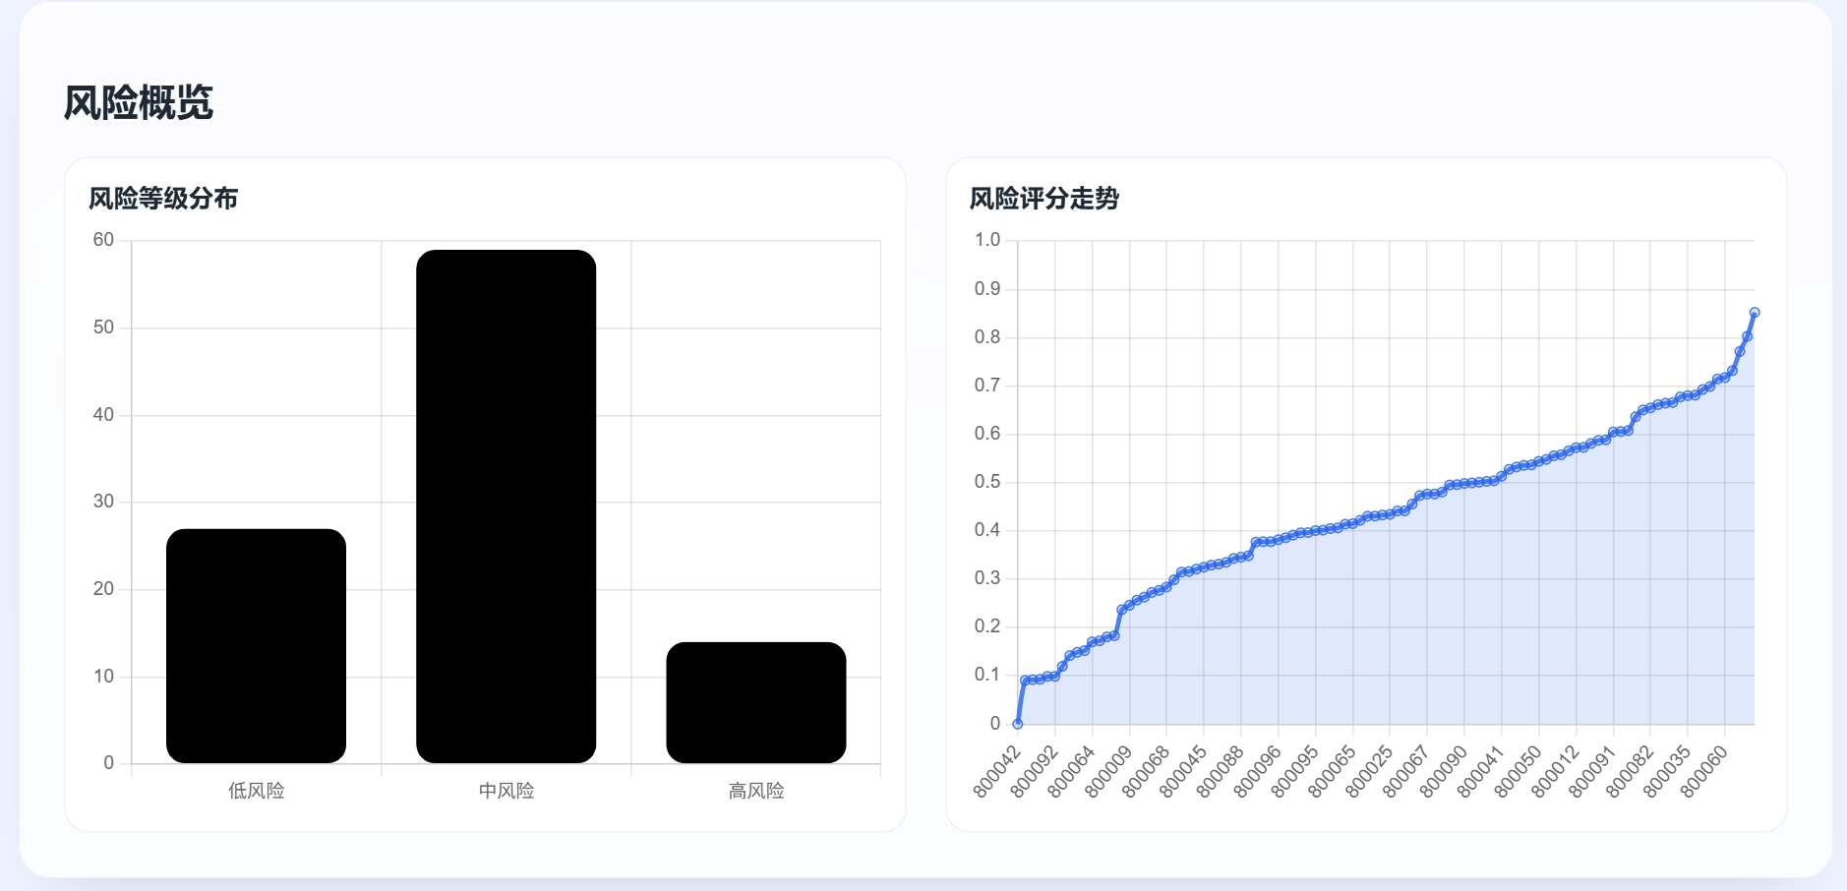
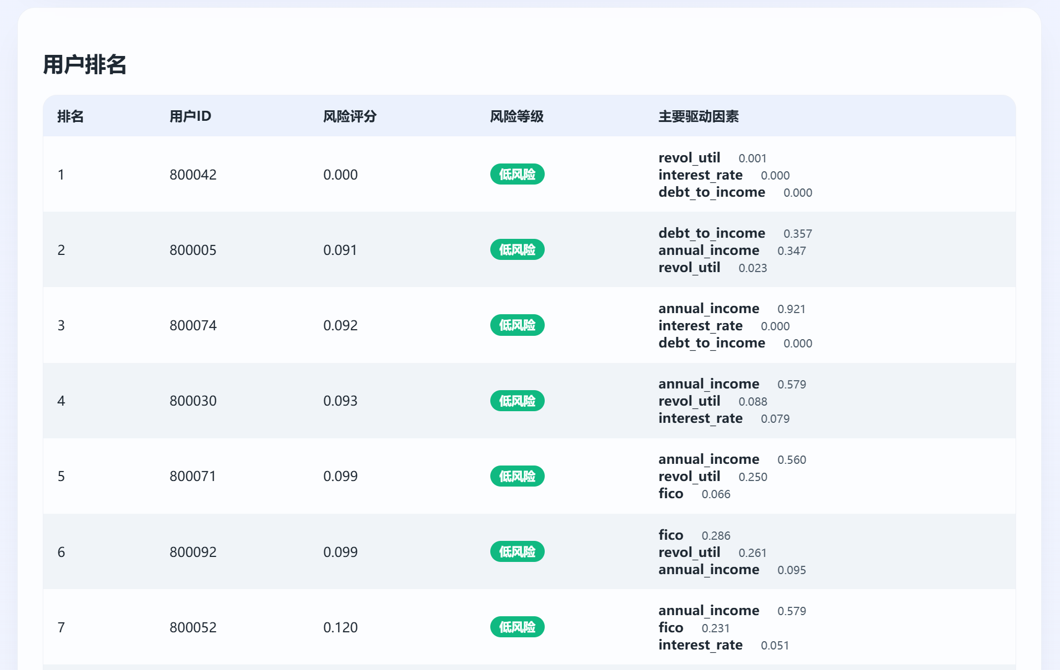
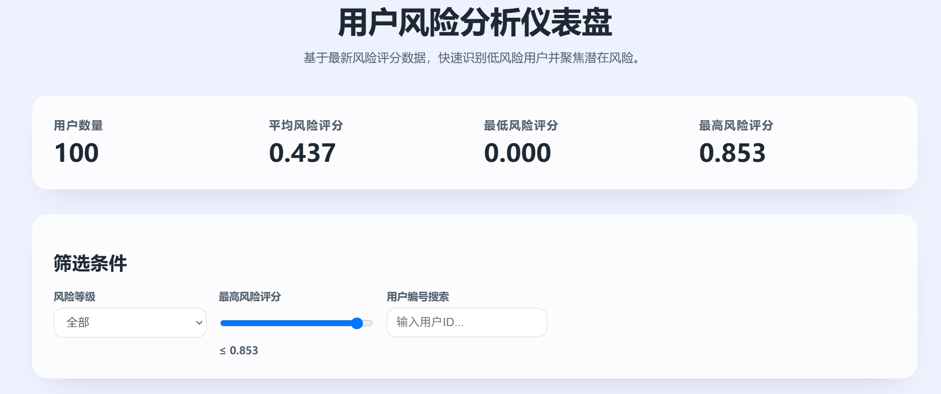
Risk analysis
Based on the dataset analysis, we will provide reference data for user financial risk analysis. To assist decision-makers, we have developed an online risk analysis dashboard that quickly identifies low-risk users and focuses on potential risks based on the latest assessment data.
Risk Analysis
Page 9
Final Project Report
Notes:
Based on the analysis results of the dataset, we will be able to comprehensively derive relevant reference data for user financial risk analysis. To better provide decision-makers with visually strong data analysis services, we have developed an online user risk analysis dashboard, which quickly identifies low-risk users and focuses on potential risks based on the latest user risk assessment data.

Slide 12
Agent Workflow
Planner Plan tasks
Executor
Train & evaluate
Visualizer Generate plots
Reporter Compile report
• Planner orchestrates data cleaning, modelling, visualisation & report tasks. • Executor trains models and returns metrics & trained artefacts. • Visualizer draws curves and charts for inclusion in reports. • Reporter compiles Markdown report and can append LLM insights.
Agent Workflow
Page 9
Final Project Report
Notes:
Beyond traditional scripting, we experimented with LangGraph to automate the modelling and reporting process. In our agent workflow the planner node determines which tasks need to run—data cleaning, training, evaluation, visualisation and report generation. The executor then trains the appropriate model and returns metrics and artefacts. Next, the visualiser produces plots such as ROC curves and confusion matrices for inclusion in the report. Finally, the reporter compiles a Markdown report and can optionally call a language model to append high‑level insights. This modular pipeline promotes reproducibility and frees us from manual bookkeeping.

Slide 13
Roles & Progress
Xu Shuangbo | Completed the full project, including data processing, modeling, and evaluation Provided English slide text and explanatory content
Li Shangze | Assisted in data collection and dataset organizationDesigned and prepared the final presentation slides
progress
Completed EDA, feature engineering and baseline models for regression and classification Achieved strong regression performance (R² ≈ 0.95/0.90) and high classification AUC (0.936) but moderate macro F1 Conducted k‑means clustering to reveal two distinct customer segments Integrated LangGraph agent workflow to automate modelling, visualisation and reporting Learned the importance of robust data cleaning, handling imbalance and tuning hyperparameters
Roles & Progress
Page 10
Final Project Report
Notes:
Our progress reflects coordinated teamwork. Xu Shuangbo made the main development, including data exploration, model design, and report writing, while also drafting most of the presentation content. Li Shangze supported the project through dataset organisation, literature review, and feedback on model choices and slide design. Roughly eighty per cent of the work was handled by Xu Shuangbo and twenty per cent by the teammate.
By this checkpoint, we have completed the exploratory analysis, feature engineering, and baseline models, achieving an R² around 0.95 and an AUC of 0.936. We also integrated the LangGraph workflow to automate the process from training to reporting and learned the importance of careful data cleaning and balanced evaluation.

Slide 14
Summary
Metric | Value
Accuracy | 0.5738
F1 Macro | 0.3831
F1 Weighted | 0.5513
AUC (ovr) | 0.8475
Established a reproducible pipeline from EDA through automated reporting. Regression model delivers highly accurate interest rate predictions. Classification model shows promise but requires improvements in macro F1. Clustering reveals two customer segments, enabling targeted strategies. LangGraph agent workflow increases automation and reproducibility.
Summary
Page 12
Final Project Report
Notes:
In summary, we have established a reproducible pipeline that moves from exploratory analysis to automated report generation. Our regression model delivers highly accurate interest rate predictions, while our classifier shows promise with a strong AUC, though macro F1 could be improved. Clustering analysis uncovered two distinct borrower segments, enabling more nuanced risk strategies. Integrating the LangGraph agent workflow has streamlined the process and improved reproducibility. In the coming weeks we will tune our models, enhance interpretability and prepare our final deliverables. Thank you for your attention, and we look forward to sharing our final results soon. Q&A / Backup That concludes the prepared material. Here we have a summary table of the classification metrics for quick reference. Please feel free to ask any questions you have about our models, the metrics we reported, the clustering analysis or the agent workflow. We are happy to discuss our methodology, dive deeper into specific results or elaborate on the business insights drawn from the analysis. Your feedback will be invaluable as we refine our approach for the final submission.

Slide 15
Thanks
Team: Northlake

