Slide 1



Financial Guardian: Financial Risk Prediction
——Final Project Report· 2025–2026 Autumn Semester
Team: Northlake
Notes:
Good morning/ afternoon, everyone. We are Team Northlake from Beijing Institute of Technology. Today, we’ll present our final project — Financial Guardian: Financial Risk Prediction, which focuses on building an intelligent and automated system for credit risk analysis.
各位老师、同学大家好， 我们是来自北京理工大学的 Northlake 团队。 今天汇报的项目是 《Financial Guardian：Financial Risk Prediction》，主要研究如何构建一个智能化、自动化的信贷风险分析系统。

Slide 2
Agenda
1. INTRO
Project overview
4. AUTOMATION
Agent workflow (LangGraph)
2. METHODS
Methodology & pipeline
5. PROGRESS
Roles & progress
3. ANALYSES
Regression analysis Classification analysis
Clustering analysis Risk analysis
6. TEAM&SUMMARY
Summary
Page 0
Final Project Report
Notes:
Here’s the outline of our presentation. We’ll start with a project overview and methods, then move to data analyses including regression, classification, clustering, and risk analysis. Finally, we’ll introduce the LangGraph workflow, team progress, and a short summary.
这是我们报告的主要内容。 首先介绍项目概况和方法，然后展示回归、分类、聚类和风险分析的结果。 最后讲解 LangGraph 自动化流程、团队分工和总结。

Slide 3
Project Overview
bigdata_project ├─ src/ ├─ agent_flow/ ├─ artifacts/ ├─ reports/ ├─ data/ ├─ main.py
├─ llm_insights.py
├─ requirements.txt
└─ README.md
src/
Core modules for data preprocessing, feature engineering, and model training.(Builds and evaluates regression/classification pipelines.)
agent_flow/
Multi-agent workflow for automated orchestration and reporting.(Planner → Executor → Visualizer → Reporter.)
artifacts/
Stores all generated outputs — metrics, plots, and evaluation results.(Visual evidence for model performance.)
Entrypoints
Scripts to run and reproduce the project. (main.py, llm_insights.py, requirements.txt, README.md)
Project Overview
Page 1
Final Project Report
Notes:
This slide shows the structure of our bigdata_project repository. The src folder contains the core modules for data preprocessing, feature engineering, and model training. The agent_flow folder implements our LangGraph workflow with four agents: Planner, Executor, Visualizer, and Reporter. All generated metrics and plots are stored in artifacts, while reports saves the final outputs. The llm_insights.py file connects to the OpenAI API to generate LLM-based analysis and Markdown reports automatically.
这一页展示的是我们项目在 bigdata_project 仓库中的结构。 src 文件夹包含数据预处理、特征工程和模型训练的核心模块； agent_flow 实现了 LangGraph 多智能体流程，包括规划、执行、可视化和报告四个阶段； 生成的指标和图表保存在 artifacts，最终报告存放在 reports。 其中 llm_insights.py 调用了 OpenAI API，用大模型自动生成分析和 Markdown 报告。

Slide 4

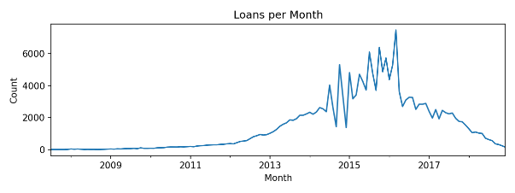
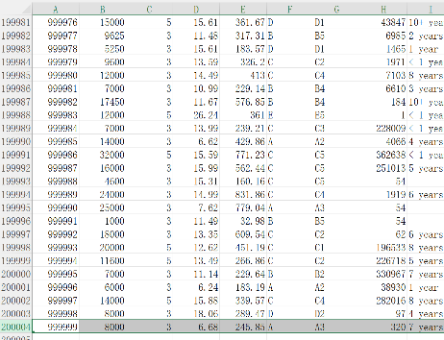
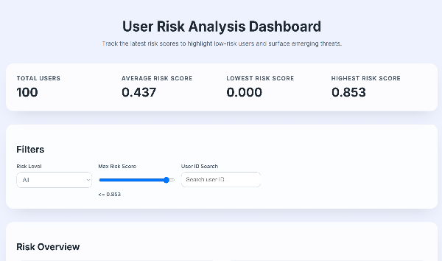
Project Overview
Dataset: historical loan records with borrower demographics, credit history and loan characteristics.(from 阿里云）
Objectives: predict interest rates (regression), classify credit grades, and discover customer segments (clustering)
Pipeline: perform EDA, engineer features, build models & evaluate results, then generate automated reports
goal
200000lines of data
Visual website
Project Overview
Page 2
Final Project Report
Notes:
Our project uses historical loan data from Alibaba Cloud to predict interest rates, classify credit grades, and find customer segments. We built a full pipeline for data cleaning, modeling, and automated reporting—aiming for the risk-analysis dashboard shown on the right.

Slide 5
Methodology & Pipeline
Main Content
EDA: explore distributions and temporal trends
Feature engineering: encode categorical, normalize continuous variables
Regression: histogram‑based gradient boosting to estimate interest rate
Classification: histogram‑based classifier to predict credit grade
Clustering: k‑means (PCA) to uncover customer segments
Reporting & Web App: automatically generate visual reports and an interactive risk dashboard
EDA
Report
Features
Regression
Classification
Clustering
Main Content of the Project
Page 3
Methodology & Pipeline
Final Project Report
Final Project Report
Notes:
Our workflow starts with EDA and feature engineering, then we use gradient boosting for both regression and classification tasks, followed by clustering to find customer segments. Finally, all results are turned into automated reports and an online risk dashboard.

Slide 6
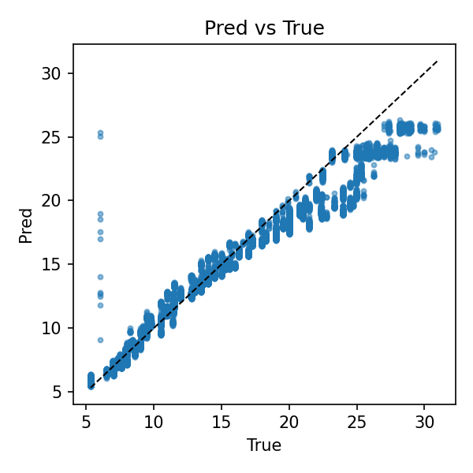
Regression Analysis—Predicting Interest Rate
 | Validation | Test
MAE | 0.7326 | 1.1081
RMSE | 1.1527 | 1.7732
R² | 0.9472 | 0.8961
Strong performance with high R² on validation and test. Low MAE(Mean Absolute Error) and RMSE(Root Mean Square Error) indicate accurate interest rate predictions.
Further tuning may reduce residual variance.
Regression Analysis: Predicting Interest Rate
Page 4
Final Project Report
Notes:
Here are the regression results for predicting loan interest rates. We used a histogram-based gradient boosting model, which achieved an R-squared of about 0.95 on validation and 0.90 on the test set, showing strong generalization. Both MAE and RMSE remain low, meaning the predictions are quite accurate. As you can see from the scatter plot, most points lie close to the diagonal line, confirming that the model captures the true relationship between features and interest rates effectively.

Slide 7
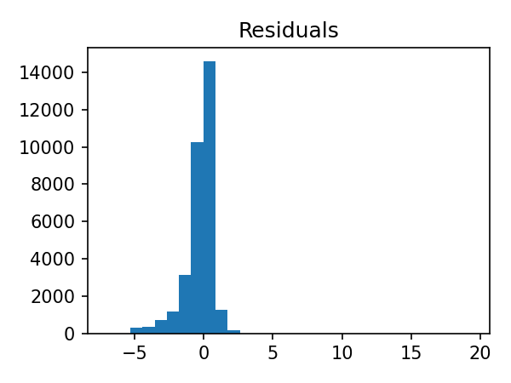
Regression Analysis—Diagnostics
• R² values of 0.947 (Val) and 0.896 (test) demonstrate excellent goodness‑of‑fit. • Residuals cluster tightly around zero, indicating low bias and homoscedasticity. • A few outliers and moderate skew suggest opportunities for further tuning.
Regression Analysis: Diagnostics
Page 5
Final Project Report
Notes:
To evaluate the regression model, we analyzed the residuals — the differences between predicted and true interest rates. Most residuals are centered tightly around zero, showing low bias and stable variance. The high R² values of about 0.95 on validation and 0.90 on test confirm that the model fits the data well. There are a few outliers and slight skewness, which could be improved with further hyperparameter tuning.

Slide 8
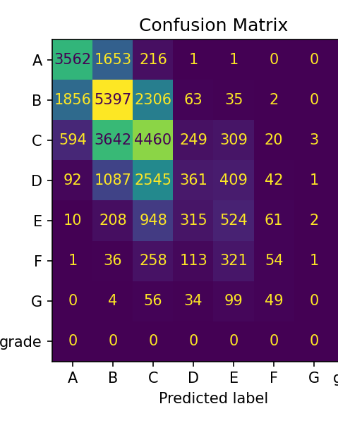
Classifications Results
 | Score
Accuracy | 0.5738
F1 Macro | 0.3831
F1 Weighted | 0.5513
AUC (ovr) | 0.8475
• Reasonable accuracy but macro F1 reveals class imbalance • Weighted F1 is higher, reflecting skewed label distribution • AUC of 0.848 indicates good discriminative power
Classification Results
Page 6
Final Project Report
Notes:
For credit-grade classification, we used a histogram-based gradient boosting model. It achieved about 57% accuracy and an overall AUC of 0.85, showing good discriminative power. The weighted F1 is higher than the macro F1, which reflects the class imbalance in the dataset. From the confusion matrix, we can see that most errors occur between adjacent grades such as B and C. Future improvement could focus on balancing the data or tuning thresholds to raise the macro F1.

Slide 9
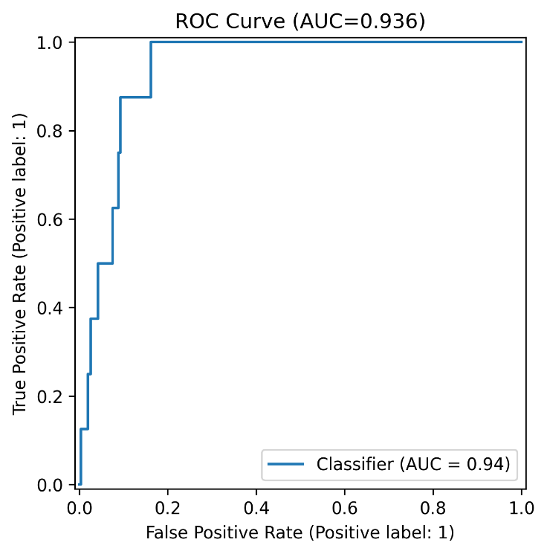
Classifications ROC & Insights
• ROC curve shows AUC = 0.936, indicating strong discrimination • Threshold chosen using Youden's J statistic to balance sensitivity & specificity • PR curve analysis highlights precision–recall trade‑offs in imbalanced data • Insights: high‑risk groups include younger borrowers with lower income; larger loans increase default risk; poor credit history strongly predicts defaults
Classification Results
Page 7
Final Project Report
Notes:
The ROC curve shows an AUC of 0.936, which means our classifier distinguishes positive and negative cases very well. We selected the threshold using Youden’s J statistic to balance sensitivity and specificity. The precision–recall curve also highlights the trade-off caused by class imbalance. From these results, we found that high-risk borrowers are often younger, have lower income, larger loans, or poor
ROC 曲线的 AUC 达到 0.936，说明模型对违约与非违约样本的区分能力很强。 我们使用 Youden’s J 指标来平衡灵敏度和特异性。 同时，PR 曲线揭示了样本不平衡带来的精确率与召回率权衡。 从这些结果可以看出，高风险借款人通常更年轻、收入较低、贷款额更大，或有不良信用记录——这些特征都显著提高违约概率。

Slide 10
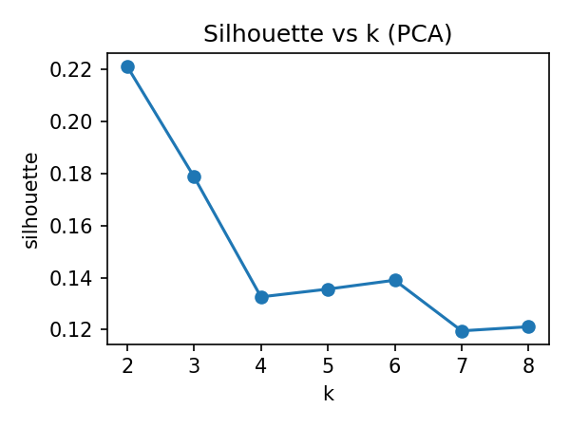
Clustering Analysis
Silhouette scores peak at k=2 (≈0.22), suggesting two distinct clusters Cluster 0: smaller loans (~$13K), moderate incomes (~$70K) and ~20 total accounts Cluster 1: larger loans (~$18K), higher incomes (~$92K) and ~35 total accounts Segmentation enables tailored risk strategies and product offerings
Clustering Analysis
Page 8
Final Project Report
Notes:
We applied k-means clustering after dimensionality reduction to uncover hidden borrower segments. The silhouette score peaks at k = 2, suggesting two clear clusters. Cluster 0 represents borrowers with smaller loans and moderate incomes, while Cluster 1 includes those with larger loans and higher incomes. This segmentation helps design targeted credit strategies and personalized financial products for different customer groups.
我们在降维后使用了 k-means 聚类来发现潜在的借款人群体。 轮廓系数在 k = 2 时达到峰值，说明存在两个较明显的聚类。 第一类用户贷款金额较小、收入适中；第二类贷款较大、收入更高。 这种客户分群有助于制定更有针对性的信贷策略和个性化金融产品。

Slide 11
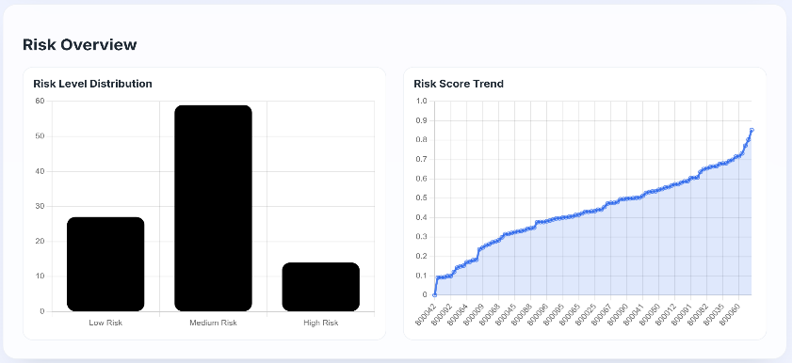
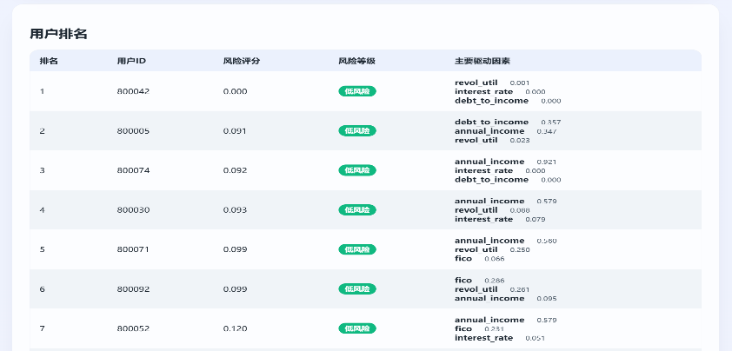
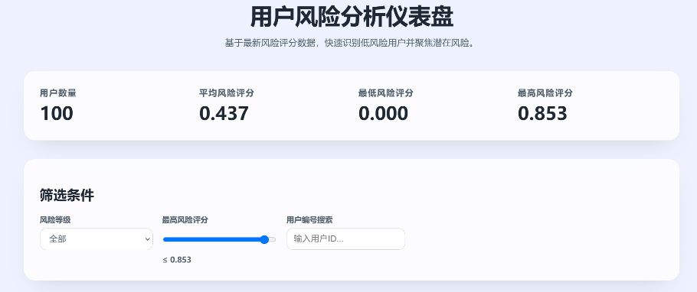
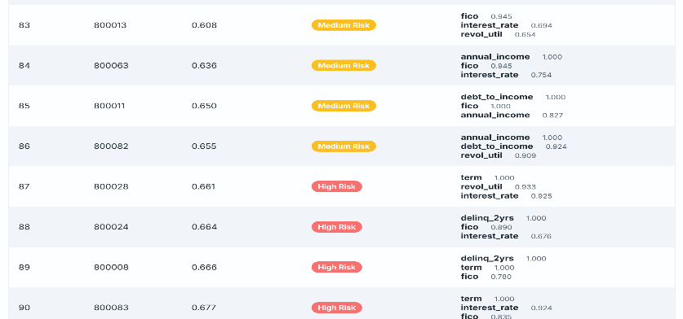
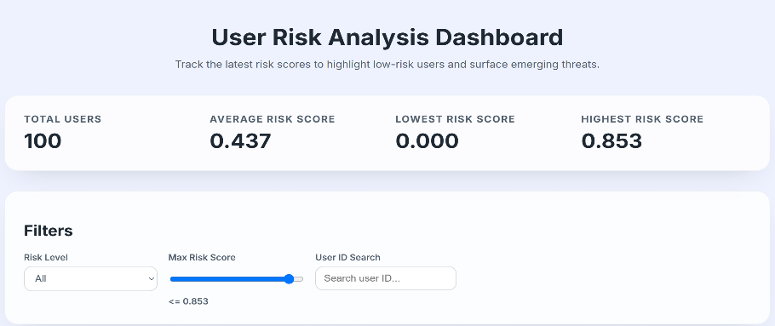
Risk analysis
Interactive Dashboard
Based on the dataset analysis, we will provide reference data for user financial risk analysis. To assist decision-makers, we have developed an online risk analysis dashboard that quickly identifies low-risk users and focuses on potential risks based on the latest assessment data.
https://shuangboxu.github.io/bigdata_project/
Risk Analysis
Page 9
Final Project Report
Notes:
This page shows our Risk Analysis Dashboard, which turns model outputs into an intuitive web tool. On the right, we can see the distribution of low, medium, and high-risk users, and the trend curve that tracks how overall risk changes over time. Below is a ranking table where each user’s risk score and the main influencing factors are displayed. On the left, users can filter by risk level, adjust score thresholds, or search by user ID for detailed analysis. This dashboard is online and interactive, helping decision-makers spot risk patterns quickly.
这一页展示的是我们的风险分析仪表盘。 它可以直观地展示不同用户的风险等级，并跟踪整体风险随时间的变化趋势。 排名表会显示每个用户的风险分数以及主要影响因素。 左侧提供交互功能，可以按照风险等级筛选、调整阈值，或搜索具体用户。 整个系统是在线可交互的，可用于实时风险监测与决策支持。

Slide 12
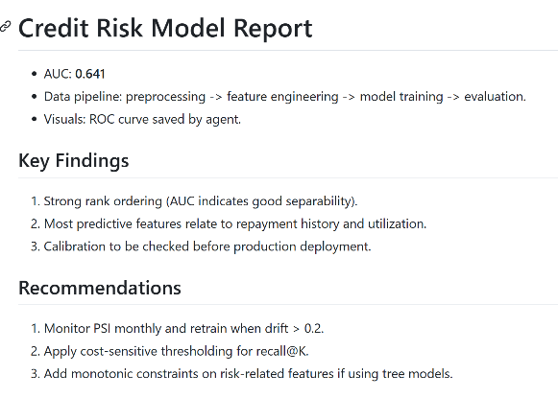
Agent Workflow
Reusable design
Planner Plan tasks
Executor
Train & evaluate
Visualizer Generate plots
Reporter Compile report
• Planner orchestrates data cleaning, modelling, visualisation & report tasks. • Executor trains models and returns metrics & trained artefacts. • Visualizer draws curves and charts for inclusion in reports. • Reporter compiles Markdown report and can append LLM insights.
LLM insight
Agent Workflow
Page 9
Final Project Report
Notes:
This slide shows our LangGraph-based agent workflow, which is not just automated but also modular and reusable. Each component — Planner, Executor, Visualizer, and Reporter — works independently and can be reused across different data projects. This design makes the workflow easy to adapt for future pipelines, such as credit scoring or recommendation analysis.
这一页展示的是我们基于 LangGraph 的智能体工作流。 它不仅实现了自动化，还具备模块化和可复用性。 每个模块（规划、执行、可视化、报告）都能独立运行，可在其他数据项目中直接复用。 这样的设计让整个流程更容易迁移和扩展，比如风险评估或推荐分析。

Slide 13
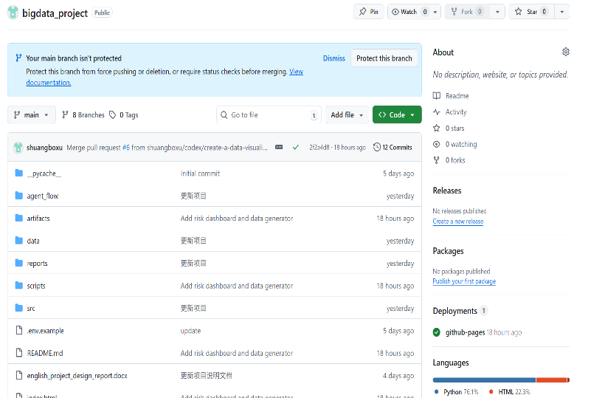
Roles
Members | Responsibilities
Xu Shuangbo | Designed the project framework and implemented the code workflow Led model development, agent integration, and report writing Managed repository updates and documentation on GitHub
Li Shangze | Collected and organized the dataset, assisted in debugging and trial runs Designed and refined the presentation slides Collaborated through GitHub for version control and progress tracking
Repository: https://github.com/shuangboxu/bigdata_project
Website: https://shuangboxu.github.io/bigdata_project
Roles & Progress
Page 10
Final Project Report
Notes:
Our project was developed collaboratively through GitHub. XuShuangbo designed the overall framework, wrote the core code, and completed the design report. LiShangze collected and organized the dataset, helped debug and test the workflow, and created the final presentation slides. Using GitHub allowed us to share code, track issues, and merge changes efficiently — it made our teamwork smoother and more professional.
我们整个项目是在 GitHub 上协同完成的。 Shuangbo 负责整体设计思路、核心代码实现，以及报告撰写； Shangze 负责数据收集与整理，调试与试运行，并完成最终展示PPT。 借助 GitHub，我们能够同步代码、跟踪进度并合并修改，大大提高了协作效率。

Slide 14
Summary
Developed a reproducible end-to-end pipeline covering EDA, modeling, evaluation, and automated reporting.
The regression model achieved strong accuracy in predicting interest rates with R² ≈ 0.90.
The classification model reached an AUC of 0.85, showing good discrimination but room to improve macro F1 due to class imbalance.
Clustering analysis revealed two major customer segments, supporting targeted risk strategies.
The LangGraph-based agent workflow automated model training, visualization, and report generation, ensuring transparency and reproducibility.
The LLM-powered reporter (via OpenAI API) automatically generated Markdown and HTML reports, adding high-level insights to assist human interpretation.
The interactive web dashboard presents up-to-date risk scores and enables interactive exploration of borrower profiles.
Summary
Page 12
Final Project Report
Notes:
To summarize, we built a reproducible end-to-end pipeline that automates everything from data analysis to reporting. The regression model achieved high accuracy in predicting interest rates, and the classification model reached an AUC of 0.85. Clustering revealed two major customer groups, supporting targeted credit strategies. Our LangGraph agent workflow and LLM-powered reporter automated training, visualization, and report writing using the OpenAI API. Finally, the online dashboard makes risk assessment more transparent and interactive. Q&A / Backup That concludes the prepared material. Here we have a summary table of the classification metrics for quick reference. Please feel free to ask any questions you have about our models, the metrics we reported, the clustering analysis or the agent workflow. We are happy to discuss our methodology, dive deeper into specific results or elaborate on the business insights drawn from the analysis. Your feedback will be invaluable as we refine our approach for the final submission.
总结来说，我们构建了一个可复现的端到端流程，实现了从数据分析到报告生成的全自动化。 回归模型在利率预测上表现出很高的准确度，分类模型的 AUC 达到 0.85。 聚类分析识别了两类主要客户群体，为精准信贷策略提供了支持。 通过 LangGraph 智能体流程和调用 OpenAI API 的 LLM 报告生成，我们实现了模型训练、可视化与报告撰写的自动化。 最后，在线仪表盘让风险评估更加透明和可交互。

Slide 15
Thanks
Team: Northlake

