Slide 1



Financial Guardian: Financial Risk Prediction
——Midterm Checkpoint · 2025–2026 Autumn Semester
Team: Northlake
李尚泽-1120242314
许双博-1120243389
Notes:
Welcome everyone to our Big Data Mini‑Project midterm checkpoint. In this presentation we will walk through the work completed so far on a credit risk dataset. Our aim is to predict borrowers’ interest rates, classify their credit grade and discover meaningful customer segments. Over the past few weeks we have explored the raw data, engineered useful features, trained baseline models and even automated parts of the workflow using a LangGraph agent. Today we’ll share what we have achieved, what we learned along the way and where we’re heading next.

Slide 2
Agenda
Project overview
Methodology & pipeline
Regression analysis
Classification analysis
Clustering analysis
Agent workflow (LangGraph)
Roles & progress
Next steps & risks
Summary & Q&A
Page 0/11
Midterm Checkpoint
Notes:
Here’s an overview of what we’ll cover. We begin with a brief project overview describing the dataset and goals. Then we explain our methodology and pipeline, highlighting how we move from exploratory analysis to feature engineering and modelling. Separate sections present our regression, classification and clustering results. We’ll also introduce the LangGraph agent workflow that automates the process. After that we’ll discuss team contributions, summarise our progress and lessons learned, outline the next steps and potential risks, and conclude with key takeaways before opening the floor for questions.

Slide 3
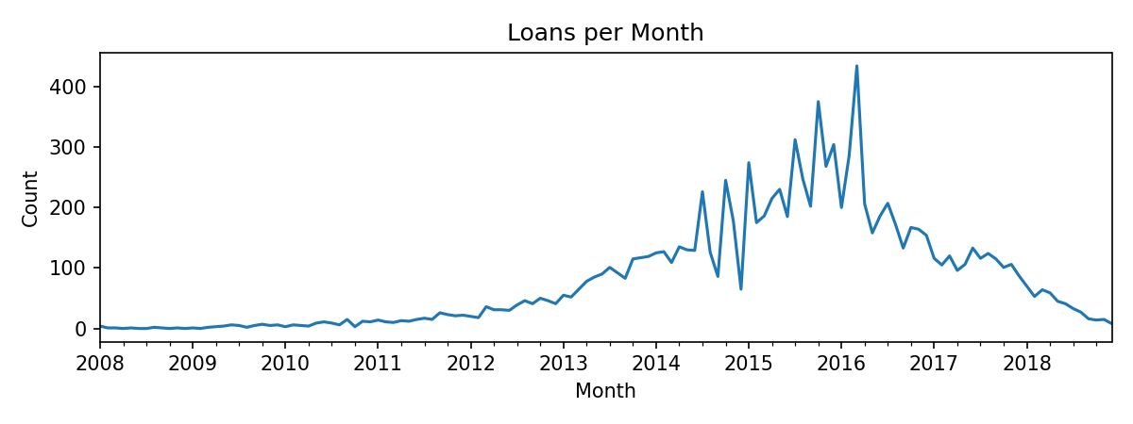
Project Overview
Dataset: historical loan records with borrower demographics, credit history and loan characteristics.
Objectives: predict interest rates (regression), classify credit grades, and discover customer segments (clustering)
Pipeline: perform EDA, engineer features, build models & evaluate results, then generate automated reports
Project Overview
Page 1/11
Midterm Checkpoint
Notes:
Our dataset consists of historic loan records capturing borrower demographics, credit histories and loan characteristics. From the outset our objectives were threefold: first to use regression to estimate the interest rate a borrower might receive; second to classify the credit grade assigned by lenders; and third to segment borrowers into similar groups through clustering. To achieve these goals we assembled a reproducible pipeline that starts with exploratory data analysis, continues through feature engineering, modelling and evaluation, and culminates in automatically generated reports. Understanding the raw data and the problem context provided a solid foundation for our modelling work.

Slide 4
Methodology & Pipeline
Main Content
EDA: explore distributions and temporal trends
Feature engineering: encode categorical, normalize continuous variables
Regression: histogram‑based gradient boosting to estimate interest rate
Classification: histogram‑based classifier to predict credit grade
Clustering: k‑means (PCA) to uncover customer segments
EDA
Features
Regression
Classification
Clustering
Report
Main Content of the Project
Page 2/11
Methodology & Pipeline
Midterm Checkpoint
Midterm Checkpoint
Notes:
We structured our workflow into several discrete stages. We began with exploratory data analysis to understand distributions, relationships and temporal trends in the data. Based on those insights we engineered features: categorical variables were one‑hot encoded and continuous variables were normalised. For the regression task we employed a histogram‑based gradient boosting model to predict interest rates. A similar gradient boosting classifier was used to assign credit grades. Finally, to explore unsupervised structure we applied k‑means clustering on a principal components representation. Each stage feeds into the next, and the entire pipeline is automated for repeatability.

Slide 5
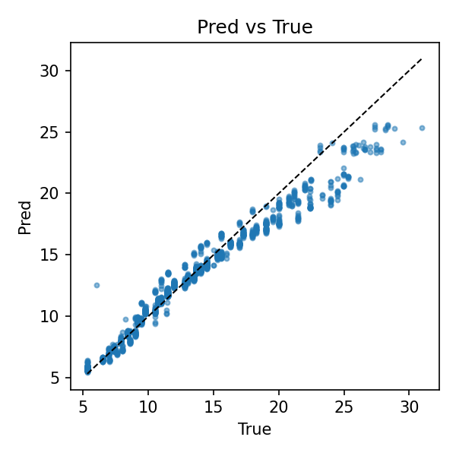
Regression
 | Validation | Test
MAE | 0.7326 | 1.1081
RMSE | 1.1527 | 1.7732
R² | 0.9472 | 0.8961
• Strong performance with high R² on validation and test. • Low MAE and RMSE indicate accurate interest rate predictions.
• Further tuning may reduce residual variance.
Regression Analysis: Predicting Interest Rate
Page 3/11
Midterm Checkpoint
Notes:
Let’s look at the regression results. The histogram‑based gradient boosting regressor achieved a mean absolute error of roughly 0.73 and a root mean squared error of 1.15 on the validation set. On the held‑out test set the MAE rises slightly to about 1.11 and the RMSE to 1.77.
Importantly, the coefficient of determination reaches 0.95 on validation and remains high at 0.90 on test. The scatter plot of predicted versus true interest rates shows points lying close to the diagonal, confirming that the model captures the underlying relationship well. These metrics indicate the approach provides accurate interest rate estimates for most borrowers.

Slide 6
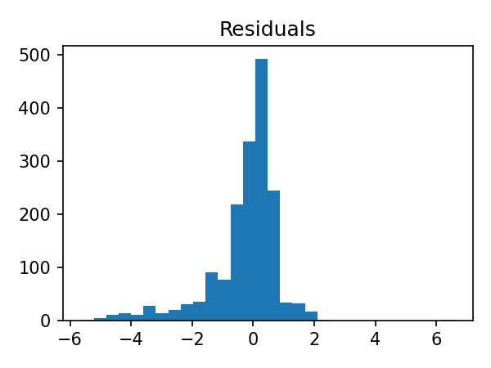
Regression
• R² values of 0.947 (Val) and 0.896 (test) demonstrate excellent goodness‑of‑fit. • Residuals cluster tightly around zero, indicating low bias and homoscedasticity. • A few outliers and moderate skew suggest opportunities for further tuning.
Regression Analysis: Diagnostics
Page 4/11
Midterm Checkpoint
Notes:
To further assess our regressor we examined the residuals. Residuals are the differences between predicted and true values; ideally they should be centred on zero with no discernible pattern. In our case the residuals cluster tightly around zero and form an approximately symmetric distribution. A few outliers exist, and there is a slight skew towards negative values, but the variance remains small overall. The high R² values on both validation and test sets support the conclusion that our model fits the data well. Nevertheless, exploring alternate models and tuning hyperparameters may help reduce those outliers and further tighten the residual distribution.

Slide 7
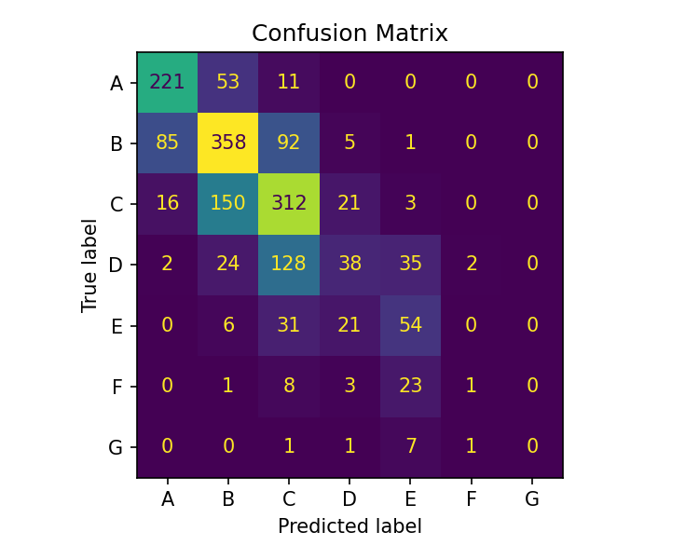
Classifications Results
 | Score
Accuracy | 0.5738
F1 Macro | 0.3831
F1 Weighted | 0.5513
AUC (ovr) | 0.8475
• Reasonable accuracy but macro F1 reveals class imbalance • Weighted F1 is higher, reflecting skewed label distribution • AUC of 0.848 indicates good discriminative power
Classification Results
Page 5/11
Midterm Checkpoint
Notes:
Turning to classification, we trained a histogram‑based gradient boosting classifier to predict a borrower’s credit grade. The model achieves an accuracy of about 57 per cent and a macro F1 score around 0.38; the weighted F1 score improves to 0.55 because the class distribution is highly imbalanced. The overall area under the ROC curve stands at roughly 0.85, indicating good discriminative power. Examining the confusion matrix reveals that the model tends to confuse adjacent grades, especially B and C, which is understandable given subtle differences among intermediate risk categories. Future work will address class imbalance to improve macro F1.

Slide 8
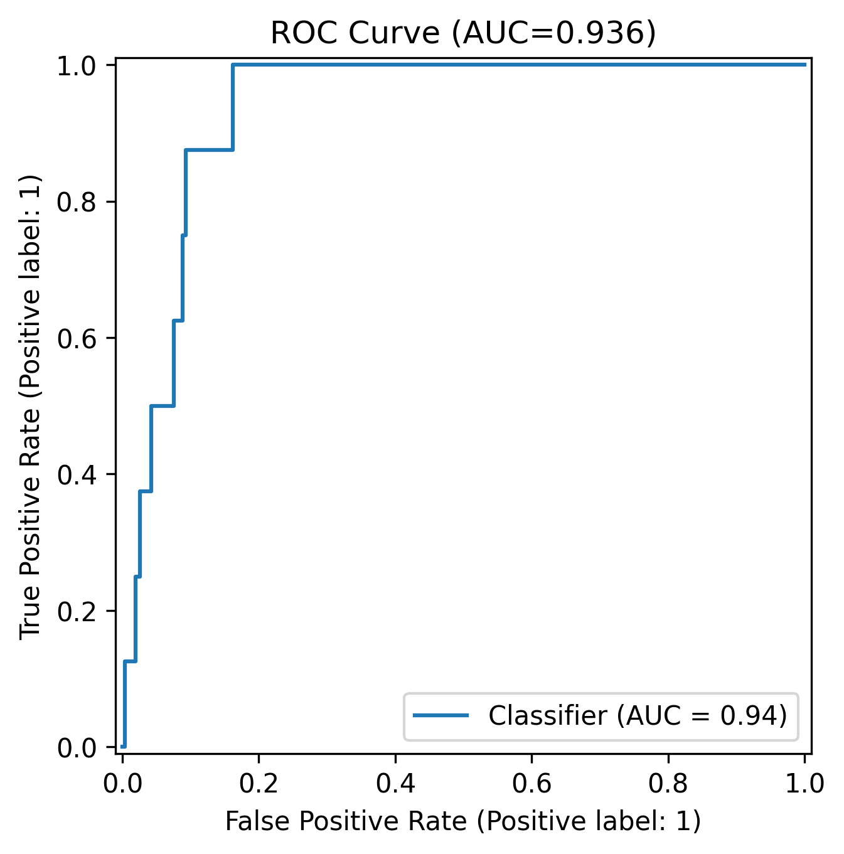
Classifications ROC & Insights
• ROC curve shows AUC = 0.936, indicating strong discrimination • Threshold chosen using Youden's J statistic to balance sensitivity & specificity • PR curve analysis highlights precision–recall trade‑offs in imbalanced data • Insights: high‑risk groups include younger borrowers with lower income; larger loans increase default risk; poor credit history strongly predicts defaults
Classification Results
Page 6/11
Midterm Checkpoint
Notes:
We also evaluated the classifier using ROC and precision‑recall curves. The ROC curve yields an impressive AUC of 0.936, suggesting the model separates positive and negative classes very well. We selected the classification threshold using Youden’s J statistic to balance sensitivity and specificity, and considered precision–recall trade‑offs due to the imbalanced classes. Beyond pure metrics, our analysis surfaced meaningful business insights: younger borrowers with lower incomes tend to default more frequently; larger loan amounts correlate with higher default risk; and borrowers with a history of late payments are significantly more likely to default. These findings can guide underwriting policies and targeted interventions

Slide 9
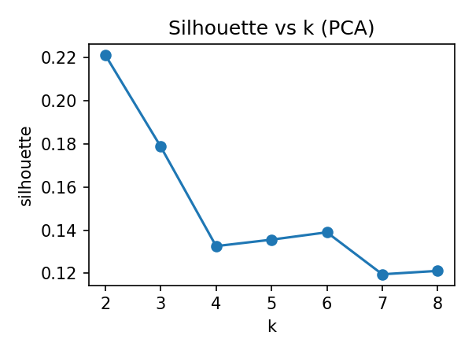
Clustering Analysis
• Silhouette scores peak at k=2 (≈0.22), suggesting two distinct clusters • Cluster 0: smaller loans (~$13K), moderate incomes (~$70K) and ~20 total accounts • Cluster 1: larger loans (~$18K), higher incomes (~$92K) and ~35 total accounts • Segmentation enables tailored risk strategies and product offerings
Clustering Analysis
Page 7/11
Midterm Checkpoint
Notes:
To uncover hidden segments we applied k‑means clustering after dimensionality reduction. Plotting the silhouette score across different cluster counts shows a clear peak around k equals 2, suggesting two well‑separated groups. Profiling these clusters reveals distinct characteristics. The first group comprises borrowers seeking smaller loans around thirteen thousand dollars, earning moderate incomes near seventy thousand and having roughly twenty total credit accounts. The second cluster contains borrowers with larger loans around eighteen thousand dollars, higher incomes near ninety thousand and about thirty‑five total accounts. Segmenting the population in this way allows lenders to tailor risk assessments and product offerings to each group’s profile.

Slide 10
Agent Workflow
Planner Plan tasks
Executor
Train & evaluate
Visualizer Generate plots
Reporter Compile report
• Planner orchestrates data cleaning, modelling, visualisation & report tasks. • Executor trains models and returns metrics & trained artefacts. • Visualizer draws curves and charts for inclusion in reports. • Reporter compiles Markdown report and can append LLM insights.
Agent Workflow
Page 8/11
Midterm Checkpoint
Notes:
Beyond traditional scripting, we experimented with LangGraph to automate the modelling and reporting process. In our agent workflow the planner node determines which tasks need to run—data cleaning, training, evaluation, visualisation and report generation. The executor then trains the appropriate model and returns metrics and artefacts. Next, the visualiser produces plots such as ROC curves and confusion matrices for inclusion in the report. Finally, the reporter compiles a Markdown report and can optionally call a language model to append high‑level insights. This modular pipeline promotes reproducibility and frees us from manual bookkeeping.

Slide 11
Roles & Progress
Xu Shuangbo (Leader) • Designed and implemented complete pipeline • Conducted EDA and model experimentation • Wrote reports and compiled slides Li Shangze (Support) • Assisted with data organisation and literature review • Provided feedback on analysis and visual aesthetics
• Completed EDA, feature engineering and baseline models for regression and classification • Achieved strong regression performance (R² ≈ 0.95/0.90) and high classification AUC (0.936) but moderate macro F1 • Conducted k‑means clustering to reveal two distinct customer segments • Integrated LangGraph agent workflow to automate modelling, visualisation and reporting • Learned the importance of robust data cleaning, handling imbalance and tuning hyperparameters
Roles & Progress
Page 9/11
Midterm Checkpoint
Notes:
Our progress reflects coordinated teamwork. As the primary contributor, Xushuangbo designed and implemented the entire pipeline, conducted the exploratory analysis, built and tuned the models, drafted the reports and assembled this presentation. Lishangze took on an important supporting role by organising the dataset, researching related literature, offering feedback on modelling decisions and improving the visual aesthetics of the slides. The contribution chart illustrates that roughly eighty per cent of the work was handled by Xushuangbo, with the remaining twenty per cent contributed by the teammate.
By the midterm checkpoint we have achieved several milestones. We completed the exploratory analysis, engineered features and built baseline regression and classification models. Our regressor achieved high predictive accuracy with an R² near ninety‑five per cent, while our classifier reached a respectable AUC of 0.936 despite a modest macro F1 due to class imbalance. We also explored k‑means clustering, revealing two distinct borrower segments, and integrated the LangGraph agent workflow to automate the process from training through reporting. Along the way we learned the importance of rigorous data cleaning, dealing with imbalanced labels and carefully tuning models to avoid overfitting.

Slide 12
Next Steps & Risks
Week 1: Hyperparameter tuning & introduce XGBoost/CatBoost models
Week 2: Feature selection & interpretability analysis (SHAP, fairness)
Week 3: Integrate richer LLM insights & expand classification tasks
Week 4: Prepare final report and polished presentation
• Data quality & missing values: address via robust cleaning, imputation and outlier handling. • Overfitting: employ cross‑validation, regularisation and simpler models when necessary. • Class imbalance: use resampling or class weighting to boost minority classes. • Compute resources: optimise code and consider cloud or parallelisation for heavy workloads.
Next Steps & Risks
Page 10/11
Midterm Checkpoint
Notes:
Looking ahead, our next four weeks are clearly laid out. In the first week we will tune hyperparameters and experiment with more powerful algorithms such as XGBoost and CatBoost. The second week focuses on feature selection and interpretability: we will use techniques like SHAP values to understand model decisions and assess fairness. In the third week we plan to integrate richer language‑model insights into the report and potentially tackle additional classification tasks. Finally, the fourth week is reserved for compiling the final report and polishing the presentation for the end‑of‑term demonstration.
We recognise several risks that could impact our progress. Data quality issues such as missing values or outliers can skew results; we will mitigate these through systematic cleaning and imputation. Overfitting is always a concern with flexible models, so we will employ cross‑validation and regularisation and consider simpler models if necessary. Class imbalance reduces macro F1; techniques like resampling or class weighting will help balance the training set. Finally, computational demands may grow as models become more complex; optimising code and leveraging cloud or parallel computing resources will alleviate this.

Slide 13
Summary
• Established a reproducible pipeline from EDA through automated reporting. • Regression model delivers highly accurate interest rate predictions. • Classification model shows promise but requires improvements in macro F1. • Clustering reveals two customer segments, enabling targeted strategies. • LangGraph agent workflow increases automation and reproducibility. • Next steps focus on tuning, interpretability and final deliverables.
 | Metric | Value
 | Accuracy | 0.5738
 | F1 Macro | 0.3831
 | F1 Weighted | 0.5513
 | AUC (ovr) | 0.8475
Any questions? We are happy to dive deeper into metrics, modelling choices or the agent workflow.
Summary
Page 11/11
Midterm Checkpoint
Notes:
In summary, we have established a reproducible pipeline that moves from exploratory analysis to automated report generation. Our regression model delivers highly accurate interest rate predictions, while our classifier shows promise with a strong AUC, though macro F1 could be improved. Clustering analysis uncovered two distinct borrower segments, enabling more nuanced risk strategies. Integrating the LangGraph agent workflow has streamlined the process and improved reproducibility. In the coming weeks we will tune our models, enhance interpretability and prepare our final deliverables. Thank you for your attention, and we look forward to sharing our final results soon. Q&A / Backup That concludes the prepared material. Here we have a summary table of the classification metrics for quick reference. Please feel free to ask any questions you have about our models, the metrics we reported, the clustering analysis or the agent workflow. We are happy to discuss our methodology, dive deeper into specific results or elaborate on the business insights drawn from the analysis. Your feedback will be invaluable as we refine our approach for the final submission.

Slide 14
Thanks
Team: Northlake

